Slide 1

Case Study With Solution
UseCase and Class Diagram

Slide 2
Courseware Management System
Courses and Topics that make up a course.
Manages Tutor who teach courses
Course administrators who mange the assignment of the courses to tutors and as well as view courses.
Course administrator and tutor manage the tutor information.
Course administrator can view the tutor as well.
Calendar or Course Schedule is generated as a result of the Students who refer to the Course schedule or Calendar to decide which courses for which they wish to take.
Tutors can also view the course calendar.

Slide 3
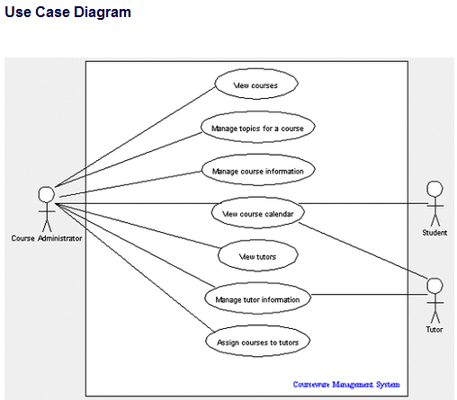

Slide 4
User Placing an Order
A customer placing an order with a sales company might follow these steps :
Browse catalog and select items.
Call sales representative.
Supply shipping information.
Supply payment information.
Receive conformation number from salesperson.

Slide 5
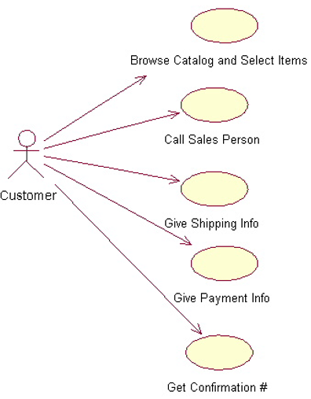

Slide 6
Altered State University (ASU) Registration System
Professors indicate which courses they will teach on-line.
A course catalog can be printed
Allow students to select on-line four courses for upcoming semester.
No course may have more than 10 students or less than 3 students.
When the registration is completed, the system sends information to the billing system.
Professors can obtain course rosters on-line.
Students can add or drop classes on-line.

Slide 7
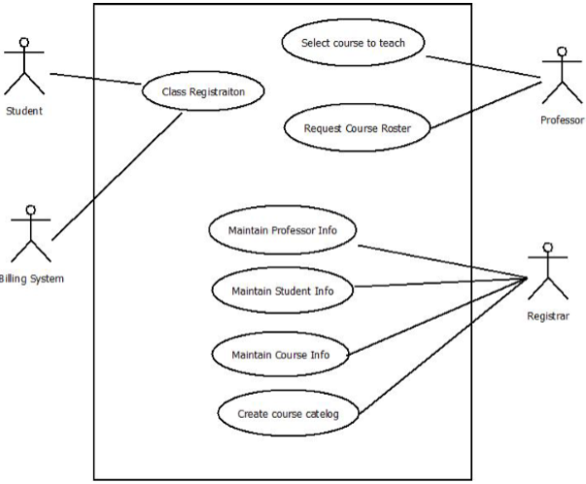

Slide 8
Vehicles Sale System.
Draw a use case diagram for the vehicle sales system. Customer makes offer for the vehicle. Customer can be new customer or old customer. New and old customer can make their own offers. For every individual they have to get registered. System can update the existing customer information as well. Customer make payment if his/ her offer is accepted. Management has right to accept or reject the offer by managing the offer. Sales person records the sales contract of the accepted offer.

Slide 9
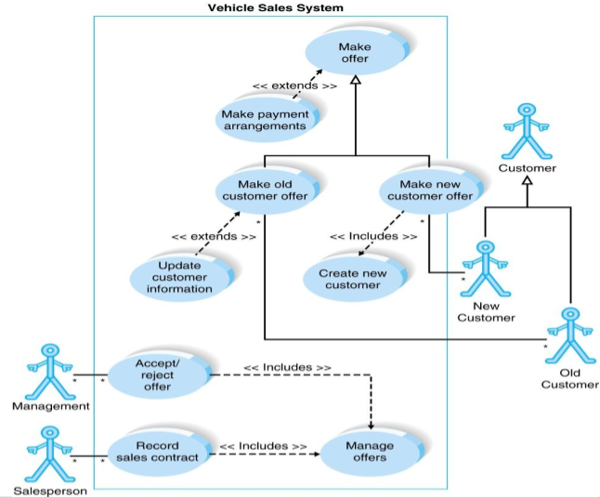

Slide 10
Hospital Management System
Draw a use case diagram for the hospital reception system. In this system, receptionist can schedule patient appointment and patient hospital admission after the patient registration. Both types of patients i.e. outpatient and inpatient can be admitted in the hospital. Receptionist also checks the insurance and claim forms and put them in file. Patient medical report is also filed by the receptionist.

Slide 11
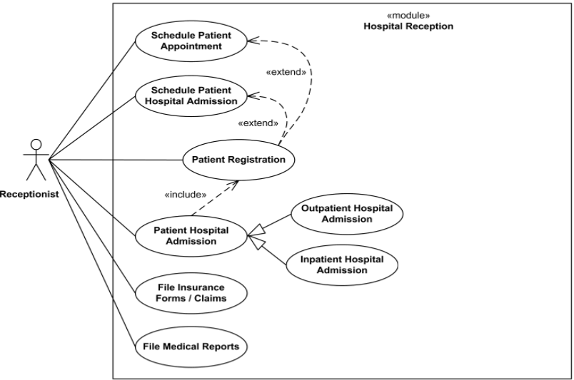

Slide 12
Library System
Books and Journals: The library contains books and journals. Some of the books are for short term loans only. All other books may be borrowed by any library member for three weeks. Members of the library can normally borrow 1 or more items at a time, members of staff may also borrow items a. Only members of staff may borrow journals up to 12 at a time.

Slide 13
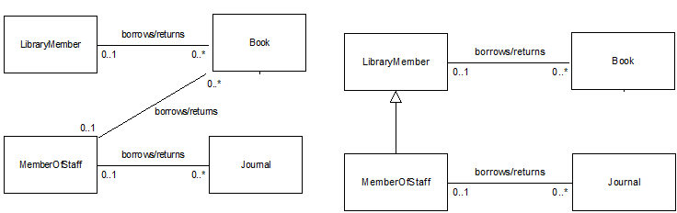

Slide 14
How might we model…
Students and staff are both members of the University. Staff can be either academic, support or research staff.

Slide 15
How might we model…
Students and staff are both members of the University. Staff can be either academic, support or research staff.
Member
Students
Staff
Support
Academic
Research

Slide 16
How might we model…
A campus is made up of many buildings. A building is made of many rooms.

Slide 17
How might we model…
A campus is made up of many buildings. A building is made of many rooms.
Campus
Building
Room

Slide 18
How might we model…
A Race has many competitors. Each competitor may have a trainer. Both types of person have a name, but competitors also have a number.

Slide 19
How might we model…
A Race has many competitors. Each competitor may have a trainer. Both types of person have a name, but competitors also have a number.
Person
Race
- name : String
Competitor
Trainer
1
0..1
- number : int

Slide 20
University Team Management
In the SAD course at Fast University, students are member of teams.
Each team has 2 or 3 members.
Each team completes 0 to 3 assignments.
Each student takes exactly two midterm test.
Computer Science students have a single account on Coding Development facility , while each engineering student has an account on the Engineering facility.
Each assignment and midterm is assigned a mark.

Slide 21
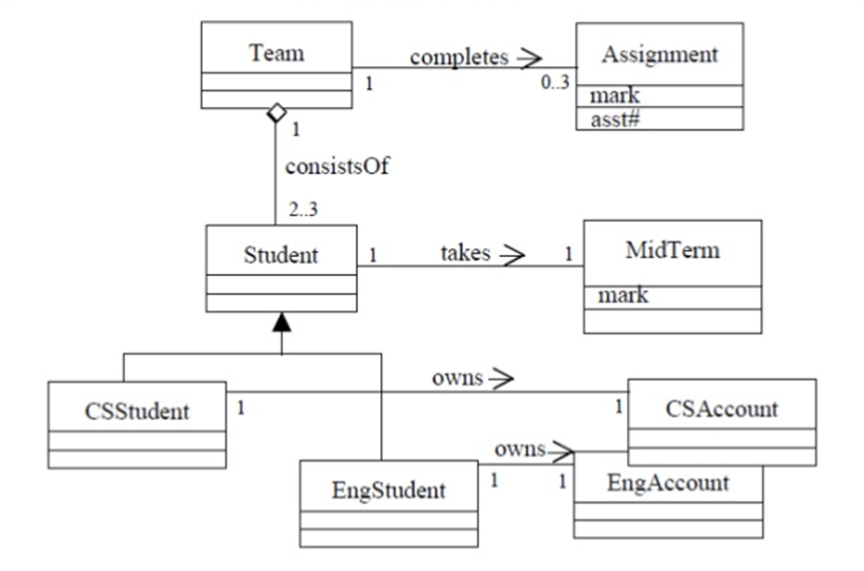

Slide 22
University System
A Fast university offers degrees to students.
The university consists of faculties each of which consists of one or more departments.
Each degree is administered by a single department.
Each student is studying towards a single degree.
Each degree requires one to 20 courses.
A student enrolls in 1-5 courses (per term).
A course cab be either graduate or undergraduate, but not both.
Likewise, students are graduates or undergraduates but not both.

Slide 23
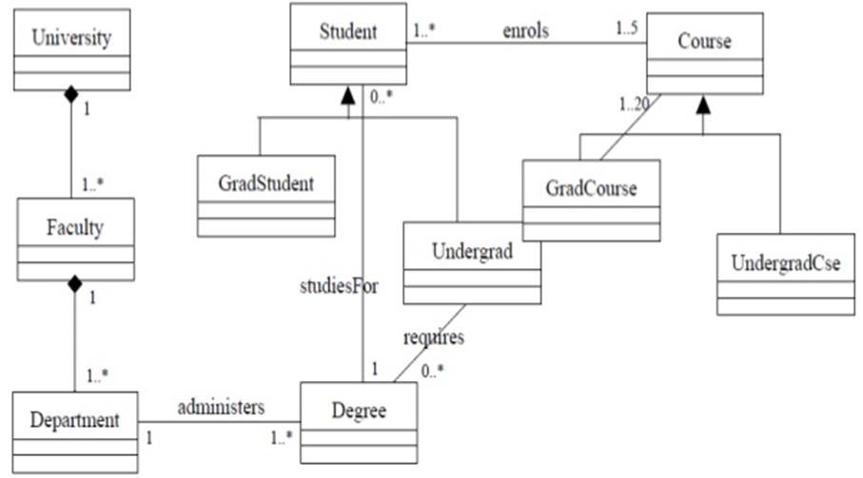
Notes:
Notes By Adil Aslam My Email Address : adilaslam5959@gmail.com

