Slide 1

Chapter 3 Transport Layer
A note on the use of these PowerPoint slides:
We’re making these slides freely available to all (faculty, students, readers). They’re in PowerPoint form so you see the animations; and can add, modify, and delete slides (including this one) and slide content to suit your needs. They obviously represent a lot of work on our part. In return for use, we only ask the following:
If you use these slides (e.g., in a class) that you mention their source (after all, we’d like people to use our book!)
If you post any slides on a www site, that you note that they are adapted from (or perhaps identical to) our slides, and note our copyright of this material.
For a revision history, see the slide note for this page.
Thanks and enjoy! JFK/KWR
All material copyright 1996-2020
J.F Kurose and K.W. Ross, All Rights Reserved
Computer Networking: A Top-Down Approach 8th edition Jim Kurose, Keith Ross Pearson, 2020
Notes:
Version History
8.0 (April 2020)
All slides reformatted for 16:9 aspect ratio
All slides updated to 8th edition material
Use of Calibri font, rather that Gill Sans MT
Add LOTS more animation throughout
added new 8th edition material on QUIC, CUBIC, delay-based congestion control
lighter header font

Slide 2
Transport layer: overview
Our goal:
understand principles behind transport layer services:
multiplexing, demultiplexing
reliable data transfer
flow control
congestion control
learn about Internet transport layer protocols:
UDP: connectionless transport
TCP: connection-oriented reliable transport
TCP congestion control

Slide 3
Residing between the application and network layers, the transport layer is a central piece of the layered network architecture.
It has the critical role of providing communication services directly to the application processes running on different hosts.
Transport Layer
3-3

Slide 4

Transport layer: roadmap
Transport-layer services
Multiplexing and demultiplexing
Connectionless transport: UDP
Principles of reliable data transfer
Connection-oriented transport: TCP
Principles of congestion control
TCP congestion control
Evolution of transport-layer functionality

Slide 5








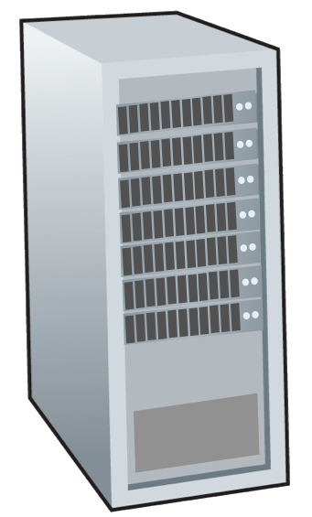







Transport services and protocols
application
transport
network
data link
physical
provide logical communication between application processes running on different hosts
mobile network
national or global ISP
transport protocols actions in end systems:
sender: breaks application messages into segments, passes to network layer
receiver: reassembles segments into messages, passes to application layer
logical end-end transport
local or regional ISP
home network
content
provider
network
application
transport
network
data link
physical
datacenter
network
two transport protocols available to Internet applications
TCP, UDP
enterprise
network
Notes:
By logical communication , we
mean that from an application’s perspective, it is as if the hosts running the processes
were directly connected; in reality, the hosts may be on opposite sides of the
planet, connected via numerous routers and a wide range of link types. Application
processes use the logical communication provided by the transport layer to send
messages to each other, free from the worry of the details of the physical infrastructure
used to carry these messages.
Let’s look at each of these three (logical communications, actions,

Slide 6
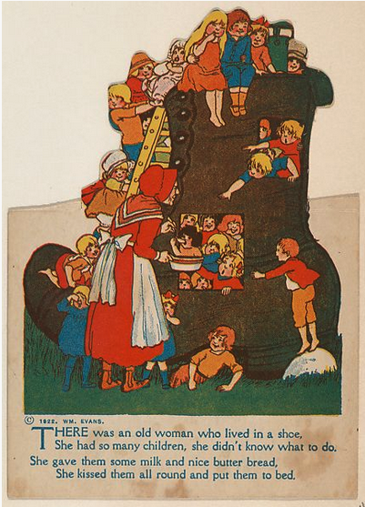
Transport vs. network layer services and protocols
household analogy:
12 kids in Ann’s house sending letters to 12 kids in Bill’s house:
hosts = houses
processes = kids
app messages = letters in envelopes
transport protocol = Ann and Bill who demux to in-house siblings
network-layer protocol = postal service

Slide 7
Transport vs. network layer services and protocols
network layer: logical communication between hosts
transport layer: logical communication between processes
relies on, enhances, network layer services
household analogy:
12 kids in Ann’s house sending letters to 12 kids in Bill’s house:
hosts = houses
processes = kids
app messages = letters in envelopes
transport protocol = Ann and Bill who demux to in-house siblings
network-layer protocol = postal service

Slide 8
Transport Layer Actions
Sender:
application
application
is passed an application-layer message
app. msg
determines segment header fields values
T_{h}
transport
app. msg
transport
T_{h}
creates segment
network (IP)
network (IP)
passes segment to IP
link
link
physical
physical

Slide 9
Transport Layer Actions
Receiver:
application
receives segment from IP
application
checks header values
transport
transport
app. msg
extracts application-layer message
network (IP)
network (IP)
demultiplexes message up to application via socket
link
link
physical
physical
app. msg
T_{h}

Slide 10
Two principal Internet transport protocols
application
transport
network
data link
physical
TCP: Transmission Control Protocol
reliable, in-order delivery
congestion control
flow control
connection setup
UDP: User Datagram Protocol
unreliable, unordered delivery
no-frills extension of “best-effort” IP
services not available:
delay guarantees
bandwidth guarantees
mobile network
national or global ISP
logical end-end transport
local or regional ISP
home network
content
provider
network
application
transport
network
data link
physical
datacenter
network
enterprise
network

Slide 11
Chapter 3: roadmap
Transport-layer services
Multiplexing and demultiplexing
Connectionless transport: UDP
Principles of reliable data transfer
Connection-oriented transport: TCP
Principles of congestion control
TCP congestion control
Evolution of transport-layer functionality

Slide 12





HTTP server
client
application
application
HTTP msg
transport
transport
network
transport
network
link
network
link
physical
link
physical
physical

Slide 13
HTTP server
client
application
application
HTTP msg
transport
H_{t}
HTTP msg
transport
network
transport
network
link
network
link
physical
link
physical
physical

Slide 14
HTTP server
client
application
application
HTTP msg
transport
H_{t}
HTTP msg
H_{n}
H_{t}
network
transport
HTTP msg
transport
network
link
network
link
physical
link
physical
physical

Slide 15
HTTP server
client
application
application
transport
transport
network
transport
network
link
network
link
physical
link
physical
physical
H_{n}
H_{t}
HTTP msg

Slide 16

HTTP server
client₁
client₂
application
P-client₁
P-client₂
application
transport
transport
network
transport
network
link
network
link
physical
link
physical
physical

Slide 17
Multiplexing/demultiplexing
multiplexing at sender:
demultiplexing at receiver:
handle data from multiple
sockets, add transport header (later used for demultiplexing)
use header info to deliver
received segments to correct
socket
application
application
P1
P2
application
socket
P3
transport
P4
process
transport
network
transport
network
link
network
link
physical
link
physical
physical

Slide 18
How demultiplexing works
host receives IP datagrams
each datagram has source IP address, destination IP address
each datagram carries one transport-layer segment
each segment has source, destination port number
host uses IP addresses & port numbers to direct segment to appropriate socket
32 bits
source port #
dest port #
other header fields
application
data
(payload)
TCP/UDP segment format

Slide 19
Connectionless demultiplexing
Recall:
when creating socket, must specify host-local port #:
DatagramSocket mySocket1 = new DatagramSocket(12534);
when receiving host receives UDP segment:
checks destination port # in segment
directs UDP segment to socket with that port #
when creating datagram to send into UDP socket, must specify
destination IP address
destination port #
IP/UDP datagrams with same dest. port #, but different source IP addresses and/or source port numbers will be directed to same socket at receiving host

Slide 20
Connectionless demultiplexing: an example
DatagramSocket serverSocket = new DatagramSocket
(6428);
DatagramSocket mySocket2 = new DatagramSocket
(9157);
DatagramSocket mySocket1 = new DatagramSocket (5775);
application
application
P1
application
P3
P4
transport
transport
network
transport
network
link
network
link
physical
link
physical
physical
source port: 6428
dest port: 9157
source port: ?
dest port: ?
source port: 9157
dest port: 6428
source port: ?
dest port: ?

Slide 21
Connection-oriented demultiplexing
TCP socket identified by 4-tuple:
source IP address
source port number
dest IP address
dest port number
server may support many simultaneous TCP sockets:
each socket identified by its own 4-tuple
each socket associated with a different connecting client
demux: receiver uses all four values (4-tuple) to direct segment to appropriate socket

Slide 22
Connection-oriented demultiplexing: example
application
application
P4
P5
P6
application
P1
P2
P3
transport
transport
network
transport
network
link
network
link
physical
link
physical
server: IP address B
physical
host: IP address A
source IP,port: B,80
dest IP,port: A,9157
host: IP address C
source IP,port: C,5775
dest IP,port: B,80
source IP,port: A,9157
dest IP, port: B,80
source IP,port: C,9157
dest IP,port: B,80
Three segments, all destined to IP address: B,
dest port: 80 are demultiplexed to different sockets

Slide 23
Figure 3.5 shows a Web server that spawns a new process for each connection. As shown in Figure 3.5, each of these processes has its own connection socket through which HTTP requests arrive and HTTP responses are sent.
We mention, however, that there is not always a one-to-one correspondence between connection sockets and processes.
In fact, today’s high-performing Web servers often use only one process, and create a new thread with a new connection socket for each new client connection. (A thread can be viewed as a lightweight subprocess.)
A server, at any given time there may be many connection sockets (with different identifiers) attached to the same process.
If the client and server are using persistent HTTP, then throughout the duration of the persistent connection the client and server exchange HTTP messages via the same server socket.
However, if the client and server use non-persistent HTTP, then a new TCP connection is created and closed for every request/response, and hence a new socket is created and later closed for every request/response.
This frequent creating and closing of sockets can severely impact the performance of a busy Web server (although a number of operating system tricks can be used to mitigate the problem).
Transport Layer
3-23

Slide 24
Summary
Multiplexing, demultiplexing: based on segment, datagram header field values
UDP: demultiplexing using destination port number (only)
TCP: demultiplexing using 4-tuple: source and destination IP addresses, and port numbers
Multiplexing/demultiplexing happen at all layers

Slide 25
Chapter 3: roadmap
Transport-layer services
Multiplexing and demultiplexing
Connectionless transport: UDP
Principles of reliable data transfer
Connection-oriented transport: TCP
Principles of congestion control
TCP congestion control
Evolution of transport-layer functionality

Slide 26
UDP: User Datagram Protocol
Why is there a UDP?
“no frills,” “bare bones” Internet transport protocol
“best effort” service, UDP segments may be:
lost
delivered out-of-order to app
no connection establishment (which can add RTT delay)
simple: no connection state at sender, receiver
small header size
no congestion control
UDP can blast away as fast as desired!
can function in the face of congestion
connectionless:
no handshaking between UDP sender, receiver
each UDP segment handled independently of others

Slide 27
UDP: User Datagram Protocol
UDP use:
streaming multimedia apps (loss tolerant, rate sensitive)
DNS
SNMP
HTTP/3
if reliable transfer needed over UDP (e.g., HTTP/3):
add needed reliability at application layer
add congestion control at application layer

Slide 28
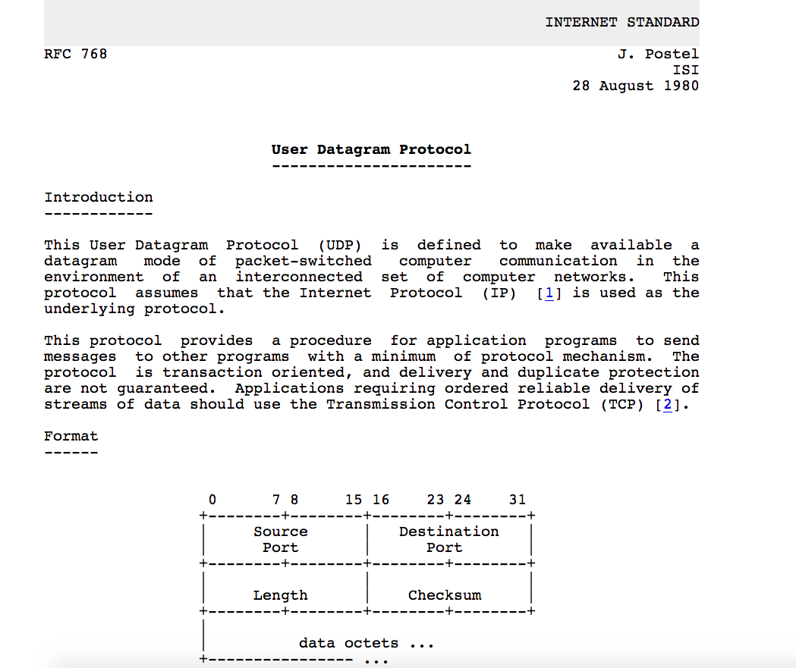
UDP: User Datagram Protocol [RFC 768]
Notes:
read this RFC – it’s only 2.5 pages!

Slide 29
UDP: Transport Layer Actions
SNMP client
SNMP server
application
application
transport
(UDP)
transport
(UDP)
network (IP)
network (IP)
link
link
physical
physical

Slide 30
UDP: Transport Layer Actions
SNMP client
SNMP server
UDP sender actions:
application
application
is passed an application-layer message
SNMP msg
transport
(UDP)
transport
(UDP)
determines UDP segment header fields values
UDP_{h}
SNMP msg
UDP_{h}
creates UDP segment
network (IP)
network (IP)
passes segment to IP
link
link
physical
physical

Slide 31
UDP: Transport Layer Actions
SNMP client
SNMP server
UDP receiver actions:
application
receives segment from IP
application
checks UDP checksum header value
transport
(UDP)
transport
(UDP)
SNMP msg
extracts application-layer message
network (IP)
network (IP)
SNMP msg
UDP_{h}
demultiplexes message up to application via socket
link
link
physical
physical

Slide 32
UDP segment header
32 bits
source port #
dest port #
length
checksum
application
data
(payload)
length, in bytes of UDP segment, including header
data to/from application layer
UDP segment format

Slide 33

UDP checksum
Goal: detect errors (i.e., flipped bits) in transmitted segment
1st number
2nd number
sum
Transmitted: 5 6 11
Received: 4 6 11
receiver-computed
checksum
=
sender-computed
checksum (as received)

Slide 34
UDP checksum
Goal: detect errors (i.e., flipped bits) in transmitted segment
sender:
treat contents of UDP segment (including UDP header fields and IP addresses) as sequence of 16-bit integers
checksum: addition (one’s complement sum) of segment content
checksum value put into UDP checksum field
receiver:
compute checksum of received segment
check if computed checksum equals checksum field value:
Not equal - error detected
Equal - no error detected. But maybe errors nonetheless? More later ….

Slide 35
Internet checksum: an example
example: add two 16-bit integers
1 1 1 0 0 1 1 0 0 1 1 0 0 1 1 0
1 1 0 1 0 1 0 1 0 1 0 1 0 1 0 1
wraparound
1 1 0 1 1 1 0 1 1 1 0 1 1 1 0 1 1
sum
1 0 1 1 1 0 1 1 1 0 1 1 1 1 0 0
checksum
0 1 0 0 0 1 0 0 0 1 0 0 0 0 1 1
Note: when adding numbers, a carryout from the most significant bit needs to be added to the result
* Check out the online interactive exercises for more examples: http://gaia.cs.umass.edu/kurose_ross/interactive/

Slide 36
Internet checksum: weak protection!
example: add two 16-bit integers
0 1
1 1 1 0 0 1 1 0 0 1 1 0 0 1 1 0
1 0
1 1 0 1 0 1 0 1 0 1 0 1 0 1 0 1
wraparound
1 1 0 1 1 1 0 1 1 1 0 1 1 1 0 1 1
Even though numbers have changed (bit flips), no change in checksum!
sum
1 0 1 1 1 0 1 1 1 0 1 1 1 1 0 0
checksum
0 1 0 0 0 1 0 0 0 1 0 0 0 0 1 1

Slide 37
Summary: UDP
“no frills” protocol:
segments may be lost, delivered out of order
best effort service: “send and hope for the best”
UDP has its plusses:
no setup/handshaking needed (no RTT incurred)
can function when network service is compromised
helps with reliability (checksum)
build additional functionality on top of UDP in application layer (e.g., HTTP/3)

Slide 38
Chapter 3: roadmap
Transport-layer services
Multiplexing and demultiplexing
Connectionless transport: UDP
Principles of reliable data transfer
Connection-oriented transport: TCP
Principles of congestion control
TCP congestion control
Evolution of transport-layer functionality

Slide 39
Principles of reliable data transfer
sending process
receiving process
application
data
data
transport
reliable channel
reliable service abstraction
Notes:
note arrows through reliable data transfer channel is just one way – reliably send from sender to receiver

Slide 40
Principles of reliable data transfer
sending process
receiving process
sending process
receiving process
application
data
data
application
data
data
transport
transport
reliable channel
sender-side of
reliable data transfer protocol
receiver-side
of reliable data transfer protocol
reliable service abstraction
transport
network
unreliable channel
reliable service implementation
Notes:
Spend some time talking about how its to the sender and receiver side protocol that IMPLEMENTS reliable data transfer
Communication over unreliable channel is TWO-way: sender and receiver will exchange messages back and forth to IMPLEMENT one-way reliable data transfer

Slide 41
Principles of reliable data transfer
sending process
receiving process
application
data
data
transport
sender-side of
reliable data transfer protocol
receiver-side
of reliable data transfer protocol
Complexity of reliable data transfer protocol will depend (strongly) on characteristics of unreliable channel (lose, corrupt, reorder data?)
transport
network
unreliable channel
reliable service implementation
Notes:
So we have a sender side and a receiver side. How much work they’ll have to do depends on the IMPAIRMENTS introduced by channel – if the channel is perfect – no problem!

Slide 42

Principles of reliable data transfer
sending process
receiving process
application
data
data
transport
sender-side of
reliable data transfer protocol
receiver-side
of reliable data transfer protocol
Sender, receiver do not know the “state” of each other, e.g., was a message received?
unless communicated via a message
transport
network
unreliable channel
reliable service implementation
Notes:
Here’s a point of view to keep in mind – it’s easy for US to look at sender and receiver together and see what is happening. OH – that message sent was lost.
But think about it say from senders POV How does the sender know if its transmitted message over the unreliable channel got though?? ONLY if receiver somehow signals to the sender that it was received.
The key point here is that one side does NOT know what is going on at the other side – it’s as if there’s a curtain between them. Everything they know about the other can ONLY be learned by sending/receiving messages.
Sender process wants to make sure a segment got through. But it can just somehow magically look through curtain to see if receiver got it. It will be up to the receiver to let the sender KNOW that it (the receiver) has correctly received the segment.
How will the sender and receiver do that – that’s the PROTOCOL.
Before starting to develop a protocol, let’s look more closely at the interface (the API if you will)

Slide 43
Reliable data transfer protocol (rdt): interfaces
rdt_send(): called from above, (e.g., by app.). Passed data to deliver to receiver upper layer
deliver_data(): called by rdt to deliver data to upper layer
sending process
receiving process
rdt_send()
data
data
deliver_data()
data
sender-side
implementation of rdt reliable data transfer protocol
receiver-side
implementation of rdt reliable data transfer protocol
packet
udt_send()
Header
data
Header
data
rdt_rcv()
unreliable channel
udt_send(): called by rdt
to transfer packet over
unreliable channel to receiver
rdt_rcv(): called when packet arrives on receiver side of channel
Bi-directional communication over unreliable channel

Slide 44
Reliable data transfer: getting started
We will:
incrementally develop sender, receiver sides of reliable data transfer protocol (rdt)
consider only unidirectional data transfer
but control info will flow in both directions!
use finite state machines (FSM) to specify sender, receiver
event causing state transition
actions taken on state transition
state: when in this “state” next state uniquely determined by next event
state
1
state
2
event
actions
Notes:
SO let’s get started in developing our reliable data transfer protocol, which we’ll call rdt (need a good acronym for protocol – like HTTP, TCP, UDP, IP)
Bullet points 1 and 2
NOW if we are going to develop a protocol, so we’ll need some way to SPECIFY a protocol. How do we do that?
We could write text, but as all know, that’s prone to misinterpretation, and might be incomplete. You might write a specification, and then think “oh yeah – I forgot about that case”
What we need is more formal way to specify a protocol. In fact, with a formal specification there may be ways to PROVE PROPERTIES about a specification. But that’s an advanced topic we won’t get into here. We’ll start here by adopting a fairly simple protocol specification technique known as finite state machines (FSM)
And as the name might suggest, a central notion of finite state machines is the notion of STATE
<talk about state>

Slide 45

rdt1.0: reliable transfer over a reliable channel
underlying channel perfectly reliable
no bit errors
no loss of packets
separate FSMs for sender, receiver:
sender sends data into underlying channel
receiver reads data from underlying channel
Wait for call from above
rdt_send(data)
Wait for call from below
rdt_rcv(packet)
sender
packet = make_pkt(data)
udt_send(packet)
receiver
extract (packet,data)
deliver_data(data)
Notes:
We’ll start with the simplest case possible - an unreliable channel that is, in fact perfect – no segments are lost, corrupted, dupplicated or reordered. The sender just sends and it pops out the other side(perhaps after some delay) perfectly.

Slide 46
rdt2.0: channel with bit errors
underlying channel may flip bits in packet
checksum (e.g., Internet checksum) to detect bit errors
the question: how to recover from errors?
How do humans recover from “errors” during conversation?

Slide 47
rdt2.0: channel with bit errors
underlying channel may flip bits in packet
checksum to detect bit errors
the question: how to recover from errors?
acknowledgements (ACKs): receiver explicitly tells sender that pkt received OK
negative acknowledgements (NAKs): receiver explicitly tells sender that pkt had errors
sender retransmits pkt on receipt of NAK
stop and wait
sender sends one packet, then waits for receiver response

Slide 48
rdt2.0: FSM specifications
rdt_send(data)
snkpkt = make_pkt(data, checksum)
udt_send(sndpkt)
rdt_rcv(rcvpkt) &&
isNAK(rcvpkt)
sender
Wait for call from above
Wait for ACK or NAK
udt_send(sndpkt)
rdt_rcv(rcvpkt) && corrupt(rcvpkt)
udt_send(NAK)
rdt_rcv(rcvpkt) && isACK(rcvpkt)
Wait for call from below
Λ
receiver
rdt_rcv(rcvpkt) && notcorrupt(rcvpkt)
extract(rcvpkt,data)
deliver_data(data)
udt_send(ACK)

Slide 49
rdt2.0: FSM specification
rdt_send(data)
snkpkt = make_pkt(data, checksum)
udt_send(sndpkt)
rdt_rcv(rcvpkt) &&
isNAK(rcvpkt)
sender
Wait for call from above
Wait for ACK or NAK
isNAK(rcvpkt)
udt_send(sndpkt)
rdt_rcv(rcvpkt) && corrupt(rcvpkt)
udt_send(NAK)
rdt_rcv(rcvpkt) && isACK(rcvpkt)
isACK(rcvpkt)
Wait for call from below
Λ
receiver
Note: “state” of receiver (did the receiver get my message correctly?) isn’t known to sender unless somehow communicated from receiver to sender
that’s why we need a protocol!
rdt_rcv(rcvpkt) && notcorrupt(rcvpkt)
extract(rcvpkt,data)
deliver_data(data)
udt_send(ACK)

Slide 50
rdt2.0: operation with no errors
rdt_send(data)
snkpkt = make_pkt(data, checksum)
udt_send(sndpkt)
rdt_rcv(rcvpkt) &&
isNAK(rcvpkt)
sender
Wait for call from above
Wait for ACK or NAK
udt_send(sndpkt)
rdt_rcv(rcvpkt) && corrupt(rcvpkt)
udt_send(NAK)
rdt_rcv(rcvpkt) && isACK(rcvpkt)
Wait for call from below
Λ
receiver
rdt_rcv(rcvpkt) && notcorrupt(rcvpkt)
extract(rcvpkt,data)
deliver_data(data)
udt_send(ACK)

Slide 51
rdt2.0: corrupted packet scenario
rdt_send(data)
snkpkt = make_pkt(data, checksum)
udt_send(sndpkt)
rdt_rcv(rcvpkt) &&
isNAK(rcvpkt)
sender
Wait for call from above
Wait for ACK or NAK
udt_send(sndpkt)
rdt_rcv(rcvpkt) && corrupt(rcvpkt)
udt_send(NAK)
rdt_rcv(rcvpkt) && isACK(rcvpkt)
Wait for call from below
Λ
receiver
rdt_rcv(rcvpkt) && notcorrupt(rcvpkt)
extract(rcvpkt,data)
deliver_data(data)
udt_send(ACK)

Slide 52
rdt2.0 has a fatal flaw!
what happens if ACK/NAK corrupted?
sender doesn’t know what happened at receiver!
can’t just retransmit: possible duplicate
handling duplicates:
sender retransmits current pkt if ACK/NAK corrupted
sender adds sequence number to each pkt
receiver discards (doesn’t deliver up) duplicate pkt
stop and wait
sender sends one packet, then waits for receiver response

Slide 53
rdt2.1: sender, handling garbled ACK/NAKs
rdt_send(data)
sndpkt = make_pkt(0, data, checksum)
udt_send(sndpkt)
rdt_rcv(rcvpkt) && (corrupt(rcvpkt) ||
isNAK(rcvpkt) )
Wait for call 0 from above
Wait for ACK or NAK 0
udt_send(sndpkt)
rdt_rcv(rcvpkt)
&& notcorrupt(rcvpkt) && isACK(rcvpkt)
rdt_rcv(rcvpkt)
&& notcorrupt(rcvpkt)
&& isACK(rcvpkt)
Λ
Λ
Wait for ACK or NAK 1
Wait for
call 1 from above
rdt_rcv(rcvpkt)
&& (corrupt(rcvpkt) ||
isNAK(rcvpkt) )
rdt_send(data)
udt_send(sndpkt)
sndpkt = make_pkt(1, data, checksum)
udt_send(sndpkt)

Slide 54
rdt2.1: receiver, handling garbled ACK/NAKs
rdt_rcv(rcvpkt) && notcorrupt(rcvpkt)
&& has_seq0(rcvpkt)
extract(rcvpkt,data)
deliver_data(data)
sndpkt = make_pkt(ACK, chksum)
udt_send(sndpkt)
rdt_rcv(rcvpkt) && (corrupt(rcvpkt)
rdt_rcv(rcvpkt) && (corrupt(rcvpkt)
sndpkt = make_pkt(NAK, chksum)
udt_send(sndpkt)
sndpkt = make_pkt(NAK, chksum)
udt_send(sndpkt)
Wait for
0 from below
Wait for
1 from below
rdt_rcv(rcvpkt) &&
not corrupt(rcvpkt) &&
has_seq1(rcvpkt)
rdt_rcv(rcvpkt) &&
not corrupt(rcvpkt) &&
has_seq0(rcvpkt)
sndpkt = make_pkt(ACK, chksum)
udt_send(sndpkt)
sndpkt = make_pkt(ACK, chksum)
udt_send(sndpkt)
rdt_rcv(rcvpkt) && notcorrupt(rcvpkt)
&& has_seq1(rcvpkt)
extract(rcvpkt,data)
deliver_data(data)
sndpkt = make_pkt(ACK, chksum)
udt_send(sndpkt)

Slide 55
rdt2.1: discussion
sender:
seq # added to pkt
two seq. #s (0,1) will suffice. Why?
must check if received ACK/NAK corrupted
twice as many states
state must “remember” whether “expected” pkt should have seq # of 0 or 1
receiver:
must check if received packet is duplicate
state indicates whether 0 or 1 is expected pkt seq #
note: receiver can not know if its last ACK/NAK received OK at sender

Slide 56
rdt2.2: a NAK-free protocol
same functionality as rdt2.1, using ACKs only
instead of NAK, receiver sends ACK for last pkt received OK
receiver must explicitly include seq # of pkt being ACKed
duplicate ACK at sender results in same action as NAK: retransmit current pkt
As we will see, TCP uses this approach to be NAK-free

Slide 57
rdt2.2: sender, receiver fragments
rdt_send(data)
sndpkt = make_pkt(0, data, checksum)
udt_send(sndpkt)
rdt_rcv(rcvpkt) &&
( corrupt(rcvpkt) ||
isACK(rcvpkt,1) )
Wait for call 0 from above
Wait for ACK
0
udt_send(sndpkt)
sender FSM
fragment
rdt_rcv(rcvpkt)
&& notcorrupt(rcvpkt)
&& isACK(rcvpkt,0)
rdt_rcv(rcvpkt) &&
(corrupt(rcvpkt) ||
has_seq1(rcvpkt))
Λ
Wait for
0 from below
receiver FSM
fragment
udt_send(sndpkt)
rdt_rcv(rcvpkt) && notcorrupt(rcvpkt)
&& has_seq1(rcvpkt)
extract(rcvpkt,data)
deliver_data(data)
sndpkt = make_pkt(ACK1, chksum)
udt_send(sndpkt)

Slide 58
rdt3.0: channels with errors and loss
New channel assumption: underlying channel can also lose packets (data, ACKs)
checksum, sequence #s, ACKs, retransmissions will be of help … but not quite enough
Q: How do humans handle lost sender-to-receiver words in conversation?

Slide 59
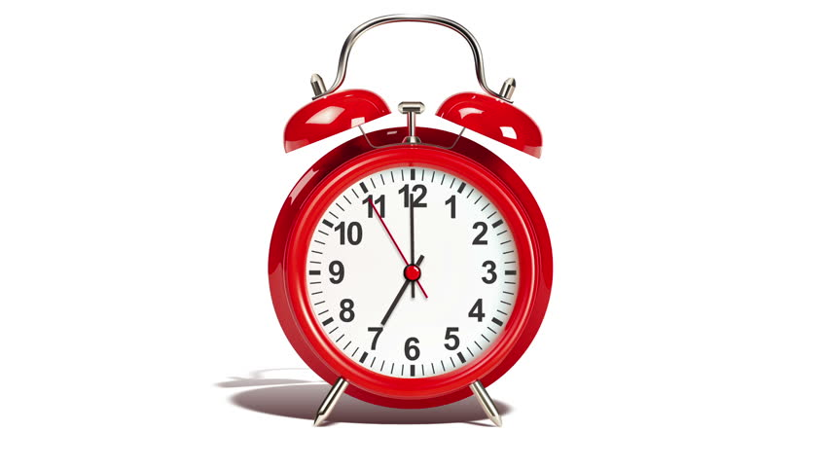
rdt3.0: channels with errors and loss
Approach: sender waits “reasonable” amount of time for ACK
retransmits if no ACK received in this time
if pkt (or ACK) just delayed (not lost):
retransmission will be duplicate, but seq #s already handles this!
receiver must specify seq # of packet being ACKed
use countdown timer to interrupt after “reasonable” amount of time
timeout

Slide 60
rdt3.0 sender
rdt_send(data)
sndpkt = make_pkt(0, data, checksum)
udt_send(sndpkt)
start_timer
Wait for
call 0 from above
Wait for ACK0
rdt_rcv(rcvpkt)
&& notcorrupt(rcvpkt)
&& isACK(rcvpkt,1)
rdt_rcv(rcvpkt)
&& notcorrupt(rcvpkt)
&& isACK(rcvpkt,0)
stop_timer
stop_timer
Wait for ACK1
Wait for
call 1 from above
rdt_send(data)
sndpkt = make_pkt(1, data, checksum)
udt_send(sndpkt)
start_timer
Notes:
We see the familiar four state sender from our rdt 2.1 and 2.2 protocols. Top two states when sending packet with zero seq # and bottom two

Slide 61
rdt3.0 sender
rdt_send(data)
rdt_rcv(rcvpkt) &&
( corrupt(rcvpkt) ||
isACK(rcvpkt,1) )
sndpkt = make_pkt(0, data, checksum)
udt_send(sndpkt)
start_timer
rdt_rcv(rcvpkt)
Λ
Λ
Wait for
call 0 from above
Wait for ACK0
timeout
udt_send(sndpkt)
start_timer
rdt_rcv(rcvpkt)
&& notcorrupt(rcvpkt)
&& isACK(rcvpkt,1)
rdt_rcv(rcvpkt)
&& notcorrupt(rcvpkt)
&& isACK(rcvpkt,0)
stop_timer
stop_timer
Wait for ACK1
Wait for
call 1 from above
timeout
udt_send(sndpkt)
start_timer
rdt_rcv(rcvpkt)
rdt_send(data)
Λ
rdt_rcv(rcvpkt) &&
( corrupt(rcvpkt) ||
isACK(rcvpkt,0) )
sndpkt = make_pkt(1, data, checksum)
udt_send(sndpkt)
start_timer
Λ
Notes:
We see the familiar four state sender from our rdt 2.1 and 2.2 protocols. Top two states when sending packet with zero seq # and bottom two

Slide 62

rdt3.0 in action
sender
receiver
sender
receiver
send pkt0
pkt0
send pkt0
pkt0
rcv pkt0
rcv pkt0
ack0
send ack0
ack0
send ack0
rcv ack0
rcv ack0
send pkt1
pkt1
send pkt1
pkt1
rcv pkt1
X
ack1
send ack1
loss
rcv ack1
send pkt0
pkt0
rcv pkt0
timeout
resend pkt1
ack0
send ack0
pkt1
rcv pkt1
ack1
send ack1
rcv ack1
send pkt0
pkt0
(a) no loss
rcv pkt0
ack0
send ack0
(b) packet loss

Slide 63
rdt3.0 in action
sender
receiver
sender
receiver
send pkt0
pkt0
rcv pkt0
send pkt0
pkt0
send ack0
rcv pkt0
rcv ack0
ack0
ack0
send ack0
send pkt1
pkt1
rcv ack0
rcv pkt1
send pkt1
pkt1
send ack1
rcv pkt1
ack1
ack1
send ack1
X
timeout
resend pkt1
loss
pkt1
rcv pkt1
timeout
resend pkt1
rcv ack1
(detect duplicate)
pkt1
rcv pkt1
send ack1
send pkt0
pkt0
ack1
(detect duplicate)
rcv pkt0
rcv ack1
send ack1
rcv ack1
ack1
ack0
send ack0
send pkt0
pkt0
(ignore)
rcv pkt0
ack0
send ack0
pkt1
(c) ACK loss
(d) premature timeout/ delayed ACK

