Slide 1

Elasticsearch DC Exit Migration
Seamlessly transitioning to a resilient, multi-region architecture.
Presented to Technical Program Managers, SREs, and Enterprise Architects.

Slide 2







Project Overview
Addressing Critical Business and Technical Demands
The current Elasticsearch deployment for the GRDA application relies on a two-datacenter (DC) model, posing limitations for enhanced resilience and regional presence. This migration initiative is driven by an enterprise mandate to deploy applications across four data centers, ensuring higher availability and optimized latency for our critical data.
4-DC Deployment
Mandated enterprise standard for all applications.
Regional Clusters
East Coast & West Coast for optimal performance.
Enhanced Resilience
Achieving higher availability for critical services.

Slide 3
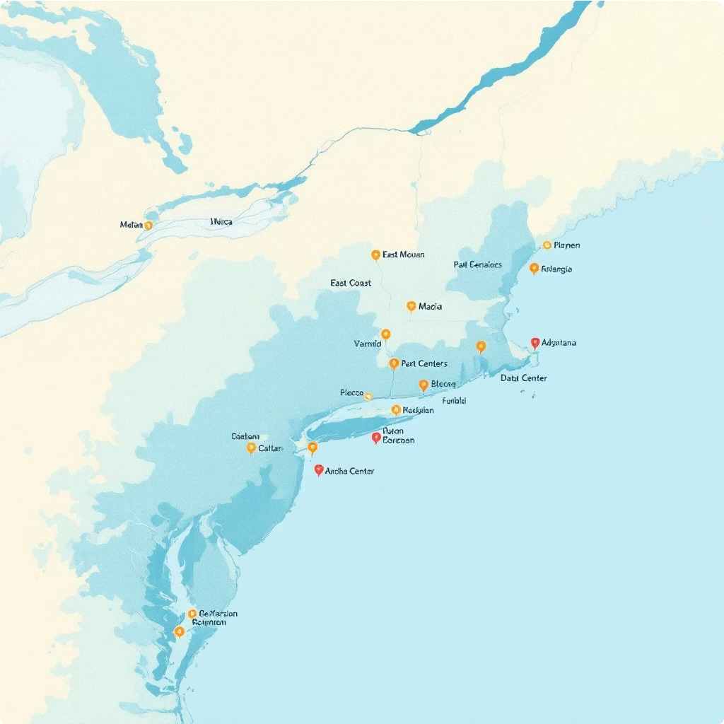
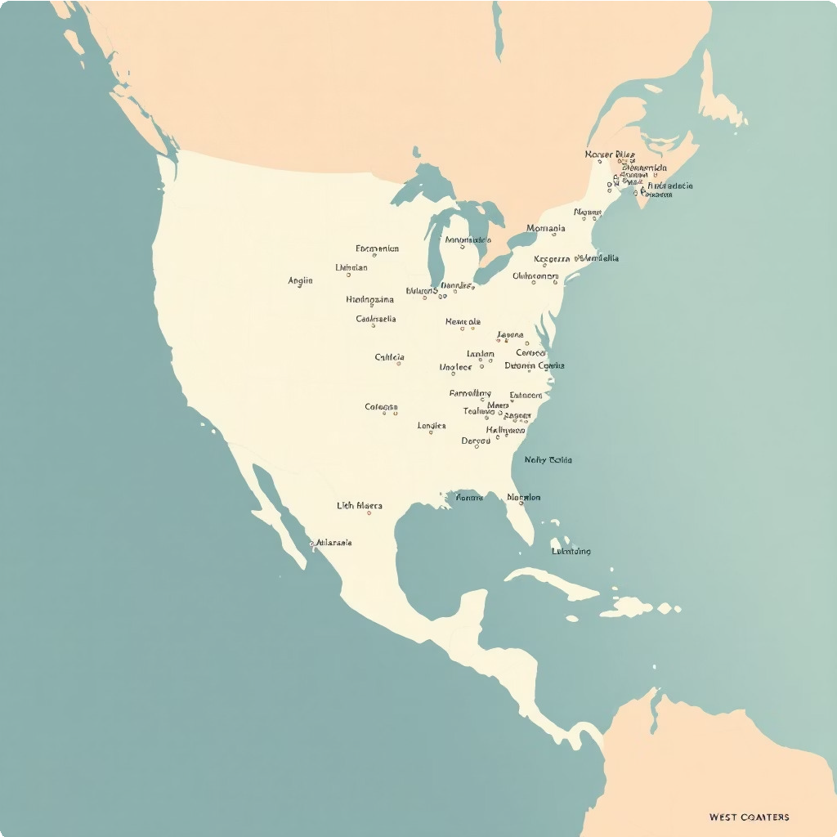
Transitioning to a Four-Datacenter Model with Cross-Cluster Replication
Problem Statement: Production & BCP
Our GRDA application currently operates with two Elasticsearch clusters: a Production cluster in Shoreview DC and a Business Continuity Planning (BCP) cluster in Tempe DC. The new enterprise requirement dictates deployment across four data centers, necessitating a significant architectural shift.
East Coast Cluster
Sterling DC Manassas DC
These two DCs will form a cohesive cluster within the East Coast region.
West Coast Cluster
Garland DC Lewisville DC
Similarly, these two DCs will comprise the West Coast cluster.
Cross-Cluster Replication (CCR) will be established between the East Coast and West Coast regions to ensure data synchronization and disaster recovery capabilities across geographically dispersed clusters.

Slide 4






Problem Statement: Non-Production
Streamlined Non-Prod Environments for Development & Testing
Unlike production, non-production Elasticsearch environments for the GRDA application will not inherit the complex high-availability setups. This simplified architecture aims to provide dedicated, isolated environments for development, testing, and user acceptance phases without the overhead of CCR.
Development (DEV)
Dedicated DC: Sterling
Currently in St. Louis, DEV will transition to a dedicated Sterling DC, offering an isolated environment for code development and initial testing.
System Integration Testing (SIT)
Dedicated DC: Lewisville
SIT, also currently in St. Louis, will move to a dedicated Lewisville DC, facilitating comprehensive integration testing.
User Acceptance Testing (UAT/PTE)
Dedicated DCs: Manassas & Garland
UAT/PTE will utilize two dedicated DCs, Manassas and Garland, to simulate real-world scenarios and handle performance testing.
Each non-production DC will operate independently, without CCR, reducing complexity and resource requirements for these environments.

Slide 5
Understanding Existing Elasticsearch Data Flow
Current State Definition
The current GRDA application's Elasticsearch implementation relies on a specific data writing and synchronization mechanism. This understanding is crucial for a smooth transition to the new architecture.
Unidirectional CCR
Bidirectional CCR resync
App writes to ES
Failover to other DC
In the current state, the application layer writes data to either the Production or BCP Elasticsearch cluster. Unidirectional CCR ensures data synchronization, with automatic failover to the operational cluster if one becomes unavailable. Bidirectional CCR then resynchronizes data once the impacted DC recovers.

Slide 6






General Design Considerations
Architectural Principles for a Robust Elasticsearch Deployment
To ensure the new Elasticsearch deployment is both performant and resilient, several key design considerations must be rigorously applied. These principles address network latency, cluster design, and disaster recovery preparedness.
Regional Cluster Separation
Stretching a cluster across 34ms network latency is not supported. Therefore, two distinct clusters (one per region) are necessary to maintain optimal performance and stability.
Minimized Design Changes
While striving to minimize changes to the current cluster design, necessary adjustments related to node roles and Index Lifecycle Management (ILM) will be implemented to optimize the new architecture.
Additional Master Nodes
Extra master nodes and a master "ready" node will be added to bolster the cluster's resilience and support various Disaster Recovery (DR) scenarios effectively.
Shard Allocation Awareness
Shard allocation awareness will be meticulously configured to ensure that primary and replica shards reside in different data centers, maximizing fault tolerance.
In-Region Snapshot Repository
Ideally, the snapshot repository will feature storage replication within its region, providing inherent in-region redundancy for critical backups.
Capacity Planning
Business as usual nodes must run at no more than 40% capacity. This reserve capacity is crucial to accommodate 2x the volume for full failover support during unforeseen events.

Slide 7



Ensuring Business Continuity and Data Integrity
Disaster Recovery Scenarios
Robust disaster recovery planning is paramount for our critical Elasticsearch clusters. We have identified and strategized for various scenarios to minimize downtime and prevent data loss.
1
Planned Datacenter Downtime
All master nodes in the impacted cluster will be migrated to the operational side, turning down masters in the maintenance DC. A 'grey master' will be enabled if that side remains up, ensuring the cluster operates with 3 master nodes. Adequate space and processing capacity (nodes running at no more than 40% capacity) are required to handle 2x volume. Failback involves removing the 'grey' master and returning to steady state.
2
Unplanned Datacenter Outage (3 Master Nodes)
Similar to planned downtime, but requires spinning up the 'off' master node to prevent potential split-brain scenarios in the cluster running with only 2 master nodes.
3
Unplanned Datacenter Outage (2 Master Nodes Impacted)
The remaining 'partner' site, already configured with 3 master nodes, will continue to function normally without additional changes, ensuring uninterrupted service.
These scenarios underscore the importance of proper node sizing and shard allocation awareness to maintain cluster health and data availability.

Slide 8




Phased Approach to Elasticsearch DC Exit Migration
Migration Milestones & Plan
The Elasticsearch DC exit migration will follow a structured, phased approach, beginning on February 18, 2026, and targeting completion by September 30, 2026. This timeline ensures careful planning, execution, and validation for each environment.
Feb 18 - Mar 31, 2026
Phase 1: Development (DEV)
Migration of the DEV environment to Sterling DC.
Key Activities: Assessment, New Cluster Setup, Data Migration, Testing.
May 16 - Jul 31, 2026
Phase 3: User Acceptance Testing (UAT/PTE) Migration of UAT/PTE environments to Manassas & Garland DCs. Key Activities: New Cluster Setup, Data Migration, Performance &
UAT.
1
2
3
4
Apr 1 - May 15, 2026
Phase 2: System Integration Testing (SIT)
Migration of the SIT environment to Lewisville DC.
Key Activities: New Cluster Setup, Data Migration, Integration Testing.
Aug 1 - Sep 30, 2026
Phase 4: Production & BCP
Migration of Production (Shoreview) and BCP (Tempe) clusters to the new East Coast (Sterling & Manassas) and West Coast (Garland & Lewisville) clusters with CCR setup.
Key Activities: Cluster Setup, Data Migration, Client Updates, Validation.
This phased strategy allows for focused attention on each environment, minimizing risks and ensuring thorough validation before proceeding to the next stage, culminating in a successful production cutover.

Slide 9
Server Migration Inventory
Detailed Breakdown of Existing & Proposed Elasticsearch Instances
This comprehensive list outlines the current Elasticsearch servers across various environments and their corresponding new hostnames, data centers, and configurations. This inventory is critical for tracking and executing the migration with precision.
This table serves as a foundational reference for all migration activities, ensuring accurate provisioning and configuration of new hosts.
pd-85a0065 | Dev | Elastic Master | 8X64 | St. Louis | UTC | pd-01a0088 | /apps 50G,/esdata 100G | Elasticsearch 7.17
pd-86a0065 | Dev | Elastic Master | 8X64 | St. Louis | UTC | pd-02a0088 | /apps 50G,/esdata 100G | Elasticsearch 7.17
pd-87a0065 | Dev | Elastic Hot | 8X64 | St. Louis | UTC | pd-lla0088 | /apps 200G,/esdata 800G | Elasticsearch 7.17
pd-88a0065 | Dev | Elastic Hot | 8X64 | St. Louis | UTC | pd-l2a0088 | /apps 200G,/esdata 800G | Elasticsearch 7.17
pd-89a0065 | Dev | Elastic Hot | 8X64 | St. Louis | UTC | pd-l3a0088 | /apps 200G,/esdata 800G | Elasticsearch 7.17
pd-90a0065 | Dev | Elastic Hot | 8X64 | St. Louis | UTC | pd-14a0088 | /apps 200G,/esdata 800G | Elasticsearch 7.17
pd-97a0065 | Dev | Kibana | 8X32 | St. Louis | UTC | pd-61a0088 | /apps 200G,/apps 200G | Elasticsearch Kibana Instance
ps-85a0065 | SIT | Elastic Master | 8X64 | St. Louis | UTC | ps-01a0088 | /apps 50G,/esdata 100G | Elasticsearch 7.17
ps-86a0065 | SIT | Elastic Master | 8X64 | St. Louis | UTC | ps-02a0088 | /apps 50G,/esdata 100G | Elasticsearch 7.17
ps-87a0065 | SIT | Elastic Hot | 8X64 | St. Louis | UTC | ps-lla0088 | /apps 200G,/esdata 800G | Elasticsearch 7.17
ps-88a0065 | SIT | Elastic Hot | 8X64 | St. Louis | UTC | ps-12a0088 | /apps 200G,/esdata 800G | Elasticsearch 7.17
ps-89a0065 | SIT | Elastic Hot | 8X64 | St. Louis | UTC | ps-l3a0088 | /apps 200G,/esdata 800G | Elasticsearch 7.17
ps-90a0065 | SIT | Elastic Hot | 8X64 | St. Louis | UTC | ps-14a0088 | /apps 200G,/esdata 800G | Elasticsearch 7.17
ps-97a0065 | SIT | Kibana | 8X32 | St. Louis | UTC | ps-61a0088 | /apps 2006,/apps 200G | Elasticsearch Kibana Instance
pp-53a0195 | Prod | Garuda Master | BX64 | ShoreView | UTC | pp-01a0089 | /apps 100G,/esdata 100G | Elasticsearch 7.17
pp-54a0195 | Prod | Garuda Master | 8X64 | ShoreView | UTC | pp-02a0089 | /apps 100G,/esdata 100G | Elasticsearch 7.17
pp-55a0195 | Prod | Garuda Master | 8X64 | ShoreView | UTC | pp-03a0089 | /apps 100G,/esdata 100G | Elasticsearch 7.17
pp-56a0195 | Prod | Garuda Data | 8X64 | ShoreView | UTC | pp-lla0089 | /apps 1T,/esdata 3T | Elasticsearch 7.17
pp-57a0195 | Prod | Garuda Data | 8X64 | ShoreView | UTC | pp-12a0089 | /apps 1T,/esdata 3T | Elasticsearch 7.17
pp-58a0195 | Prod | Garuda Data | 8X64 | ShoreView | UTC | pp-l3a0089 | /apps 1T,/esdata 3T | Elasticsearch 7.17
pp-59a0195 | Prod | Garuda Data | 8X64 | ShoreView | UTC | pp-14a0089 | /apps 1T,/esdata 3T | Elasticsearch 7.17
pp-60a0195 | Prod | Garuda Data | 8X64 | ShoreView | UTC | pp-15a0089 | /apps 1T,/esdata 3T | Elasticsearch 7.17
pp-92a0196 | Prod | Kibana /Garuda | 8X32 | ShoreView | UTC | pp-61a0088 | /apps 300G,/apps 300G | Elasticsearch Ribana Instance
pp-93a0196 | Prod | Kibana / Garuda | 8X32 | ShoreView | UTC | pp-62a0088 | /apps 300G,/apps 300G | Elasticsearch Kibana Instance
pr-58a0196 | BCP | Garuda Master | 8X64 | Tempe | UTC | pr-01a0089 | /apps 100G,/esdata 100G | Elasticsearch 7.17
pr-59a0196 | BCP | Garuda Master | 8X64 | Tempe | UTC | pr-02a0089 | /apps 100G,/esdata 100G | Elasticsearch 7.17
pr-60a0196 | BCP | Garuda Master | 8X64 | Tempe | UTC | pr-03a0089 | /apps 100G,/esdata 100G | Elasticsearch 7.17
pr-61a0196 | BCP | Garuda Data | 8X64 | Tempe | UTC | pr-lla0089 | /apps 1T,/esdata 3T | Elasticsearch 7.17
pr-62a0196 | BCP | Garuda Data | 8X64 | Tempe | UTC | pr-12a0089 | /apps 1T,/esdata 3T | Elasticsearch 7.17
pr-63a0196 | BCP | Garuda Data | 8X64 | Tempe | UTC | pr-13a0089 | /apps 1T,/esdata 3T | Elasticsearch 7.17
pr-64a0196 | BCP | Garuda Data | 8X64 | Tempe | UTC | pr-14a0089 | /apps 1T,/esdata 3T | Elasticsearch 7.17
pr-65a0196 | BCP | Garuda Data | 8X64 | Tempe | UTC | pr-15a0089 | /apps 1T,/esdata 3T | Elasticsearch 7.17
pr-91a0188 | BCP | Kibana / Garuda | 8X32 | Tempe | UTC | pr-61a0088 | /apps 300G,/apps 300G | Elasticsearch Kibana Instance

