Slide 1

Exploratory Data Analysis
Kings County, Seattle Housing data
LaShanni Butler
Flatiron School
1/25/19

Slide 2

Agenda
Overview
Background
Question
Techniques
Recommendations

Slide 3

Overview
Exploratory data analysis (EDA) is an approach analyzing data to understand their main characteristics, often with visual methods (like graphs)
Basically, EDA helps us get a basic description of the data, visualize it, identify patterns and challenges of using the data
This Photo by Unknown Author is licensed under CC BY-SA

Slide 4


Background
We’re looking at Kings County (KC), Seattle data
Based on this, we’re trying to make housing price predictions
We’re asking the question: What best predicts the price of a house in KC?

Slide 5
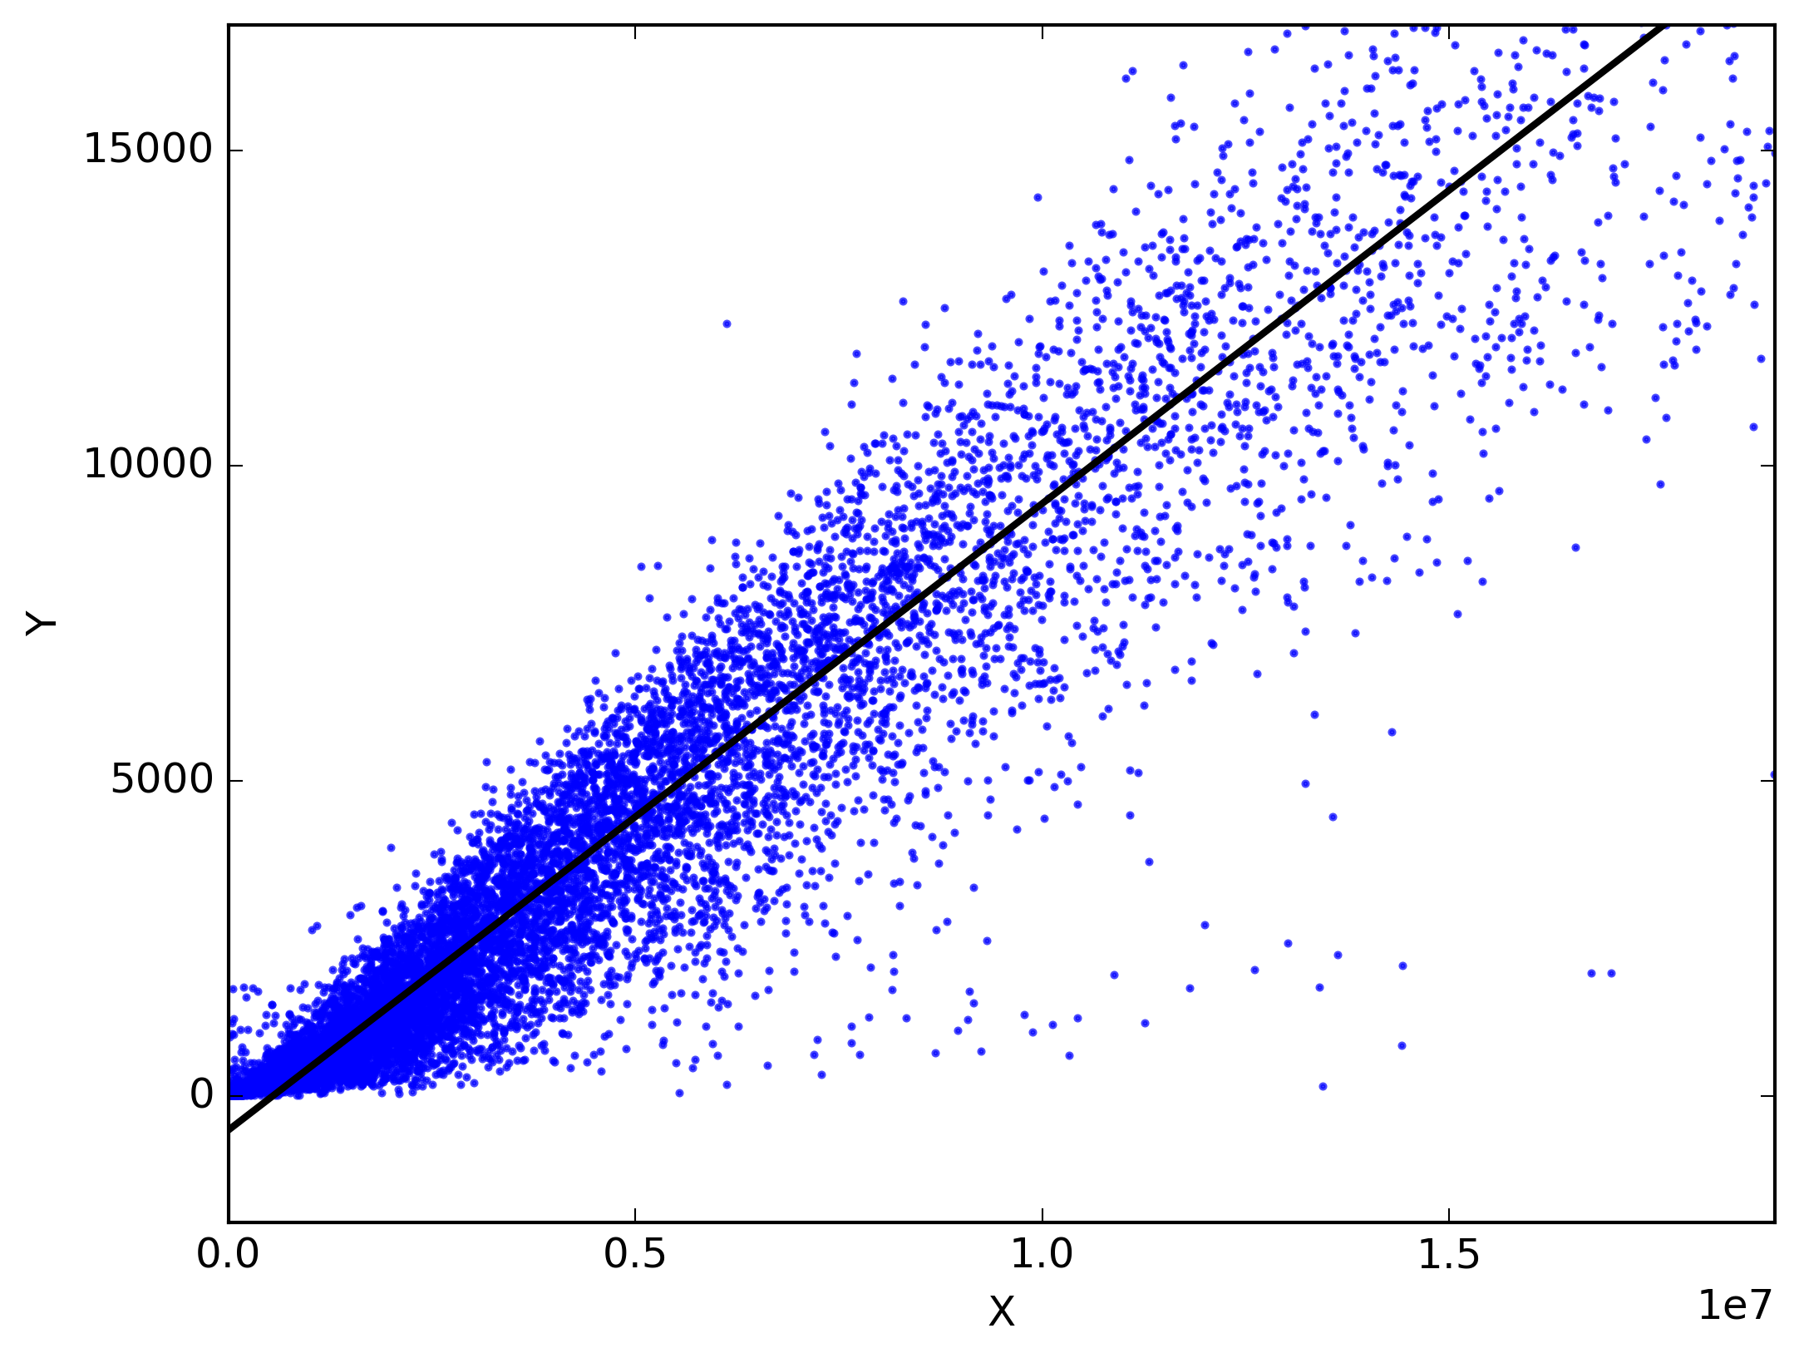
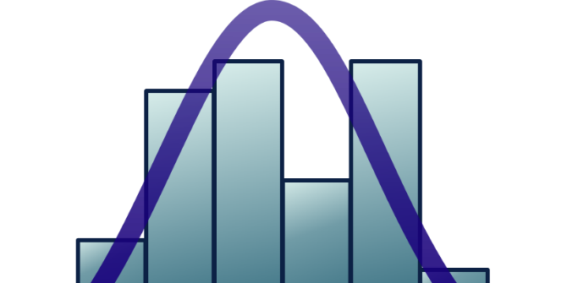
Techniques
We used statistics (specifically linear regression) to look see what drove home prices in Seattle
Linear regression models are used to show or predict the relationship between two factors
Regressions that show a high level of accuracy between the factors are generally considered good
This Photo by Unknown Author is licensed under CC BY

Slide 6

Techniques
Based on the statistical results, recommendations were made for KC home prices
Factors that I thought would influence the home prices (such as waterfront property), really had no affect on price!
This Photo by Unknown Author is licensed under CC BY-SA

Slide 7
Recommendations
Based on my analysis, I learned the following:
Home prices are influenced by the number of bedrooms in a home
Homes with 2 floors had the widest range in price. So I assumed many buyers are attracted to home with 2 floors
Homes with a condition of 3 also have the widest price range. So this might be attractive to buyers in KC
The year a home was built did not seem to influence the price too much
The most desirable zip codes for buyers were in the 98000, 98050 and 98100

