Slide 1

Optimizing Workforce
E ciency: Analyzing
Performance Data of 3,000 Employees in E cel

Slide 2





Introduction to Workforce E ciency
In today's competitive environment, optimizing workforce efﬁciency is crucial. This presentation analyzes the performance data of 3,000 employees using Excel, aiming to identify trends and areas for improvement. We will explore effective strategies to enhance overall productivity and employee satisfaction.

Slide 3




Importance of Performance Data
Utilizing performance data allows organizations to make informed decisions. By analyzing metrics such as productivity, attendance, and employee engagement, companies can pinpoint strengths and weaknesses. This data-driven approach is essential for developing targeted strategies to boost workforce efﬁciency.

Slide 4



Data Collection Methods
To effectively analyze performance, various data collection methods can be employed. Surveys, time tracking, and self-assessments are valuable tools. By gathering comprehensive data, organizations can ensure a holistic view of employee performance, leading to better analysis and insights.

Slide 5
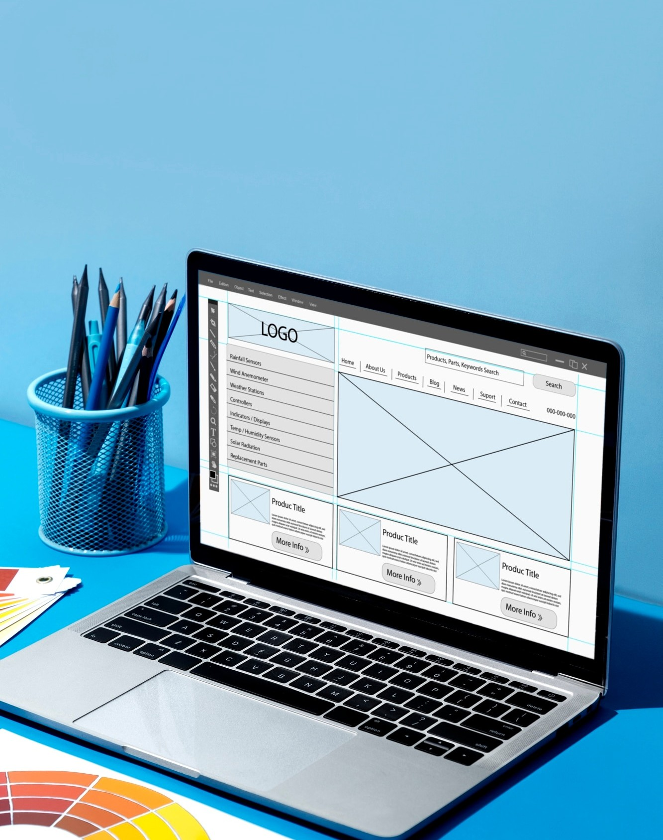





Utilizing Ecelcel fforor AnalyAnalysissis
Excel is a powerful tool for analyzing large datasets. By employing features such as pivot tables, charts, and formulas, organizations can visualize trends and summarize data effectively. This enables quick identiﬁcation of performance gaps and opportunities for improvement.

Slide 6




Identifying Key Performance Indicators
Establishing Key Performance Indicators (KPIs) is vital for measuring employee performance. Metrics like sales targets, customer satisfaction, and project completion rates can provide insights into efﬁciency. Regularly reviewing these KPIs helps in tracking progress and aligning goals with organizational objectives.

Slide 7




Strategies for Improvement
Based on performance data analysis, organizations can implement targeted strategies for improvement. This may include training programs, mentorship, and reward systems. Fostering a culture of continuous development ensures that employees feel valued and
motivated to enhance their
performance.

Slide 8




Monitoring Progress and
Feedback
Regularly monitoring progress and providing feedback is crucial for sustained improvement. Utilizing performance reviews, one-on-one meetings, and surveys can help maintain open communication. This ensures that employees are aware of their performance and can adjust their
efforts accordingly.

Slide 9
Conclusion and Future Steps
In conclusion, optimizing workforce efﬁciency through performance data analysis is essential for organizational success. By leveraging tools like Excel and focusing on KPIs, companies can enhance productivity and employee satisfaction. Moving forward, continuous monitoring and adaptation will ensure lasting improvements.

Slide 10
Thanks!

