Slide 1

POWER PREDICTION OF VLSI CIRCUITS
BY
SUGANTHA KRISHNAN
MOHAN BABU
SENTHILKUMAR SEELAN
PRAVIN

Slide 2
Proposed ML solution
Input the data from excel
Feature engineering
Model training
Model testing
Feature selection
Evaluation of the trained model

Slide 3
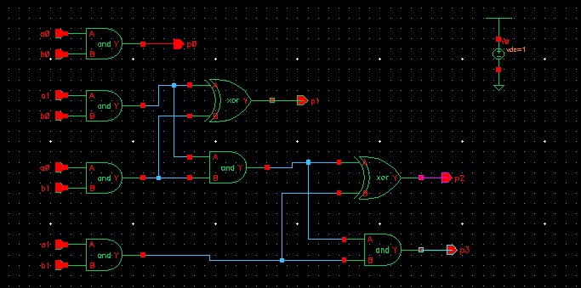
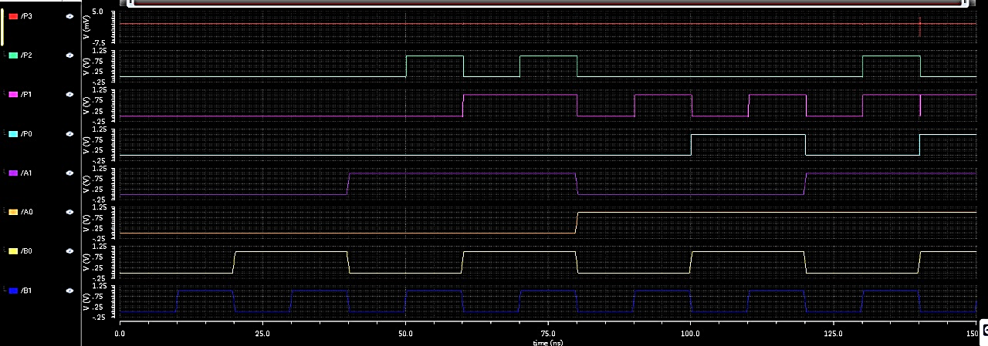
2 BIT MULTIPLIER:
Transient analysis using bit stimulus:
Circuit in cadence:

Slide 4
DATASET OF 2-BIT MULTIPLIER

Slide 5
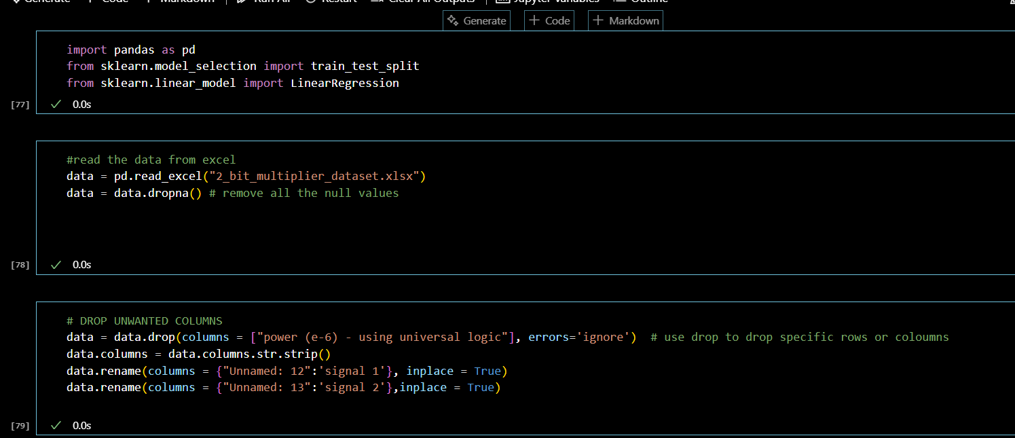
code:
The snippets shows the feature engineering involved in the process

Slide 6
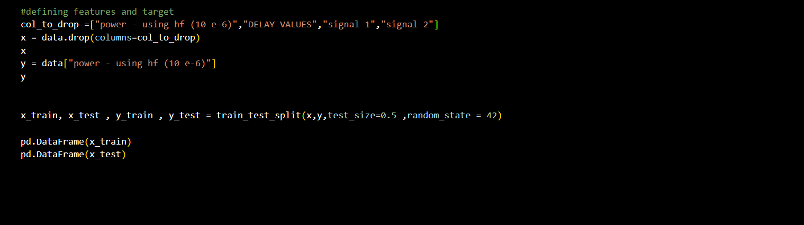
Code:
This snippet show the code for splitting the data into training and testing set
Input features used : input values in both binary and decimal + their product outputs
Target used :static power values upon performing each operation

Slide 7
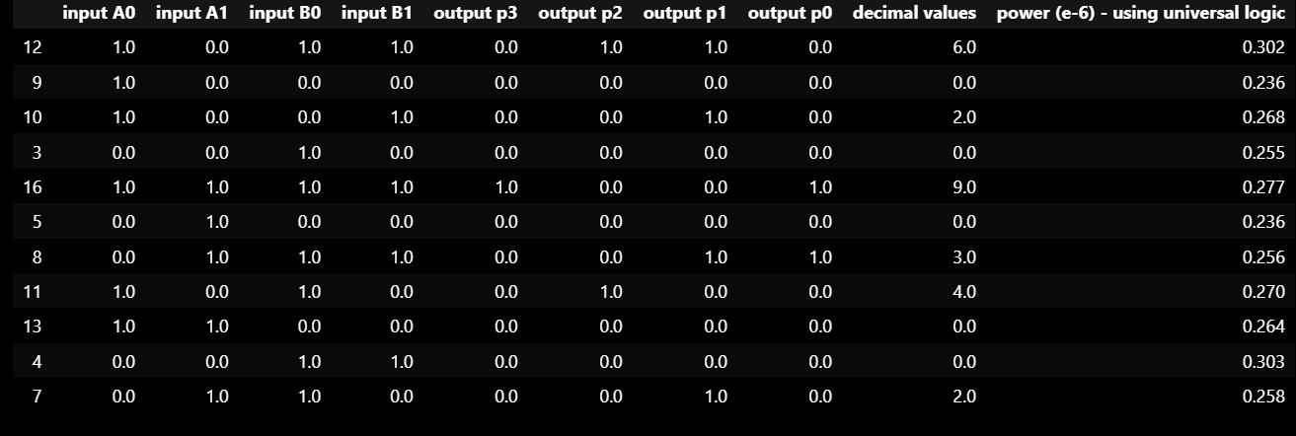
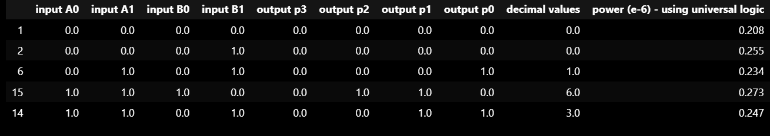
Training dataset and testing dataset : input features
Training dataset:
Testing dataset:

Slide 8
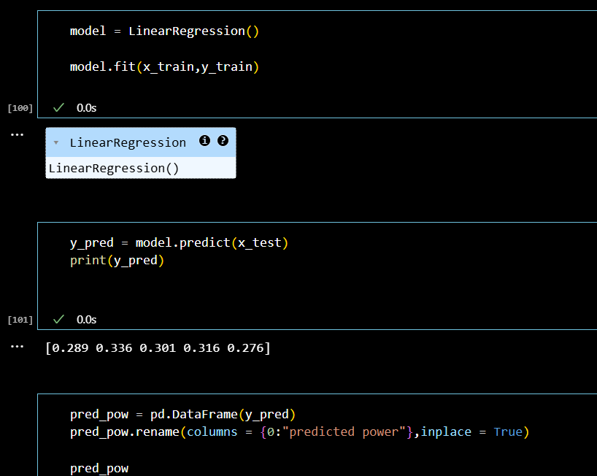
Model training :
For the 2-bit multiplier we trained the model with linear regression and successfully predicted the power values
We also used mean absolute error as the performance metrix and the value obtained was 0.0006.. Indicating that the model has predicted the values with high accuracy

Slide 9
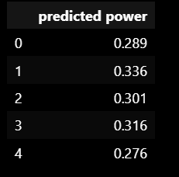
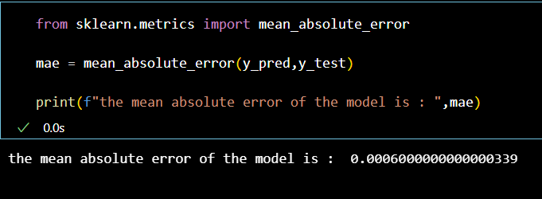
Results:
Predicted power: MAE PERFORMANCE:

Slide 10
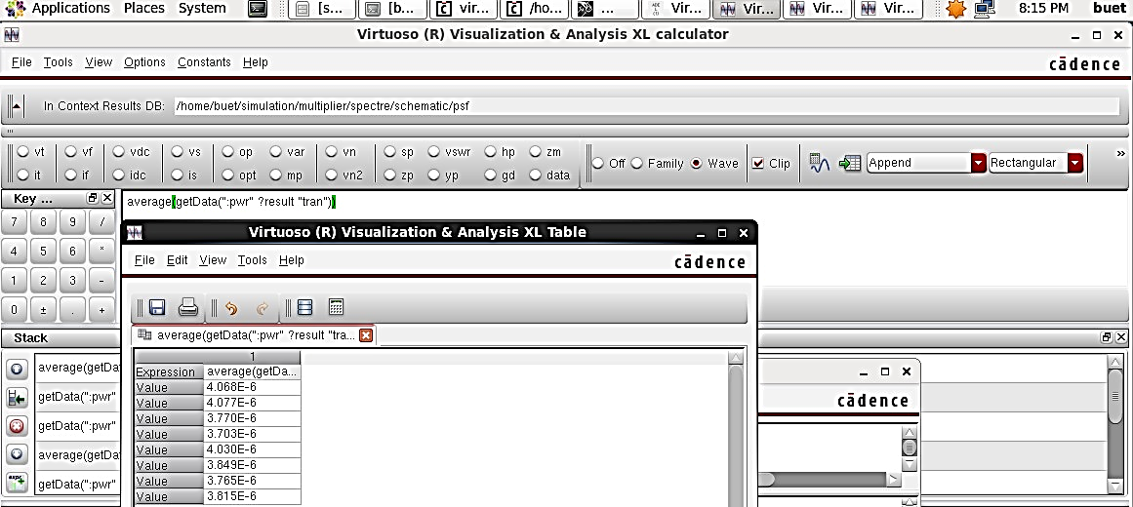
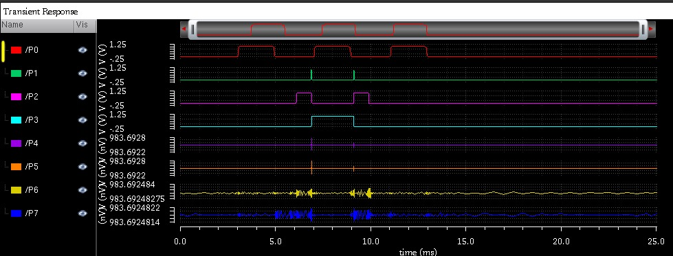
4 BIT MULTIPLIER
For the values, 0000 0000; 0000 1111; 0011 0011; 0101 0101
Power for the values, 1001 0011 0101 0010 1101 1010 1101 1011 1100 0011 0100 1100 0100 1111 0110 1101

Slide 11
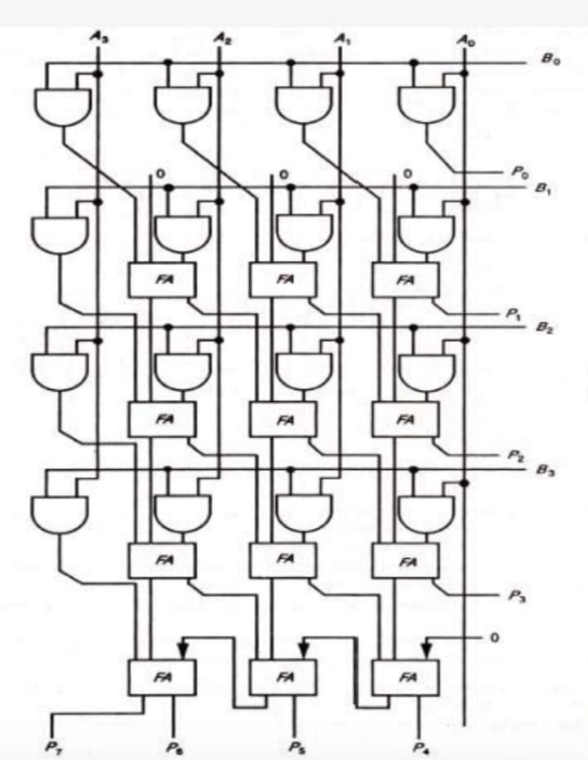
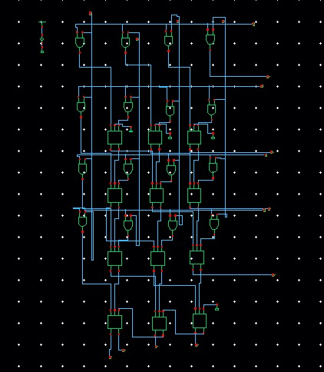
4 BIT MULTIPLIER:
CIRCUIT DIAGRAM:
CIRCUIT IN CADENCE:

Slide 12
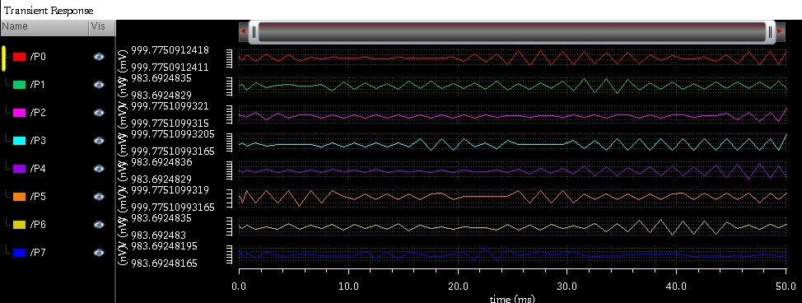
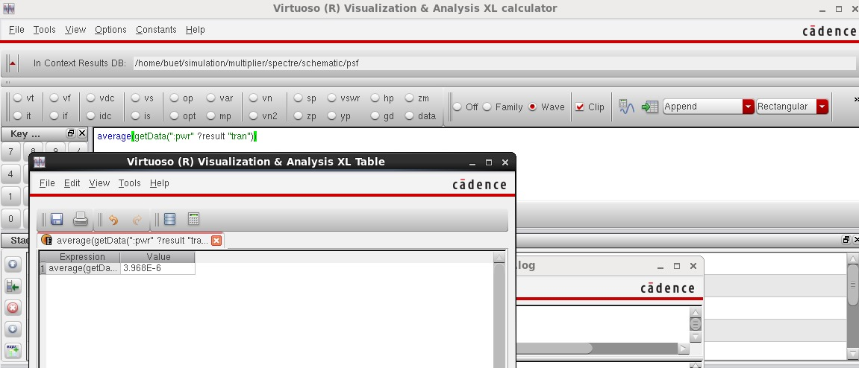
4 BIT MULTIPLIER
Transient analysis for dc values with calculator:

Slide 13
Dataset used: final_data.xlsx
input1 | decimal1 | input2 | decimal2 | product of numbers | product in binary | POWER in MICROWATTS( E-06)
0 | 0 | 0 | 0 | 0 | 0 | 4.090
0 | 0 | 1 | 1 | 0 | 0 | 4.161
0 | 0 | 10 | 2 | 0 | 0 | 4.161
0 | 0 | 11 | 3 | 0 | 0 | 4.227
0 | 0 | 100 | 4 | 0 | 0 | 4.161
0 | 0 | 101 | 5 | 0 | 0 | 4.227
0 | 0 | 110 | 6 | 0 | 0 | 4.227
0 | 0 | 111 | 7 | 0 | 0 | 4.294
0 | 0 | 1000 | 8 | 0 | 0 | 4.161
0 | 0 | 1001 | 9 | 0 | 0 | 4.227
0 | 0 | 1010 | 10 | 0 | 0 | 4.227
0 | 0 | 1011 | 11 | 0 | 0 | 4.294
0 | 0 | 1100 | 12 | 0 | 0 | 4.227
0 | 0 | 1101 | 13 | 0 | 0 | 4.294
0 | 0 | 1110 | 14 | 0 | 0 | 4.294
0 | 0 | 1111 | 15 | 0 | 0 | 4.360
1 | 1 | 0 | 0 | 0 | 0 | 4.161
1 | 1 | 1 | 1 | 1 | 1 | 4.239
1 | 1 | 10 | 2 | 2 | 10 | 4.140
1 | 1 | 11 | 3 | 3 | 11 | 4.190
1 | 1 | 100 | 4 | 4 | 100 | 4.040
1 | 1 | 101 | 5 | 5 | 101 | 4.091

Slide 14
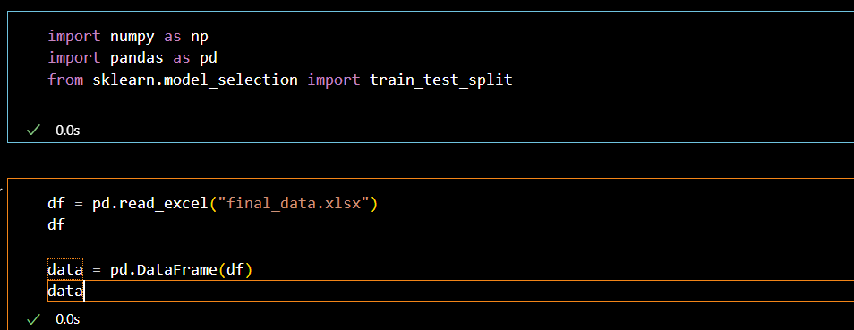
CODE:
The dataset used in here is attached as a .xlsx file in the previous slide

Slide 15
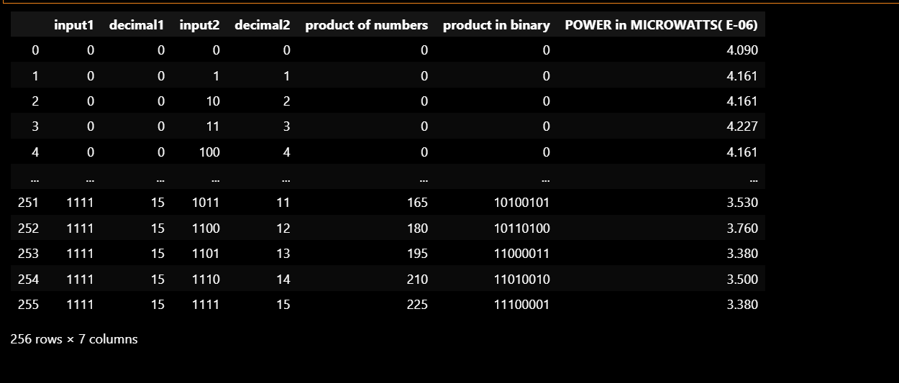

Slide 16
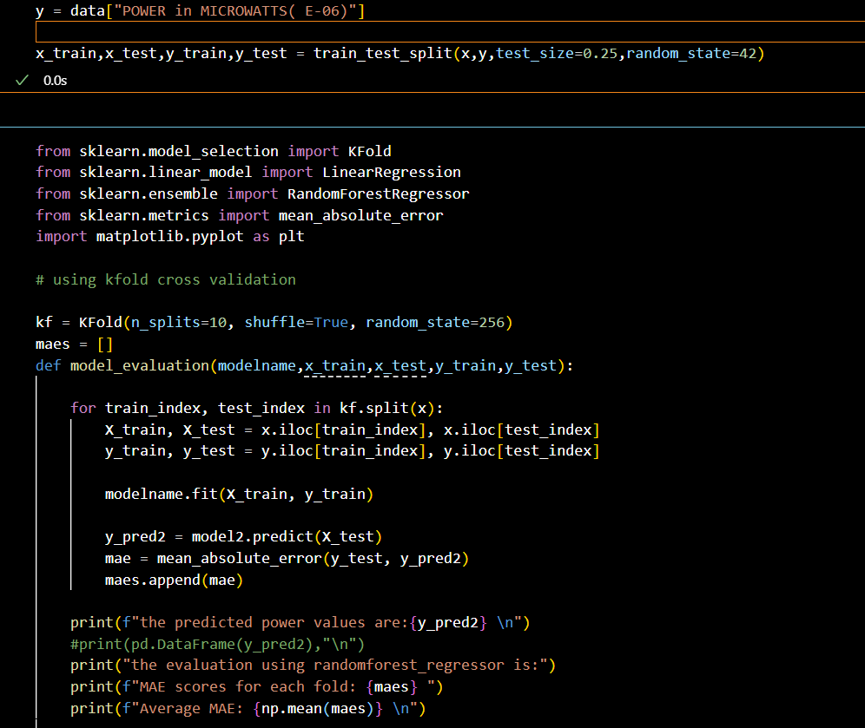
Code:
In this snippet after splitting the data into training and testing sets we tried a new method instead of normal model training.
This method is called “KFOLD CROSS VALIDATION”. Here we the data into ‘k’ number of sets and train the model k times with alternating testing datasets
This allows model to understand the patterns more deeply from the given data

Slide 17
Code:
We use two different models to compare the efficiency of two models
1. random forest regression
2.linear regression

Slide 18
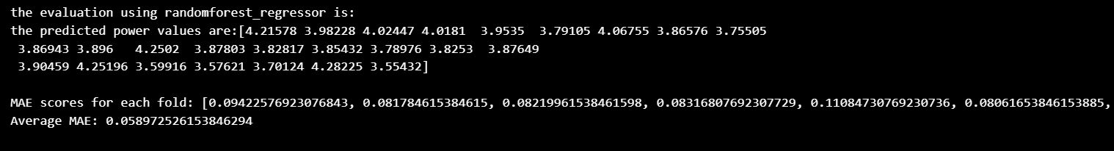
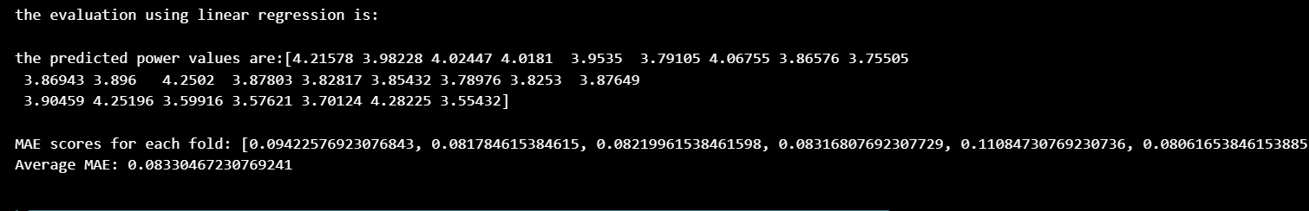
Results:
1. using random forest:
2.Using linear regression:
The results of prediction from both the models are given here
Using “kfold cross validation” by keeping k = 10 , we get 10 different predicted values for 10 different testing datasets.
The average mean absolute error from all these predicted values are calculated

Slide 19
Results: Plots
We also included scatterplots for both the model performances to provide more understabale insights
We see that both the plots seems very similar this is because the difference in their respective average mean absolute error is very small
Average MAE:
1.linear regression:
0.08330467230769241
2.Random forest regression
0.058972526153846294

Slide 20
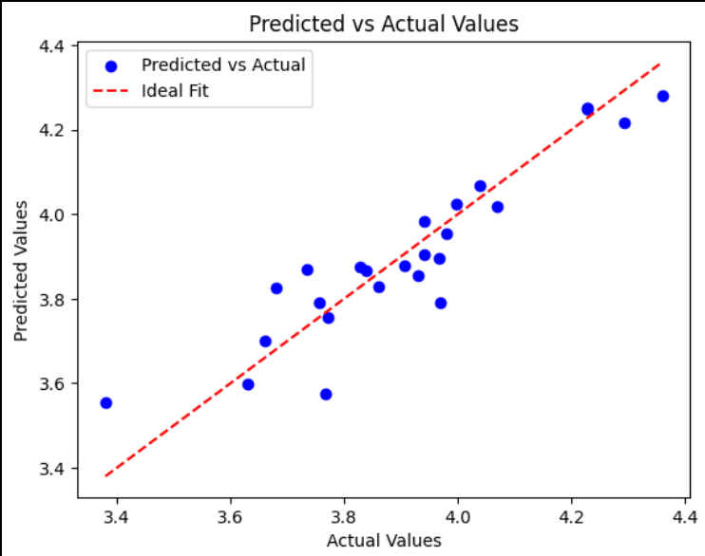
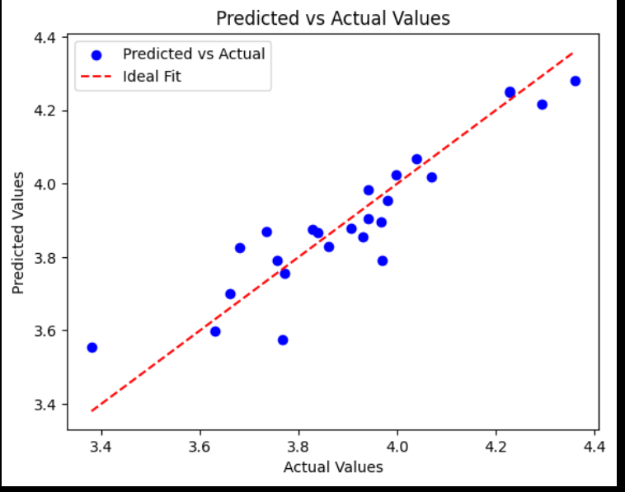
Results:plots we also made scatterplots for both the models performances to provide more understandable insights from the result
1.Random forest regression
2.Linear regression:

Slide 21
Conclusion: 4 BIT MULT
Based on the performance of both the models we get the mean absolute error in 0.0…. Values, this indicates that both models have their own respective errors in prediction.
based on the given input data using input values and their combination alones , this is fairly a well trained results from both the models.
The accuracy of results can be improved if the training data includes other possible features like delay values, dynamic power values and etc..

