Slide 1
OpenHack with IBM
Call for Code 2020: COVID-19

Slide 2
Team and Use Case
Team Name | Team Member Name | Mail Id | PU
CRISIS HACKERS | Asha | Asha_V01@infosys.com | INS-ADM
 | Sumita | sumita.kale@infosys.com | INS-ADM
 | Vinay | Vinay.sharma02@infosys.com | INS-ADM
Use Case description | Crisis communication Whether via text, phone, websites, or communication apps, conversing with chatbots and other AI-enabled resources can play a critical role in helping communities quickly understand crucial information and free up customer service resources to focus on higher-level issues. End-user can converse with this Chatbot for getting – Basic Information related to COVID-19. Information about the increase in case in user’s vicinity in last 24 hour. Statistics about the Covid cases for a country. Latest News in any area/country/state. Details of the symptoms of Covid-19

Slide 3
Use Case
OUR UNDERSTANDING OF USE CASE
CONTEXT
In times of crisis like Covid-19 pandemic, communications systems are often overwhelmed with people trying to find basic information about testing, symptoms, community response, and other resources. When communication lines get clogged, people who need real help can't get through. Chatbots help respond to tens, even hundreds of thousands of messages a day.
BUSINESS RELEVANCE
Communication and awareness is the hour of the need, people can use this bot and embed in their existing application if they want. Chatbots can help everyone by providing them timely awareness of the happenings of this pandemic.
BUSINESS SOLUTION
It is not possible for a single person to respond to multiple queries parallel, Chatbots can do that easily. We will have a AI-Voice Enabled Chatbot that will help answer many queries revolving around COVID-19.

Slide 4
a. Use case explanation and scope - 2 minutes
b. Architecture and technical design of the solution - 2 minutes
c. Working demo of the solution from desktop/laptop - 4 minutes
d. Questions and Answer Session - 3 minutes

Slide 5
Technical Solution
SOLUTION ARCHITECTURE
Design
Web Application will be used for chatbot interface with IBM Watson assistant and Watson discovery.
Deployment
Public Web Application- User would be able to access the chatbot from Web browser independent of device(Mobile/Desktop/Laptop)
How did you arrive this solution?
Chatbot is much needed at the hour as communication, knowledge and awareness is the key to fight this pandemic
TECHNOLOGY STACK
IBM Watson
IBM Discovery
IBM Text-To-Speech
IBM Speech-To-Text
IBM Cloud Functions
Node-Red is used to integrate multiple IBM cloud resources and to create the web application.
Why did you choose this stack?
Open source and easily available tools/softwares that can be integrated to achieve the implementation

Slide 6
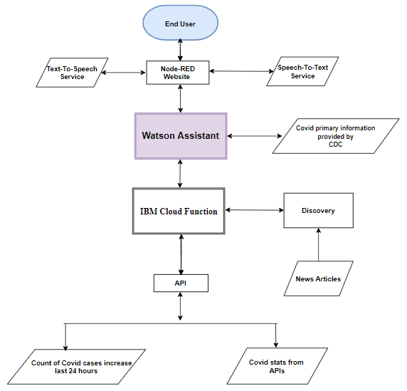
Architecture Flow Diagram

Slide 7
Thank You

