Slide 1
OpenHack with IBM
Call for Code 2020: COVID-19

Slide 2
Team and Use Case
Team Name | Team Member Name | Mail Id | PU
CRISIS HACKERS | Asha | Asha_V01@infosys.com | INS-ADM
 | Sumita | sumita.kale@infosys.com | INS-ADM
 | Vinay | Vinay.sharma02@infosys.com | INS-ADM
Use Case description | Crisis communication Whether via text, phone, websites, or communication apps, conversing with chatbots and other AI-enabled resources can play a critical role in helping communities quickly understand crucial information and free up customer service resources to focus on higher-level issues. End-user can converse with this ChatBot for getting – Information related to COVID-19 Information about the increase in case in user’s vicinity in last 24 hour. Information about nearest COVID operating hospitals.

Slide 3
Use Case
< YOUR UNDERSTANDING OF USE CASE > (focus on what is the business problem?)
CONTEXT
In times of crisis like Covid-19 pandemic, communications systems are often overwhelmed with people trying to find basic information about testing, symptoms, community response, and other resources. When communication lines get clogged, people who need real help can't get through. Chatbots help respond to tens, even hundreds of thousands of messages a day.
BUSINESS RELEVANCE
Communication and awareness is the hour of the need, people can use this bot and embed in their existing application if they want. Chabots can help everyone by making them aware of the happening of this pandemic.
BUSINESS SOLUTION
It is not possible for a single person to respond to multiple queries parallel, Chatbots can do that easily. We will have a chatbot process that will answer
all queries revolving around COVID-19.

Slide 4
Technical Solution
<SOLUTION ARCHITECTURE> (add additional slides as needed***)
Design
Slack will be used for chatbot interface with IBM Watson assistant and Watson discovery.
Deployment
Slack
How did you arrive this solution?
Chatbot is much needed at the hour as communication, knowledge and awareness is the key to fight this pandemic
<TECHNOLOGY STACK> (add additional slides as needed***)
Add the stack here
IBM Watson + IBM cloud + Discovery
Why did you choose this stack?
Open source and easily available

Slide 5
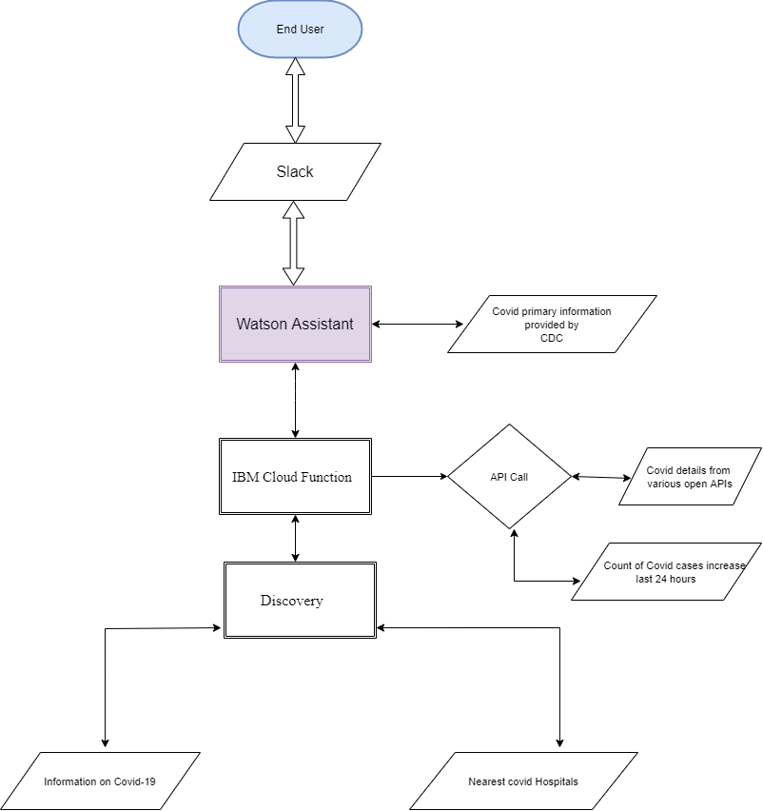
Architecture Flow Diagram

Slide 6
Thank You

