Slide 1
DevOps (The Basics & Git Commands)
by
Suganya

Slide 2
What is DevOps?
DevOps is a Software Development approach which involves Continuous Development, Continuous Testing, Continuous Integration, Continuous Deployment and Continuous Monitoring of the software throughout its development life cycle.
DevOps is the preferred approach to develop high quality software in shorter development cycles which results in greater customer satisfaction.

Slide 3
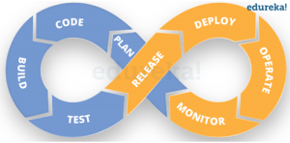
DevOps Life Cycle :

Slide 4
DevOps Lifecycle can be broadly broken down into the below DevOps Stages:
Continuous Development
Continuous Integration
Continuous Testing
Continuous Monitoring
Virtualization and Containerization
These stages are the building blocks to achieve DevOps as a whole.

Slide 5
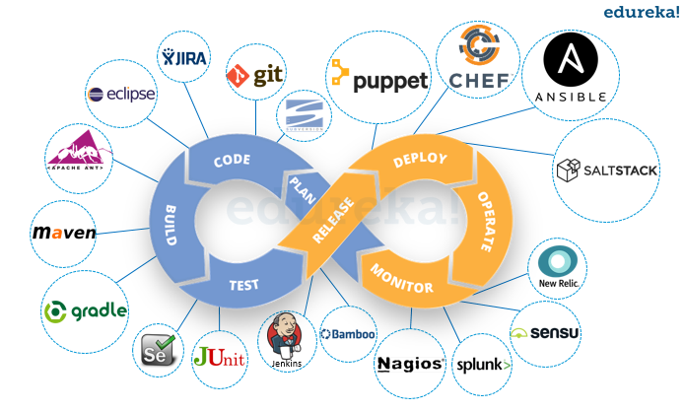
DevOps - Tools

Slide 6
Git
As Git is a distributed version control system, it can be used as a server out of the box.
Dedicated Git server software helps, amongst other features, to add access control, display the contents of a Git repository via the web, and help managing multiple repositories.

Slide 7
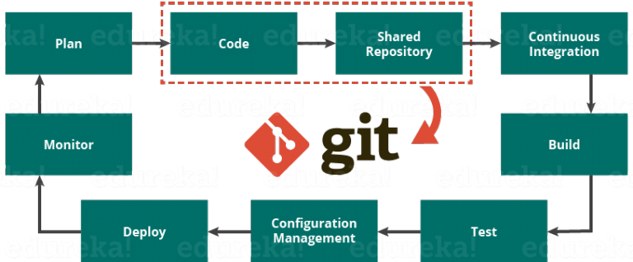
Git : How Git fits in DevOps

Slide 8
Basic Commands in Git
Git config : Create & Configure git repository.
Git init : Initialization of repository functionality.
Git clone : Clone your repository as a replica to take a copy of your own repository to create new one.
Git push : Pushes all the modified local objects to the remote repository and advances its branches.
Git pull : Fetches the files from the remote repository and merges it with your local one.

Slide 9
Git fetch : Fetches all the objects from the remote repository that are not present in the local one.
Git Status : Shows you the status of files in the index versus the working directory. It will list out files that are untracked (only in your working directory), modified (tracked but not yet updated in your index), and staged (added to your index and ready for committing).
Git add : Adds files changes in your working directory to your index. Example: git add .
Git rm : Removes files from your index and your working directory so they will not be tracked.

Slide 10
Git Commit : Takes all of the changes written in the index, creates a new commit object pointing to it and sets the branch to point to that new commit.
Git Starsh : Similar to “commit”, helps in freezing the code.
Git Checkout : Checks out a different branch – switches branches by updating the index, working tree, and HEAD to reflect the chosen branch.
Git merge : Merges one or more branches into your current branch and automatically creates a new commit if there are no conflicts.

Slide 11
Git Tag : Tags a specific commit with a simple, human readable handle that never moves
Git branch : Displays branch name.
Git gc : Garbage collector.
Git Diff : helps to know about code commit difference in the multiple branches after commit/push.
Git grep : Search codes.
Git fsck : Displays old and unused codes.
Git prune : Delete all old files.

Slide 12
Thank you ..

