Slide 1
Feature Exploration and Model Comparison for Stock Market Prediction: Unveiling the Superiority of LSTM or ARIMA

Slide 2
INTRODUCTION
This research study focuses on comparing the predictive abilities of Long Short-Term Memory (LSTM) and Autoregressive Integrated Moving Average (ARIMA) techniques in forecasting stock market trends.
The study explores various features derived from different aspects of market data, including Open, Close, High, and Low prices, to identify the most informative indicators for accurate prediction of stock market behavior.
LSTM, a type of recurrent neural network, is known for capturing long-term dependencies in sequential data, while ARIMA is a classical time series model that captures autoregressive and moving average components.
The research conducts an extensive experimental analysis to examine the strengths and weaknesses of LSTM and ARIMA models in handling the complexities of stock market data. Performance evaluation of these models is conducted across different market conditions and time periods to provide insights into their relative capabilities.
The findings of this research will contribute to the field of stock market prediction by emphasizing the importance of feature exploration and model selection.
Investors and financial professionals can benefit from the research findings by making more informed decisions based on reliable stock market predictions.

Slide 3
Indicators
Indicators typically refers to technical chart patterns deriving from the price, volume, or open interest of a given security.
Closing price and volume change
Commodity Channel Index
Degree of Variation
True Strength Index
Upper and Lower Bollinger Bound
Average ease of movement
Upper Lower vortex indicators
Know Sure Thing
De trended Price oscillator
Moving Average
Exponential Moving Average
Moving Average Convergence Divergence
Relative Strength Index
Negative Volume Index
True Range Index
Rate of Change
Williams Percentage Range
On-balance Volume
Force Index

Slide 4
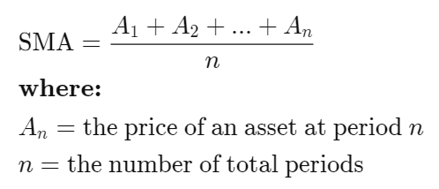
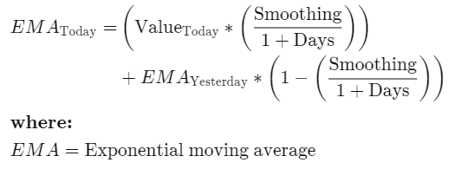
Moving average
Moving Average Convergence Divergence
Line = 12-day EMA - 26-day EMA
Signal Line = 9-day EMA of the MACD Line
Histogram = MACD Line - Signal Line
Exponential Moving Average
Relative Strength Index
RSI = 100 - (100 / (1 + RS))
RS = Average of x days' up closes / Average of x days' down closes

Slide 5

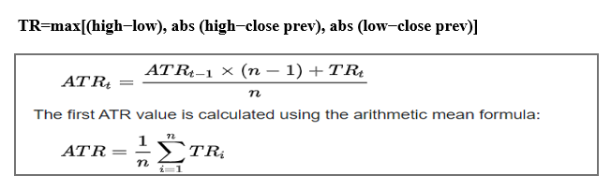
Negative Volume Index
Rate of Change
True Range Index
Williams Percentage Range

Slide 6
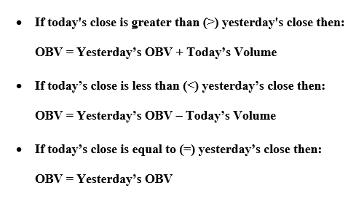
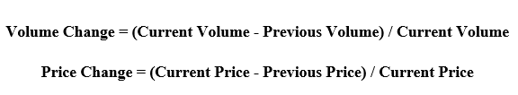
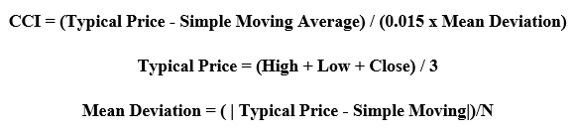
On-balance Volume
Force Index
Closing price and volume change
Commodity Channel Index

Slide 7
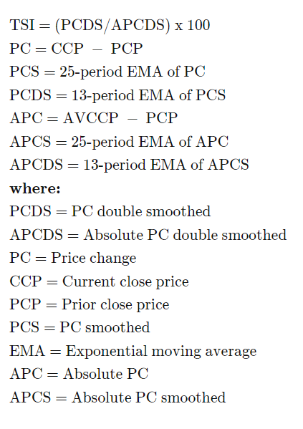

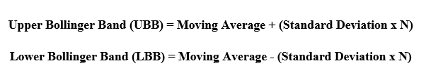
Degree of Variation
True Strength Index
Upper and Lower Bollinger Bound

Slide 8
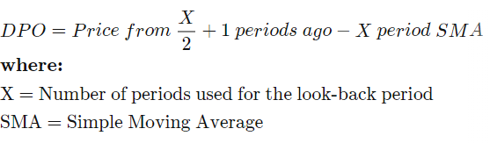

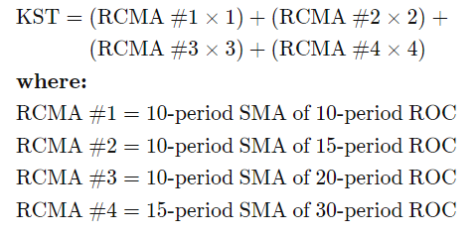
Upper Lower vortex indicators
De trended Price oscillator
Know Sure Thing
Average ease of movement

Slide 9
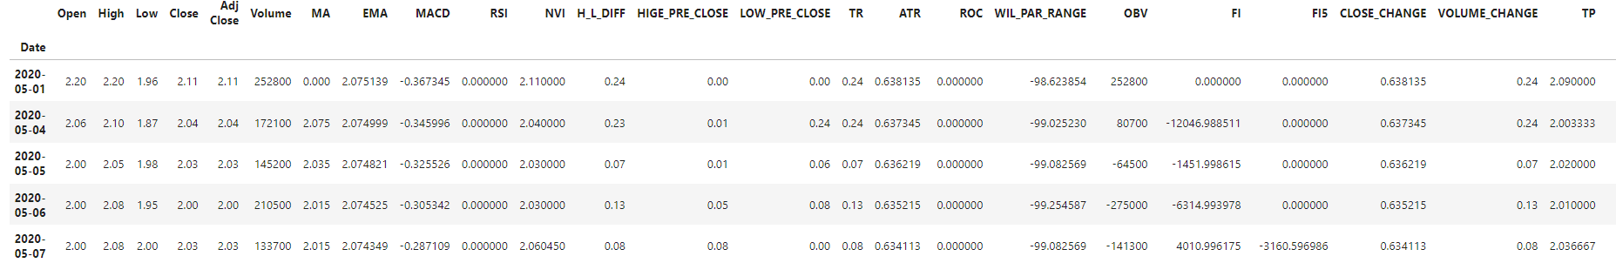
Data were taken from the yfinance library for the tickers “GOOGL”,” TCS”,” IBM”. By using the various indicators, multiple attributes are added to the data.
DATA DESCRIPTION

Slide 10
METHODOLOGY
Feature exploration is a fundamental step in developing effective predictive models. In this study, various features derived from different aspects of market data are explored.
These features include Open, Close, High, and Low prices, which provide valuable information about the behavior of stocks.
By examining and analyzing these features, the research aims to identify the most influential indicators for accurate prediction of stock market trends.
LSTM is a type of recurrent neural network known for its ability to capture long-term dependencies in sequential data.
ARIMA is a classical time series model that captures autoregressive and moving average components.
LSTM and ARIMA models to this data, they gain insights into the strengths and weaknesses of each model.
This analysis allows them to understand how well these models handle the inherent complexities of stock market data and how their performance varies under different market conditions

Slide 11
METRICS
MSE stands for Mean Squared Error. It is a commonly used metric to measure the average squared difference between the predicted and actual values in a regression problem.
MSE provides a quantitative measure of how well a regression model fits the data.
MSE = (1/n) * Σ(y_pred - y_actual)^2
where, n is the number of data points,
The resulting value of MSE is always non-negative.
A lower MSE indicates that the regression model has better accuracy and fits the data more closely.
By comparing the outcomes of LSTM and ARIMA
The mean square error of LSTM is less than the mean square of ARIMA
Mean square error of LSTM =0.0095
Mean square of ARIMA =3.44

Slide 12
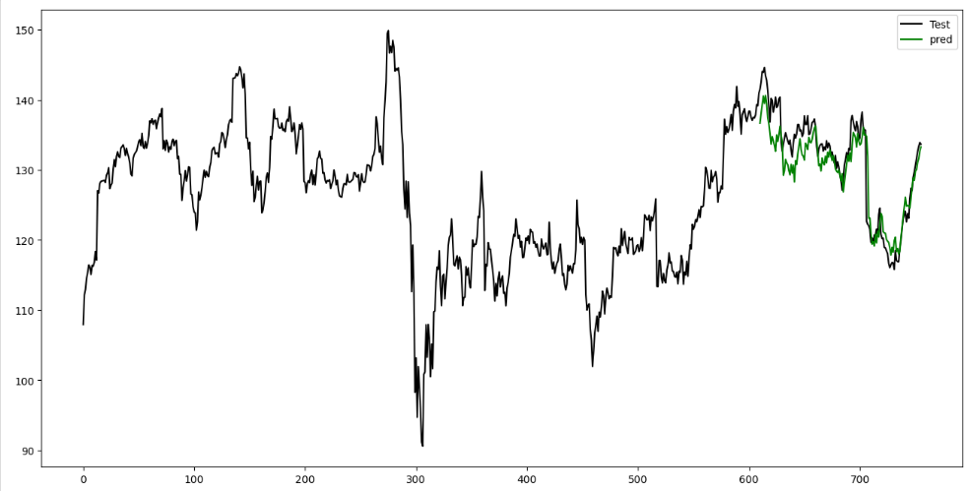
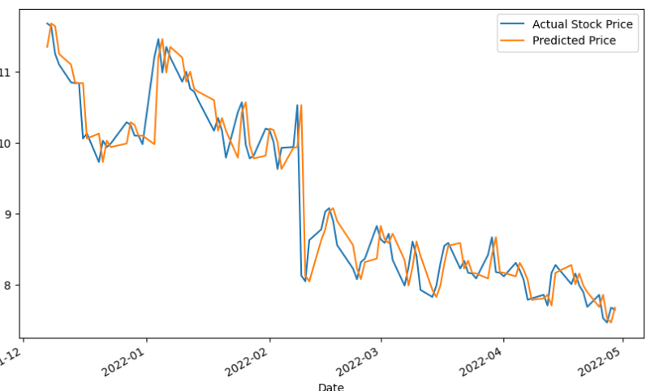

Slide 13
CONCLUSION
In my field of research, I have observed that LSTM, unlike ARIMA, can handle multiple columns of data and can benefit from training with a larger number of epochs.
Consequently, when unveiling new features, I have found that incorporating multiple features with LSTM yields more accurate predictions compared to using a single feature with ARIMA.

Slide 14
FUTURE WORK
By conducting analysis with an expanded set of features, the aim is to identify the important and useful features for stock market prediction.
Additionally, the objective is to determine the optimal combination of these features that yields the most accurate predictions for stock market analysis.

Slide 15
REFERENCE
https://www.sciencedirect.com/science/article/abs/pii/S1568494621009947
G.J. Deboeck, Trading on the Edge: Neural, Genetic, and Fuzzy Systems for Chaotic Financial Markets, Wiley, New York, 1994
T.H. Nguyen, K. Shirai, J. Velcin, Sentiment analysis on social media for stock movement prediction, Expert Syst. Appl. 42 (24) (2015) 9603–9611.
S. Karasu, A. Altan, S. Bekiros, W. Ahmad, A new forecasting model with wrapper-based feature selection approach using multi-objective optimization technique for chaotic crude oil time series, Energy 212 (2020) 118750
A. Altan, S. Karasu, The effect of kernel values in support vector machine to forecasting performance of financial time series, J. Cogn. Syst. 4 (1) (2019) 17–21

Slide 16
Thank you

