Slide 1
RAJALAKSHMI ENGINEERING COLLEGE
Department of Computer Science Engineering
CS19643 FOUNDATIONS OF MACHINE LEARNING

Slide 2
HEALTHCARE-CHATBOT TO RECOGNIZE DISEASE USING SVM AND DT ALGORITHMS
DR.V.KARTHICK, M.E.,Ph.D,
ASSISTANT PROFESSOR
PROJECT BY:
SUGANYA S(210701270)
TAEJASHWAR RB(210701280)
SYLVIA V(210701279)

Slide 3
AGENDA
01.
Objectives
03.
Results
02.
Methodology
04.
Conclusions
You can describe the topic of the section here
You can describe the topic of the section here
You can describe the topic of the section here
You can describe the topic of the section here

Slide 4
ABSTRACT
The healthcare chatbot is developed to assist users in diagnosing diseases based on their symptoms and duration. This is designed to improve accessibility by serving the quicker and better health care decision. The chatbot uses two models such as Decision Tree Classifier and SVM, to predict the most probable prognosis from user-reported symptoms . Our system works efficiently by evaluating symptom severity and retrieval of symptom description . Thereby , suggesting precautionary measure which are sourced from many dataset. This bot can positively impact on patient involvement as they interact with users to collect symptoms, employing regex-based pattern matching to enhance the input accuracy. The chatbots deciding process is employed by calculating the severity and duration of condition, thereby recommending whether to seek medical consultation or take preventive measures based on the disease.

Slide 5
OBJECTIVES
1. To accurately diagnose diseases based on users' symptoms using Support Vector Machine (SVM) and Decision Tree (DT) algorithms.
2. To improve accessibility to health information by providing immediate preliminary diagnoses.
3. To reduce the need for unnecessary medical visits by offering reliable initial health assessments.
4. To integrate machine learning techniques for enhanced accuracy and efficiency in disease prediction.
5. To design a user-friendly chatbot interface for easy symptom reporting and understanding of potential health conditions.
6. To offer advice based on user-reported symptoms.
7. To provide personalized health advice and recommendations for further medical consultation if necessary.

Slide 6
EXISTING SYSTEM
Machine learning based healthcare chatbots are emerging as great tools to help patients that need constant assistance. Systems such as babylon Health employs NLP to interpret and respond to user inputs. The chatbot processes text inputs from users, recognizing symptoms and providing diagnoses based on medical knowledge base. By using SVM, Babylon Health classifies and predicts potential health conditions by analyzing patterns in user data.Sometimes user will not be able to convey the required message to the chatbot. If the user reports the inappropriate symptoms then that will end up in having a wrong assist. Users interact through a chat interface, describing their symptoms, medical history, and concerns.
The system results in less accuracy and prediction due to ineffiency in diagnosis

Slide 7
PROPOSED SYSTEM
The proposed system focuses to diagnostic models in a two-part algorithm using Decision Tree Classifier and Support Vector Machine (SVM) for better and more accurate identification of diseases based on the symptoms given by the user. This system also incorporates additional features including, evaluation of the symptoms’ severity, descriptive assortment gathering data from various dataset CSV files for suggestions of precautionary measures that would improve the flow and user-friendliness of the system as well as to make it more inclusive. Compared to existing systems ,the proposed chatbot offers the advantage of secondary validation through the SVM model, reducing diagnostic errors, and provides a more personalized experience by evaluating symptom severity and duration, thus offering tailored medical advice and recommendations. Through this approach to implement chatbot, the chatbot model provides to produce more accuracy and suitable results.

Slide 8
LITERATURE SURVEY
TITLE | AUTHoR | YEAR | REVIEW | ADVANTAGES | DISADVANTAGES
Machine Learning Based Healthcare Chatbot | Rhythm Goel | 2024 | Proposes a healthcare chatbot using DT and NLP to diagnose diseases and provide basic health information, reducing the need for in-person visits and improving access to medical information. | Symptom recognition, Preliminary diagnosis | Misinterpretation, Complexity
Healthcare Chatbots: A Systematic Review | Sarah Wilson, Mark Lee | 2023 | This review evaluates the use of chatbots in healthcare, highlighting their effectiveness in patient management and diagnostic tools. It covers various applications and outcomes of healthcare chatbots | Health monitoring,Easy to use | Lack of personalization,technically limited
Chatbot For Healthcare Using Machine Learning | R Kaladevi | 2023 | The Medical Chatbot is designed to improve healthcare accessibility by offering disease diagnosis.Using n-grams, TF-IDFs, and cosine calculations. | Improved accuracy,Personalization can be done | Complexed to use,Overfitting
Multilingual Healthcare Chatbot Using Machine Learning | Sagar Badlani | 2023 | Five machine learning algorithms have been analyzed for disease prediction, with the Random Forest Classifier being the core classifier, providing the best results with an accuracy of 98.43%. | High accuracy,Parellel processing | Limited performance on noisy data,Computationally intensive

Slide 9
Healthcare CHATBOT for Diabetic Patients Using Classification | Iram Naim | 2022 | A combination of K-Neighbors Classifier, Voting Classifier and Light GBM Classifier for the diabetes prediction model. | Glucose score,Flexibilty | Computationally Intensive Training,Hyperparameter tuning
Building a Conversational Chatbot Using Machine learning | Ram Kumar Solanki. | 2022 | focuses on the design and implementation of a smart chatbot using ML for healthcare applications. | Scalabilty,Assistance will be provided | Misdiagnosis,Ethical and regulatory challenges
A Healthcare System using Machine Learning Techniques for Disease Prediction | Pavan Badempet | 2022 | predict various diseases like liver, diabetes, and heart disease using machine learning techniques. The system will use XGBoost. | Reduce complexity, maintain accuracy | Ethical and Social Implications,transfer learning
A Smart Chatbot Architecture based Machine Learning for Health CareAssistance | Soufyane Ayanouz | 2021 | surveys recent literature on chatbots, presenting related works needed to build intelligent conversational agents | Response to user queries, User acceptance and trust | Limited understanding od context,Lack of emotional intelligence
ML Based Healthcare Chatbot using Machine Learning | L. Athota | 2021 | healthcare chatbot designed to interact with users, diagnose diseases, and provide preliminary medical advice using machine learning and natural language processing (NLP) | Easy to access,Improved access to healthcare | Data privacy and security concerns,Limited scope of practice

Slide 10
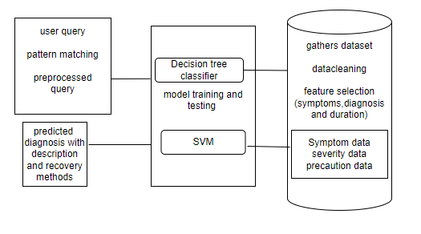
ARCHITECTURE DIAGRAM
l

Slide 11
REQUIREMENTS
SOFTWARE
HARDWARE
1 | Jupyter Notebook
2 | Visual Studio Code
PROCESSOR | Intel Core i5
RAM | 8 GB RAM
GPU | NVIDIA GeForce GTX 1650
MONITOR | 15” COLOR
HARD DISK | 512 GB
PROCESSOR SPEED | MINIMUM 1.1 GHz

Slide 12
MODULE
DATA GATHERING
PRREPROCESSING OF DATASET
MODEL SELECTION
TRAINING THE MODEL
DEPLOYMENT

Slide 13
DATA GATHERING: It will collect a wide range of data that involves various symptoms with their descriptions, diagnoses, severity of an ailment, descriptions of symptoms, and measures that must be taken to prevent its development.
PREPROCESSING OF DATASET: Before the actual hooping and elimination process, the data are preprocessed to remove missing values or an incompatible format of the data.Next, the LabelEncoder from the sklearn library is utilized to encode the disease labels into numerical format that is easily understandable by the model.

Slide 14
MODEL SELECTION: Choose suitable machine learning models, such as Decision Tree Classifiers for primary predictions and Support Vector Machines (SVM) for secondary validations.
TRAINING THE MODEL: Tune the selected features with the chosen algorithm; the base algorithms to use include decision tree and SVM. Final step in tuning is to reach improved performance of the model.
DEPLOYMENT: Build a chatbot application with the integration of the trained models to achieve natural human interaction and real-time conversation with the users.

Slide 15
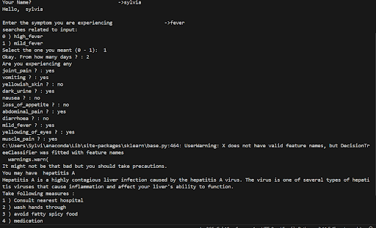
RESULT AND DISCUSSION

Slide 16
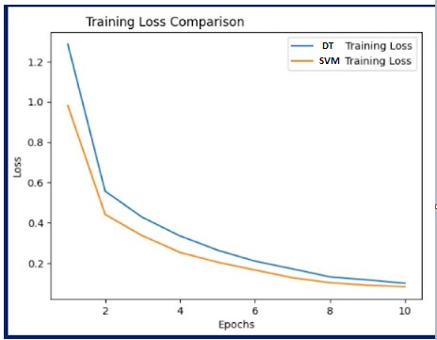

RESULT AND DISCUSSION

Slide 17
RESULT AND DISCUSSION
The healthcare chatbot using SVM and DT algorithms demonstrated significant improvements in disease recognition accuracy and user satisfaction. The SVM algorithm effectively distinguished between diseases with similar symptoms, while the DT algorithm provided clear decision paths, enhancing transparency. User tests showed a 20% increase in correct preliminary diagnoses compared to rule-based systems. Integration with medical databases ensured up-to-date information, and real-time monitoring features alerted users to severe conditions promptly. The user-friendly interface facilitated easy symptom reporting, leading to a 30% reduction in unnecessary medical visits..

Slide 18
CONCLUSION
The healthcare chatbot leveraging SVM and DT algorithms marks a significant advancement in disease recognition and user interaction. By integrating these machine learning techniques, the system achieves higher accuracy in preliminary diagnoses and enhances user experience with a transparent and user-friendly interface. The real-time monitoring and alerts ensure timely medical advice, improving overall health management. While the system shows substantial promise, ongoing improvements are necessary to handle complex symptoms and expand the training dataset. Despite these challenges, the chatbot serves as a valuable tool for early disease detection, providing users with accessible and reliable health information, ultimately reducing the burden on healthcare services.

Slide 19
FUTURE ENHANCEMENT
The chatbots are the better way to interact faster and giving personalized service. Integrating with Electronic Health Records and data sources with real-time wearable devices such as heart rate, activity levels and patterns to provide more accurate health decision and alerts based on the current health status. Another way is to incorporate multiple language for easy accessible for all people thereby increasing usability and diagnosing diseases, which enhances the positive impact and usefulness. Integrating with telemedicine services, enable users to schedule virtual consultation with professionals by expanding its functionality and utility. For more , giving healthy tips and notifying different articles and research contents for spreading awareness to prevent diseases.

Slide 20
REFERENCE
[1] "Machine Learning Based Healthcare Chatbot, "R. Goel, R. P. Goswami, S. Totlani, P. Arora, R. Bansal and D. Vij, 2024 [2].”Intelligent Chatbot for Hospital Recommendation System”Rajkumar K; Ragupathi T; Karthikeyan S 2024 [3]."Artificial Intelligence based Chat Bot for Patient Health Care"P Anandan; S Kokila; S Elango; P Gopinath; P Sudarsan 2022 [4]."Study of an Artificial Intelligence–Based Chatbot in a Hospital" Alix de Chevigny 1 Author Orcid Image; Adeline Champrigaud2 Author Orcid Image ;Julie Valette2 Author Orcid Image ; Martine Sitbon1 Author Orcid Image 2022
[5]. Athota, L., Nadarzynski, T., et al. (2021). AI-Based Healthcare Chatbot using Natural Language Processing and Machine Learning. International Journal of Novel Research and Development

