Slide 1
Systems Thinking
Dr Anand Samuel BE MS PhD
Vice Chancellor, VIT University

Slide 2
Systems Thinking
Systems thinking utilizes habits, tools and concepts to develop an understanding of the interdependent structures of dynamic systems. When individuals have a better understanding of systems, they are better able to identify the leverage points that lead to desired outcomes.
Systems thinking is a management discipline that concerns an understanding of a system by examining the linkages and interactions between the components that comprise the entirety of that defined system.

Slide 3
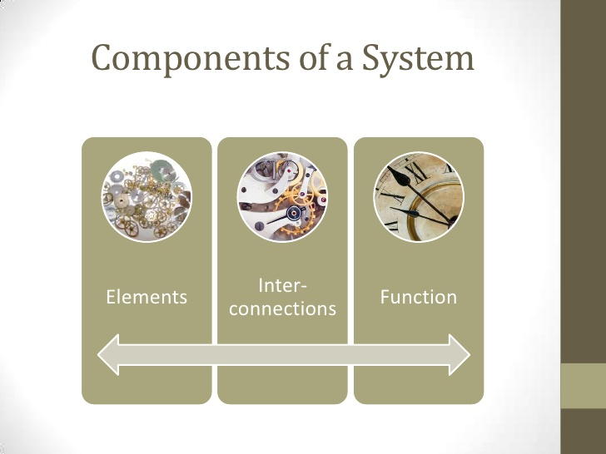

Slide 4
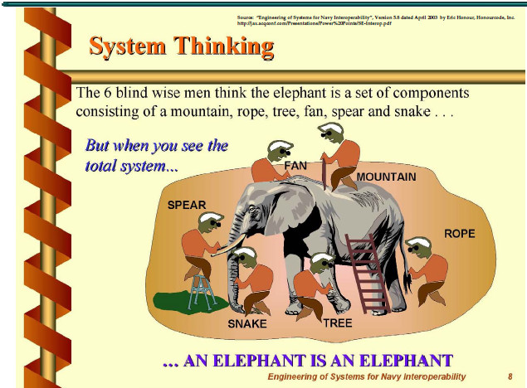
One should not see the component / element etc in isolation.
The integrated big picture of Total System should kept in mind,

Slide 5
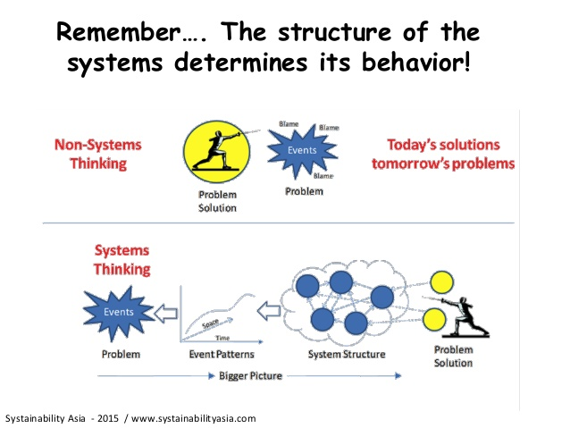

Slide 6
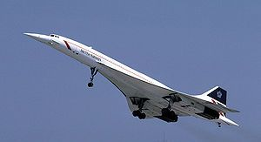
Concord, the supersonic jet, is an engineering marvel. But now it is in showcase, with out being useful because the customer expectations were not fulfilled.
Typical example of failure of system thinking!

Slide 7

Selling AIR in bottles and cans, Result of lack of systems thinking?

Slide 8


# Systems Approach
In Bangalore Parthenon plants caused Asthma for many. Tourists complained about it and stopped coming to B’lore. Govt. asked scientists for a solution. They said a type of beetle loves eating Parthenon and so may be brought in plenty and let it live. As expected beetles ate all the plants in a months time. After that it wanted food for living and so went to near by fields and ate Sun Flower !! Farmers were affected. Caused major embarrassment to the Govt.

Slide 9
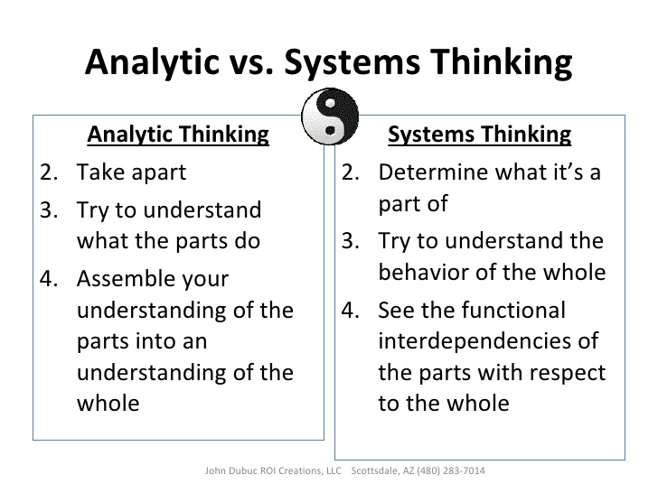

Slide 10
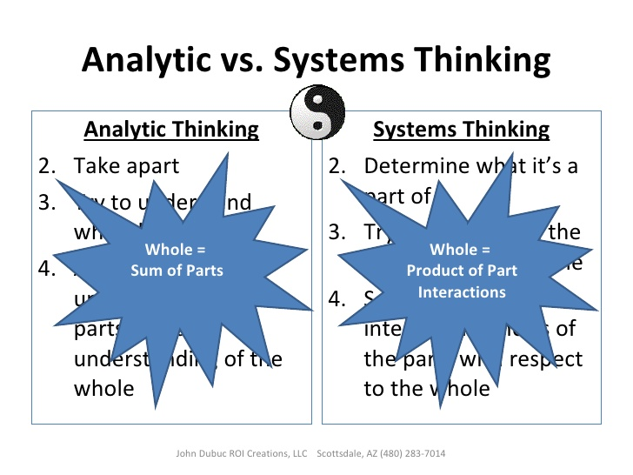

Slide 11
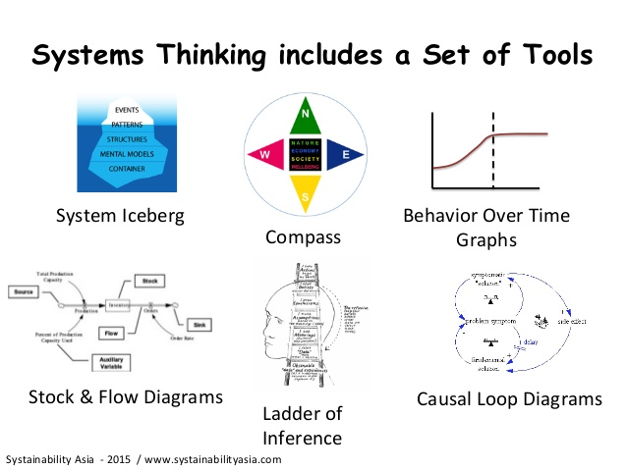

Slide 12
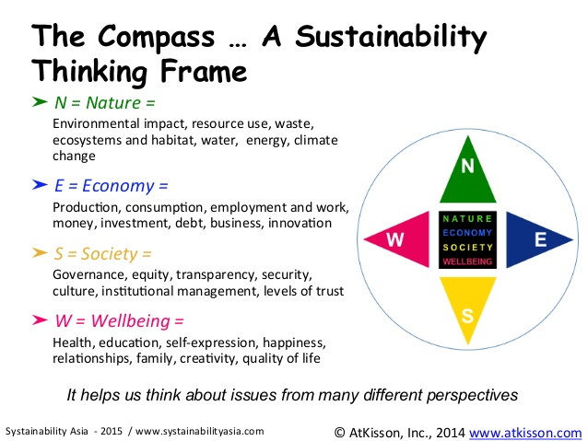

Slide 13
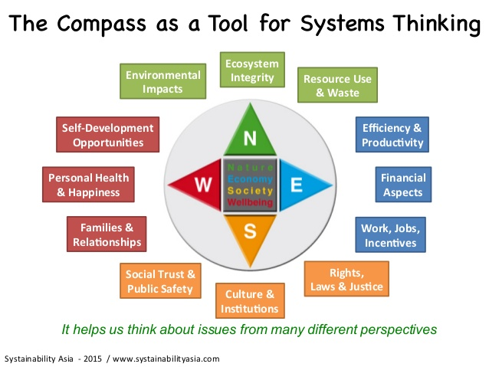

Slide 14
Using Compass as a tool for Systems Thinking,
Synthesize the following and formulate the problem solving strategy.
Water shortage @ VIT
Energy Conservation @ VIT
Attendance Shortage
Time Management
Open Book test
Hostel Timing
Use of Social Media
Library access for 24 hrs
Writing Reports
PBL
English as communication language in Campus
Attire in the campus.

Slide 15
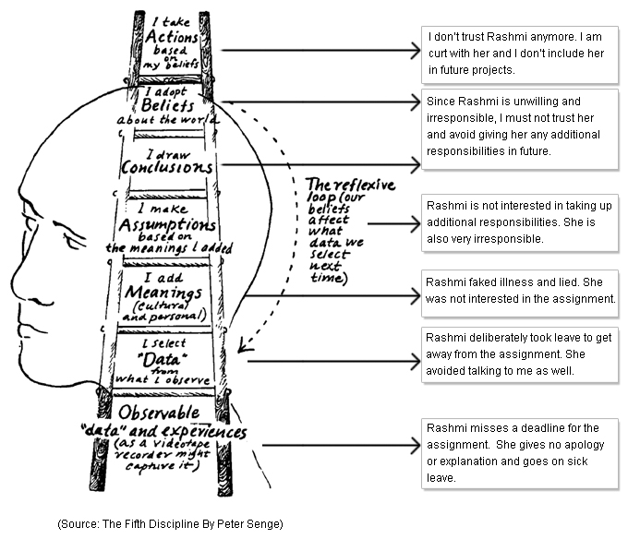

Ladder of inference

Slide 16
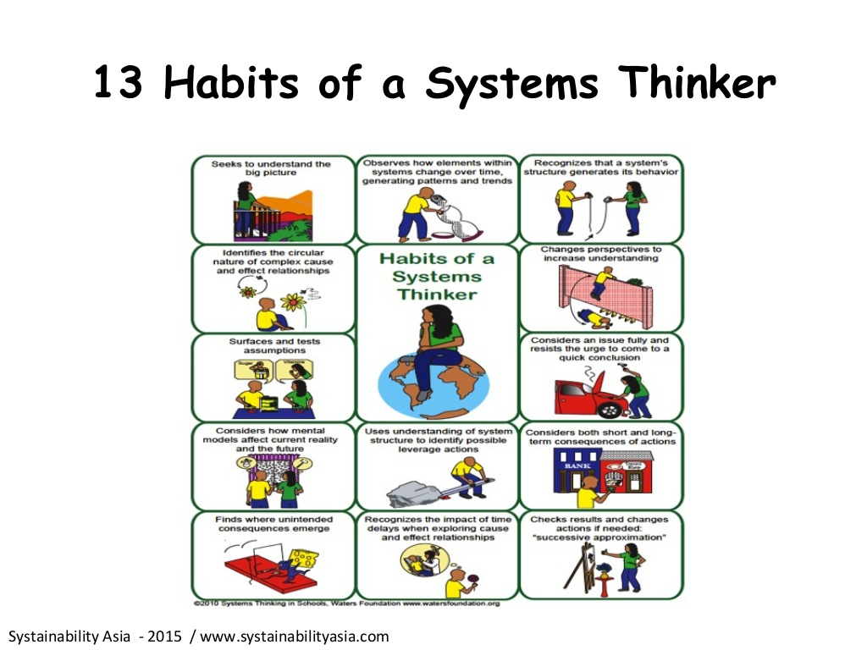

Slide 17
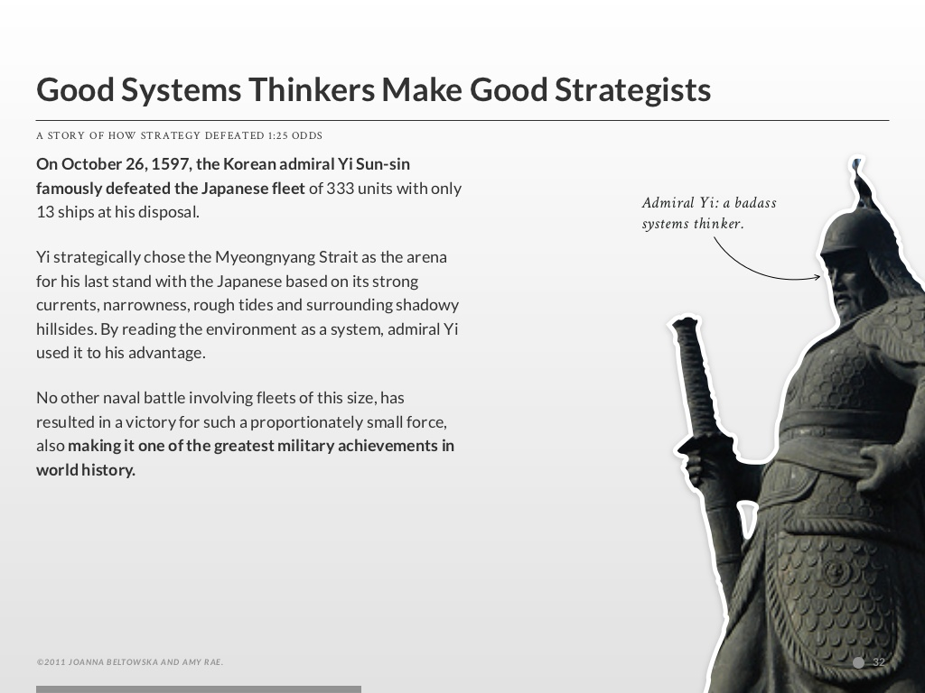

Slide 18
https://www.youtube.com/watch?v=AP7hMdnNrH4
View the video and
For further knowledge view the following video
https://www.youtube.com/watch?v=0QtQqZ6Q5-o&ebc=ANyPxKo3KgXQn2SDl8kG_Bj_RDTaOwXADuV4gPkkx_WmL_TkobLpxg_5vo5vzQ_OVYrIfsTVpvgg5NAwSdd9UbEVZbN6NoT9oA&spfreload=10

