Slide 1
Ultimate gym By:

Slide 2
HOMEPAGE

Slide 3
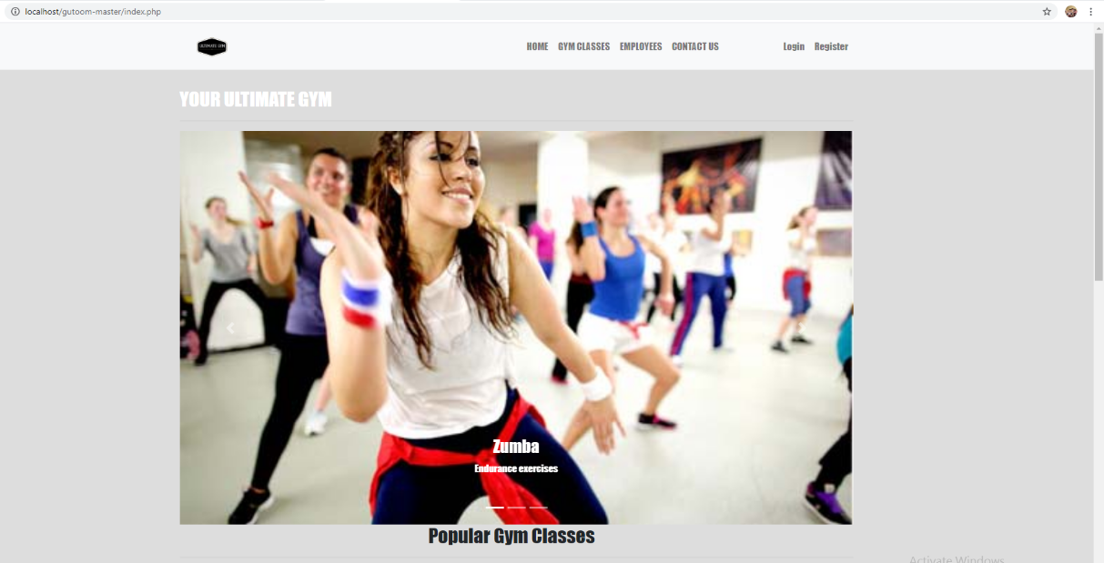
This is the homepage. This is the first thing the user sees. You will see a slideshow OF THE DIFFERENT CLASSES OFFERED AND A SHORT DESCRIPTION.

Slide 4
Gym classes page

Slide 5
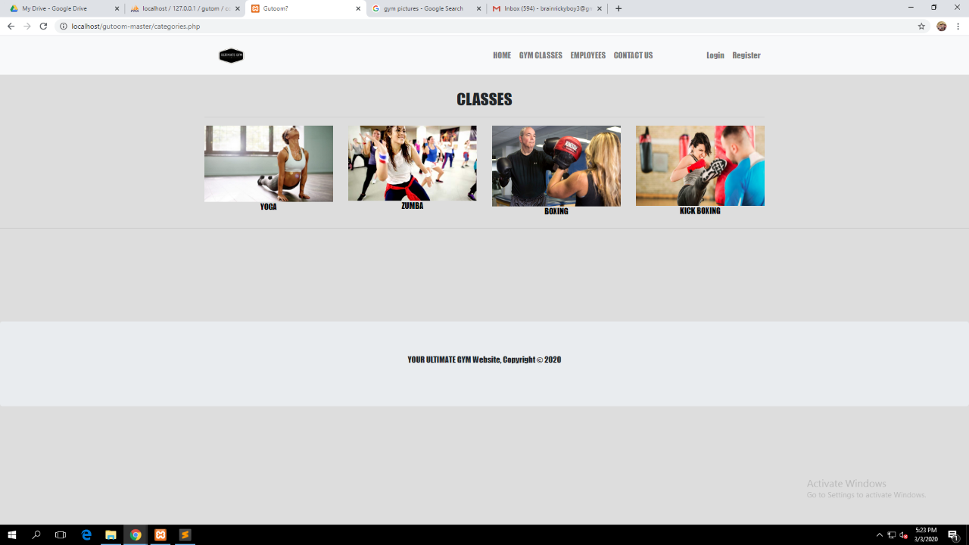
YOU CAN SEE THIS IN THIS PAGE THE DIFFERENT CLASSES. YOU CAN CLICK THEM TO GO TO THEIR SPECIFIC CLASS PAGE>.

Slide 6
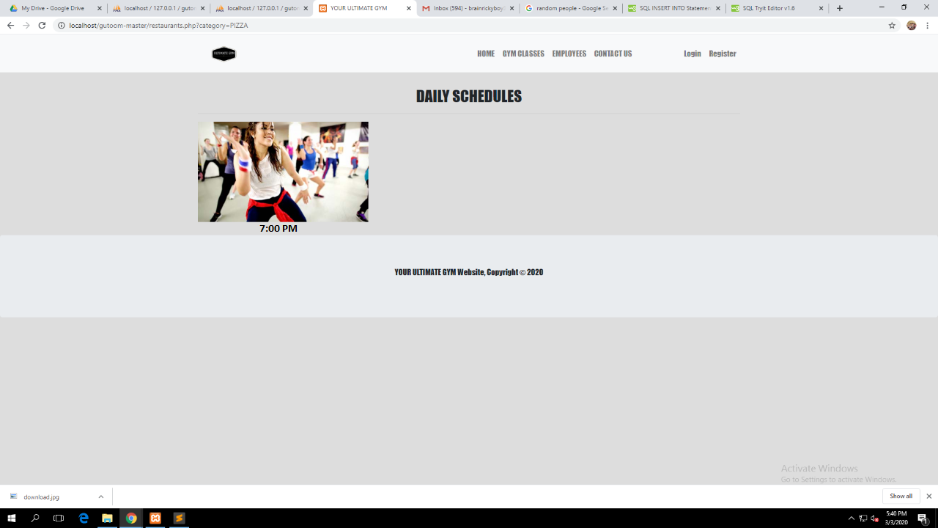
HERE YOU CAN CHOOSE THE DIFFERENT SCHEDULES OF THAT SPECIFIC CLASS.

Slide 7
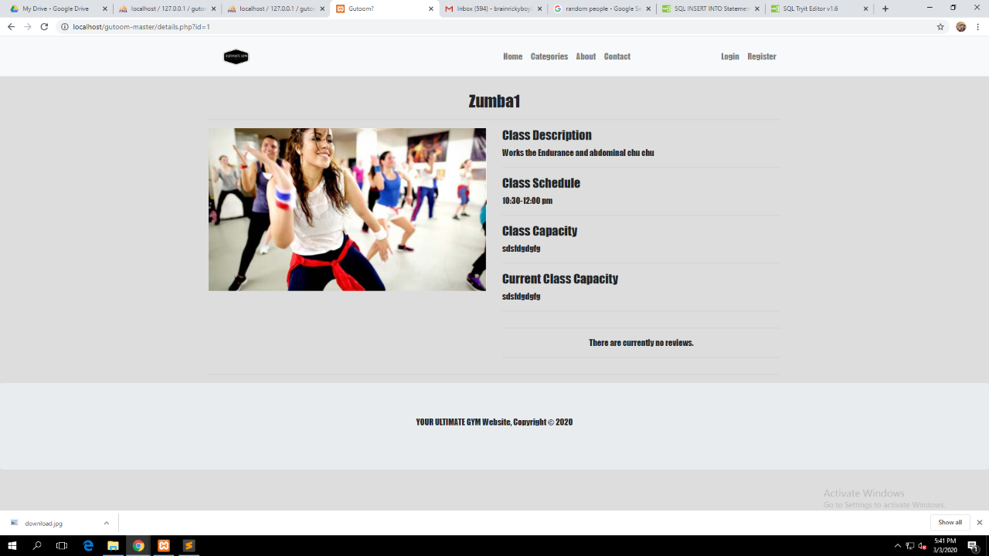
THIS IS THE DETAILS PAGE FOR NOT MEMBERS.

Slide 8
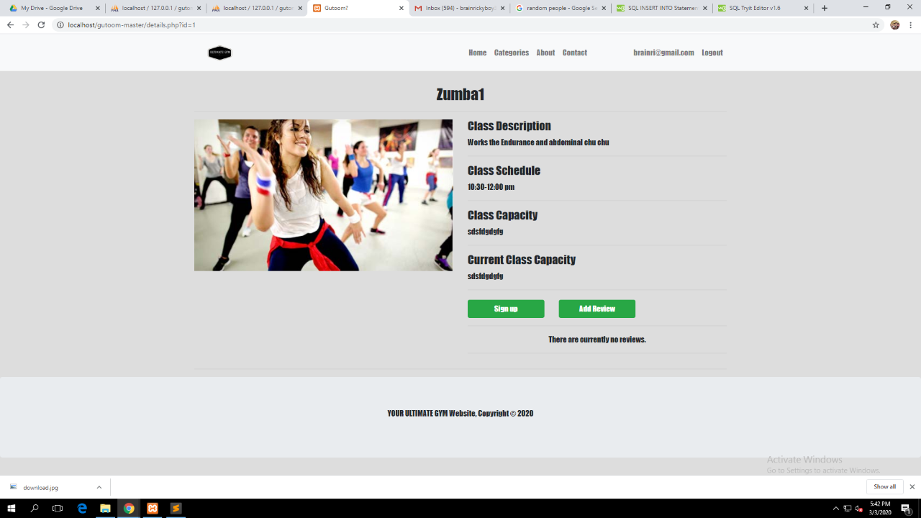
THIS IS THE DETAILS FOR MEMBERS.

Slide 9
Log-in page

Slide 10
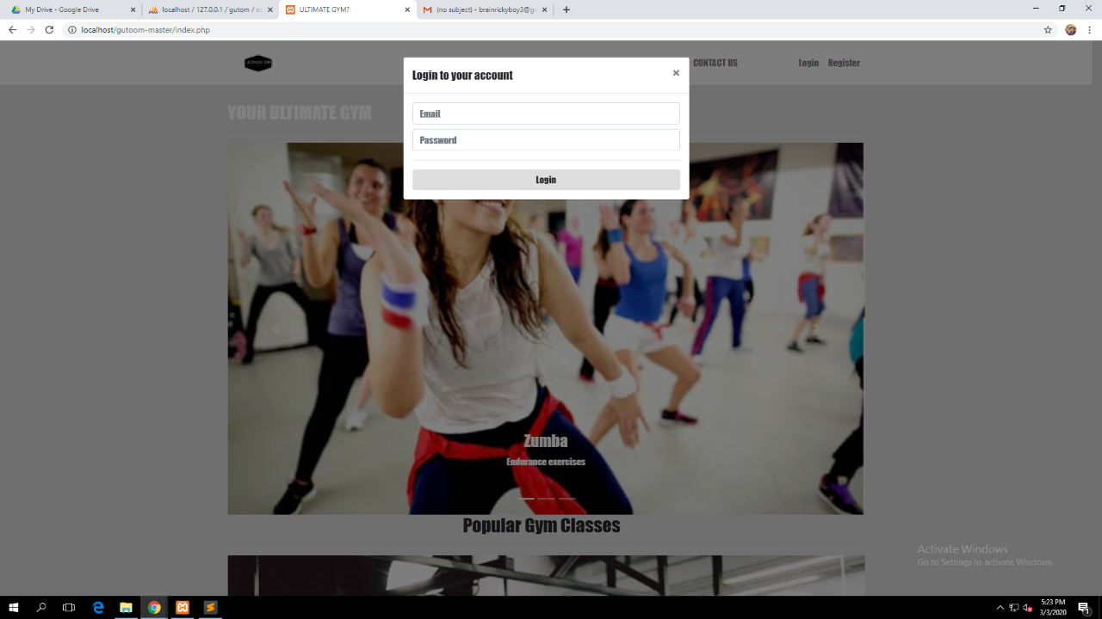
THIS IS THE LOGIN PAGE.

Slide 11
REGISTER PAGE

Slide 12
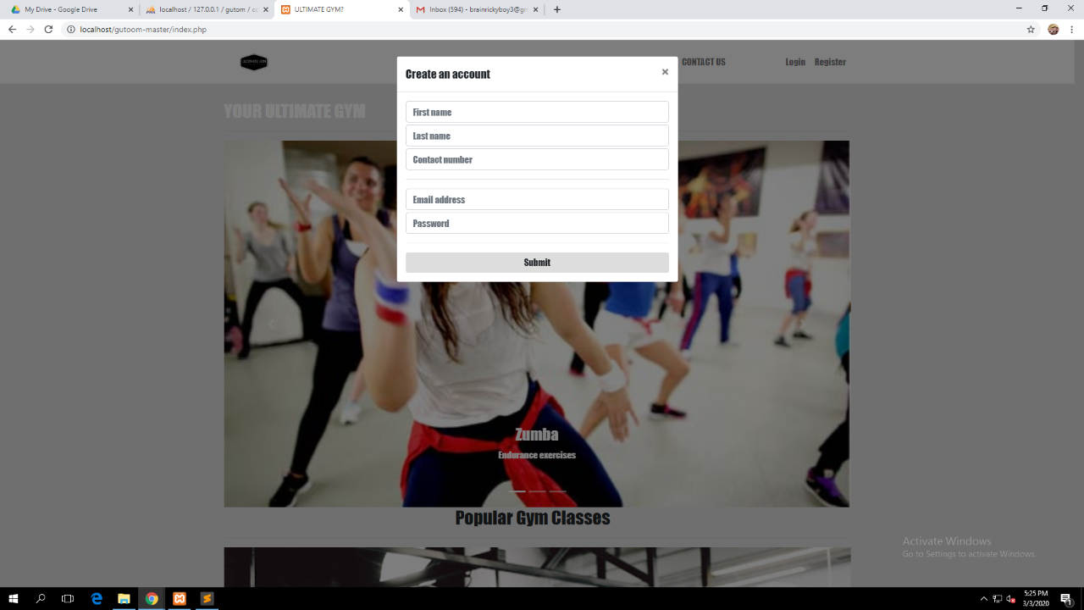
THIS IS THE REGISTER PAGE FOR CREATING NEW ACCOUNTS.

