Slide 1
Visualization analysis on happiness dataset
of Wooldridge book
Sugarbayar Enkhbayar - 456296
Hamed ahmed - 454827
January 19, 2024
Sugarbayar, E & Hamed Ahmed
January 19, 2024

Slide 2
Agenda
Part I: Data description
Part II: Relation between happiness status and features /character, family, work, education/
Part III: General characteristic of happy and unhappy people
Sugarbayar, E & Hamed Ahmed
January 19, 2024

Slide 3
Part I: Data description
Source - “Happiness survey” dataset from Econometric book by Jeffrey Wooldridge (US regions, 1994-2006)
Variable - used 11 variables from 5 categories
Table: Categories of variables
Category | Variables | Values
Geospatial | year | 1994,…2006
 | US regions | washington, oregon…
Character | gender | female …
 | skin | black …
 | tvhours | hours per day watching tv
Family | divorce | Yes / No
 | babies | number
Work | workstat | keeping house / fulltime / parttime / retired / …
 | income range | 1000$ / 1000$-2000$ /…
Education | educ year | number
 | score | occupational prestige score [ 0 - 100]
Sugarbayar, E & Hamed Ahmed
January 19, 2024

Slide 4
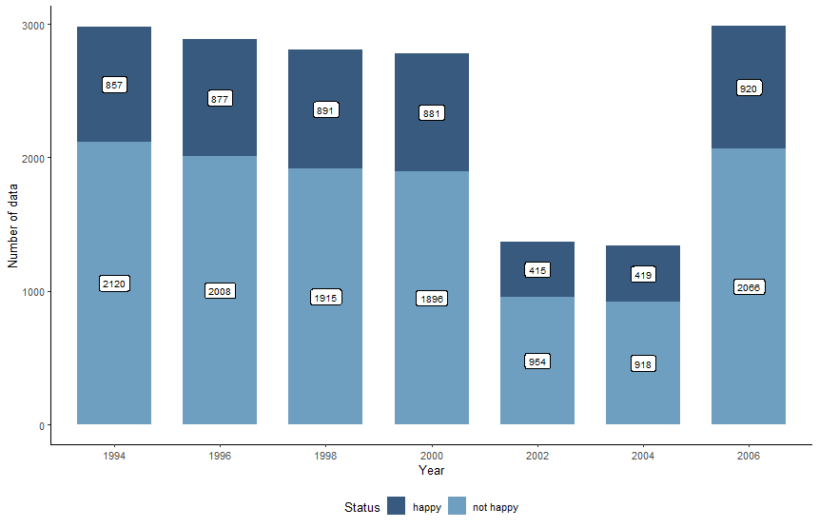
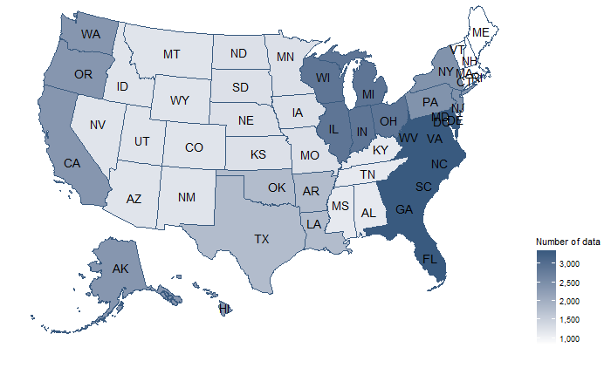
Part II: Happiness factors /geospatial/
More than 50% of people are unhappy
Most data was collected from Pacific, South Atlantic and East North Central
Figure: Number of data by happiness status, year
Figure: Number of data by region
Sugarbayar, E & Hamed Ahmed
January 19, 2024

Slide 5
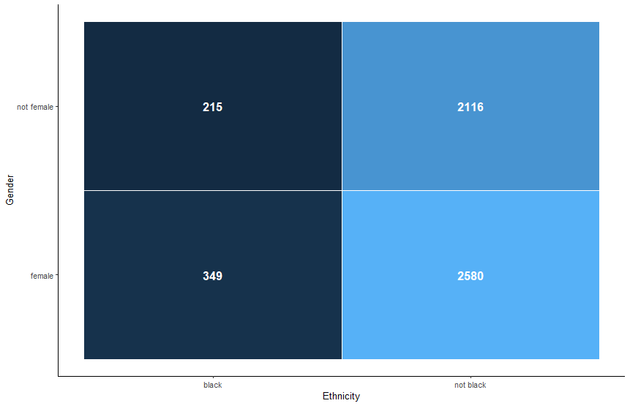
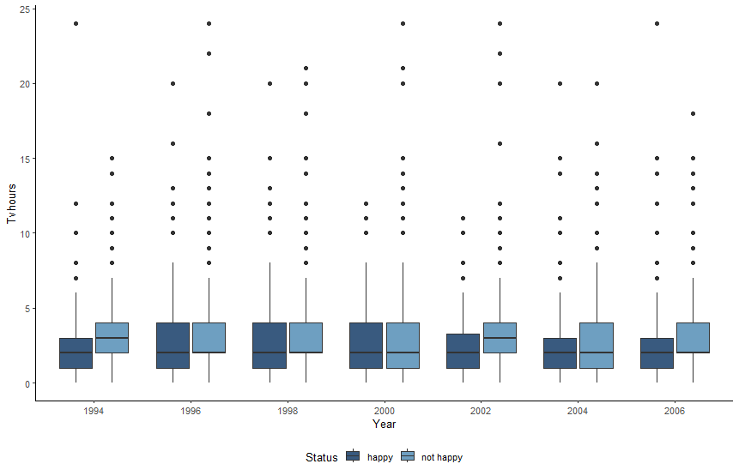
Part II: Happiness factors /character/
Women are happier than men
Not black & Female – most happy
Unhappy → more tv hour
More tv hour → unhappy
Figure: Number of happy people by gender, ethnicity
Figure: Tvhours by happiness status, year
Sugarbayar Enkhbayar (UW)
Sugarbayar, E & Hamed Ahmed
January 19, 2024
January 19, 2024

Slide 6
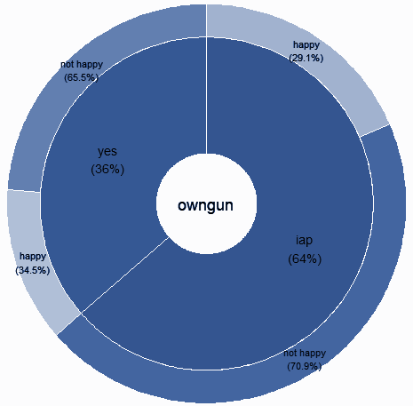
Part II: Happiness factors /character/
There is relation between gun and happiness status
own gun → unhappy, unhappy → own gun
Figure: Number of people with gun
Sugarbayar Enkhbayar (UW)
Sugarbayar, E & Hamed Ahmed
January 19, 2024
January 19, 2024

Slide 7
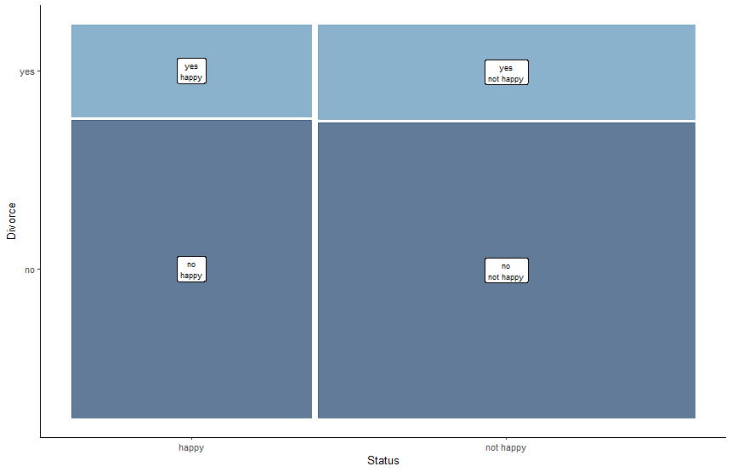
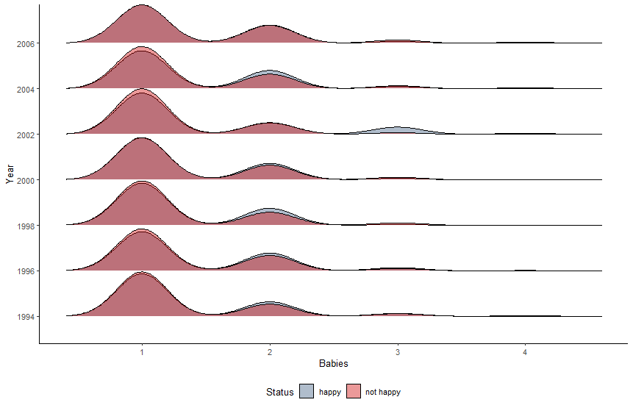
Part II: Happiness factors /family/
Not enough information - relation between divorced and happiness status
Most people with 1 child → unhappy
Most people with 2 child → happy
Figure: Number of people by happiness status, divorced
Figure: Number of babies by happiness status, year
Sugarbayar Enkhbayar (UW)
Sugarbayar, E & Hamed Ahmed
January 19, 2024
January 19, 2024

Slide 8
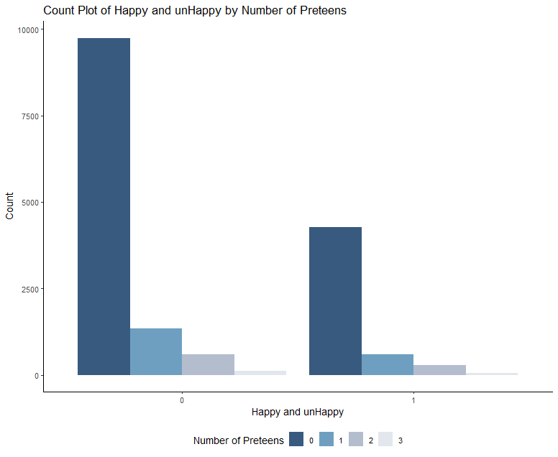
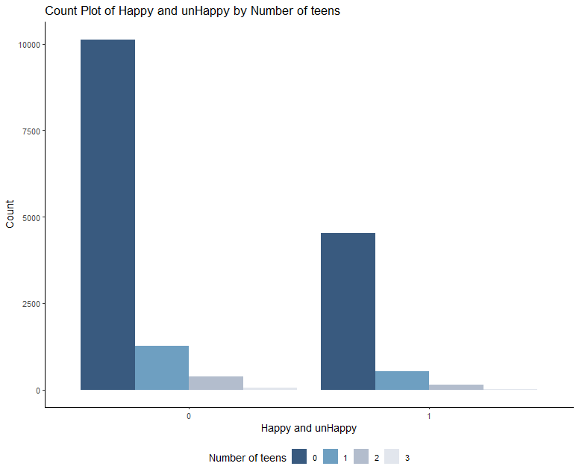
Part II: Happiness factors /family/
Preteen → happiness
Teens → happiness
Having no child at all is more likely to be not happy than happy
Figure: Count plot of very happy ratings by Number of preteens
Figure: Count plot of happy and unhappy by number of teens
Sugarbayar Enkhbayar (UW)
Sugarbayar, E & Hamed Ahmed
January 19, 2024
January 19, 2024

Slide 9
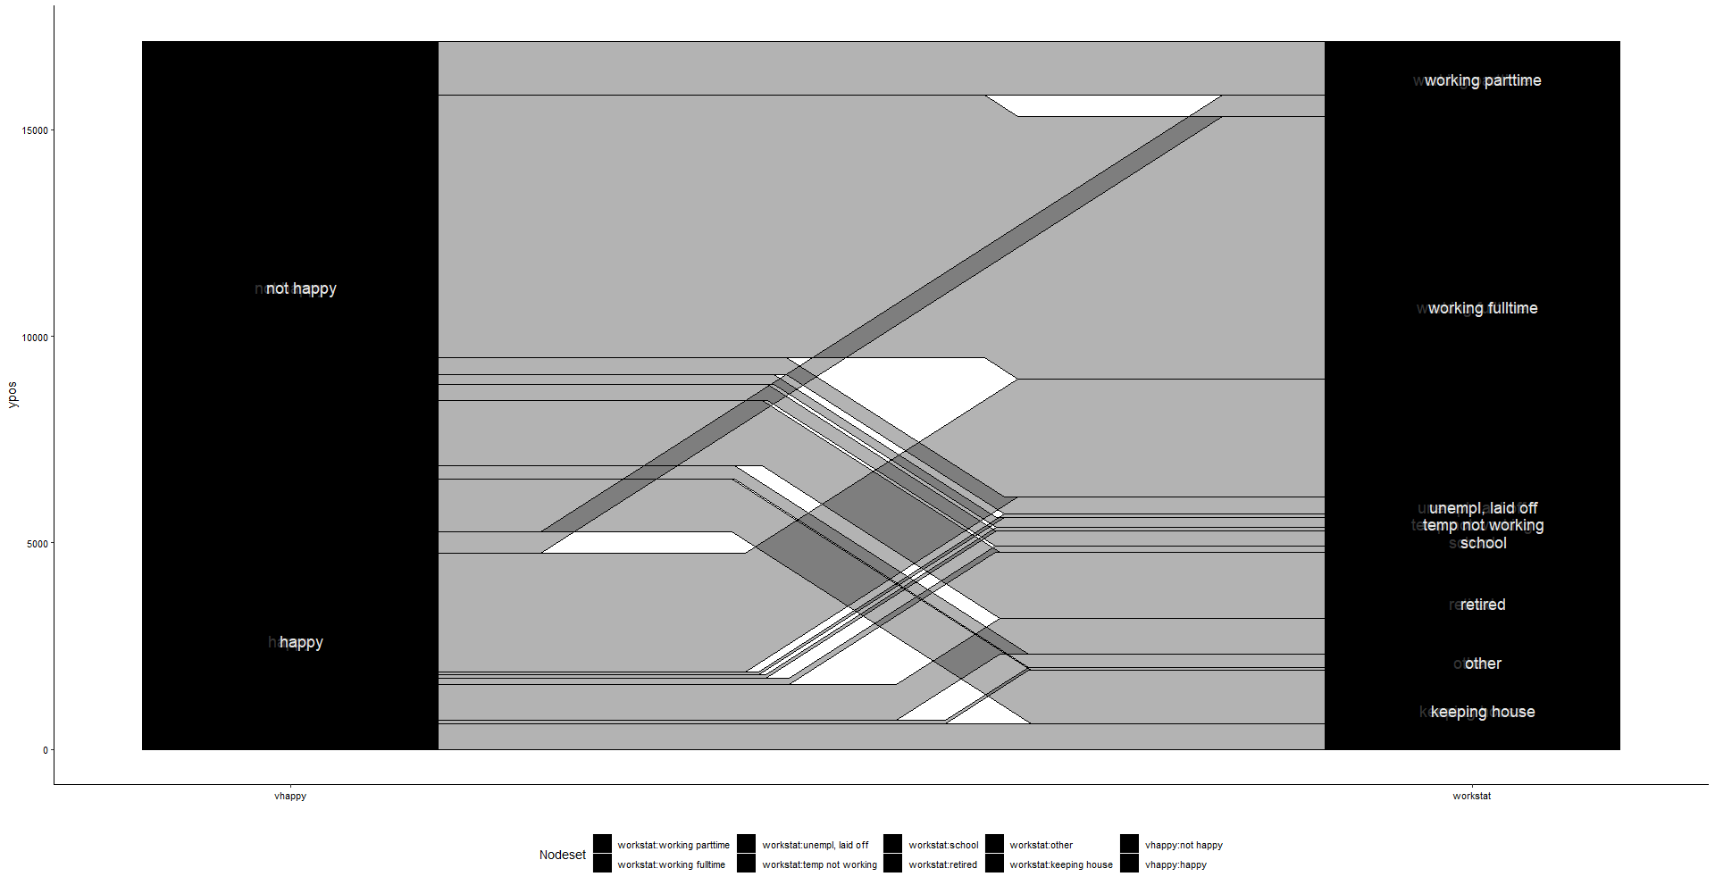
Part II: Happiness factors /work/
Most people with full time job or part time job → more unhappy
Figure: Number of people by happiness status, work status
Sugarbayar Enkhbayar (UW)
Sugarbayar, E & Hamed Ahmed
January 19, 2024
January 19, 2024

Slide 10
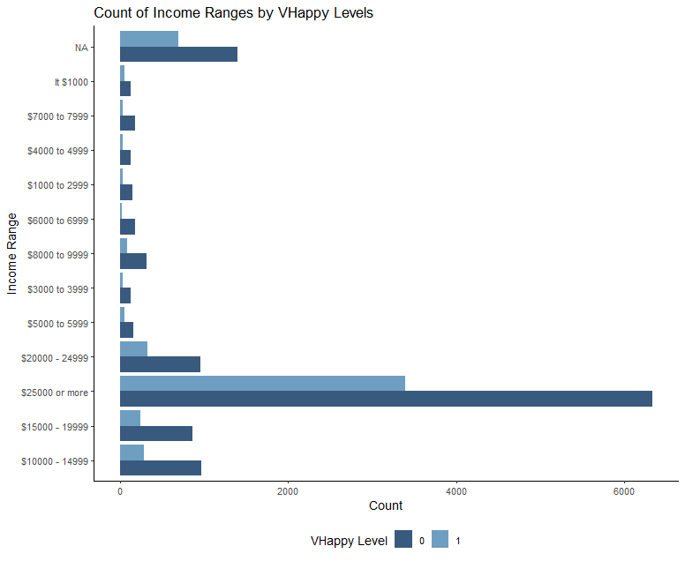
Part II: Happiness factors /work
Income → happy / not happy
Figure: Count of income ranges by happy levels
Sugarbayar Enkhbayar (UW)
Sugarbayar, E & Hamed Ahmed
January 19, 2024
January 19, 2024

Slide 11
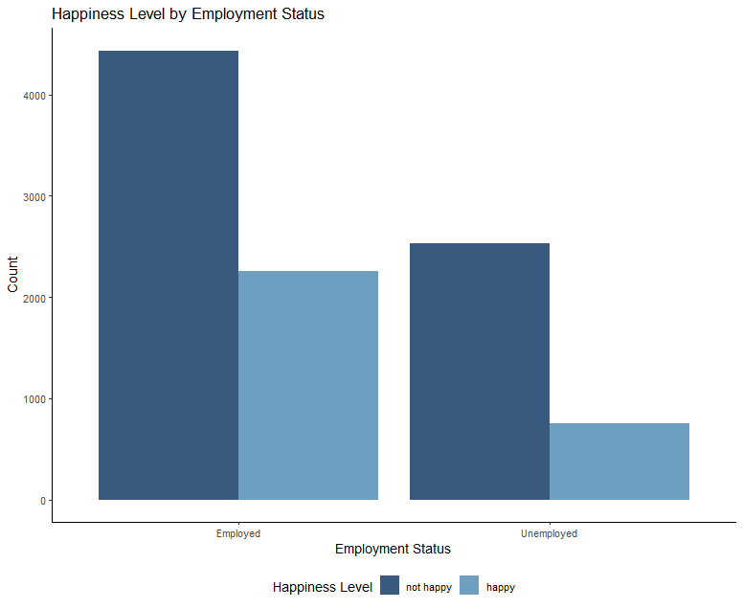
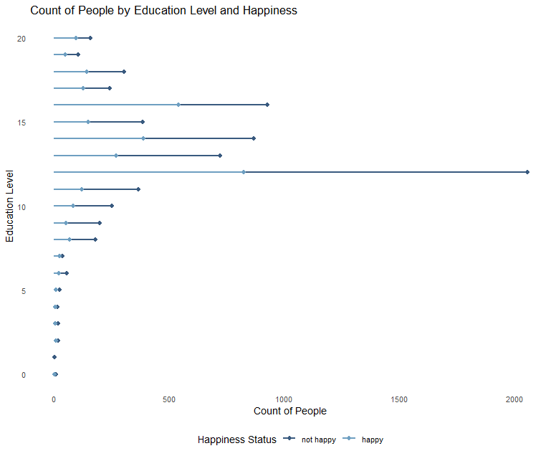
Part II: Happiness factors /work/Education
Employment→ happy / not happy
Education level → happy / not happy
Figure: Happiness level by employment status
Figure: Count of People by Education level and happiness
Sugarbayar Enkhbayar (UW)
Sugarbayar, E & Hamed Ahmed
January 19, 2024
January 19, 2024

Slide 12
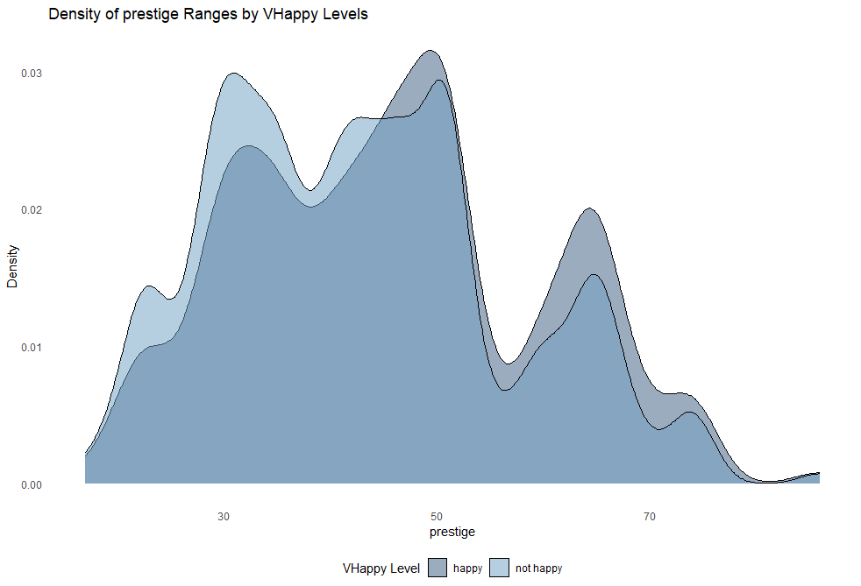
Part II: Happiness factors /Character
prestige → happy / not happy
Figure: Density of prestige Ranges by happiness status
Sugarbayar Enkhbayar (UW)
Sugarbayar, E & Hamed Ahmed
January 19, 2024
January 19, 2024

Slide 13
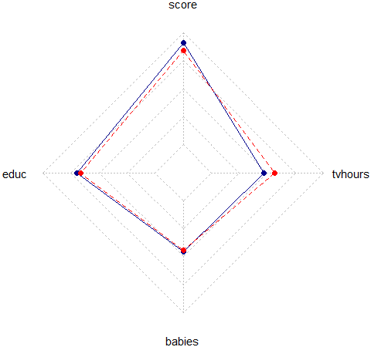
Part III: General characteristic
Happy people → more occupational prestige score, less tv hours, more babies, more education level
Unhappy people → less occupational prestige score, more tv hours, less babies, less education level
Figure: Characteristic of happy and unhappy people by 4 variables
Sugarbayar Enkhbayar (UW)
Sugarbayar, E & Hamed Ahmed
November 15. 2023
January 19, 2024

