Slide 1
Machine Learning 1: Classification and Regression task
Sugarbayar Enkhbayar
Wojciech Szymczak
Faculty of Economics Science
University of Warsaw
Jun 2023
Sugarbayar (UW)
Jun 12, 2023

Slide 2
Agenda
I. Classification task
II. Regression task
Sugarbayar (UW)
Jun 12, 2023

Slide 3

Classification task: Data –> Cleaning (missing value, outlier, normalize/)-> Explanatory analysis -> Model building -> Best model
Train set – 20 variables, 10k rows
Test set – 19 variables, 5k rows
Table 1: Dataset
Sugarbayar (UW)
Jun 12, 2023

Slide 4
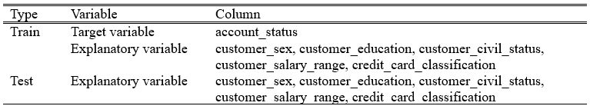
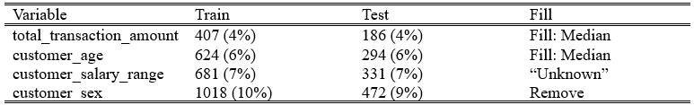
Classification task: Data –> Cleaning (missing value, outlier, normalize/)-> Explanatory analysis -> Model building -> Best model
Data type change – character to factor
Missing value – filled by Median value
Table 2: Convert data type
Table 3: Missing value
Sugarbayar (UW)
Jun 12, 2023

Slide 5
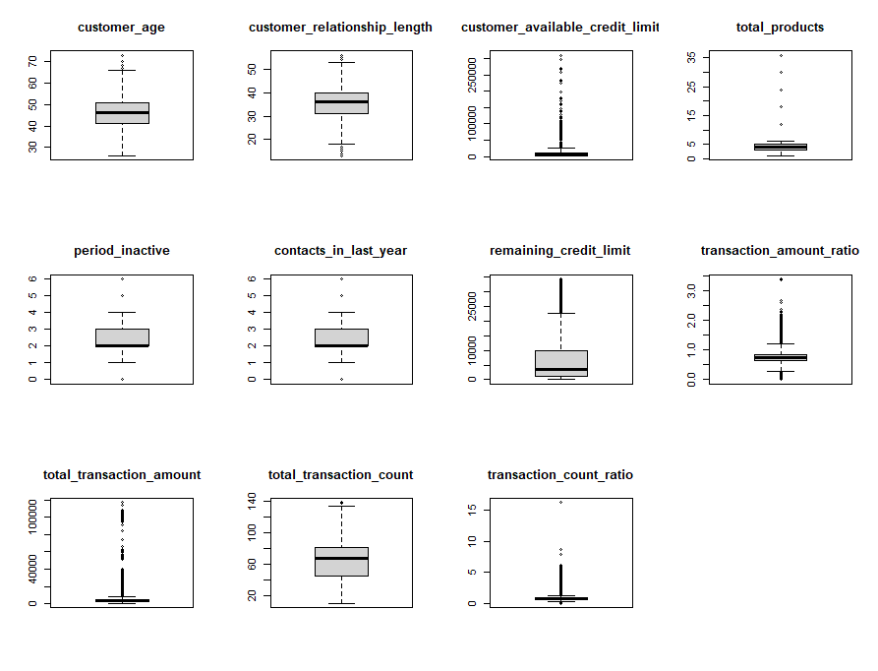
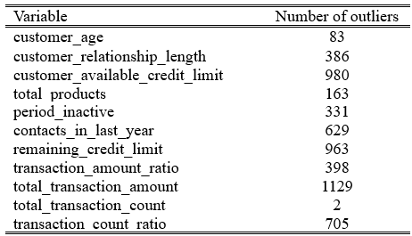
Classification task: Data –> Cleaning (missing value, outlier, normalize/)-> Explanatory analysis -> Model building -> Best model
Outliers – used IQR(interquartile range) to identify outliers
– replaced by the median value
Table 5: Boxplot of variables
Table 4: Outliers
Sugarbayar (UW)
Jun 12, 2023

Slide 6
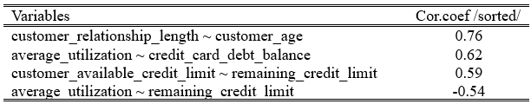
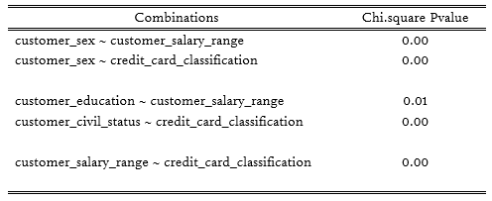
Classification task: Data –> Cleaning (missing value, outlier, normalize/)-> Explanatory analysis -> Model building -> Best model
Correlation between numeric and numeric: All correlation coefficients are lower than 0.8
Correlation between categorical and categorical: customer sex variable has correlation with some variables
Table 6: Top 4 Correlation between numeric variables
Table 7: Correlation between categorical variables. (Chi-square H0: No correlation)
Sugarbayar (UW)
Jun 12, 2023

Slide 7
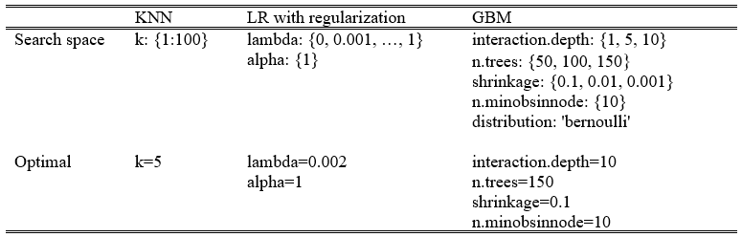
Classification task: Data –> Cleaning (missing value, outlier, normalize/)-> Explanatory analysis -> Model building -> Best model
Variable selection:
Remove customer_sex: based on explanatory analysis
Remove customer_available_credit_limit: based on the logit model (highest p_value)
Model building:
Imbalanced (class) – small data:
- Up resampling methods
- Smote resampling method
Model:
- Logistic regression
- KNN
- Logistic regression with regularization
- Gradient boosting model
Table 8: Hyperparameter tuning
Data split:
Train data divide into 2 parts (train 70%, validation 30%)
Cross-validation:
5 folds – optimal hyperparameters
Sugarbayar (UW)
Jun 12, 2023

Slide 8
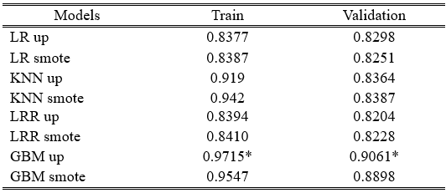
Classification task: Data –> Cleaning (missing value, outlier, normalize/)-> Explanatory analysis -> Model building -> Best model
Gradient Boosting with up resampling method is the best model. We used it to predict the test set.
Table 9: Balanced accuracy
Sugarbayar (UW)
Jun 12, 2023

Slide 9
Regression task: Data –> Initial data analysis -> Model building -> Best model
Train set – 2,398,116 rows, 14 variables
Internal division: 70% model training, 30% model validation
Test set – 599,561 rows, 13 variables
Outcome variable - newborn_weight
Szymczak (UW)
Jun 12, 2023

Slide 10
Regression task: Data –> Initial data analysis -> Model building -> Best model
Data type change – character to factor
Missing value – used XGBoost to fill the missings - numeric and factors
If spotted variables with outliers, used binning to capture them in several categories and still use for analysis; possible nonlinear relationship-> cigarettes, number of prenatal months. Numeric Outliers replaced with medians
In some cases, used polynomial in the final equation because of promising results
Correlation between numeric and numeric: Used PCA, Scale, Center in Pre-processing
Table 10: Convert data type
Type | Variable | Transformation
Numeric | mother_body_mass_index | Non-linearity: used polynomial in equation
 | mother_delivery_weight | Non-linearity: used polynomial in equation
 | mother_height | Non-linearity: used polynomial in equation
 | mother_weight_gain | Non-linearity: used polynomial in equation
 | father_age | Non-linearity: used polynomial in equation
 | cigarettes_before_pregnancy | no_cig if did not smoke + quantiles if smoked
 | number_prenatal_visits | quantiles
Factor | mother_marital_status | No change
 | mother_race | No change
 | father_education | Binned: Primary and other education; Secondary Education; Tertiary Education
 | prenatal_care_month | Binned: no prenatal care; prenaral care before 3 month; prenetal care after 3 month
 | previous_cesarean | Binned: Yes; No + Other
 | newborn_gender | No change
Szymczak (UW)
Jun 12, 2023

Slide 11
Regression task: Data –> Initial data analysis -> Model building -> Best model
Applied various models:
Simple Linear Regression
Stepwise AIC Forward Selection
LASSO Regression
Ridge Regression
Elastic Net
XGBoost Random Forest
Data split:
Train data divide into 2 parts (train 70%, validation 30%)
Cross-validation:
5 folds – optimal hyperparameters
Szymczak (UW)
Jun 12, 2023

Slide 12
Regression task: Data –> Initial data analysis -> Model building -> Best model
XGBoost Random Forest method is the best model. We used it to predict the test set.
Table 11: Model MAPE
Model | MAPE on training | MAPE on validation
OLS | 0.1608147 | 0.1507628
OLS Forward AIC Selection | 0.1608147 | 0.1507628
Lasso | 0.1618197 | 0.1509835
Ridge | 0.1614087 | 0.1509835
Elastic Net | 0.1614087 | 0.1509835
XGBoost Random Forest | 0.1586538 | 0.1491029
Szymczak (UW)
Jun 12, 2023

