Slide 1
CGB1201 – JAVA PROGRAMMING
Department of Artificial Intelligence and Data Science
Academic Year: 2024 – 2025 (Odd Semester)
Register Number : 2303811724322112
Name : SUGAPRIYA A.
Year : II
Semester : III
Section : B
Date : 03-12-2024

Slide 2
Title of the Project
MOVIE TICKET BOOKING SYSTEM

Slide 3
Abstract
This project aims to develop a comprehensive Movie Ticket Booking System that provides an user-friendly platform for customers to explore movie showtimes, book tickets, and manage their reservations.
For customers, the platform offers functionalities such as browsing movie listings, filtering by genre or time, selecting preferred seats, and making secure payments.
For theatre staff, the system provides tools to manage movie schedules, update seating arrangements, monitor ticket sales, and generate reports.

Slide 4
Introduction
The Movie Ticket Booking System is a user-friendly application designed to simplify the process of reserving movie tickets.
It provides a convenient platform for users to browse available movies, view showtimes, and check seat availability in real time.
Users can easily book tickets for their preferred movie by selecting a showtime and the number of seats they wish to reserve.

Slide 5
Java Programming - Concepts Used
AWT (Abstract Window Toolkit)
Event Handling
OOP Concepts
Collections Framework

Slide 6
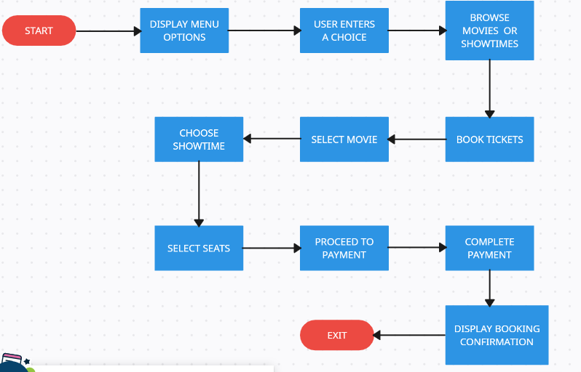
Proposed Architecture

Slide 7
Proposed Architecture - Description
Start:
The process begins when the user starts the application.
Display Menu Options:
The system presents a menu of options to the user, such as viewing available movies, booking tickets, and exiting.
User Enters a Choice:
The user selects an action from the menu.
This choice determines the next step in the process.

Slide 8
Proposed Architecture - Description (Cont..)
Book Tickets:
If the user decides to book tickets, the system navigates through the ticket booking process.
Select Movie:
The user selects a specific movie for which they want to book tickets.
Choose Showtime:
After selecting the movie, the user picks a preferred showtime from the available options.
Select Seats:
The user specifies the number of seats they want to book.The system checks for availability before proceeding to the next step.

Slide 9
Proposed Architecture - Description (Cont..)
Proceed to Payment:
The system calculates the total cost based on the number of seats.
Complete Payment:
The user completes the payment using their preferred method (e.g., card, UPI, cash).
Display Booking Confirmation:
Once the payment is processed, the system displays a confirmation message,
Exit:
The user can choose to exit the application at any point.

Slide 10
List of Modules
GUI Setup Module
Movie Management Module
Ticket Booking Module
Reservation Management Module
Movie Display Module

Slide 11
Module Description
GUI Setup Module:
Sets up the AWT components like buttons, text fields, choice lists, and labels.
Adds components to the frame and sets the layout using FlowLayout.
Movie Management Module:
initializeMovies(): Initializes the movie data (names, showtimes, and available seats).
updateShowTimes(): Updates the showtimes dropdown when a movie is selected.

Slide 12
Module Description (Cont..)
Ticket Booking Module:
bookTickets(): Validates input, checks seat availability, books tickets, generates a unique reservation ID, and updates the movie data.
Reservation Management Module:
viewReservation(): Retrieves and displays reservation details using the reservation ID.
Movie Display Module:
showMovies(): Displays all available movies, their showtimes, and the number of available seats.

Slide 13
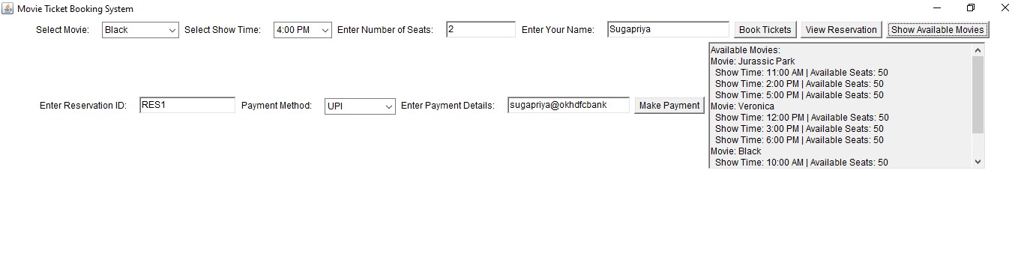
Results and Discussion

Slide 14
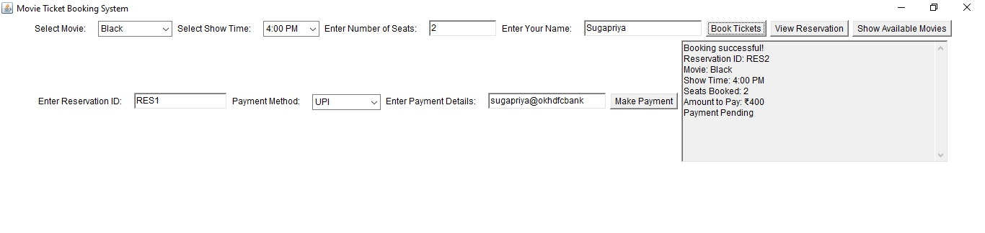
Results and Discussion (Cont..)

Slide 15
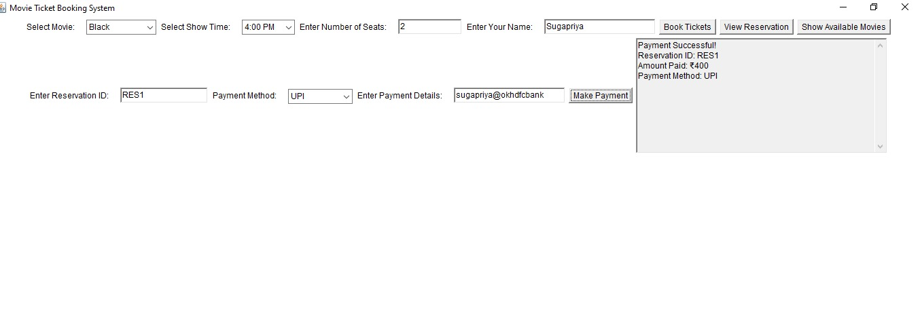
Results and Discussion (Cont..)

Slide 16
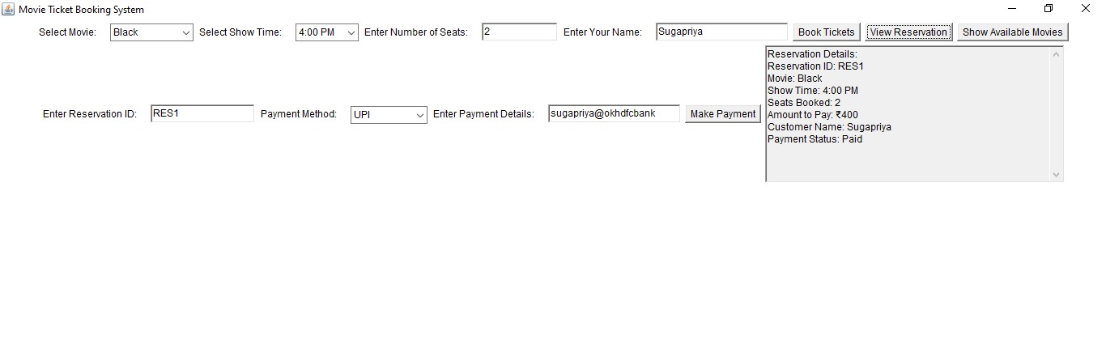
Results and Discussion (Cont..)

Slide 17
Conclusion
It effectively demonstrates the use of AWT for GUI development, event-driven programming for responsiveness, and object-oriented principles for modularity and clarity.
By managing tasks like movie scheduling, seat availability, ticket booking, and reservation retrieval, the program showcases efficient data handling using collections like HashMap and ensures a smooth user experience.
The clear separation of concerns between the GUI, business logic, and data management enhances maintainability and readability.

Slide 18
Thank You
ANY QUERIES???

