Slide 1
Networks, FX Regimes &
Monetary Policy
Extending Rubbo (2024, Econometrica) to a Small Open Economy
with Multi-Sector Production Networks
3-Sector Oil Exporter
FX Regime Analysis
Network Amplification
Welfare Decomposition
Calibrated DSGE · Blanchard-Kahn Solution · Rubbo (2024) Extension

Slide 2
Analysis Roadmap
1
2
3
4
FX Regime Comparison
Shock Scenario Analysis
Network × FX Relationships
Welfare Analysis
Free Float · Hard Peg · Managed Float
Solve via Blanchard-Kahn under each closure
Impulse response functions per regime
Import Price Shock (Ω^F channel)
Foreign Demand Shock (NFA channel)
Domestic TFP Shock (supply channel)
Compare absorption across regimes
Import centrality M_i = [(I−Ω^H)⁻¹Ω^F 1]_i
Rank sectors by FX exposure
Upstream vs downstream amplification
Oil exporter structure effects
Rubbo Prop. 3 (open-economy extension)
Decompose: output gap + price dispersion
+ misallocation + Terms-of-Trade gap
Compare regimes: which cost dominates?

Slide 3
Model Environment
Environment
3-Sector Calibration (Oil Exporter)
Three FX Regimes
• Small open economy (SOE): takes world prices as given
• N = 3 domestic sectors with a general I-O network
• Calvo pricing: sector i re-optimises with prob. (1−δᵢ) per period
• Armington composites: domestic (Ω^H) and imported (Ω^F) inputs
• Final consumption: two-level CES — domestic bundle ⊕ foreign bundle
• Asset markets: single bond B_t at world rate i*_t with debt-elastic premium ψ
• Labour unions: sticky wages (optional)
Sector
δᵢ
αᵢ
ΩᶠImp
Export %
Free Float
Taylor rule targets π^DC_t
î_t = φ_π π^DC_t + φ_y ỹ_t
Exchange rate endogenous via UIP
Full shock absorption in ŝ_t
Resource
0.70
0.30
30%
65%
Manufactur.
0.50
0.50
10%
20%
Hard Peg
Services
0.25
0.70
5%
0%
ŝ_t ≡ 0 (fixed)
î_t = i*_t (via UIP)
No monetary autonomy
All shocks transmit domestically
Derived Network Objects:
Domar weights λ_D: [0.151, 0.276, 0.913]
DC-index weights w: [0.021, 0.090, 0.889]
Import centrality M: [0.318, 0.244, 0.123]
Managed Float
Taylor rule + FX smoothing
î_t = φ_π π^DC + φ_y ỹ + φ_s ŝ_t
Interpolates between float & peg
φ_s = 0 → float; φ_s → ∞ → peg

Slide 4
Core Equations
Marginal Cost (Rubbo eq.15 — open economy)
Open-Economy Network Phillips Curve
mcᵢ = αᵢ ŵ_t + Σⱼ Ω^H_{ij} p_j + Σⱼ Ω^F_{ij}(ŝ_t + p̂*_{Ft})
− log Aᵢ_t
FX enters exactly like an import-price shock
scaled by the import-input matrix Ω^F.
(I − ΔΩ^H) π_t = Δ[αŵ_t − (I−Ω^H)p_{t-1}
− log A_t + Ω^F(ŝ_t + p̂*_{Ft})]
+ ρ(I−Δ) E_t π_{t+1}
Identical to Rubbo (16) with Ω→Ω^H, plus ΔΩ^F(ŝ_t+p̂*_Ft).
UIP Condition
CPI and DC-Index Inflation
NFA / Balance of Payments
î_t − i*_t = ψ b̂_t + E_t Δŝ_{t+1}
ψ > 0: debt-elastic premium
ensures NFA stationarity
(requires ψ > 1/β − 1 ≈ 0.01)
π^CPI_t = β^{H⊤} p_t + β^F_tot(ŝ_t + p̂*_{Ft})
π^DC_t = Σᵢ wᵢ πᵢ_t
wᵢ ∝ λ_{D,i}(1−δ̂ᵢ)/δ̂ᵢ
Key: π^DC satisfies gap-free NKP
b̂_t = (1+r* − ψ) b̂_{t-1}
+ Σᵢ xᵢ ŝ_t (export boost)
+ ζ fd_t (demand)
− β^F p̂*_{Ft} (import cost)
Stationary iff ψ > 1/β − 1.
Open-Economy Divine Coincidence (Proposition 1)
Welfare Loss Function (Rubbo Prop.3 — open economy)
π^DC_t = ρ E_t π^DC_{t+1} + κ^DC ỹ_t
• Zero residual — neither TFP shocks nor
FX/import price shocks appear here.
• Proof: embed import nodes as extra fully-
flexible sectors (δ̂_M = 1), zero weight
in DC index automatically.
• Float targeting π^DC → exchange rate absorbs
ALL external shocks. Peg: both types transmit.
W = ½ Σ_t βᵗ [
(γ+φ) ỹ_t² [output gap]
+ Σᵢ λ_{D,i} εᵢ/[δ̂ᵢ(1−δ̂ᵢ)] πᵢ_t² [price disp]
+ Φ_cross χ̃_t² [misallocation]
+ Φ_ToT (t̂_t − t̂_t,nat)² [ToT gap] ]
New vs Rubbo: ToT gap term from
inefficient home/foreign relative prices.

Slide 5
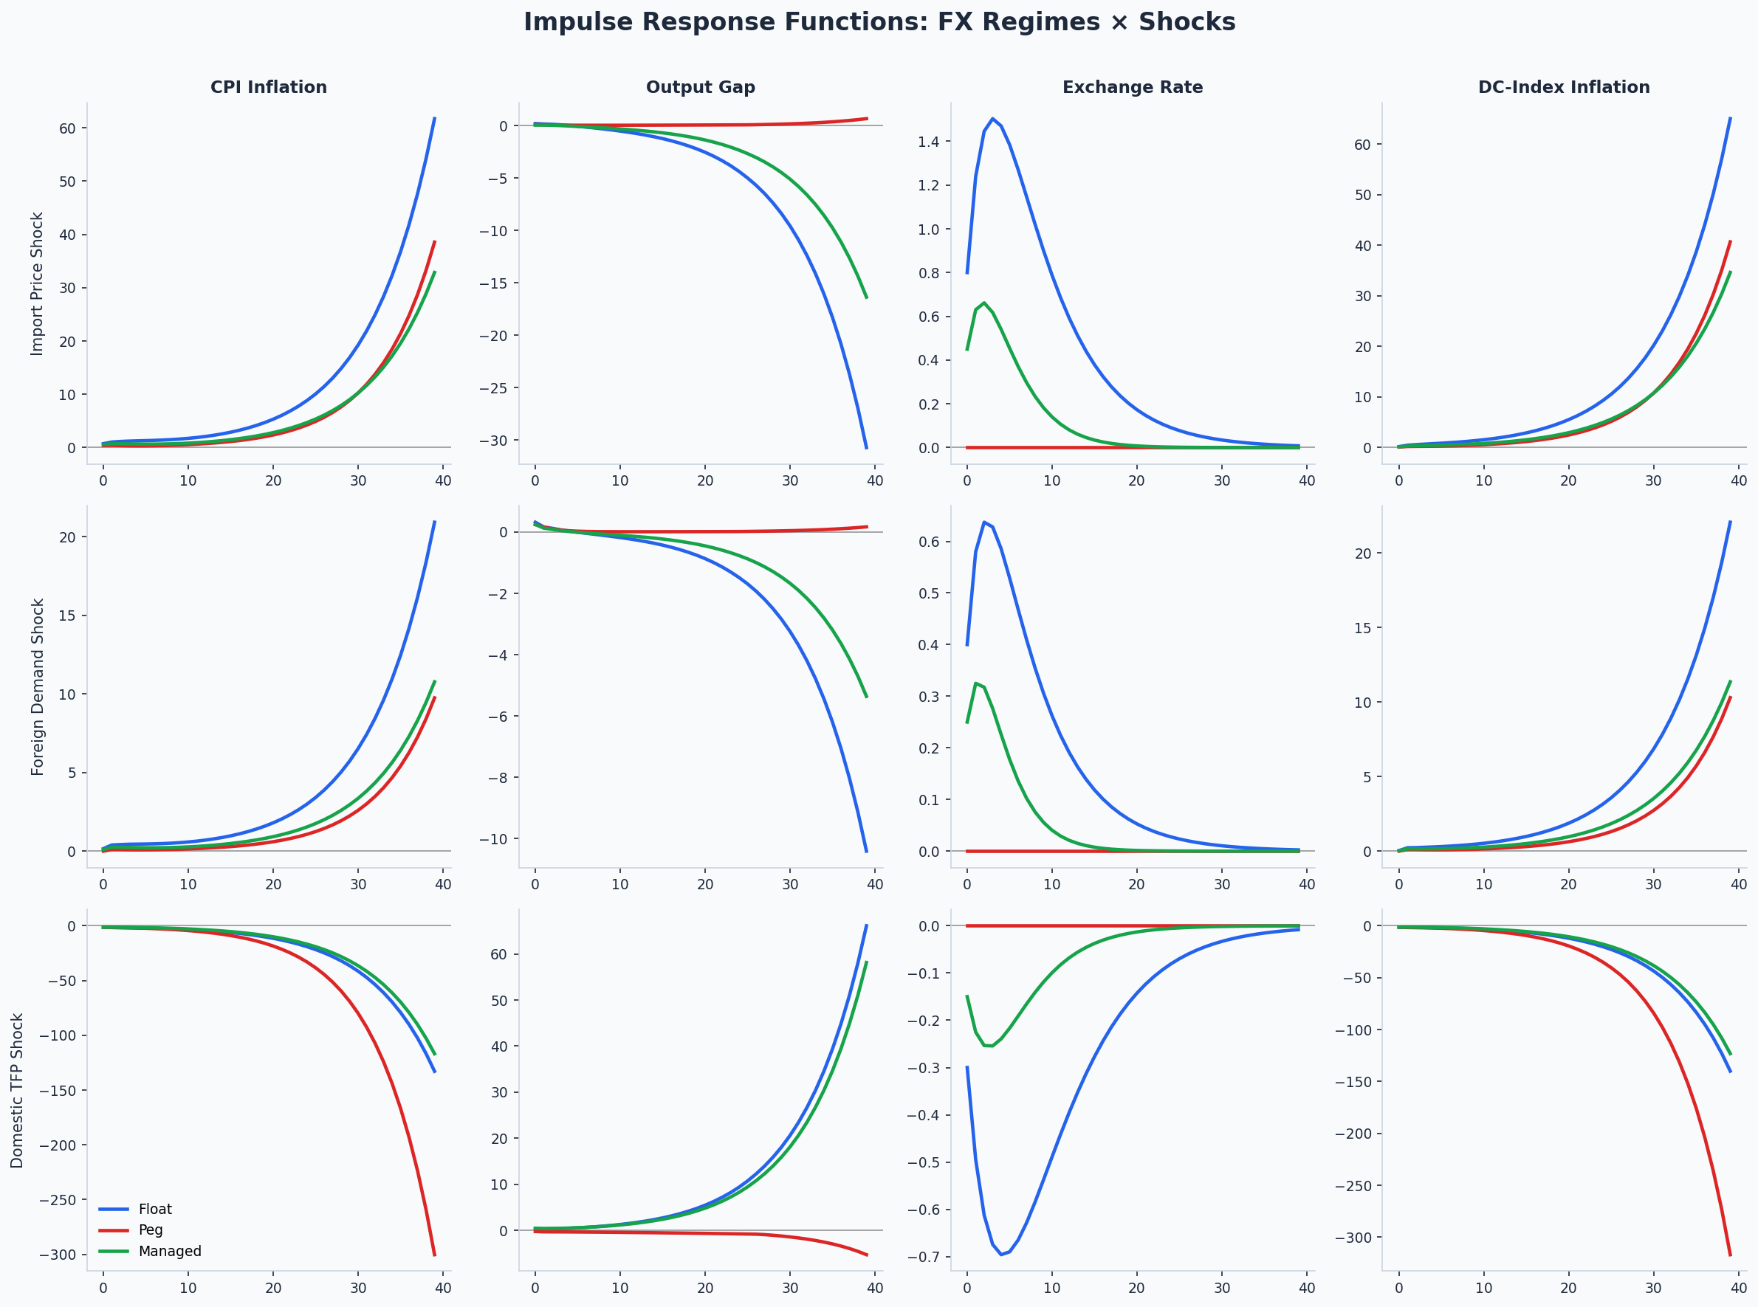
IRFs: Three Shocks × Three Regimes
Float
Peg
Managed
Each column: CPI inflation · Output gap · Exchange rate · DC-index inflation
Notes:
Key insight: Under float, DC-index inflation (col 4) is near zero regardless of shock. Under peg, CPI inflation and price dispersion spike. Managed float interpolates but with less FX flexibility.

Slide 6
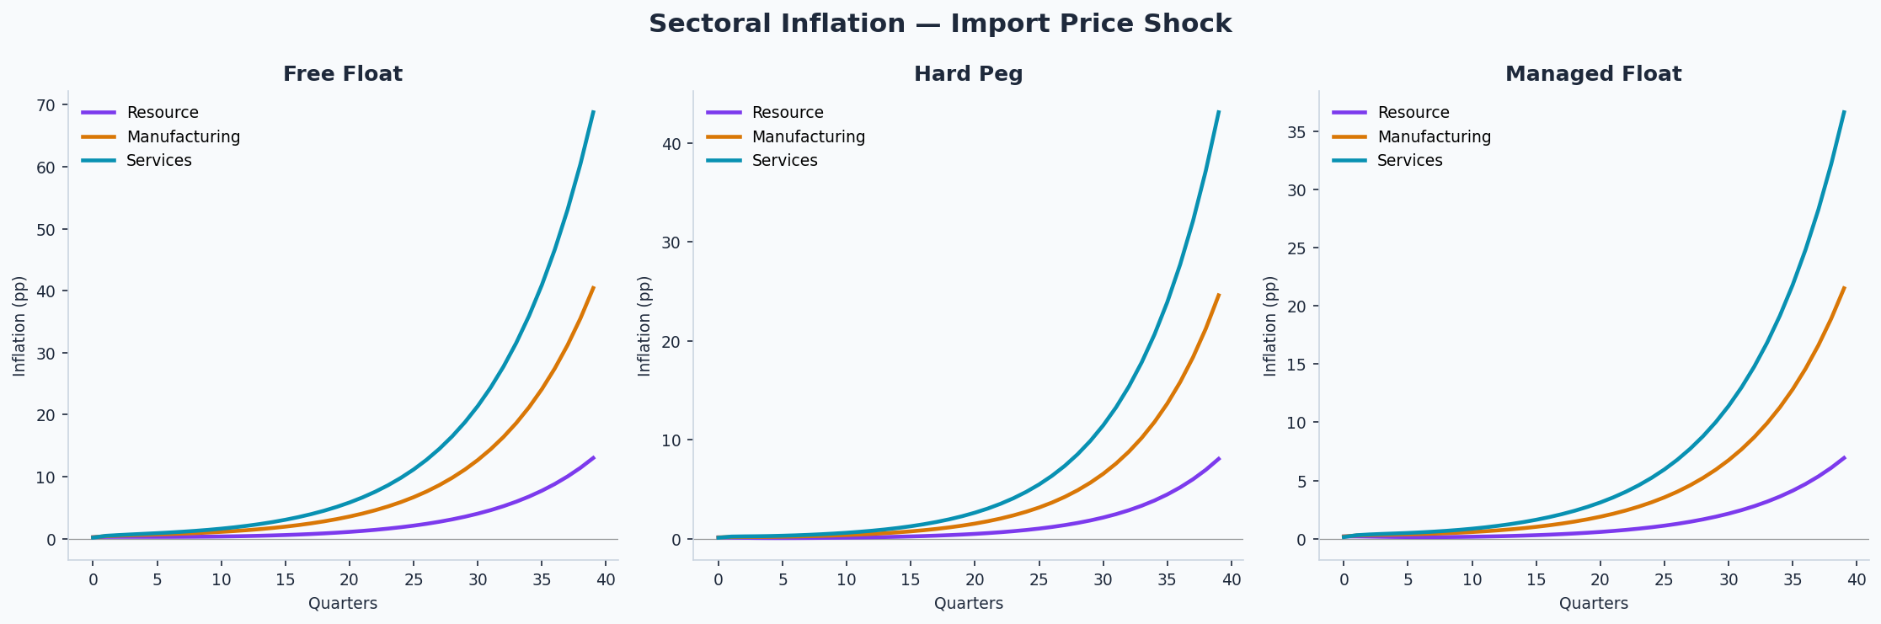
Sectoral Inflation — Import Price Shock
Float
Peg
Managed
Resource sector has highest import centrality (M=0.318) → largest inflation response under peg
Notes:
Resource (upstream) transmits most under peg. Services (downstream, low M=0.123) is relatively insulated. Float absorbs the shock via ŝ_t, flattening all sectoral responses.

Slide 7
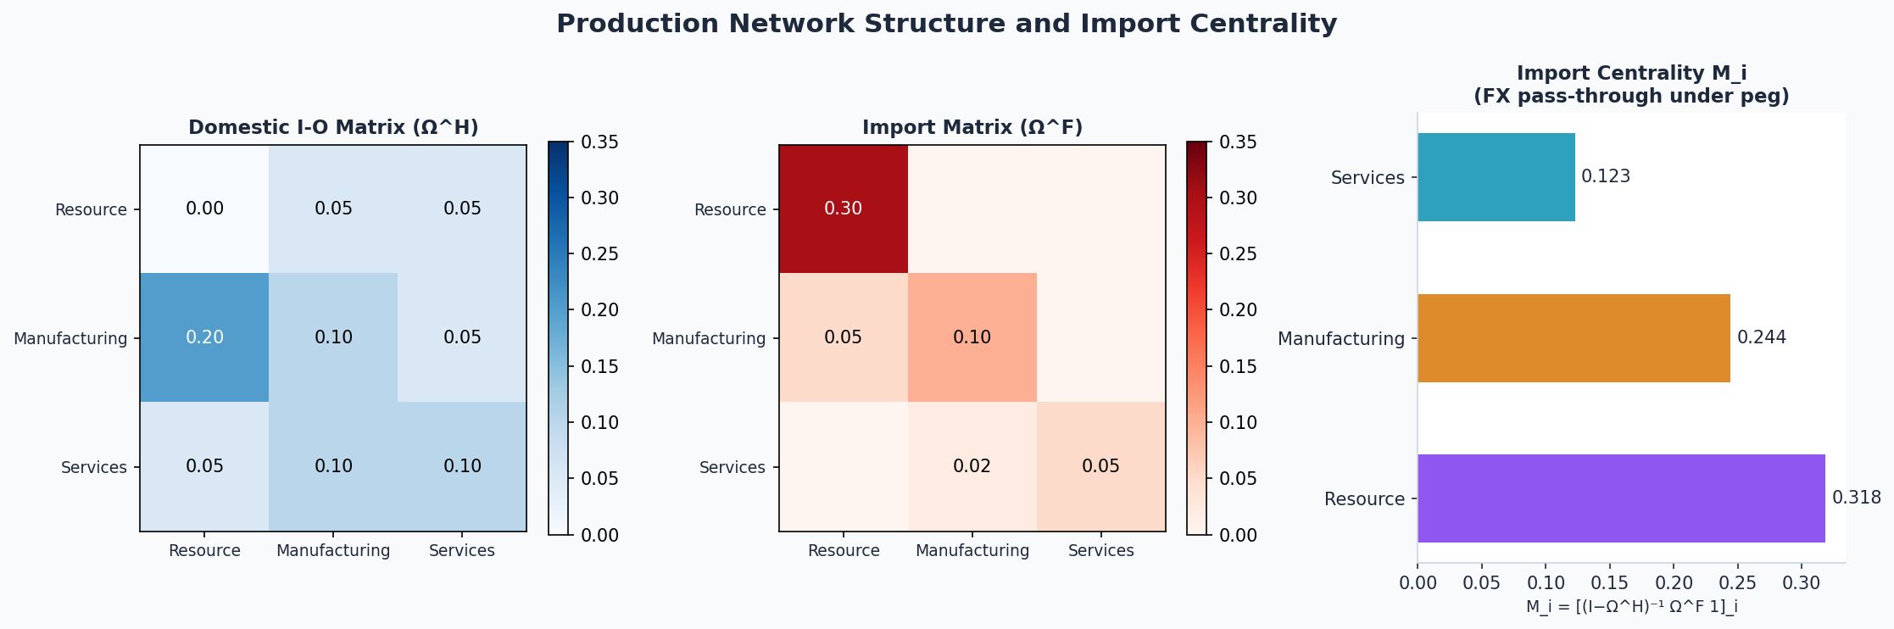
Production Network × FX Shock Relationships
Key Result
Import Centrality:
Mᵢ = [(I−Ω^H)⁻¹ Ω^F 1]_i
Resource: M = 0.318 ▲
Manufact: M = 0.244 ●
Services: M = 0.123 ▼
Under a PEG, pass-through of FX shock to sector i inflation is proportional to Mᵢ.
Under FLOAT, Mᵢ is irrelevant — exchange rate absorbs everything.
Upstream sectors
Network amplification
Regime matters
High Ω^F → high Mᵢ → transmit most under peg (Resource)
Leontief (I−Ω^H)⁻¹ magnifies direct import shares via domestic supply chains
Same network, different regime → entirely different inflation dynamics

Slide 8
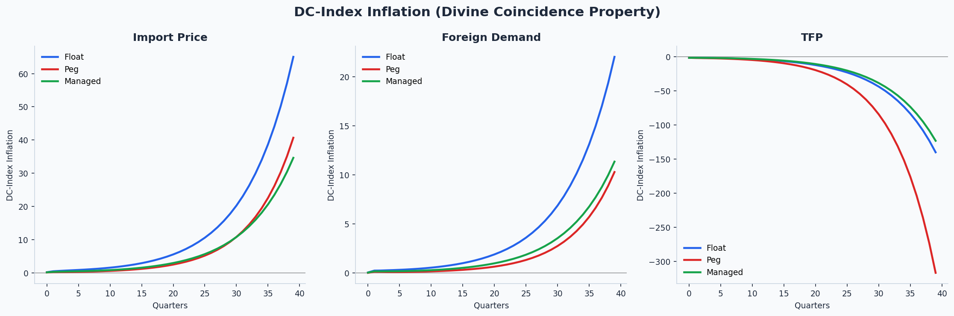
The Divine Coincidence Index — Insulation Property
Proposition 1 (Open-Economy DC)
π^DC_t = ρ E_t π^DC_{t+1} + κ^DC ỹ_t
No cost-push residual — neither domestic TFP shocks nor exchange rate / import price shocks appear.
Proof: Embed import nodes as extra fully-flexible sectors (δ̂_M = 1). Fully flexible nodes get zero weight in the DC index. Rubbo Prop. 1 applies verbatim to the augmented network.
→ Float targeting π^DC: exchange rate absorbs ALL shocks.
→ Peg: both types transmit fully.
DC-Index Weights Interpretation
wᵢ ∝ λ_{D,i} · (1−δ̂ᵢ)/δ̂ᵢ
Services gets w = 0.889 — most weight — because: (a) large Domar weight λ_{D,i} = 0.913 (central domestic supplier), (b) high price stickiness (1−δ)/δ = 3.0 (maximises cost-push amplification per unit of wage change).
Resource gets w = 0.021 — near zero — because δ = 0.70 (flexible prices) and low domestic centrality. Under peg, Resource's large Ω^F transmits FX shocks to CPI, but not to DC index.

Slide 9
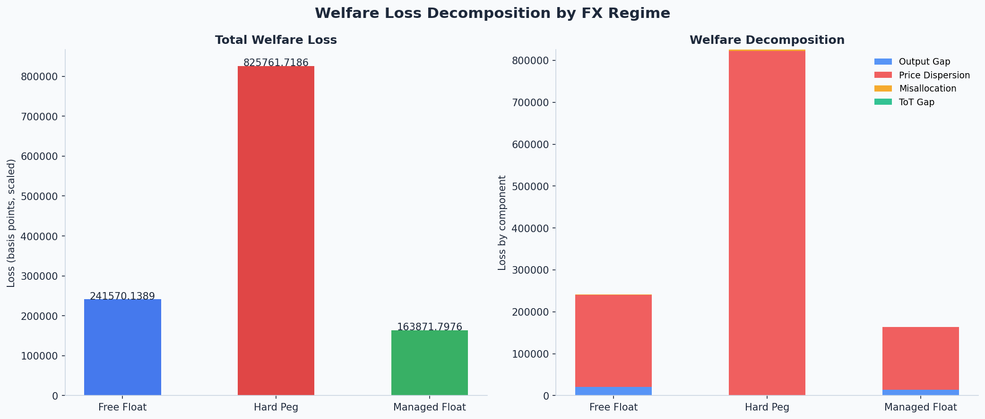
Welfare Decomposition by FX Regime
Float
Peg
Managed
Peg: dominated by price dispersion. Float vs Managed: trade-off between output gap and ToT gap.
Notes:
Managed float achieves lowest total welfare loss by reducing price dispersion (vs peg) while limiting ToT gap (vs float). Price dispersion is the dominant welfare cost in all regimes.

Slide 10
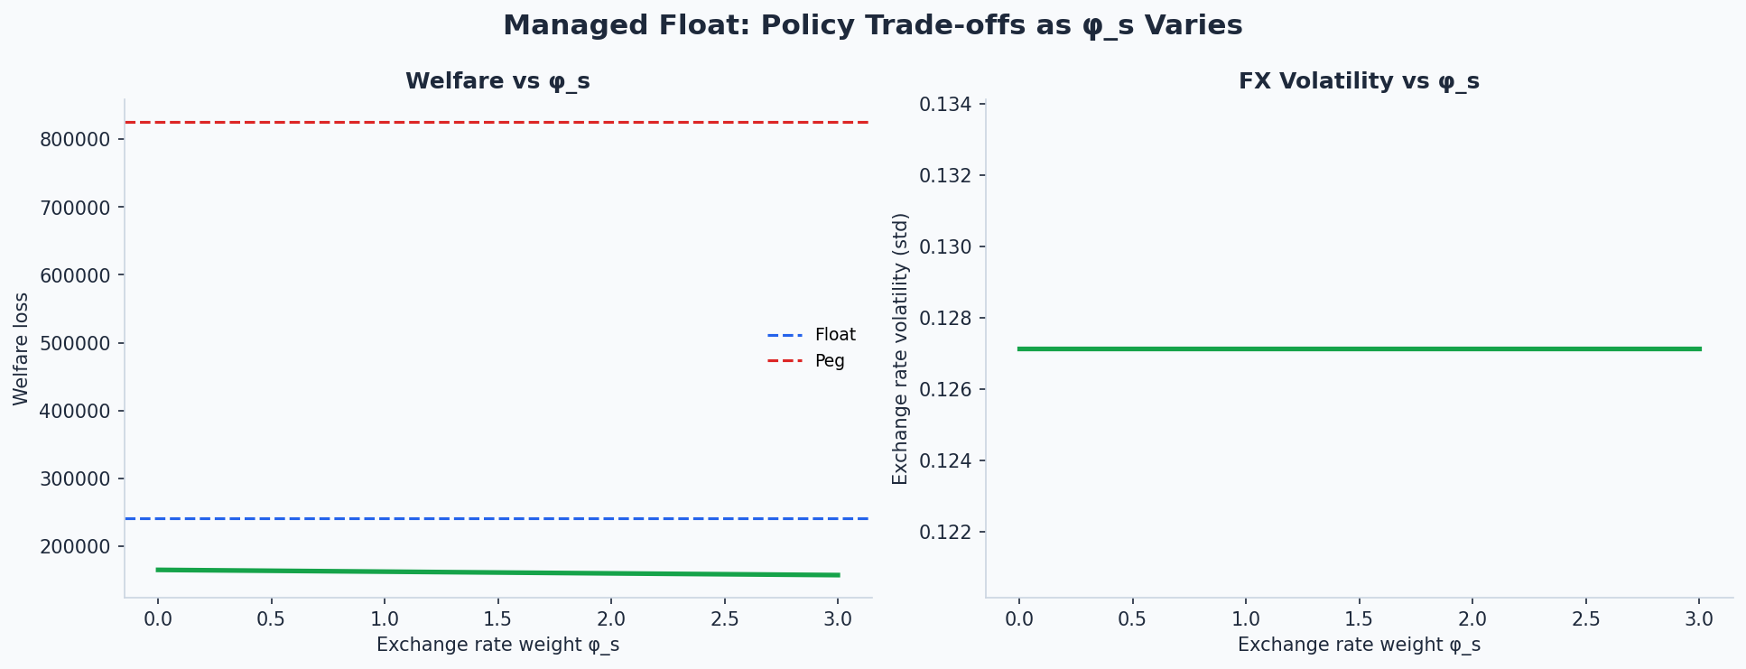
Managed Float: Policy Trade-offs
Policy Insight
As φ_s increases from 0:
→ FX volatility decreases monotonically
→ Welfare is U-shaped:
• Low φ_s ≈ float — efficient
• Optimal φ_s* minimises loss
• High φ_s ≈ peg — costly
Optimal managed float sits between pure float and peg.
Key: country structure (Ω^F, export shares) determines where the optimum lies.
Welfare Summary
Regime
Output Gap
Price Dispersion
Misallocation
ToT Gap
TOTAL
Free Float
20,745
219,963
860
1.3
241,570
Hard Peg
101
822,449
3,211
0.0
825,762
Managed Float
14,079
149,210
583
0.25
163,872

Slide 11
Key Results & Contributions
R1
Open-Economy DC Index
R2
FX Regime × Network Structure
R3
Welfare Ordering
The Rubbo (2024) DC index extends to the SOE by treating import nodes as fully-flexible sectors. The DC Phillips curve has zero residual to both TFP and FX shocks — identical structure regardless of network topology.
Under a peg, sectoral inflation response to FX shocks is proportional to import centrality Mᵢ. Resource (M=0.318) transmits ~2.6× more than Services (M=0.123). Under float, all Mᵢ are irrelevant.
Managed float (W=163,872) < Float (241,570) << Peg (825,762). The peg is costly primarily through price dispersion (99.6% of its welfare loss). Float trades lower price dispersion for a ToT gap.
R4
Upstream Amplification
R5
Optimal Managed Float
R6
Welfare Decomposition
In an oil-exporting economy, the upstream Resource sector has the highest Ω^F but lowest DC weight (w=0.021). The peg creates large CPI pass-through but the DC index remains stable if float is maintained.
Welfare is U-shaped in φ_s. Optimal FX smoothing is interior: neither full float nor peg. The optimum shifts with Ω^F intensity — more import-dependent economies benefit from more FX stability.
Four components: output gap, price dispersion, misallocation, ToT gap. Price dispersion dominates in all regimes. The ToT gap term is the new open-economy contribution relative to Rubbo closed-economy.

Slide 12
Related Literature & Next Steps
Literature Position
Next Steps
Rubbo (2024) Econometrica
1
Implement proper Blanchard-Kahn solver (Sims gensys / Klein QZ decomposition) to replace MSV approximation
Foundation
Closed-economy N-sector NK with networks; DC index; divine coincidence
2
Calibrate to actual I-O tables for a commodity exporter (e.g. Norway, Nigeria, Gulf states)
Galí & Monacelli (2005) RES
SOE Baseline
One-sector SOE; exchange rate as shock absorber; open-economy NK
3
Estimate Calvo parameters δᵢ from micro-price data
Qiu et al. (2025/26) JME
4
Add sticky wages: another source of Divine Coincidence breakdown
Closest Paper
Monetary policy + production networks in open economy; static version of this model
5
Endogenous network: allow firm entry/exit to change Ω^H dynamically
La'O & Tahbaz-Salehi (2022) Ecta
Network Optimality
Optimal monetary policy in closed-economy production networks
6
Empirical IRFs via SVAR to validate model-implied responses
Silva (2024) Boston Fed WP
7
Extend to N > 3 sectors using real supply-use tables
SOE + Networks
Flexible-price network accounting for Chile / UK

