Slide 1

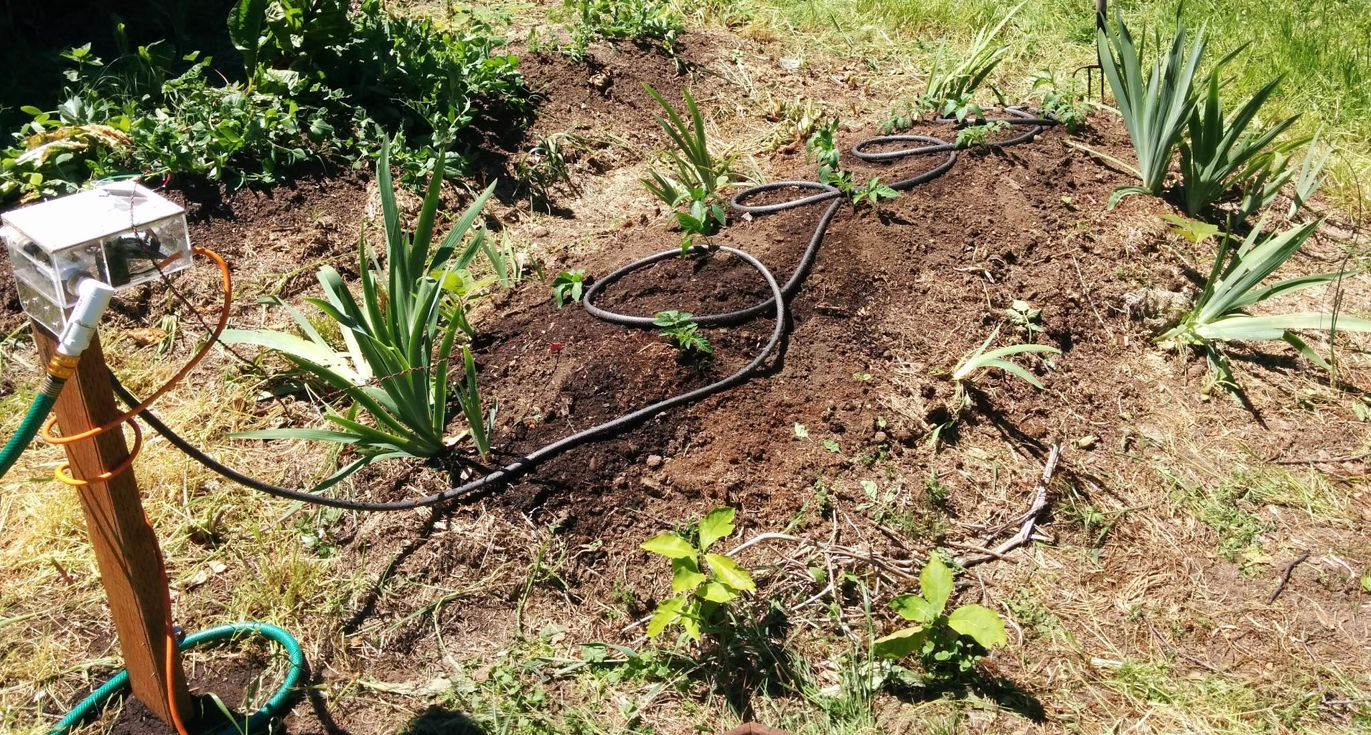
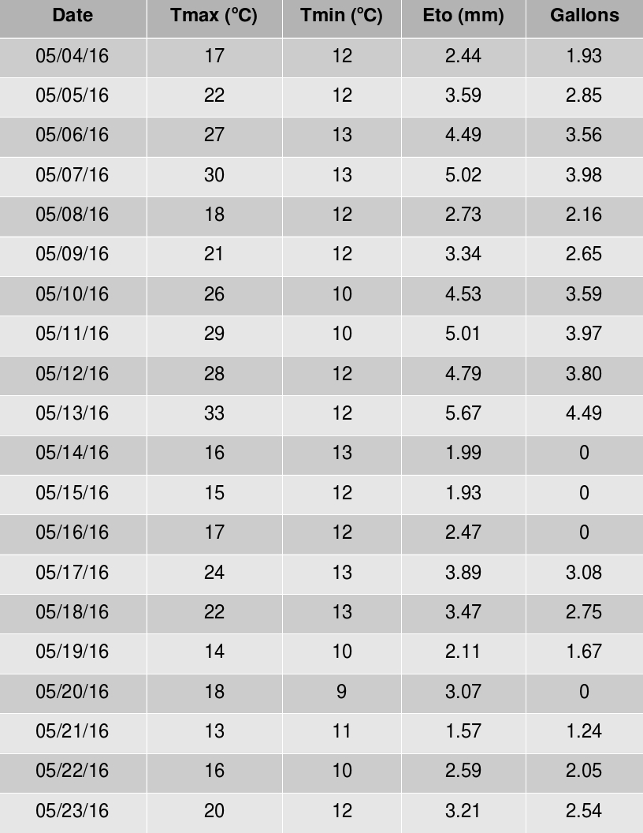


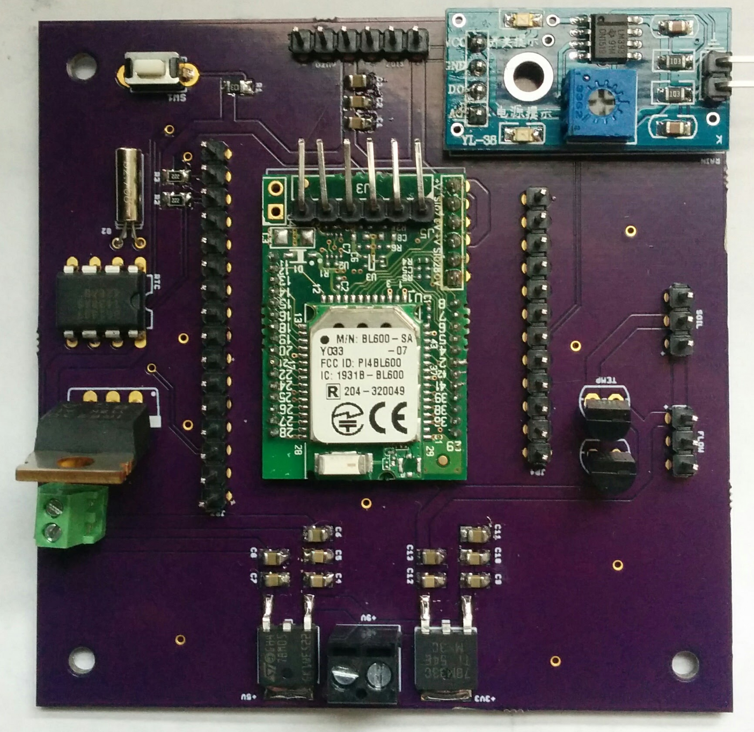
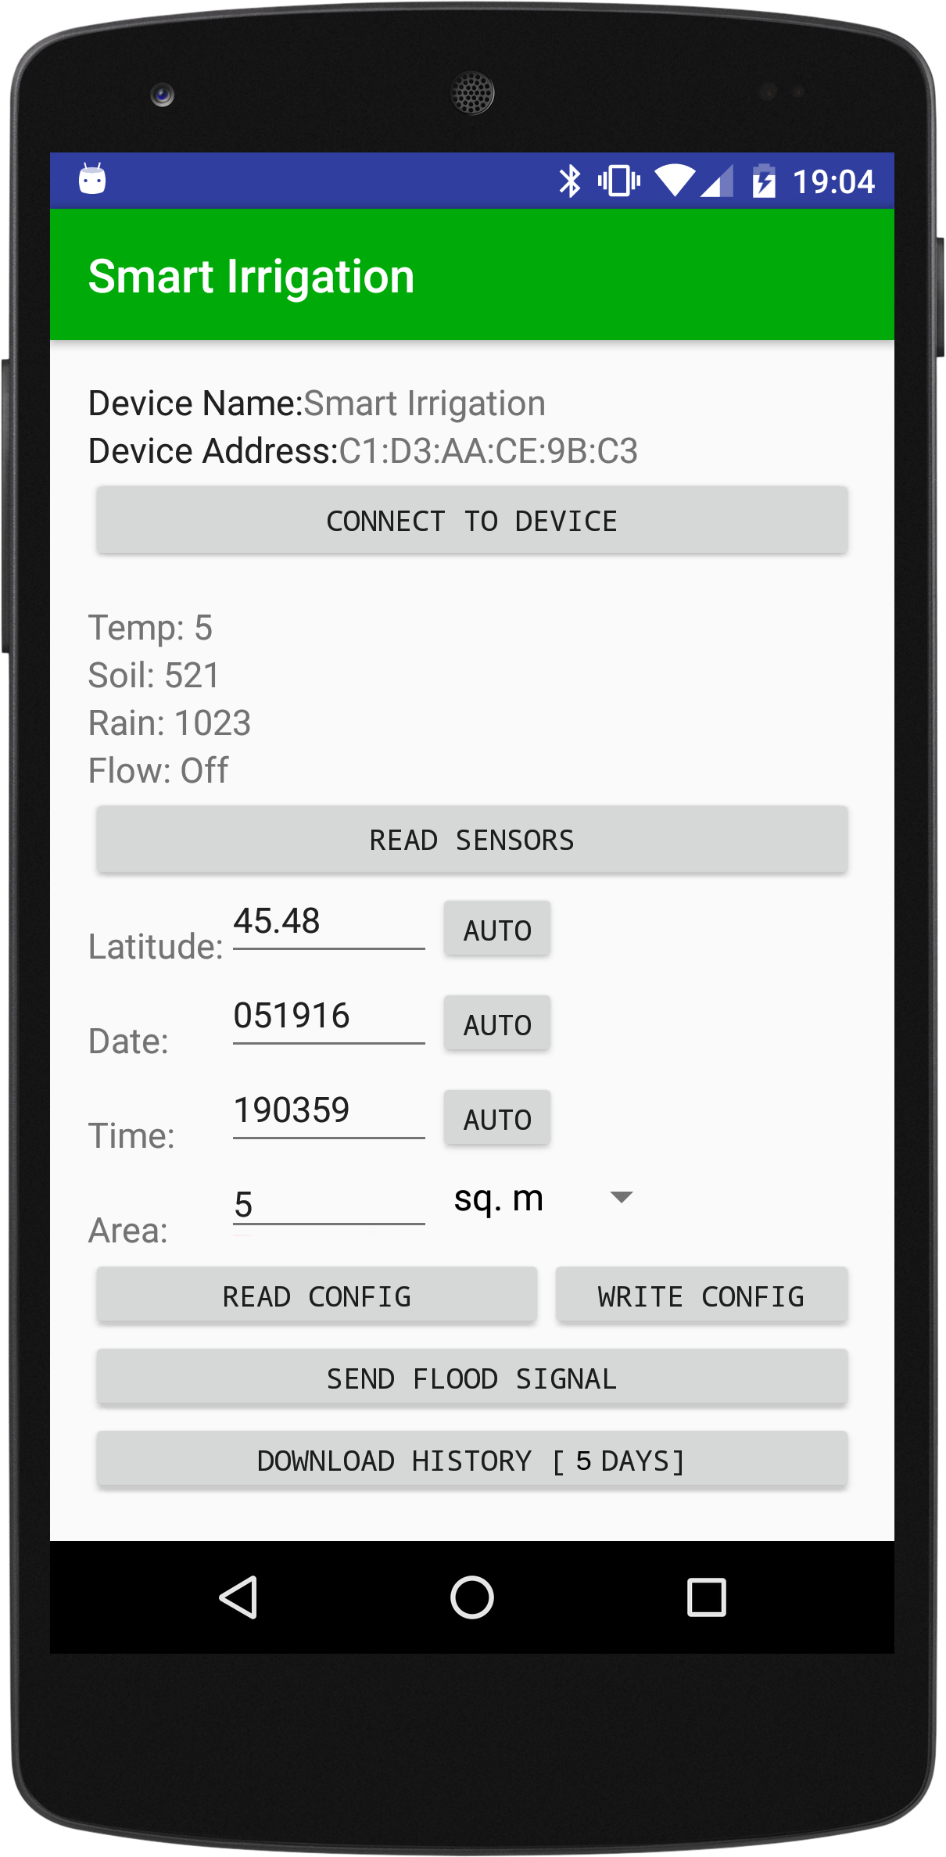
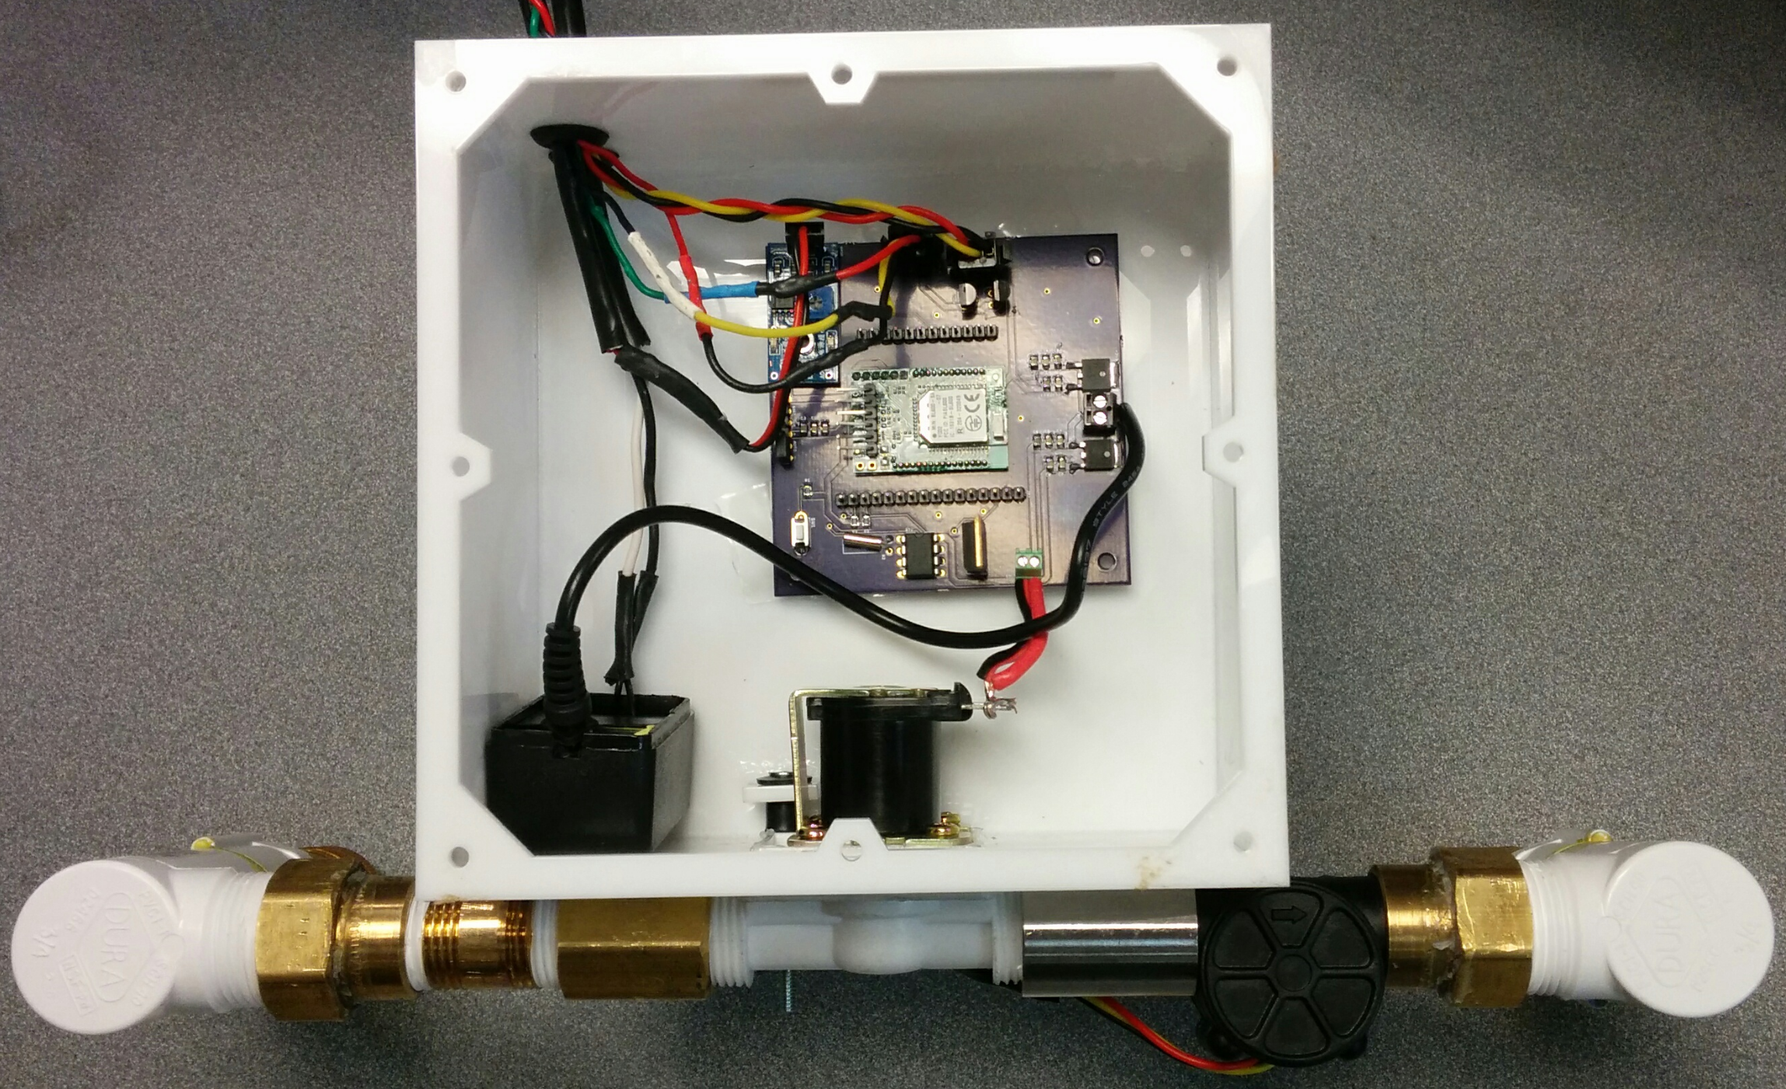

Smart Irrigation
Advisor: Dr. Roy Kravitz
Sponsor: Intel IoT Group
Team Members:
Austin Morlan, Bryan Martin,
Dylan Johnson, Taylor Griffin
Problem
Water is a precious resource and current irrigation practices are managing water consumption poorly. There should be more efficient ways to administer water without proving too costly to the user.
Irrigation should be scheduled in such a way that minimizes water consumption without compromising crop yield. Current irrigation controllers require frequent calibration and employ an array of environmental sensors that increase unit cost. The use of soil moisture sensors in current implementations is problematic due to sensor corrosion and variance in readings at different depths and locations.
There is a need for a low cost, low maintenance irrigation controller that can effectively manage water resources regardless of location, terrain, and local climate. Such a device would need to minimize the use of sensors to lower unit cost and be able to operate in areas without internet connectivity.
Results
Table 1:
Device was field tested in Bryan’s garden from May 4th to May 23rd. The area to be irrigated was 3 m².
E_{to} is calculated in mm. Gallons of water irrigated is determined by converting from metric volume of E_{to} • Area.
Values of zero gallons correspond to days where the rain was detected.
Solution
The proposed solution uses water-budgeting irrigation scheduling. This method attempts to track the amount of water entering and leaving the soil through various processes. Our water-budgeting scheme tracks the following factors:
Evaporation of water from soil to environment
Transpiration of water from crops to environment
Precipitation of water from environment to soil
Evaporation and transpiration are determined using the Hargreaves Reduced-set Method⁽¹⁾ which estimates evapotranspiration using ambient air temperature, latitude, and day of the year. This method reduces the number of sensors to two: a temperature sensor and a precipitation sensor are all that are required since latitude and calendar day can be supplied during configuration of device via app.
Device:
Minimum amount of sensors required for algorithm calculation
Printed circuit board for component connections
Enclosure to properly protect fragile components from the weather
Android App:
Communicates with device via Bluetooth Low-Energy (BLE)
Sends configuration information for irrigation policy (time, date, latitude)
Receives irrigation statistics
Displays sensor readings
Figure 2: Installed device irrigating tomato, pepper, and iris plants
How It Works
The water-budget irrigation method can be summarized as:
Where Irr is the amount of water to be applied, E_{to} is the crop evapotranspiration, and P is precipitation. All values are in mm.
E_{to} is estimated using the Hargreaves Reduced-set Method:
HC, HE, and HT are constants specified by the method and can be calibrated. R_{a} is the solar radiation that is calculated using the latitude and calendar day set during configuration of device.
The device samples temperature and precipitation sensors every hour. The precipitation sensor returns a wet or dry value in order to reduce complexity and cost. E_{to} calculations are performed daily using the daily high and low temperature values. This value is multiplied by the area to be irrigated in order to find the volume of water needed. A solenoid is then opened to actuate water flow and amount of water dispensed is measured using a hall-effect flow sensor.
Over the 20-day testing period the device calculated a total evapotranspiration of 67.91mm and irrigated a total of 46.3 gallons of water. Over the same period a total of 10.6 gallons of water was applied to the vegetable bed via precipitation⁽²⁾. A total of 56.9 gallons of water was applied to the vegetable bed. This result can be compared favorable to historical data and to general irrigation guidelines. 10-year historical evapotranspiration for Forest Grove, Oregon, over the same period is 84.4mm⁽³⁾. General gardening guidelines⁽⁴⁾ typically recommend 1” of watering per week plus an additional ½” weekly for average temperatures above 70 ºF. Using these guidelines, a total of 63.4 gallons of water would need to be applied by either irrigation or precipitation.
Conclusions
Overall, irrigation scheduling using water-budgeting and evapotranspiration estimations has been demonstrated successfully. The device calculated reasonable evapotranspiration values compared to historical data and also supplied a reasonable amount of irrigation water compared to general guidelines. While initial results are very promising, more testing data is required. Further testing should be conducted at sites varying in location, soil quality, and crops grown.
After collecting more testing data, it may be desirable to adjust constants used in calculations to compensate for differences in soil type, crops grown, environmental factors, etc.
The rain detection algorithm may be improved by scaling the evapotranspiration term by a wet-to-dry ratio rather than the current binary implementation.
References:
FAO Irrigation and Drainage Paper 56
USGS, Oregon Water Science Center, HYDRA Rainfall Network
US Department of Interior, Bureau of Reclamation, Cooperative Agricultural Weather Network
Bonnie Plant Farm, “How Much Water Do Plants Need?”
Figure 1: PCB and Android application
Figure 3: Fully assembled device
Department of Electrical and Computer Engineering

