Slide 1
SECURE DATA HIDING IN IMAGES USING STEGANOGRAPHY
CAPSTONE PROJECT
Presented By: Sai Sugathri Bulusu
Student Name : Sai Sugathri Bulusu
College Name & Department : Kakatiya Institute of Technology
and Science, Warangal ; CSE(Networks)

Slide 2
OUTLINE
Problem Statement
Technology used
Wow factor
End users
Result
Conclusion
Git-hub Link

Slide 3
Problem Statement
Ensuring safe communication and data protection is essential in today's digital world. Conventional encryption techniques could draw notice and cause suspicion. The goal of this project is to create a steganography-based system that safely conceals messages inside pictures, guaranteeing secrecy and integrity while rendering them invisible to unauthorised users. Furthermore, conventional data security approaches are frequently subject to intrusions, therefore investigating alternate strategies for secure communication is essential. This project adds an additional degree of security by enclosing communications in graphics, guaranteeing that private data is shielded from possible dangers.

Slide 4
Technology used
Python: Programming Language
Opencv2: Image processing library
NumPy: Library for arrays, mathematical functions
Steganography Techniques: Hiding data using image pixels
ASCII Encoding: Storing text in images using character encoding

Slide 5
Wow factors
Password Protection: Ensures only authorized users can retrieve hidden messages
Minimal Image Distortion: Message is embedded without altering the image quality significantly
Real-time Encryption & Decryption: Quick processing for encoding and retrieving data
User-Friendly Interface: Simple input prompts for easy usage
Platform Independence: Works on different operating systems (Windows, Linux, macOS)

Slide 6
End users
The end users of this Secure Data Hiding in Images Using Steganography project include individuals and organizations that require confidential communication and secure data storage. This includes cybersecurity professionals, government agencies, journalists, and whistleblowers who need to conceal sensitive information from unauthorized access. Additionally, corporate businesses can use this technique to protect intellectual property, while students and researchers can explore steganography for educational and security analysis purposes. Everyday users may also leverage this system for personal data protection and privacy in digital communication.

Slide 7
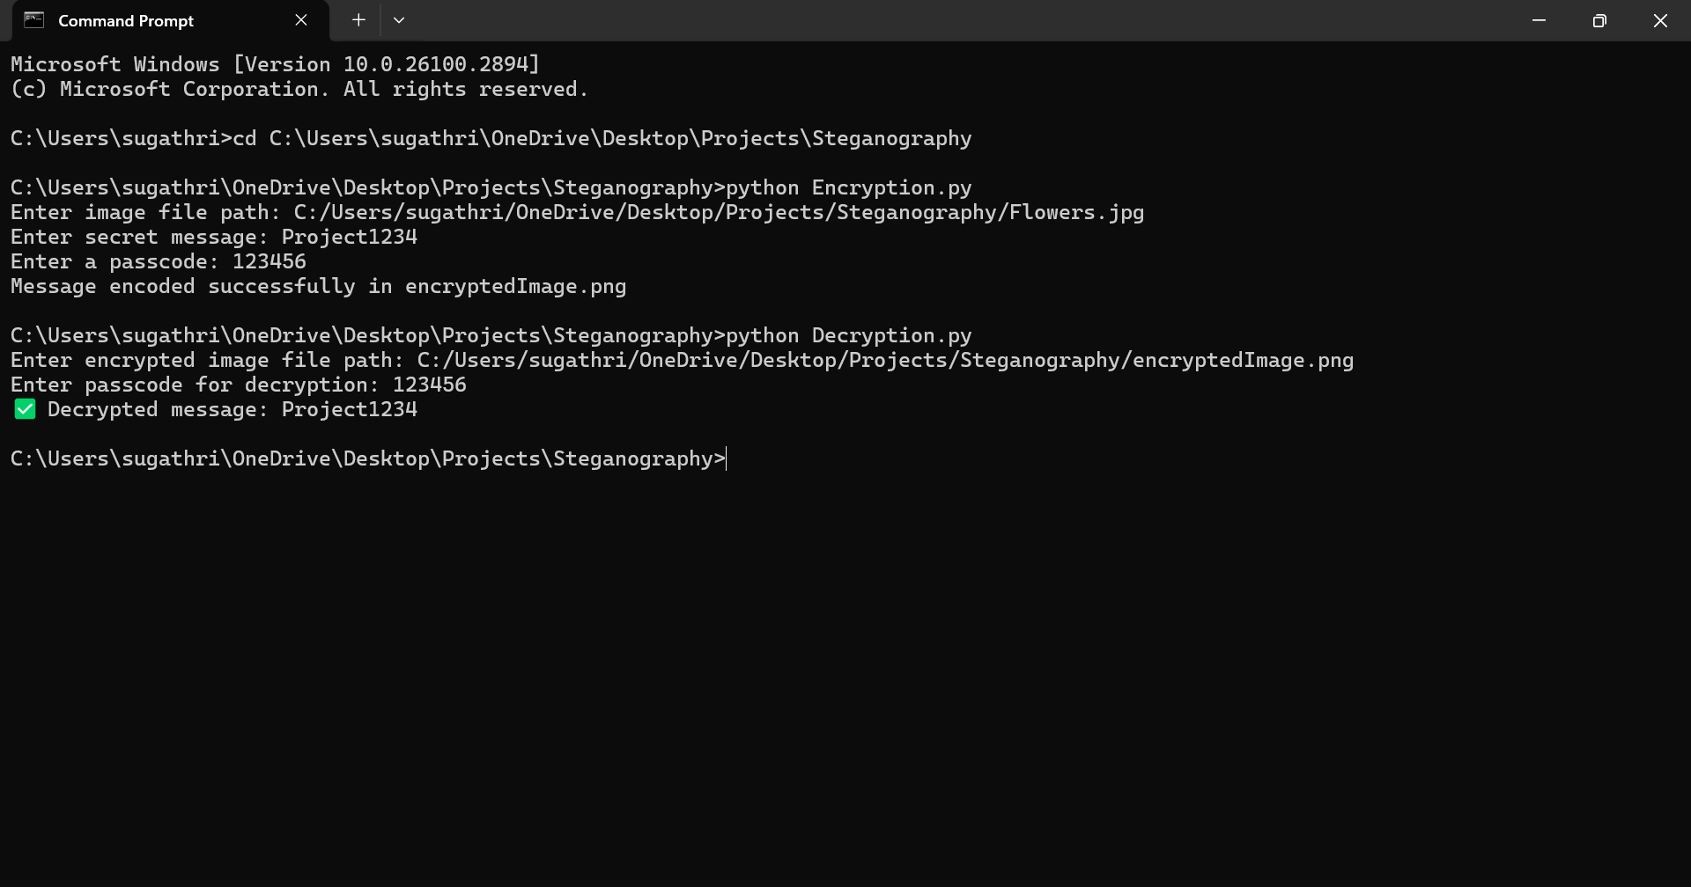
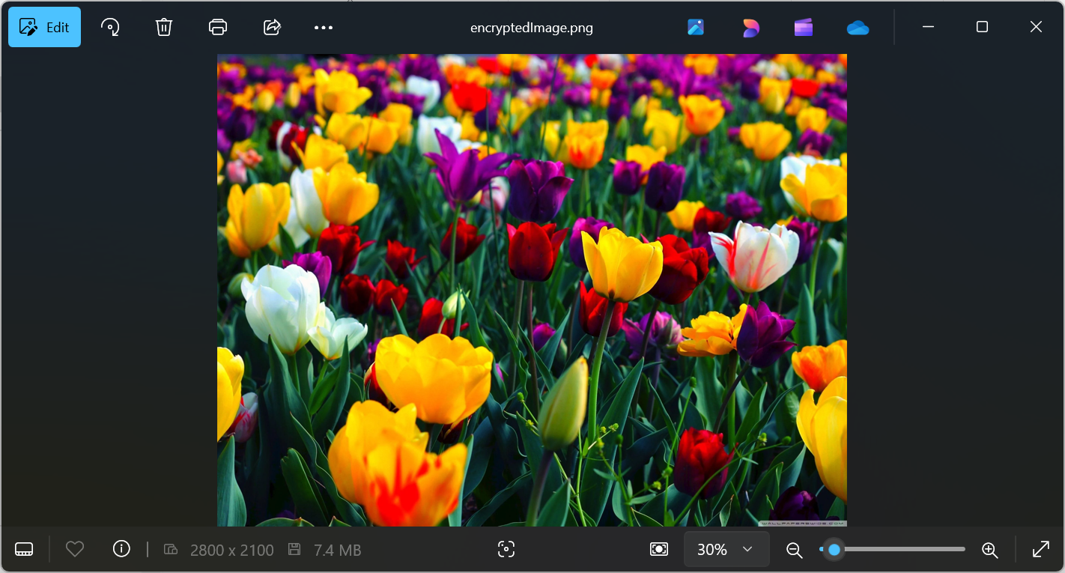
Results

Slide 8
Conclusion
This project provides a secure and effective way to hide sensitive information within images using steganography. The use of password protection enhances security, ensuring only authorized users can access the data. The system is efficient, lightweight, and suitable for real-world applications where confidentiality is required.

Slide 9
GitHub Link
https://github.com/Sugathri14/SteganographyProject.git

Slide 10
THANK YOU

