Slide 1
CGB1201 – JAVA PROGRAMMING
Department of Artificial Intelligence and Data Science
Academic Year: 2024 – 2025 (Odd Semester)
Register Number : 2303811724322113
Name : SUJITHA G
Year : II
Semester : III
Section : B
Date : 3/12/2024

Slide 2
ONLINE BOOK STORE
Develop an online bookstore to handle book sales, manage inventory, and provide a seamless shopping experience for customers.

Slide 3
Problem Identification
Limited Convenience: Customers need an easier way to buy books online.
Inventory Issues: Manual stock management can lead to errors.
Lack of Personalization: No recommendations to help customers find books.

Slide 4
Objective
Easy Shopping: Simplify online book browsing and purchasing.
Efficient Inventory: Automate stock management.
Personalized Experience: Provide book recommendations.

Slide 5
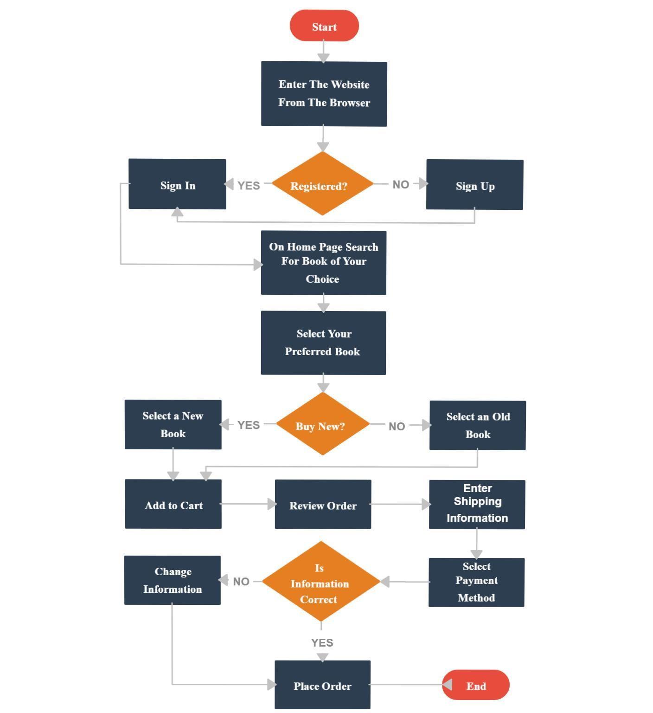
Proposed Architecture

Slide 6
List of Modules
User Module
Book Management Module
Shopping Cart Module
Order Management Module
Admin Module

Slide 7
Module Description
User Module
User registration and login (Sign Up/Sign In).
Authentication for accessing the bookstore features.
Book Management Module
Search for books based on keywords or categories.
Display details of books (title, author, price, new/used condition, etc.).
Handle book selection.
Shopping Cart Module
Add books to the cart.
View and edit the cart's contents.
Calculate the total price of items in the cart

Slide 8
Module Description (Cont..)
Order Management Module
Manage the shipping information.
Handle payment options and process payments.
Validate order details before placing the order.
Confirm and record the order.
Admin Module
Manage the book inventory (add/edit/remove books).
Monitor user orders and ensure timely processing.
Generate reports for business analytics.

Slide 9
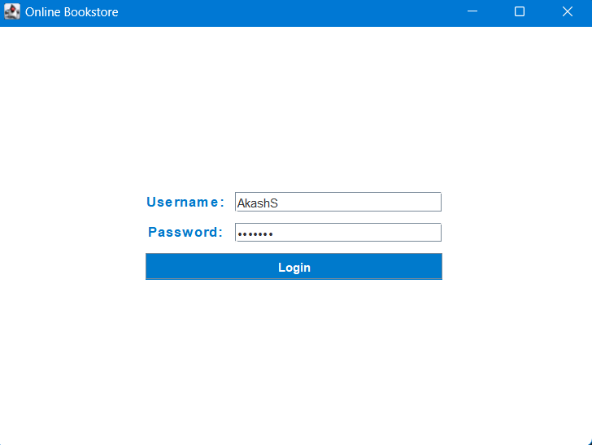
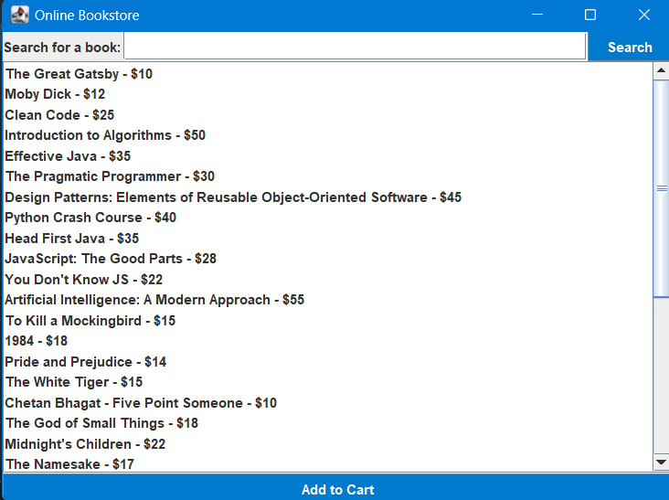
Results
1 LOGIN PAGE 2 SEARCH PAGE

Slide 10
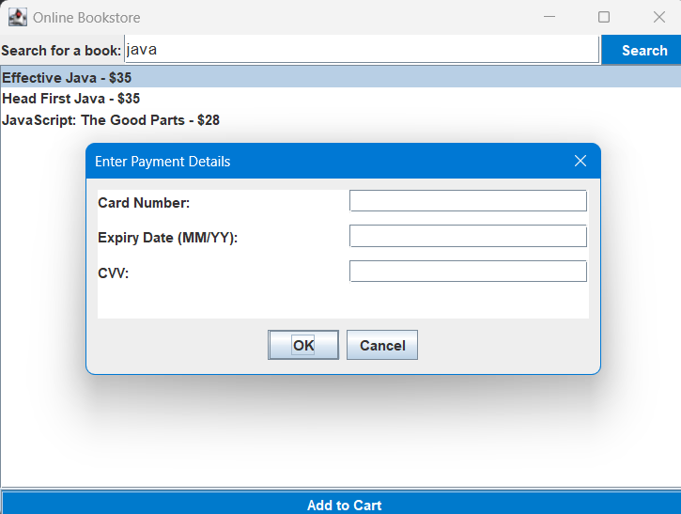
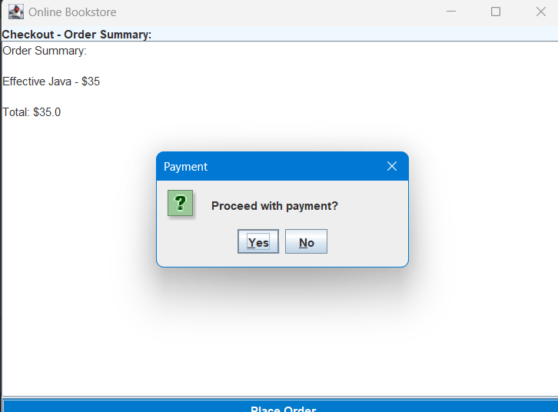
Results (con)
3 PAYMENT PROCESS 4 SUMMARY CHECK

Slide 11
Results (cont..)
5 FINISH & LOGOUT

Slide 12
Conclusion
Comprehensive System: A Java-based platform for seamless online book purchasing with key modules like User, Book, Cart, Order, and Admin Management.
User & Admin Features: Allows users to register, browse, and place orders; admins manage inventory and orders.
Key Benefits: A scalable, user-friendly system that automates book purchasing and serves as a learning model for efficient software development.

Slide 13
Thank You
ANY QUERIES???

