Slide 1
E-commerce Customer Segmentation & Prediction

Slide 2
Why did I choose this Topic?
E-commerce is one of the fastest growing industries globally — understanding customer behaviour is critical for business survival.
RFM Analysis is a proven, industry-used technique that I wanted to implement end-to-end from raw data to deployment.
Customer segmentation directly impacts revenue — retaining an existing customer is 5x cheaper than acquiring a new one
I wanted to combine unsupervised and supervised ML in one project — clustering to discover segments, then classification to predict them in real time

Slide 3
Agenda
1. Project Overview & Objectives
2. Dataset Overview
3. Data Cleaning
4. Exploratory Data Analysis
5. RFM Feature Engineering
6. Customer Segmentation
7. Predictive Classification
8. Streamlit App & Deployment
9. Conclusion & Recommendations

Slide 4
Project Overview & Objectives
About the Project
UK-based e-commerce company with 541,909 transactions across 38 countries
Goal: Segment customers using RFM Analysis and predict segments for new customers
Objectives
Develop a customer segmentation model using unsupervised ML (KMeans)
Build a predictive classifier (Logistic Regression, RF, XGBoost)
Conduct thorough EDA to understand purchasing patterns
Provide actionable business recommendations per segment
Deploy interactive Streamlit app for real-time prediction
Tech Stack
Python | Scikit-learn | XGBoost | Streamlit | Pandas | NumPy

Slide 5
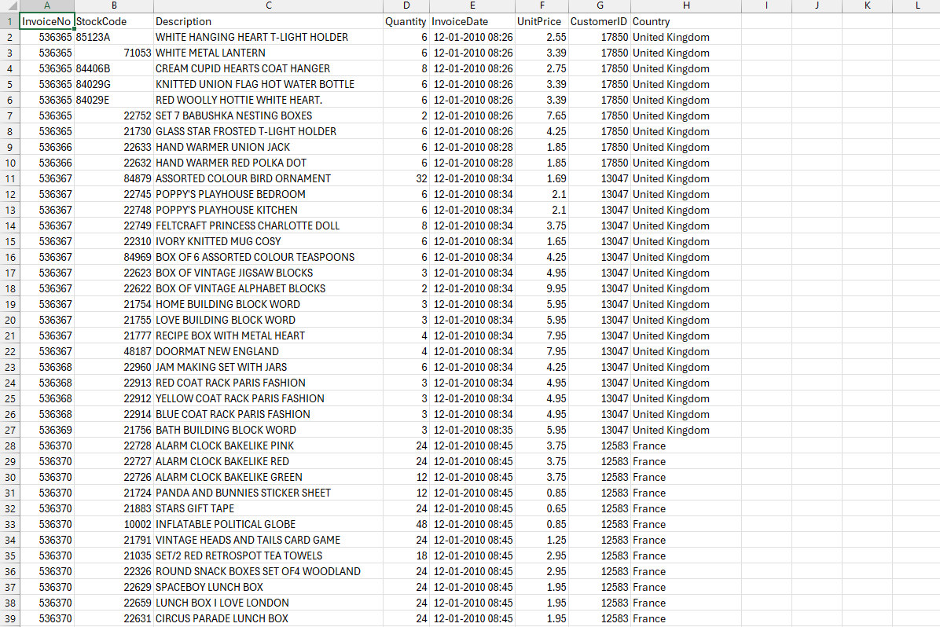
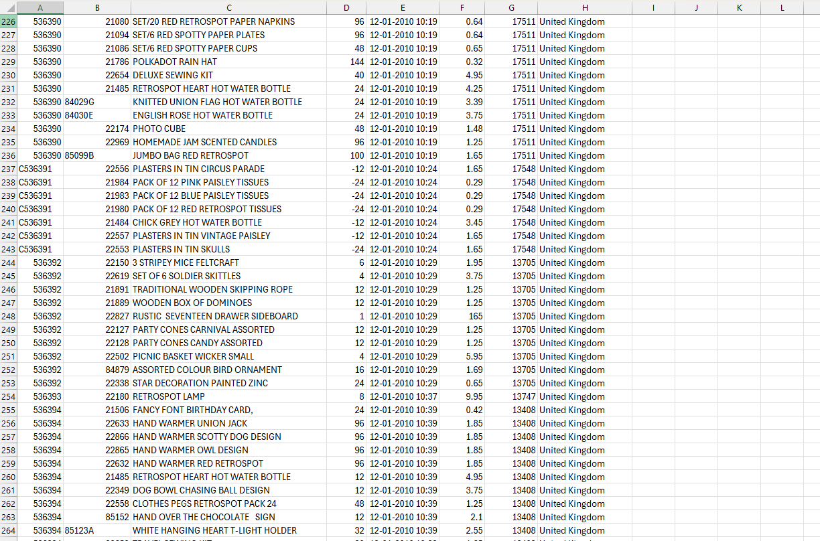
Dataset & Data Cleaning
Understanding the raw data and preparing it for analysis

Slide 6
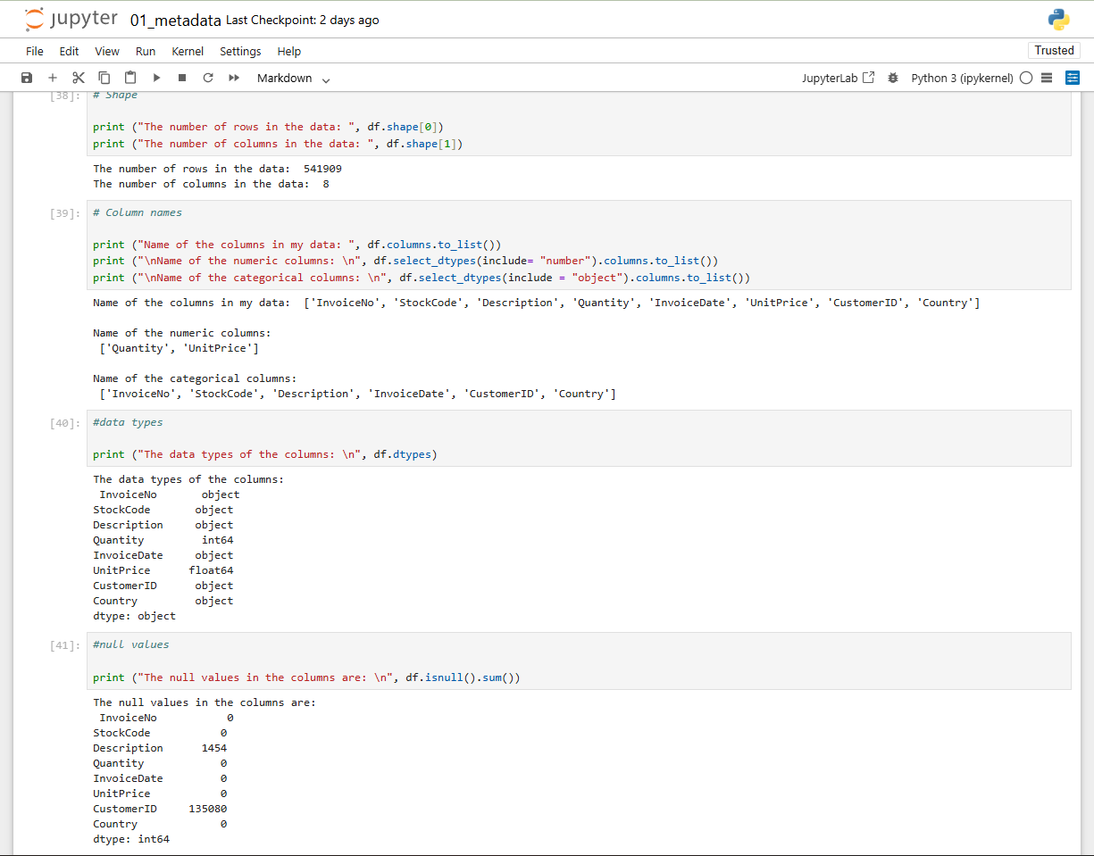
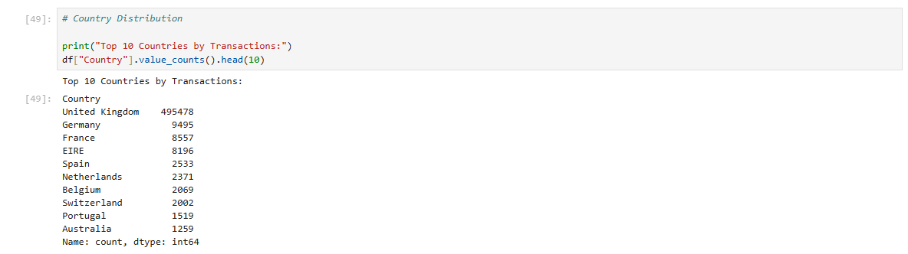
Dataset Overview
Attribute | Value
Total Rows | 541, 909
Total Column | 8
Date Range | December 2010 – December 2011
Countries | 38
File Format | CSV

Slide 7
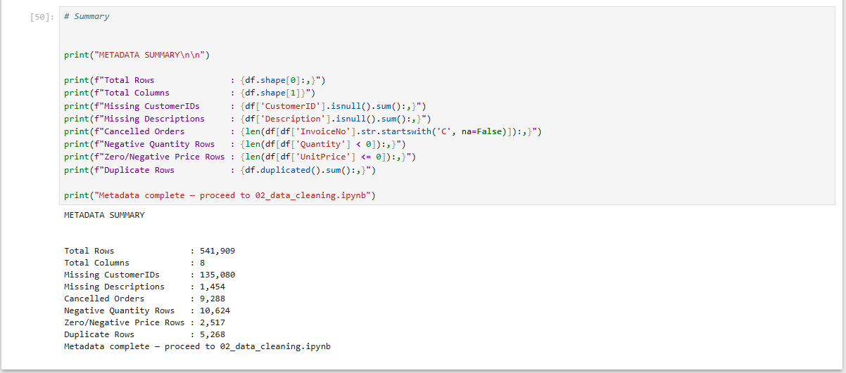
Dataset Overview
Issues | Count | Percentage | Action Taken
Missing CustomerIDs | 135,080 | 24.9% | Retained for EDA, removed for RFM
Missing Descriptions | 1,454 | 0.27% | Resolved after cleaning
Cancelled Orders | 9,288 | 1.71% | Removed in cleaning
Negative Quantities | 10,624 | 1.96% | Removed in cleaning
Zero/Negative Prices | 2,517 | 0.46% | Removed in cleaning
Duplicate Rows | 5,268 | 0.97% | Removed in cleaning

Slide 8
Data Cleaning
What Was Removed
Cancelled Orders (InvoiceNo starting with 'C'): Distort Frequency and Monetary values
Negative Quantities: Returns that reduce Monetary artificially
Zero/Negative Prices: Free samples or data entry errors
Duplicate rows: Prevent double-counting transactions
What Was Retained
Missing CustomerIDs: Kept for EDA, removed only at RFM aggregation stage.

Slide 9
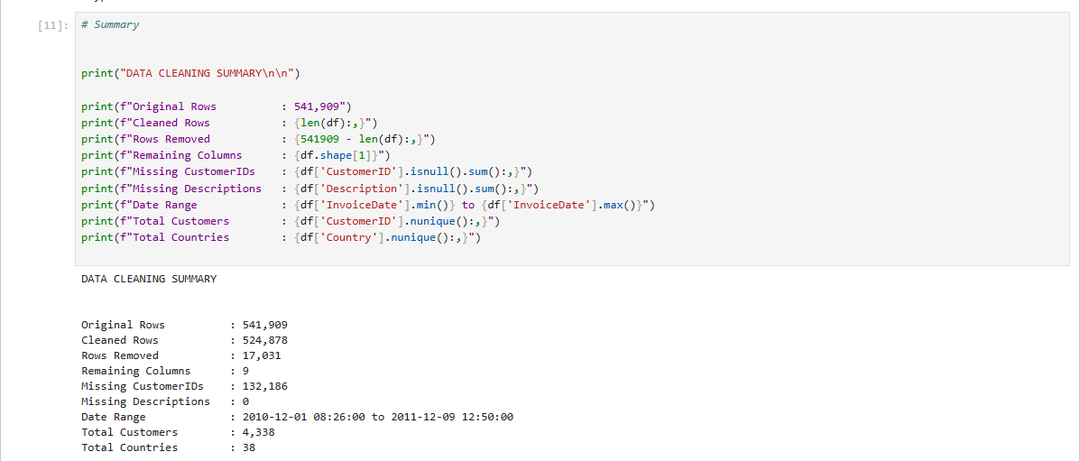
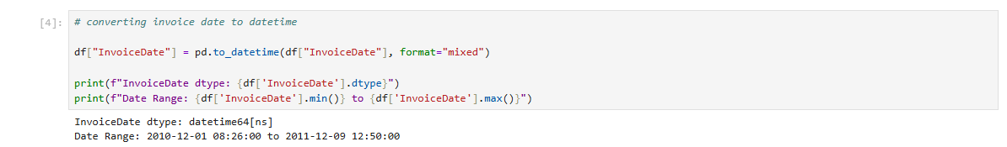
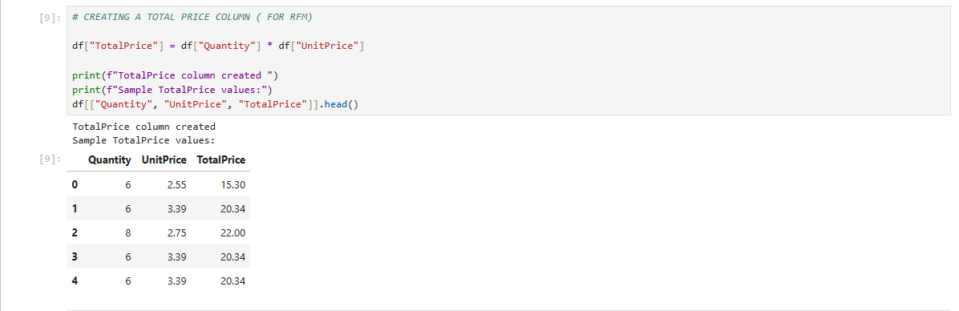
Cleaning Result
Metric | Value
Original Rows | 541,909
Rows Removed | 17,031
Cleaned Rows | 524,878
Remaining Columns | 9 (TotalPrice added)
Missing CustomerIDs Remaining | 132,186
Missing Descriptions Remaining | 0
Date Range | December 2010 – December 2011
Unique Customers | 4,338
Unique Countries | 38

Slide 10
Exploratory Data Analysis
Uncovering patterns and insights from transaction data.
It is done in two phases:
Pre-cleaning analysis: using raw data to understand data quality issues.
Post-cleaning analysis: using the cleaned dataset to derive business insights.

Slide 11
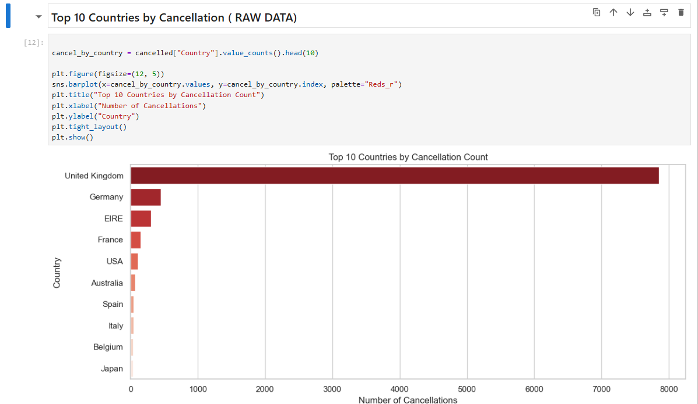
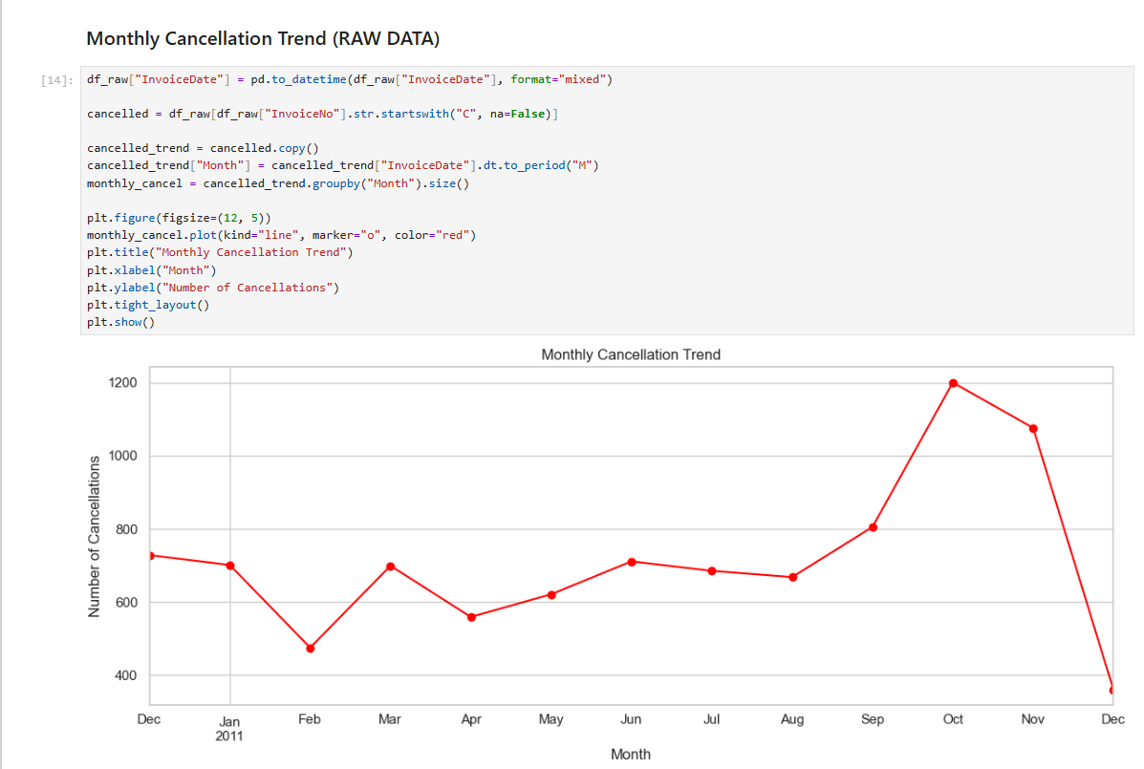
EDA Performed ( Raw Data)
Fig 1: Top 10 Countries by Cancellation.
United Kingdom is the Top Country as per Cancellation.
Fig 2: Monthly Cancellation Trend.
Highest monthly cancellation was in the month of October.

Slide 12
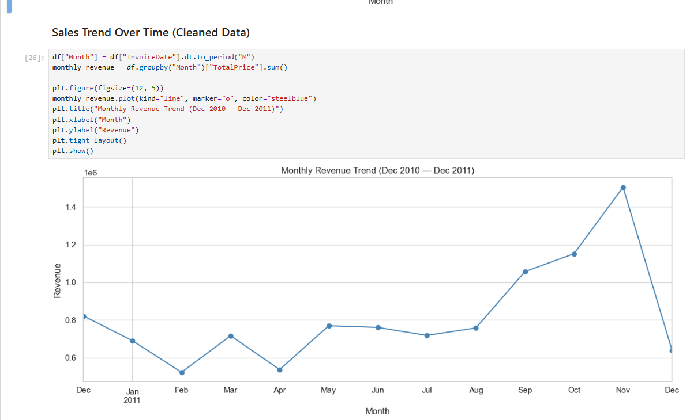
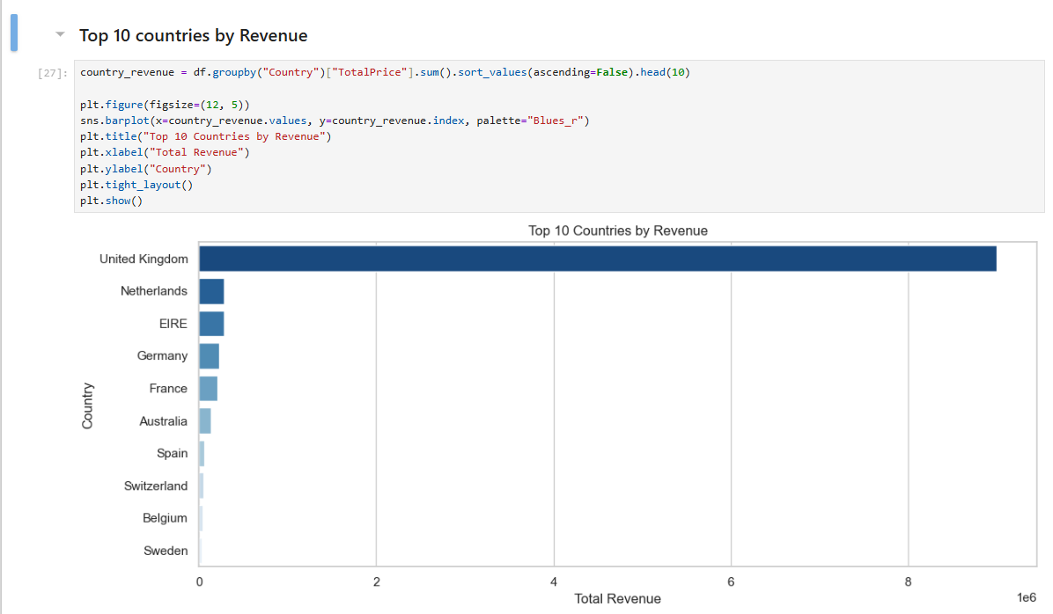
EDA Performed ( Clean Data)
Fig 1: Sales Trend Over Time.
The highest sales was made in the month of November.
Fig 2: Top 10 countries by Revenue.
United Kingdom is the highest revenue generator.

Slide 13
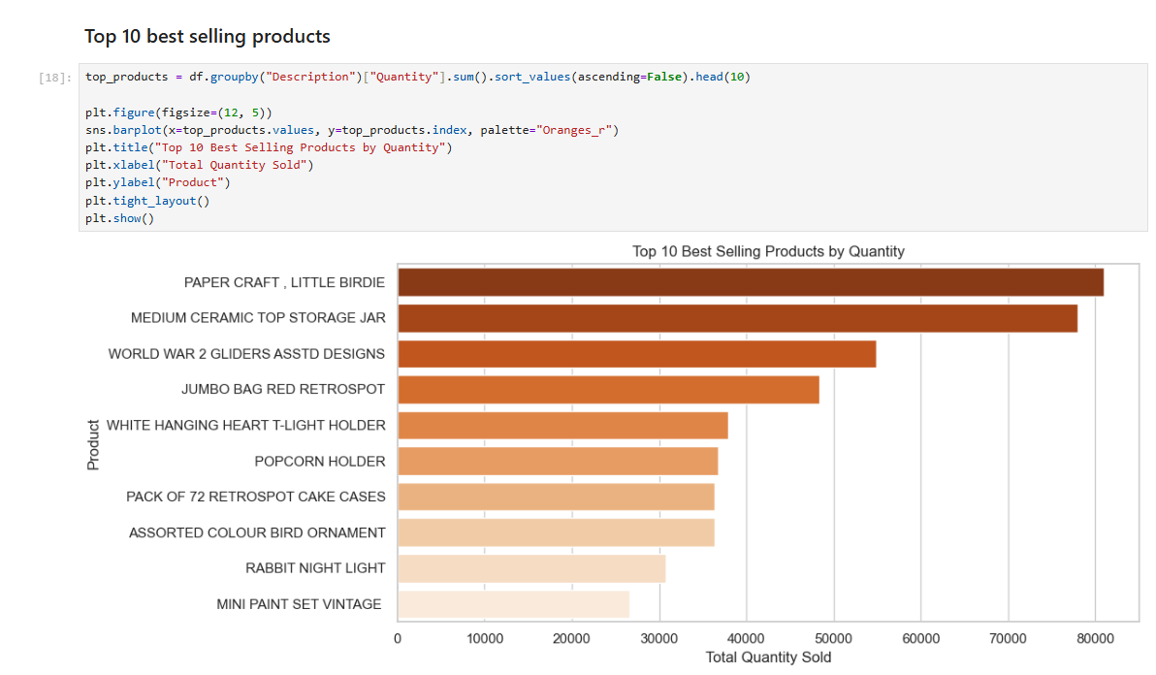
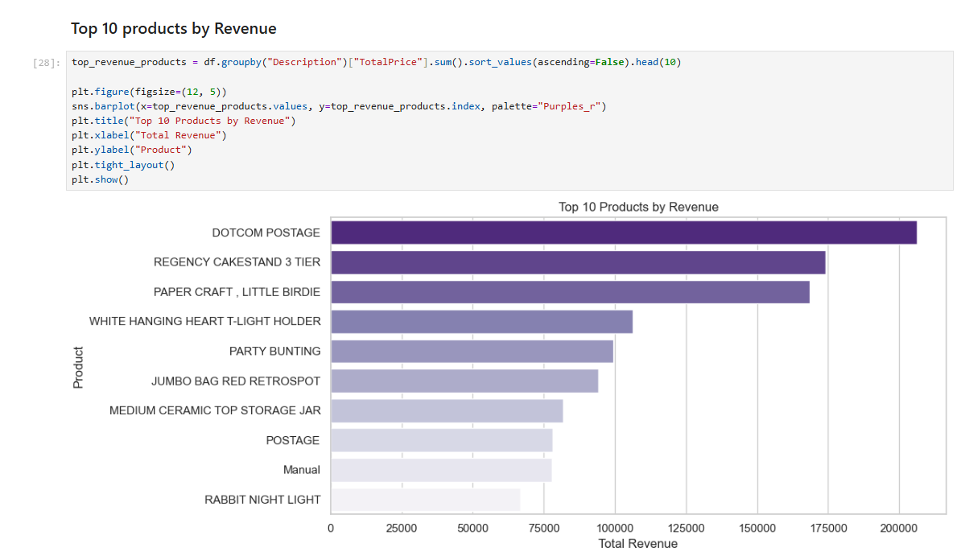
EDA Performed ( Clean Data)
Fig 1: Top 10 best selling products.
The top selling product is paper craft, little birdie.
Fig 2: Top 10 products by Revenue.
Dotcom Postage generated the maximum revenue.

Slide 14
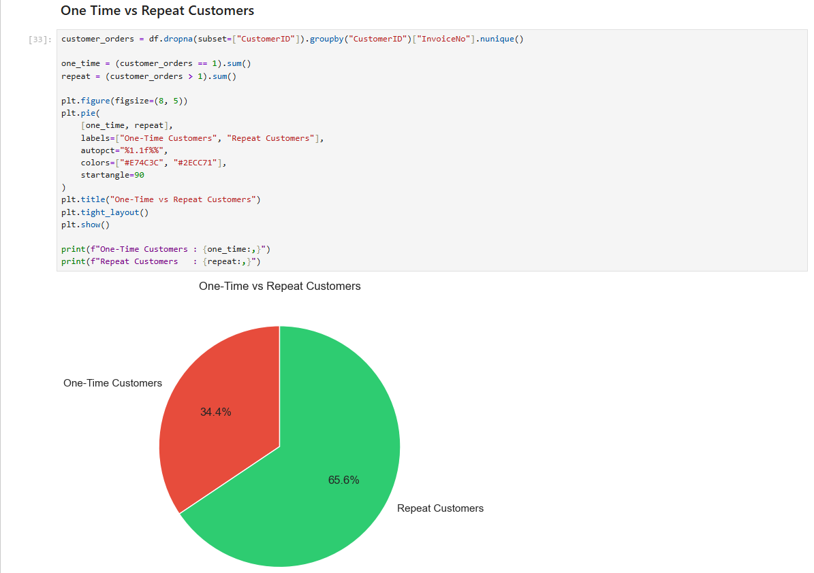
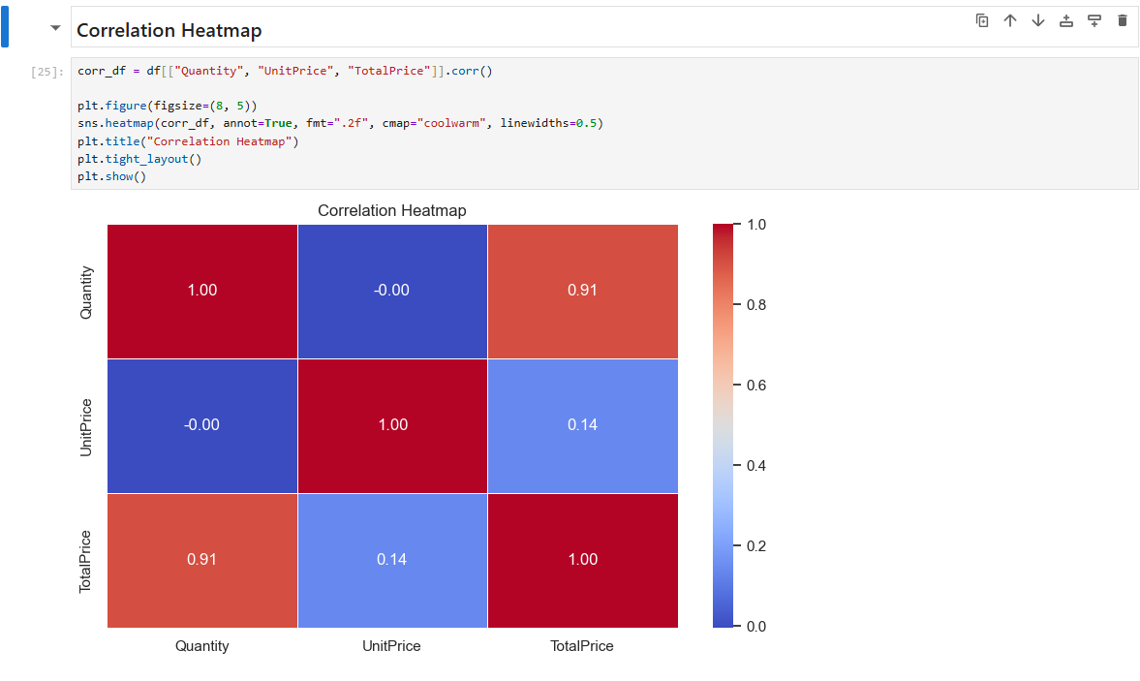
EDA Performed ( Clean Data)
Fig 1: One Time vs Repeat Customers.
Repeat Customers were about 65.6% (2,845).
Fig 2: Correlation Heatmap
Quantity vs TotalPrice → 0.91 (Very Strong Positive Correlation).
UnitPrice vs TotalPrice → 0.14 (Weak Positive Correlation)

Slide 15
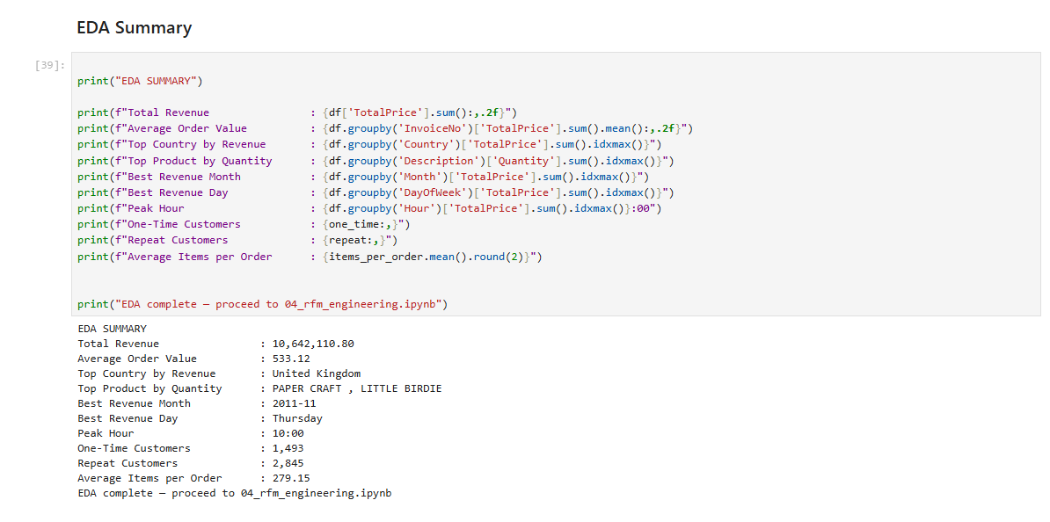
EDA — Key Insights
Summary Statistics
Total Revenue: 10,642,110 | Average Order Value: 533 | Avg Items per Order: 279
Business Insights
United Kingdom dominates revenue — primarily domestic business
November 2011 highest revenue — strong holiday season impact
Peak purchasing: 10 AM on Thursdays — ideal for email campaigns
65.6% repeat customers (2,845) | 34.4% one-time customers (1,493)
High AOV of 533 suggests wholesale/B2B purchasing behaviour

Slide 16
RFM Feature Engineering
Quantifying customer behaviour through Recency, Frequency and Monetary analysis
Feature | Definition | Calculation
Recency | How recently did the customer purchase? | Days between last purchase and snapshot date
Frequency | How often does the customer purchase? | Count of unique invoice numbers per customer
Monetary | How much does the customer spend? | Sum of TotalPrice per customer

Slide 17
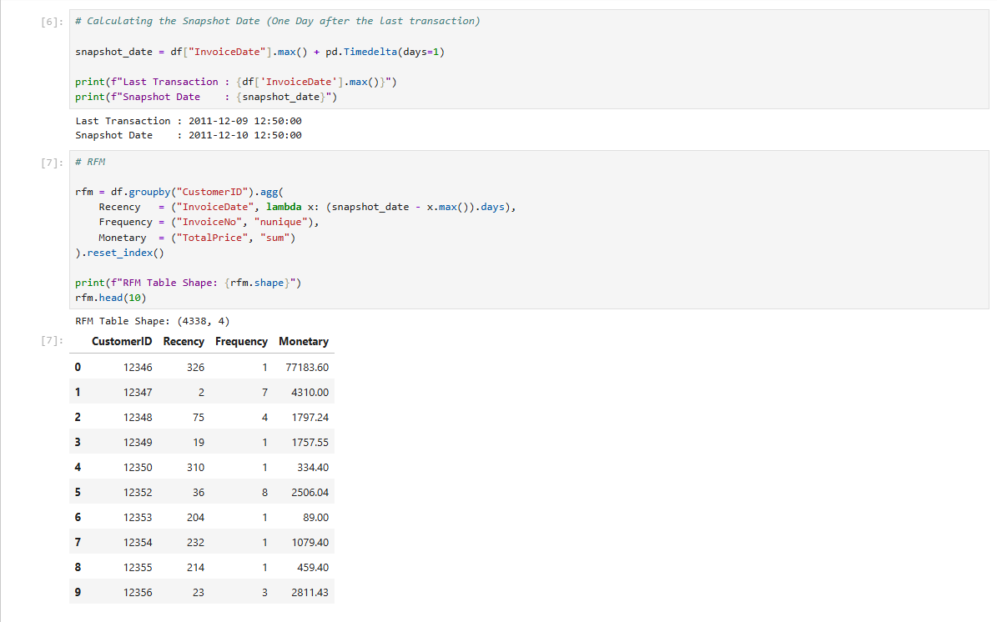
RFM Feature Engineering
What is RFM?
Recency: Days since last purchase (lower = better)
Frequency: Number of unique invoices per customer (higher = better)
Monetary: Total spend per customer in GBP (higher = better)

Slide 18
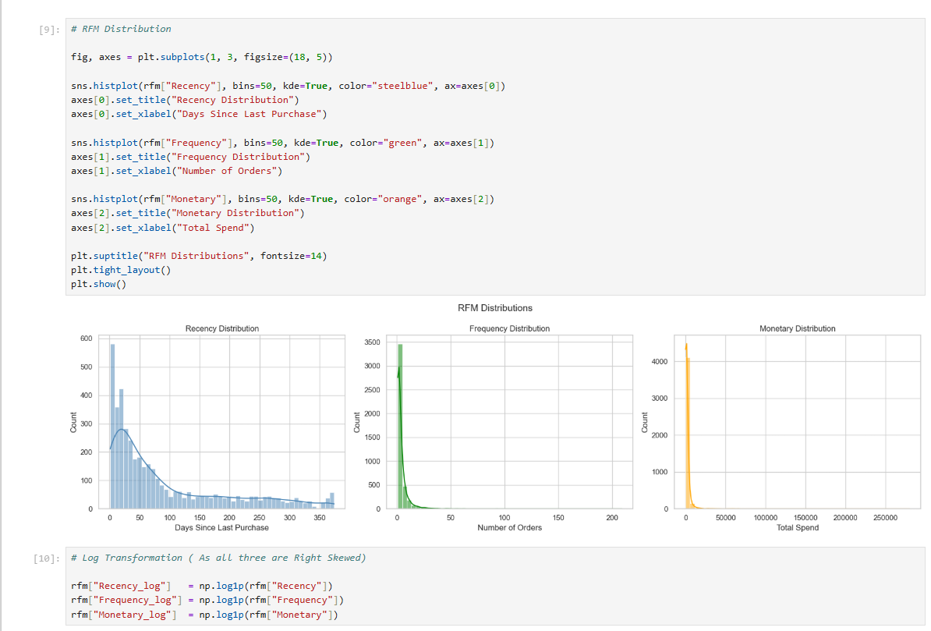
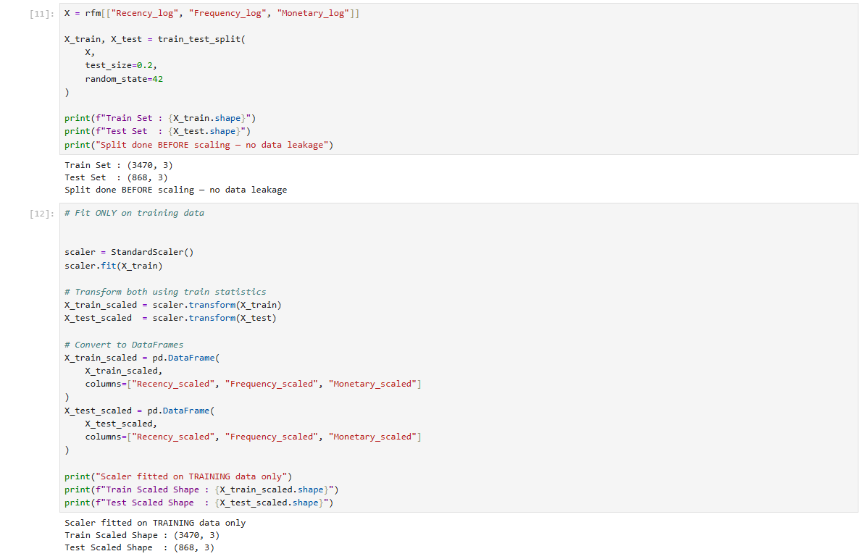
RFM Feature Engineering
Preprocessing Steps
Log1p Transformation: Reduces right skew in all 3 RFM features
Train-Test Split BEFORE scaling: Prevents data leakage
StandardScaler fitted on training data only (3,470 customers)

Slide 19
Customer Segmentation (Unsupervised ML)
Finding the Optimal K:
Elbow Method
Silhouette Score
Grouping customers using unsupervised machine learning algorithms.
K-Means
Hierarchical Clustering
DBSCAN.

Slide 20
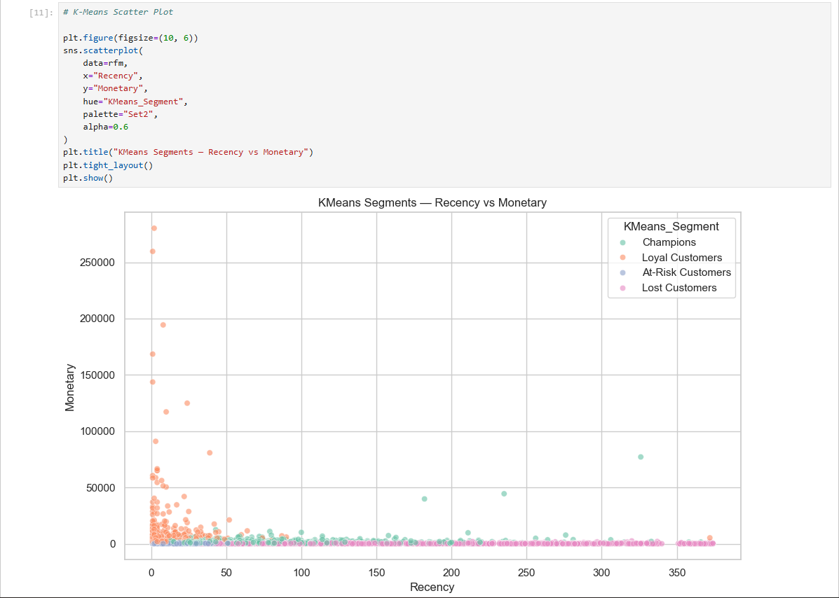
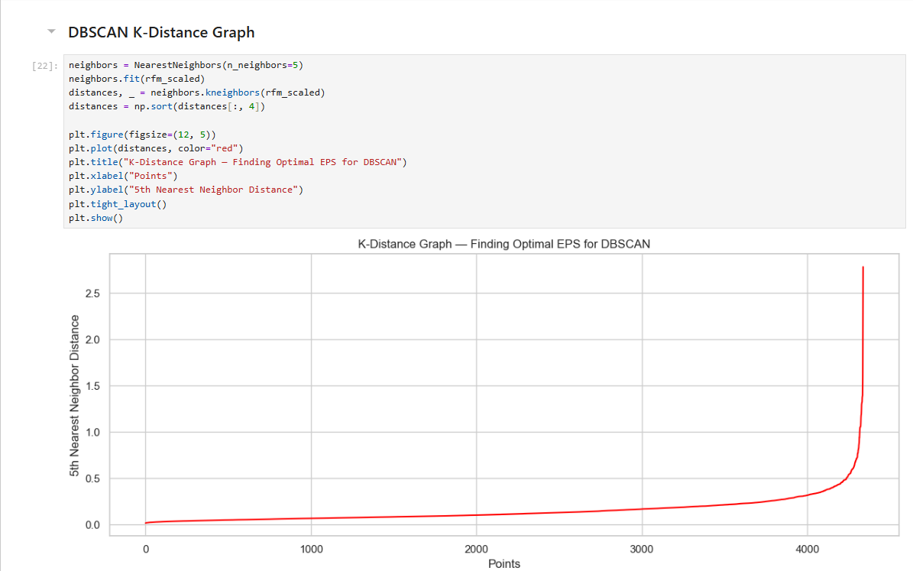
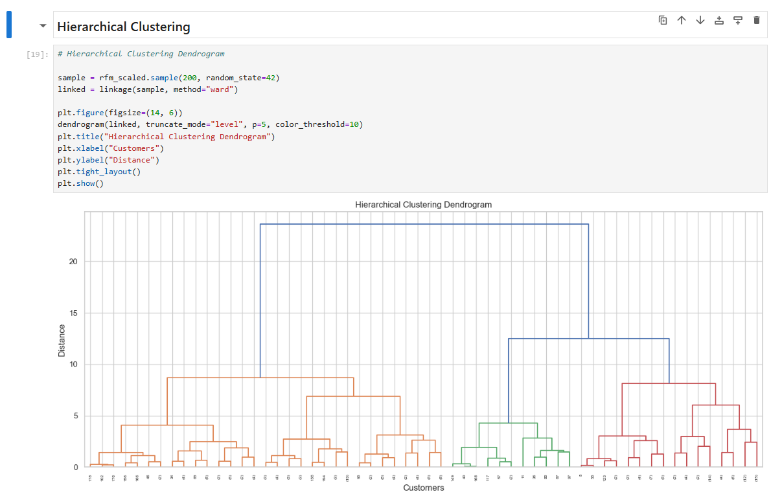
Customer Segmentation
Algorithm Comparison
KMeans (K=4): Silhouette 0.3373 — Best, clear balanced segments
Hierarchical Clustering: Silhouette 0.3019 — Good but less interpretable
DBSCAN: Silhouette 0.2930 — Poor, 62 noise points, unsuitable

Slide 21
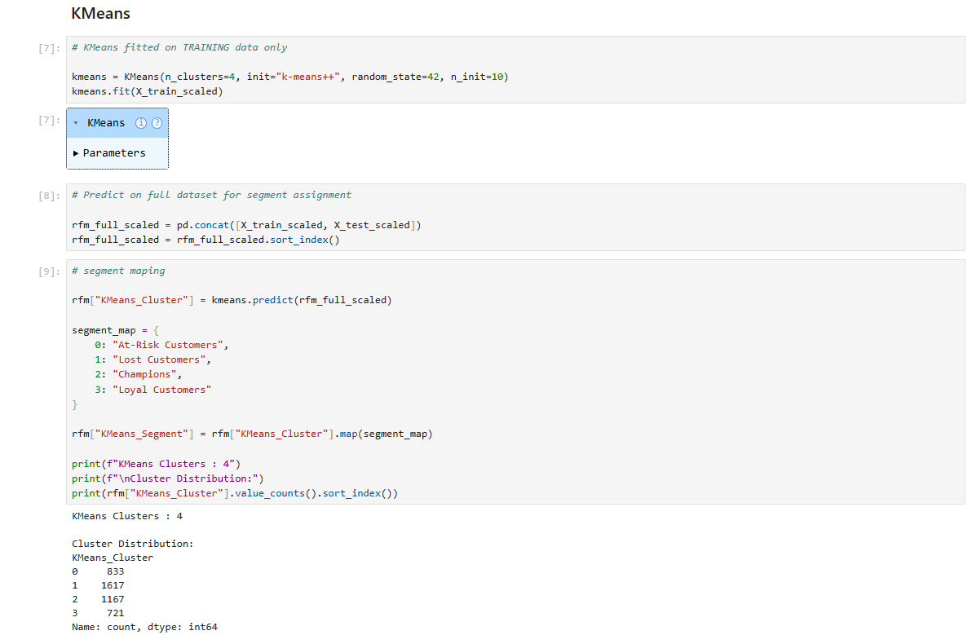
Customer Segmentation
Segment Profiles (K=4)
Champions (1,167): Low recency, high frequency, high spend
Loyal Customers (721): Consistent buyers, moderate engagement
At-Risk Customers (833): Previously active, declining engagement
Lost Customers (1,617): Inactive, high recency, very low spend

Slide 22
Predictive Classification (Supervised ML)
Training supervised models to predict customer segments in real time.
Why use Supervised ML:
KMeans assigns segments to existing customers in the dataset
New customers with no prior history cannot be clustered without re-running KMeans
A trained classifier can instantly predict the segment of any new customer from just 3 input values
This makes the model production-ready and deployable in real-time applications

Slide 23
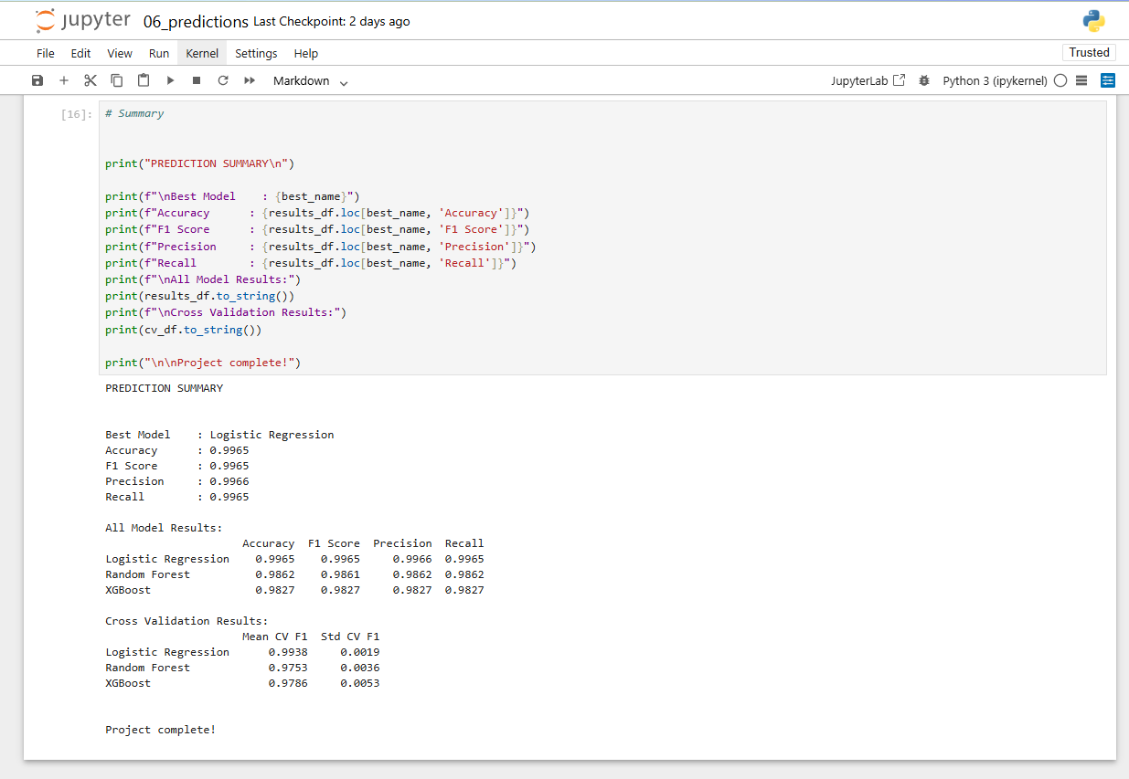
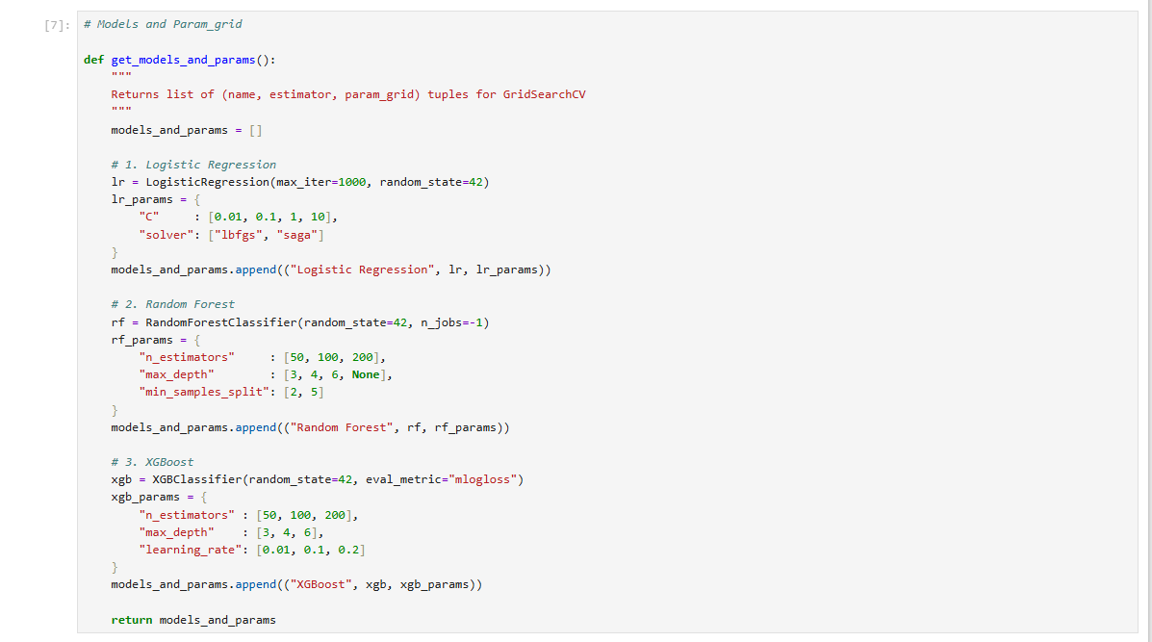
Predictive Classification — Results
Model Performance (Test Set)
Logistic Regression: Accuracy 0.9965 | F1 0.9965 | CV F1 0.9931 ✔
Random Forest: Accuracy 0.9862 | F1 0.9861 | CV F1 0.9741
XGBoost: Accuracy 0.9827 | F1 0.9827 | CV F1 0.9775

Slide 24
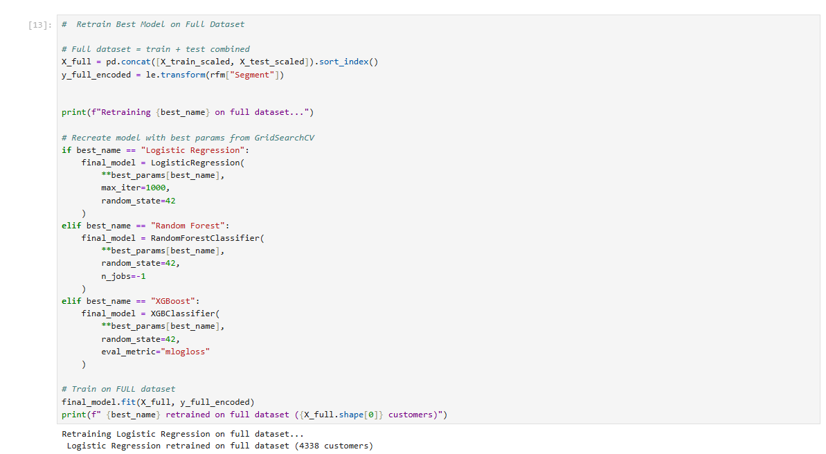
Predictive Classification — Results
Best Model: Logistic Regression — Retrained on all 4,338 customers

Slide 25
Actionable strategies per customer segment
Quantifying customer behaviour through Recency, Frequency and Monetary analysis

Slide 26
Business Recommendations
Champions (1,167 — 26.9%)
Loyalty programs, VIP memberships, early product access, referral incentives
Loyal Customers (721 — 16.6%)
Upsell higher value products, personalized recommendations, membership upgrades
At-Risk Customers (833 — 19.2%)
Win-back campaigns, limited-time discounts, personalised re-engagement emails
Lost Customers (1,617 — 37.3%)
Aggressive re-engagement, significant discounts, churn surveys, reduce spend

Slide 27
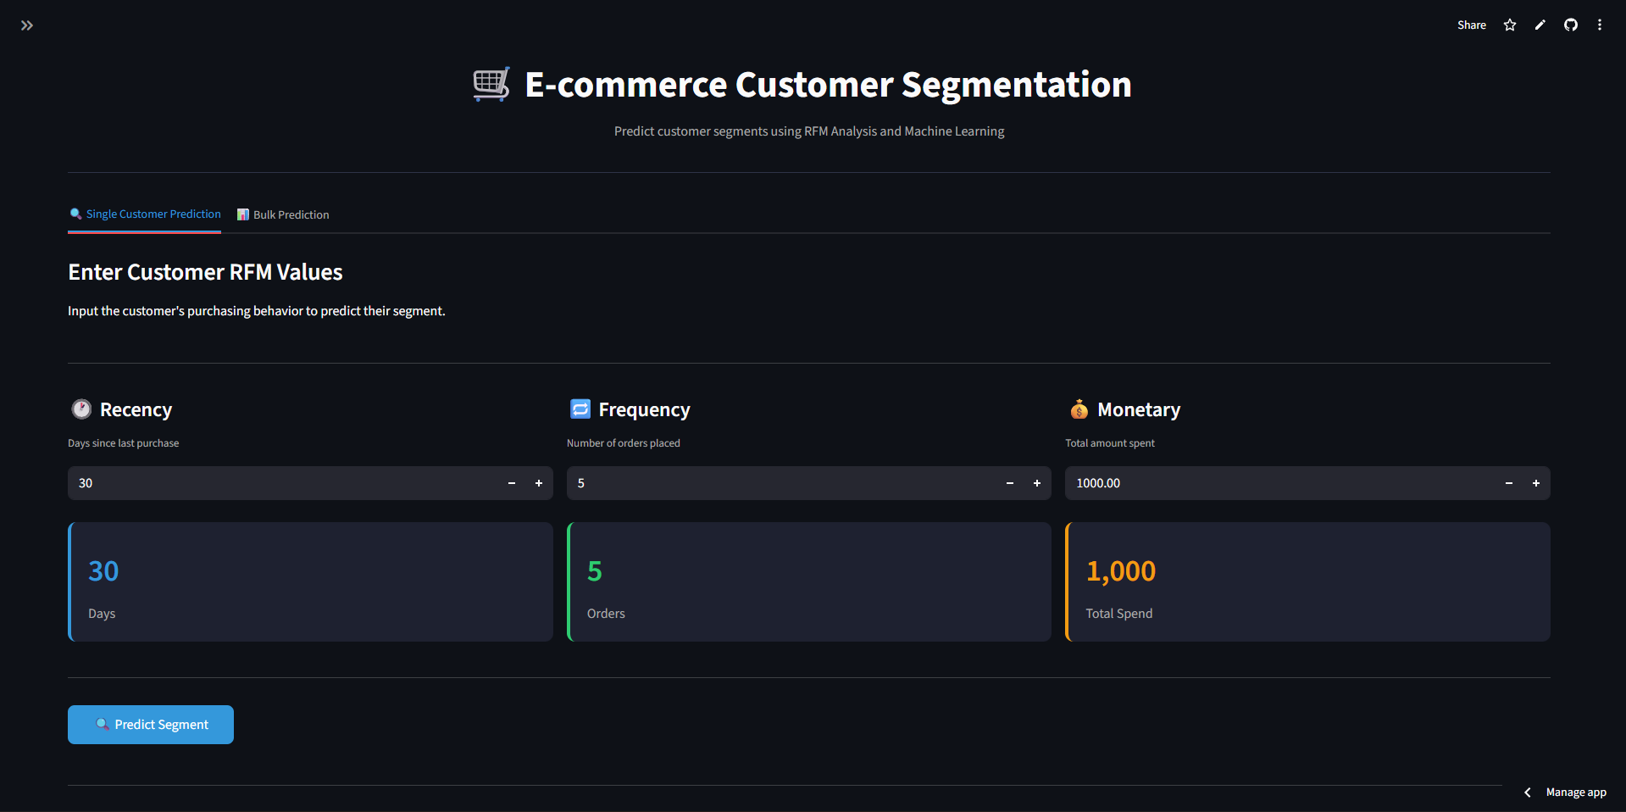
Deployment & GitHub
Streamlit app for real-time prediction and GitHub repository

Slide 28
Streamlit App & Deployment
App Features
Single Customer Prediction: Enter R, F, M values → segment + confidence score
Bulk CSV Upload: Predict segments for multiple customers at once
Business recommendations displayed per predicted segment
Pipeline Architecture (src/ folder)
preprocessor.py | training.py | deployment.py | app.py
Deployed on Streamlit Cloud
GitHub: github.com/Sugnik27/rfm-customer-segmentation-ml

Slide 29
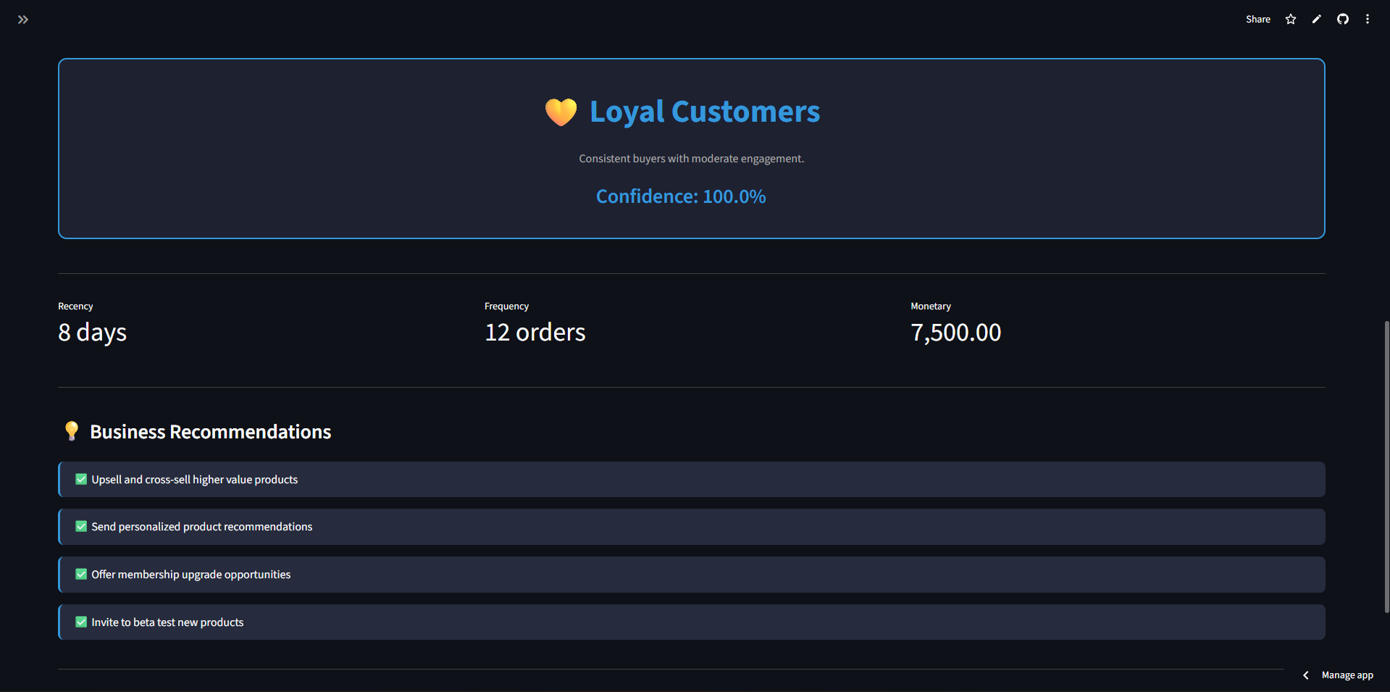
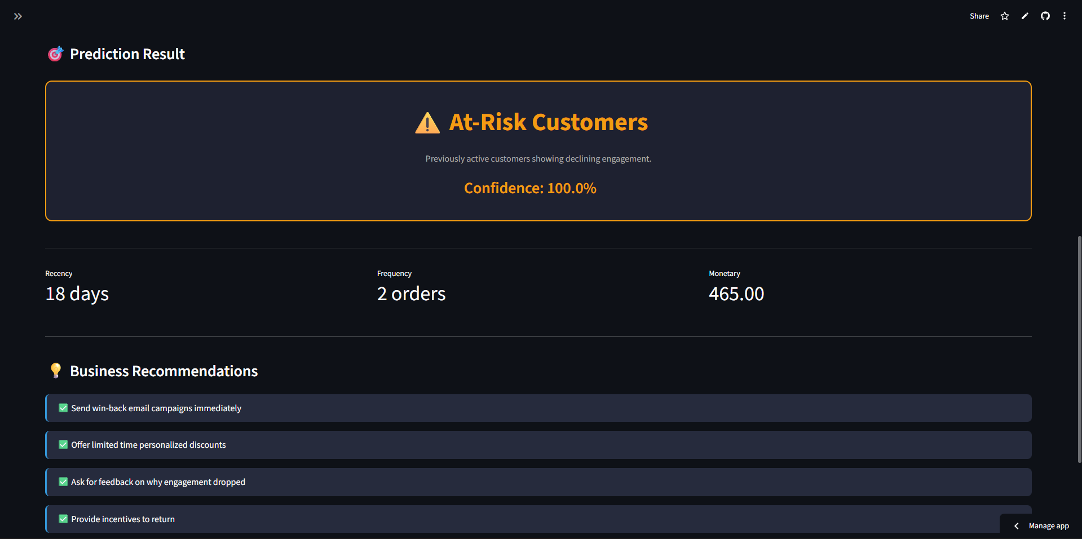
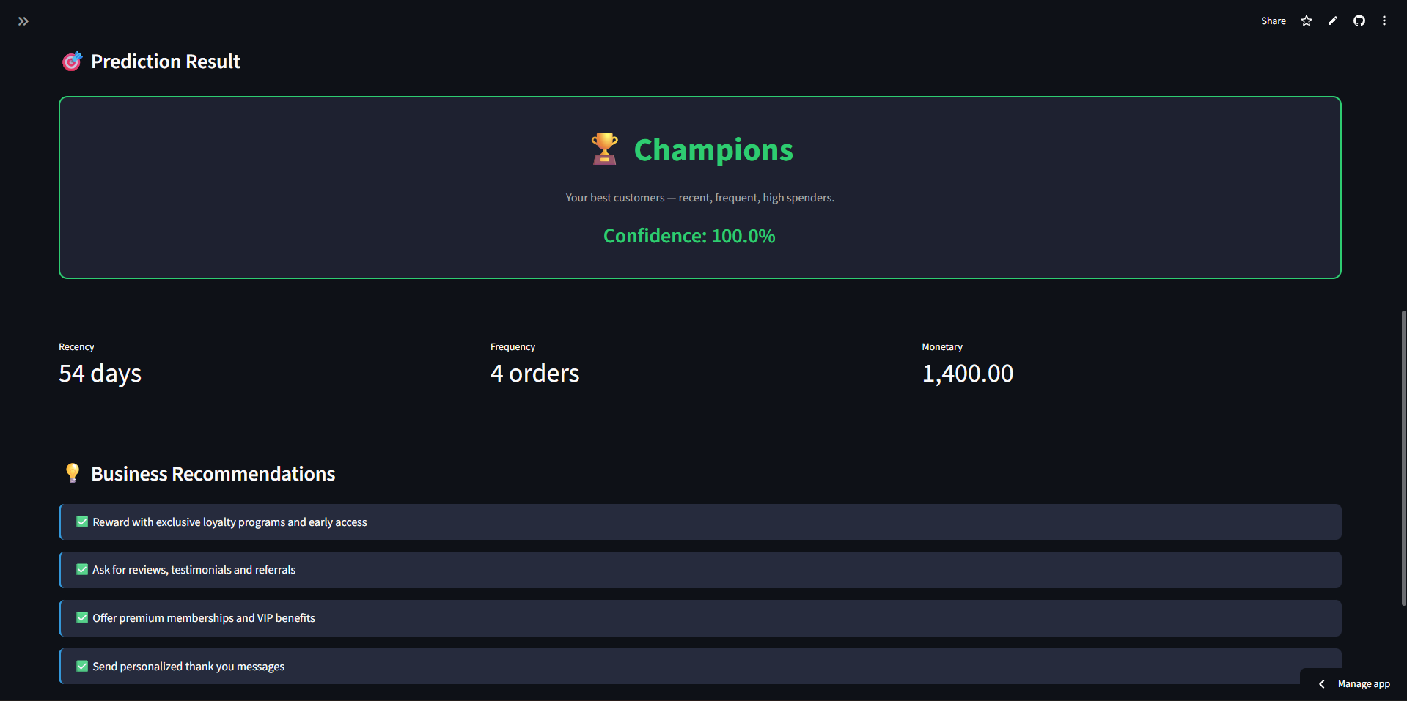
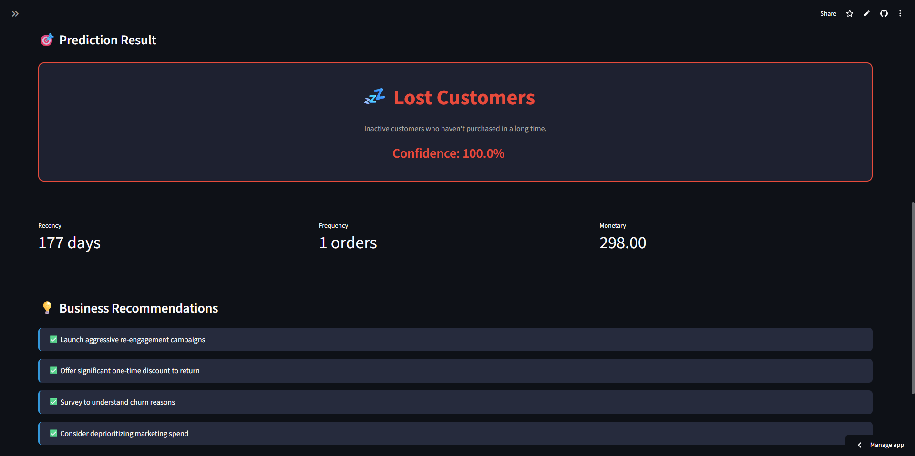
Streamlit App in Action

Slide 30
Key takeaways and future improvements
Identifying four distinct customer groups using KMeans clustering

Slide 31
Conclusion
What We Achieved
Segmented 4,338 customers into 4 actionable groups using KMeans (Silhouette: 0.3373)
Logistic Regression: 99.65% F1 with no overfitting (CV F1: 99.31%)
Zero data leakage — split before scaling, scaler fitted on train data only
Deployed interactive Streamlit app with real-time prediction + GitHub repository
Future Improvements
Real-time pipeline connecting directly to live transaction databases
Customer Lifetime Value (CLV) prediction as an additional model output
A/B testing to measure impact of segment-based marketing campaigns

Slide 32
Questions ?

Slide 33
Thank You!

