Slide 1
R
S₁
S₂
S₃
选择一个随机数k_{r}∈Z_{q}
选择一个随机数α∈Z_{q}
验证
验证
验证

Slide 2
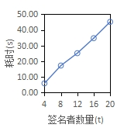
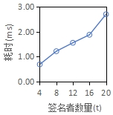
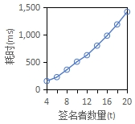
参与者A
参与者B
setup/keygen/sigining
setup/keygen/sigining
LocalParty
③
LocalParty
params
outCh
消息路由
outCh
④
params
data
msg
⑧
data
temp
endCh
endCh
temp
Update(msg)
msg
②
⑤
Start()
Rounds
Rounds
①
⑥
round1(runing)
Next()
round1(runing)
round2
round2
⑦
round3
...
save
...
round x
(a)签名者初始化算法

Slide 3
通信层
业务层
signing
setup
keygen
signing
LocalParty
Rounds
params
round1
业务
data
outCh
round2
LocalParty
LocalParty
LocalParty
temp
endCh
round...
算法层
Rounds
Rounds
Rounds
setup/keygen/sigining
LocalParty
Rounds
params
round1
data
outCh
round2
temp
endCh
round...
参与者A
参与者B
setup/keygen/sigining
setup/keygen/sigining
LocalParty
③
LocalParty
params
outCh
消息路由
outCh
④
params
data
msg
⑧
data
temp
endCh
endCh
temp
Update(msg)
msg
②
⑤
Start()
Rounds
Rounds
①
⑥
round1(runing)
Next()
round1(runing)
round2
round2
⑦
round3
...
save
...
round x

Slide 4
S_{c}
S₁
S₂
S₃

Slide 5
S_{c}
S₁
S₂
S₃

Slide 6
S_{c}
S₁
S₂
S₃
进行MSP算法

Slide 7
R
S₁
S₂
S₃
以x为秘密构造Shamir秘密共享分片
储存u₁
储存u₂
储存u₂
保存索引
R
S₁
S₂
S₃
X

Slide 8
R
S₁
S₂
S₃
取K的横坐标为r
验证

Slide 9
R
S₁
S₂
S₃
验证

Slide 10
开始
初始化LocalParty
启动LocalParty
go LocalParty.Start()
outCh是否有msg
否
是
解析消息msg，向对应的LocalParty传达消息
LocalParty.Update(msg)
endCh是否有结果消息
否
是
验证结果正确性，输出测试结果
结束

