Slide 1
GROCERY DELIVERY WESITE
BY TECHNO FOLKS

Slide 2
PROBLEM STATEMENT
Traditional grocery shopping requires customers to physically visit stores, navigate crowded aisles, and wait in long checkout lines. This process can be time-consuming and inconvenient, especially for busy individuals who have limited time to dedicate to grocery shopping. Additionally, customers may face challenges in finding specific products, accessing detailed product information, and making informed purchasing decisions.

Slide 3
SOLUTION
This website aims to simplify the grocery shopping experience by allowing customers to browse and select items from a variety of local stores or from the same store, add them to their cart, and choose a pickup time and location that works best for them or the items will be delivered to their house.

Slide 4
Product Overview
1.Login/SignUp
2.Search Stores
3.Add Groceries to cart
4.Payment/Delivery
User Register if they are a new user else login with the credentials
User can chose their desired store in the given location
User can choose the required item and quantity and add to cart
The total amount will be displayed and user can choose payment and delivery method

Slide 5
TechStack
HTML
CSS
JAVASCRIPT
BOOTSTRAP
PHP
REACTJS
.
.
.
.
.
.

Slide 6
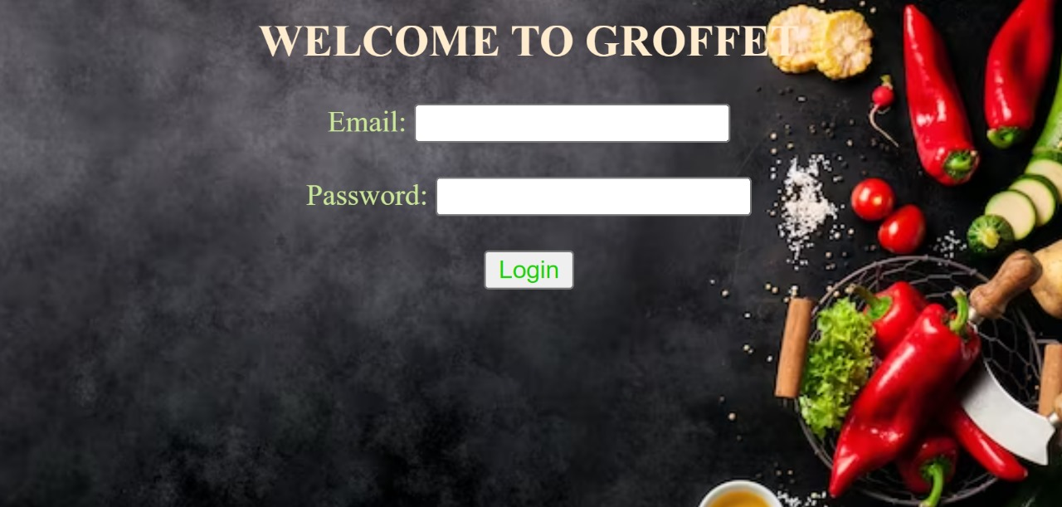
SAMPLE 0UTPUT

Slide 7
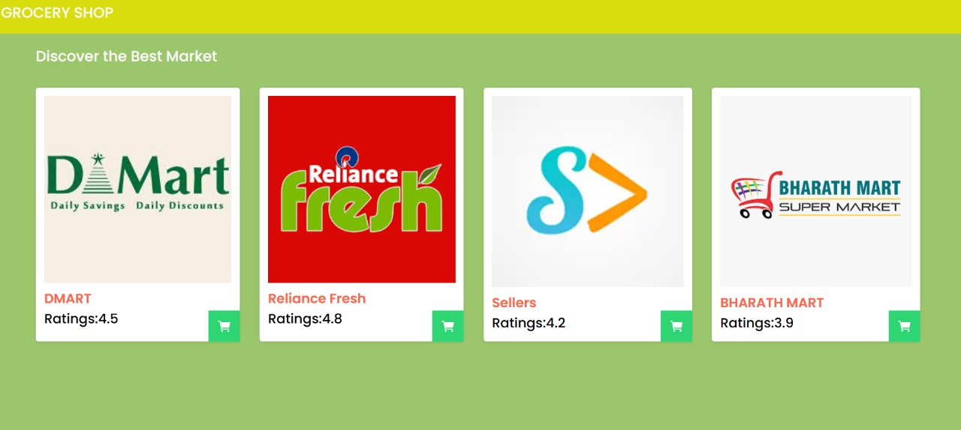
SAMPLE 0UTPUT

Slide 8
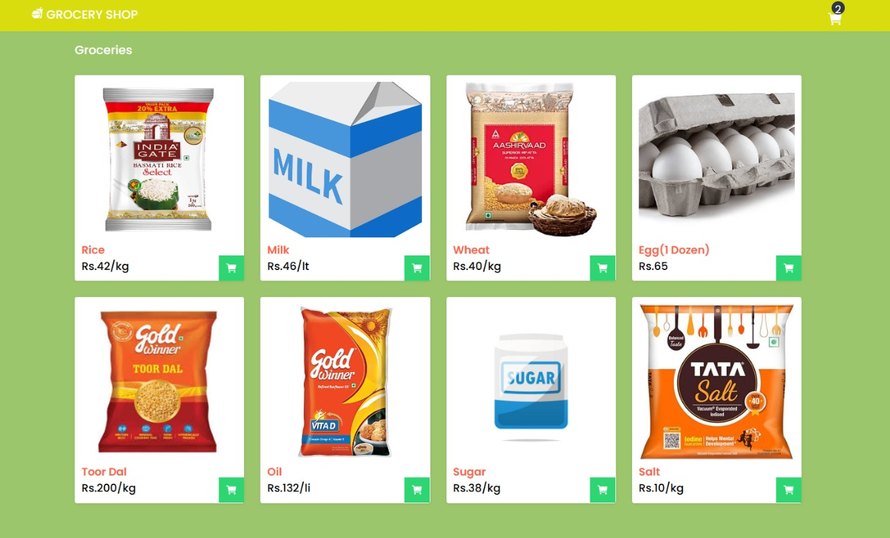
SAMPLE 0UTPUT

Slide 9
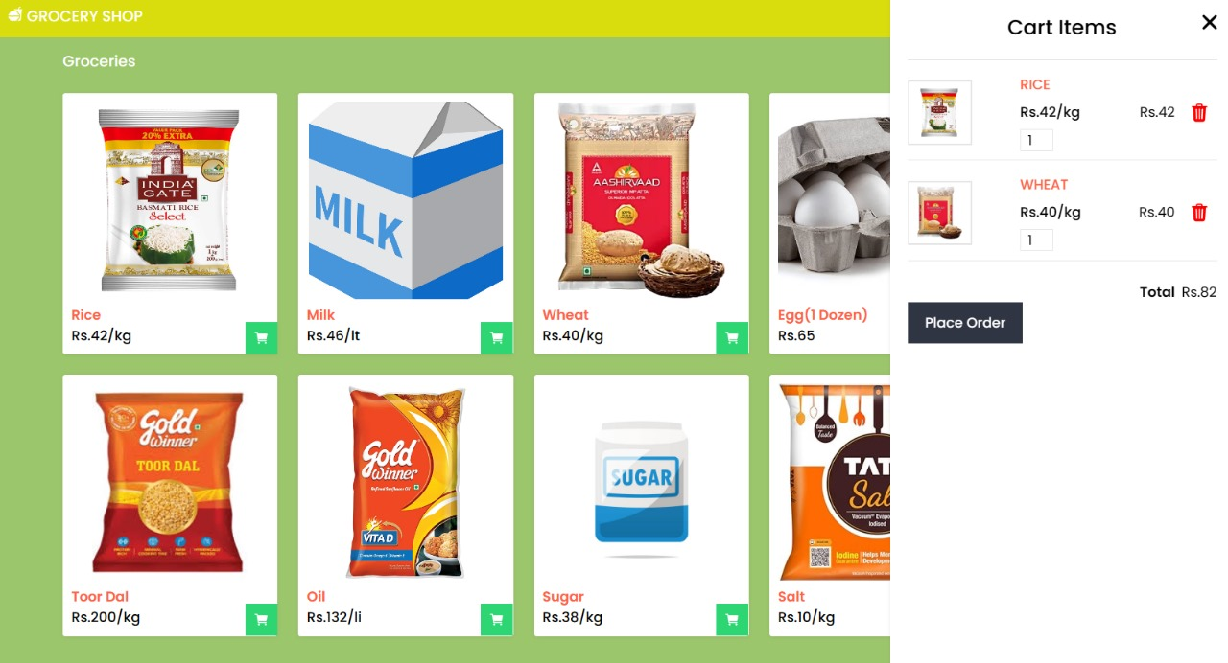
SAMPLE 0UTPUT

Slide 10
Our Team
1.Sugumar G
2.BhuvanRaj S
3.Kunali M
4.Sowmya R
.
.
.
.

Slide 11
THANK YOU

