Slide 1
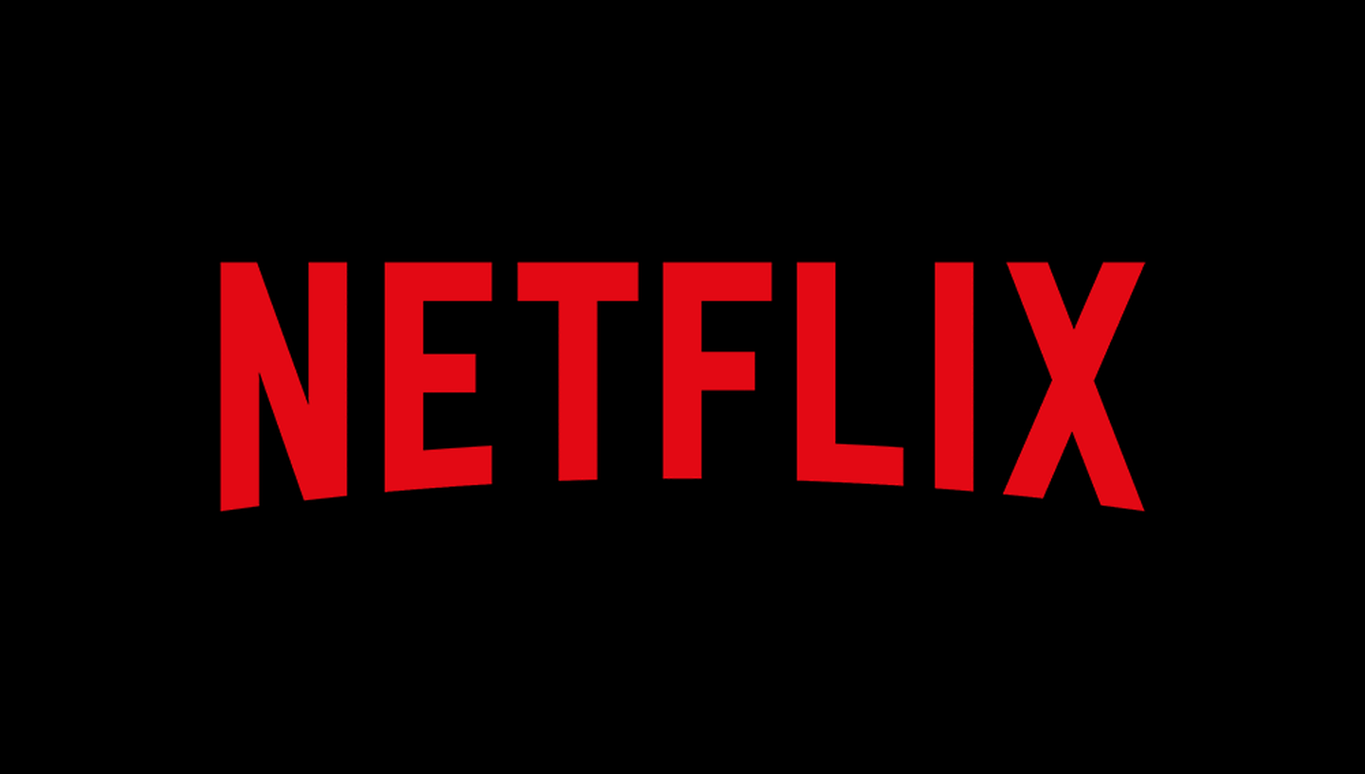

Content Recommendation System
Presenter:
Sai Sugun Ravipalli
Graduate Student at UT Dallas
BUAN 6341

Slide 2

Objective
Gain insights into Netflix's content distribution, focusing on movies and TV shows.
Understand the trends in Netflix's content library, including factors such as ratings, genres, international distribution, and the platform's emphasis on TV shows versus movies.
Creating a movie recommendation algorithm which uses the TF-IDF matrix and cosine similarity to find titles that are textually similar to a given input title.
Identify directors or actors known for producing or starring in content with specific ratings.

Slide 3
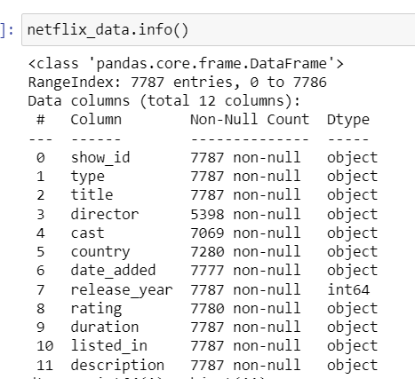
Dataset Variables

Slide 4
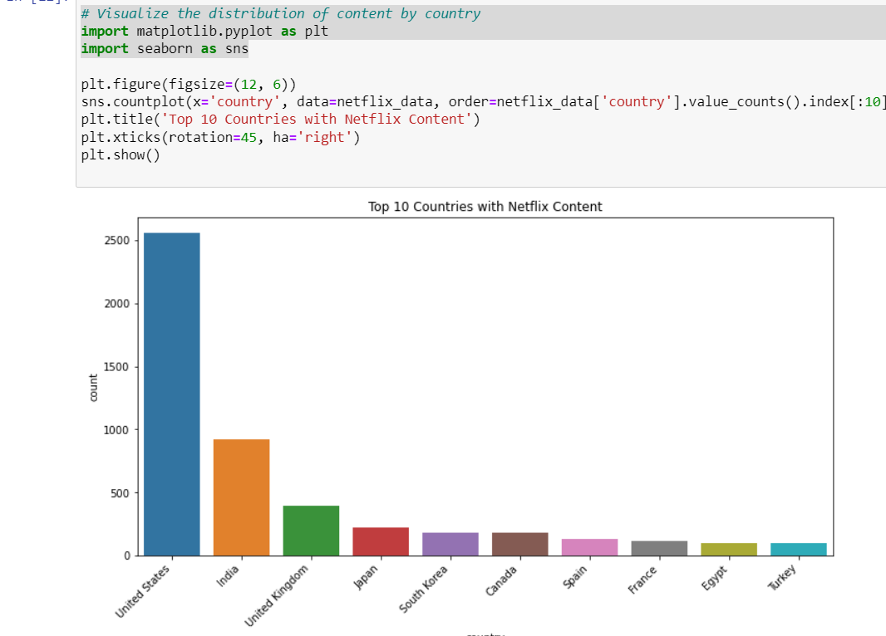
MAJOR COUNTRIES DRIVING THE CONTENT

Slide 5
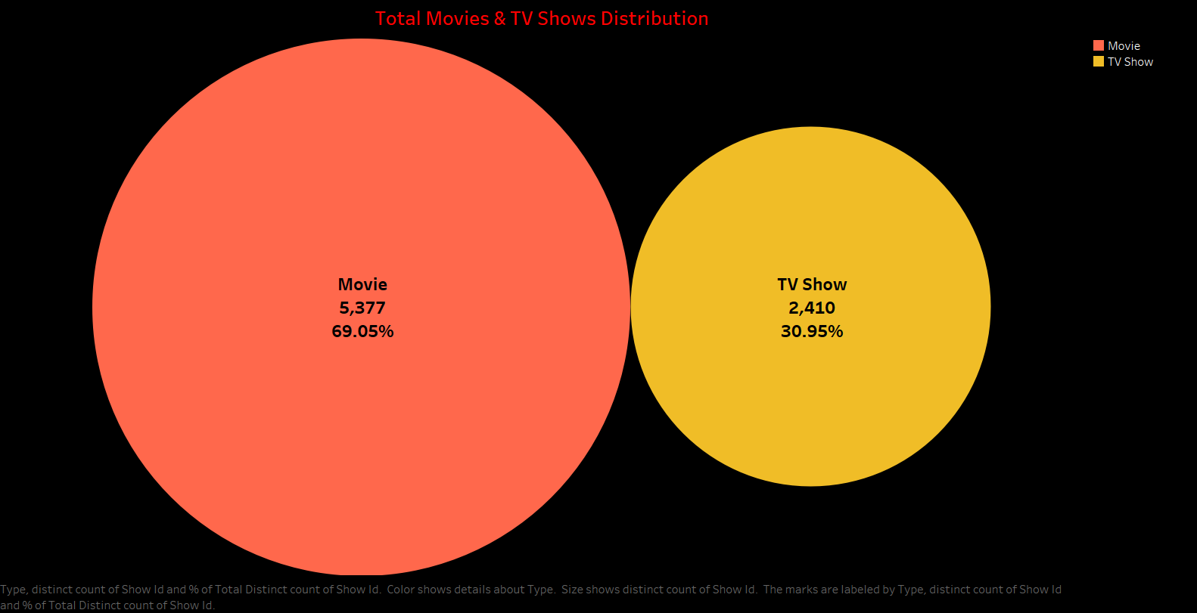

Slide 6
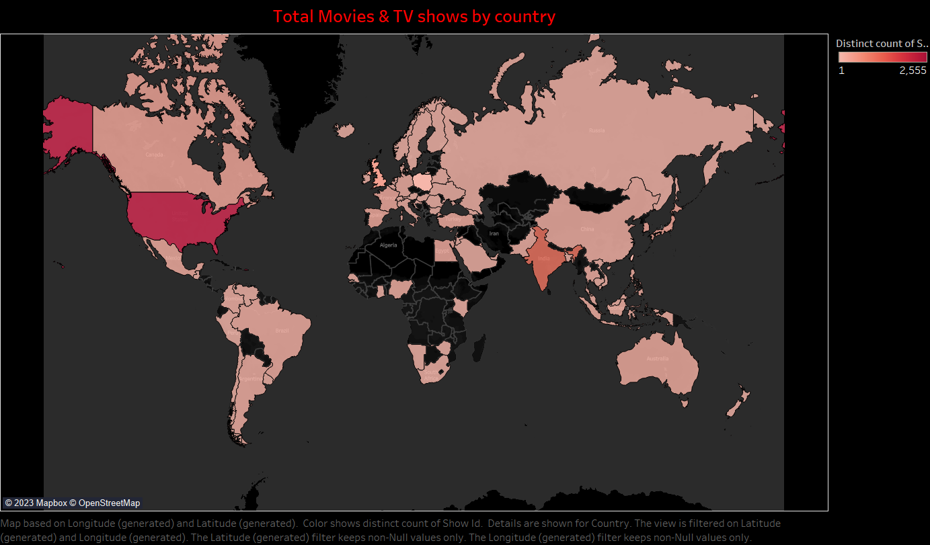

Slide 7
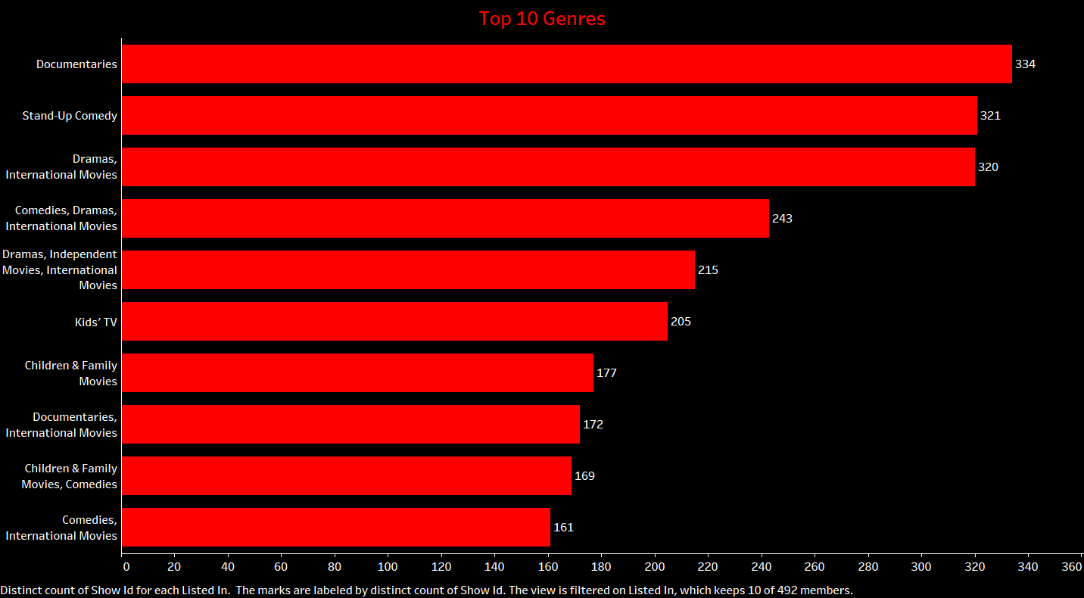

Slide 8
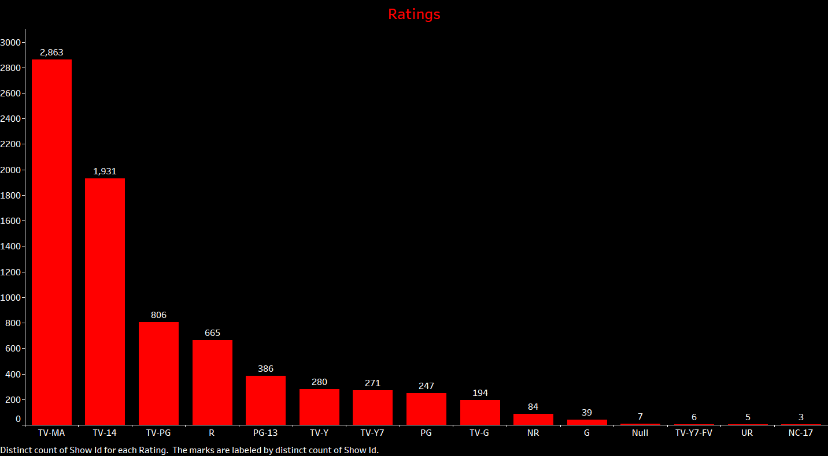

Slide 9
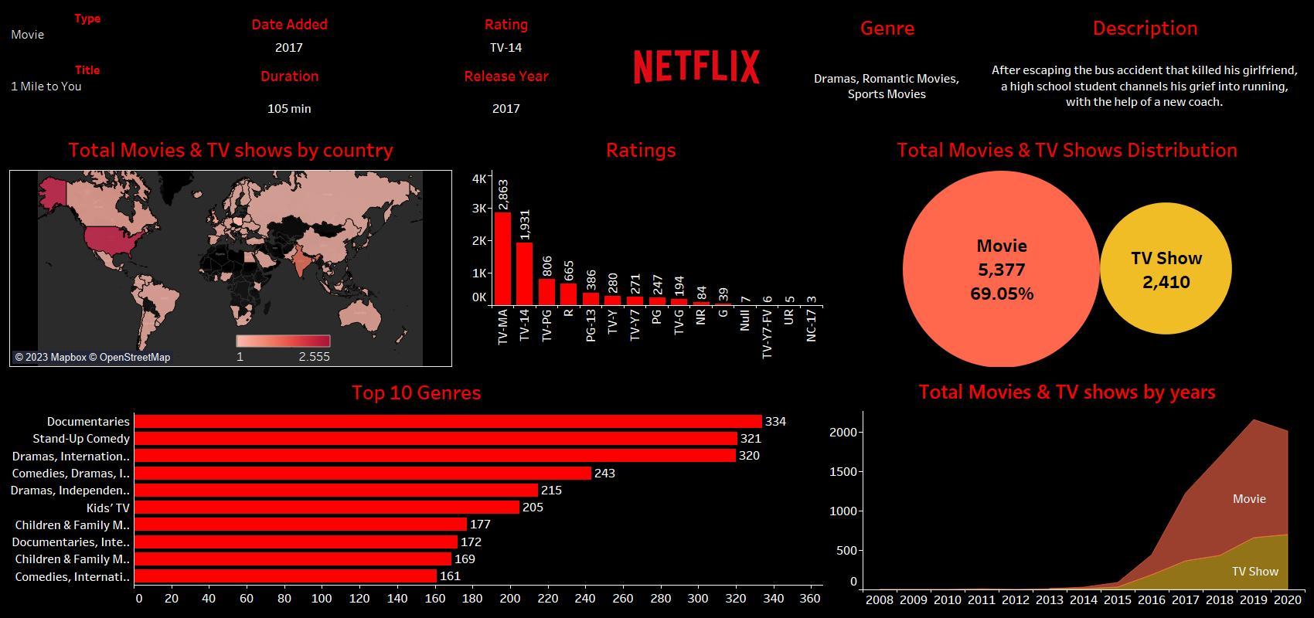
Tableau Dashboard

Slide 10
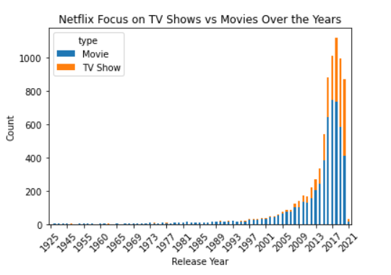
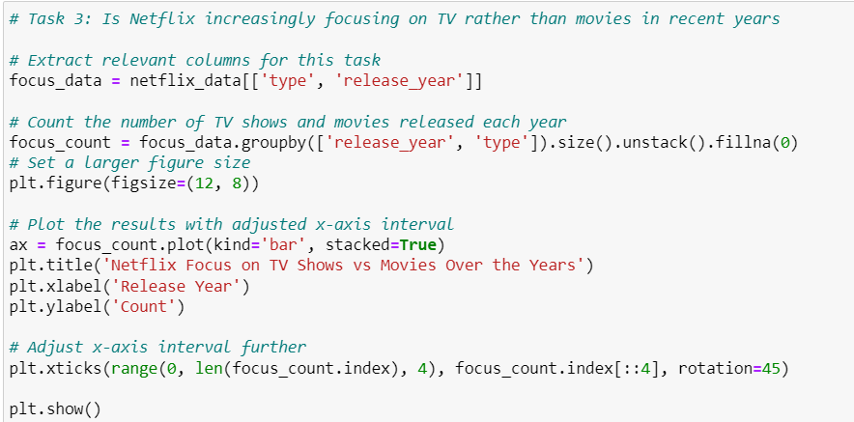
NETFLIX SHIFT OF FOCUS

Slide 11
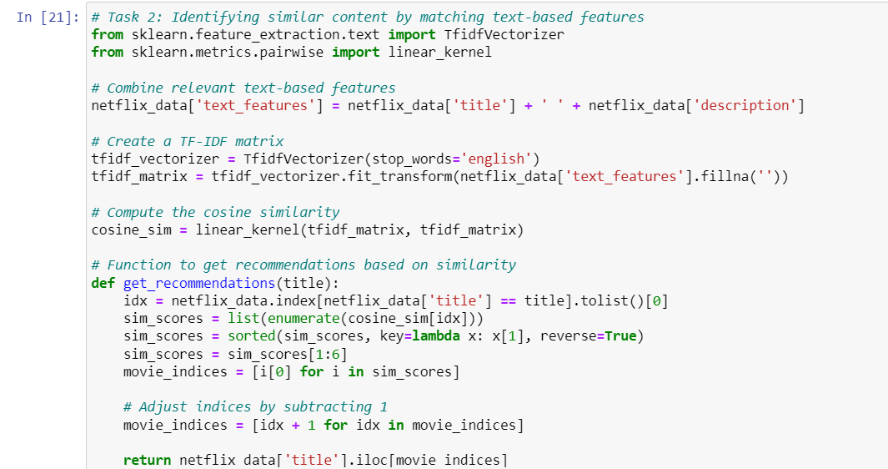
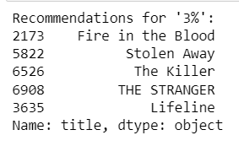
MOVIE RECOMMENDATION SYSTEM
Sample Output

Slide 12
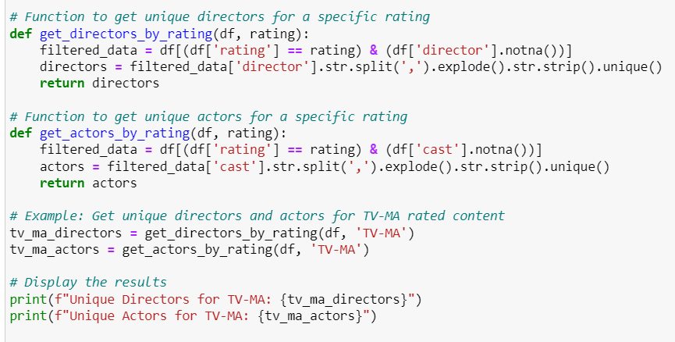
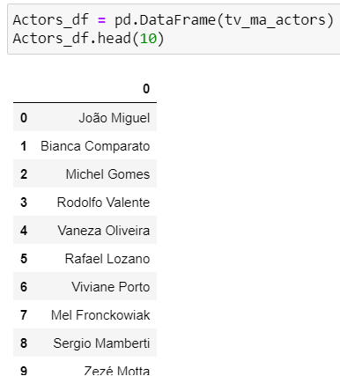
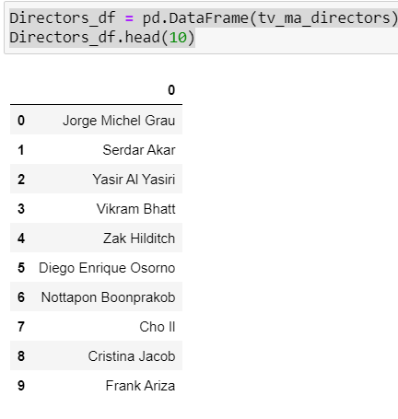
Identify directors or actors known for starring in content with specific ratings.
Sample Output

Slide 13
Results
The top-rated movies analysis revealed the distribution of ratings, with TV-MA being the most prevalent, followed by TV-14 and TV-PG.
Decadal analysis showcased the changing landscape of top-rated content, with shifts in the prominence of specific ratings over different decades.
Content distribution by country highlighted the United States, India, and the United Kingdom as the leading contributors to Netflix's diverse content library.
The content similarity analysis successfully provided recommendations for similar titles, improving user experience and content discovery.
The focus analysis indicated a noticeable increase in the production of TV shows compared to movies in recent years, suggesting a strategic shift in Netflix's content strategy.

Slide 14
Conclusions
Strategic Content Adaptation: Netflix has strategically evolved its content library, making significant adjustments over the years to cater to changing viewer preferences and market dynamics.
Genre and Rating Focus: The platform's content strategy involves a keen focus on specific genres and ratings, reflecting a targeted approach to meet diverse viewer demands and preferences.
Format Preference: The investigation reveals a noteworthy shift in focus towards TV shows in recent years, indicating a strategic emphasis on episodic content over traditional movies.
Enhanced User Engagement: The recommendations generated through content similarity analysis contribute to an enriched user experience, fostering higher engagement by aligning content suggestions with viewer preferences.
Actionable Insights: The insights gained from this analysis provide valuable guidance for content creators, platform managers, and decision-makers within Netflix, offering actionable strategies to further optimize content offerings and viewer satisfaction.

Slide 15
