Slide 1
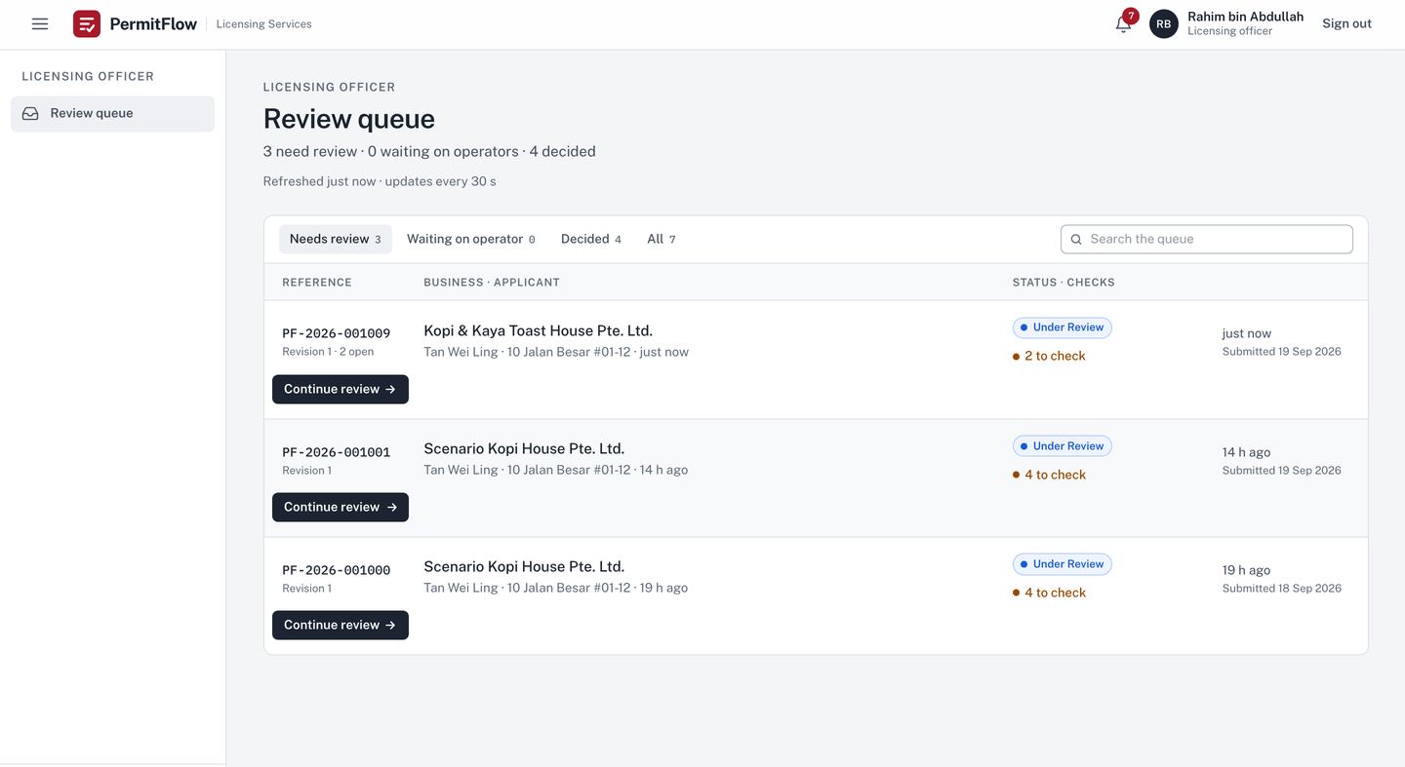

Officer
PermitFlow
Modernising regulatory licensing workflows
A working product for the Food Establishment Licence: submit, review, feedback, resubmit and decide, with an advisory document check.
Full Stack Developer Assessment · Xtremax, Singapore · September 2026
v0.3.0 · permitflow.space

Slide 2
THE PROBLEM
02 / 12
Licence applications go round in a slow, lossy loop, and each turn costs both sides time and trust.
Application
Documents
Review
Feedback
Resubmission
Review again
Feedback again
01
Incomplete or incorrect submissions cause repeated rejection cycles.
02
Feedback is not tied to a section or a document, so the business does not know what to fix.
03
The whole application is re-entered on resubmission and data is lost between rounds.
04
The officer cannot see what changed, or whether an earlier issue was actually resolved.
05
The same comments are rewritten for the same common problems.
06
Applications get lost between stages and the record of what happened is incomplete.
Source: the assessment brief

Slide 3
THE SOLUTION
03 / 12
One continuous workflow: submit, review, feedback tied to a section or a document, then resubmit only what was flagged.
Operator
New application
→
four sections, validated as you go
Applies
Browse files
→
a check runs on each upload
→
Submit application
Officer
Start review
→
findings beside each document
→
Add feedback
Reviews
tied to a section or a document, from a template when it is a common issue
→
Request resubmission
Operator
Respond to feedback
→
only the flagged parts reopen
→
Replace document
Responds
Resubmit
as a new revision
Officer
Compare revisions
→
Mark resolved
→
Mark site visit scheduled
→
Mark site visit done
Continues
Route to approval
→
Approve
issues the licence certificate
Every dark or outlined chip is a control label in the product, spelled as it appears.

Slide 4
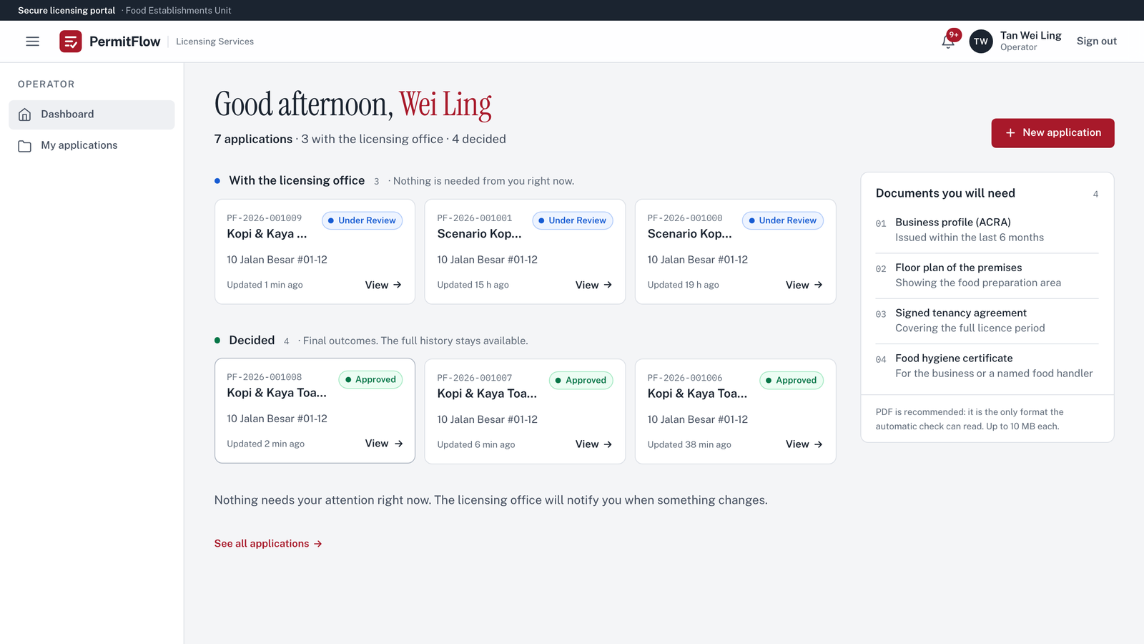
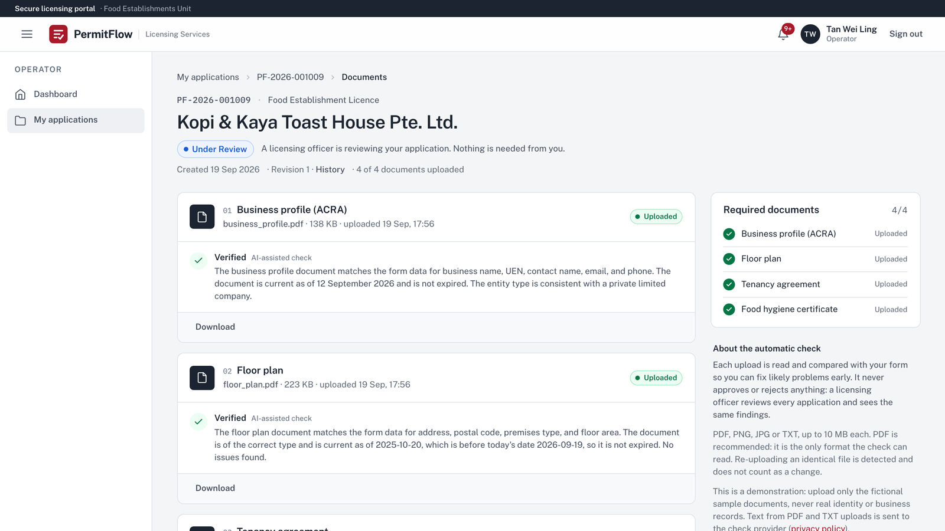
THE PRODUCT · OPERATOR
04 / 12
The operator's side: applications grouped by who needs to act, and a check result on every upload.
Operator
Dashboard: applications grouped by who needs to act
Operator
Documents: a check result on each upload, in plain language

Slide 5
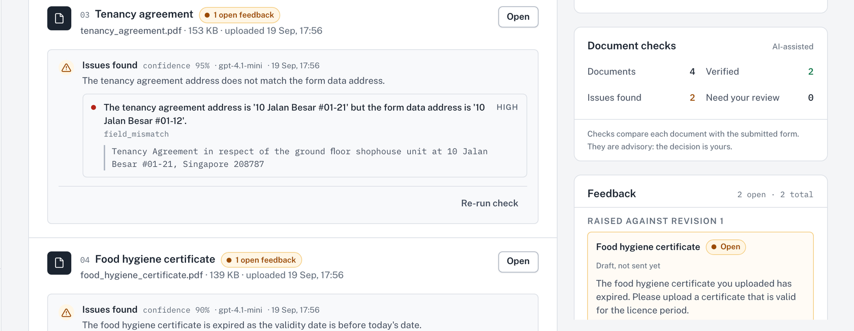
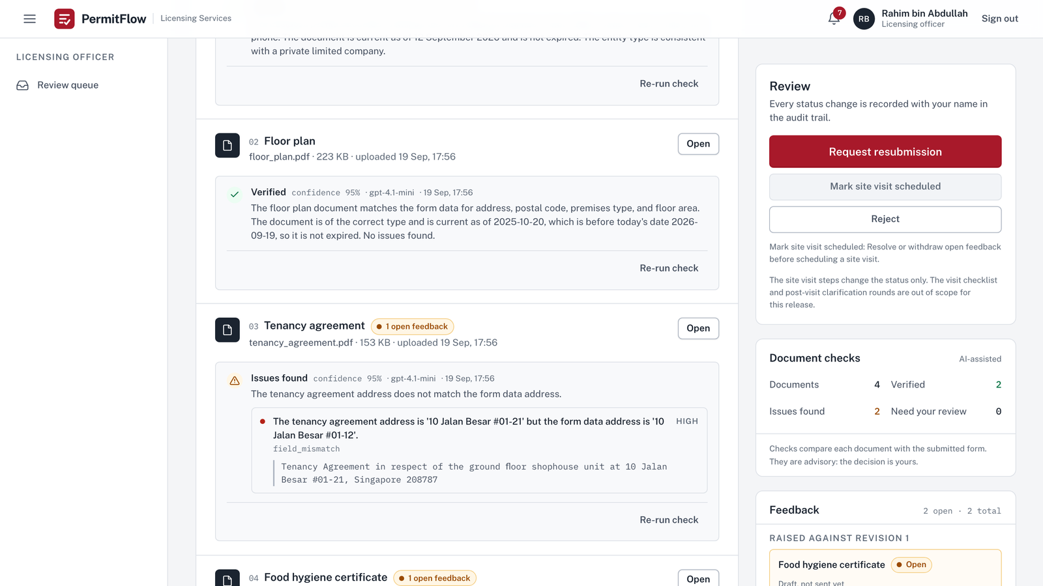
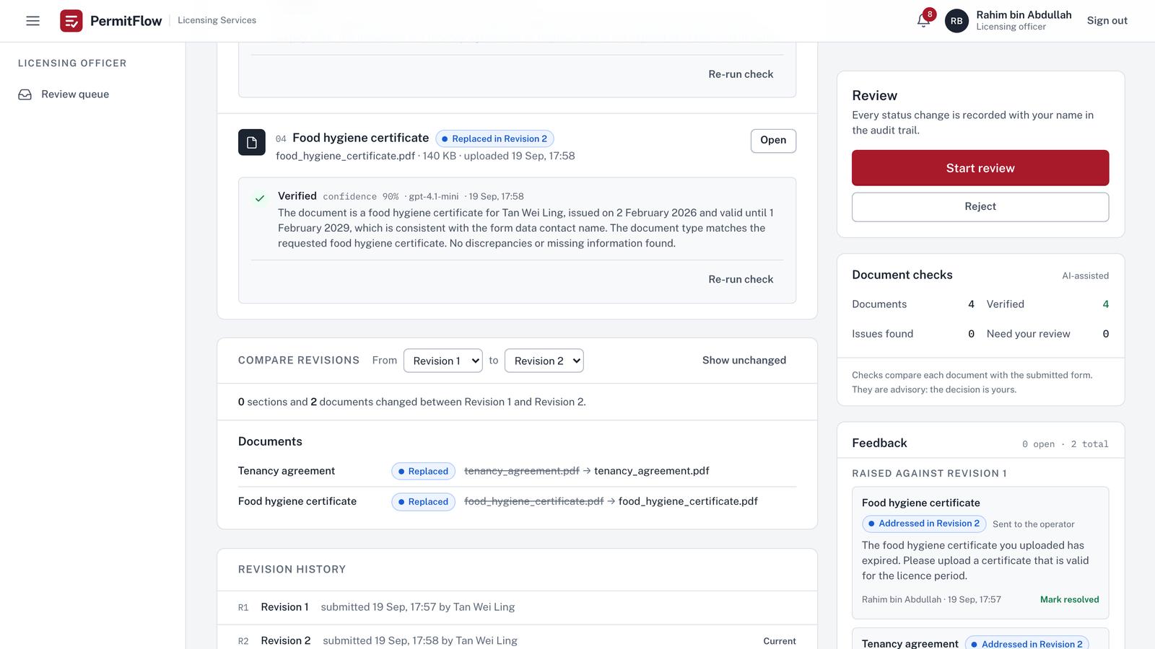
THE PRODUCT · OFFICER
05 / 12
Officer
Finding, evidence and confidence beside the document · two open feedback items
The officer's side: findings with evidence beside each document, and a compare view for every round.
Officer
Case: findings with evidence beside each document, feedback rail on the right
Officer
Compare revisions: what changed, and each item's resolution

Slide 6
AI DOCUMENT VERIFICATION
06 / 12
The AI assists. Humans decide.
Per upload, before submission
What the officer sees
What the officer decides
Deterministic by design, not AI
Advisory check on every document
Officer
Every decision is a person's, and audited
Never touched by the model
Extract the text; unreadable files are reported without a model call
Compare the document with the form: name, UEN, address, dates
Flag issues with a closed issue code
Quote the evidence from the document
Self-reported confidence; below 0.6 becomes Needs your review
Outcome: Verified, Issues found, Needs your review
Each issue with its code, severity and evidence quote
Confidence and model on the card; prompt version in the audit event and the trace
Re-run check at any time
The findings never change a status or write feedback
The Approve dialog warns about unresolved findings but never blocks
The state machine has no AI actor
Feedback templates
Revision compare
Status changes
The prompt-injection rule, applied before the verdict is read
Operator
sees the outcome, a plain explanation and each issue in plain words. Never the evidence quote, never the confidence.
Advisory by design: the check informs the officer and never decides.

Slide 7
A REAL WORKFLOW
07 / 12
Two planted problems, one feedback round,
and the record shows exactly what changed.
Kopi & Kaya Toast House Pte. Ltd.
UEN 202355555E
10 Jalan Besar #01-12
PF-2026-001009
Revision 1 submitted
Checks return two findings
Feedback on both documents
Only two slots reopen
Resolved, on to the site visit
Operator
Expired certificate · tenancy for unit #01-21
Officer
Add feedback
Operator
Officer
Start review
Request resubmission
Replace document
Mark resolved
Resubmit
Mark site visit scheduled
DOCUMENTS AND CHECK RESULTS
FEEDBACK RAISED AGAINST REVISION 1
Business profile (ACRA)
Food hygiene certificate
Addressed in Revision 2
Resolved
Verified
Open
business_profile.pdf
Template: Food hygiene certificate has expired
Floor plan
Tenancy agreement
Addressed in Revision 2
Resolved
Verified
Open
floor_plan.pdf
The tenancy agreement names unit #01-21, but the application and the business profile give #01-12
Tenancy agreement
Issues found
Compare revisions
0 sections and 2 documents changed
Verified
field_mismatch · "10 Jalan Besar #01-21" against the form's #01-12
From Revision 1 to Revision 2
Replaced in Revision 2 · tenancy_agreement.pdf
Food hygiene certificate
Status
Pending Pre-Site Resubmission
Pre-Site Resubmitted
Issues found
Site Visit Scheduled
Verified
expired_document · valid until 3 January 2025
Replaced in Revision 2 · food_hygiene_certificate.pdf
Officer labels shown. Recorded on the development environment, 19 September 2026.

Slide 8
WHAT MAKES IT DIFFERENT
08 / 12
Six principles, each enforced by code.
01
Continuous workflow
One application, any number of rounds. Fourteen states with actors, guards and labels as a table; every status change goes through one function.
04
AI-assisted, never AI-decided
The verifier writes only to verification_runs. The state machine has no AI actor. Injection is handled by a deterministic rule before the verdict is read.
02
Immutable revisions
Every submission is a snapshot. The compare view is a read-time diff, computed and never stored, so nothing is lost between rounds by construction.
05
Same-transaction audit
A status change, its audit row, the operator's notification and, on approval, the licence certificate either all happen or none do.
03
Contextual feedback
Every item is tied to a section or a document. "Only the flagged parts" is an authorization rule: the server answers 403, the UI walks the operator through exactly those targets.
06
Role-aware by construction
Authorization is server-side on every route with an authorization test per endpoint. Operators receive their own labels and never an internal status code.

Slide 9
BUILT TO BE TAKEN TO PRODUCTION
09 / 12
A modular monolith with an explicit state machine, an advisory AI module and an audit trail written in the same transaction.
React 19 UI · TypeScript strict · Vite · TanStack Query
Operator · Officer · Admin (reserved)
BROWSER
Operator and officer workspaces, role-specific labels; a check's status is polled while it runs
Three roles; every authorization decision is made on the server
FastAPI · JWT with a role claim · rate limits
AI verification
API
Role guard per router, ownership as 404, one error envelope with a request id
In-process background task per upload; Re-run check recovers after a restart
Application services · pure Python domain
VerificationProvider
DOMAIN
Workflow table, verification rules, diff, upload rules; no FastAPI or SQLAlchemy import
Structured output through two strict schemas, then deterministic post-rules
Repositories · audit trail
FileStorage
OpenAI (gpt-4.1-mini) or Mock
DATA
Append-only audit rows in the same transaction
Allowlist, 10 MB, magic bytes
Mock by default, in tests and CI; with no key a check is stored unavailable, no model call
PostgreSQL 18
Railway · two environments
LangSmith · Prometheus · Grafana
RUNS ON
Row locks, UUIDs, revisions as JSONB snapshots; 18 on Railway, 16 locally and in CI
Images built once in CI; dev on push, production run by hand from main and paused for an approval; health gate
AI traces with inputs hidden; metrics behind a token, one dashboard, six alert rules

Slide 10
ENGINEERING QUALITY
10 / 12
Checked by tests, gates and a written record.
759 backend tests 158 frontend tests 8 Playwright specs 95 % and 81 % coverage 588 state-machine combinations 23 threats 74 stories, 11 deferred
Tests. Backend on a real PostgreSQL; Playwright journey and scenarios in CI against the full stack.
State machine. 588 transition combinations over 14 states and 3 actors; every invalid one rejected.
Authorization. Server-side on every route; an authorization test for every application-scoped endpoint; ownership answered as 404.
Validation. Strict schemas at the HTTP boundary and on the model's output; one error envelope with a request id.
Audit. Append-only rows in the same transaction as the change; actor and time on every event.
CI gates. Lint, types, an 80 % coverage floor that fails the build, the six-stage AI gate, accessibility, secret and dependency scans.
AI evaluation. 14 golden cases and 21 fairness runs, 18 of them name-swapped, on the live model; nightly and on change.
Delivery. Images built once; production behind an approval; health gates after every deploy; request ids everywhere; Prometheus metrics and a Grafana dashboard with six alert rules.

Slide 11
WHAT I WOULD DO NEXT
11 / 12
Known gaps first, then what production would need.
01
First: use case 3, the site-visit checklist
02
A queue and a worker for the AI checks
Statuses and transitions exist and are tested; the checklist, capture screen and clarification round are not built.
So checks survive deploys and scale on their own; today they run in-process.
03
Object storage with a virus scan
04
Frontend and edge hardening
S3-compatible storage with signed URLs behind the existing storage interface.
httpOnly cookie sessions, CSP nonces, rate-limit windows shared across instances.
05
Identity
06
Data protection
Registration, password reset, MFA and SSO; seeded accounts today.
Retention and redaction for document text sent to the model; an in-region provider.
07
AI evaluation and assurance
08
The admin epic
A labelled set from officer overrides, broader red-teaming, calibration, multilingual injection defence.
Oversight dashboard, AI health, audit feed, user management; role and routes reserved.
09
Delivery, backups and alert routing
Scheduled backups with a tested restore; a staging rehearsal for migrations; image scanning; alerts routed to a channel, exporters for nginx and Postgres.

Slide 12
PermitFlow
From submission to resolution: one traceable licensing workflow.
Submit
→
Check
→
Review
→
Feedback
→
Resubmit
→
Compare
→
Resolve
→
Decide
permitflow.space
github.com/SuhaasNv/permitflow
A working MVP built with production practices, in a three-day engineering constraint.

