Slide 1
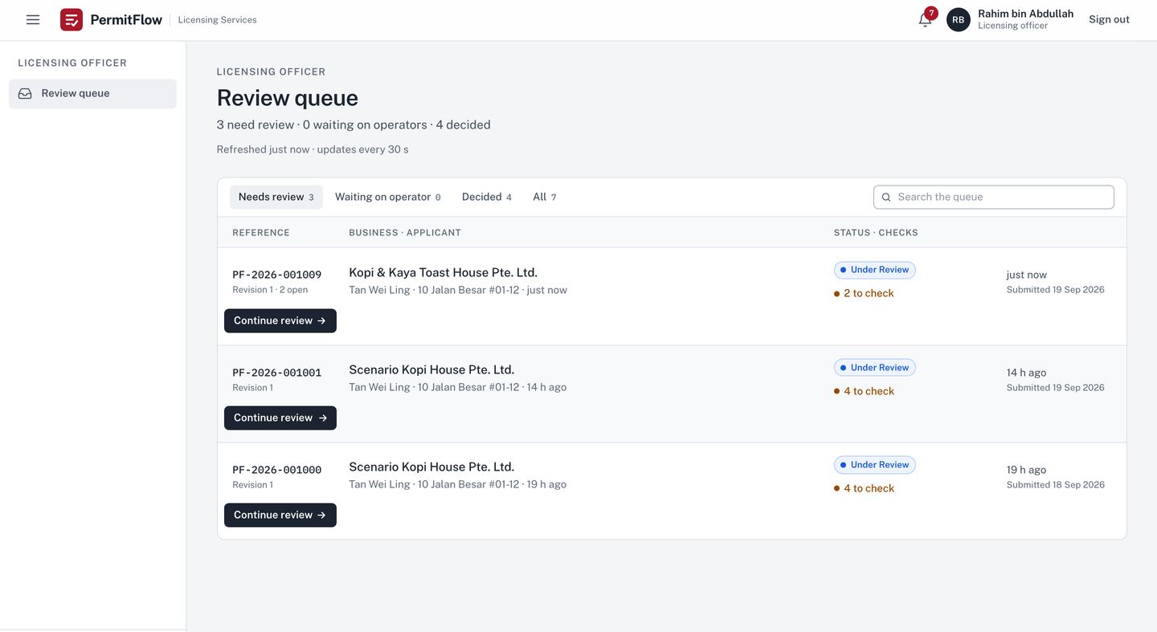

Officer
PermitFlow
PermitFlow: how it is built
Scope, architecture, the decisions that make the brief's guarantees true, the pipeline, the evidence, and the gaps. Every claim names its file.
Technical debrief · Full Stack Developer Assessment · Xtremax, Singapore · September 2026
v0.3.0 · permitflow.space · github.com/SuhaasNv/permitflow
Notes:
This is the technical half of the debrief. The pitch deck showed the product; this deck shows how it is built and why. I will go in the order the brief evaluates: scope judgement, then the architecture and four decisions, then production readiness through the pipeline and the test evidence, then how I used AI, then what I would do next. Every slide names the file a reviewer can open.

Slide 2
THE BRIEF, DECODED
02 / 17
Three use cases, one status table, five things being evaluated.
UC1
Operator submission and resubmission
Built
STATUS TABLE
Form with sections, drag-and-drop uploads, live AI status per document, progress, feedback on top, edit only flagged parts, unlimited rounds, history.
Status table: 12 internal statuses with a different label per role. Implemented as data in domain/labels.py, verbatim from the brief, plus draft and withdrawn as written assumptions.
WHAT IS EVALUATED, AND WHERE IT IS IN THIS DECK
UC2
Officer review and feedback
Built
Scope judgement
slides 3 to 5
Full submission, AI results, contextual feedback with templates, status change notifies, changed sections highlighted, compare revisions, resolution tracked, audit trail.
Production readiness
slides 11 to 14
AI tool usage
slide 15
UC3
On-site assessment and post-site clarification
Deferred
The three post-site statuses and their transitions exist and are tested; the checklist model and screens are not built. Recorded in SCOPE.md with what production needs.
Code quality
slides 6 to 10
Documentation
docs/README.md is the index; docs/reviews/ASSESSMENT_TRACEABILITY.md maps every brief line to code, test and evidence
Notes:
The brief gives three use cases and says two is fine. It also gives a status table with different labels per role, and it lists five evaluation areas. I built use cases one and two in full because they are one loop: submit, review, feedback, resubmit, compare. Use case three is deferred, but the state machine already holds its statuses, so adding it is additive, not a rewrite. The status table is data in the code, not prose. The deck follows the five evaluation areas in order, and the traceability document maps every checkable line of the brief to where it is implemented and tested.

Slide 3
SCOPE
03 / 17
One polished, tested, deployed vertical slice. Everything else written down with what production would need.
MUST
SHOULD
COULD
DEFERRED
20 of 20 built
6 of 7 done
5 of 8 done
13 items, each with a reason
Form, uploads with allowlist, magic bytes and 10 MB
AI check per document with live status
Explicit state machine, 14 statuses, role labels
Feedback tied to a section or document, templates
Targeted resubmission, immutable revisions, compare
Audit trail, in-app notifications
Server-side authorization, error envelope
Tests per layer, CI, Railway, README, SCOPE.md
Queue groups and search
Re-run a check (operator and officer)
Delete a document while in draft
Compare any two revisions
Evaluation set: 14 cases, mock gate, live nightly
Request logging with request id
S7 admin persona: deferred to v0.4.0
Dashboard summary
Withdraw with a reason (new terminal status)
Licence certificate on approval, preview, PDF
Owner's domain, two environments, TLS
Legal, privacy and accessibility review
Open: officer assignment, image OCR, bundle download
UC3 checklist (1.5 days estimated)
Email delivery (mocked, in-app only)
Worker queue for AI checks (in-process today)
Object storage (volume today)
Registration, reset, MFA, SSO
Configurable forms, OCR, push, WAF, virus scan
Session in sessionStorage, US-region providers, one replica: disclosed with severity
SCOPE.md: decision in one line, MUST / SHOULD / COULD / DEFERRED tables, 17 assumptions, a stack paragraph, and a check at each sprint close.
Notes:
SCOPE.md was written before code and re-read at each sprint close. Twenty MUST items, all built. Seven SHOULD items, six done; the admin persona was cut on the last day per the cut order in SPRINTS.md and moved to v0.4.0. Eight COULD items, five done, including the withdraw status, the licence certificate and the domain. [Click] The deferred table has thirteen rows, and each row has three things: what is deferred or mocked, why, and what production would need. The last row is the honest one: the session token in sessionStorage, providers in the US region, one replica. Each accepted for a demonstration and each disclosed with severity in the readiness review.

Slide 4
ASSUMPTIONS
04 / 17
Where the brief was ambiguous, the assumption is written down and enforced by code.
01
A draft state exists before Application Received
02
Under Review starts on an explicit officer action
Needed for save and return; never shown to officers; deletable outright until submitted (US-045). SCOPE.md assumption 2 and 14.
So the actor lands in the audit trail. Start review is a transition row, not a side effect. Assumption 3.
03
Requesting resubmission needs at least one open feedback item
04
Addressed is automatic, resolved is a decision
Guard on the transition; the button is disabled with the reason. Assumption 4, domain/workflow.py.
The linked section or document changed in the next revision: addressed. The officer confirms: resolved. Assumption 7.
05
Only flagged sections may change on resubmission: enforced
06
Operators see Pending Approval as a waiting state
The API returns 403 for any other change. A product decision open to reversal. Assumption 13, domain/resolution.py.
The brief's own table gives that label; the officer-only label Route to Approval and the decision note never reach an operator. Assumption 17.
All 17 assumptions: SCOPE.md. Each one that changes behaviour has a test.
Notes:
Six of the seventeen assumptions, the ones that changed behaviour. The brief's table starts at Application Received, so a draft state is an assumption. The brief does not say who moves a case to Under Review, so I made it an officer action, which puts an actor in the audit trail. Requesting resubmission with no feedback would strand the operator, so it is guarded. Addressed versus resolved separates what the system can know from what the officer decides. Only flagged sections is enforced at the API, not suggested. And the approval stage: the brief's constraints say operators never see it, while the brief's own table gives operators a Pending Approval label; I followed the table and the spirit, no internal code and no officer-only label ever reaches an operator.

Slide 5
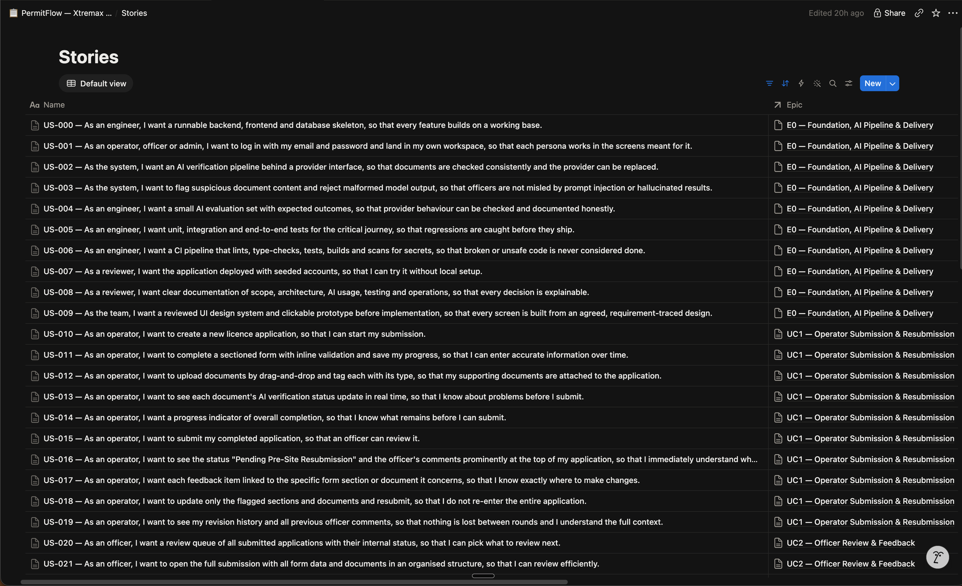
HOW THE WORK WAS RUN
05 / 17
Three one-day sprints on a board that mirrors the repository, a definition of done per story, a close ritual per sprint.
Board and repository, one to one
70 stories in five epics on the board; USER_STORIES.md carries the same ids, titles and acceptance criteria; every branch name carries its story id. Design phase 17 Sep, Sprints 1 to 3 on 18 and 19 Sep.
Cadence
Planning, 15 minutes at the start of the day. Mid-sprint check at midday: cut or simplify then, not at 23:00. Review and close at the end of the day. Two stories in progress at most.
Definition of done, per story
Acceptance criteria met; server validation and authorization tested with the wrong role and owner; the standard error body; audit in the same transaction; no path from AI output to state; tests per layer green in CI; docs and the board updated.
Close ritual, run three times
Tests green, commits checked, board final, CHANGELOG entry with Shipped, Slipped and Retro, SCOPE.md re-read, commit docs: close sprint N. At the third close the admin epic was cut per the cut order, to v0.4.0.
docs/planning: SPRINTS.md (cadence, sprint DoD, close ritual, cut order) · DEFINITION_OF_DONE.md · KANBAN.md · USER_STORIES.md · notion/
Notes:
How the work was run. Three one-day sprints, because a one-day sprint is the shortest cycle that still has a goal, a review and a close. The Notion board and the stories file in the repository are one to one: same ids, same titles, same acceptance criteria, and the branch names carry the story id, so a commit maps to a story maps to a requirement. Each story has a definition of done that is mostly about safety: validation, authorization tested with the wrong role, the error body, same-transaction audit, no path from the AI to state. [Click] Each sprint closed with the same ritual, three times: tests green, the board final, a CHANGELOG entry with what shipped, what slipped and a retro line, and SCOPE.md re-read. The admin epic was cut at the third close, per the cut order written on day one, and moved to v0.4.0.

Slide 6
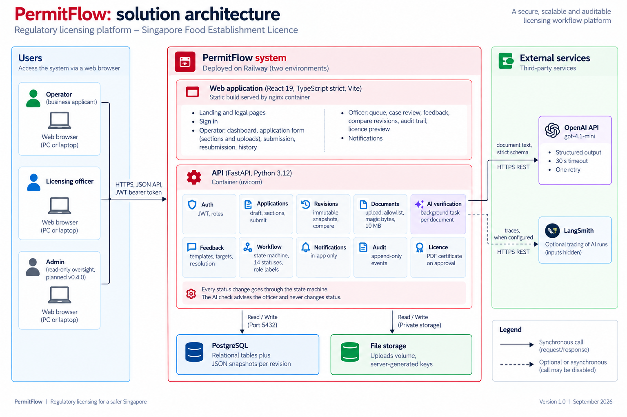
ARCHITECTURE
06 / 17
A modular monolith: one API in strict layers, one web app, one database, an isolated AI module.
Layers, enforced
api, services, domain, repositories, models. domain is pure Python: no SQLAlchemy, no FastAPI, no I/O. tests/unit/test_layering.py fails the build if a layer imports downward the wrong way. ADR-001.
PostgreSQL only
Relations for users, applications, feedback and audit; every submitted revision an immutable JSON snapshot. Row locks and a version column for concurrency. ADR-002.
AI in-process, behind an interface
Background task per document, result polled every 2 s, stale runs marked failed on restart. VerificationProvider with OpenAI and a deterministic mock. ADR-004, the worker is next.
Stack
FastAPI, SQLAlchemy 2, Pydantic v2, Alembic; React 19, TypeScript strict, Vite, TanStack Query, React Hook Form, Zod; pytest, vitest, Playwright. ADR-009.
docs/architecture/ARCHITECTURE.md (API table, request flows) · docs/architecture/decisions (12 ADRs, three groups: shape, rules, delivery)
Notes:
The shape. One FastAPI backend in five layers with a test that enforces the direction of imports; the domain layer is pure Python and is the code a reviewer should read first: the state machine, the labels, the diff, the editability rules. One React app that calls the API directly. One PostgreSQL with relational tables plus a JSON snapshot per revision. Files on a volume behind a storage interface. The AI verifier is a module with one caller, services.verification, and one interface, so it can move to a worker or another provider without touching the rest. Twelve ADRs in three groups; the next four slides are the rules that make the brief's guarantees true.

Slide 7
DECISION 1 OF 4 · ADR-003
07 / 17
The workflow is a table, not a set of if statements.
EVIDENCE IN THE CODE
CHOSE
The fourteen statuses and every allowed move as data: from, to, actor, guard, label. One function, transition(), consults it. available_actions() gives the UI its buttons with the reason a button is disabled.
domain/workflow.py
18 transition rows plus withdraw from any post-submission state; guards: is_complete, open_feedback_count, has_changes_to_flagged_targets
domain/labels.py
the brief's table verbatim: internal status, officer label, operator label, badge tone
OVER
tests/unit/test_workflow.py
Status changes scattered through services, or a workflow library with its own model of the world.
every (source, target, actor) combination: 14 x 14 x 3 = 588 cases; terminal states have no exits; guards
BECAUSE
POST /officer/applications/{id}/transition
A table can be compared with the brief's status table line by line and tested exhaustively. Adding a status is a row. Reject is possible from every non-terminal post-submission state, so no case can get stuck.
row lock, expected_version, 409 invalid_transition with the allowed list, audit and notification in the same transaction
TRADE-OFF
THE PATH
Guards are Python callables, so a guard that needs data the context does not carry means extending the context. Accepted: the context has three fields and has not grown since Day 1.
Officer action
→
transition(status, target, actor)
→
guard
status, audit, notification
→
one commit
Notes:
Decision one. The brief's status table has to hold exactly, with a different label per role. So the workflow is data: a tuple of transition rows, each with the source, the target, the actor, an optional guard and the label the button shows. One function consults it, and it is the only way status changes. The test iterates every combination of source, target and actor, 588 cases, and asserts that only the listed rows pass. The labels file is the brief's table typed in, and a test compares it. Reject from every post-submission state is deliberate: the brief says no application is lost, and a case that cannot move is a lost case.

Slide 8
DECISION 2 OF 4 · ADR-005
08 / 17
Operators never see internal status codes, because the API cannot send them.
EVIDENCE IN THE CODE
CHOSE
Role checked per router; ownership enforced in the one function that loads an application (another owner's case is a 404, not a 403); a separate response model per role, so the operator view has no field for the internal status or the officer label.
api/deps.py
get_current_user (JWT, active user), require_role('officer'), require_role('admin')
repositories/applications.py
get_for(user, id) applies the operator_id filter; NotFound for another owner
OVER
schemas/applications.py vs schemas/officer.py
Checking roles in the UI, or one shared response shape with fields hidden client-side.
operator view: operator label, released feedback without author, no internal status, no decision note before the outcome
BECAUSE
tests/integration
The brief's constraint, operators cannot see the approval stage, becomes a property of the types and the tests, not a hope. A leaked field would be a schema change, which a reviewer sees in the diff.
an authorization test for every endpoint: wrong role 403, wrong owner 404, cross-application ids 404, admin read-only
TRADE-OFF
THE PATH
Two response models to keep in step when a field is added. Accepted: the layering test and the API table in ARCHITECTURE.md make a missed field visible.
JWT
→
require_role per router
→
get_for(user, id): 404
role view model
→
response
Notes:
Decision two is the brief's hardest constraint: operators must never see the internal approval stage. The usual answer is to hide it in the UI. Here the operator response model does not have the field. Role is checked per router, ownership is checked in the one function that loads an application, and another owner's application is a 404 so the id space leaks nothing. Every endpoint has an authorization test: wrong role, wrong owner, an id from another application. Admin is read-only by construction: it has no transitions.

Slide 9
DECISION 3 OF 4 · ADR-006
09 / 17
The AI check advises. Strict schemas and deterministic rules decide what an answer is allowed to mean.
EVIDENCE IN THE CODE
CHOSE
A provider interface with two implementations (OpenAI structured output, deterministic mock). A pinned wire schema, then a strict domain model (extra forbidden, confidence 0 to 1, status must agree with the issue list), then rules after the model: confidence under 0.6 or an injection phrase forces needs_review. The result is stored on the run and shown to the officer. It never touches status, feedback or editability.
infra/ai/base.py, openai_provider.py, mock.py
VerificationProvider; prompt_version 2026-09-19.3 stamped on every run; 30 s timeout, one retry
domain/verification_rules.py
VerificationResult (extra=forbid), apply_rules(threshold, injection phrases), find_injection_phrases
OVER
services/verification.py
Letting the model's answer drive the workflow, or free-text answers parsed by hand.
the only caller of infra.ai; own session and transaction; text extraction capped (30 pages, 20 000 chars, 10 s); never raises out of the task
BECAUSE
evals/: 14 golden cases, 2 injection cases, 21 fairness runs
The brief says AI assists and the officer decides. With strict schemas a bad answer becomes a flagged answer, never a state change. Over quota or on failure the run is stored unavailable and the application proceeds.
mock gate on every push, live nightly, LangSmith experiment per run; docs/ai/AI_ASSURANCE.md
TRADE-OFF
THE PATH
Confidence is the model's own estimate and is uncalibrated; the injection heuristic is English-only phrases. Both recorded as next steps with the tools to fix them.
upload
→
extract, capped
→
model, 30 s
→
wire schema
domain model
→
rules
→
run stored
→
officer sees
Notes:
Decision three. The model sees the extracted text and the form section and returns a structured answer through a pinned wire schema. That answer is validated into a strict domain model: unknown fields are rejected, confidence is bounded, and the status must agree with the issue list whatever the model said. Then deterministic rules run: low confidence or an instruction-like phrase in the document forces needs review. The result goes on the verification run and into the officer's view with its evidence. It never changes status. If the provider fails, times out, or the daily quota is spent, the run is stored unavailable and the application proceeds; the check is advisory, so refusing a model call is always safe. Every prompt change is gated by fourteen golden cases and twenty-one name-swap fairness runs.

Slide 10
DECISION 4 OF 4 · ADR-007 AND ADR-008
10 / 17
Nothing is lost between rounds: every submission is a frozen snapshot, and every change writes its audit row in the same transaction.
EVIDENCE IN THE CODE
CHOSE
Each submit or resubmit stores Revision N: the form as JSON plus the document ids. The comparison between revisions is computed at read time from the snapshots. Audit events, notifications and the licence on approval are written in the same database transaction as the change; there is no update or delete path for audit rows.
models: application_revisions, audit_events
immutable rows; raised_in_revision on feedback; sha256 on documents so an identical re-upload is no change
domain/diff.py, services/compare.py
field-level form diff and document add, remove, replace; GET /applications/{id}/compare?from=n&to=m
OVER
services/resubmission.py
Editing one mutable record, storing diffs instead of snapshots, or a separate logging pipeline and database triggers.
SELECT FOR UPDATE, only flagged targets may change (403), at least one flagged target changed (422), Revision N+1, feedback to addressed, audit, notify, one commit
BECAUSE
GET /officer/applications/{id}/audit
Never lost between rounds and complete audit trail become true by construction. The officer's compare view cannot disagree with what was submitted. A change without its audit row cannot exist, and vice versa.
actor, role, plain-language summary from domain/audit_labels.py, payload, chronological; 748 backend tests include every event type
TRADE-OFF
THE PATH
Snapshots grow with rounds; at this form size a revision is a few kilobytes. A separate audit store would be the answer at a scale this product is not at.
submit
→
Revision N
→
feedback released
resubmit: flagged only
→
Revision N+1
→
compare at read
audit, same commit
Notes:
Decision four covers two ADRs because they are one promise. Every submission is a frozen snapshot of the form and the document ids; the diff the officer sees is computed from two snapshots when asked, so it can never disagree with what was submitted. The resubmission path locks the row, checks that only flagged targets changed, requires at least one of them to have changed, writes the new revision, marks feedback addressed, writes the audit rows and the notifications, and commits once. Audit rows have no update or delete path in the code. The audit endpoint shows actor, role, a plain-language summary and the payload, in order.

Slide 11
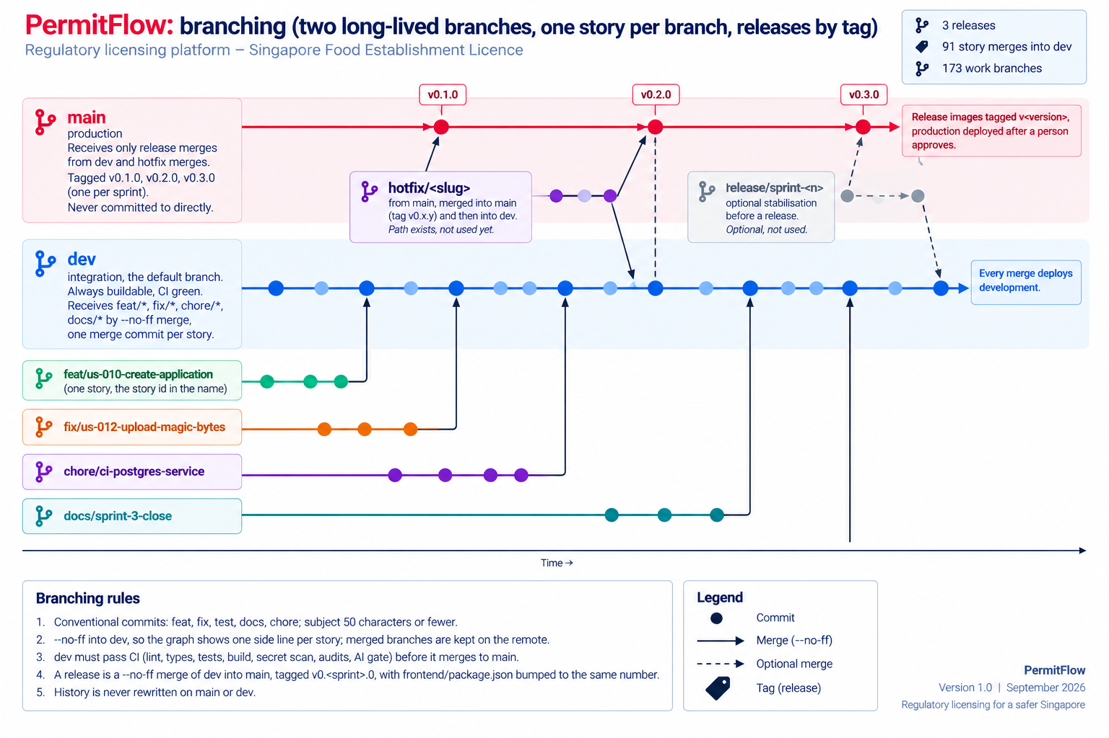
DELIVERY · BRANCHING
11 / 17
Two long-lived branches, one story per branch, releases by tag.
main and dev
main is production and receives only release merges from dev (or a hotfix); tagged v0.1.0, v0.2.0, v0.3.0, one per sprint. dev is integration and the default branch: always buildable, CI green, every merge deploys development.
One story per branch
feat/us-<id>-<slug>, fix/*, chore/*, docs/*, each from dev and back into dev with --no-ff, so the graph shows one side line per story and the branch name maps to the board. 91 story merges, 173 work branches kept on the remote.
Release and hotfix
A release is a --no-ff merge of dev into main with frontend/package.json bumped to the tag; CI tags the images with the same string. A hotfix branches from main and merges into main, then dev. The path exists; it was not needed.
Rules
Conventional commits with a subject of 50 characters or fewer; history never rewritten on main or dev; nothing pushed without an explicit decision. docs/operations/BRANCHING.md.
docs/operations/BRANCHING.md · git log --merges dev · git tag
Notes:
Branching. Two long-lived branches: main is production and only receives releases, dev is integration and deploys the development environment on every merge. Every story gets its own branch named after its id, merged with no fast-forward so each story is one visible merge commit; the merged branches are kept on the remote so the history reads branch by branch. [Click] A release is a merge of dev into main with the version bumped and tagged; CI tags the images with the same string, so the git tag, the package version and the image tag agree. A hotfix path exists from main; it was not needed in three days. Ninety-one story merges and a hundred and seventy-three work branches for seventy stories.

Slide 12
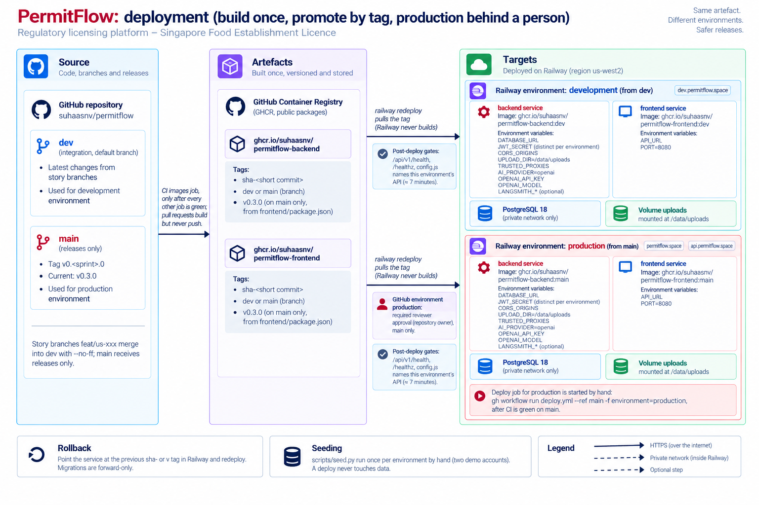
DELIVERY · ADR-011
12 / 17
Build once, promote by tag, production behind a person.
Images built once
CI builds both images after every other job is green and pushes them to GHCR with sha-<commit>, the branch, and v0.3.0 on main. Railway never builds; the tested artefact is the deployed artefact.
Two environments, nothing shared
development from dev, production from main. Own PostgreSQL 18, own uploads volume, own secrets, own tokens, own domains.
Gates
Production waits for the repository owner's approval in the GitHub environment. Both environments gate on /api/v1/health, /healthz and config.js naming the right API. Rollback is the previous tag.
Known limit
A workflow_run job executes on the default branch, dev, and the production environment admits only main, so production is deployed by hand: gh workflow run deploy.yml --ref main. Documented in OPERATIONS.md.
docs/operations/OPERATIONS.md: shape, secrets and variables, seeding, custom domain, rollback, what was verified
Notes:
Delivery. CI builds the two Docker images once and pushes them to the GitHub registry with three tags: the commit, the branch, and the version on main. Railway pulls by tag and never builds, so what was tested is what runs. Two environments that share nothing. Production waits for a person, me, to approve the job in GitHub, and both environments gate on health and on the frontend naming the right API. One limit found at the release: the automatic production job is rejected by GitHub's branch policy because workflow_run executes on the default branch, so production is dispatched by hand with the same approval and gates. It is written down rather than worked around.

Slide 13
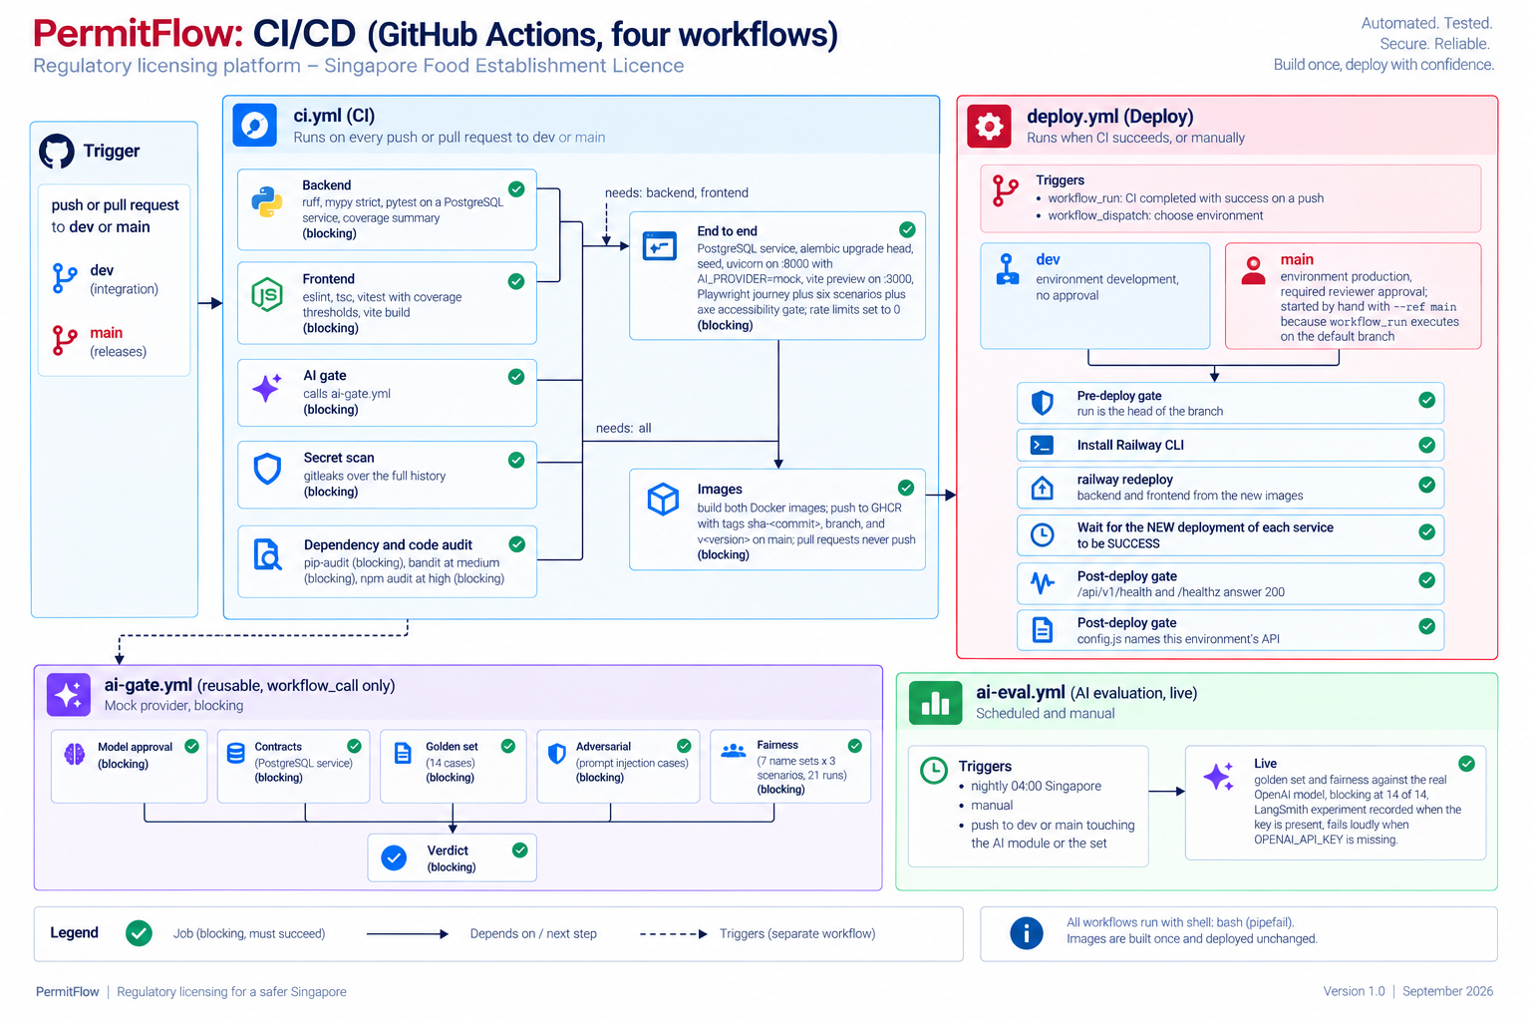
DELIVERY · CI
13 / 17
Seven CI jobs, an AI gate with six, a live evaluation, and a deploy that waits for health.
Everything blocks
Backend (ruff, mypy strict, 748 pytest on PostgreSQL), Frontend (eslint, tsc, 152 vitest with thresholds, build), gitleaks, pip-audit, bandit, npm audit, End to end (the whole stack in the runner, Playwright), Images. No job is advisory.
AI gate on every push
Model approval, contracts on a real database, 14 golden cases, adversarial injection cases, 21 fairness runs, verdict. On the mock provider so it is deterministic and free.
Live evaluation
Nightly and on AI-path pushes against the real OpenAI model: blocking at 14 of 14, each run recorded as a LangSmith experiment. Fails loudly when the key is missing.
Reproducible
The end-to-end job runs migrations, seed, uvicorn and vite preview inside the runner, with rate limits set to 0 and the mock provider. The same commands run locally.
.github/workflows: ci.yml, ai-gate.yml (workflow_call), ai-eval.yml, deploy.yml · shell: bash with pipefail everywhere
Notes:
CI. Seven jobs, all blocking, and the image job waits for every one of them. The AI gate is a reusable workflow called by CI: model approval, contract tests on a real database, the golden set, the adversarial cases, the fairness check, and a verdict; on the mock provider so it is deterministic. The live evaluation is a separate workflow because it costs money and needs a key: nightly and whenever the AI module or the set changes, blocking at fourteen of fourteen, each run a LangSmith experiment. One lesson from the last day: the contracts job passed falsely once because a pipe masked the exit code; every workflow now runs with pipefail and the job greps for the word passed.

Slide 14
PRODUCTION READINESS
14 / 17
Checked by tests, gates and a written record.
748 backend tests, 96 % statements 152 frontend tests, 80.6 % 8 Playwright specs, axe over 23 states 23 threats, each with a control 20 readiness rows with severity
Input validation Pydantic 422 with per-field details; upload allowlist, size streamed to 10 MB, magic bytes; zod schemas built from the server's form schema.
Threat model
docs/security/THREAT_MODEL.md: T1 to T22 plus T1a, STRIDE per asset, the control for each, what is accepted for a demonstration and why.
Error envelope { error: { code, message, details } } on every route, including 401, 403, 422, 429 and 500 with a request id and no stack trace.
Readiness review
Concurrency SELECT FOR UPDATE on the application; expected_version on transitions (409 version_conflict); stale AI runs recovered on restart.
docs/reviews/PRODUCTION_READINESS_REVIEW.md: 20 rows, severity, what mitigates today, what production needs.
Abuse limits 240 requests and 20 sign-ins per client per minute with Retry-After; 20 open drafts; 60 checks per applicant and 1 000 per day, over quota stored unavailable.
Security hardening
docs/security/SECURITY_REVIEW.md: four attack scenarios walked through against the code, with the fix or the accepted risk.
Headers and secrets CSP, HSTS, COOP, Permissions-Policy on both tiers; Argon2, JWT 8 h re-validated per request; gitleaks over the history; .env.example documents every variable.
UAT
Accessibility and legal axe gate in CI over 23 screen states; labels never colour alone; policy pages and demonstration notices; fonts self-hosted.
docs/uat/UAT_PLAN.md: twelve scripts, executed on development and again on production after v0.3.0.
Notes:
Production readiness as evidence rather than adjectives. Seven hundred and forty-eight backend tests on a real PostgreSQL, a hundred and fifty-two frontend tests with coverage thresholds that fail the build, eight Playwright specs including an accessibility gate over twenty-three screen states. Validation at every boundary, one error shape everywhere, row locks and a version column, abuse limits with quotas counted where the truth lives. [Click] And the written record: a threat model with a control per threat, a readiness review with severity per row, a security review that walks four attack scenarios, and a UAT plan executed twice. Where something is accepted for a demonstration, the document says so and says what production needs.

Slide 15
AI USAGE
15 / 17
AI wrote most of the code. The rules it worked under, and the checks on its output, are in the repository.
BUILDING THE PRODUCT
DEBRIEF MATERIAL, SECOND SESSION
Tools
Claude Code (Opus 5, some Fable 5.1) in Cursor's terminal; Cursor to read every diff before a commit; Wispr Flow to dictate the long briefs; Claude in Chrome for the dashboard steps and persona run-throughs; Notion, Railway, GitHub through MCP and CLIs.
Skills
brag (launch video workflow); the HyperFrames set: hyperframes-core, -animation, -keyframes, -cli, -audio, media-use, general-video, slideshow; demo-video (Playwright footage recipe); claude-video-generator (narrated walkthrough rules).
Standing context
Two instruction files: a global engineering standard and the checked-in CLAUDE.md (three personas, layering, every status change through workflow.py, AI never mutates state, same-transaction audit, error envelope, the per-story checklist). The brief's five context types, each with an example in AI_USAGE.md.
Pipeline
Playwright records the development environment at 1920 x 1080 with a drawn cursor; narration through Kokoro via hyperframes tts; music from the HeyGen catalogue with my own sign-in; a HyperFrames composition checked and rendered at 60 fps.
How output was checked
Full suites on every story; browser checks at 390, 1024 and 1280; subagent reviews with separate briefs (design critique, edge cases, bug hunts, a strict assessor); every finding reproduced before a fix; docs checked against code at each sprint close.
Guardrails
Plans reviewed by four persona subagents through fourteen revisions before any build; the code, not the design documents, as the source of truth; a leak sweep of every recording for emails and ids; footage on development, never production.
Where it was wrong
Invented enum values and a valid verdict on an expired certificate (pinned schema, date in the prompt); a scope-creeping story and a red landing band (rejected); a transition the state machine did not allow (became Return to review); a scratch file swept into a commit.
Diagrams in this deck
ChatGPT image generation from prompts written against the workflows and docs; each picture rated against the code before use; two rejected for invented components (a CDN, an Azure tenant, a proxying frontend).
README.md AI Usage (short) · AI_USAGE.md (full record: verbatim prompts, discarded output, who did what)
Notes:
How AI was used, honestly. Claude Code wrote most of the code and the documents, inside two instruction files that are in the repository, so the rules it followed are reviewable. I read every diff in Cursor before a commit and pushed only on an explicit yes. Output was checked by the suites, by browser checks at three widths, by subagent reviews with separate briefs, and by a strict assessor pass on the last day. The list of where it was wrong is in the README. The debrief material came from a second session with Claude Code skills for video: brag for the launch video, the HyperFrames set for composition and rendering, demo-video for the footage, and claude-video-generator for the narrated walkthrough. The diagrams in this deck were generated by ChatGPT from prompts I wrote against the code, and each was rated before use; two were rejected because they invented a CDN and an Azure tenant.

Slide 16
WHAT I WOULD DO NEXT
16 / 17
Known gaps first, then what production would need.
01
Use case 3
02
A worker for the AI checks
The checklist model, the officer capture screen with draft save, per-item clarification and the operator's targeted response. The statuses and transitions exist. About 1.5 days.
Redis and a worker, or a Postgres SKIP LOCKED queue, so checks survive deploys and scale apart from the API. ADR-004 has one call site to change.
03
Object storage and backups
04
Session and edge
S3-compatible bucket with signed URLs and a virus scan; a file backup and a restore drill; a retention policy for documents and traces.
httpOnly cookie with CSRF protection instead of sessionStorage; CSP nonces; the rate windows in Redis or at the edge.
05
AI assurance
06
Admin epic, v0.4.0
A labelled set from officer overrides; promptfoo or PyRIT red-team beyond two injection cases; Project Moonshot for Singapore evidence; calibrated confidence; in-region tracing; a multilingual injection classifier.
Overview with AI health and quota counters, audit feed, read-only case view, user management. Role and routes reserved, screens not built.
07
Delivery
08
Product
Staging with a copy of production data for migration rehearsal; two replicas; Semgrep and CodeQL; Trivy with an SBOM on the images.
Email delivery, officer assignment, more licence types via a configurable form schema, a public verification page for certificates.
README.md What I would do next · docs/reviews/PRODUCTION_READINESS_REVIEW.md (severity per row)
Notes:
Known gaps first. Use case three is the largest functional gap and the first thing to schedule; the state machine already holds it. Then the worker for the AI checks, object storage with backups, and the session and edge hardening that a demonstration accepted. AI assurance has a specific list: a labelled set grown from officer overrides, a red-team suite, Project Moonshot for the Singapore evidence, calibrated confidence, in-region tracing. The admin epic is scoped on the board as v0.4.0. Delivery wants staging, replicas and image scanning. Each item has a row with severity in the readiness review.

Slide 17
PermitFlow
Every decision has a file. Every claim has a test.
SCOPE.md
→
ADRs
→
workflow.py
→
tests
→
ci.yml
→
deploy.yml
→
permitflow.space
permitflow.space
github.com/SuhaasNv/permitflow
Thank you. Questions on any file, any decision, any gap.
Notes:
That is the technical account. Scope written before code and re-read at each close; four decisions that turn the brief's guarantees into properties of the code; a pipeline that deploys only what it tested; evidence in tests and in documents that say what is accepted and why. I am happy to open any file.

