Slide 1
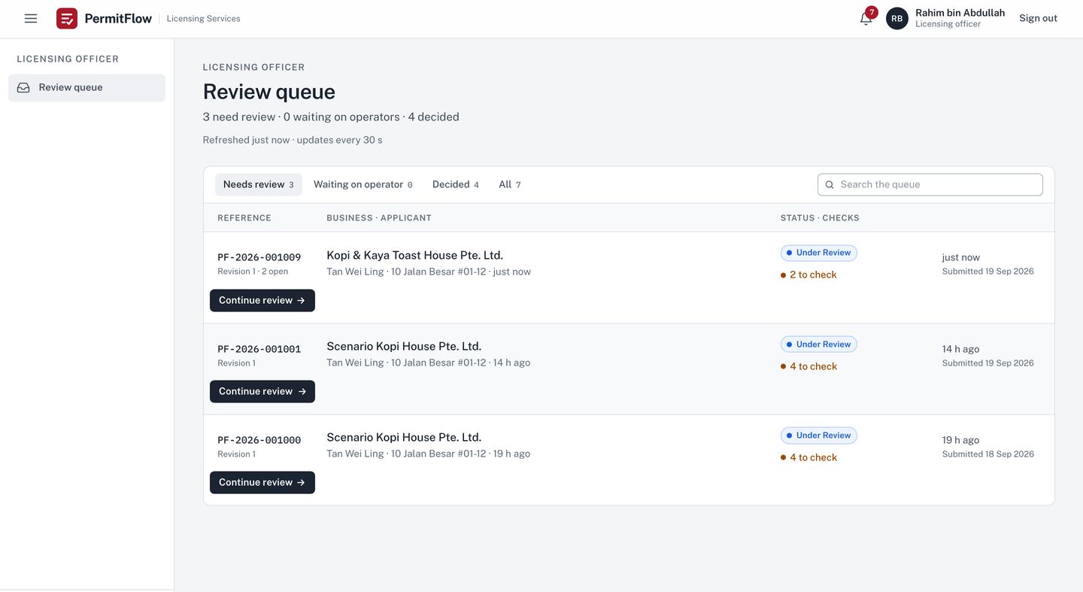

Officer
PermitFlow
PermitFlow: how it is built
Scope, architecture, the decisions that make the brief's guarantees true, the pipeline, the evidence, and the gaps. Every claim names its file.
Technical debrief · Full Stack Developer Assessment · Xtremax, Singapore · September 2026
v0.3.0 · permitflow.space · github.com/SuhaasNv/permitflow

Slide 2
THE BRIEF, DECODED
02 / 21
Three use cases, one status table, five things being evaluated.
UC1
Operator submission and resubmission
Built
STATUS TABLE
Form with sections, drag-and-drop uploads, live AI status per document, progress, feedback on top, edit only flagged parts, unlimited rounds, history.
Status table: 12 internal statuses with a different label per role. Implemented as data in domain/labels.py, verbatim from the brief, plus draft and withdrawn as written assumptions.
WHAT IS EVALUATED, AND WHERE IT IS IN THIS DECK
UC2
Officer review and feedback
Built
Scope judgement
slides 3 to 5
Full submission, AI results, contextual feedback with templates, status change notifies, changed sections highlighted, compare revisions, resolution tracked, audit trail.
Production readiness
slides 12 to 15
AI tool usage
slides 16 to 19
UC3
On-site assessment and post-site clarification
Deferred
The three post-site statuses and their transitions exist and are tested; the checklist model and screens are not built. Recorded in SCOPE.md with what production needs.
Code quality
slides 6 to 11
Documentation
docs/README.md is the index; docs/11-reviews/ASSESSMENT_TRACEABILITY.md maps every brief line to code, test and evidence

Slide 3
SCOPE
03 / 21
One polished, tested, deployed vertical slice. Everything else written down with what production would need.
MUST
SHOULD
COULD
DEFERRED
20 of 20 built
6 of 7 done
5 of 8 done
13 rows, grouped here
Form, uploads with allowlist, magic bytes and 10 MB
AI check per document with live status
Explicit state machine, 14 statuses, role labels
Feedback tied to a section or document, templates
Targeted resubmission, immutable revisions, compare
Audit trail, in-app notifications
Server-side authorization, error envelope
Tests per layer, CI, Railway, README, SCOPE.md
Queue groups and search
Re-run a check (operator and officer)
Delete a document while in draft
Compare any two revisions
Evaluation set: 14 cases, mock gate, live nightly
Request logging with request id
S7 admin persona: deferred to v0.4.0
Dashboard summary
Withdraw with a reason (new terminal status)
Licence certificate on approval, preview, PDF
Owner's domain, two environments, TLS
Legal, privacy and accessibility review
Open: officer assignment, image OCR, bundle download
UC3 checklist (1.5 days estimated)
Email delivery (mocked, in-app only)
Worker queue for AI checks (in-process today)
Object storage (volume today)
Registration, reset, MFA, SSO
Configurable forms, OCR, push, WAF, virus scan
Session in sessionStorage, US-region providers, one replica: disclosed with severity
SCOPE.md: decision in one line, MUST / SHOULD / COULD / DEFERRED tables, 17 assumptions, a stack paragraph, and a check at each sprint close.

Slide 4
ASSUMPTIONS
04 / 21
Where the brief was ambiguous, the assumption is written down and enforced by code.
01
A draft state exists before Application Received
02
Under Review starts on an explicit officer action
Needed for save and return; never shown to officers; deletable outright until submitted (US-045). SCOPE.md assumption 2 and 14.
So the actor lands in the audit trail. Start review is a transition row, not a side effect. Assumption 3.
03
Food licensing; the operator applies for the business
04
Addressed is automatic, resolved is a decision
The brief names no licence: I chose Singapore's Food Establishment Licence (four sections, four documents an AI check can compare with the form). Operators are the business owner or an agent applying on its behalf; the account holder is the applicant, authority is not verified. Assumptions 1 and 10.
The linked section or document changed in the next revision: addressed. The officer confirms: resolved. Assumption 7.
05
Only flagged sections may change on resubmission: enforced
06
Operators see Pending Approval as a waiting state
The API returns 403 for any other change. A product decision open to reversal. Assumption 13, domain/resolution.py.
The brief's own table gives that label; the officer-only label Route to Approval and the decision note never reach an operator. Assumption 17.
All 17 assumptions: SCOPE.md. Each one that changes behaviour has a test.

Slide 5
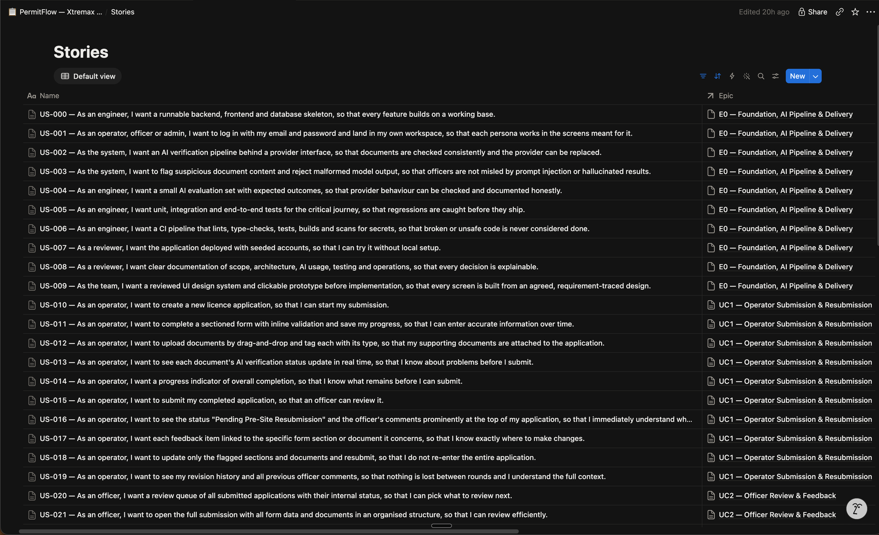
HOW THE WORK WAS RUN
05 / 21
Three one-day sprints on a board that mirrors the repository, a definition of done per story, a close ritual per sprint.
Board and repository, one to one
74 stories in five epics on the board (11 deferred: use case 3 and the admin epic); USER_STORIES.md carries the same ids, titles and acceptance criteria; every branch name carries its story id. Design phase 17 Sep, Sprints 1 to 3 on 18 and 19 Sep.
Cadence
Planning, 15 minutes at the start of the day. Mid-sprint check at midday: cut or simplify then, not at 23:00. Review and close at the end of the day. Two stories in progress at most.
Definition of done, per story
Acceptance criteria met; server validation and authorization tested with the wrong role and owner; the standard error body; audit in the same transaction; no path from AI output to state; tests per layer green in CI; docs and the board updated.
Close ritual, run three times
Tests green, commits checked, board final, CHANGELOG entry with Shipped, Slipped and Retro, SCOPE.md re-read, commit docs: close sprint N. At the third close the admin epic was cut per the cut order, to v0.4.0.
docs/05-planning: SPRINTS.md (cadence, sprint DoD, close ritual, cut order) · DEFINITION_OF_DONE.md · KANBAN.md · USER_STORIES.md · notion/

Slide 6
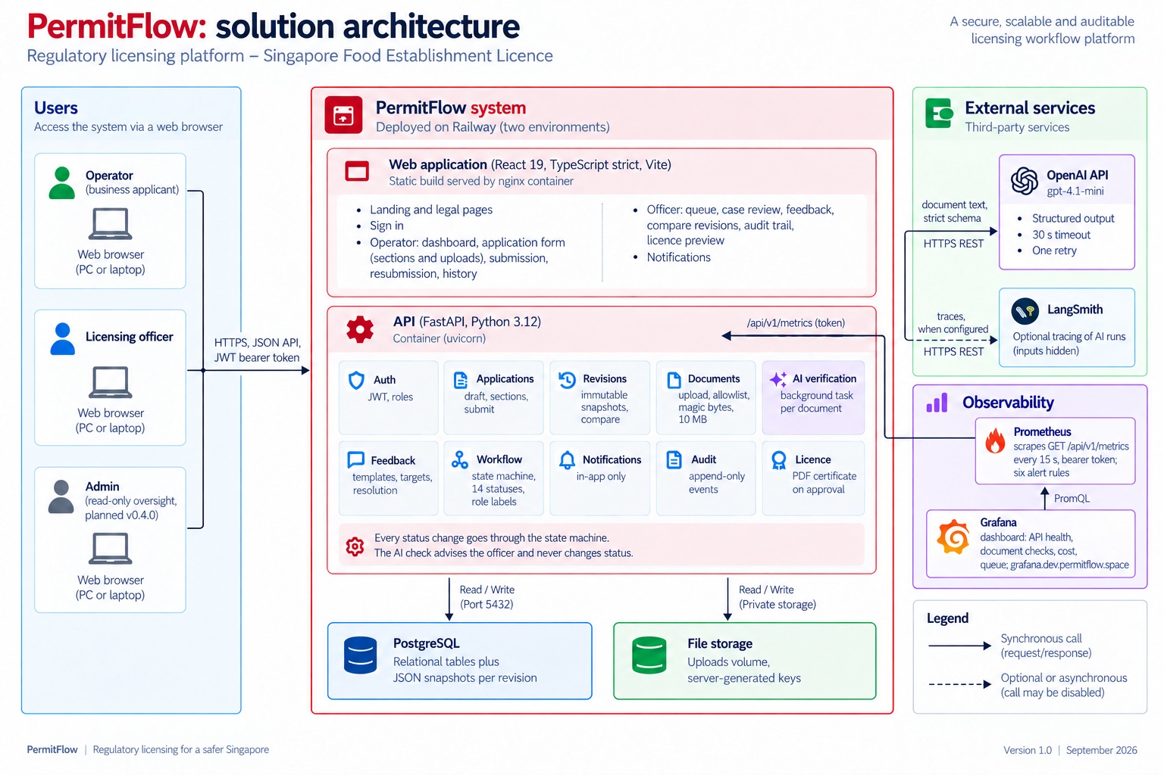
ARCHITECTURE
06 / 21
A modular monolith: one API in strict layers, one web app, one database, an isolated AI module.
Layers, enforced
api, services, domain, repositories, models. domain is pure Python: no SQLAlchemy, no FastAPI, no I/O. tests/unit/test_layering.py fails the build if a layer imports downward the wrong way. ADR-001.
PostgreSQL only
Relations for users, applications, feedback and audit; every submitted revision an immutable JSON snapshot. Row locks and a version column for concurrency. ADR-002.
AI in-process, behind an interface
Background task per document, result polled every 2 s, stale runs marked failed on restart. VerificationProvider with OpenAI and a deterministic mock. ADR-004, the worker is next.
Stack and telemetry
FastAPI, SQLAlchemy 2, Pydantic v2, Alembic; React 19, TypeScript strict, Vite, TanStack Query, React Hook Form, Zod; pytest, vitest, Playwright (ADR-009). Prometheus scrapes GET /api/v1/metrics behind a token; Grafana shows one dashboard; six alert rules (US-077).
docs/03-architecture/ARCHITECTURE.md (API table, request flows) · docs/03-architecture/decisions (12 ADRs, three groups: shape, rules, delivery)

Slide 7
DECISION 1 OF 4 · ADR-003
07 / 21
The workflow is a table, not a set of if statements.
EVIDENCE IN THE CODE
CHOSE
The fourteen statuses and every allowed move as data: from, to, actor, guard, label. One function, transition(), consults it. available_actions() gives the UI its buttons with the reason a button is disabled.
domain/workflow.py
16 explicit rows, plus reject from 7 states and withdraw from 10 (33 transitions); guards: is_complete, open_feedback_count, has_changes_to_flagged_targets
domain/labels.py
the brief's table verbatim: internal status, officer label, operator label, badge tone
OVER
tests/unit/test_workflow.py
Status changes scattered through services, or a workflow library with its own model of the world.
every (source, target, actor) combination: 14 x 14 x 3 = 588 cases; terminal states have no exits; guards
BECAUSE
POST /officer/applications/{id}/transition
A table can be compared with the brief's status table line by line and tested exhaustively. Adding a status is a row. Reject is possible from every state the MVP can reach and withdraw from every post-submission state, so no case can get stuck; the three post-site states get reject when use case 3 ships.
row lock, expected_version, 409 invalid_transition with the allowed list, audit and notification in the same transaction
TRADE-OFF
THE PATH
Guards are Python callables, so a guard that needs data the context does not carry means extending the context. Accepted: the context has three fields and has not grown since Day 1.
Officer action
→
transition(status, target, actor)
→
guard
status, audit, notification
→
one commit

Slide 8
DECISION 1 OF 4 · THE TABLE ITSELF
08 / 21
The table in domain/workflow.py: a row per allowed move, one function that consults it.
@dataclass(frozen=True)
class Transition:
source: S
target: S
actor: Actor
guard: Guard | None = None
label: str = ""
TRANSITIONS: tuple[Transition, ...] = (
Transition(S.DRAFT, S.APPLICATION_RECEIVED,
Actor.OPERATOR, _needs_complete, "Submit"),
Transition(S.APPLICATION_RECEIVED, S.UNDER_REVIEW,
Actor.OFFICER, None, "Start review"),
...
Transition(S.PENDING_APPROVAL, S.APPROVED,
Actor.OFFICER, None, "Approve"),
Transition(S.PENDING_APPROVAL, S.UNDER_REVIEW,
Actor.OFFICER, None, "Return to review"),
)
TRANSITIONS += tuple(
Transition(src, S.REJECTED, Actor.OFFICER, _needs_note, "Reject")
for src in _REJECT_SOURCES
)
Data, not branches
A frozen dataclass per row; the tuple is the whole policy. transition() looks a row up, runs its guard, and returns the new status or a typed error (invalid, forbidden, guard).
Guards are named
_needs_complete, _needs_note, open feedback counts: small callables over a three-field context, listed in the evidence on the previous slide.
The sweep
test_workflow.py builds VALID from this tuple and iterates 14 x 14 x 3 combinations, asserting the kind of refusal, not only that it refused.
backend/app/domain/workflow.py · backend/tests/unit/test_workflow.py · the same table drives available_actions() for the UI

Slide 9
DECISION 2 OF 4 · ADR-005
09 / 21
Operators never see internal status codes, because the API cannot send them.
EVIDENCE IN THE CODE
CHOSE
Role checked per router; ownership enforced in the one function that loads an application (another owner's case is a 404, not a 403); a separate response model per role, so the operator view has no field for the internal status or the officer label.
api/deps.py
get_current_user (JWT, active user), require_role('officer'), require_role('admin')
repositories/applications.py
get_for(user, id) applies the operator_id filter; NotFound for another owner
OVER
schemas/applications.py vs schemas/officer.py
Checking roles in the UI, or one shared response shape with fields hidden client-side.
operator view: operator label, released feedback without author, no internal status, no decision note before the outcome
BECAUSE
tests/integration
The brief's constraint, operators cannot see the approval stage, becomes a property of the types and the tests, not a hope. A leaked field would be a schema change, which a reviewer sees in the diff.
an authorization test for every endpoint: wrong role 403, wrong owner 404, cross-application ids 404, admin read-only
TRADE-OFF
THE PATH
Two response models to keep in step when a field is added. Accepted: the layering test and the API table in ARCHITECTURE.md make a missed field visible.
JWT
→
require_role per router
→
get_for(user, id): 404
role view model
→
response

Slide 10
DECISION 3 OF 4 · ADR-006
10 / 21
The AI check advises. Strict schemas and deterministic rules decide what an answer is allowed to mean.
EVIDENCE IN THE CODE
CHOSE
A provider interface with two implementations (OpenAI structured output, deterministic mock). A pinned wire schema, then a strict domain model (extra forbidden, confidence 0 to 1, status must agree with the issue list), then rules after the model: confidence under 0.6 or an injection phrase forces needs_review. The result is stored on the run and shown to the officer. It never touches status, feedback or editability.
infra/ai/base.py, openai_provider.py, mock.py
VerificationProvider; prompt_version 2026-09-19.3 stamped on every run; 30 s timeout, one retry
domain/verification_rules.py
VerificationResult (extra=forbid), apply_rules(threshold, injection phrases), find_injection_phrases
OVER
services/verification.py
Letting the model's answer drive the workflow, or free-text answers parsed by hand.
the only caller of infra.ai; own session and transaction; text extraction capped (30 pages, 20 000 chars, 10 s); never raises out of the task
BECAUSE
evals/: 14 golden cases, 2 injection cases, 21 fairness runs (18 name-swapped against 3 baselines)
The brief says AI assists and the officer decides. With strict schemas a bad answer becomes a flagged answer, never a state change. Over quota or on failure the run is stored unavailable and the application proceeds.
mock gate on every push, live nightly, LangSmith experiment per run; docs/07-ai/AI_ASSURANCE.md
TRADE-OFF
THE PATH
Confidence is the model's own estimate and is uncalibrated; the injection heuristic is English-only phrases. Both recorded as next steps with the tools to fix them.
upload
→
extract, capped
→
model, 30 s
→
wire schema
domain model
→
rules
→
run stored
→
officer sees

Slide 11
DECISION 4 OF 4 · ADR-007 AND ADR-008
11 / 21
Nothing is lost between rounds: every submission is a frozen snapshot, and every change writes its audit row in the same transaction.
EVIDENCE IN THE CODE
CHOSE
Each submit or resubmit stores Revision N: the form as JSON plus the document ids. The comparison between revisions is computed at read time from the snapshots. Audit events, notifications and the licence on approval are written in the same database transaction as the change; there is no update or delete path for audit rows.
models: application_revisions, audit_events
immutable rows; raised_in_revision on feedback; sha256 on documents so an identical re-upload is no change
domain/diff.py, services/compare.py
field-level form diff and document add, remove, replace; GET /applications/{id}/compare?from=n&to=m
OVER
services/resubmission.py
Editing one mutable record, storing diffs instead of snapshots, or a separate logging pipeline and database triggers.
SELECT FOR UPDATE, only flagged targets may change (403), at least one flagged target changed (422), Revision N+1, feedback to addressed, audit, notify, one commit
BECAUSE
GET /officer/applications/{id}/audit
Never lost between rounds and complete audit trail become true by construction. The officer's compare view cannot disagree with what was submitted. A change without its audit row cannot exist, and vice versa.
actor, role, plain-language summary from domain/audit_labels.py, payload, chronological; 752 backend test cases include every event type
TRADE-OFF
THE PATH
Snapshots grow with rounds; at this form size a revision is a few kilobytes. A separate audit store would be the answer at a scale this product is not at.
submit
→
Revision N
→
feedback released
resubmit: flagged only
→
Revision N+1
→
compare at read
audit, same commit

Slide 12
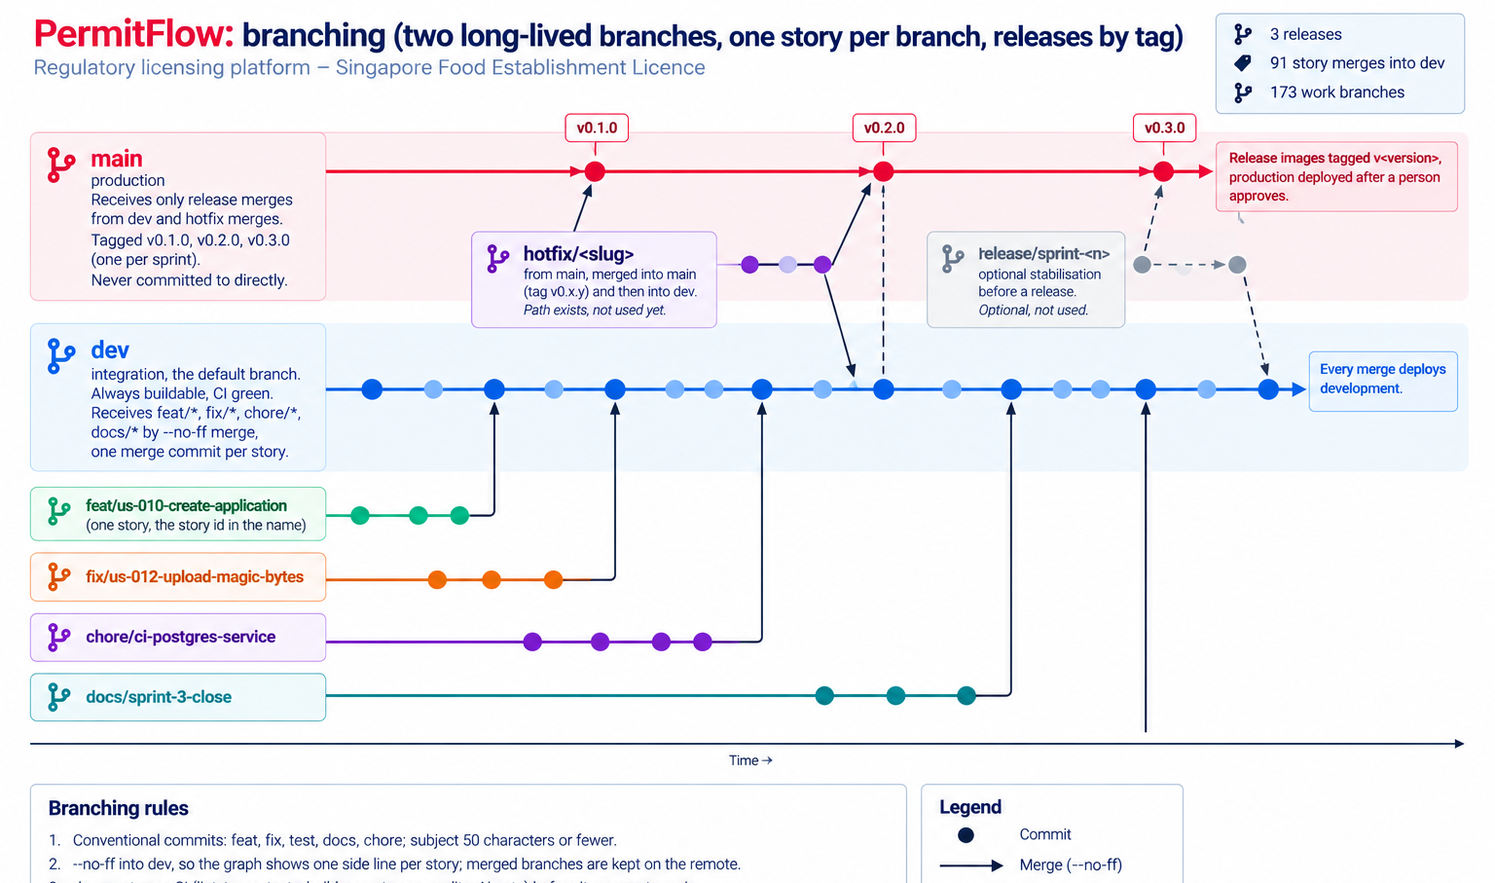
DELIVERY · BRANCHING
12 / 21
Two long-lived branches, one story per branch, releases by tag.
main and dev
main is production and receives only release merges from dev (or a hotfix); tagged v0.1.0, v0.2.0, v0.3.0, one per sprint. dev is integration and the default branch: always buildable, CI green, every merge deploys development.
One story per branch
feat/us-<id>-<slug>, fix/*, chore/*, docs/*, each from dev and back into dev with --no-ff, so the graph shows one side line per story and the branch name maps to the board. 153 merge commits on dev and 86 branches still on the remote (git log --merges dev, git branch -r), on 20 Sep.
Release and hotfix
A release is the dev pull request merged into main, then a git tag on that commit; only the tag's CI run writes the v0.x.0 images. Production is then pinned to that sha- image and deployed with approval. A hotfix branches from main and merges into main, then dev.
Rules
main is protected: changes arrive by pull request from dev with seven green checks, no force pushes, the rule applies to the owner. dev is protected against force pushes. Conventional commits; history never rewritten. docs/09-operations/BRANCHING.md.
docs/09-operations/BRANCHING.md · git log --merges dev · git tag

Slide 13
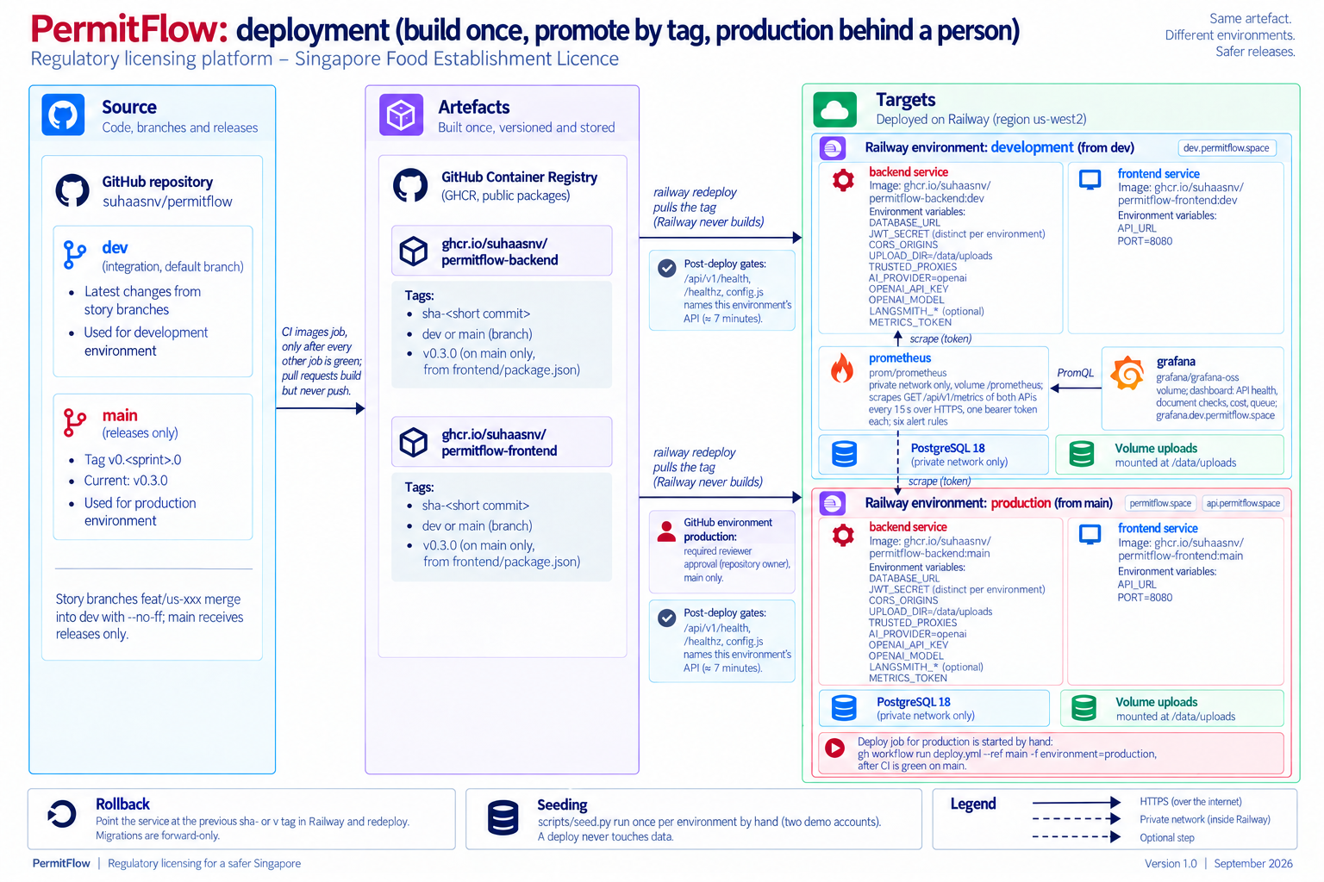
DELIVERY · ADR-011
13 / 21
Build once, promote by tag, production behind a person.
Images built once
CI builds both images after every other job is green and pushes them to GHCR as sha-<commit> and the branch name. A release tag (v0.3.0) is written only by the CI run for that git tag and must match package.json, so it can never be overwritten. Railway never builds.
Two environments, plus the monitor
development from dev, production from main; own PostgreSQL 18, volume, secrets, tokens, domains. Development also runs prometheus (private, scrapes both APIs, one token each) and grafana at grafana.dev.permitflow.space, from public images.
Gates
Production is pinned to a release sha-<commit> image, changed by hand at a release. The deploy job records the live deployment id, waits for a different id to reach SUCCESS, then checks /api/v1/health, /healthz and config.js. Production waits for the owner's approval in GitHub.
Known limit
A workflow_run job executes on the default branch, dev, which the production environment does not admit, so production is deployed by hand: gh workflow run deploy.yml --ref main, with the approval and the gates. Documented in OPERATIONS.md.
docs/09-operations/OPERATIONS.md: shape, secrets and variables, seeding, custom domain, rollback, what was verified

Slide 14
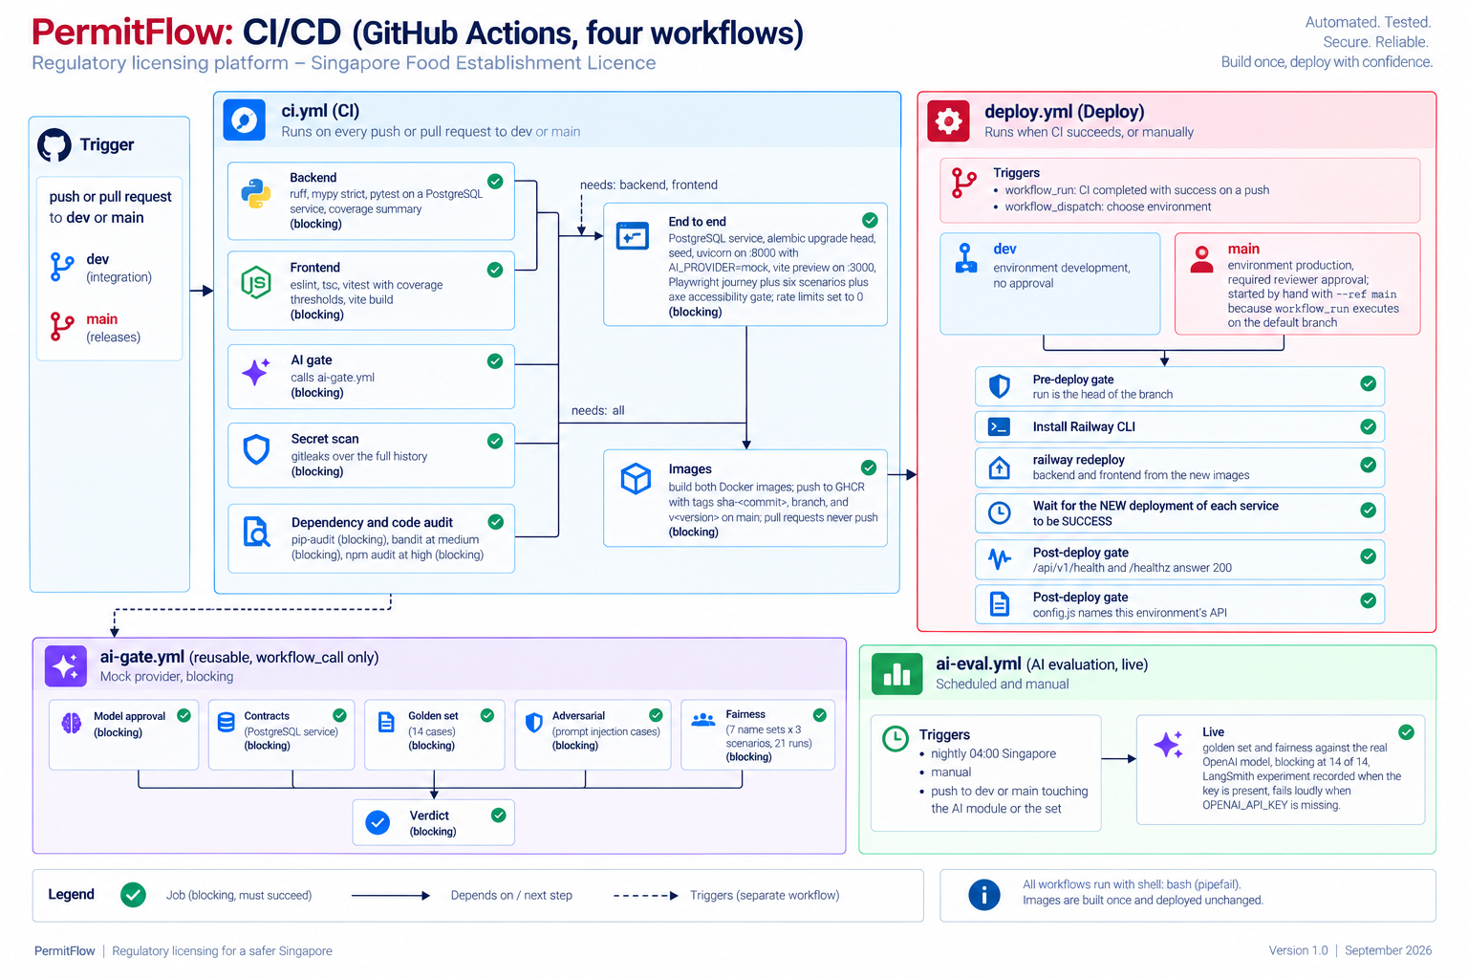
DELIVERY · CI
14 / 21
Seven CI jobs, an AI gate with six, a live evaluation, and a deploy that waits for health.
Everything blocks
Backend (ruff, mypy strict, 763 pytest cases on PostgreSQL), Frontend (eslint, tsc, 158 vitest with thresholds, build), gitleaks, pip-audit, bandit, npm audit, End to end (the whole stack in the runner, Playwright), Images. No job is advisory.
AI gate on every push
Model approval, contracts on a real database, 14 golden cases, adversarial injection cases, 21 fairness runs (18 name-swapped), verdict. On the mock provider so it is deterministic and free.
Live evaluation
Nightly and on AI-path pushes against the real OpenAI model: blocking at 14 of 14, each run recorded as a LangSmith experiment. Fails loudly when the key is missing.
Reproducible
The end-to-end job runs migrations, seed, uvicorn and vite preview inside the runner, with rate limits set to 0 and the mock provider. The same commands run locally.
.github/workflows: ci.yml, ai-gate.yml (workflow_call), ai-eval.yml, deploy.yml · shell: bash with pipefail everywhere

Slide 15
PRODUCTION READINESS
15 / 21
Checked by tests, gates and a written record.
763 backend test cases, 95 % statements 158 frontend tests, 81 % 8 Playwright specs, axe over 23 states 23 threats, each with a control 24 readiness rows with severity
Input validation Pydantic 422 with per-field details; upload allowlist, size streamed to 10 MB, magic bytes; zod schemas built from the server's form schema.
Threat model
docs/06-security/THREAT_MODEL.md: T1 to T23 plus T1a, STRIDE per asset, the control for each, what is accepted for a demonstration and why.
Error envelope { error: { code, message, details } } on every route, including 401, 403, 422, 429 and 500 with a request id and no stack trace.
Concurrency SELECT FOR UPDATE on the application; expected_version on transitions (409 version_conflict); stale AI runs recovered on restart.
Readiness review
docs/11-reviews/PRODUCTION_READINESS_REVIEW.md: 24 rows, severity, what mitigates today, what production needs.
Abuse limits 240 requests and 20 sign-ins per client per minute with Retry-After; 20 open drafts; 60 checks per applicant and 1 000 per day, over quota stored unavailable.
Security hardening
Headers and secrets CSP, HSTS, COOP, Permissions-Policy on both tiers; Argon2, JWT 8 h re-validated per request; gitleaks over the history; .env.example documents every variable.
docs/06-security/SECURITY_REVIEW.md: four attack scenarios walked through against the code, with the fix or the accepted risk.
Accessibility and legal axe gate in CI over 23 screen states; labels never colour alone; policy pages and demonstration notices; fonts self-hosted.
UAT
docs/10-uat/UAT_PLAN.md: twelve scripts, executed on development and again on production after v0.3.0.
Observability GET /api/v1/metrics behind a bearer token: requests, latency, refusals, check outcomes and cost, transitions, queue; Prometheus with six alert rules; one Grafana dashboard, local and on Railway (US-077).

Slide 16
AI USAGE, 1 OF 4 · BUILDING THE PRODUCT
16 / 21
AI wrote most of the code inside rules that are checked in. Every decision and every check is mine.
Models and tools
Claude Code in the Cursor terminal (Opus 5, some sessions Fable 5.1); Cursor to read every diff; Wispr Flow for the long briefs; Claude in Chrome for run-throughs and dashboards, my own sign-in, no secret through the agent.
Share of the work
Nearly all application code and most documents generated by the agent; every decision, prompt, review, merge and push mine. OpenAI only inside the product.
Workflow first
Requirements with ids, SCOPE.md, solutioning, a 23-artboard prototype, three one-day sprints on the board, one branch per story, CI/CD and two environments from day 3.
Standing context
Two instruction files in every session; the project one is checked in as CLAUDE.md (two slides on). The brief's five context types, each with an example in AI_USAGE.md.
How output was checked
Full suites, ruff, mypy strict, tsc strict on every story; browser checks at three widths; subagent reviews that had to reproduce a finding; docs checked against code at each close.
README.md AI Usage (short) · AI_USAGE.md (full record: tools, context, prompts, checks, what was discarded)

Slide 17
AI USAGE, 2 OF 4 · WHERE IT WAS WRONG
17 / 21
Six things the AI got wrong, what caught each one, and what changed.
01
Invented enum values, and an expired certificate read as valid
02
A scope-creeping story and a red landing band
First live run of the verifier. Caught by reading the run. Fix: the vocabulary pinned in the wire schema, today's date in the prompt; the harness now gates every prompt change.
Proposed unasked. Caught at review. Both rejected and recorded in the story notes; SCOPE.md changes only by decision.
03
A transition the state machine did not allow
04
A scratch file swept into a commit
An approval-stage option offered without checking the table. Caught by the sweep. It exposed a real gap: Return to review was added as a row.
A subagent's test file caught by git add -A while it was still running. Caught in the diff. Staging became explicit from then on.
05
Licence dates computed in UTC
06
A harness fault blamed on the model
A day off in Singapore. Caught in the rendered PDF. Fixed to Asia/Singapore with a test.
The first fairness run reported two name-swapped cases as differing; the harness had left the baseline email in the form. Caught by reading the traces. Twenty-one of twenty-one after the fix, recorded as such.
AI_USAGE.md section 6: the full list, with what I would not defend line by line (the certificate layout code, the widest Tailwind class strings, the fairness harness).

Slide 18
AI USAGE, 3 OF 4 · THE RULES THE AGENT WORKED UNDER
18 / 21
CLAUDE.md is checked in: the standing rules every session read first, and the checklist run after every story.
Sources of truth
SCOPE.md, REQUIREMENTS.md with ids, USER_STORIES.md one to one with the board, the architecture documents, the threat model. Code and a document disagree: fix one in the same change.
Personas and engineering rules
Three roles; server-side authorization; operators never receive internal codes; strict layering; every status change through workflow.py; the AI never mutates state; immutable revisions; same-transaction audit.
Notion board, same turn
In progress when a story starts, Done only on its definition of done, slipped with a note; new or renamed stories mirrored in the same turn.
After every story, the checklist
Tests per layer; env vars to .env.example, README, OPERATIONS; schema changes to a migration and DOMAIN_MODEL; endpoints to the API table plus an authorization test; ADRs; SCOPE.md at once; prompt changes to docs/07-ai.
Every hat, every day
One developer, so the agent carries PM, architect, QA, security, DevOps, writer and reviewer duties per story; sprint close daily; a handover line if a session stops mid-story; no push without my yes.
CLAUDE.md at the repository root (sections 0 to 8) · AI_USAGE.md section 3 (the context the AI was given)

Slide 19
AI USAGE, 4 OF 4 · THE DEBRIEF MATERIAL
19 / 21
Two decks and three videos, made by a second session from the repository, with the same rules.
What was made
Launch video 70.7 s, narrated walkthrough 4 min 36 s, technical video 4 min, all 1920 x 1080 at 60 fps with subtitles; the pitch deck (12 slides) and this deck (21 slides). All in docs/13-debrief/.
How
A second Claude Code session after the code freeze, with the video skills installed for the workflow; Playwright footage from the development environment at 4K, a synthetic voice, catalogue music under it, rendered at 60 fps.
Guardrails
Plans reviewed by four persona subagents through fourteen revisions before any build; the code, not the design documents, as the source of truth for every label; a leak sweep of every recording; production never touched.
Diagrams
Generated by ChatGPT from prompts written against the workflows, Dockerfiles and operations documents, each with an acceptance list; rated against the code before use, two rejected for invented components.
Decks
One content.json per deck through a pptxgenjs generator; facts pulled from the repository; a cold hiring-manager review on 20 Sep corrected five counts and one claim before this version.
AI_USAGE.md section 1 (second-session row) and section 4 (Debrief material) · docs/13-debrief/README.md

Slide 20
WHAT I WOULD DO NEXT
20 / 21
Known gaps first, then what production would need.
01
Use case 3
02
A worker for the AI checks
The checklist model, the officer capture screen with draft save, per-item clarification and the operator's targeted response. The statuses and transitions exist. About 1.5 days.
Redis and a worker, or a Postgres SKIP LOCKED queue, so checks survive deploys and scale apart from the API. ADR-004 has one call site to change.
03
Object storage and backups
04
Session and edge
S3-compatible bucket with signed URLs and a virus scan; a file backup and a restore drill; a retention policy for documents and traces.
httpOnly cookie with CSRF protection instead of sessionStorage; CSP nonces; the rate windows in Redis or at the edge.
05
AI assurance
06
Admin epic, v0.4.0
A labelled set from officer overrides; promptfoo or PyRIT red-team beyond two injection cases; Project Moonshot for Singapore evidence; calibrated confidence; in-region tracing; a multilingual injection classifier.
Overview with AI health and quota counters, audit feed, read-only case view, user management. Role and routes reserved, screens not built.
07
Delivery
08
Product
Staging with a copy of production data for migration rehearsal; two replicas; Semgrep and CodeQL; Trivy with an SBOM. Observability, second half: alerts routed to a channel (Alertmanager), nginx and Postgres exporters, one Prometheus per environment, a runbook per alert.
Email delivery, officer assignment, more licence types via a configurable form schema, a public verification page for certificates.
README.md What I would do next · docs/11-reviews/PRODUCTION_READINESS_REVIEW.md (severity per row)

Slide 21
PermitFlow
Every decision has a file. Every claim has a test.
SCOPE.md
→
ADRs
→
workflow.py
→
tests
→
ci.yml
→
deploy.yml
→
permitflow.space
permitflow.space
github.com/SuhaasNv/permitflow
Thank you. Questions on any file, any decision, any gap.

