Slide 1
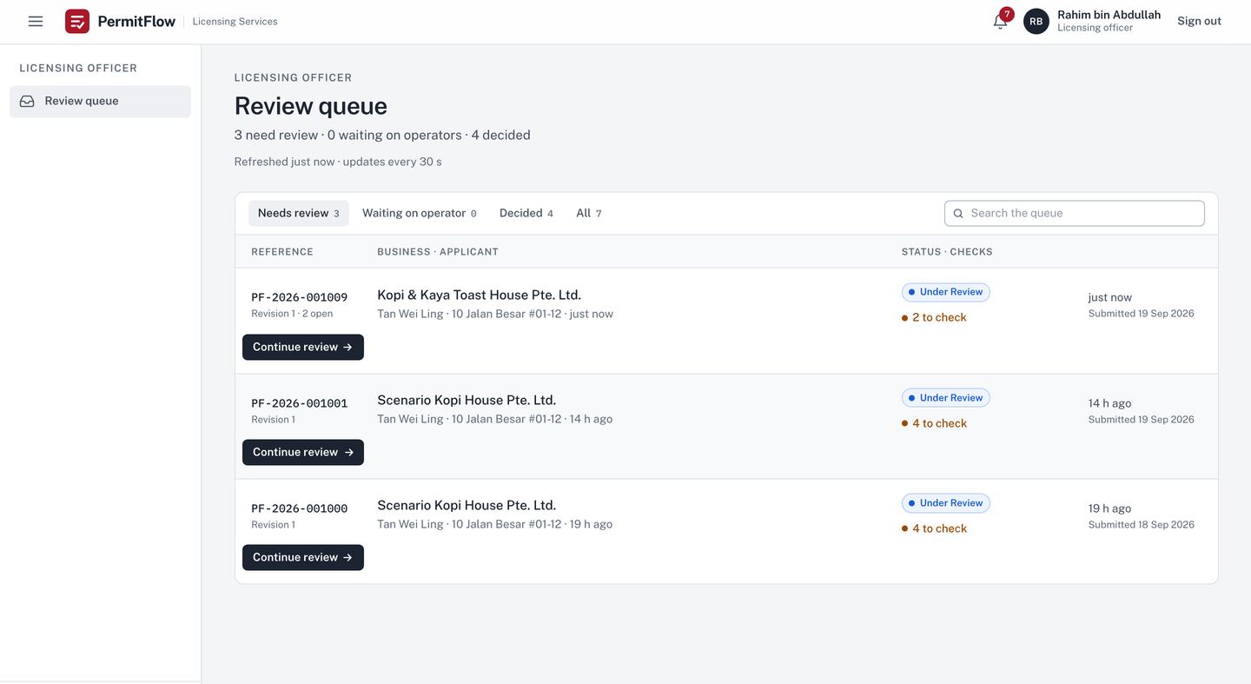

Officer
PermitFlow
Modernising regulatory licensing workflows
A working product for the Food Establishment Licence: submit, review, feedback, resubmit and decide, with an advisory document check.
Full Stack Developer Assessment · Xtremax, Singapore · September 2026
v0.3.0 · permitflow.space
Notes:
Good afternoon. PermitFlow is the application I built for the Full Stack Developer assessment: a licensing operations platform for a Food Establishment Licence, live at permitflow.space with two demonstration accounts. In the next ten minutes I will show the problem as the brief describes it, the product decisions I made, the working system, and what I would do next. Everything on these slides is in the repository; I will name the file where it helps.

Slide 2
THE PROBLEM
02 / 11
Licence applications go round in a slow, lossy loop, and each turn costs both sides time and trust.
Application
Documents
Review
Feedback
Resubmission
Review again
Feedback again
01
Incomplete or incorrect submissions cause repeated rejection cycles.
02
Feedback is not tied to a section or a document, so the business does not know what to fix.
03
The whole application is re-entered on resubmission and data is lost between rounds.
04
The officer cannot see what changed, or whether an earlier issue was actually resolved.
05
The same comments are rewritten for the same common problems.
06
Applications get lost between stages and the record of what happened is incomplete.
Source: the assessment brief
Notes:
The brief describes a slow, lossy loop between a business and a licensing officer. An application comes in, documents are attached, an officer reviews, sends feedback, the business resubmits, and the officer reviews again; the loop closes on itself, and each turn loses something. [Click] Six specific frictions, taken from the brief and recorded in docs/discovery/PROBLEM.md: incomplete submissions cause repeated rejection cycles; feedback is not tied to a section or a document; operators re-enter everything and data is lost between rounds; officers cannot see what changed or whether an issue was actually fixed; officers retype the same comments; and applications get lost through status changes, with an incomplete audit trail.

Slide 3
THE SOLUTION
03 / 11
One continuous workflow: submit, review, feedback tied to a section or a document, then resubmit only what was flagged.
Operator
New application
→
four sections, validated as you go
Applies
Browse files
→
a check runs on each upload
→
Submit application
Officer
Start review
→
findings beside each document
→
Add feedback
Reviews
tied to a section or a document, from a template when it is a common issue
→
Request resubmission
Operator
Respond to feedback
→
only the flagged parts reopen
→
Replace document
Responds
Resubmit
as a new revision
Officer
Compare revisions
→
Mark resolved
→
Mark site visit scheduled
→
Mark site visit done
Continues
Route to approval
→
Approve
issues the licence certificate
Every dark or outlined chip is a control label in the product, spelled as it appears.
Notes:
The answer is one continuous workflow that both people share. The operator applies through a four-section form, uploads the four required documents, sees an automatic check on each one, and presses Submit application. [Click] The officer presses Start review, sees the findings beside each document, adds feedback tied to a section or a document, from a template if it is a common issue, and presses Request resubmission. [Click] The operator sees exactly what was asked for, replaces only the flagged documents or edits only the flagged sections, and presses Resubmit. [Click] The officer compares the two revisions, marks each item resolved, records the site visit as scheduled and then done, routes the application to approval and approves. Every verb here is a button in the product, spelled as it appears; the officer's available actions come from the state machine, not from the screen.

Slide 4
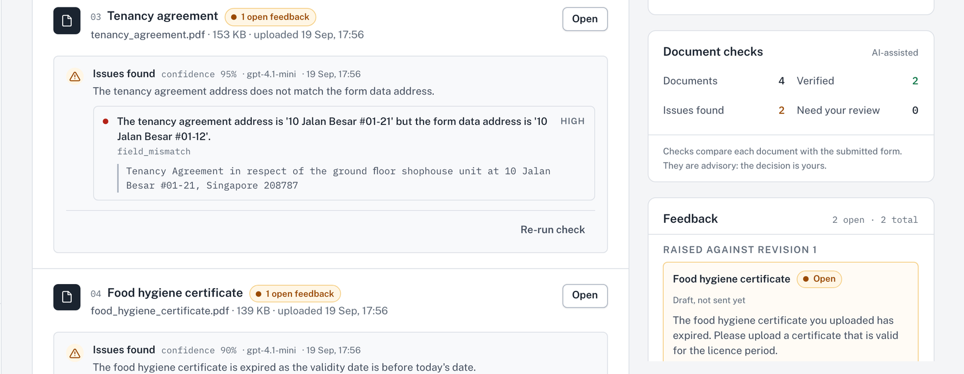
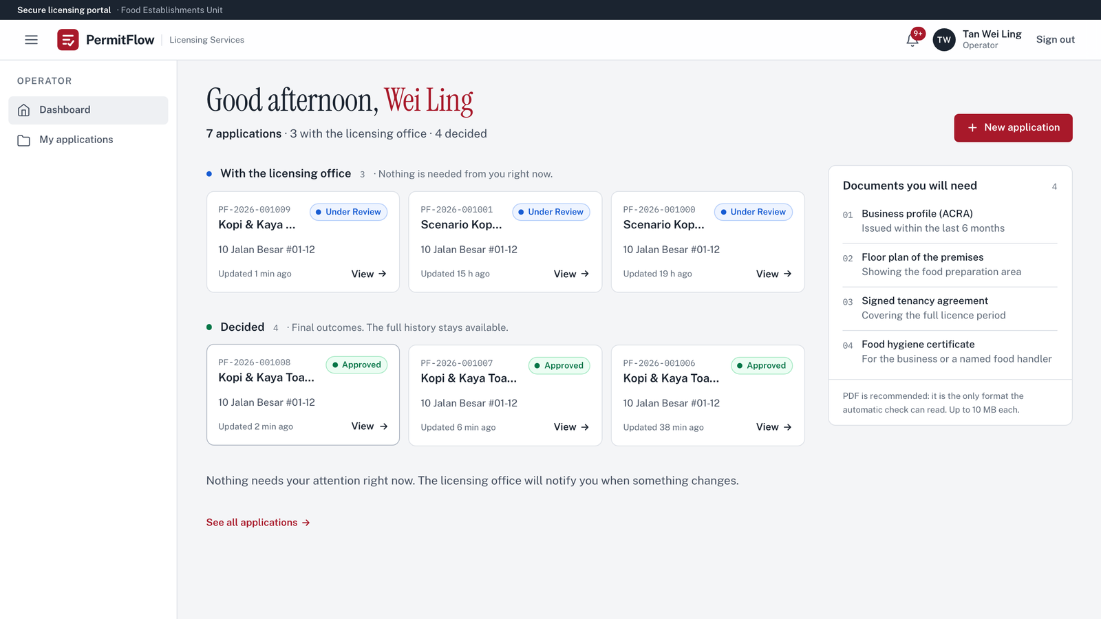
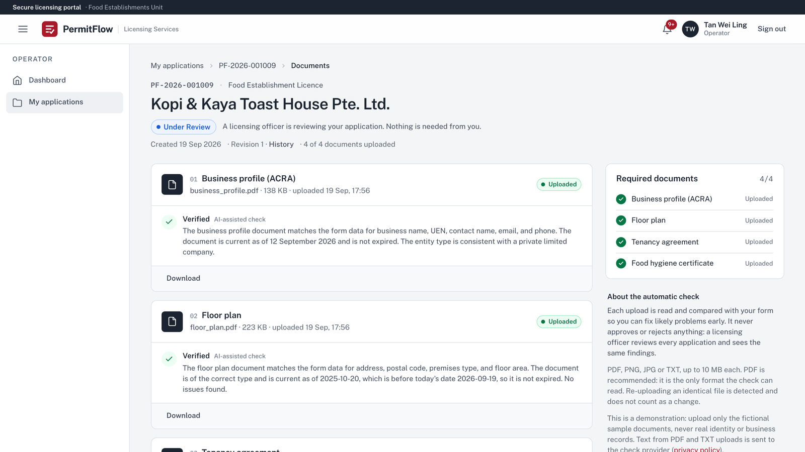
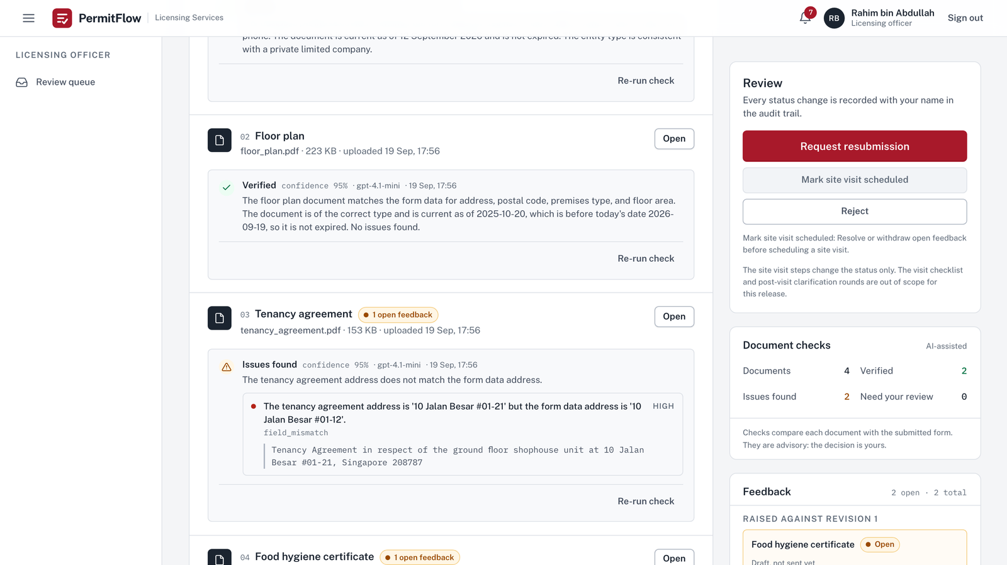
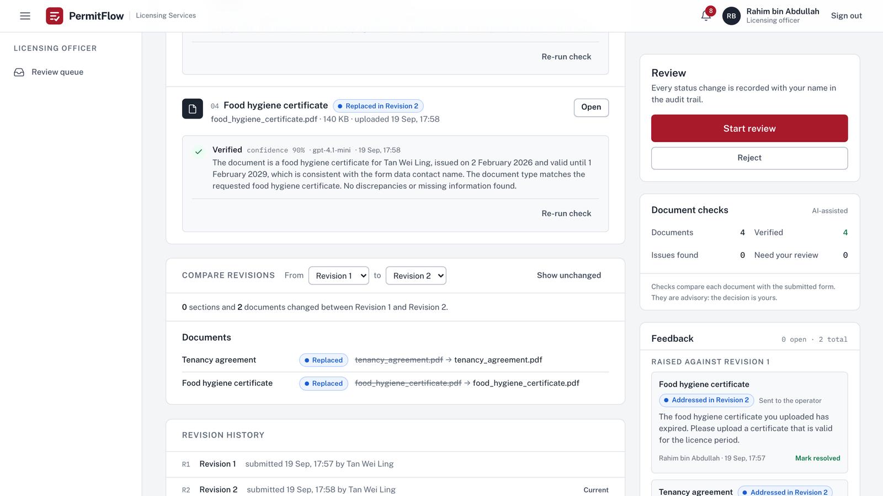
The product runs one workflow for two personas and keeps every step traceable.
04 / 11
Officer
Finding, evidence and confidence beside the document · two open feedback items
Operator
Dashboard: applications grouped by who needs to act
Operator
Documents: a check result on each upload, in plain language
Officer
Case: findings with evidence beside each document, feedback rail on the right
Officer
Compare revisions: what changed, and each item's resolution
Notes:
This is the product as deployed, captured on 19 September 2026 on the development environment. The operator's dashboard groups applications by what needs the operator's attention. The documents page shows each upload with its check result in operator language: Verified, or Needs your attention, never a confidence figure. The officer's case page shows the same documents with the finding, the quoted evidence, the confidence and the model, and the feedback rail on the right. The compare view lists what changed between two revisions. [Click] Zooming into the officer's case: the finding for the tenancy agreement quotes the line in the document, the rail shows two open feedback items, and the primary action is Request resubmission. One workflow, two personas, full traceability.

Slide 5
AI DOCUMENT VERIFICATION
05 / 11
The AI assists. Humans decide.
Per upload, before submission
What the officer sees
What the officer decides
Deterministic by design, not AI
Advisory check on every document
Officer
Every decision is a person's, and audited
Never touched by the model
Extract the text; unreadable files are reported without a model call
Compare the document with the form: name, UEN, address, dates
Flag issues with a closed issue code
Quote the evidence from the document
Self-reported confidence; below 0.6 becomes Needs your review
Outcome: Verified, Issues found, Needs your review
Each issue with its code, severity and evidence quote
Confidence and model on the card; prompt version in the audit event and the trace
Re-run check at any time
The findings never change a status or write feedback
The Approve dialog warns about unresolved findings but never blocks
The state machine has no AI actor
Feedback templates
Revision compare
Status changes
The prompt-injection rule, applied before the verdict is read
Operator
sees the outcome, a plain explanation and each issue in plain words. Never the evidence quote, never the confidence.
Advisory by design: the check informs the officer and never decides.
Notes:
The AI is a verifier, not a decider. When a document is uploaded, before anyone submits, the text is extracted and checked for readability, compared with the form, and the model returns a structured result: issues with a closed code, a quoted piece of evidence, and a self-reported confidence. The operator sees the outcome, a plain explanation and each issue in plain words, never the evidence quote and never the confidence. The officer sees everything: the outcome, each issue with its code and evidence, the confidence and the model on the card, with the prompt version recorded in the audit event and the trace, and a Re-run check button. The decision is the officer's. The Approve dialog warns about unresolved findings but never blocks. Three things are deterministic on purpose and never touched by the model: feedback templates, the revision compare, and status changes. The provider sits behind an interface with a mock used in tests and CI, so the model is replaceable. That design is ADR-006. One more rule: the injection check is a deterministic rule that runs before the verdict is read, and the output passes two strict schemas before it is stored.

Slide 6
A REAL WORKFLOW
06 / 11
Two planted problems, one feedback round,
and the record shows exactly what changed.
Kopi & Kaya Toast House Pte. Ltd.
UEN 202355555E
10 Jalan Besar #01-12
PF-2026-001009
Revision 1 submitted
Checks return two findings
Feedback on both documents
Only two slots reopen
Resolved, on to the site visit
Operator
Expired certificate · tenancy for unit #01-21
Officer
Add feedback
Operator
Officer
Start review
Request resubmission
Replace document
Mark resolved
Resubmit
Mark site visit scheduled
DOCUMENTS AND CHECK RESULTS
FEEDBACK RAISED AGAINST REVISION 1
Business profile (ACRA)
Food hygiene certificate
Addressed in Revision 2
Resolved
Verified
Open
business_profile.pdf
Template: Food hygiene certificate has expired
Floor plan
Tenancy agreement
Addressed in Revision 2
Resolved
Verified
Open
floor_plan.pdf
The tenancy agreement names unit #01-21, but the application and the business profile give #01-12
Tenancy agreement
Issues found
Compare revisions
0 sections and 2 documents changed
Verified
field_mismatch · "10 Jalan Besar #01-21" against the form's #01-12
From Revision 1 to Revision 2
Replaced in Revision 2 · tenancy_agreement.pdf
Food hygiene certificate
Status
Pending Pre-Site Resubmission
Pre-Site Resubmitted
Issues found
Site Visit Scheduled
Verified
expired_document · valid until 3 January 2025
Replaced in Revision 2 · food_hygiene_certificate.pdf
Officer labels shown. Recorded on the development environment, 19 September 2026.
Notes:
A real record from today, PF-2026-001009 on the development environment, with the demonstration documents from docs/demo/documents; the clean business profile was uploaded, so two of the set's three planted issues are in play. Kopi and Kaya Toast House applies for 10 Jalan Besar #01-12. [Click] Revision 1 is submitted and it carries two planted problems: the tenancy agreement names unit #01-21 and the food hygiene certificate has expired. Both checks return Issues found; the business profile and floor plan are Verified. [Click] The officer adds feedback on both documents, one from the template for an expired certificate, and presses Request resubmission. [Click] The operator sees Pending Pre-Site Resubmission and a notice that the licensing office asked for two changes. Only those two document slots reopen; the server refuses any other change with a 403. The operator replaces both files and presses Resubmit. [Click] Revision 2 is stored as a new immutable snapshot. Both checks now say Verified, and each feedback item shows Addressed in Revision 2. The officer's compare view reads: 0 sections and 2 documents changed. [Click] The officer presses Start review on Revision 2, marks both items resolved and presses Mark site visit scheduled; the site visit is only reachable from Under Review, which the state machine enforces. Every step is in the audit trail with the actor and the time.

Slide 7
WHAT MAKES IT DIFFERENT
07 / 11
Six principles, each enforced by code.
01
Continuous workflow
One application, any number of rounds. Fourteen states with actors, guards and labels as a table; every status change goes through one function.
04
AI-assisted, never AI-decided
The verifier writes only to verification_runs. The state machine has no AI actor. Injection is handled by a deterministic rule before the verdict is read.
02
Immutable revisions
Every submission is a snapshot. The compare view is a read-time diff, computed and never stored, so nothing is lost between rounds by construction.
05
Same-transaction audit
A status change, its audit row, the operator's notification and, on approval, the licence certificate either all happen or none do.
03
Contextual feedback
Every item is tied to a section or a document. "Only the flagged parts" is an authorization rule: the server answers 403, the UI walks the operator through exactly those targets.
06
Role-aware by construction
Authorization is server-side on every route with an authorization test per endpoint. Operators receive their own labels and never an internal status code.
Notes:
Six principles, each enforced by code or a test; where the evidence is a layering test rather than a named test, I say so. One: one continuous workflow. Fourteen states, actors, guards and labels are a table in domain/workflow.py; every status change goes through one function, and 588 combinations are tested. Two: immutable revisions and a read-time diff. Every submission is a snapshot; the compare view is computed, never stored, so nothing is lost between rounds by construction. Three: contextual feedback. Every item is tied to a section or a document, and 'only the flagged parts' is an authorization rule the server answers with 403, not a hint in the UI. [Click] Four: AI-assisted, never AI-decided. The verifier writes only to verification_runs and the state machine has no AI actor; the layering test and the transition tests cover it, and there is no single test named for that property, which is a fair criticism I would accept. The state machine does define a system actor; it is the checklist auto-transition for use case 3, not the verifier. Five: the status change, its audit row, the notification and, on approval, the licence certificate all happen in one transaction or not at all. Six: role-aware by construction. Authorization is server-side on every route, every endpoint has an authorization test, and operators never receive an internal status code.

Slide 8
BUILT TO BE TAKEN TO PRODUCTION
08 / 11
A modular monolith with an explicit state machine, an advisory AI module and an audit trail written in the same transaction.
React 19 UI · TypeScript strict · Vite · TanStack Query
Operator · Officer · Admin (reserved)
BROWSER
Operator and officer workspaces, role-specific labels; a check's status is polled while it runs
Three roles; every authorization decision is made on the server
FastAPI · JWT with a role claim · rate limits
AI verification
API
Role guard per router, ownership as 404, one error envelope with a request id
In-process background task per upload; Re-run check recovers after a restart
Application services · pure Python domain
VerificationProvider
DOMAIN
Workflow table, verification rules, diff, upload rules; no FastAPI or SQLAlchemy import
Structured output through two strict schemas, then deterministic post-rules
Repositories · audit trail
FileStorage
OpenAI (gpt-4.1-mini) or Mock
DATA
Append-only audit rows in the same transaction
Allowlist, 10 MB, magic bytes
Mock by default, in tests and CI; with no key a check is stored unavailable, no model call
PostgreSQL 16
Railway · two environments
LangSmith
RUNS ON
Row locks, UUIDs, revisions as JSONB snapshots
Images built once in CI; dev on push, production run by hand from main and paused for an approval; health gate
AI traces with inputs hidden
Notes:
The architecture is a modular monolith: React 19 with TypeScript in front, FastAPI behind it. The API layer owns authentication and the role guards and returns one error envelope; AI verification runs beside it as an in-process background task. Application services call a pure Python domain, where the workflow table, the verification rules and the diff live with no framework imports; a layering test enforces that. The provider interface takes structured output through two strict schemas and deterministic post-rules. Repositories write audit rows in the same transaction; files sit on a volume behind a storage interface; the provider calls OpenAI, or the mock provider by default and in tests; with no key configured a check is stored as unavailable and no model is called. PostgreSQL 16 stores revisions as JSONB snapshots. CI builds two images once and Railway pulls them; dev deploys on every push, production is run by hand from main and pauses for an approval before Railway is touched. The full diagram is docs/architecture/permitflow-architecture.png and the decisions are the twelve ADRs.

Slide 9
ENGINEERING QUALITY
09 / 11
Checked by tests, gates and a written record.
748 backend tests 152 frontend tests 8 Playwright specs 96 % and 80.6 % coverage 588 state-machine combinations 22 threats 70 stories, 4 deferred
Tests. Backend on a real PostgreSQL; Playwright journey and scenarios in CI against the full stack.
State machine. 588 transition combinations over 14 states and 3 actors; every invalid one rejected.
Authorization. Server-side on every route; one test per endpoint; ownership answered as 404.
Validation. Strict schemas at the HTTP boundary and on the model's output; one error envelope with a request id.
Audit. Append-only rows in the same transaction as the change; actor and time on every event.
CI gates. Lint, types, coverage thresholds, the six-stage AI gate, accessibility, secret and dependency scans.
AI evaluation. 14 golden cases and a 21-run fairness check on the live model; nightly and on change.
Delivery. Images built once; production behind an approval; health gates after every deploy; request ids everywhere.
Notes:
The numbers first: 748 backend tests on a real PostgreSQL, 152 frontend tests, eight Playwright specs, 96 and 80.6 percent coverage enforced in CI, 588 state-machine combinations, 22 threats with controls, 12 ADRs, 70 stories. [Click] Each line of the checklist has one piece of evidence. The state machine test rejects every invalid transition with a clear error. Every endpoint has an authorization test and ownership is answered as 404. Pydantic validates the HTTP boundary and the model's output with one error envelope carrying a request id. Audit rows are append-only in the same transaction. CI gates: lint, types, tests with coverage thresholds, a six-stage AI gate on the mock, the axe-core accessibility gate, gitleaks, pip-audit, bandit and npm audit. The live AI evaluation runs 14 golden cases and a 21-run fairness check against the real model, nightly and on change, blocking at 14 of 14 and 21 of 21. Deployment builds the images once; production is run by hand from main, pauses for an approval, and is gated on health afterwards. [Click] Scope: use cases 1 and 2 are complete with the brief's twelve states plus draft and withdrawn. Use case 3, the site-visit checklist, is deferred with its three statuses present and tested. Four things are simplified for a demonstration and listed with severity in the readiness review: email is mocked, files live on a volume, AI checks run as in-process background tasks, and the rate limiter is in-process. One more thing the panel will ask: the code was written with Claude Code under standing rules in CLAUDE.md; I read every diff before it was committed, every story carried its tests, and AI_USAGE.md records what the AI got wrong, from invented enum values on the first live run to a scratch file swept into a commit, and what was done about each.

Slide 10
WHAT I WOULD DO NEXT
10 / 11
Known gaps first, then what production would need.
01
Use case 3: the site-visit checklist
02
A queue and a worker for the AI checks
Statuses and transitions exist and are tested; the checklist, capture screen and clarification round are not built.
So checks survive deploys and scale on their own; today they run in-process.
03
Object storage with a virus scan
04
Frontend and edge hardening
S3-compatible storage with signed URLs behind the existing storage interface.
httpOnly cookie sessions, CSP nonces, rate-limit windows shared across instances.
05
Identity
06
Data protection
Registration, password reset, MFA and SSO; seeded accounts today.
Retention and redaction for document text sent to the model; an in-region provider.
07
AI evaluation and assurance
08
The admin epic
A labelled set from officer overrides, broader red-teaming, calibration, multilingual injection defence.
Oversight dashboard, AI health, audit feed, user management; role and routes reserved.
09
Delivery and backups
Scheduled backups with a tested restore; a staging rehearsal for migrations; image scanning.
Notes:
What I would do next, in the README's order, each with a severity in the readiness review. Use case 3 first, because it is the largest functional gap. Then the infrastructure changes production needs: a queue and worker so AI checks survive deploys, object storage with signed URLs and a virus scan, an httpOnly cookie with CSRF protection, CSP nonces and edge rate limiting. Three High items from the readiness review sit here as well: backups with a tested restore; identity, because the demonstration runs on seeded accounts with no registration, reset, MFA or SSO; and data protection, because extracted document text goes to OpenAI with no retention or redaction policy yet. For the AI: a labelled set grown from officer overrides, red-teaming beyond the two injection cases, Project Moonshot as the Singapore assurance evidence, confidence calibration, a multilingual injection classifier, in-region tracing and OCR for scanned uploads. The admin epic, delivery hardening including backups and a restore drill, and then product: email delivery, officer assignment, more licence types through a configurable form schema, a public licence verification page and digital signing. Each item has an entry with severity in docs/reviews/PRODUCTION_READINESS_REVIEW.md.

Slide 11
PermitFlow
From submission to resolution: one traceable licensing workflow.
Submit
→
Check
→
Review
→
Feedback
→
Resubmit
→
Compare
→
Resolve
→
Decide
permitflow.space
github.com/SuhaasNv/permitflow
A working MVP built with production practices, in a three-day engineering constraint.
Notes:
To close: from submission to resolution, one traceable licensing workflow. Submit, check, review, feedback, resubmit, compare, resolve, decide. It is a working MVP built with production practices in a three-day constraint, and the documents say plainly what is not production yet. The site is permitflow.space and the repository is github.com/SuhaasNv/permitflow. If it helps in the discussion, the six things I would open first are SCOPE.md, domain/workflow.py with its exhaustive test, the resubmission loop in the browser, domain/verification_rules.py with the evals folder, the deploy workflow with the production approval, and the production readiness review. Thank you; I am happy to take questions.

