Slide 1
WEB DEVELOPMENT
S Suhaasini
Internship Project

Slide 2
ABSTRACT
The task was to create a multi page responsive website.
The website for an imaginary café called Caffeista has been developed using HTML, CSS and Javascript.
The website contains 5 pages namely- Home page, Login/Signup page, Products page which redirects to the payment page and finally the thank you page.
The website has 2 style sheets for designing the layout of the pages and a javascript validation page.

Slide 3
TABLE OF CONTENTS
INTRODUCTION
SYSTEM ARCHITECTURE
METHODOLOGY
IMPLEMENTATION
CONCLUSION

Slide 4
INTRODUCTION
The aim of this project is to create a website which is user friendly and is easy to use. The Caffeista is the website of an imaginary café and a bakery which provides online services of delivering orders of food and drinks such as coffee, cappuccino, tea, hot chocolate, cold coffee and so on. On the confectioneries, it provides sandwiches, cakes, pastries, muffins, waffles etc. The webpages have been designed to make the interface user friendly.

Slide 5
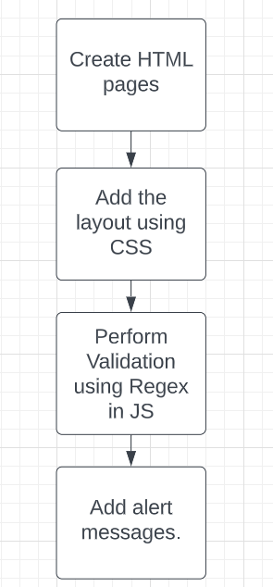
SYSTEM ARCHITECTURE

Slide 6
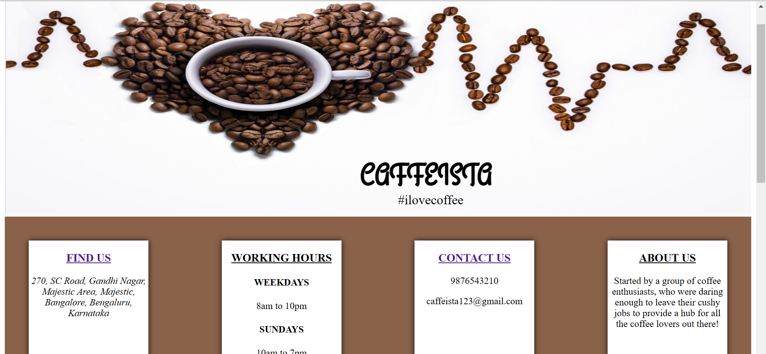
METHODOLOGY
The HTML pages have been created and linked with one another using anchor tags.
The icons and fonts were referred from other sources.
The validation of the login credentials has been carried out using Javascript.

Slide 7
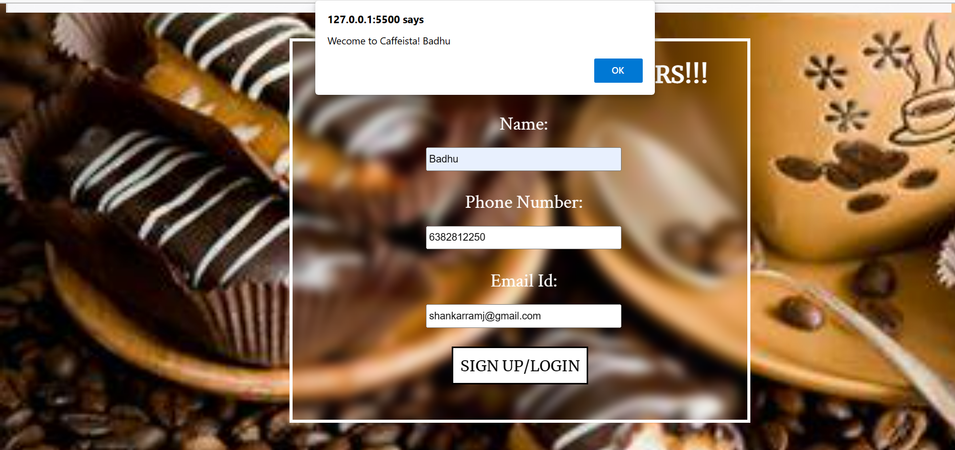
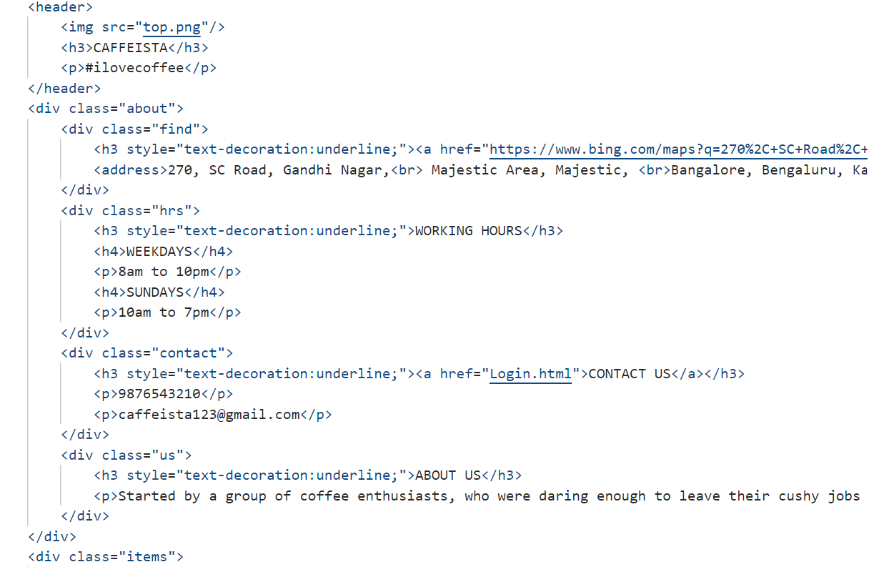
IMPLEMENTATION

Slide 8
CONCLUSION
The multi page responsive website has been created using HTML, CSS and Javascript.
The future works of this website includes working on validating in Javascript, creating payment interface and displaying orders of previous transactions.
The future versions will include displaying total, connecting to a database to maintain records of orders and displaying food based on customer preferences.
The payment interface is under development.

