Slide 1

Arabic dialect Prediction

Slide 2
Agenda
Methodology.
Pipeline.

Slide 3
Pipeline
Step 1.
Step 2.
Data Resampling
Step 4.
Training and Prediction
Step 5.
Deployment
Step 3.
Text preprocessing
Exploratory Data Analysis

Slide 4
Methodology
Step 1. Exploratory Data Analysis
Step 2. Data Resampling
Step 3. Text preprocessing
Step 4. Training and Prediction
Step 5. Deployment
Through the following procedures we hope to reach the lowest RMSE and highest R2 values for this regression problem:

Slide 5
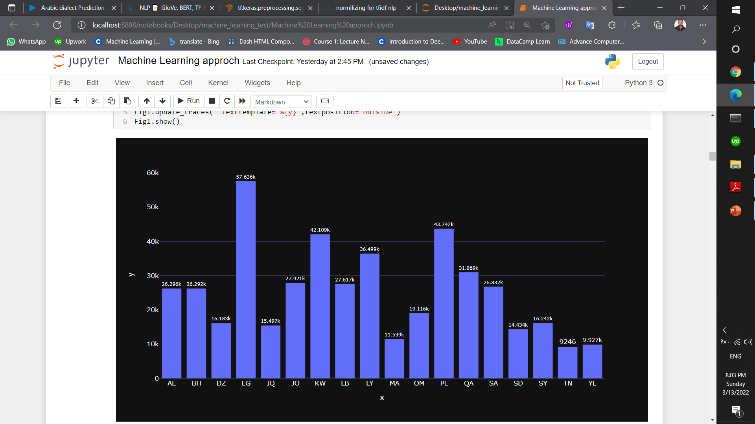
Step 1.
Step 2.
Data Resampling
Step 4.
Training and Prediction
Step 5.
Deployment
Step 3.
Text preprocessing
Pipeline
Exploratory Data Analysis
Data is Imbalanced and that can cause a lot of frustration, so we need to balance our data

Slide 6
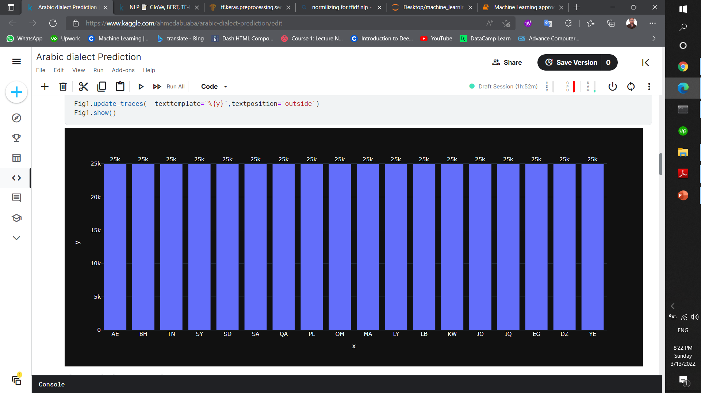
Pipeline
Step 1.
Step 2.
Data Resampling
Step 4.
Training and Prediction
Step 5.
Deployment
Step 3.
Text preprocessing
Exploratory Data Analysis
Data Resampling
By using resampling Technique:
using over-sampling method that can add more copies to the minority class.
using under-sampling method that can delete instances from the over-represented class.

Slide 7
Pipeline
Step 1.
Step 2.
Data Resampling
Step 4.
Training and Prediction
Step 5.
Deployment
Step 3.
Exploratory Data Analysis
Text preprocessing
Prepare our data by removing some useless information, so our model can learn from it easily by removing:
Punctuation
URLs
Newline character
Emoji
Multi spaces
Some Repeated letters

Slide 8
Pipeline
Step 1.
Step 2.
Data Resampling
Step 4.
Training and Prediction
Step 5.
Deployment
Step 3.
Text preprocessing
Exploratory Data Analysis
Training and Prediction
Classical ML approach
For training and prediction, Starting with Classical ML approach ,I used (Random Forest) For Machine learning model using TFIDF with n-gram=(1 , 3)
Before Preprocessing & Resampling | After Preprocessing & Resampling
13 % | 51 %

Slide 9
Pipeline
Step 1.
Step 2.
Data Resampling
Step 4.
Training and Prediction
Step 5.
Deployment
Step 3.
Text preprocessing
Exploratory Data Analysis
Training and Prediction
Deep Learning approach
For deep learning I used Multi-dialect-Arabic-BERT trained on 10M Arabic tweets.
Before Preprocessing & Resampling | After Preprocessing & Resampling
47 % | 64 %

Slide 10
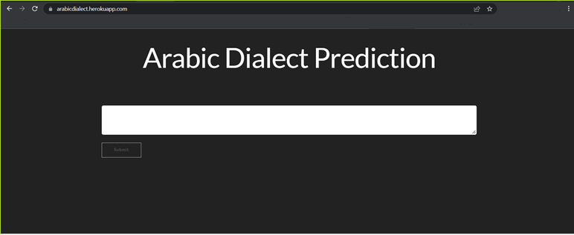
Pipeline
Step 1.
Step 2.
Data Resampling
Step 4.
Training and Prediction
Step 5.
Step 3.
Text preprocessing
Exploratory Data Analysis
Deployment
https://arabicdialect.herokuapp.com/

Slide 11
THANK YOU

