Slide 1
Chapter 3 – Agile Software Development

Slide 2
Topics covered
Agile methods
Plan-driven and agile development
Extreme programming
Agile project management
Scaling agile methods

Slide 3
Rapid software development
Rapid development and delivery is now often the most important requirement for software systems
New software is needed to be developed quickly to take advantage of new opportunities and to respond to competitive pressure. Rapid development and delivery is therefore now often the most critical requirement for software systems.
Software has to evolve quickly to reflect changing business needs.
Rapid software development
Rapid software development processes are designed to produce useful software quickly.
The software is not developed as a single unit but as a series of increments, with each increment including new system functionality.

Slide 4
Rapid software development
Although there are many approaches to rapid software development, they share some fundamental characteristics:
Specification, design and implementation are interleaved;
System is developed as a series of versions with stakeholders involved in specifying and evaluating each version;
System user interfaces are often developed using an interactive development environment (IDE) that allows the interface design to be quickly created by drawing and placing icons on the interface;

Slide 5
Agile methods
Dissatisfaction with the overheads involved in software methods of the 1980s and 1990s (i.e., heavyweight, plan-driven development approaches) led to the creation of agile methods. These methods:
Focus on the code rather than the design and documentation.
Agile methods universally rely on an incremental approach to software specification, development, and delivery.
Are intended to deliver working software quickly and evolve this quickly to meet changing requirements.
They are best suited to application development where the system requirements usually change rapidly during the development process.
The aim of agile methods is to reduce overheads in the software process (e.g. by limiting documentation) and to be able to respond quickly to changing requirements without too much rework.

Slide 6
The principles of agile methods
Principle | Description
Customer involvement | Customers should be closely involved throughout the development process. Their role is provide and prioritize new system requirements and to evaluate the iterations of the system.
Incremental delivery | The software is developed in increments with the customer specifying the requirements to be included in each increment.
People not process | The skills of the development team should be recognized and exploited. Team members should be left to develop their own ways of working without prescriptive processes.
Embrace change | Expect the system requirements to change and so design the system to accommodate these changes.
Maintain simplicity | Focus on simplicity in both the software being developed and in the development process. Wherever possible, actively work to eliminate complexity from the system.

Slide 7
Agile method applicability
Agile methods have been very successful for some types of system development:
Product development where a software company is developing a small or medium-sized product for sale.
Custom system development within an organization, where there is a clear commitment from the customer to become involved in the development process and where there are not a lot of external rules and regulations that affect the software.

Slide 8
Problems with agile methods
Agile methods success depend on having a customer who is willing and able to spend time with the development team and who can represent all system stakeholders. However, it can be difficult to keep the interest of customers who are involved in the process.
Team members may be unsuited to the intense involvement that characterizes agile methods, and therefore not interact well with other team members.,
Prioritizing changes can be difficult where there are multiple stakeholders. Typically, each stakeholder gives different priorities to different changes.

Slide 9
Problems with agile methods
Maintaining simplicity requires extra work. Under pressure from delivery schedules, the team members may not have time to carry out desirable system simplifications.
It is difficult for organizations to move to a working model in which processes are informal and defined by development teams.

Slide 10
Plan-driven and agile development
Agile development
Agile approaches to software development consider design and implementation to be the central activities in the software process. They incorporate other activities, such as requirements elicitation and testing, into design and implementation.
Specification, design, implementation and testing are inter-leaved and the outputs from the development process are decided through a process of negotiation during the software development process.

Slide 11
Plan-driven and agile development
Plan-driven development
A plan-driven approach is based around separate development stages with the outputs to be produced at each of these stages planned in advance.
The outputs from one stage are used as a basis for planning the following process activity.
Not necessarily waterfall model – plan-driven, incremental development is possible
Iteration occurs within activities with formal documents used to communicate between stages of the process. For example, the requirements will evolve and, ultimately, a requirements specification will be produced. This is then an input to the design and implementation process.

Slide 12
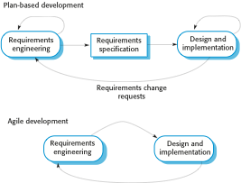
Plan-driven and agile specification

Slide 13
Technical, human, organizational issues
Most projects include elements of plan-driven and agile processes. Deciding on the balance depends on answering the following questions:
Is it important to have a very detailed specification and design before moving to implementation? If so, you probably need to use a plan-driven approach.
Is an incremental delivery strategy, where you deliver the software to customers and get rapid feedback from them, realistic? If so, consider using agile methods.
How large is the system that is being developed? Agile methods are most effective when the system can be developed with a small co-located team who can communicate informally. This may not be possible for large systems that require larger development teams so a plan-driven approach may have to be used.

Slide 14
Technical, human, organizational issues
What type of system is being developed?
Plan-driven approaches may be required for systems that require a lot of analysis before implementation (e.g. real-time system with complex timing requirements).
What is the expected system lifetime?
Long-lifetime systems may require more design documentation.
What technologies are available to support system development?
Agile methods rely on good tools to keep track of an evolving design
How is the development team organized?
If the development team is distributed or if part of the development is being outsourced, then you may need to develop design documents to communicate across the development teams.

Slide 15
Technical, human, organizational issues
Are there cultural or organizational issues that may affect the system development?
Traditional engineering organizations have a culture of plan-based development, as this is the norm in engineering.
How good are the designers and programmers in the development team?
It is sometimes argued that agile methods require higher skill levels than plan-based approaches in which programmers simply translate a detailed design into code
Is the system subject to external regulation?
If a system has to be approved by an external regulator (e.g. the Federal Aviation Authority (FAA) approve software that is critical to the operation of an aircraft) then you will probably be required to produce detailed documentation as part of the system safety case.

Slide 16
Extreme programming
Perhaps the best-known and most widely used agile method.
For example, in XP, several new versions of a system may be developed by different programmers, integrated and tested in a day.

Slide 17
Extreme programming
The XP process to produce an increment of the system that is being developed can be as the following:
Requirements are expressed as scenarios (called user stories)
Select which user stories are going to be implemented for each system release and dates for those releases.
User stories are implemented directly as a series of tasks.
Programmers work in pairs and develop tests for each task to verify when the stories are finished correctly
All tests must be successfully executed when new code is integrated into the system.

Slide 18
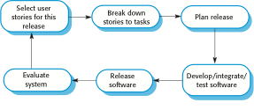
The extreme programming release cycle

Slide 19
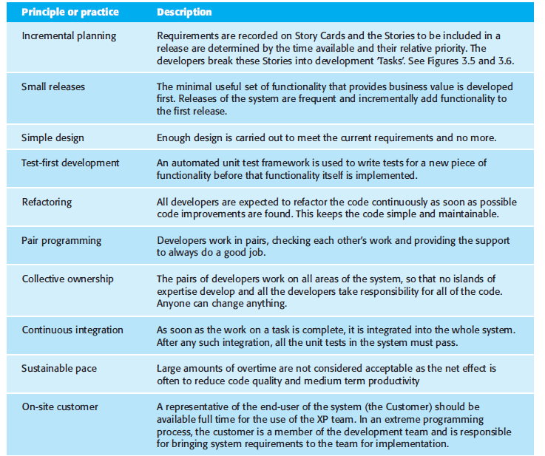
Extreme programming practices

Slide 20
XP and agile principles
Customer involvement means full-time customer engagement with the team.
Incremental development is supported through small, frequent system releases.
People not process are supported through pair programming, collective ownership, and a sustainable development process that does not involve excessively long working hours.
Change is supported through regular system releases, test-first development, refactoring to avoid code degeneration, and continuous integration of new functionality.
Maintaining simplicity through constant refactoring of code.

Slide 21
Requirements scenarios
In XP, a customer or user is part of the XP team and is responsible for making decisions on requirements.
User requirements are expressed as scenarios or user stories.
These are written on cards and the development team break them down into implementation tasks. These tasks are the basis of schedule and cost estimates.
The customer chooses the stories for inclusion in the next release based on their priorities and the schedule estimates.

Slide 22
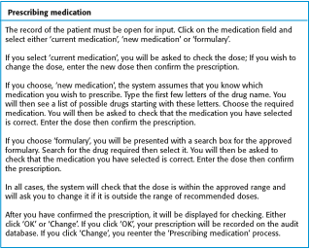
A ‘prescribing medication’ story

Slide 23
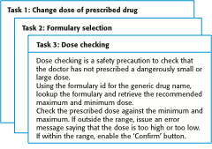
Examples of task cards for prescribing medication

Slide 24
Refactoring
Programming team look for possible software improvements and make these improvements even where there is no immediate need for them.
This improves the understandability of the software and so reduces the need for documentation.
Changes are easier to make because the code is well-structured and clear.
However, some changes requires architecture refactoring and this is much more expensive.

Slide 25
Examples of refactoring
Re-organization of a class hierarchy to remove duplicate code.
Tidying up and renaming attributes and methods to make them easier to understand.
The replacement of inline code with calls to methods that have been included in a program library.

Slide 26
Pair programming
In XP, programmers work in pairs, sitting together to develop code. However, the same pairs do not always program together. Rather, pairs are created dynamically so that all team members work with each other during the development process.
Measurements suggest that development productivity with pair programming is similar to that of two people working independently.
The sharing of knowledge that happens during pair programming is very important as it reduces the overall risks to a project when team members leave.

Slide 27
Advantages of pair programming
The use of pair programming has a number of advantages:
This helps develop common ownership of code and spreads knowledge across the team.
It serves as an informal review process as each line of code is looked at by at least two people.
It encourages refactoring as the whole team can benefit from this.

Slide 28
Scaling agile methods
Agile methods have proved to be successful for small and medium sized projects that can be developed by a small co-located team.
success of agile methods comes because of improved communications which is possible when everyone is working together.
Scaling up agile methods involves changing these to cope with larger, longer projects where there are multiple development teams, perhaps working in different locations.

Slide 29
Large systems development
Large software system development is different from small system development in a number of ways:
Large systems are usually collections of separate, communicating systems, where separate teams develop each system. Frequently, these teams are working in different places, sometimes in different time zones.
Large systems are ‘Brownfield systems’, that is they include and interact with a number of existing systems. Many of the system requirements are concerned with this interaction and so don’t really lend themselves to flexibility and incremental development.

Slide 30
Large system development
Large systems and their development processes are often constrained by external rules and regulations limiting the way that they can be developed, that require certain types of system documentation to be produced, etc.
Large systems have a long procurement and development time. It is difficult to maintain coherent teams who know about the system over that period as, inevitably, people move on to other jobs and projects.
Large systems usually have a diverse set of stakeholders. It is practically impossible to involve all of these different stakeholders in the development process.

Slide 31
Scaling out and scaling up
There are two perspectives on the scaling of agile methods:
‘Scaling up’ is concerned with using agile methods for developing large software systems that cannot be developed by a small team.
‘Scaling out’ is concerned with how agile methods can be introduced across a large organization with many years of software development experience.
When scaling agile methods it is essential to maintain the fundamentals of agile methods
Flexible planning, frequent system releases, continuous integration, test-driven development and good team communications.

Slide 32
Scaling up to large systems
The critical adaptations that have to be introduced are as follows:
For large systems development, it is not possible to focus only on the code of the system. You need to do more up-front design and system documentation
Cross-team communication mechanisms have to be designed and used. This should involve regular phone and video conferences between team members and frequent, short electronic meetings where teams update each other on progress.
Continuous integration, where the whole system is built every time any developer checks in a change, is practically impossible. However, it is essential to maintain frequent system builds and regular releases of the system.

Slide 33
Scaling out to large companies
It is difficult to introduce agile methods into large companies for a number of reasons:
Project managers who do not have experience of agile methods may be reluctant to accept the risk of a new approach.
Large organizations often have quality procedures and standards that all projects are expected to follow and, because of their bureaucratic nature, these are likely to be incompatible with agile methods.
Agile methods seem to work best when team members have a relatively high skill level. However, within large organizations, there are likely to be a wide range of skills and abilities.
There may be cultural resistance to agile methods, especially in those organizations that have a long history of using conventional systems engineering processes.

Slide 34
Key points
A particular strength of extreme programming is the development of automated tests before a program feature is created. All tests must successfully execute when an increment is integrated into a system.
Scaling agile methods for large systems is difficult. Large systems need up-front design and some documentation.

