Slide 1

Data Structures
Chapter 1
Introduction to Data Structures

Slide 2
Chapter 1: Outline
01
Objectives
02
Definition of Data Structures
03
Random Access Memory
04
Software Development
05
Case Study & Exercises

Slide 3
Objectives of Chapter 1
Understand the fundamentals of Data Structures
Understand the role of Random-Access Memory (RAM)
Learn about the Software Development Cycle and the role of data structures
Applying the problem-solving steps using a Case Study

Slide 4
Definition of Data Structures
Data organization
Data management
Data storage format
that enables efficient access and modification.
Data structure is about
In other words, it is a collection of data values, the relationships among them, and the operations that can be applied to the data.

Slide 5
Data, Data, Data …
It is all about Data!
INPUT
Data
PROCESS
Data
OUTPUT
Data
Data come from Keyboard, Internet, Camera, Files, etc.
Adobe Photoshop process picture (data), and then save them to Hard Disk.
Calculator process numbers (data), perform calculations and display results.
MS Word process text (data) into something more beautiful, and send it to printer.

Slide 6
Random Access Memory
RAM
OS Kernel Space
This space is reserved for the Operating System (i.e. Windows 10)
Code Segment
OS loads programs to this section before they are executed.
Data Segment
Programs reserve space for their data in this section

Slide 7
Random Access Memory
RAM
OS Kernel Space
if(op==‘+’)
R=X+Y;
if(op==‘*”)
R=X*Y;
…
Computer Instructions move from here to CPU for execution
Code Segment
X: Y:
OP:
R:
10
15
Data is organized, manipulated, and processed here
Data
Segment
‘+’
25

Slide 8
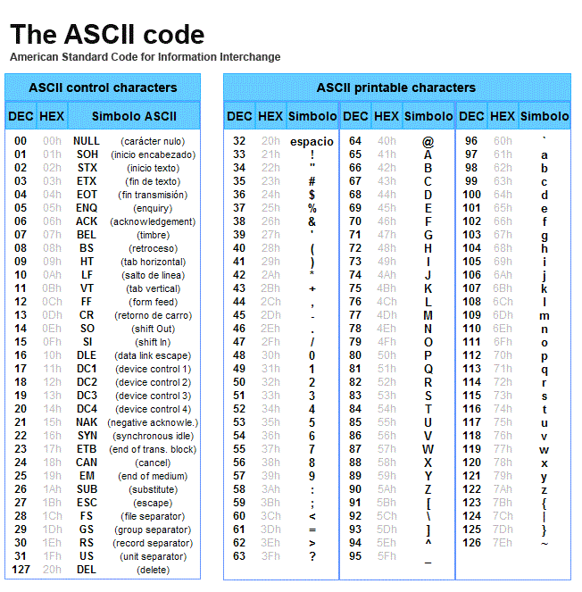
Random Access Memory
Data is store in RAM in the form of 0’s and 1’s
Groups of 0’s and 1’s are coded into symbols
Codes follow universal standers, like Unicode and ASCII code ( shown in this table ).

Slide 9
Software
Computer Software is
a group of instructions that tells a computer what to do or how to perform some tasks
Today, computers are everywhere; inside our cars, smart phones, smart TVs, inside home devices, etc…

Slide 10
Software Development
The Steps in software development are:
Identify and Understand the Problem.
Analyze the Problem.
Input.
Process.
Output.
Design Solution(s).
Choose best Solution.
Algorithms.
I/O Screens.
Databases.
Code the Solution.
Test the Solution.

Slide 11
Software Development
The Steps in software development are:
Identify and Understand the Problem.
Analyze the Problem.
Input.
Process.
Output.
Design Solution(s).
Choose best Solution.
Algorithms.
I/O Screens.
Databases.
Code the Solution.
Test the Solution.
What is required to solve the Problem?
List of Requirements
Scope
Scope defines the boundaries of the problem. For Example:
If we are required to design a
University Registration System, then
An Employees Payroll is considered
out of the scope!

Slide 12
Software Development
The Steps in software development are:
Identify and Understand the Problem.
Analyze the Problem.
Input.
Process.
Output.
Design Solution(s).
Choose best Solution.
Algorithms.
I/O Screens.
Databases.
Code the Solution.
Test the Solution.
Where does the data come from?
The Keyboard (Default Input)
Text File
Database
Internet
Camera
Hard Coded
etc.

Slide 13
Software Development
The Steps in software development are:
Identify and Understand the Problem.
Analyze the Problem.
Input.
Process.
Output.
Design Solution(s).
Choose best Solution.
Algorithms.
I/O Screens.
Databases.
Code the Solution.
Test the Solution.
A Set of Instructions, for example:
Assignment Statements: x=10;
Mathematical Expressions: y=y+1;
Decision Control Structures: if(x>5)x++;
Looping Control Structures: while(x>1)x--;

Slide 14
Software Development
The Steps in software development are:
Identify and Understand the Problem.
Analyze the Problem.
Input.
Process.
Output.
Design Solution(s).
Choose best Solution.
Algorithms.
I/O Screens.
Databases.
Code the Solution.
Test the Solution.
Where does the data go to?
The Screen (default output)
Text File
Database
Printer
etc.

Slide 15
Software Development
The Steps in software development are:
Identify and Understand the Problem.
Analyze the Problem.
Input.
Process.
Output.
Design Solution(s).
Choose best Solution.
Algorithms.
I/O Screens.
Databases.
Code the Solution.
Test the Solution.
What are the alternatives?
At this stage we may need to conduct a feasibility study, and check other solutions too.

Slide 16
Software Development
The Steps in software development are:
Identify and Understand the Problem.
Analyze the Problem.
Input.
Process.
Output.
Design Solution(s).
Choose best Solution.
Algorithms.
I/O Screens.
Databases.
Code the Solution.
Test the Solution.
What is Algorithm?
Algorithm is a set of instructions that solve a problem.

Slide 17
Software Development
The Steps in software development are:
Identify and Understand the Problem.
Analyze the Problem.
Input.
Process.
Output.
Design Solution(s).
Choose best Solution.
Algorithms.
I/O Screens.
Databases.
Code the Solution.
Test the Solution.
The Types of Algorithms are:
Pseudocodes
Flowcharts

Slide 18
Software Development
The Steps in software development are:
Identify and Understand the Problem.
Analyze the Problem.
Input.
Process.
Output.
Design Solution(s).
Choose best Solution.
Algorithms.
I/O Screens.
Databases.
Code the Solution.
Test the Solution.
The Types of Algorithms are:
Pseudocodes
Flowcharts
English like step-by-step instructions
to problem solving

Slide 19
Software Development
The Steps in software development are:
Identify and Understand the Problem.
Analyze the Problem.
Input.
Process.
Output.
Design Solution(s).
Choose best Solution.
Algorithms.
I/O Screens.
Databases.
Code the Solution.
Test the Solution.
Start
Read A
Read B
The Types of Algorithms are:
C= A+B
Pseudocodes
Flowcharts
Print C
Example: Read two numbers (A and B), store their sum in (C), then print the sum.
Stop

Slide 20
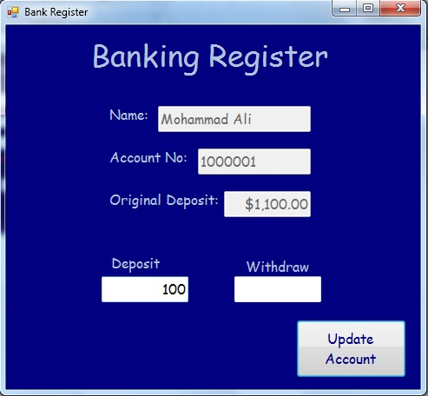
Software Development
The Steps in software development are:
Identify and Understand the Problem.
Analyze the Problem.
Input.
Process.
Output.
Design Solution(s).
Choose best Solution.
Algorithms.
I/O Screens.
Databases.
Code the Solution.
Test the Solution.
A visual Presentation of the Input/Output Screens.
Example: Banking Register

Slide 21
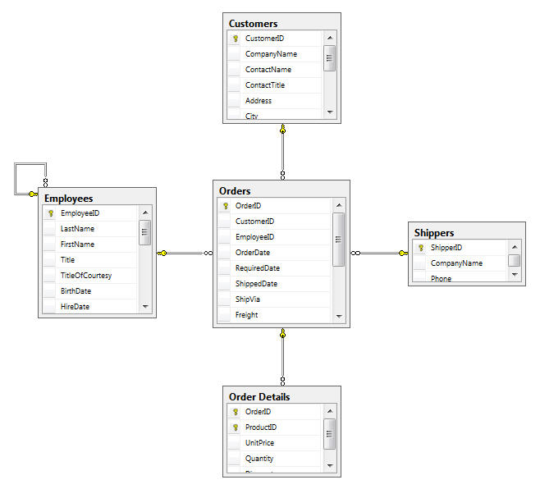
Software Development
The Steps in software development are:
Identify and Understand the Problem.
Analyze the Problem.
Input.
Process.
Output.
Design Solution(s).
Choose best Solution.
Algorithms.
I/O Screens.
Databases.
Code the Solution.
Test the Solution.
Managing Data in related tables.
Example: Ordering System

Slide 22
Software Development
The Steps in software development are:
Identify and Understand the Problem.
Analyze the Problem.
Input.
Process.
Output.
Design Solution(s).
Choose best Solution.
Algorithms.
I/O Screens.
Databases.
Code the Solution.
Test the Solution.
Examples:
C / C++
C#
Java
Python
JavaScript
PHP
Visual Basic
Oracle / DBMS
etc…
Choose suitable Programming Language

Slide 23
Software Development
The Steps in software development are:
Identify and Understand the Problem.
Analyze the Problem.
Input.
Process.
Output.
Design Solution(s).
Choose best Solution.
Algorithms.
I/O Screens.
Databases.
Code the Solution.
Test the Solution.
Examples:
Visual Studio
Visual Studio Code
JGrasp
Eclipse
NetBeans
IntelliJ IDEA
BlueJ
Code::Blocks
etc…
Choose good IDE
(Integrated Development Environment)

Slide 24
Case Study: Library System
The activities of the library system:
Borrow Book
Return Book
Search for Book

Slide 25
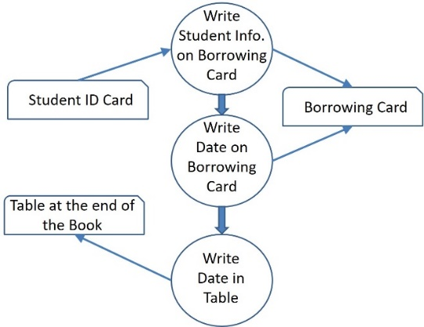
Case Study: Library System
Borrow Book:

Slide 26
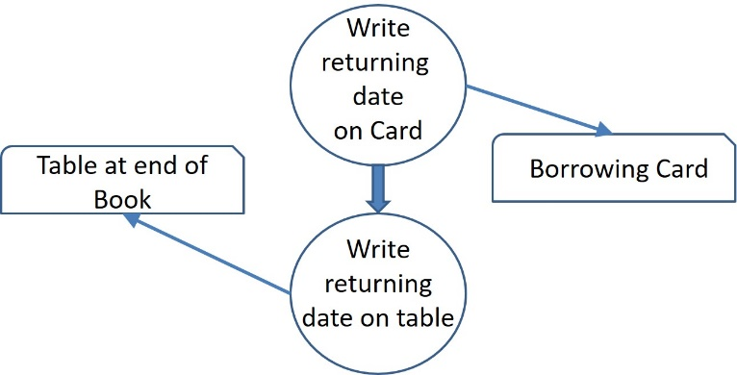
Case Study: Library System
Return Book:

Slide 27
Case Study: Library System
Search for Book:
Look for Book’s Card in drawer!
Look for book on the shelves!

Slide 28
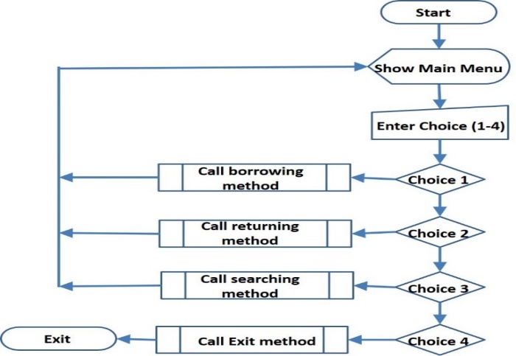
Case Study: Library System
Design the Main Algorithm:

Slide 29
Case Study: Library System
Design the Main Menu:
My Books Library
Main Menu
Borrow Book
Return Book
Search
Exit
Enter your choice (1-4): _

Slide 30
Case Study: Library System
Design the Borrow Book Screen:
My Books Library
Borrow Book
Enter Student ID: _______
Enter Book ID: ________
Student Name: XXXXXXXXXXXX
Book Title: XXXXXXXXXXXX
Correct? (Y/N) ___

Slide 31
Case Study: Library System
Design the Return Book Screen:
My Books Library
Return Book
Enter Book ID: ________
Student Name: XXXXXXXXXXXX
Book Title: XXXXXXXXXXXX
Correct? (Y/N) ___

Slide 32
Exercises
Data Structures is about
Organizing data
Managing data
Storing data
All of the above
Programs reserve space for data in the
Hard Disk
Magnetic Tape
Main Memory
Read-Only Memory
Data may take the form of
Numbers
Strings
Characters
All of the above
When we run a program, the operating system loads it into
ROM
RAM
CPU
OS
Boot Loaders are small programs that live in
ROM
RAM
CPU
Hard Disk

Slide 33
Exercises
The smallest unit of data is the
Byte
Bit
Number
Word
Coding Systems are developed to standardize the
CPU
data
computer instructions
operating systems
We declare variables in our programs to hold
codes
data
operating systems
instructions
The aim of studying data structures is to
develop computer hardware
develop computer software
write machine instructions
analyze programs
The first step for problem-solving is
analyze the problem
understand the problem
design the solution
write computer code

Slide 34
Data Structures
Linear
None-Linear
( Push, Pop )
( LIFO )
Stack
Queue
Tree
Graph
( Binary Trees, Heaps, Traversing BT )
( Insert, Remove )
( FIFO )
( Undirected Graphs, Digraphs)
( Graph Search)
Definition
Operations
Implementations
Real-Life Examples
Array-Based
Linked-Based
Postorder
Inorder
Preorder
Depth-First Search
Breadth-First Search
Linked Lists, Circular Doubly Linked Lists
Stacks: Balancing Brackets, Prefix -> Infix, Postfix Evaluation.
Queues: Print Buffers, Print Spoolers, Simulation Problems, Palindromes.
Trees: Heap Sort, Priority Queues, BSTs, Tree Sort, Huffman Coding.
Graphs: Transportation Networks, Flow Graphs, Games Graphs, Communications )

Slide 35
End of Chapter

