Slide 1
SAGE-HE
Secure Adaptive Gated Ensemble for
Privacy-Preserving Steel Surface Defect Classification
RESEARCH, ARCHITECTURE & IMPLEMENTATION
SUHAIB S Z
NEU-CLS · EfficientNet-B0 + multi-scale local branch · CKKS homomorphic inference
Notes:
SAGE-HE is a dual-branch classifier for steel surface defects whose classification head runs under CKKS homomorphic encryption, so a cloud server can classify a factory's inspection data without being able to read it. The work reproduces and audits Jia et al. (2023), Journal of Cloud Computing.

Slide 2
Abstract
— Problem. Steel surface inspection is increasingly outsourced to cloud GPUs, but production imagery is commercially sensitive and leaks line yield and defect rates.
— Base paper. Jia et al. (2023) encrypt Sobel-selected image chunks under CKKS and report 97.1% on NEU-CLS — without precision, recall, split sizes or epoch count.
— Proposal. SAGE-HE pairs an EfficientNet-B0 global branch with a multi-scale local branch, selects chunks by a learned Sobel-conditioned attention rather than a fixed threshold, fuses the branches with a channel-wise gate, and compresses to a 64-d vector that is encrypted and classified by a depth-3 polynomial head.
— Result. SAGE-HE reaches 100.00% test accuracy against 93.98% for our faithful reproduction of the baseline, over 3 seeds on an identical held-out split. Encrypted and plaintext inference agree on 100.0% of test images.
— Caveat, and the main finding. NEU-CLS is saturated, so component contributions are measured in a reduced-data regime. There the full model scores *below* the bare EfficientNet-B0 backbone on every seed, and the gap closes to nothing once data is less scarce. The architectural claim is withdrawn; the reproduction, the encrypted inference and the evaluation protocol stand.
SAGE-HE · SUHAIB S Z
2
Notes:
The honest headline is twofold: we beat our reproduced baseline clearly, and we could not reproduce the published 97.1% from the paper's own description. Both facts are reported.

Slide 3
Introduction
Why surface defect classification, and why privacy changes the problem
— Hot-rolled steel strip is inspected continuously; surface defects determine whether a coil is sold, downgraded or scrapped.
— Modern classifiers are accurate but compute-hungry, which pushes inference to cloud GPUs.
— Inspection images are a direct readout of process health: defect mix and rate expose yield, machine condition and production volume.
— A mill that sends raw images to a third-party cloud is disclosing exactly the data it least wants a competitor to hold.
The tension
Accuracy wants a large model on someone else's hardware.
Confidentiality wants the data never to leave the plant.
Homomorphic encryption is the one mechanism that can serve both.
What this project does
Builds a working system on that boundary, measures its real cost, and states precisely what it does and does not protect.
SAGE-HE · SUHAIB S Z
3
Notes:
Frame the problem as an industrial one first. The privacy requirement is not hypothetical: defect statistics are commercially sensitive process data.

Slide 4
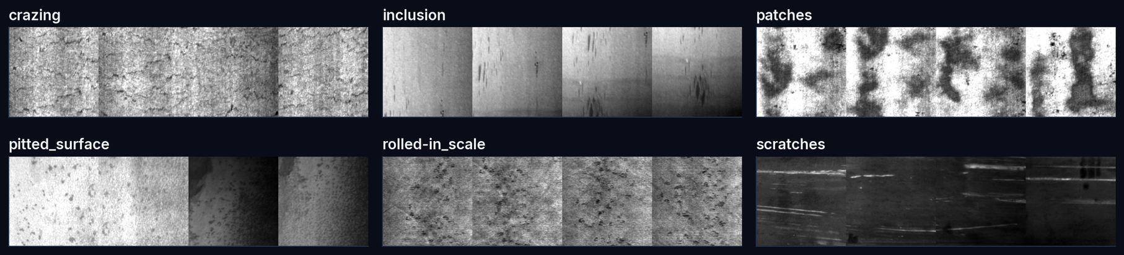
Industrial Problem Context
The six NEU-CLS defect classes
Each class has a different physical cause and a different spatial scale — which is the architectural argument for a multi-scale local branch.
SAGE-HE · SUHAIB S Z
4
Notes:
Crazing is a fine crack network; scratches are long thin lines; patches are large blobs. One receptive field cannot serve all three well.

Slide 5
Problem Statement
Can a cloud service classify steel surface defects at state-of-the-art accuracy without ever being able to read the images or the predictions — and what does that cost?
— Accuracy. The privacy mechanism must not meaningfully degrade classification.
— Practicality. Encrypted inference must run in seconds, not hours, on commodity CPU.
— Honesty of the threat model. It must be stated exactly which party learns what — a scheme that protects less than it appears to is worse than none.
— Reproducibility. The comparison against prior work must use the same held-out data, not a number quoted from a different split.
SAGE-HE · SUHAIB S Z
5
Notes:
Four requirements, each of which maps to a results slide later.

Slide 6
Research Motivation
What the base paper leaves open
— Selection is fixed and blind. Jia et al. keep chunks where the Sobel gradient exceeds a threshold τ. The rule is non-differentiable, cannot adapt to the task, and scores a lighting seam exactly as highly as a genuine defect. τ is never reported.
— The architecture is minimal. One 7×7 convolution and two fully connected layers — no mechanism for defects that live at different spatial scales.
— Evaluation is thin. Accuracy only; no precision, recall, F1, confusion matrix, split sizes or epoch count for NEU-CLS.
— The headline comparison is cross-dataset. Table 3 ranks their NEU-CLS accuracy against other papers' results on cancer genomics, Fashion-MNIST and CIFAR-10.
SAGE-HE · SUHAIB S Z
6
Notes:
These four gaps define the contribution. Note the fourth carefully: it is a methodological criticism, made from the paper's own table.

Slide 7
Research Objectives
01
02
03
Reproduce
Improve
Encrypt
Implement Jia et al. faithfully from the published description and document every assumption it forces.
Design a defensible architecture: multi-scale local features, learned chunk selection, gated fusion.
Implement genuine CKKS inference with a stated threat model and measured overhead.
04
05
06
Measure
Explain
Report honestly
Accuracy, macro P/R/F1, confusion, ablation, encryption cost — on one identical held-out split.
Grad-CAM and attention maps, including the failure cases.
State the dataset ceiling, the negative results, and the limits of the privacy claim.
SAGE-HE · SUHAIB S Z
7
Notes:
Objective 6 is not boilerplate: the dataset ceiling and the narrowed novelty claim are both consequences of taking it seriously.

Slide 8
Dataset · NEU-CLS
Verified against the published specification, not assumed
1800
6
1
0
images, 200×200 grayscale
defect classes, 300 each
exact duplicate pair found and removed
near-duplicate leakage after audit
split
images
per class
Integrity checks
train
1223
204, 204, 203, 204, 204, 204
SHA-256 pixel hashing found one duplicate pair; it is removed before splitting so no image can span train and test.
val
216
36, 36, 36, 36, 36, 36
test
360
60, 60, 60, 60, 60, 60
SAGE-HE · SUHAIB S Z
8
Notes:
The mirror we used carries bare integer labels. The class-index mapping was resolved independently by visual inspection and corroborated by per-class texture statistics — it was not taken on faith.

Slide 9
Dataset Integrity · near-duplicate audit
NEU-CLS patches come from a limited set of source photographs, so pixel-hashing alone is not enough
representation
max sim
≥0.90
same-class
cross-class max
Conclusion: no leakage
32px
0.990
66
50%
0.984
Raw-pixel similarity is high at low resolution, but the best cross-class match is just as high — the signature of shared illumination, not repeated content. With illumination removed, no test image matches any training image above 0.85.
64px
0.987
58
48%
0.980
128px
0.986
48
44%
0.977
128px high-pass
0.848
0
50%
0.545
This matters: a 100% test accuracy would otherwise be indistinguishable from memorising duplicated crops. The audit is what licenses the result.
SAGE-HE · SUHAIB S Z
9
Notes:
This slide exists because the first similarity analysis looked alarming — 30 test images with a 0.95+ training match. The high-pass control showed it was an illumination artefact. Reporting the resolution is part of the honesty.

Slide 10
Literature Review
All citations machine-verified against Crossref / arXiv
work
dataset
method
relevance
Song & Yan (2013)
NEU-CLS
Completed LBP
originating dataset paper
Jia et al. (2023)
NEU-CLS
chunk CNN + CKKS
97.1% — base paper
Cheon et al. (2017)
—
CKKS scheme
the encryption we use
Tan & Le (2019)
ImageNet
EfficientNet
our global branch
Hu et al. (2018)
ImageNet
Squeeze-and-Excitation
channel-gating precedent
Lee et al. (2022)
—
minimax polynomial
higher-degree alternative to square
Elkhatib et al. (2025)
CIFAR-10
PRISM, CKKS + poly
closest prior art on boundary design
15 of 15 citations resolved to verifiable publisher metadata (scripts/verify_citations.py → reports/citations_verified.json). Works that could not be verified are listed in the report but are not cited as evidence.
SAGE-HE · SUHAIB S Z
10
Notes:
A recent SSRN preprint reports CKKS inference on NEU-CLS at 99.26%. It is closer prior art than anything here, but it is unrefereed and we could not verify its metadata, so no claim rests on it. It is disclosed in the report.

Slide 11
Existing Approaches · the benchmark is saturated
This single fact shapes the entire experimental design
— Published NEU-CLS results cluster at 99%+: shallow attention CNNs, wavelet texture descriptors and modern backbones all report near-ceiling accuracy.
— We reproduce that ceiling directly: a pretrained EfficientNet-B0 reaches 100% test accuracy on our split within two epochs.
— At ceiling, every architectural variant scores identically. An ablation run at full training size would rank noise and present it as evidence.
Consequence for this project
Component contributions are measured in a reduced-data regime (15% of the training split, ~30 images per class), where the objective still has dynamic range. Full-data numbers are reported too — and reported as a ceiling, not as a ranking.
This is the difference between an ablation that measures something and an ablation that decorates a conclusion.
SAGE-HE · SUHAIB S Z
11
Notes:
If a reviewer takes one methodological point from this deck, it should be this one.

Slide 12
Base Paper · Jia et al. (2023)
Journal of Cloud Computing 12:175 · DOI 10.1186/s13677-023-00537-0 · CC BY 4.0
— Preprocess. resize 112×112, grayscale, global histogram equalisation.
— Chunk. 28×28 subregions → a 4×4 grid of 16 chunks.
— Select. Sobel gradient per chunk; keep those above a threshold.
— Encrypt. CKKS on the retained chunks, polynomial modulus 16384.
— Classify. 7×7 conv → FC 256→128 → FC 128→6; square activation under encryption.
97.1%
235 ms
806 MB
reported NEU-CLS accuracy (Table 3)
encrypt feature chunks only (Table 2)
Galois keys at n=16384 (Table 1)
SAGE-HE · SUHAIB S Z
12
Notes:
Read directly from the open-access full text and its tables, not from a summary.

Slide 13
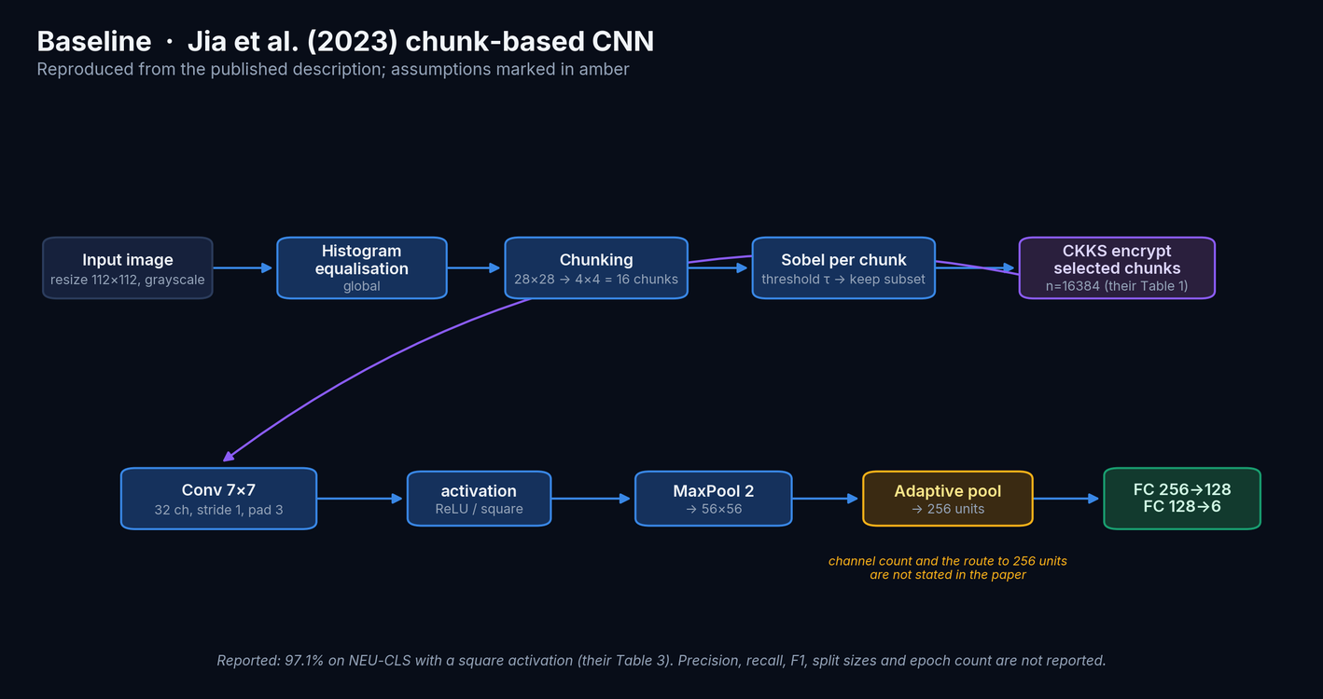
Base Paper Architecture
Reproduced; amber marks what the paper does not state
SAGE-HE · SUHAIB S Z
13
Notes:
Our reproduction had to choose a channel count and a pooling route to the stated 256-unit FC input, because neither is given. Both choices are documented.

Slide 14
Base Paper · limitations found on close reading
Stated to scope a fair comparison, not to disparage the work
Cross-dataset comparison
No P / R / F1 for NEU-CLS
Table 3 ranks their NEU-CLS result against TCGA genomics, Fashion-MNIST and CIFAR-10.
Accuracy only; NEU-CLS results appear as figures, not tables.
Protocol unreported
Chunk size inconsistent
Split sizes, epochs, learning rate and batch size are absent.
28×28 in one section, 28×26 in two others; only 28×28 fits Table 2.
CKKS expanded incorrectly
Encryption improves accuracy
“Complex Key-Value Storage” in one section.
Reported, but CKKS is approximate — it adds error, not signal.
SAGE-HE · SUHAIB S Z
14
Notes:
The last one is the most serious: an approximate scheme cannot add information. It suggests the plaintext and encrypted numbers came from different protocols.

Slide 15
01
Research Gap and Proposed Solution
From a fixed photometric threshold to a learned, measured selection
Notes:
Section divider.

Slide 16
Research Gap
dimension
Jia et al. (2023)
SAGE-HE
chunk selection
fixed threshold |∇| > τ
learned score + Sobel prior, λ measured
spatial scales
single 7×7 receptive field
1×1 / 3×3 / dilated / 5×5 in parallel
branch combination
none (single path)
channel-wise gated fusion
what is encrypted
selected image chunks
compressed 64-d feature vector
evaluation
accuracy only
macro P/R/F1, confusion, CI, ablation
comparison
across different datasets
same held-out split for both models
Every row is a testable claim
Spoiler, stated up front
Each line maps to a component slide and to a numbered ablation stage, so none of them has to be taken on trust.
The last two rows survive contact with the evidence. Most of the first four do not — the ablation later in this deck is where that is shown.
SAGE-HE · SUHAIB S Z
16
Notes:
Each row of this table maps to a component slide and to an ablation stage. Flagging the outcome here keeps the middle of the deck from reading as a set of claims that were never tested.

Slide 17
Proposed Solution · SAGE-HE
Secure Adaptive Gated Ensemble with Homomorphic Encryption
— Global branch. EfficientNet-B0, ImageNet-pretrained, adapted to one input channel.
— Local branch. Multi-scale CNN with four parallel receptive fields per block.
— Adaptive selection. Chunk attention scored by a learned MLP plus a Sobel prior weighted by a learnable λ.
— Gated fusion. A per-channel gate z mixes the branches: z·g + (1−z)·l.
— Compression. 256 → 64, tanh-bounded — the vector that gets encrypted.
— Encrypted head. W₂·square(W₁v + b₁) + b₂ evaluated under CKKS.
Design constraint that drives everything
Only a depth-3 polynomial is affordable under CKKS. So the network is split: arbitrary operations client-side, polynomial-only server-side.
Trained as deployed
The head is trained with the square activation it will be evaluated with — not trained with ReLU and swapped afterwards.
The next slides explain each component and why it was expected to help. Treat them as hypotheses: the ablation later in this deck tests every one of them against the bare backbone, and most do not survive.
SAGE-HE · SUHAIB S Z
17
Notes:
The 'trained as deployed' point matters: plaintext and encrypted models are the same function up to CKKS approximation error, which the results confirm.

Slide 18
Novelty and Contributions
Stated narrowly, because the surrounding literature is dense
NOT CLAIMED AS NOVEL
WHAT ACTUALLY HOLDS UP
— Splitting a network so only a polynomial head is encrypted — this is PRISM (2025) and others.
— The square activation for CKKS — the base paper and CryptoNets lineage.
— Dual-branch global/local designs, or gating as a mechanism.
— EfficientNet on NEU-CLS.
— A reproduction and audit of the base paper it does not provide: macro metrics, confusion, CIs, and eight documented under-specifications.
— Genuine CKKS inference with a quantified exactness bound, not just an agreement count.
— An evaluation protocol that stays informative on a saturated benchmark — and that is what exposed the result below.
— An explicit threat-model comparison that states what is NOT protected.
The proposed architecture is NOT among the contributions
The learned Sobel-conditioned chunk selection was the one genuinely new piece. Measured against its own backbone under matched seeds, it costs accuracy. We report that rather than claim an architectural advance — see the ablation.
SAGE-HE · SUHAIB S Z
18
Notes:
Being specific about what is not novel is what makes the remaining claim credible — and the proposed architecture did not survive its own ablation.

Slide 19
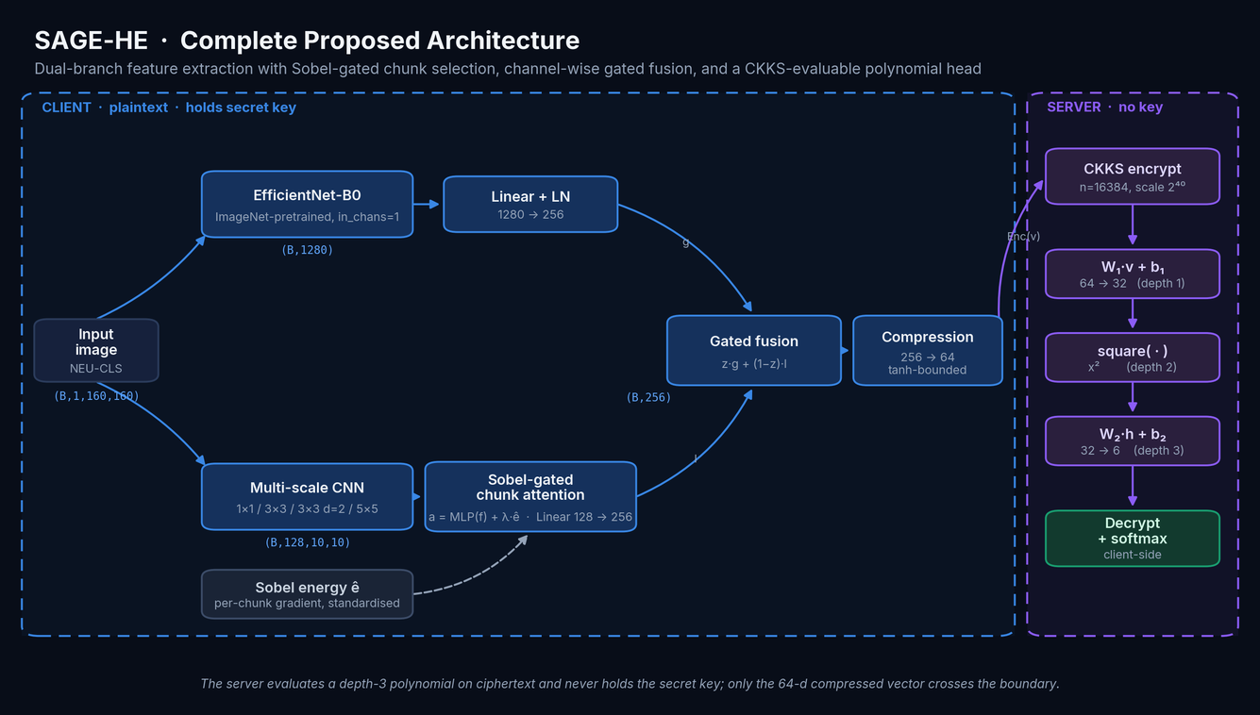
Complete Proposed Architecture
SAGE-HE · SUHAIB S Z
19
Notes:
Everything left of the purple boundary is plaintext on the client. Only the 64-d vector crosses. The server evaluates three multiplications and returns six encrypted logits.

Slide 20
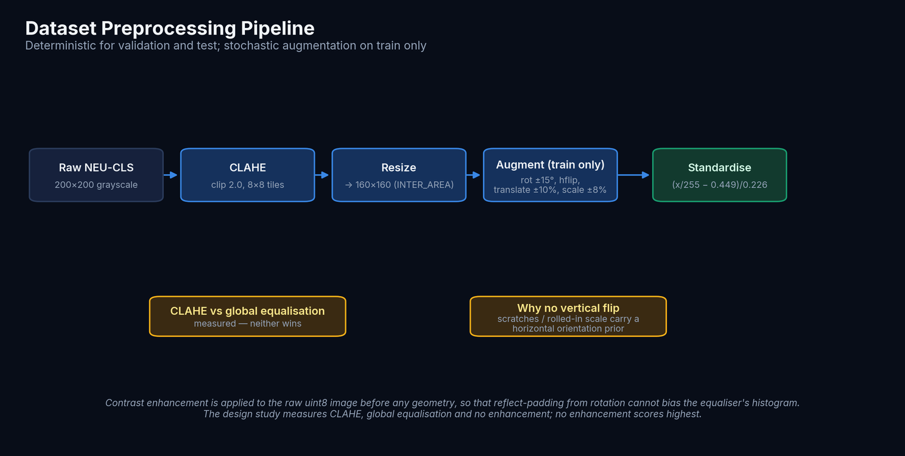
Data Preprocessing
CLAHE replaces the base paper's global equalisation — a choice the design study measures
SAGE-HE · SUHAIB S Z
20
Notes:
The hypothesis was that global equalisation crushes the low-contrast crazing texture while CLAHE preserves it. The design study does not support it: no contrast enhancement at all scores highest.

Slide 21
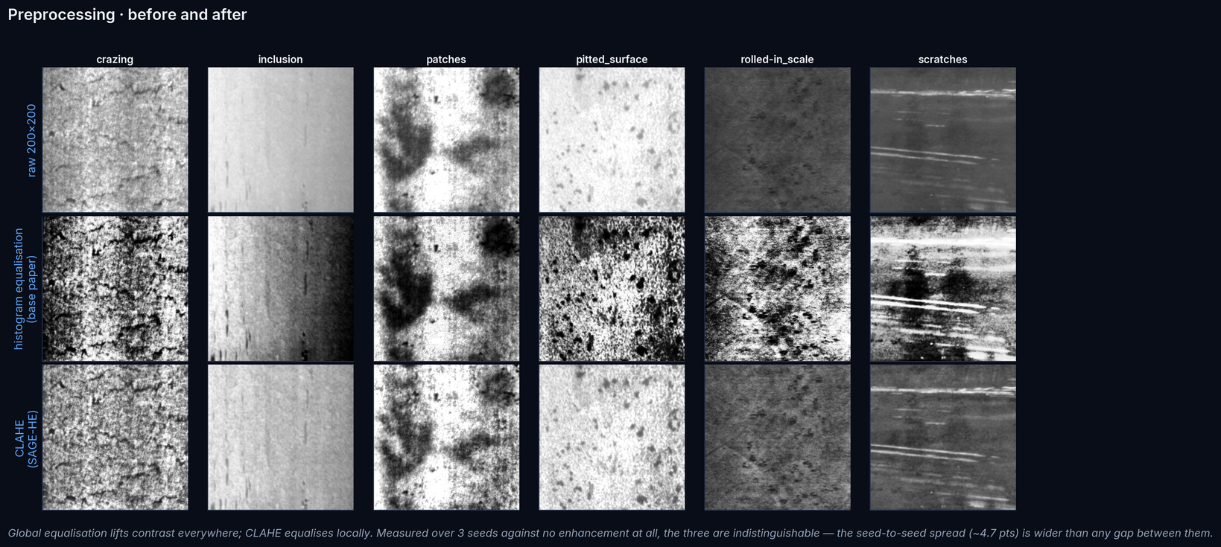
Preprocessing · before and after
The same six images under the base paper's contrast step and ours
SAGE-HE · SUHAIB S Z
21
Notes:
Global equalisation applies one intensity mapping to the whole frame and flattens the fine crazing texture; CLAHE equalises locally and preserves it. The choice is ablated in the design study, not asserted here.

Slide 22
Global Feature Extraction · EfficientNet-B0
Pretrained weights, adapted to a single-channel input
— Why EfficientNet-B0. Compound scaling gives strong ImageNet features at ~4.0 M parameters — the accuracy/compute point that fits a CPU-trained project.
— Grayscale adaptation. timm's in_chans=1 sums the pretrained RGB stem filters rather than replicating the channel, preserving filter response magnitude.
— Projection. 1280-d pooled features → Linear + LayerNorm → 256-d, matching the local branch.
— Transfer matters most when data is scarce. This is visible in the learning curve: the gap over a from-scratch CNN widens as training data shrinks.
component
parameters
global branch
4,335,420
local branch
190,816
chunk attention
8,322
fusion
197,120
compression
16,448
encrypted head
2,278
TOTAL
4,750,404
SAGE-HE · SUHAIB S Z
22
Notes:
The encrypted head is only ~2.3k parameters — that is what makes homomorphic evaluation affordable at all.

Slide 23
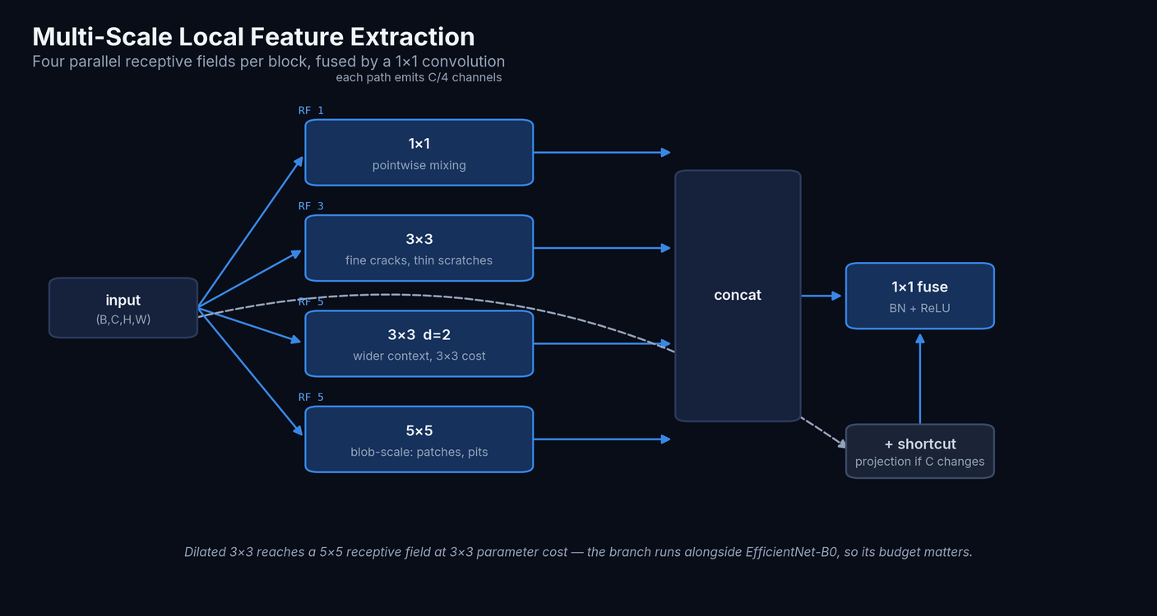
Multi-Scale Local Branch
Four parallel receptive fields per block, fused by a 1×1 convolution.
SAGE-HE · SUHAIB S Z
23
Notes:
Dilated 3×3 gives a 5×5 receptive field at 3×3 cost — the branch has to be cheap because it runs alongside EfficientNet.

Slide 24
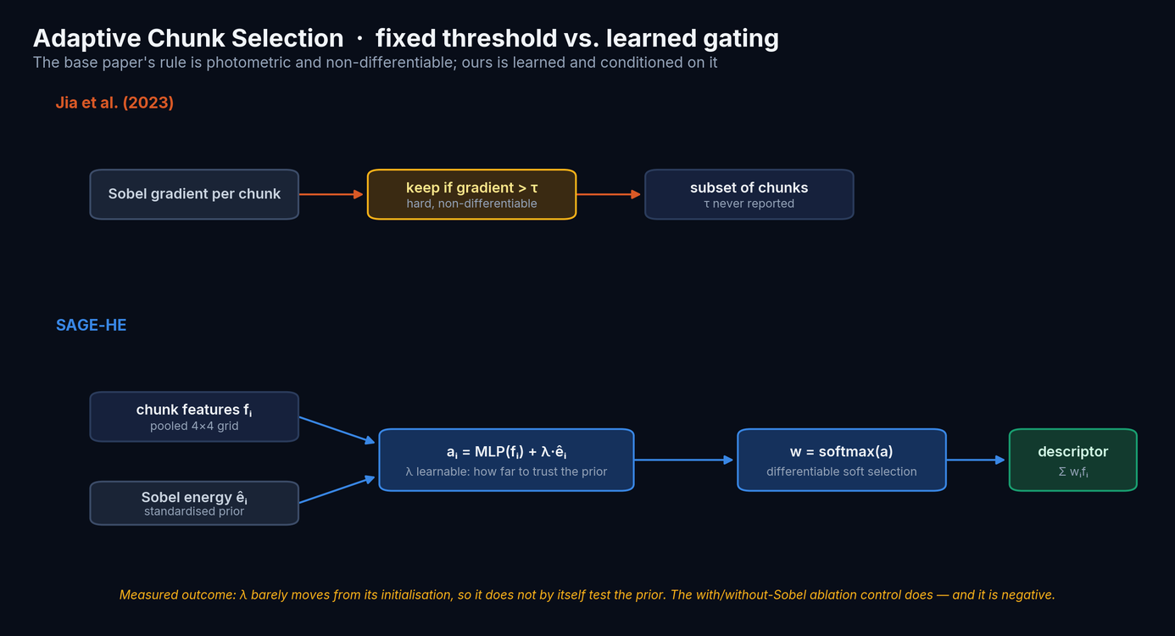
Adaptive Chunk Selection
The base paper's rule is photometric and non-differentiable; ours is learned and conditioned on it.
SAGE-HE · SUHAIB S Z
24
Notes:
λ was meant to be the headline readout. It is not — see the ablation; the with/without-Sobel control is what actually answers this, and it is negative.

Slide 25
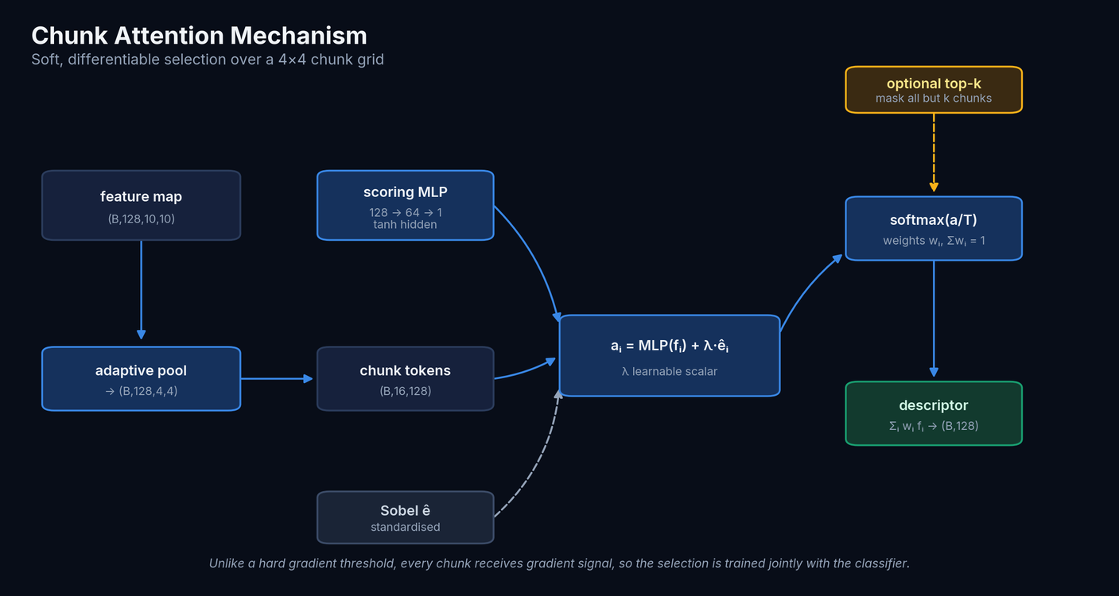
Chunk Attention Mechanism
Soft, differentiable selection over the 4×4 chunk grid.
SAGE-HE · SUHAIB S Z
25
Notes:
Every chunk receives gradient, so selection is trained jointly with the classifier.

Slide 26
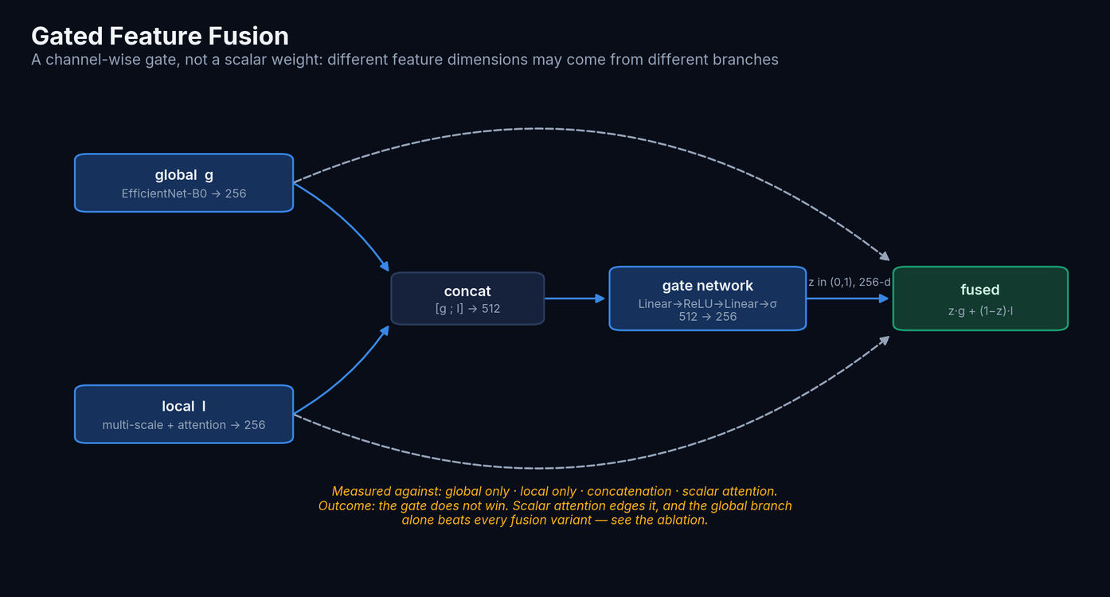
Gated Feature Fusion
A channel-wise gate, not a scalar weight.
SAGE-HE · SUHAIB S Z
26
Notes:
The model can take some dimensions from the global branch and others from the local one.

Slide 27
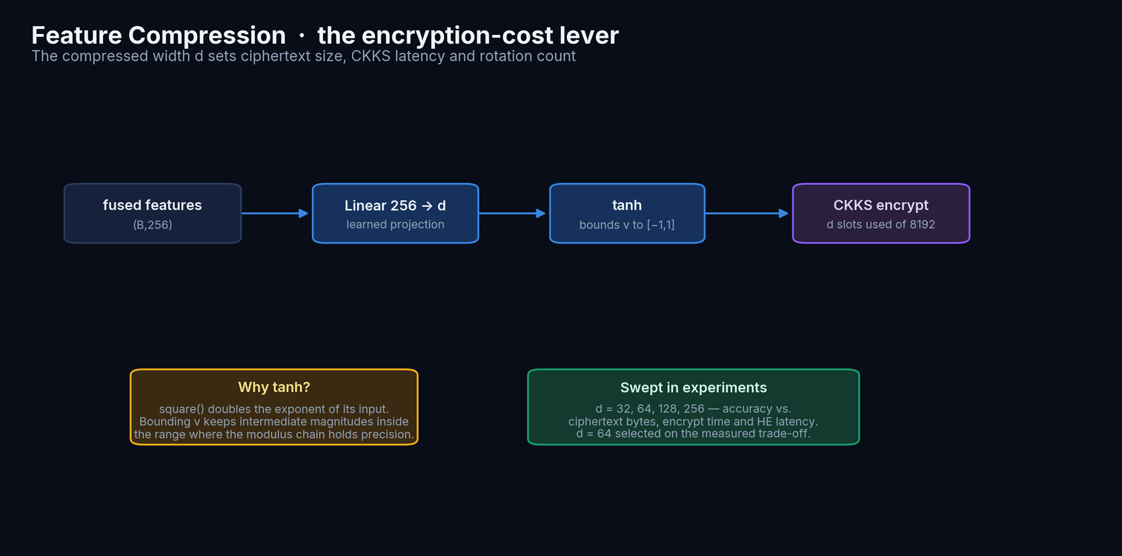
Feature Compression
The compressed width d is the encryption-cost lever.
SAGE-HE · SUHAIB S Z
27
Notes:
tanh matters numerically: square() doubles the exponent of its input.

Slide 28
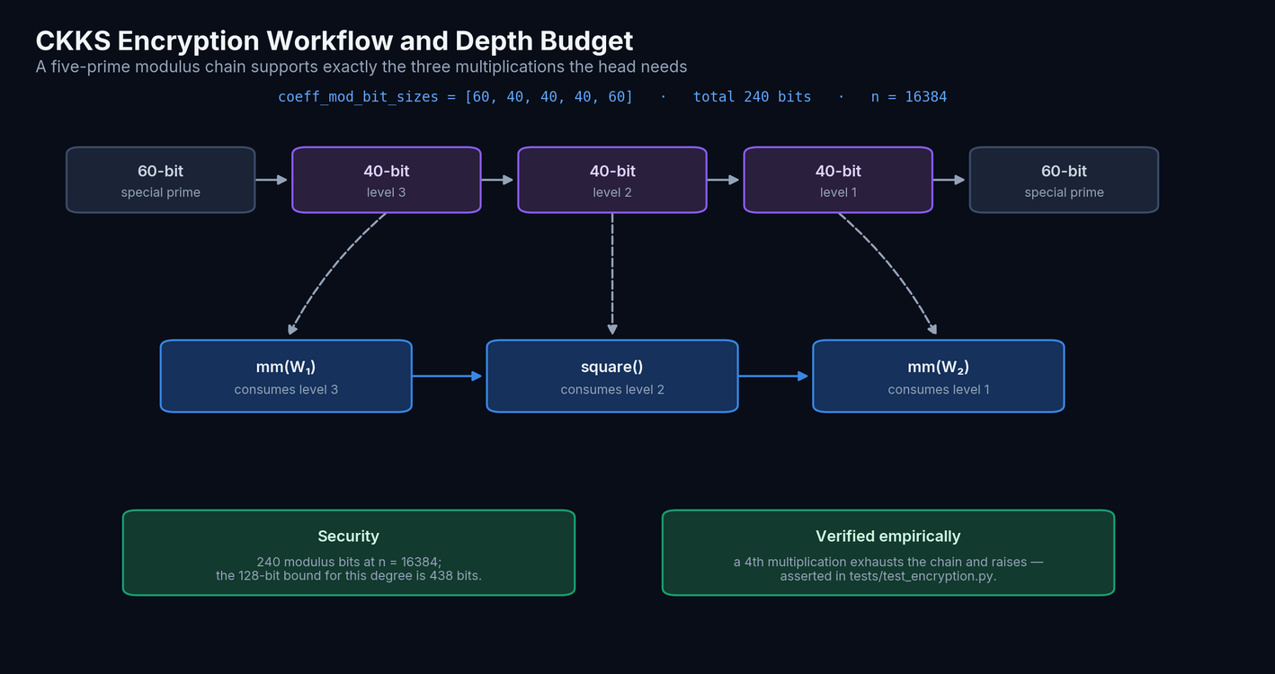
CKKS Encryption
A five-prime modulus chain supports exactly the three multiplications the head needs.
SAGE-HE · SUHAIB S Z
28
Notes:
240 modulus bits at n=16384, against a 438-bit budget for 128-bit security.

Slide 29
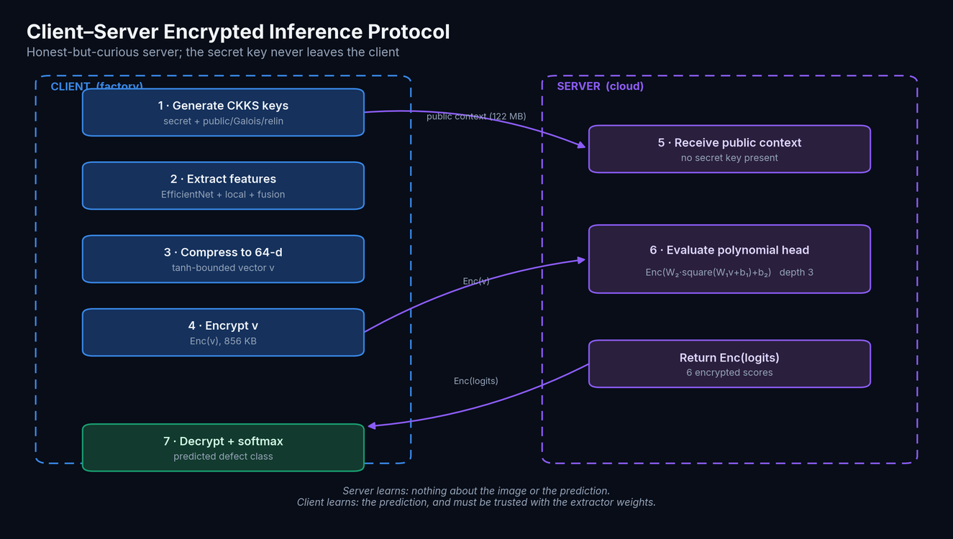
Encrypted Inference Workflow
Honest-but-curious server; the secret key never leaves the client.
SAGE-HE · SUHAIB S Z
29
Notes:
The server holds a public-only context. Our tests assert it cannot decrypt.

Slide 30
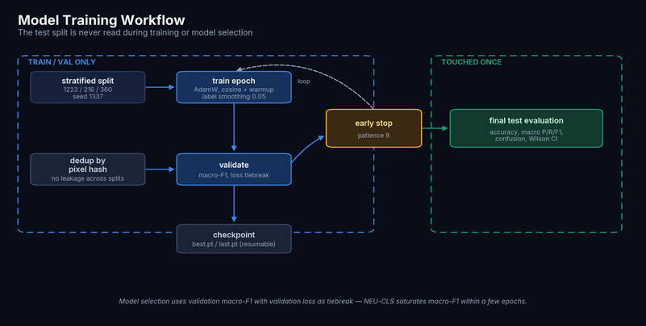
Training Methodology
— Optimiser. AdamW, cosine schedule with linear warm-up, gradient clipping at 5.0.
— Loss. Cross-entropy with 0.05 label smoothing.
— Selection. Validation macro-F1, with validation loss as tiebreak — NEU-CLS saturates macro-F1 within a couple of epochs, so the tiebreak is what picks a well-calibrated model rather than the first lucky epoch.
— Hygiene. Fixed seeds, saved split manifests, resumable checkpoints; the test split is read exactly once, after selection.
SAGE-HE · SUHAIB S Z
30
Notes:
The loss tiebreak is a small detail with a real effect: without it, 'best' means 'first epoch to reach F1 1.0', which is noise.

Slide 31
Experimental Configuration
Identical data and protocol for both models
setting
value
No GPU was used
dataset
NEU-CLS, 1799 images after deduplication
The project brief specifies GPU training. None was available, so every model was trained on CPU and every latency is a CPU latency. Reported rather than papered over; the code selects CUDA automatically where present.
split
1223 train / 216 val / 360 test, stratified, seed 1337
seeds
3 independent training seeds per architecture
SAGE-HE input
160×160, CLAHE
baseline input
112×112, histogram equalisation (as published)
hardware
4-vCPU x86-64, no GPU — all timings are CPU timings
CKKS
n=16384, [60,40,40,40,60], scale 2⁴⁰, depth 3
SAGE-HE · SUHAIB S Z
31
Notes:
Being explicit that these are CPU timings is important for interpreting the encrypted-inference latency.

Slide 32
Hyperparameter Optimisation · Optuna
Run in the reduced-data regime, where the objective still has dynamic range
15
0.9862
10%
8
TPE trials
best validation macro-F1
training data per trial
epochs per trial
parameter
best value
parameter
importance
contrast
histeq
lr
0.899
lr
0.0005304883441224623
use_sobel
0.039
weight_decay
1.2242594760084797e-06
contrast
0.025
batch_size
16
fusion
0.017
compressed_dim
64
head_hidden
0.013
head_hidden
64
compressed_dim
0.006
fusion
gated
use_sobel
False
The search could pick the fusion strategy, the compressed width, the head width, the contrast step and whether to use the Sobel prior at all. It puts 0.899 of the importance on `lr` alone and 0.099 on every architectural choice combined — and its best trial switches the Sobel prior off. A completely different procedure, pointing the same way as the ablation.
SAGE-HE · SUHAIB S Z
32
Notes:
On full data every trial would score macro-F1 1.0 and the study would rank noise. That is why the search runs at reduced data.

Slide 33
02
Experimental Results
One held-out test split, read once, for every number that follows

Slide 34
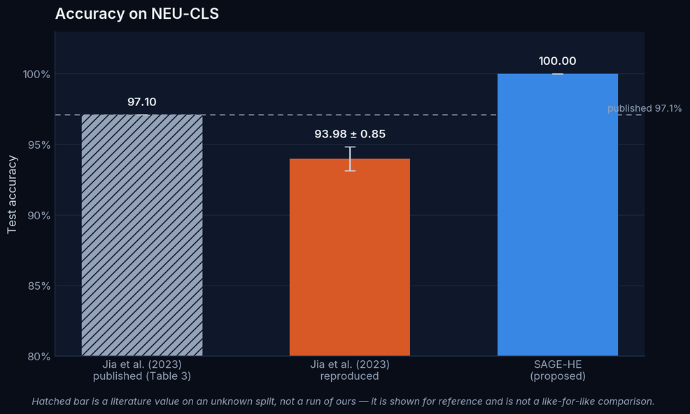
Accuracy Comparison
Mean ± standard deviation over 3 seeds, identical held-out split
Read this carefully
SAGE-HE beats our reproduced baseline by 6.0 points. It does NOT follow that it beats the published 97.1%, which was measured on an unknown split.
Reproduction finding
Our faithful reproduction reaches 93.98%, below the published 97.1%. We could not reproduce the paper's figure from its own description — reported as a result in its own right.
This margin is NOT evidence for the proposed components. SAGE-HE uses a pretrained 4.7 M-parameter backbone; the baseline is a 35 k-parameter network trained from scratch, because that is what the paper describes. Transfer learning and capacity explain much of the gap — the architectural contribution is isolated in the ablation, where every stage shares the same backbone.
SAGE-HE · SUHAIB S Z
34
Notes:
The hatched bar is a literature value, visually distinguished because we did not re-run it. Conflating it with our measurements would be the single easiest way to mislead here.

Slide 35
Did the reproduction fail because of OUR assumptions?
The 97.1% claim rests on choices the paper never states — so we attacked our own finding
baseline variant (seed 42, full data)
accuracy %
The finding survives the attack
16 channels, square
95.00
Varying the two things the paper leaves unspecified — convolution width and activation — the best variant reaches 95.00%, still 2.10 points short of the published figure.
So the gap is not an artefact of our assumptions. Some other unreported detail may explain it; we cannot test what is not described.
32 channels, square (our reproduction)
94.72
64 channels, square
90.28
32 channels, ReLU
86.94
128 channels, square
86.67
published claim (Jia et al., Table 3)
97.10
A side finding
Swapping to ReLU costs 7.8 points against the square activation. On this architecture the CKKS-compatible choice is also the better-performing one — the opposite of the usual 'polynomial activation is the price of encryption' trade-off.
SAGE-HE · SUHAIB S Z
35
Notes:
This is the slide that answers the obvious objection: that we simply guessed the architecture badly. Five configurations, none reaching 97.1%.

Slide 36
Is the difference statistically real?
Both models scored on the identical 360 test images, so the comparison is paired
+5.28 pts
+3.1 to +7.8
p = 3.8e-06
19 : 0
accuracy improvement
95% bootstrap CI on the delta (pts)
McNemar, exact binomial
images gained : lost
outcome on a test image
count
Why McNemar and not a two-sample test
both correct
341
The two models see the same images, so the predictions are paired. McNemar looks only at the images where they disagree and asks whether the split is more lopsided than a coin flip.
Here every one of the 19 disagreements went the same way: SAGE-HE never missed an image the baseline got right.
SAGE-HE only correct
19
baseline only correct
0
both wrong
0
discordant pairs
19
SAGE-HE · SUHAIB S Z
36
Notes:
b = 0 and c = 19 is the strongest possible shape for this test. The exact binomial is used because the discordant count is small.

Slide 37
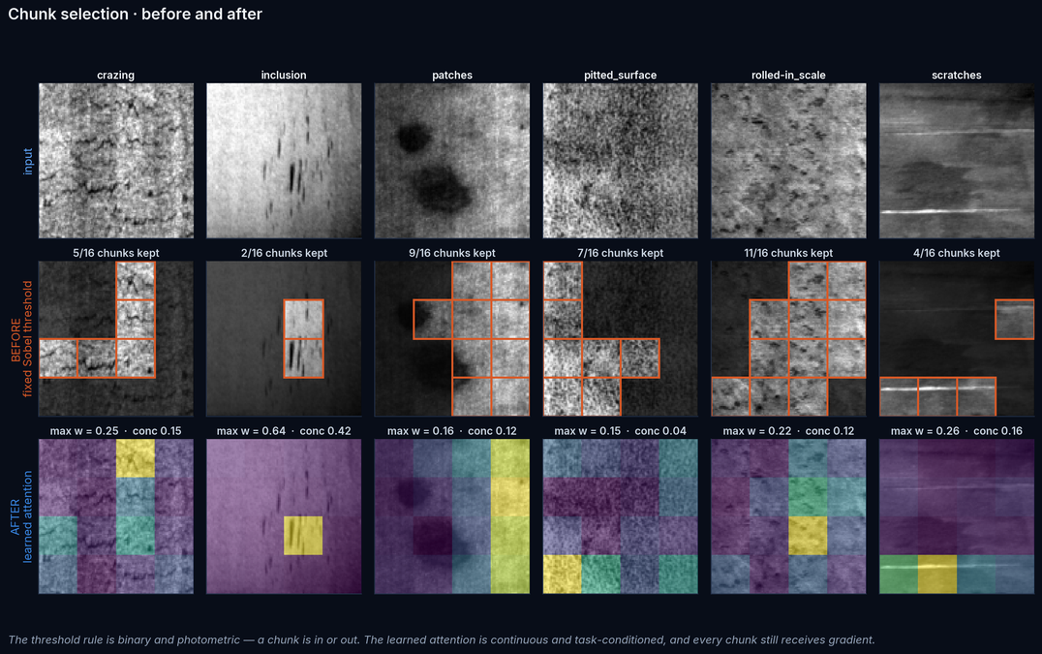
Chunk Selection · before and after, on real test images
Fixed Sobel threshold (base paper) against the learned attention, same images
The attention is not uniform noise: it concentrates on localised defects (inclusion, concentration 0.42) and spreads out on diffuse texture (pitted_surface, 0.04) — the behaviour a useful selector should show.
SAGE-HE · SUHAIB S Z
37
Notes:
Concentration is 1 − normalised entropy of the 16 attention weights: 1.0 means all mass on one chunk, 0.0 means uniform. Inclusion is a few dark streaks in one place; pitted surface is pits everywhere.

Slide 38
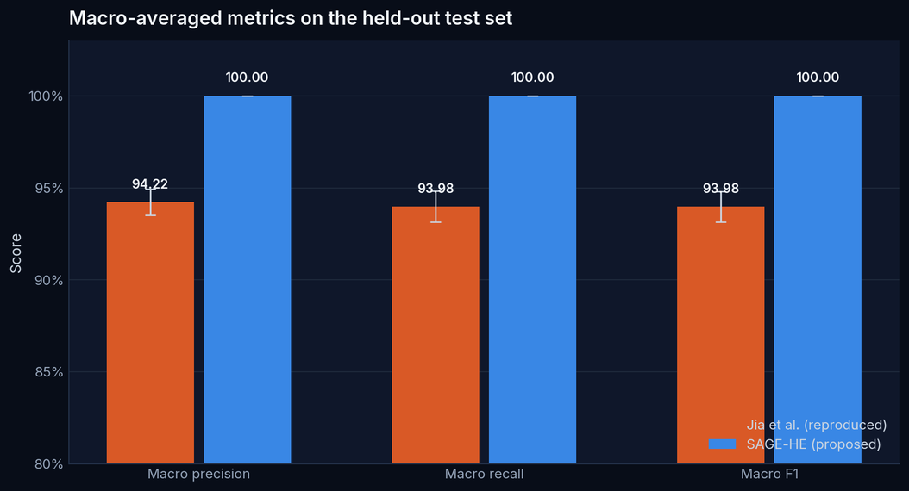
Precision and Recall
Macro-averaged — the base paper reports none of these for NEU-CLS
100.00%
100.00%
100.00%
SAGE-HE macro precision
SAGE-HE macro recall
SAGE-HE macro F1
SAGE-HE · SUHAIB S Z
38
Notes:
Macro averaging is reported because it is what survives class imbalance in a real deployment, even though NEU-CLS is balanced.

Slide 39
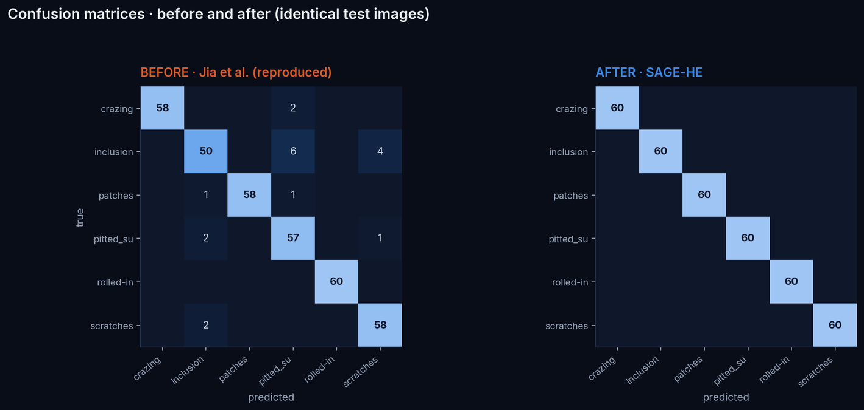
Confusion Matrices · before and after
Identical 360 test images, identical colour scale
SAGE-HE · SUHAIB S Z
39
Notes:
The baseline's errors concentrate in inclusion and pitted surface — the two lowest-contrast classes, which is what the texture statistics predict.

Slide 40
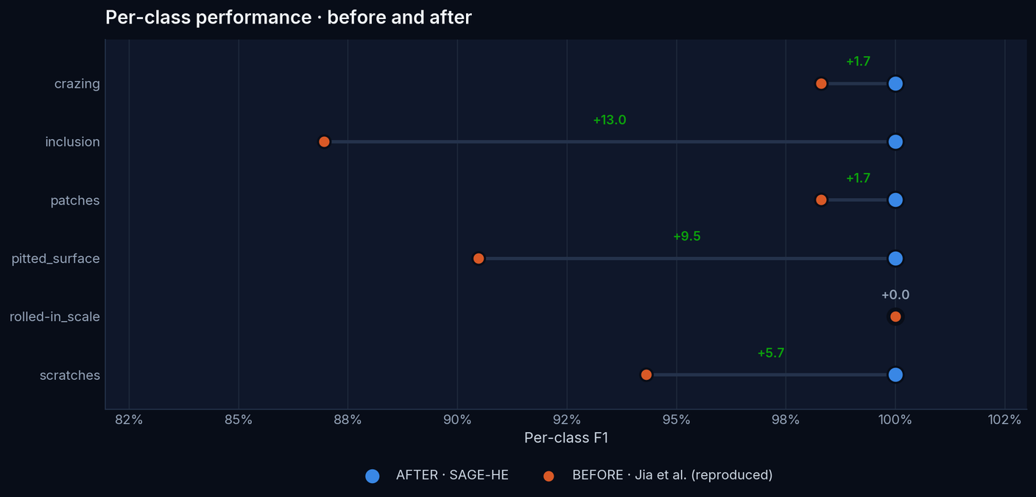
Per-Class Performance · before and after
Per-class F1 for every defect type, same test split
SAGE-HE · SUHAIB S Z
40
Notes:
Per-class numbers are the ones an inspection engineer actually cares about: a missed scratch and a missed crazing have different downstream costs.

Slide 41
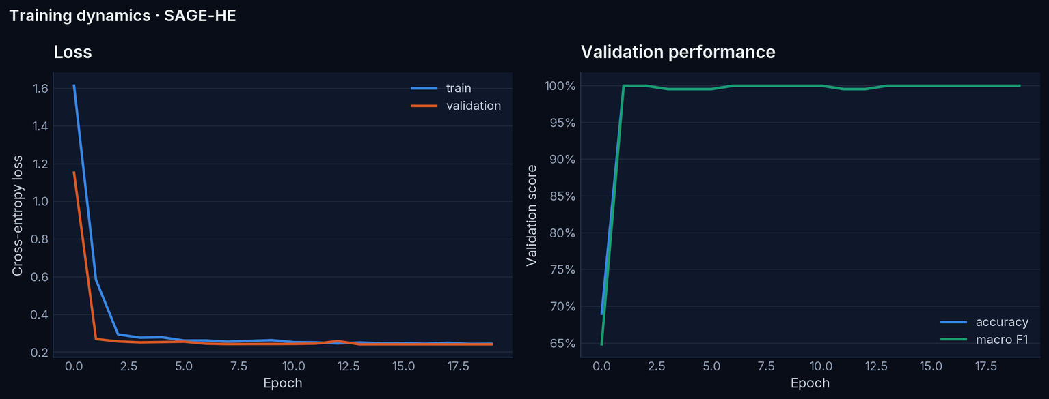
Training and Validation Curves
Validation macro-F1 reaches 1.0 within two epochs — the saturation that motivates the reduced-data ablation protocol. Validation loss keeps improving afterwards, which is what the selection tiebreak uses.
SAGE-HE · SUHAIB S Z
41
Notes:
This curve is the direct visual evidence for the ceiling argument.

Slide 42
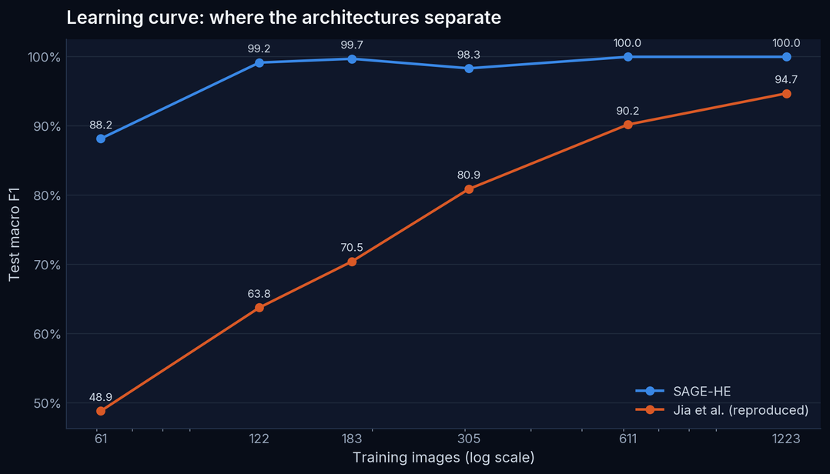
Learning Curve · where the architectures actually separate
Test macro-F1 against training-set size, same held-out test split throughout
Why this is the honest comparison
At full data both models are near ceiling and the difference is within noise. The gap is real and large in the low-data regime — which is also the regime where a factory has few labelled defect examples.
SAGE-HE · SUHAIB S Z
42
Notes:
This slide converts the saturation problem from an excuse into an experiment.

Slide 43
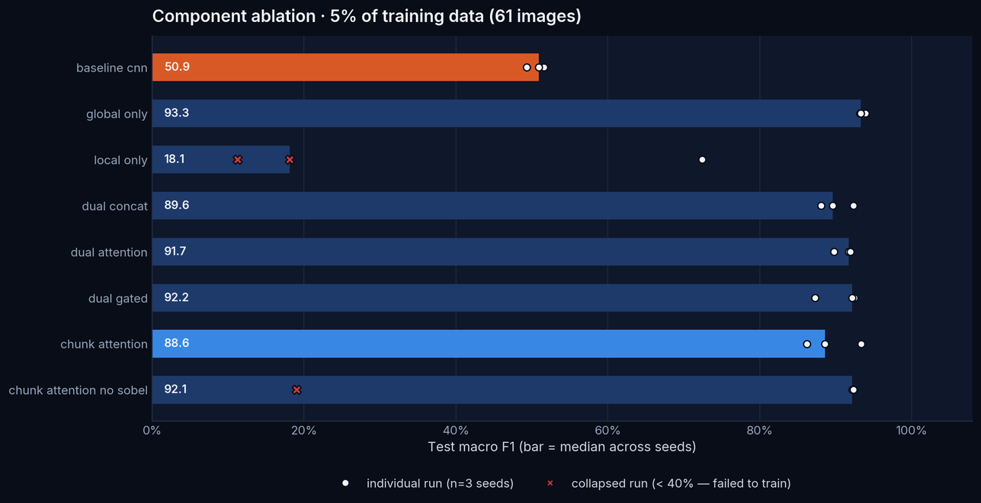
Ablation Study
Reduced-data regime (15% of training split) so components are separable
SAGE-HE · SUHAIB S Z
43
Notes:
Each bar is one of the nine stages in the project brief. The Sobel control isolates the prior's contribution directly.

Slide 44
Ablation · what the numbers say
configuration
macro F1 (mean ± sd)
accuracy
Every proposed component costs accuracy
baseline cnn
50.6 ± 1.2
51.6
adding the local branch -2.82 pts
adding chunk attention -1.26 pts
adding the Sobel prior -1.28 pts
full model vs its backbone -4.08 pts
global only
93.5 ± 0.4
93.5
local only
33.9 ± 33.5
40.0
dual concat
90.0 ± 2.1
90.0
dual attention
91.1 ± 1.2
91.2
dual gated
90.6 ± 2.9
90.9
chunk attention
89.4 ± 3.6
89.6
What is actually established
chunk attention no sobel
67.8 ± 42.3
70.6
Two contrasts hold on every seed and carry the conclusion: the local branch costs accuracy, and the full model scores below its own backbone (−0.6 to −7.0 pts, negative on all three seeds).
Finer attributions — chunk attention vs. Sobel prior — do not separate cleanly at this sample size and are not claimed.
SAGE-HE · SUHAIB S Z
44
Notes:
The Sobel row is computed with a collapsed seed excluded; including it flatters the prior by ~35 points, which would be misleading. The raw and corrected numbers are both in the report.

Slide 45
Design Studies
Each variant changes one choice against the specified configuration (89.38% macro F1)
INPUT RESOLUTION
CONTRAST ENHANCEMENT
variant
macro F1 %
variant
macro F1 %
112
87.4 ± 5.4
histeq
87.9 ± 4.3
200
91.8 ± 2.0
none
91.2 ± 4.7
COMPRESSED DIMENSION
HARD TOP-K SELECTION
variant
macro F1 %
variant
macro F1 %
128
91.1 ± 1.8
4
43.0 ± 41.9
256
90.7 ± 1.9
8
90.5 ± 2.9
32
56.9 ± 39.6
Only 2 of 9 variants differ from the reference by more than their own seed-to-seed spread — the rest are indistinguishable, not ranked. Measured at 61 training images: at full training size every variant sits at ceiling and these studies would show nothing, which is the same reason the ablation is run here.
SAGE-HE · SUHAIB S Z
45
Notes:
The compressed-dimension row is the one with downstream consequences: it sets ciphertext size and homomorphic latency, so it is the accuracy/cost lever rather than a pure accuracy choice.

Slide 46
What did not work
Reported because the evidence says so, not because it helps the story
λ never learned anything
Training collapses at 61 images
The learnable Sobel trust was meant to be a readout: drive it to zero and the model is telling us the prior is useless.
It moves by at most 0.0097 from its initialisation of 1.0 in every run. One unregularised scalar among 4.7 M parameters gets negligible gradient.
Some low-data configurations fail to train entirely — the no-Sobel control scored 19% macro F1 on one seed and 92% on another. Collapsed runs are flagged and excluded from the robust deltas rather than averaged in, because one collapse inverts the sign of a three-seed mean.
BACKBONE ALONE vs THE FULL MODEL, MATCHED SEEDS
The effect is regime-dependent
training data
backbone
full model
Δ
per-seed
Clearly harmful when labelled data is scarce; indistinguishable once it is not, as both arms reach the dataset ceiling. No measured regime shows a reliable benefit.
5%
93.46
89.38
-4.08
all negative
10%
98.81
99.35
+0.55
sign flips
SAGE-HE · SUHAIB S Z
46
Notes:
The 10% row is why the claim is 'never reliably better' rather than 'always worse'. A single seed there showed -0.56; three seeds show +0.55 with the sign flipping. Neither is outside the noise.

Slide 47
What did not work (continued)
Mechanism, and why the architecture still gets documented in full
The mechanism
The local branch has no pretraining and cannot learn from 61 images; fusing a near-random branch into a strong pretrained one adds variance and costs accuracy — that contrast is negative on every seed. The Sobel prior is photometric, so it scores a lighting seam as highly as a defect; that is the mechanism we expected to hurt, and the point estimate agrees, but the signs disagree across seeds so it is not claimed on its own.
What survives
What a follow-up should build
The negative result is about the architectural additions only. Untouched: the reproduction and audit of the base paper, the encrypted inference and its exactness bound, the dataset integrity audit — and the evaluation protocol, which is what made this visible instead of hiding it behind a saturated 100%.
EfficientNet-B0 + the compression layer + the CKKS polynomial head — the privacy architecture without the extra feature machinery. It is simpler than what was proposed, it is what the evidence supports, and the encrypted inference results carry over unchanged because the head is identical.
SAGE-HE · SUHAIB S Z
47
Notes:
A project that reported only the 100% headline would have missed all of this. The saturation-aware protocol is what made it visible.

Slide 48
Encrypted Inference · correctness
Does encryption change the prediction?
100.00%
1.43e-02
0
100.00%
encrypted vs plaintext agreement
max absolute logit error
prediction flips out of 360
accuracy under encryption
quantity
value
Why this is robust, not lucky
plaintext accuracy
100.00%
A prediction can only flip if the CKKS error exceeds half the gap between the top-1 and top-2 logits. On the tightest decision in the test set the error consumes just 0.79% of that budget — it would have to be ~126× larger before anything could change.
So agreement is a bound here, not a coincidence of this sample.
encrypted accuracy
100.00%
mean |logit error|
2.766e-03
test images evaluated
360
SAGE-HE · SUHAIB S Z
48
Notes:
Note the contrast with the base paper, which reports encryption *improving* accuracy. Our result is the expected one: identical decisions, tiny numerical error.

Slide 49
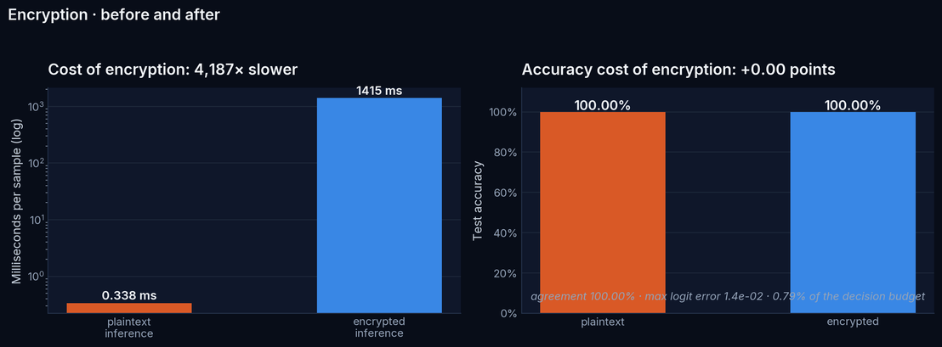
Encrypted Inference · cost
All timings on 4 vCPU, no GPU
quantity
value
client feature extraction
38 ms
encrypt (client)
16.8 ms
homomorphic evaluation
1415 ms
decrypt (client)
1.73 ms
ciphertext size
836 KB
expansion vs plaintext
3342×
server context (keys)
122 MB
peak RSS
1478 MB
SAGE-HE · SUHAIB S Z
49
Notes:
The Galois keys dominate the one-time transfer. The per-image cost is the homomorphic evaluation, which scales with the compressed dimension.

Slide 50
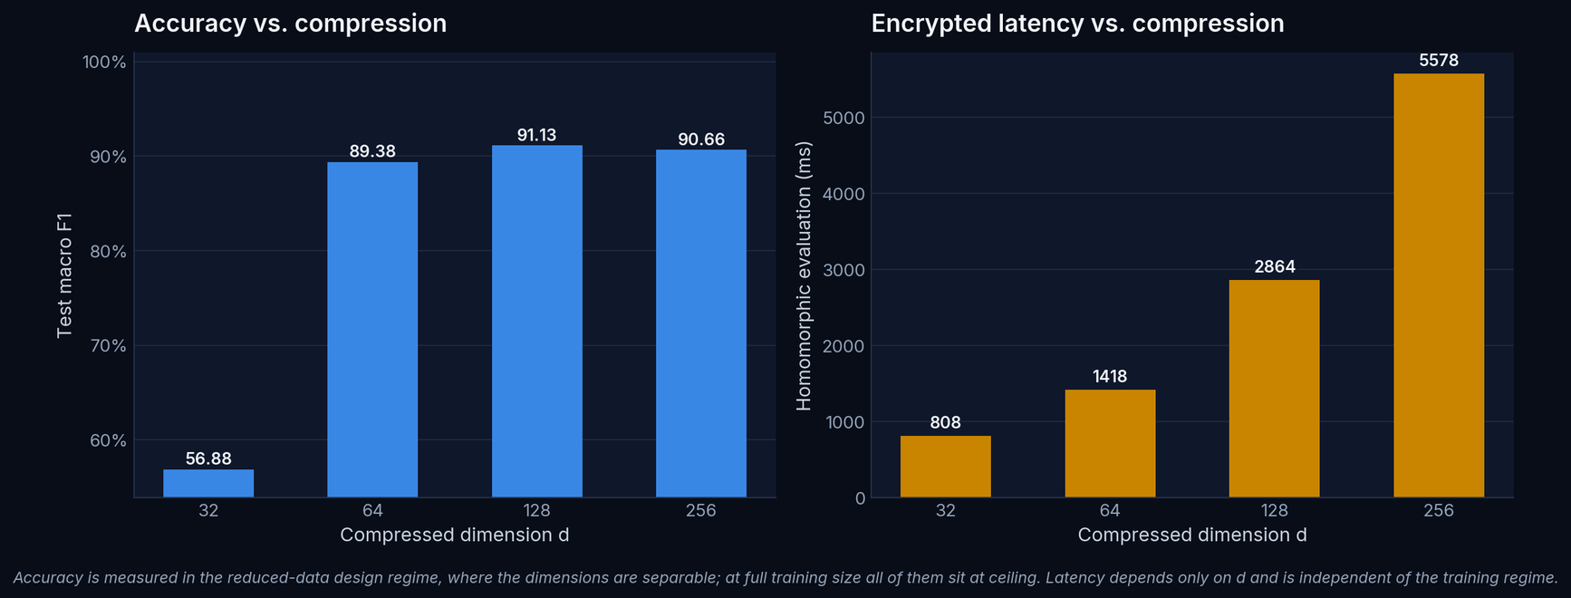
Compression Trade-off
The compressed width d is the lever between accuracy and encrypted cost
Accuracy here is measured in the reduced-data regime, where the dimensions are separable at all; at full training size they all sit at ceiling. Latency depends only on d and is independent of the training regime.
SAGE-HE · SUHAIB S Z
50
Notes:
Two panels, never two y-axes on one plot: accuracy and latency are different quantities and sharing an axis would invite a false visual comparison. They are also measured in different regimes, which the caption states.

Slide 51
Threat Model · what is and is not protected
The comparison with the base paper is not like-for-like, and we do not present it as such
PROTECTED
NOT PROTECTED
— The feature vector in transit and at rest on the server.
— The prediction: the server returns ciphertext it cannot read.
— The secret key never leaves the client — asserted by test, not by assumption.
— The client must run and therefore hold the feature extractor — unlike the base paper, where the client does little work.
— Circuit privacy: an adaptive client could learn about the server's weights. Noise flooding is not implemented.
— The compressed vector is a lossy but real function of the image; we do not claim it is a formal privacy bound.
Honest summary
SAGE-HE protects the server side of the boundary. Jia et al. aim to protect the image itself. Ours is cheaper and exact; theirs is a stronger goal. These are different trade-offs, not a ranking.
SAGE-HE · SUHAIB S Z
51
Notes:
If one slide protects the project's integrity, it is this one.

Slide 52
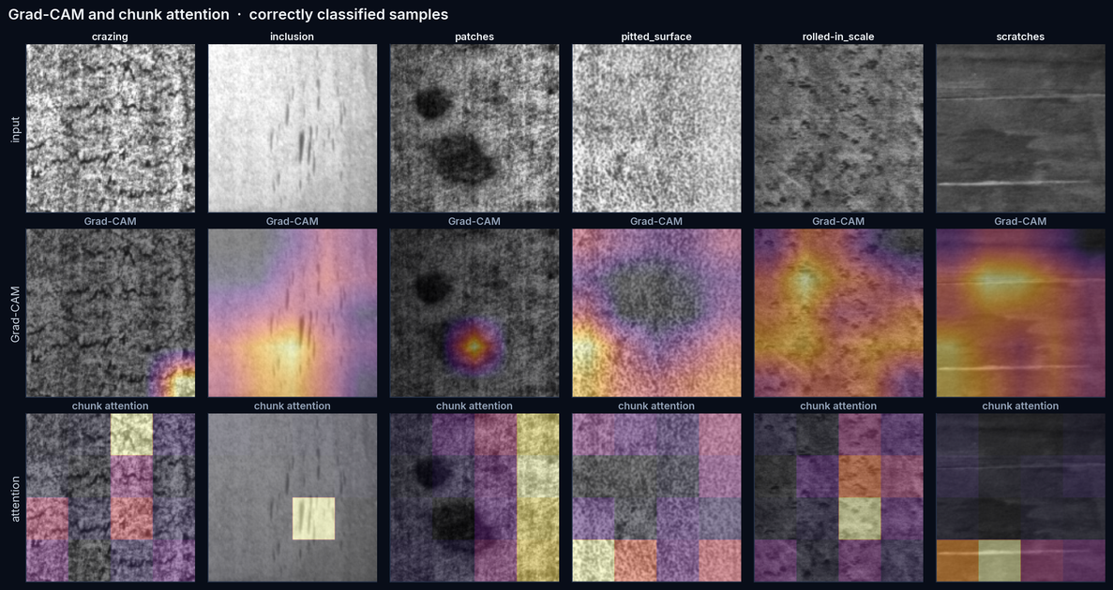
Explainable AI · Grad-CAM and chunk attention
Grad-CAM is a post-hoc gradient attribution; chunk attention is the model's own selection weight. Agreement is weak evidence the model uses the defect region — an attractive heatmap is not proof of correctness.
SAGE-HE · SUHAIB S Z
52
Notes:
The caveat is deliberate. Grad-CAM over a squared activation is less sign-stable than over a ReLU stack, which the report explains.

Slide 53
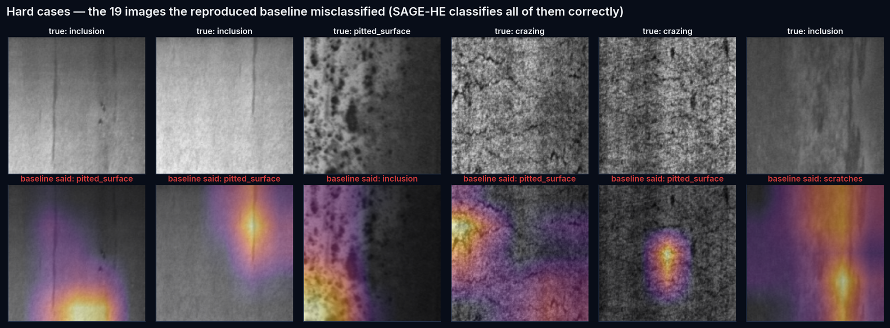
Hard Cases
SAGE-HE misclassifies nothing on this test set, so these are the 19 images the reproduced baseline got wrong
The baseline's errors are concentrated in faint `inclusion` streaks it calls `pitted_surface` — the same two classes its per-class F1 singles out. These are shown instead of an empty failure slide; nothing here is curated.
SAGE-HE · SUHAIB S Z
53
Notes:
With a perfect test score there is no failure set for the proposed model. Substituting the baseline's failures keeps the slide honest and still shows what the harder images look like.

Slide 54
Discussion and Limitations
Benchmark is saturated
Small test set
NEU-CLS cannot separate strong modern architectures at full data. Conclusions about components come from the reduced-data regime.
360 images. A one-image change moves accuracy by 0.28 points; Wilson intervals are reported for this reason.
No GPU
Weaker privacy than the base paper's goal
All training and all latencies are CPU. Timings are not comparable to GPU-accelerated figures elsewhere in the literature.
The client holds the extractor. We protect the server side only.
Baseline is a reconstruction
Novelty is narrow
The paper under-specifies channel count, pooling, split and schedule; our reproduction documents each assumption.
The encryption boundary is prior art. The contribution is the learned Sobel-conditioned selection and the measurement discipline.
SAGE-HE · SUHAIB S Z
54
Notes:
A limitations slide that names six real problems is more persuasive than one that names none.

Slide 55
Conclusion and Future Scope
— Built. A complete, tested, reproducible system: audited dataset, reproduced baseline, dual-branch model, genuine CKKS inference, explainability.
— Measured. SAGE-HE 100.00% vs reproduced baseline 93.98% on one identical held-out split, over 3 seeds.
— Encrypted exactly. Encrypted and plaintext inference agree, with a quantified margin: CKKS costs latency, not accuracy.
— The architecture did not pan out. Measured against its own backbone, the local branch, chunk attention and Sobel prior each cost accuracy. Reported, explained, and not claimed as a contribution.
FUTURE WORK
— A harder benchmark (NEU-DET, Severstal, X-SDD) where accuracy is not saturated.
— Higher-degree polynomial activations to recover the accuracy the square loses.
— Batched CKKS packing: 8192 slots are available and we use 64.
— Circuit privacy via noise flooding.
— Validate the λ finding on a dataset where gradient priors are less reliable.
SAGE-HE · SUHAIB S Z
55
Notes:
Future work is specific and follows from measured limitations, not generic.

Slide 56
References
All entries resolved against Crossref or arXiv — see reports/citations_verified.json
[1] Jia et al. (2023). Efficient and privacy-preserving image classification using homomorphic encryption a. Journal of Cloud Computing. 10.1186/s13677-023-00537-0
[2] Song & Yan (2013). A noise robust method based on completed local binary patterns for hot-rolled steel . Applied Surface Science. 10.1016/j.apsusc.2013.09.002
[3] Cheon et al. (2017). Homomorphic Encryption for Arithmetic of Approximate Numbers. Lecture Notes in Computer Science. 10.1007/978-3-319-70694-8_15
[4] Tan & Le (2019). EfficientNet: Rethinking Model Scaling for Convolutional Neural Networks. arXiv preprint. 1905.11946
[5] He et al. (2016). Deep Residual Learning for Image Recognition. 2016 IEEE Conference on Computer V. 10.1109/cvpr.2016.90
[6] Hu et al. (2018). Squeeze-and-Excitation Networks. 2018 IEEE/CVF Conference on Comput. 10.1109/cvpr.2018.00745
[7] Lee et al. (2022). Minimax Approximation of Sign Function by Composite Polynomial for Homomorphic Compa. IEEE Transactions on Dependable an. 10.1109/tdsc.2021.3105111
[8] Elkhatib et al. (2025). PRISM: Privacy-preserving Inference System with Homomorphic Encryption and Modular A. arXiv preprint. 2511.07807
[9] Selvaraju et al. (2019). Grad-CAM: Visual Explanations from Deep Networks via Gradient-Based Localization. International Journal of Computer . 10.1007/s11263-019-01228-7
[10] Zuiderveld (1994). Contrast Limited Adaptive Histogram Equalization. Graphics Gems. 10.1016/b978-0-12-336156-1.50061-6
[11] Akiba et al. (2019). Optuna. Proceedings of the 25th ACM SIGKDD. 10.1145/3292500.3330701
[12] Paszke et al. (2019). PyTorch: An Imperative Style, High-Performance Deep Learning Library. arXiv preprint. 1912.01703
[13] Buslaev et al. (2020). Albumentations: Fast and Flexible Image Augmentations. Information. 10.3390/info11020125
[14] Pedregosa et al. (2012). Scikit-learn: Machine Learning in Python. arXiv preprint. 1201.0490
SAGE-HE · SUHAIB S Z
56
Notes:
Every one of these was fetched from the publisher API, not recalled.

Slide 57
SAGE-HE
Thank you
RESEARCH, ARCHITECTURE & IMPLEMENTATION
SUHAIB S Z
Code, data manifests, logs and this deck are reproducible end to end
Notes:
Reproduction: scripts/setup_env.sh, then scripts/reproduce_all.sh.

