Slide 1
Early-Stage Prediction of Dry Eye Disease
A Machine Learning Approach Using Lifestyle, Sleep & Digital Habits
2026 · Research Proposal
1/10

Slide 2
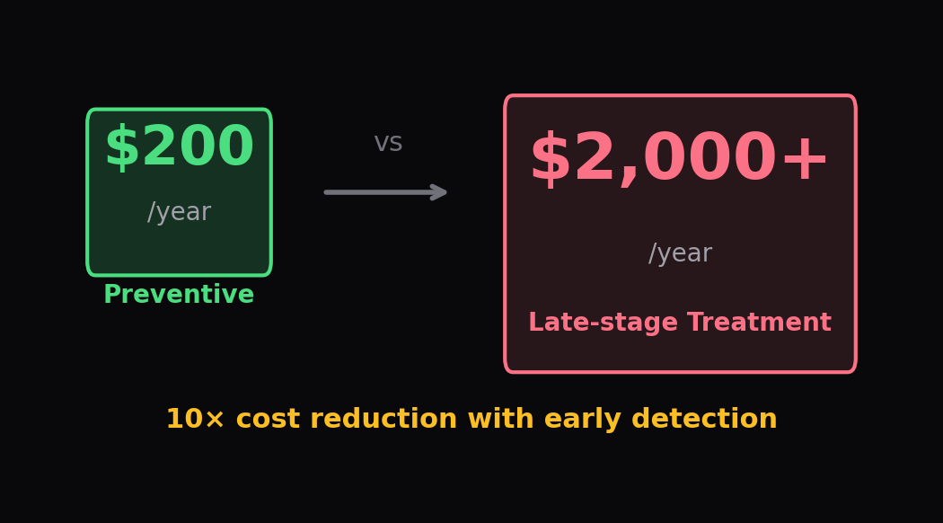
THE PROBLEM
344M+
75%
$3.8B
7+ hrs
people affected globally
remain undiagnosed
annual burden (US alone)
avg daily screen exposure
2/10

Slide 3
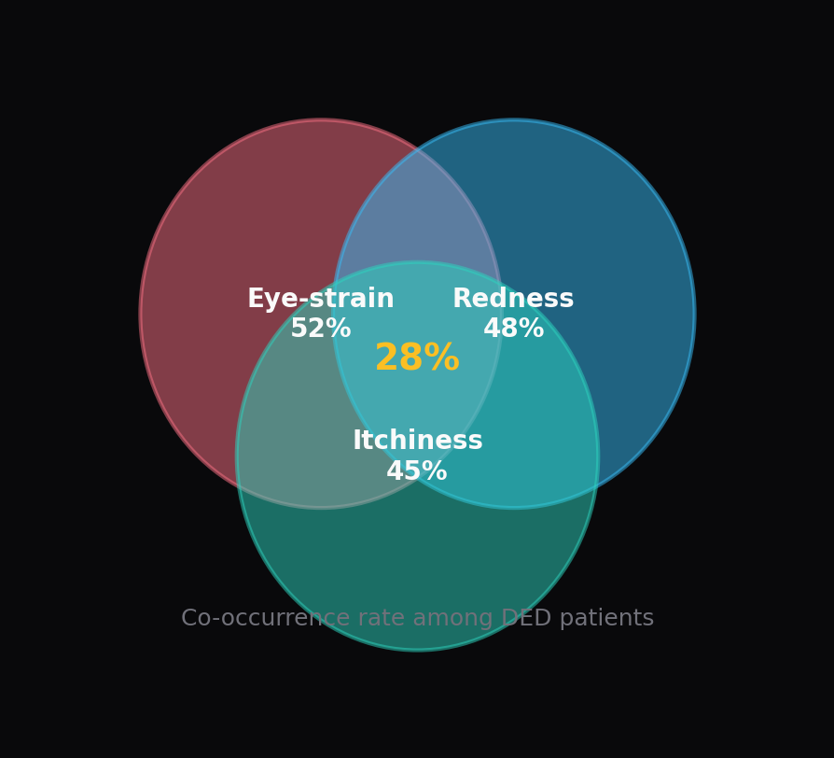
WHY EARLY DETECTION MATTERS
Irreversible Damage
Chronic DED → corneal scarring & vision loss
80% Preventable
Early-stage manageable with lifestyle changes
Gen Z at 2.5× Risk
Digital generation: dramatically higher incidence
Silent Onset
Symptoms dismissed until damage is advanced
3/10

Slide 4
PROBLEM STATEMENT
"Can we predict the onset of Dry Eye Disease using non-invasive, routinely available patient data — including sleep patterns, stress levels, digital screen habits, and ocular symptoms — enabling timely preventive intervention before irreversible damage occurs?"
01
Classification model achieving ≥ 75% F1-Score
02
Identify top risk factors via feature importance
03
Interpretable risk-scoring tool for primary care
04
Validate across demographics for generalizability
4/10

Slide 5
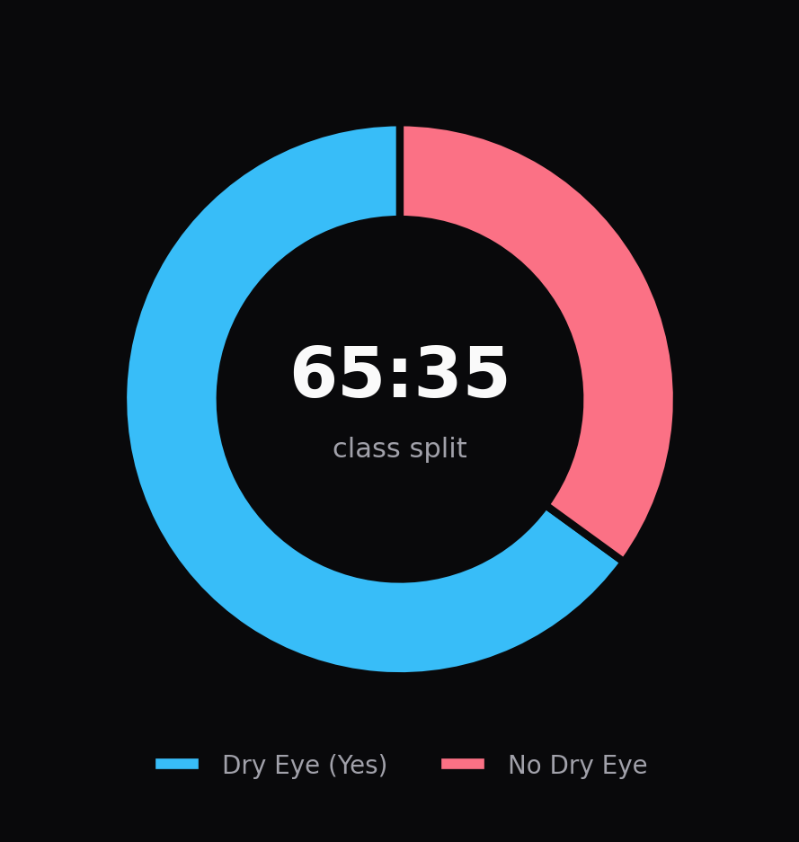
DATASET
20,000
26
Records
Features
Demographics
Sleep & Stress
Cardiovascular
Gender · Age · Height · Weight
Duration · Quality · Disorder · Sleepiness · Stress
Blood Pressure · Heart Rate · Steps · Activity
Lifestyle
Digital
Ocular
Caffeine · Alcohol · Smoking · Medication
Screen Time · Device Before Bed · Blue-light Filter
Eye-strain · Redness · Itchiness / Irritation
5/10

Slide 6
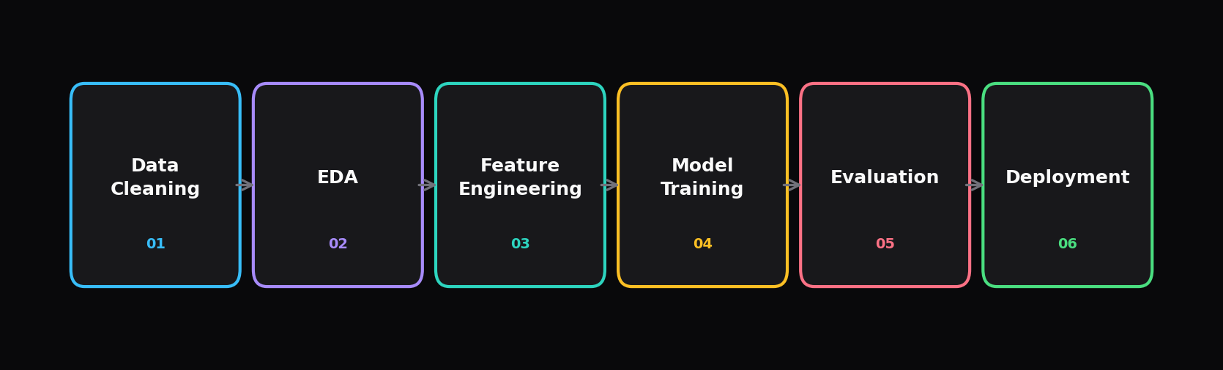
METHODOLOGY
01 Data Cleaning
02 EDA
03 Feature Engineering
Handle missing values, parse BP, encode Y/N → 0/1, normalize
Distributions, correlations, class imbalance assessment (65:35)
Cramér's V (categorical), Point-Biserial r (numeric), Chi² tests
04 Model Training
05 Evaluation
06 Deployment
6 classifiers, 80/20 stratified split, StandardScaler for distance-based
Accuracy, Precision, Recall, F1-Score, AUC-ROC, 5-fold cross-validation
Feature importance ranking, confusion matrix analysis, risk-score tool
6/10

Slide 7
MODELS
Logistic Regression
Decision Tree
Random Forest
Linear
Tree-Based
Ensemble
Baseline · Interpretable coefficients
Explainable · Visual decision paths
Bagging · Reduces overfitting
Gradient Boosting
XGBoost
K-Nearest Neighbors
Ensemble
Ensemble
Instance-Based
Sequential error correction
State-of-the-art tabular performance
Non-parametric · Distance-based
7/10

Slide 8
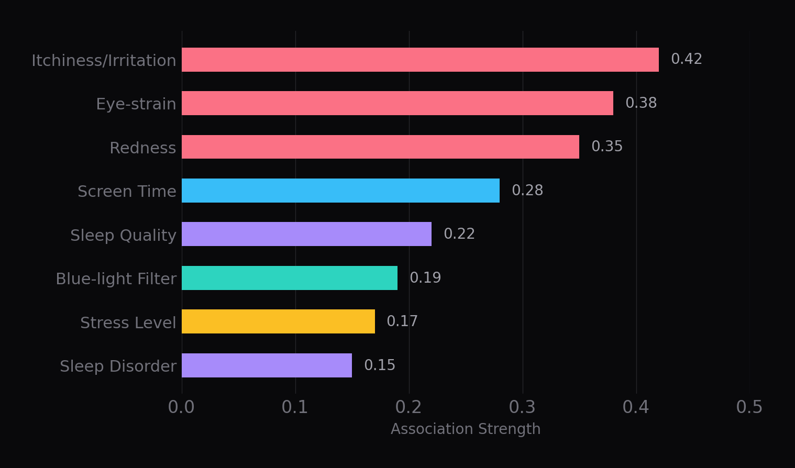
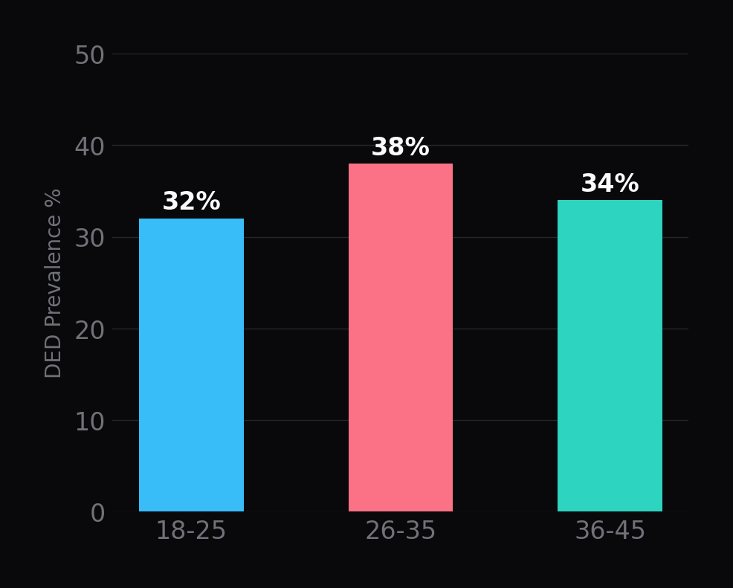
KEY INSIGHTS — RISK FACTORS
DED Prevalence by Age Group
8/10

Slide 9
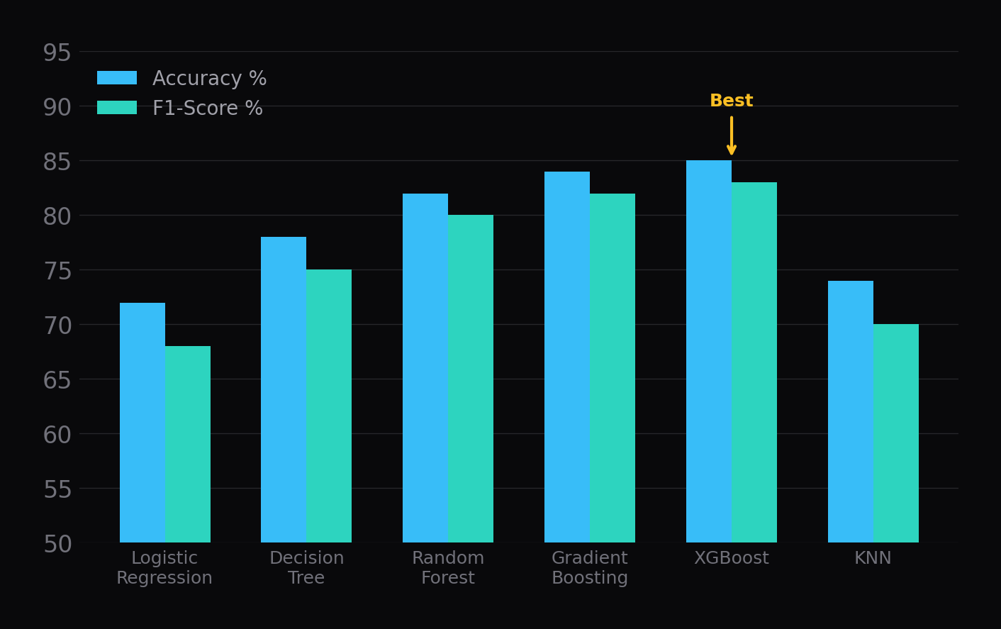
MODEL PERFORMANCE
Takeaways
XGBoost
Best overall F1 and accuracy
Gradient Boosting
Strong runner-up on all metrics
Random Forest
Robust with low overfitting
KNN
Weakest — struggles with high dimensionality
9/10

Slide 10
Thank You
Questions & Discussion
2026
10/10

