Slide 1
PROBLEM SIH26027
RailPlan AI
AI-powered automatic block planning to maximise asset availability
One optimiser plans Engineering, Traction Distribution and Signal & Telecom maintenance together — against real corridor windows, protected train paths and the goods forecast.
SOURCE SYSTEMS INTEGRATED
PLANNING HORIZONS
OPTIMISER
PRIORITY SCORING
6
Weekly + Monthly
GLPK MILP
ML + rules
TMS · SMMS · TDMS · COA · Timetable · Goods
15-minute planning granularity
greedy fallback, independent re-check
every score is explainable
Smart India Hackathon 2026 · Ministry of Railways · Transportation & Logistics
Decision support only — final blocks still require authorised approval. Synthetic demonstration data, not Indian Railways production data.

Slide 2
THE PROBLEM
Three departments plan the same track, separately
Engineering, Traction Distribution and S&T each request blocks through BDMS on their own, from data that never meets.
Data lives in silos
Planning is manual
Assets pay the price
Track defects sit in TMS, signalling defects in SMMS, OHE work in TDMS.
Corridor availability sits separately again, in COA.
No single view of what the whole network actually needs.
Each department books in its own due-date order.
A window taken by one is simply gone for the rest.
Compatible work that could share one possession does not.
The line closes more times than the work itself requires.
Overdue safety-critical work waits behind routine work.
Train operations absorb avoidable downtime.
WHAT THE PROBLEM STATEMENT ASKS FOR
"Develop an Automatic Block Planning system that integrates maintenance, defects and corridor data to generate optimized block schedules. The system should prioritize maintenance activities to minimize asset downtime and maximize the availability of critical infrastructure, ensuring uninterrupted train operations."

Slide 3
THE SOLUTION
One pipeline, from six feeds to a safe block plan
The same inputs also build a department-by-department baseline, so the improvement is measured, never claimed.
1
2
3
4
5
Integrate
Prioritise
Find safe time
Optimise
Re-check
Six adapters normalise TMS, SMMS and TDMS work with COA windows, protected train paths and the goods forecast.
▶
A logistic-regression risk model scores every task 0–100, with a transparent weighted rule engine as the declared fallback.
▶
Protected passenger movements plus a configurable buffer are cut out of every window; each rejection carries a reason code.
▶
A GLPK MILP picks which jobs go where and bundles compatible ENG/TRD/S&T work into a single possession.
▶
An independent validator re-derives every rule and throws away an unsafe plan; the manual baseline runs on identical inputs.
Hard constraints, never relaxed
Answers a judge can check live
A block may never overlap a protected train path plus its safety buffer.
Traction work without power isolation, S&T work without a disconnection: rejected.
A task that does not fit the window stays unscheduled, with its reason shown.
Weights, train buffer and slot size each live in one config object — change one, re-run.
Every adapter is swappable (MOCK / JSON / REST) if a real feed is unavailable.
Solver status is reported as returned: OPTIMAL, FEASIBLE, FALLBACK_FEASIBLE, INFEASIBLE, FAILED.

Slide 4
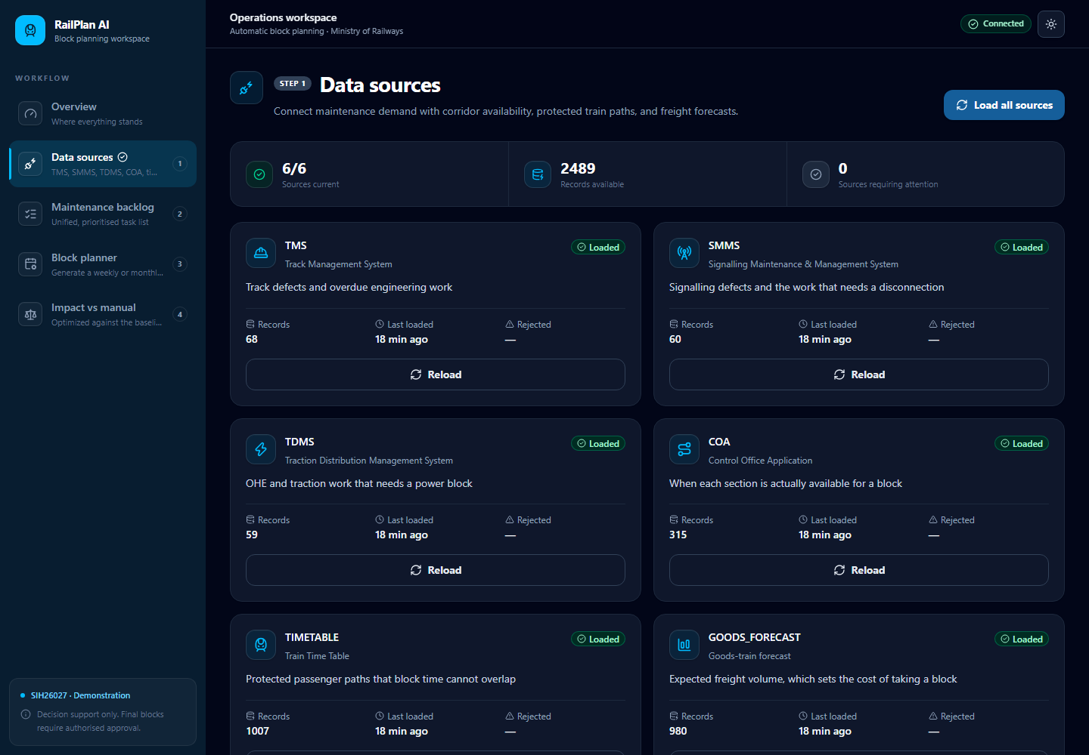
STEP 1 · INTEGRATION
All six required inputs, loaded and counted
Each adapter validates, maps external section and asset codes onto canonical records, and upserts without duplication.
RECORDS LOADED
TMS
68
Track Management System
SMMS
60
Signalling Maintenance & Mgmt
TDMS
59
Traction Distribution Mgmt
COA
315
Control Office Application
TIMETABLE
1,007
Train Time Table
GOODS_FORECAST
980
Goods-train forecast
What each adapter guarantees
Zod-validated input; accepted and rejected counts recorded per sync run.
Idempotent upsert — re-loading a feed changes nothing.
Fixtures are deterministic and labelled synthetic on every screen.
Data sources — 6/6 sources current, 2,489 records, 0 requiring attention

Slide 5
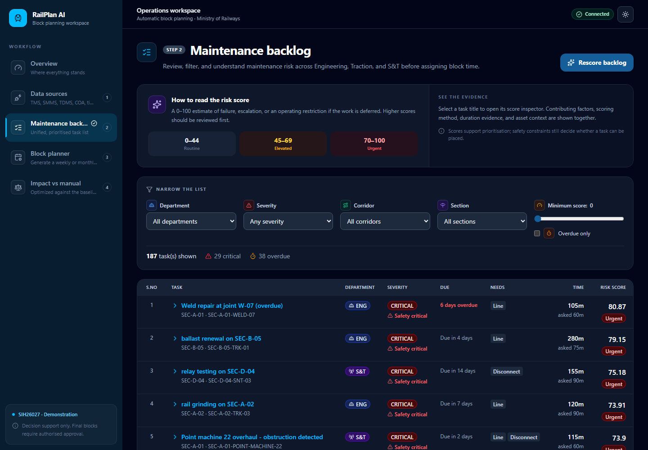
STEP 2 · AI PRIORITISATION
A risk score you can argue with
Every task carries a 0–100 estimate of failure, escalation or an operating restriction if the work is deferred — plus the factors behind it.
LEARNED MODEL (LEVEL 2)
Logistic regression in plain JavaScript, trained on maintenance history with a time-based split.
Validation accuracy
75.4%
ROC AUC
0.8161
Log loss
0.5227
Train / validation rows
1650 / 550
Trained on synthetic history — reported as SYNTHETIC, not production accuracy.
Fallbacks that keep it honest
Rule engine (Level 1): weighted sum of severity, asset criticality, overdue days, safety flag, speed restriction, corridor importance and repeat defects.
Used whenever history is thin or the model fails to load — always labelled RULE_FALLBACK.
Duration engine: historical median and P90 per task type and department.
P90 drives feasibility; requested, predicted and sample count are all shown.
Maintenance backlog — 187 tasks, 29 critical, 38 overdue, all 187 scored

Slide 6
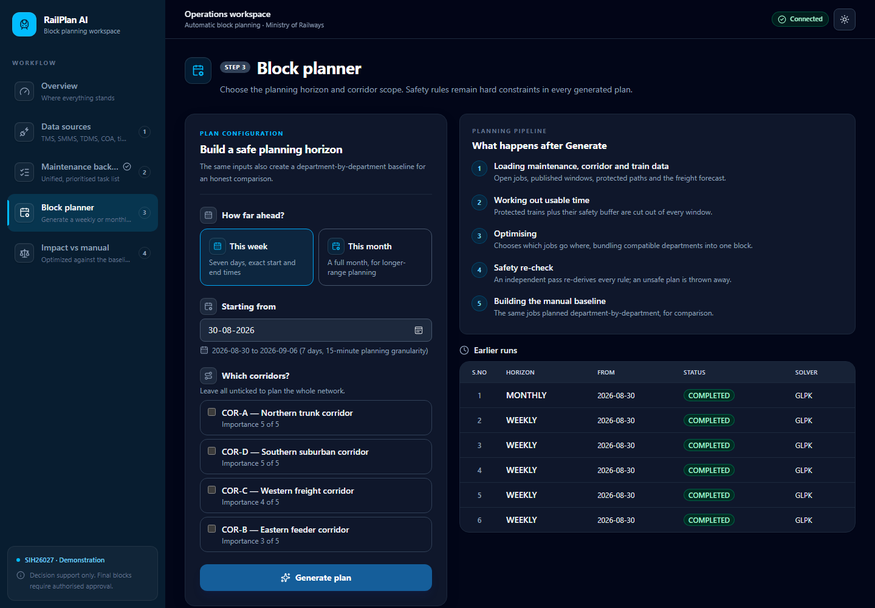
STEP 3 · CANDIDATE WINDOWS
Only the time that is genuinely safe
Half-open intervals, protected trains and their buffer subtracted, freight pressure priced in — then the optimiser sees what is left.
Interval arithmetic, unit-tested
No overlap, full overlap, partial at start, partial at end.
One train splitting a window; several trains splitting a window.
Touching intervals — [start, end) never double-counts a boundary minute.
WHY A TASK GETS REJECTED
NO_BLOCK_WINDOW
TRAIN_CONFLICT
INSUFFICIENT_DURATION
POWER_ISOLATION_UNAVAILABLE
DISCONNECTION_UNAVAILABLE
INCOMPATIBLE_TASK
OUTSIDE_HORIZON
Block planner — horizon, corridor scope, and the five stages that run on Generate
Every unscheduled task names one. Nothing disappears silently.

Slide 7
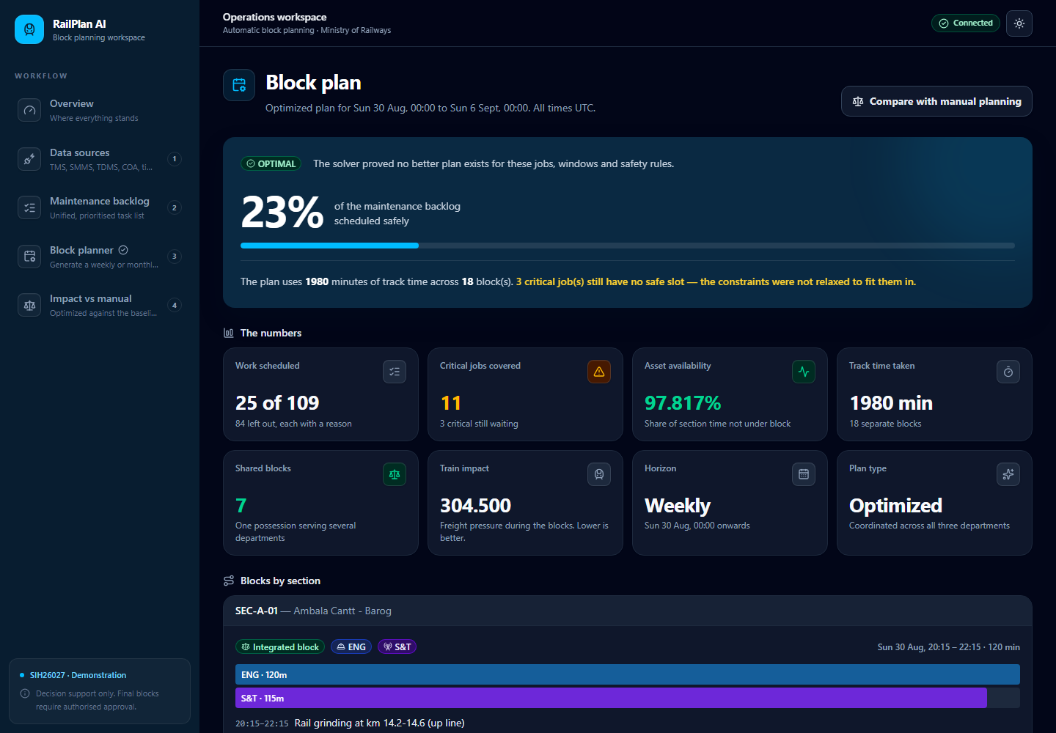
STEP 4 · OPTIMISED PLAN
A weekly plan the solver proved optimal
One possession can serve several departments at once — and the jobs that could not be placed safely are still on the page.
SOLVER STATUS
ASSET AVAILABILITY
OPTIMAL
97.817%
No better plan exists for these jobs, windows and rules
Share of section time not under block
TRACK TIME TAKEN
SHARED BLOCKS
1,980 min
7
across 18 separate blocks
one possession serving several departments
Honest about what was left out
84 jobs left out, each with a reason code attached.
3 critical jobs still have no safe slot — the constraints were not relaxed to fit them in.
An independent validator re-derives every rule afterwards and rejects a plan with a train conflict, a task outside a block, a missing power or disconnection requirement, a duplicate assignment, or a block outside the horizon.
Block plan — weekly horizon, OPTIMAL, 25 of 109 jobs placed across 18 blocks

Slide 8
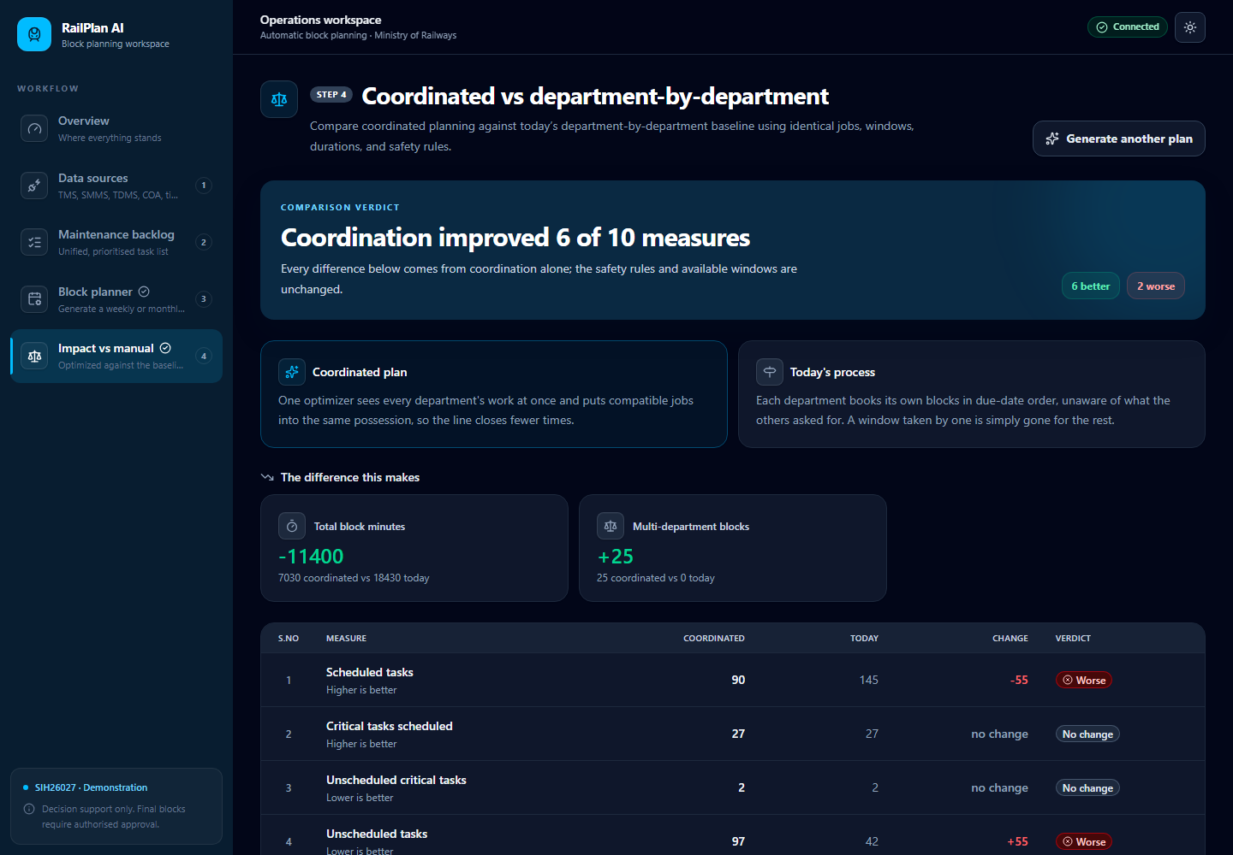
STEP 5 · PROOF
Coordinated vs department-by-department
Same jobs, same windows, same durations, same safety rules — the only variable is coordination.
TOTAL BLOCK MINUTES
MULTI-DEPARTMENT BLOCKS
−11,400
+25
7,030 coordinated vs 18,430 today
25 coordinated vs 0 today
The trade-off we are not hiding
The baseline places more tasks (145 vs 90) — by taking 2.6× more track time.
Coordination buys back 11,400 block minutes and closes the line far less often.
Critical coverage is unchanged: 27 scheduled, 2 unscheduled, on both sides.
No number is hard-coded
Both plans are computed at run time from the same inputs.
Change a weight or the train buffer, press Generate, and every figure moves.
Asset availability is derived from horizon minutes and section count, not asserted.
Monthly horizon — coordination improved 6 of 10 measures, and 2 got worse

Slide 9
DELIVERABLE 4
Weekly and monthly, from one engine
Both horizons share the same priority, candidate-window, validation, baseline and metrics modules.
WEEKLY
MONTHLY
Seven days · 15-minute slots
28–31 days · day-wise allocation
Exact start and end times for every block.
Detailed task-within-block timings, grouped by section.
The short-term execution view for the district.
Coarser slots for longer-range coordination.
Labelled a planning view, not a granted operational block.
Long-term backlog burn-down across all three departments.
MONTHLY BACKLOG SCHEDULED
CRITICAL COVERED
ASSET AVAILABILITY
SHARED BLOCKS
48%
27
99.125%
25
90 of 187 jobs placed
2 critical still have no safe slot
across the monthly horizon
multi-department possessions

Slide 10
HOW IT IS BUILT
A stack chosen to be inspected, not just demoed
Frontend
Backend
Planning core
Angular 22, standalone components, client-side rendering only.
Signals for all state; Signal Forms; httpResource for reads.
Tailwind CSS 4 as the only design system — no component library.
Department shown by text and colour, never colour alone.
Node.js 24, plain JavaScript, ES modules, Express 5.
MySQL 8.0 with handwritten SQL and mysql2/promise — no ORM.
Domain modules: routes, controller, validation, service, repository.
Engines and solvers are pure logic, with no Express inside.
glpk.js MILP behind a single solver adapter.
Greedy fallback when the solver fails, reported as FALLBACK_FEASIBLE.
An independent plan validator running after the solver, not inside it.
The manual baseline planner as a first-class deliverable.
Tested where it matters
Deliberately out of scope
Backend on node --test: adapter validation and idempotency, priority fallback, logistic regression on a known dataset, duration P90, interval subtraction, rejection reasons, baseline, GLPK, fallback, validation and metrics.
Frontend on Vitest + jsdom via @angular/build:unit-test — every generated spec kept and extended.
No auth, RBAC, approval workflow or audit framework — this is decision support.
No BDMS write-back: no official API contract is published, so we do not pretend to have one.
No Docker, CI/CD or cloud deployment in the MVP.

Slide 11
WHERE THIS GOES
What is next, and what we will not claim
Next steps
What we do not claim
Swap each MOCK adapter for the REST adapter once a real TMS / SMMS / TDMS / COA feed exists — the code path is already there.
Retrain the risk model on real maintenance history; the training pipeline is unchanged.
BDMS write-back once an official API contract is published.
Retrospective learning: feed executed block outcomes back into the duration and risk estimates.
The model is trained on synthetic history and is reported as such — no production accuracy is asserted.
The system does not operate signalling, grant a traffic block, or switch traction power.
It does not replace authorised railway officials; every plan is a recommendation.
No improvement percentage is hard-coded anywhere in the codebase.
Decentralised and manual → data-driven and coordinated
Six feeds integrated · every task scored and explained · safety constraints enforced as hard limits · weekly and monthly plans · and a measured comparison against how it is done today.

Slide 12
Thank you
RailPlan AI · SIH26027 · AI-Powered Automatic Block Planning
Questions welcome — weights, buffers and the horizon can be changed live and the plan regenerated.
Live demo
Change a weight
Re-run the solver
Synthetic demonstration data — not Indian Railways production data.

