Slide 1

Customer Shopping Behavior Analysis
Comprehensive Data Report · April 2026

Slide 2
Dataset Overview
3,900
$59.76
Total Customers
Average Purchase
Complete transaction records analyzed
USD per transaction
3.75
18
Review Rating
Data Columns
Out of 5 stars
Demographics, purchases, behavior
Dataset spans multiple product categories, demographics, and seasonal patterns

Slide 3
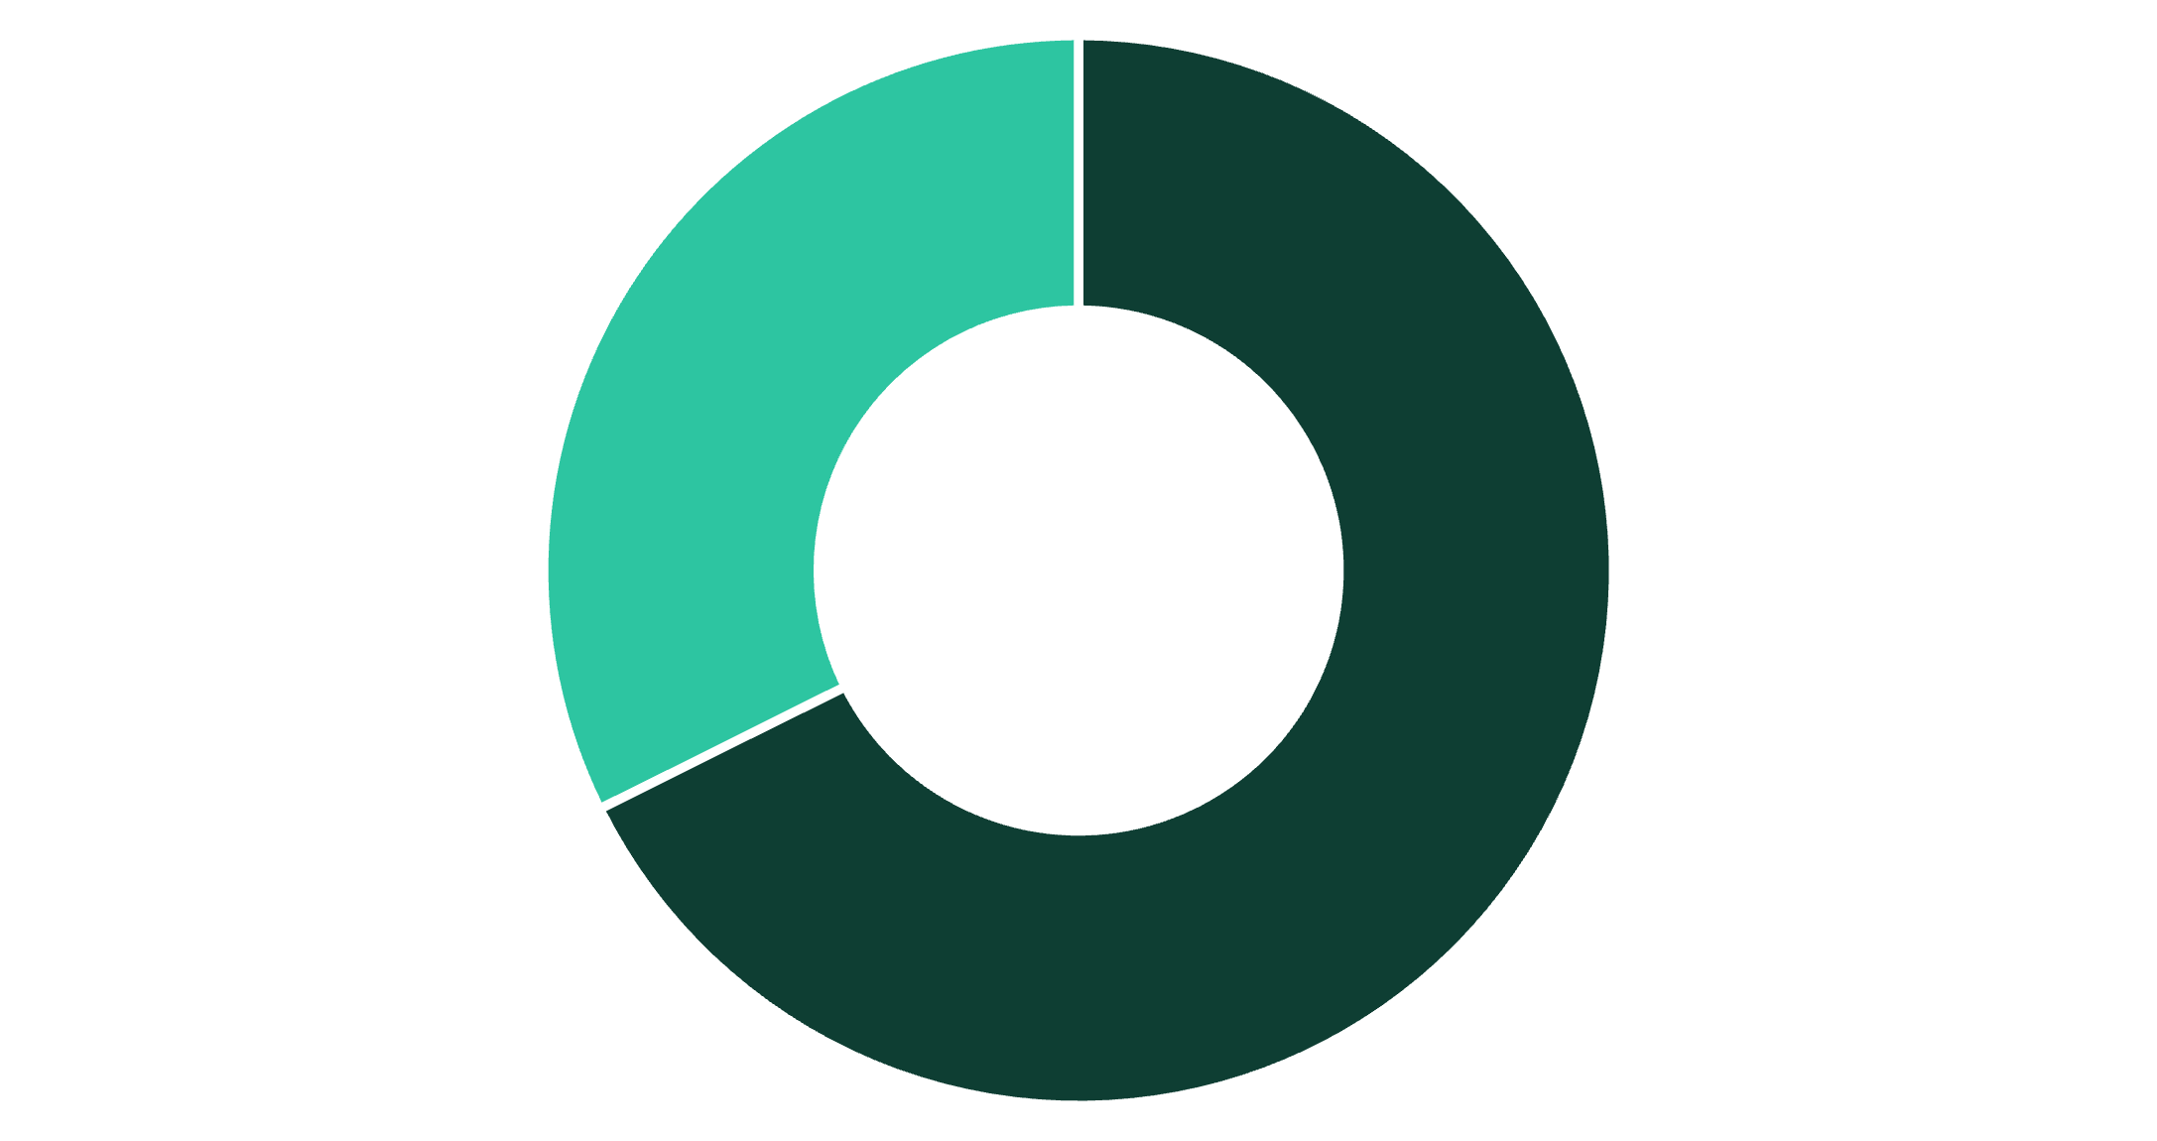
Revenue by Gender
Key Finding
Male customers generate 67.7% of revenue vs. 32.3% for females
Opportunity: Female customer acquisition represents untapped revenue potential
Male
Female

Slide 4
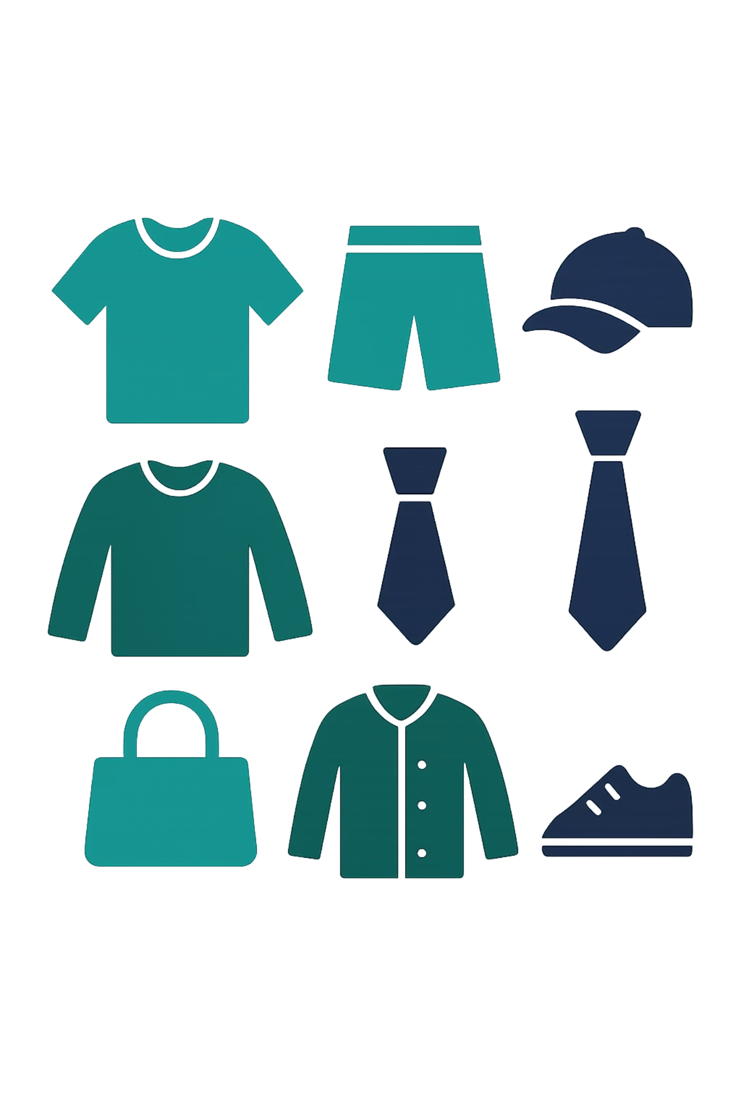

Product Performance Insights
Top Rated
Discount Dependency
Sandals (3.82 avg) lead footwear and accessories
Hats (50%) and Sneakers (49.66%) rely heavily on discounts
Shipping Impact
Express users spend 3.5% more on average

Slide 5
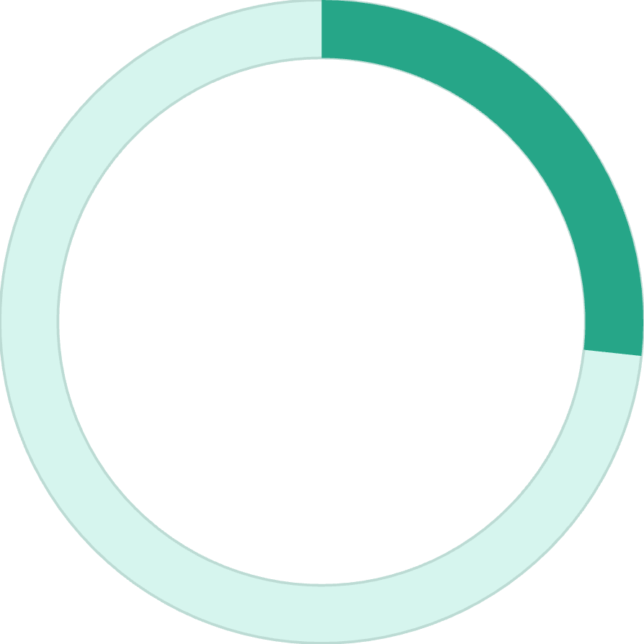
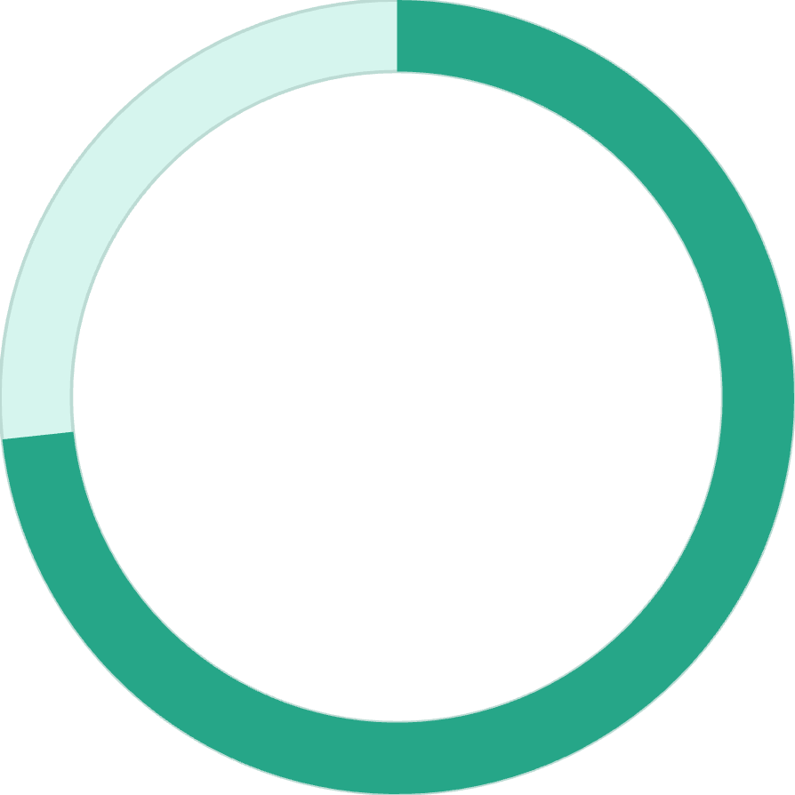
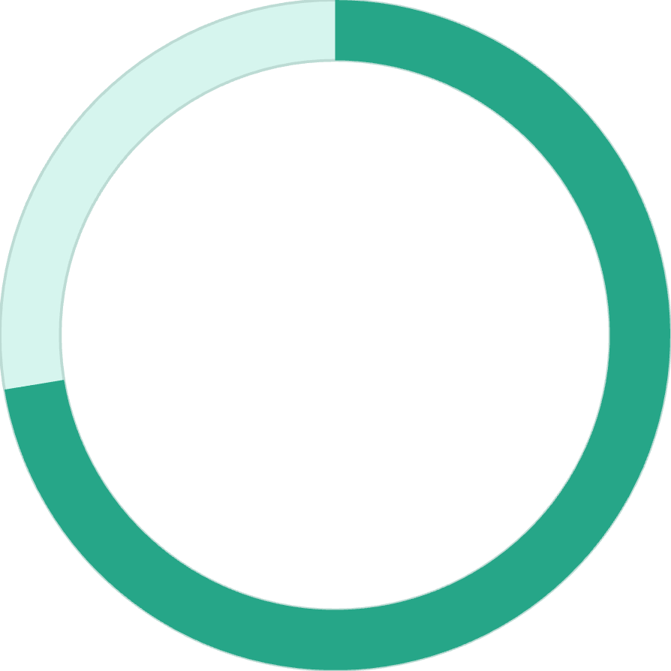
Subscription Status Analysis
26.7%
73.3%
72.4%
Subscribed
Unsubscribed
Repeat Buyers Unsubscribed
1,053 customers
2,847 customers
Among >5 purchases
Average spend nearly identical: $59.87 (non-subscribers) vs. $59.49 (subscribers)

Slide 6



Customer Segmentation
Loyal
1
>10 purchases
Returning
2
2-10 purchases
New
3
1 purchase
Strong Foundation
Critical Gap
79.9% loyal customers (3,116)
Only 2.1% new customers (83)

Slide 7
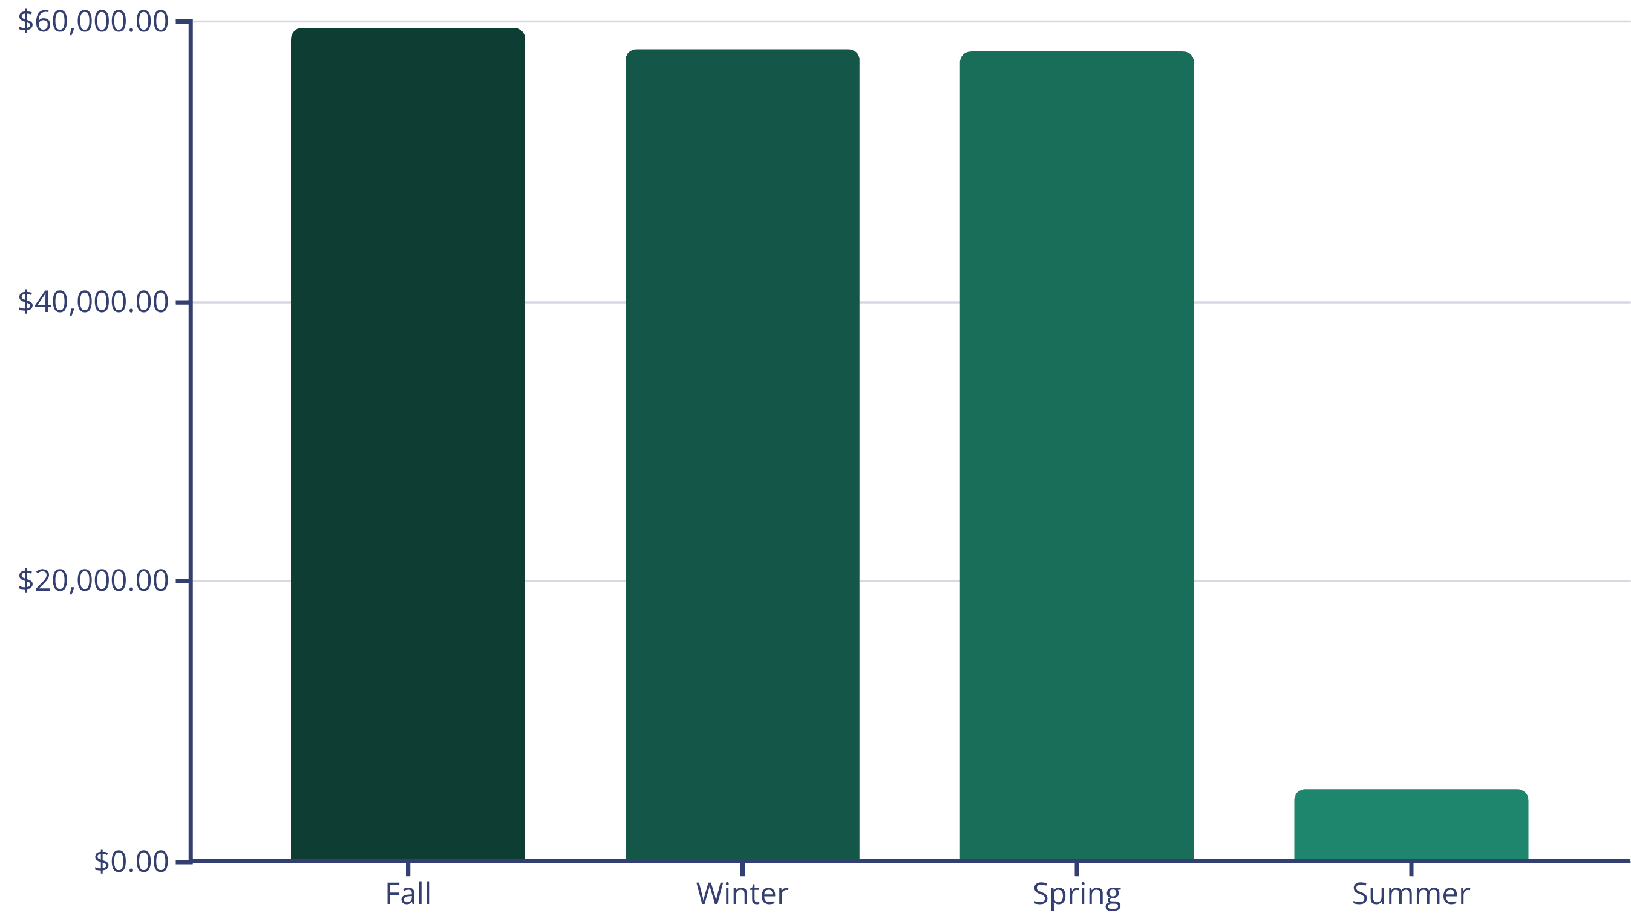

Seasonal Revenue Trends
Summer Collapse
91% drop from Fall peak — critical revenue recovery opportunity

Slide 8
Age Group Revenue Distribution
26.6%
25.3%
Young
Middle-Aged
$62,143 revenue
$59,197 revenue
23.9%
23.8%
Adult
Senior
$55,978 revenue
$55,763 revenue
Near-equal spread confirms strong cross-generational appeal

Slide 9
Top Product Categories
Clothing
Accessories
$103K revenue
$73K revenue
Blouse, Pants, Shirt lead
44% of total revenue
Jewelry: 171 orders
Strong cross-sell potential
Footwear
Outerwear
$36K revenue
$18K revenue
Sandals: 160 orders
High discount dependency
Jacket: 163 orders
Underperforming category

Slide 10
Strategic Priorities
01
02
03
Summer Product Strategy
Subscription Conversion
Free Shipping Threshold
Recover 91% seasonal drop — Critical, Immediate
Target repeat buyers — High, 0-3 months
Implement $75+ minimum — High, 0-1 month
04
05
Discount Policy Review
New Customer Acquisition
Fix Hat/Sneaker pricing — High, 1-2 months
Digital campaigns — High, 1-3 months

