Slide 1
Retail Sales Performance Analysis
BY Mohammed Suhail Ismail
25-04-2025

Slide 2
📊 Executive Summary (KPIs)
💰 Total Sales: 456K.
🛒 Avg Order Value: $456.00.
📦 Transactions: 1,000.
💵 Total Profit: 91.2K.
🌟 Top Category: Electronics.
👥 Top Age Group: 36–50.
👗 Female customers slightly lead in sales.
Strong overall sales and engagement.
Opportunity to improve profitability.
Demographic-focused marketing recommended.

Slide 3
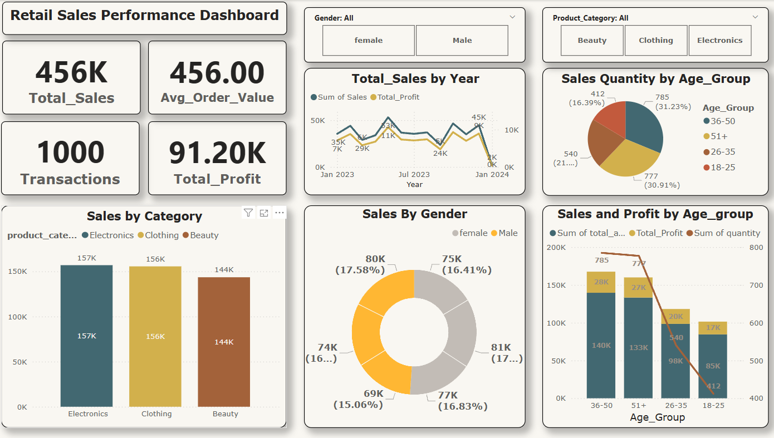

Slide 4
📈 Sales Trend by Month
Peak in mid-2023, dip in early 2024.
Suggests seasonal influence.
Profit tracks with sales.
✅ Recommendation: Analyze Q1 drops, leverage seasonal campaigns.

Slide 5
📦 Sales by Product Category
Electronics top at 157K.
Clothing and Beauty also strong.
Category mix is well distributed.
✅ Focus campaigns on top products.
✅ Test niche items in underperforming categories.

Slide 6
👥 Sales Quantity by Age Group
36–50 and 18–25 lead sales volume.
26–35 slightly behind expectations.
51+ shows moderate participation.
✅ Create targeted offers for 26–35.
✅ Enhance accessibility for 51+.

Slide 7
🚻 Sales by Gender
Female: 17.58%.
Male: 16.41%.
Balanced performance overall.
No major disparity.
✅ Try gender-specific campaigns.
✅ Explore product preferences by gender.

Slide 8
💵 Sales & Profit by Age Group
36–50 group highest sales and profit.
18–25 has decent margins despite volume.
Opportunity in other age ranges.
✅ Loyalty programs by age.
✅ Upsell within high-performing groups.

Slide 9
💼 Strategic Recommendations for Stakeholders
📊 Sales & Marketing Teams
Target the 36–50 age group aggressively — they drive the most profit.
Re-engage the 26–35 segment with seasonal offers and tailored messaging.
Develop gender-personalized campaigns based on slight sales skew.
🛒 Product & Merchandising
Promote Electronics — the top-performing category.
Bundle or cross-sell within Beauty to increase value.
Analyze underperformers for discontinuation or repositioning.
📦 Operations & Fulfillment
Investigate Q1 sales dip for logistics/inventory issues.
Optimize shipping modes for better customer retention.

Slide 10
🙏 Thank You!
👤 Prepared by:
Mohammed Suhail Ismail Data Analyst Date: 25 April 2025

