Slide 1
Superstore Sales & Profit Analysis Dashboard
BY
Mohammed Suhail Ismail
22-04-2025

Slide 2
Executive Summary (KPIs)
💰 Total Sales: $2.3M+
📈 Total Profit: $280K+
🏆 Top Category: Technology
🌍 Top Region: West
- West region has highest sales but lowest profit margin
- Furniture category suffers from high return rates
- Standard Class shipping mode has frequent delays
- Discounts often correlate with low profitability
- Technology is the most profitable category

Slide 3
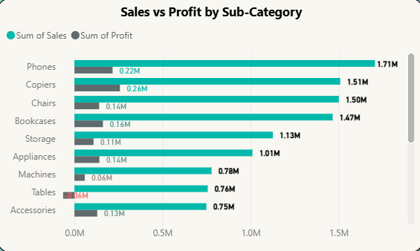
Sales vs Profit by Sub-Category.
📊 Chart: Clustered Bar Chart.
📊 Sub-Category Profitability: Phones & Copiers are top performers, Tables show negative profit despite high sales.

Slide 4
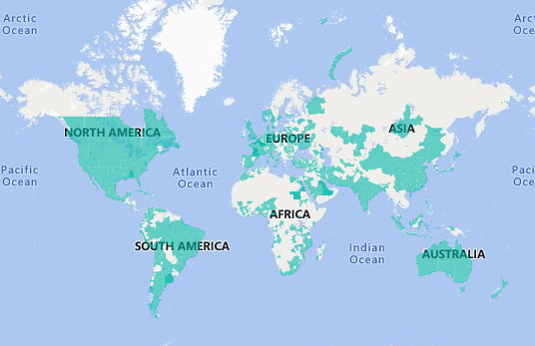
Profit by Region / State
📍 Chart: Map
West & East show strong performance.
Central region has volume but needs margin improvements.

Slide 5
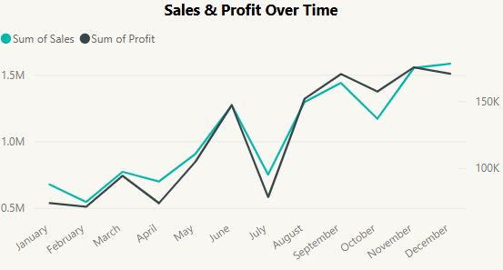
Monthly Sales & Profit Trend
📈 Chart: Dual Axis Line Chart.
Sales peak in Q4 – possible seasonal demand.
Profit dips in discount periods (e.g., November).

Slide 6
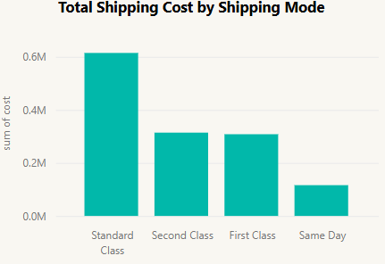
Shipping Mode Efficiency
🚚 Chart: Bar Chart.
Standard Class most used, but Second Class is more cost-effective.
Opportunity to optimize shipping costs.

Slide 7
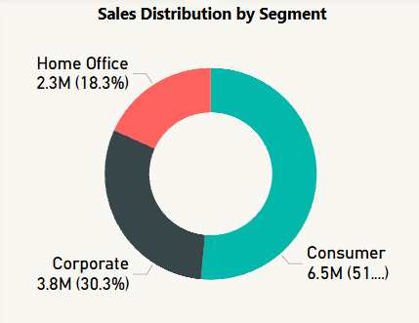
Sales Distribution by Segment
The Consumer segment accounts for the largest share of total sales, contributing approximately 51.5% (6.5M).
The Corporate segment follows, contributing around 30.3% (3.8M) of total sales.
The Home Office segment contributes the smallest share, at 18.3% (2.3M).
Profit margins are fairly consistent across segments, indicating a stable pricing strategy.
Recommendation: Focus on scaling the Home Office segment through targeted promotions while maintaining margin efficiency across all segments.

Slide 8
Key Insights & Recommendations
💡 Focus marketing on Technology & Office Supplies.
📊 Investigate Table pricing strategy
📉 Reduce discounting on Furniture (Tables).
📦 Promote Second Class shipping further to control costs.
📊 Use monthly trends to plan inventory and campaigns.
💡 Investigate Table pricing strategy
💡 Run targeted campaigns for Home Office segment.

Slide 9
Thank You!
👤 Prepared by:
Mohammed Suhail Ismail Data Analyst Date: 22 April 2025

