Slide 1
Introduction to Object Oriented Programming

Slide 2
Topics
Why use OOP?
Building blocks of OOP
Classes
Objects
What is OOP?
OOP concepts
Abstraction
Encapsulation
Inheritance
Polymorphism
Advantages vs Disadvantages
Conclusion

Slide 3
Topics
Why use OOP?
Building blocks of OOP
Classes
Objects
What is OOP?
OOP concepts
Abstraction
Encapsulation
Inheritance
Polymorphism
Advantages vs Disadvantages
Conclusion

Slide 4

Why use OOP?
Object Oriented Programming (OOP) is one of the most widely used programming paradigm
Why is it extensively used?
Well suited for building trivial and complex applications
Allows re-use of code there features can be easily by increasing productivity
New built into the existing code
Reduced production cost and maintenance cost
Common programming languages used for OOP include C++, Java, and C#

Slide 5
Topics
Why use OOP?
Building blocks of OOP
Classes
Objects
What is OOP?
OOP concepts
Abstraction
Encapsulation
Inheritance
Polymorphism
Advantages vs Disadvantages
Conclusion

Slide 6
Building Blocks of OOP: Objects & Classes
Object: models a
Real world object (ex. computer, book, box)
Concept (ex. meeting, interview)
Process (ex. sorting a stack of papers or comparing two computers to measure their performance)
Class: prototype or blueprint from which objects are created

Slide 7

Building Blocks of OOP: Objects & Classes
Class has
Set of attributes or properties that describes every object
Set of behavior or actions that every object can perform
Object has
Set of data (value for each of its attribute)
Set of actions that it can perform
An identity
Every object belongs to a class

Slide 8


Real World Example of Objects & Classes
Object: FordCar1
Attributes
Color: Yellow
Type: Coupe
Model: Mustang
Cylinder: 6
Behavior
Start, Accelerate, Reverse, Stop
Class: FordCar
Attributes
Color, Type, Model, Cylinder
Behavior
Start, Accelerate, Reverse, Stop
Object: FordCar2
Attributes
Color: Orange
Type: Coupe
Model: Focus
Cylinder: 4
Behavior
Start, Accelerate, Reverse, Stop

Slide 9


Another Real World Example..
Object: Person1
Class: Person
Attributes
Name: Ann
Height: 5’ 4”
Age: 21
Behavior
Speak, Listen, Eat, Run, Walk
Attributes
Name, Height, Age
Behavior
Speak, Listen, Eat, Run, Walk
Object: Person2
Attributes
Name: Adam
Height: 5’ 9”
Age: 24
Behavior
Speak, Listen, Eat, Run, Walk

Slide 10
Class
A class is a set of variables (to represent its attributes) and functions (to describe its behavior) that act on its variables

Slide 11

Class ShippingBox
sender_name : string
receiver_name : string
cost_per_pound : int
weight : int
shipping_cost() : int
int shipping_cost() {
return cost_per_pound*weight;
}

Slide 12
Object
Object is an instance of a class that holds data (values) in its variables. Data can be accessed by its functions

Slide 13
Objects of ShippingBox class
Object BoxA
sender_name = Julie
receiver_name = Jill
cost_per_pound = 2
weight = 5
shipping_cost()
Class ShippingBox
Object BoxB
sender_name = Jim
receiver_name = John
cost_per_pound = 5
weight = 10
shipping_cost()

Slide 14
Topics
Why use OOP?
Building blocks of OOP
Classes
Objects
What is OOP?
OOP concepts
Abstraction
Encapsulation
Inheritance
Polymorphism
Advantages vs Disadvantages
Conclusion

Slide 15
What is OOP?
Paradigm for problem solving by interaction among objects
It follows a natural way of solving problems
Ex. Ann wants to start her car
(1) Ann walks to her car
(2) Ann sends a message to the car to start by turning on the ignition
(3)The car starts

Slide 16
Problem Solving in OOP
Problem: Ann wants to start her car
Object Ann
Object Ann’s car
Name = Ann
Age = 21
Speak()
Run()
Walk()
Color = Yellow
Type = Coupe
Model = Mustang
Cylinder = 6
Start()
Accelerate()
Stop()
message

Slide 17
Topics
Why use OOP?
Building blocks of OOP
Classes
Objects
What is OOP?
OOP concepts
Abstraction
Encapsulation
Inheritance
Polymorphism
Advantages vs Disadvantages
Conclusion

Slide 18
Abstraction
Extracting essential properties and behavior of an entity
Class represents such an abstraction and is commonly referred to as an abstract data type
Ex. In an application that computes the shipping cost of a box, we extract its properties: cost_per_pound, weight and its behavior: shipping_cost()

Slide 19

Abstraction
Shipping Box
Abstraction
Class
Attributes
Sender’s name,
Receiver’s name,
Cost of shipping per pound,
Weight
Behavior
Calculate shipping cost
sender_name : string
receiver_name : string
cost_per_pound : int
weight : int
shipping_cost() : int

Slide 20
Topics
Why use OOP?
Building blocks of OOP
Classes
Objects
What is OOP?
OOP concepts
Abstraction
Encapsulation
Inheritance
Polymorphism
Advantages vs Disadvantages
Conclusion

Slide 21
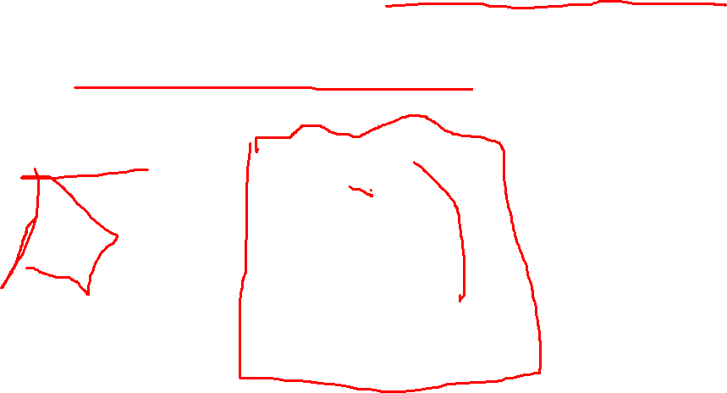
Encapsulation
Mechanism by which we combine data and the functions that manipulate the data into one unit
Objects & Classes enforce encapsulation
sender_name
receiver_name
cost_per_pound
weight
shipping_cost()

Slide 22
Topics
Why use OOP?
Building blocks of OOP
Classes
Objects
What is OOP?
OOP concepts
Abstraction
Encapsulation
Inheritance
Polymorphism
Advantages vs Disadvantages
Conclusion

Slide 23
Inheritance
Create new classes (derived classes) from existing classes (base classes)
The derived class inherits the variables and functions of the base class and adds additional ones!
Provides the ability to re-use existing code

Slide 24
Inheritance Example
BankAccount CheckingAccount SavingsAccount
customer_name : string
account_type : string
balance : int
deposit() : int
withdrawal() : int
customer_name : string
account_type : string
balance : int
insufficient_funds_fee : int
deposit() : int
withdrawal() : int
process_deposit() : int
customer_name : string
account_type : string
balance : int
interest_rate : int
deposit() : int
withdrawal() : int
calculate_interest() : int

Slide 25
Inheritance Example
BankAccount
customer_name : string
account_type : string
balance : int
deposit() : int
withdrawal() : int
CheckingAccount
SavingsAccount
insufficient_funds_fee : int
process_deposit() : int
interest_rate : int
calculate_interest() : int

Slide 26
Topics
Why use OOP?
Building blocks of OOP
Classes
Objects
What is OOP?
OOP concepts
Abstraction
Encapsulation
Inheritance
Polymorphism*
Advantages vs Disadvantages
Conclusion
(* To be covered in the next class)

Slide 27
Disadvantages of OOP
Initial extra effort needed in accurately modeling the classes and sub-classes for a problem
Suited for modeling certain real world problems as opposed to some others

Slide 28
Conclusion
Classes & Objects
Concepts in OOP
Abstraction
Encapsulation
Inheritance
Advantages & Disadvantages
Next class
Be prepared for an in-class activity (based on topics covered today)!
Polymorphism in OOP!

Slide 29
Thank you!

