Slide 1
WEEK # 4 : How is it Organized?
Last week we learned a lot of advanced JavaScript, but not all of it so we will continue from there.
Prototypes, Closures, Event Loop
OOP
React
Exercise Console Based To-Do App, Your API Demos
And lot of things that we normally do…

Slide 2
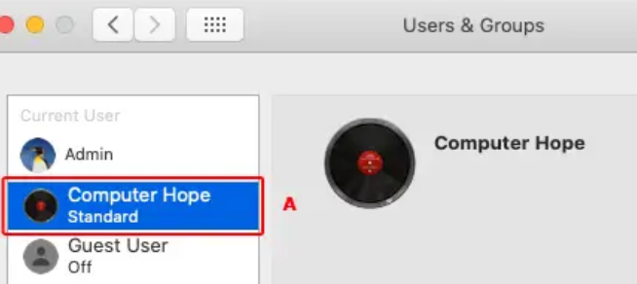
Prototypes
we often want to take something and extend it
slightly modified variants
reuse what we have in user, not copy/reimplement its methods
just build a new typed on top of it.
So, to inherit these
Characteristics we use
“Prototypal inheritance”

Slide 3
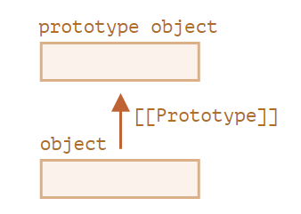
[[Prototype]]
objects have a special hidden property
is either null or references another object. That object is called “a prototype”.
“When we read a property from object, and it’s missing, JavaScript automatically takes it from the prototype.”

Slide 4
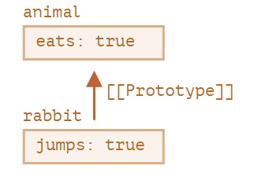
We follow the [[Prototype]] reference and find ‘eats’ it in animal.
properties and methods become automatically available in rabbit.
"animal is the prototype of rabbit”.

Slide 5
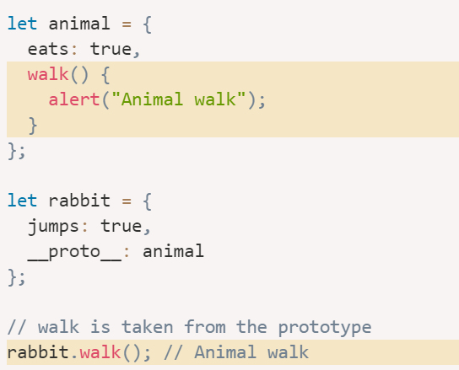
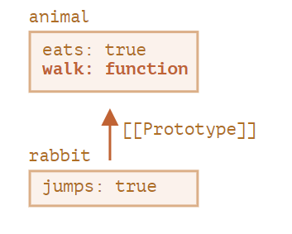
Methods can also be called from inherited object.
The walk() method is automatically taken from the prototype.
So we inherit both methods & properties.

Slide 6
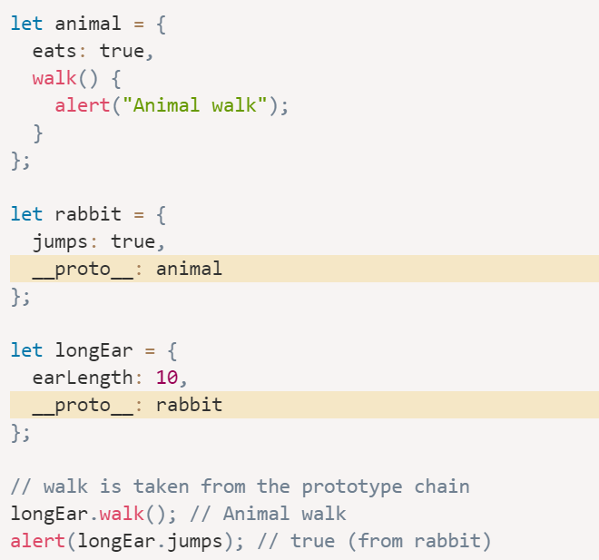
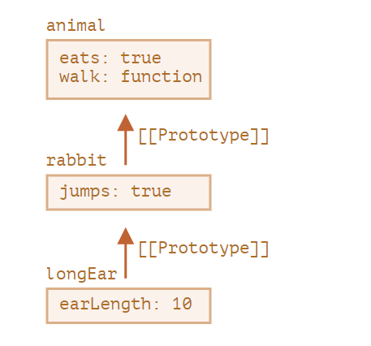
Prototype Chains
The order of inheritance is bottoms-ups

Slide 7
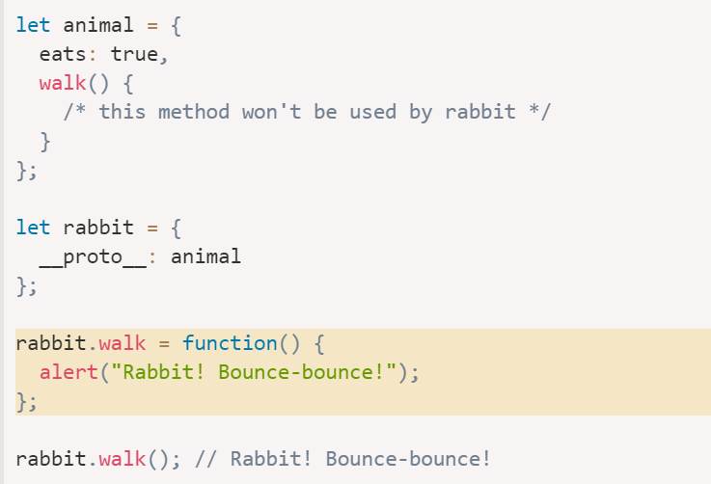
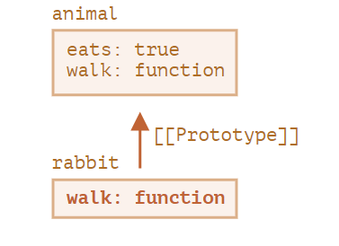

Slide 8
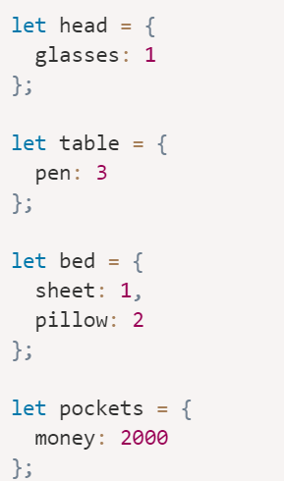
Let’s Get Your Hands Dirty
assign prototypes : pockets → bed → table → head

Slide 9
Closures
A function that remembers its outer variables and can access them

Slide 10
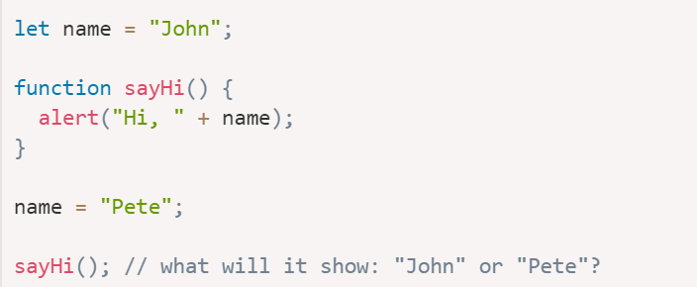
What will the code Log?

Slide 11
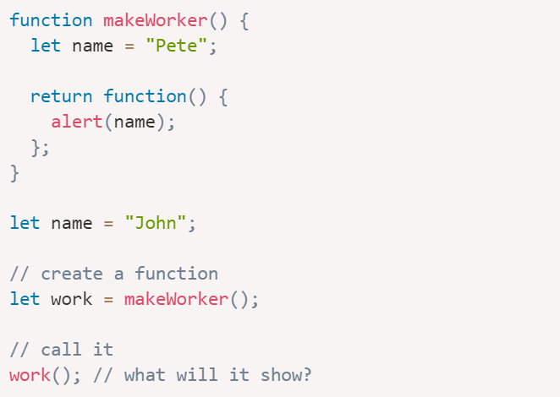
What will the below code Log?

Slide 12
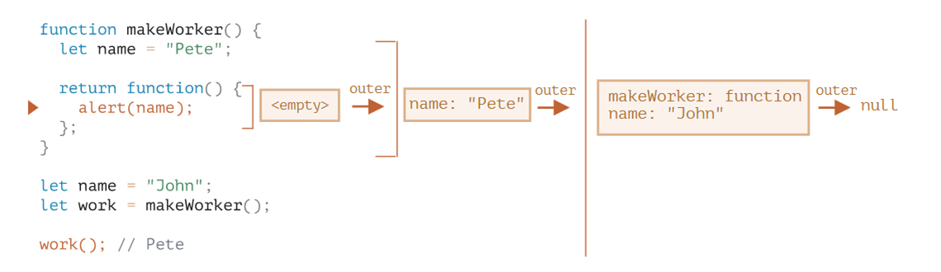
The WHY

Slide 13
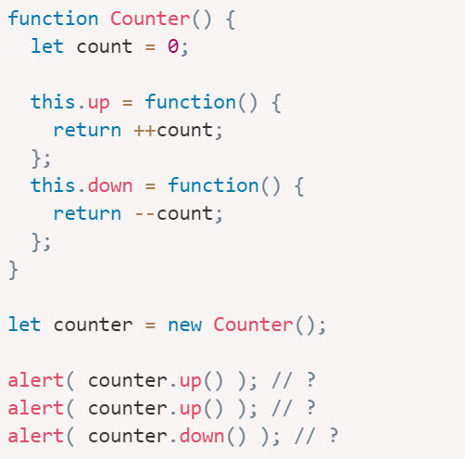
One Last

Slide 14
Event Loops
There’s an endless loop, where the JavaScript engine waits for tasks, executes them and then sleeps, waiting for more tasks.

Slide 15
Why What & HOW ??
WHY IS IT IMPORTANT ?
JavaScript execution flow is based on an event loop.
important for optimizations
WHAT IS EVENT LOOP?
There’s an endless loop, where the JavaScript engine waits for tasks, executes them and then sleeps, waiting for more tasks.
While there are tasks:
execute them, starting with the oldest task.
Sleep until a task appears, then go to 1.

Slide 16
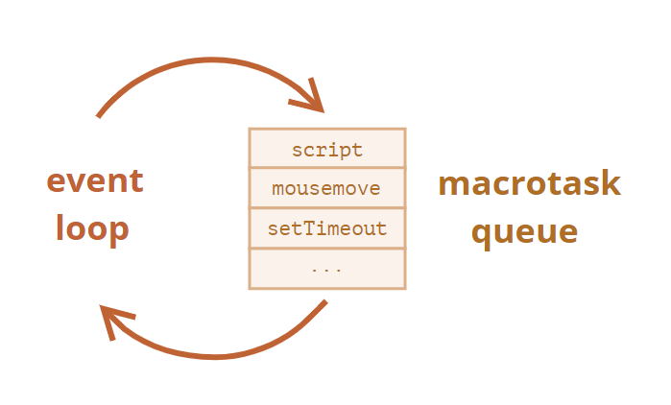
TASKS
JavaScript code which is scheduled to be run
e.g. event callback, interval, timeout.
Tasks are set – the engine handles them – then waits for more tasks.
IF a task comes while the engine is busy, then it’s enqueued.

Slide 17
TWO more points:
Results are displayed / rendered only after the task is completed.
“Page Unresponsive”

Slide 18
TO-DO App
Todo / Tasks
ID
DESCRIPTION
STATUS
Behaviors / features
Create Tasks
Update Tasks – change status, and – or description. (ID cannot be changed)
Delete Tasks
-------------------------------------------------------------------------------
User may create any number of tasks.

