Slide 1
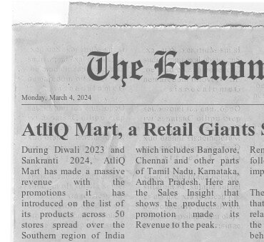
Sales Insight of Atliq Mart
on the Promotional Offers:
25% Off
Get 25% off on selected items.
33% Off
Enjoy a 33% discount
on various products.
BOGOF
Buy One, Get One Free offer
on selected merchandise.
Rs 500 Cashback
Earn a cashback of Rs 500 on
a minimum purchase amount.
50% Off
Take advantage of a 50% discount
on specific items.

Slide 2
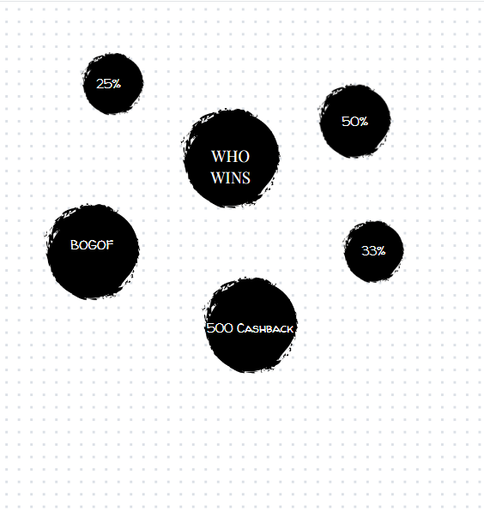
Promotion Analysis:
→ Diwali 2023
→ Sankranti 2024
50 stores in the southern region of
India participated in a massive promotion
during Diwali - 2023 and Sankranti - 2024.
It's time to analyze, understand, and decide on the
promotion for the upcoming year.
This is a crucial step in ensuring the success and
visibility of the company's products or services.

Slide 3

Let's analyze the impact of
various offers:
25%, 33%, 50%, BOGOF and
500 Cashback BASED ON
sales and revenue.
Business Understanding:
Analyse the trends of this year to target the
Regions, Customers and Promos for the upcoming Year

Slide 4
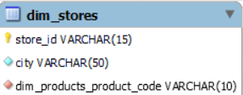
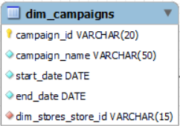
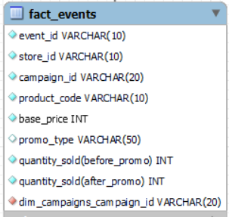
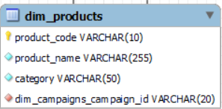
Data Source:
Please click on the link below to download the data set
Problem_Statements_and_Data_Sets
Data Requirement: The Data required to the Sales and Insights for the AtliQ Mart
is already been extracted AND CAN BE DOWNLOADED FROM ABOVE LINK

Slide 5
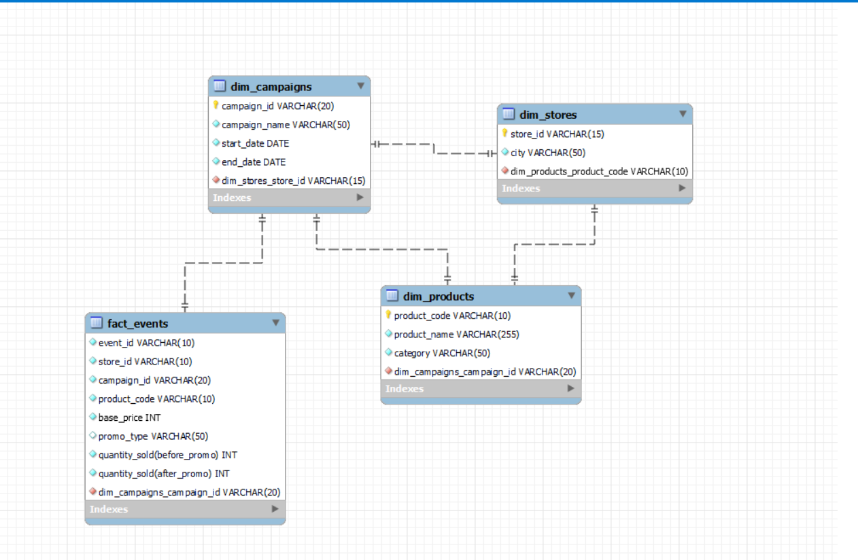
ER Modelling:

Slide 6
AD-HOC REQUETS

Slide 7
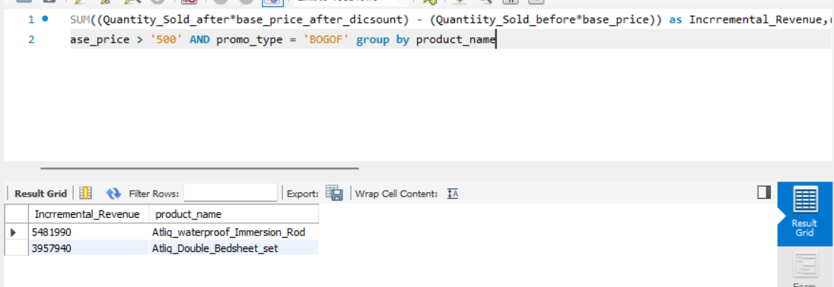
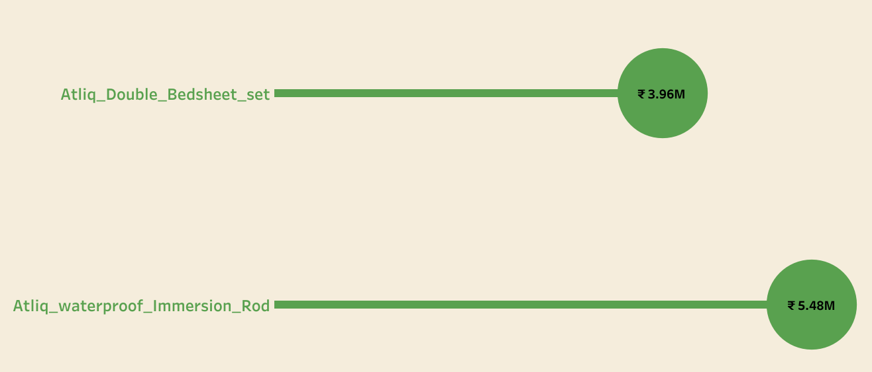
BOGOF TOP PRODUCTS:
These are the top products with base price greater than 500 and was able to make massive revenue when applied BOGOF promo:
Product 1: Atliq Double Bedsheet Set which was able to make around ₹ 3.9 Million in overall campaign
Product 2: Atliq Waterproof Immersion Rod which hit the revenue around ₹5.48 Million
Ad-hoc report 1

Slide 8
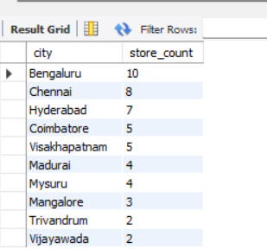
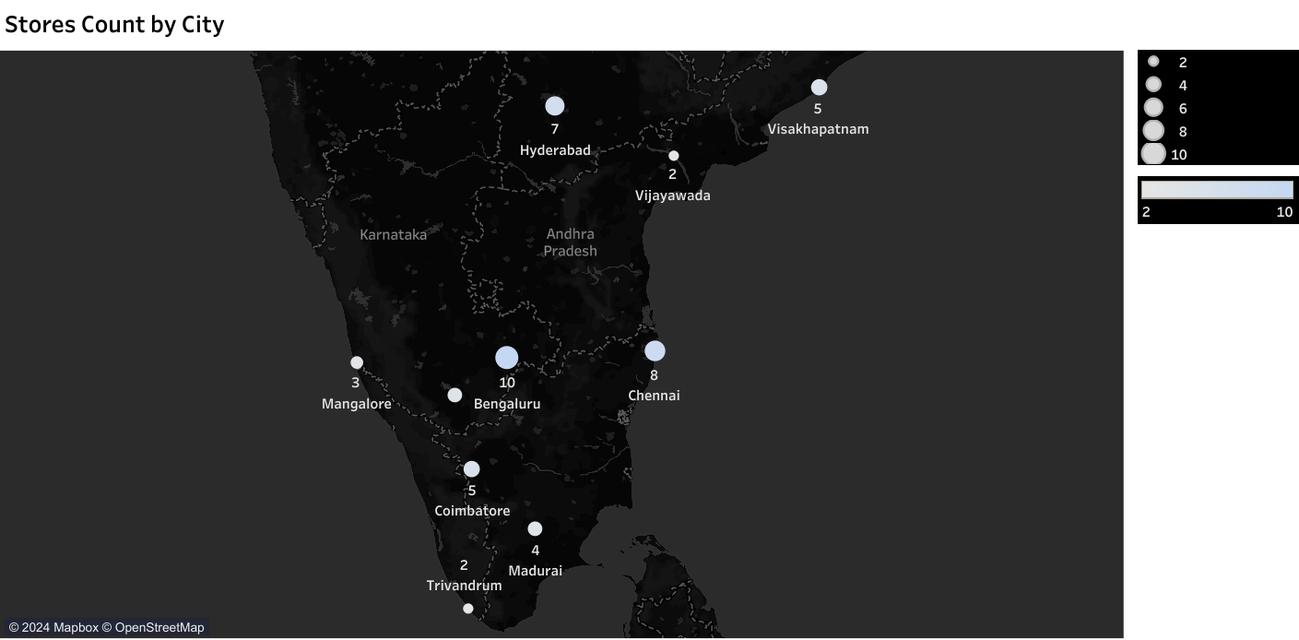
Overall Store Count in Southern Part of India
The Top Four Cities in the list are:
Bangalore,
Chennai,
Hyderabad, followed by Coimbatore and Visakhapatnam
Store Count by State:
TamiLNadu – AtliQ Mart has established
17 stores
Karnataka – 17 Stores are spread across
the state
A.P – 14 Stores are located
Kerala – 2 Stores
Ad-hoc report 2

Slide 9
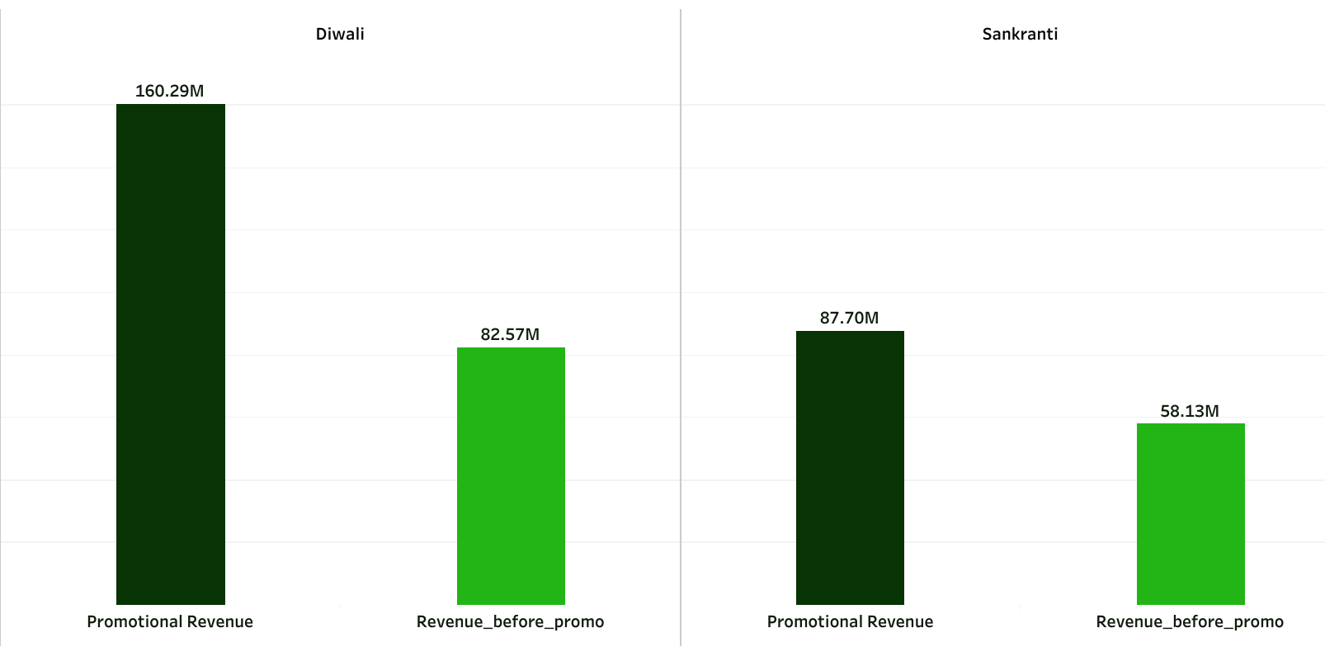
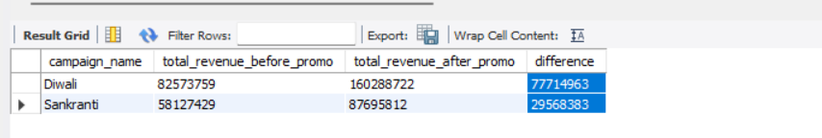
OMG! It’s a Huge Difference
Overall Revenue based on Campaign:
Revenue generated before promo → 140.70 M
Revenue generated after promo → 247.98 M
The Turnover of about 76% rise was shown
Diwali:
Turnover before promo: 82.57 M
Turnover after promo: 160.29 M
Sankranti:
Turnover before promo: 58.13 M
Turnover after promo: 87.70 M
Ad-hoc report 3

Slide 10
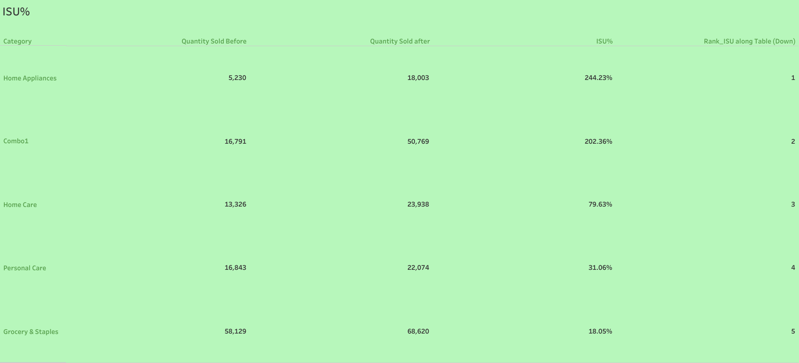
Performance of Sold Units during Diwali campaign:
The picture below shows how the Quantities have been traded and the rankings as per their % increase in their sold units during Diwali campaign
Top Tickers:
Top being the Home Appliances units
which resulted in 244% in change with respect to the quantity sold
before
The second most sold quantity
Been Combo1 products making
202% of units being sold during
Diwali.
The Home Care, Personal Care
And Grocery Staples are not
to the Mark.
Ad-hoc report 4

Slide 11
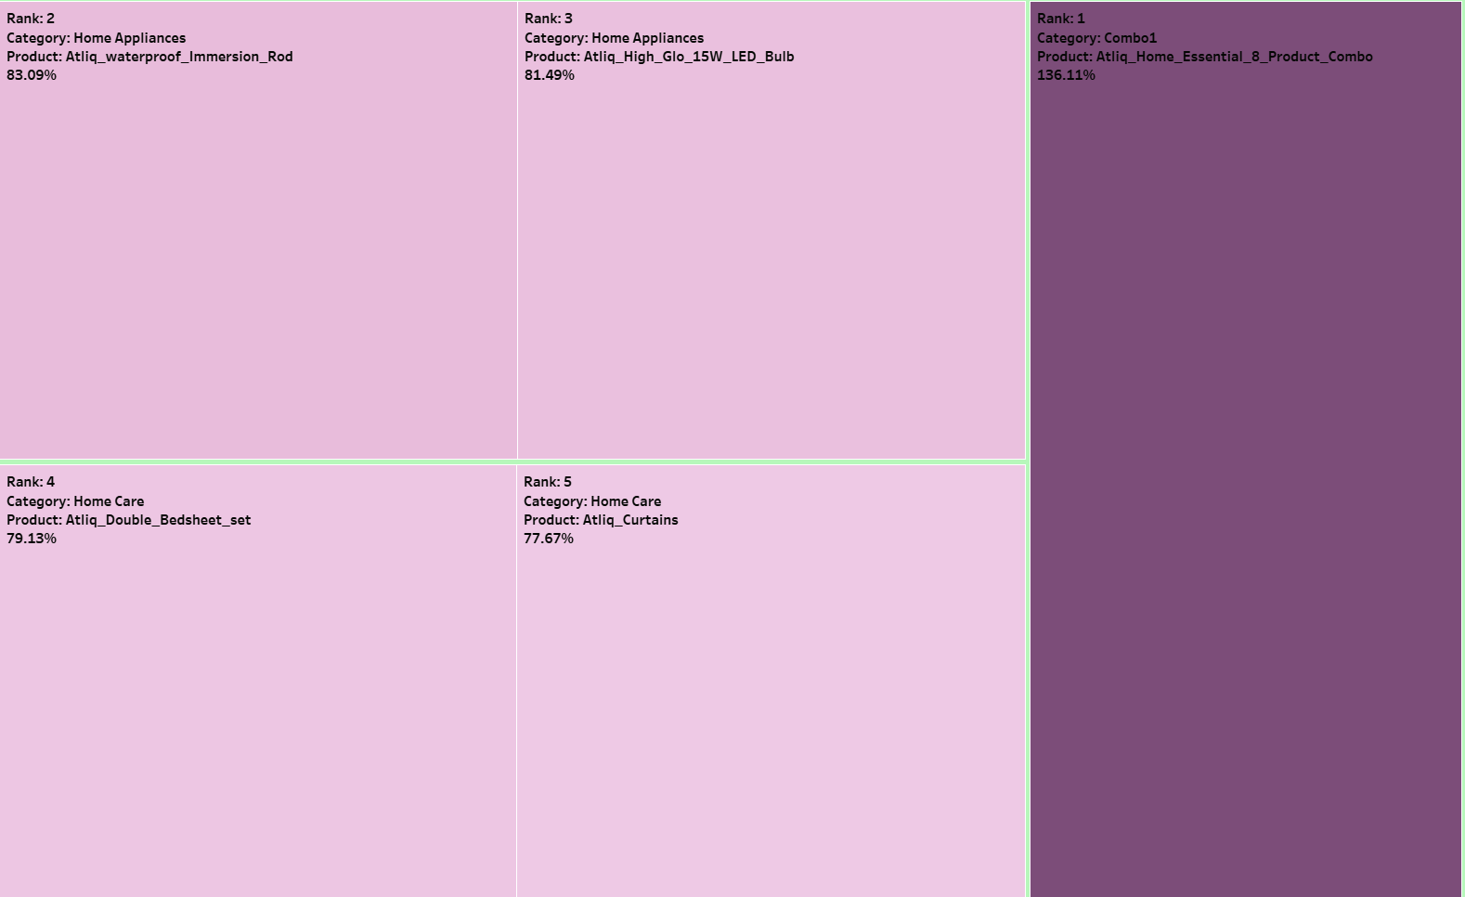
The Top 5 products with respect to IR%:
Among the overall Incremental Revenue of AtliQ products,
The five products that really made it to the peak in IR%:
AtliQ Home Essential 8 Product Combo
AtliQ Waterproof Immersion Rod
Atliq High Glo 15W LED Bulb
Atliq Double Bedsheet Set
Atliq Curtains
Ad-hoc report 5

Slide 12

STORE PERFORMANCE
ANALYSIS

Slide 13
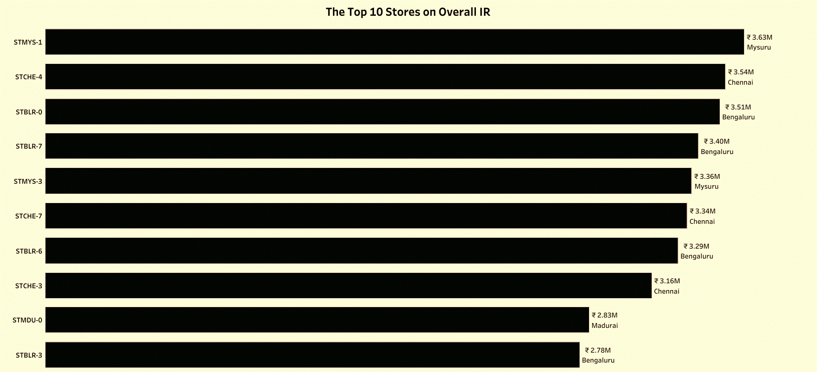
The Top Ranked Outlets:
“STMYS-1” in Mysuru records the
Highest IR all over generating
around ₹3.6 M and “STMYS-3”
being 5th among the top 10.
Chennai makes around ₹10.04 M
with its 3 Outlets
Bangaluru with its 4 divisions
across the city makes it over
₹12.98 M.
“STMDU-0” at Madurai has solely
made it ₹2.83M

Slide 14
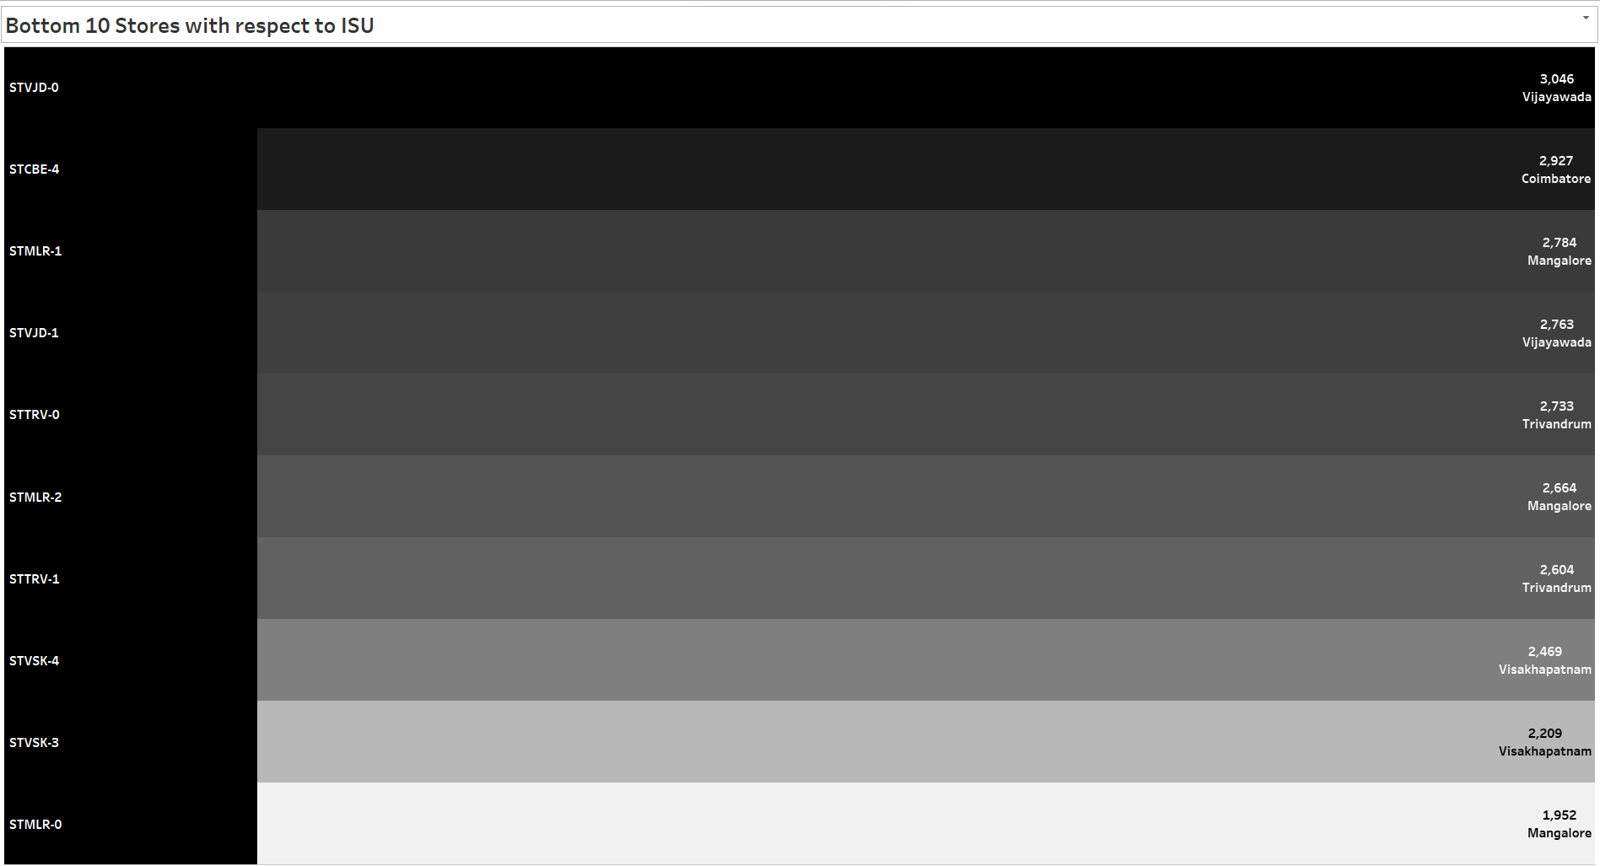
The Bottom Stores in case of ISU are:
The stores located in Vijayawada, Trivandrum,
Mangalore, Vishakhapatnam and Coimbatore made a least number In terms of product movement
The Bottom 10 Stores on Incremental Sold Units
Mangalore - Only 7400 units/3 stores
Vijayawada - Only 5809 units/2 stores
Trivandrum - Only 5337 units/2 stores
Visakhapatnam - Only 4678 units/2 stores
Coimbatore - Only 2927 units/1 stores

Slide 15
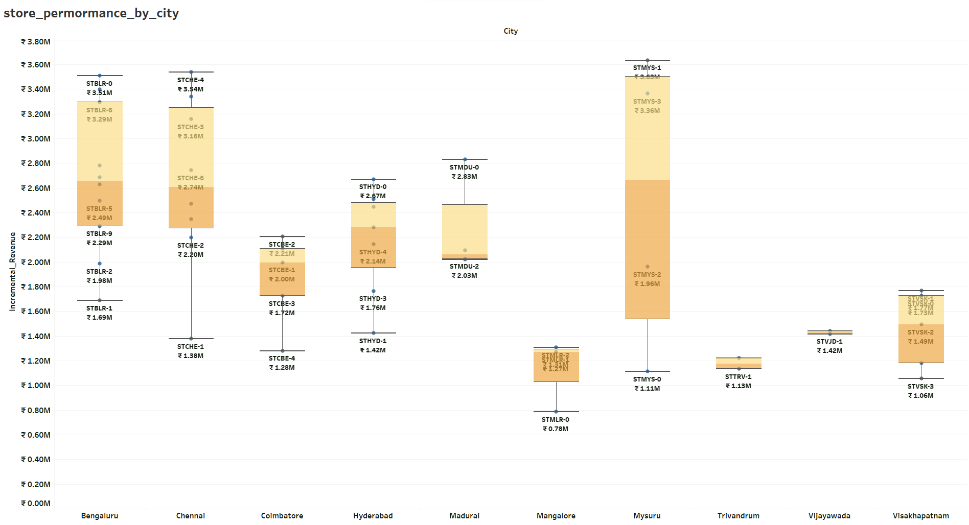
Ad-hoc report 4
Store Performance as per city:
Mysuru, Chennai and Bengaluru are in a row to the trend of the stores on the basis of its
Incremental Revenue

Slide 16

PROMOTIONAL ANALYSIS

Slide 17
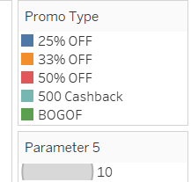
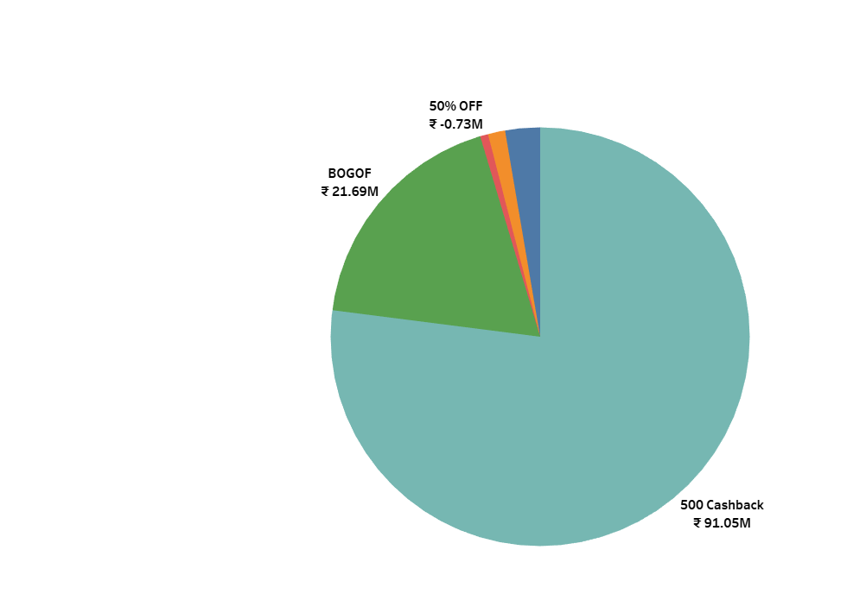
Overall Revenue by Promotion Type:
500 CASHBACK
The Peak in Overall Revenue was won by
“500 Cashback” Promotion which created
the IR of ₹91.05 M.
The Second most guy in the queue generated
the IR of ₹ 21.69 M in overall IR is “BOGOF”

Slide 18
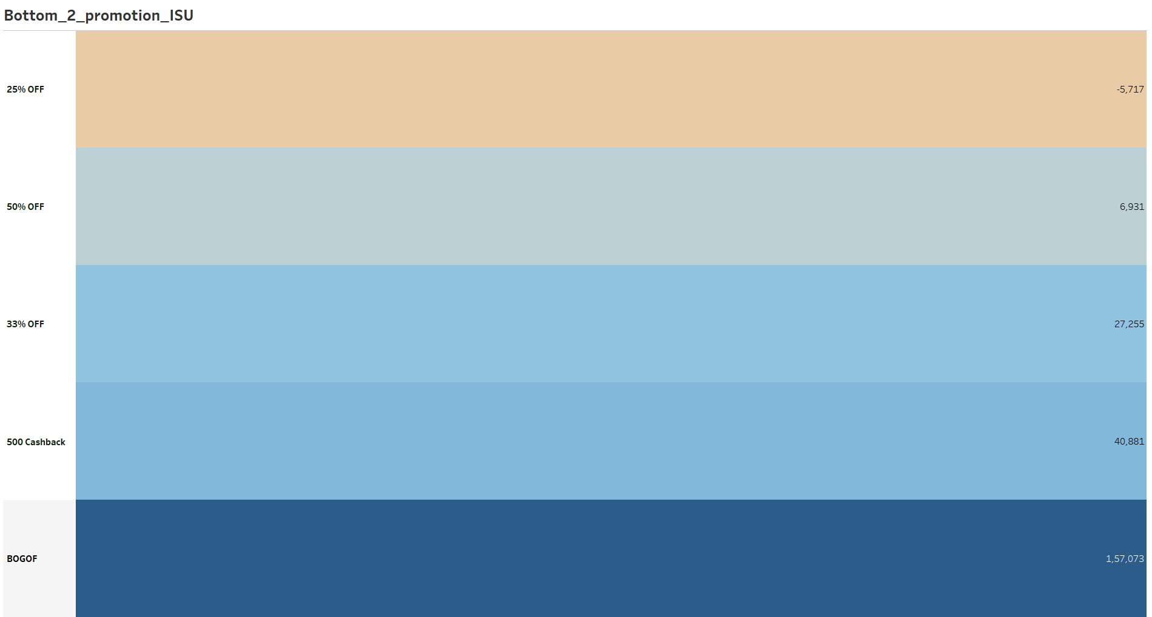
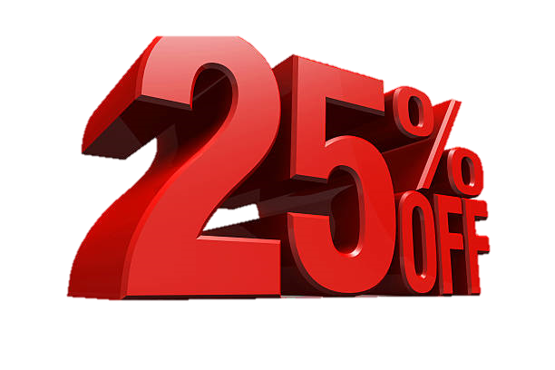

The Bottom two promotions that really made a poor units movement rate
Comparatively products of about 5,700 Units that falls under
25% promo offers were retained

Slide 19
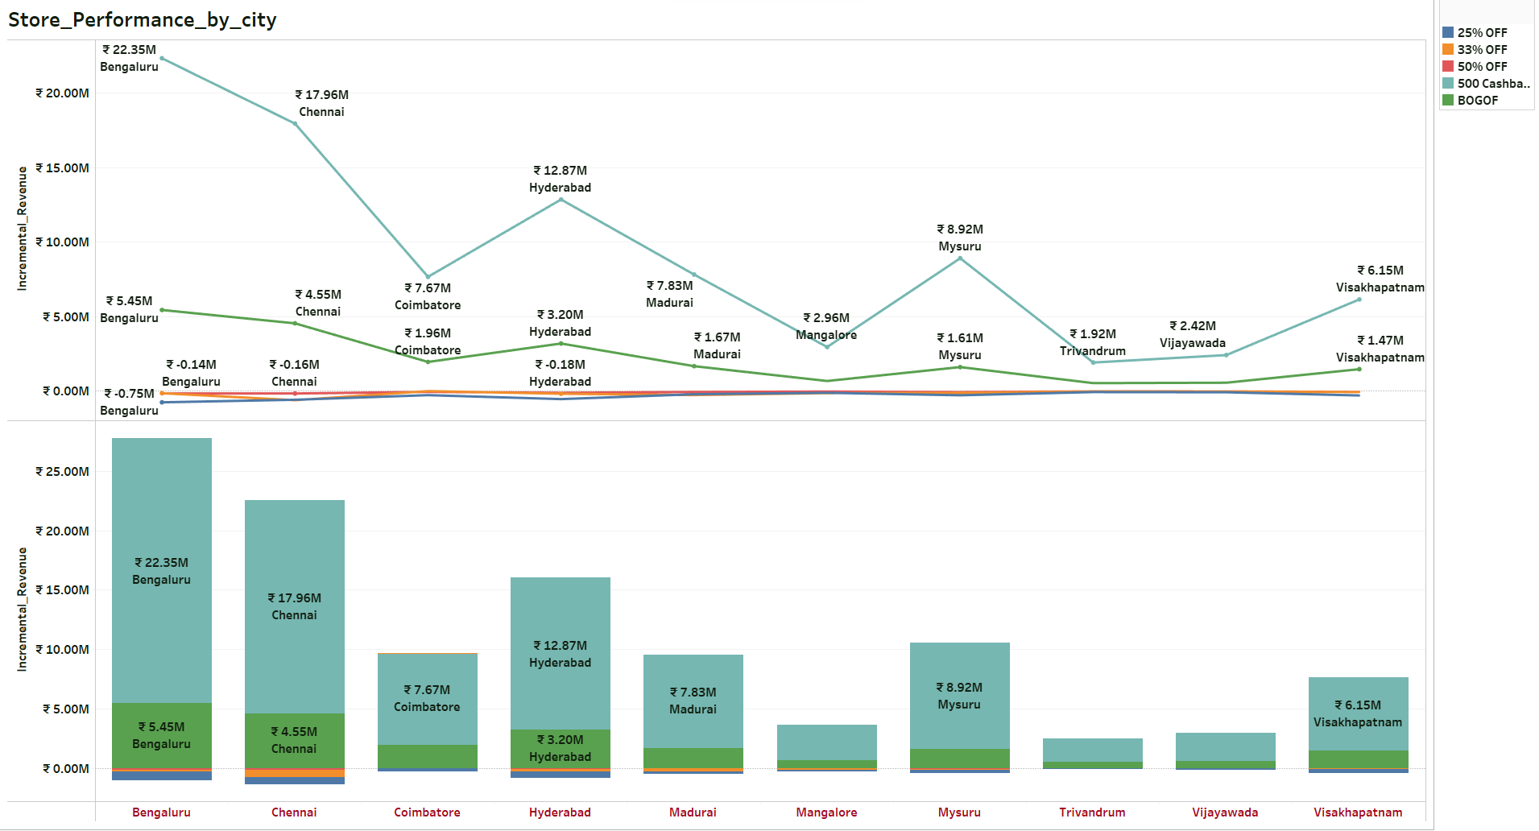
Significance Change that was observed “BOGOF” vs “500 Cashback” vs “25%,33%,50%” Offers

Slide 20
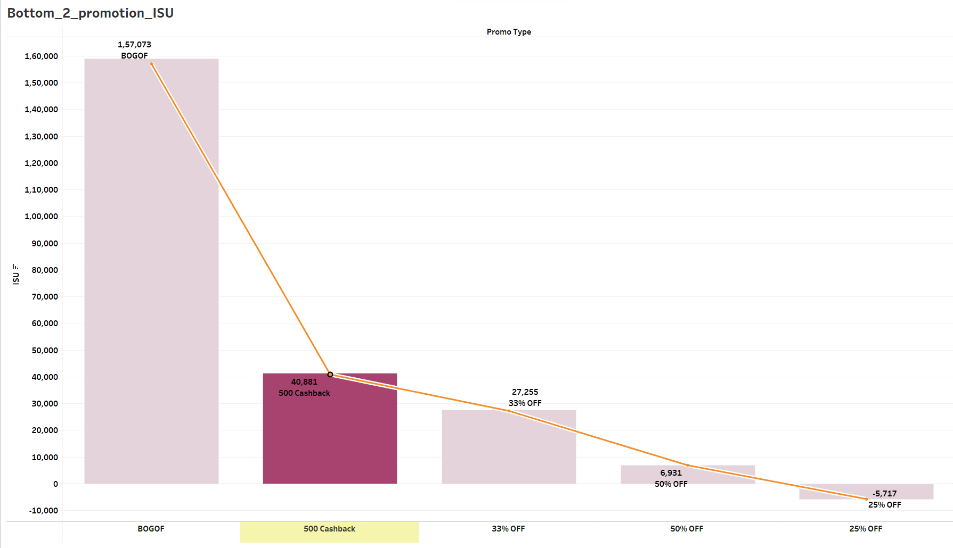
BOGOF is a life saver.
It really contributed a lot to maintain
the balance between healthy Margin
and ISU
While the product of 50% and 25% were moving on an average of 6.9K and
(-5.7K) Units,
The product which had the BOGOF made it to the top of the rate of Sold Units Selling 157K products

Slide 21

Product and Category Analysis

Slide 22
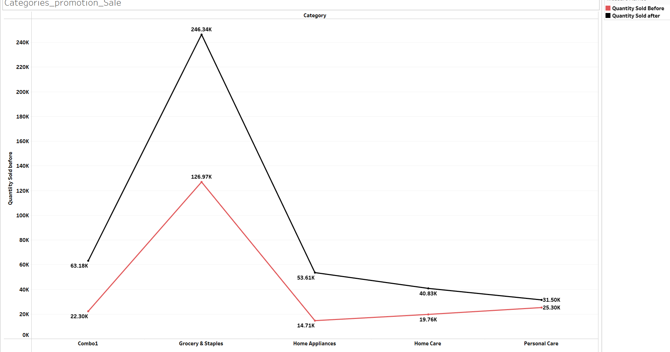
Product Categories that hit the most significant Sales
The Difference in Sold Units before Promo
and after promo:

Slide 23
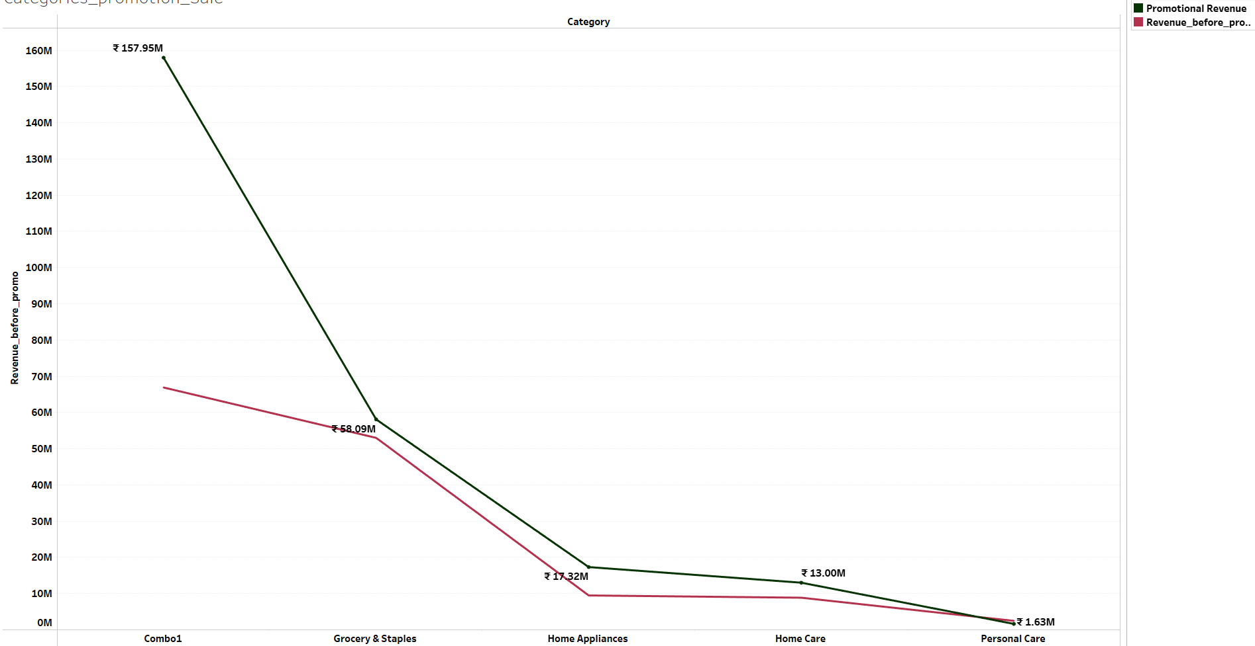
Combo1:
₹66.90M → ₹157.95M
Grocery & Staples:
₹52.99M → ₹58.09M
Home Appliances:
₹9.48M → ₹17.32M
Home Care:
₹8.86M → ₹13M
Product Categories that recorded the highest IR Sales after promo

Slide 24
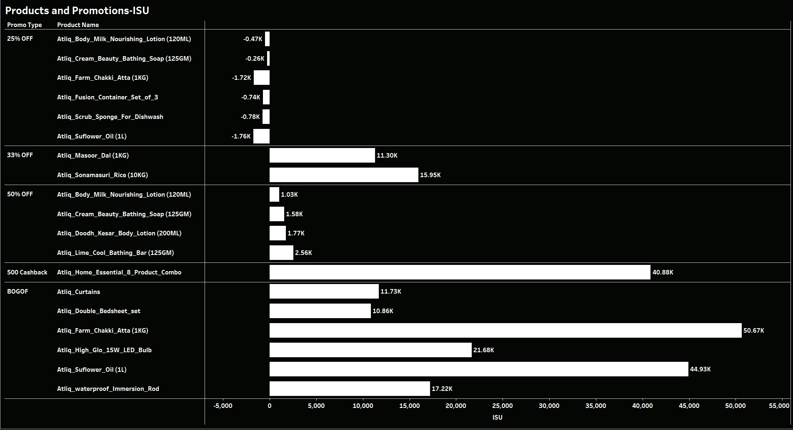
The Product that did show the highest sale rate during promo:
Atliq Farm Chakki Atta(1KG) → 50.67K
Atliq Sunflower Oil(1L) → 44.93K
Atliq Home Essential 8 product Combo → 40.88K

Slide 25
The Products that did extremely poor in terms of ISU include:
Atliq Body Milk Nourishing Lotion(120ML)
Atliq Cream Beauty Bathing Soap(125GM)
Atliq Fusion Container Set of 3
Atliq Scrub Sponge For Dishwash
Atliq Sunflower Oil(1L)
Atliq Farm Chakki Atta(1KG)

Slide 26
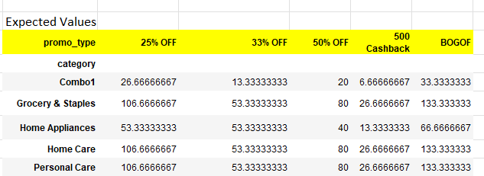
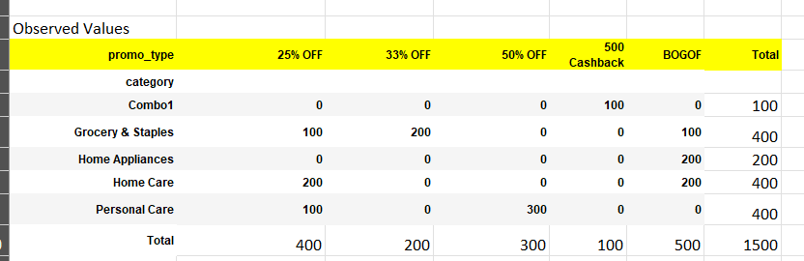
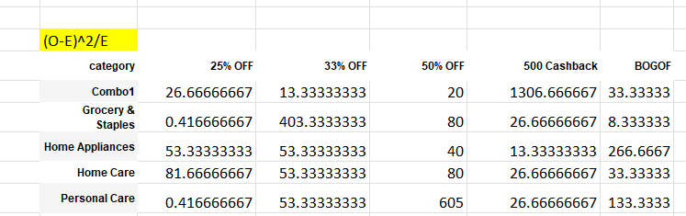
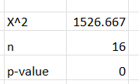
A Chi-Square Test Proved that there is a Significant relationship Exists between
the Categories and the Promotion:

Slide 27
Based on the chi-square test results provided:
Chi-Square Statistic: 1526.666667
Degrees of Freedom (n): 16
P-value: 0
With a p-value of 0, we reject the null hypothesis of independence between the product categories and promotion types.
This suggests that there is a significant association between the two variables.
In other words, the distribution of product categories varies significantly across different promotion types, and vice versa.
The high chi-square statistic further supports the conclusion of a significant association between the variables.
The larger the chi-square value, the stronger the evidence against the null hypothesis of independence.
Summary:
we can conclude that there is a strong and statistically significant association between the product categories and promotion types. This finding has important implications for marketing strategies and promotional planning,
it suggests that certain product categories are more likely to be associated with specific promotion types.

