Slide 1
Unsupervised Spatio-Temporal logic inference

Slide 2

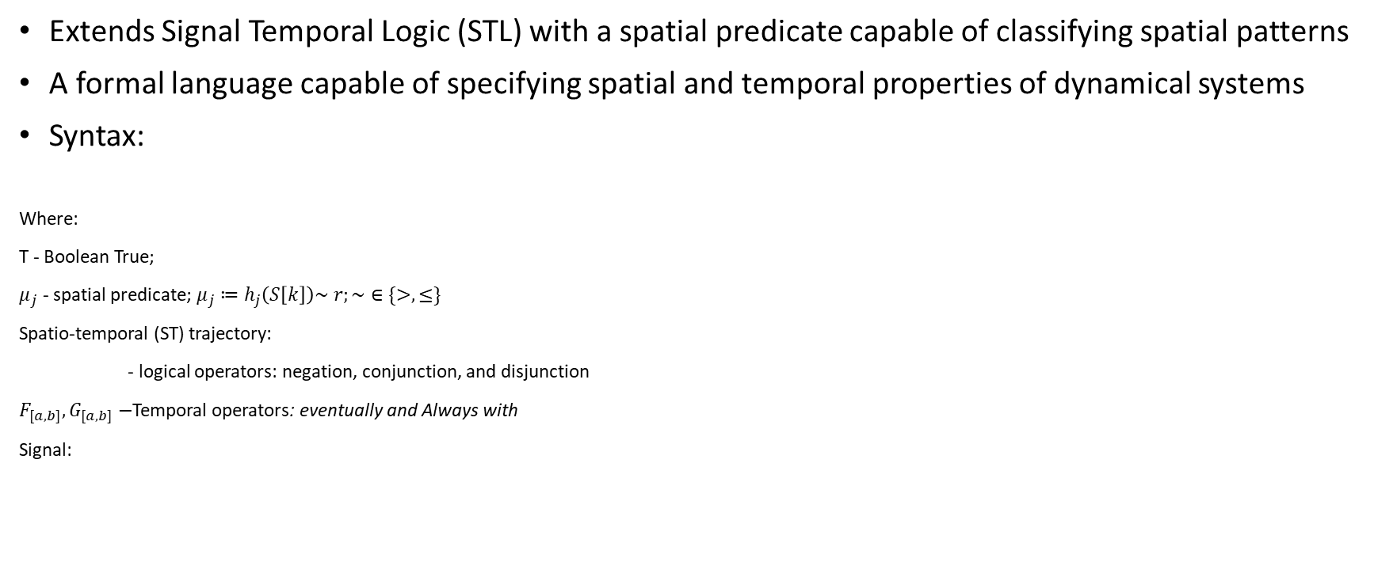
Support Vector Machine Signal Temporal Logic (SVM-STL)
Extends Signal Temporal Logic (STL) with a spatial predicate capable of classifying spatial patterns
A formal language capable of specifying spatial and temporal properties of dynamical systems
Syntax:
Where:
T - Boolean True;
$μ_{j}$ - spatial predicate$\text{; }μ_{j}≔h_{j}\left(S\left[k\right]\right)\sim r;\sim ∈\{>, ≤\}$
Spatio-temporal (ST) trajectory:
- logical operators: negation, conjunction, and disjunction
$F_{[a,b]},G_{[a,b]}−$Temporal operators: eventually and Always with
Signal:

Slide 3





$μ_{j}$ - spatial predicate$\text{; }μ_{j}≔h\left(S\left[k\right]\right)\sim r;r∈ℝ^{n_{I}}\sim ∈\{>, ≤\}$
Feature extraction
Multiclass classifier
$${s\left[k\right]∈ ℝ}^{n_{I}}$$
$$S\left[k\right]=I∈ℝ^{L×W×C}$$
$$f_{clf}:ℝ^{L×W×C}→ ℝ^{m}$$
$$f_{clf}^{θ_{h}}:ℝ^{m}→ ℝ^{n_{I}}$$
$$s\left[k\right]= h_{θ_{h}}(S\left[k\right])$$

Slide 4



$$𝒟_{node}$$
$$𝒟_{left}$$
$$𝒟_{right}$$

Slide 5
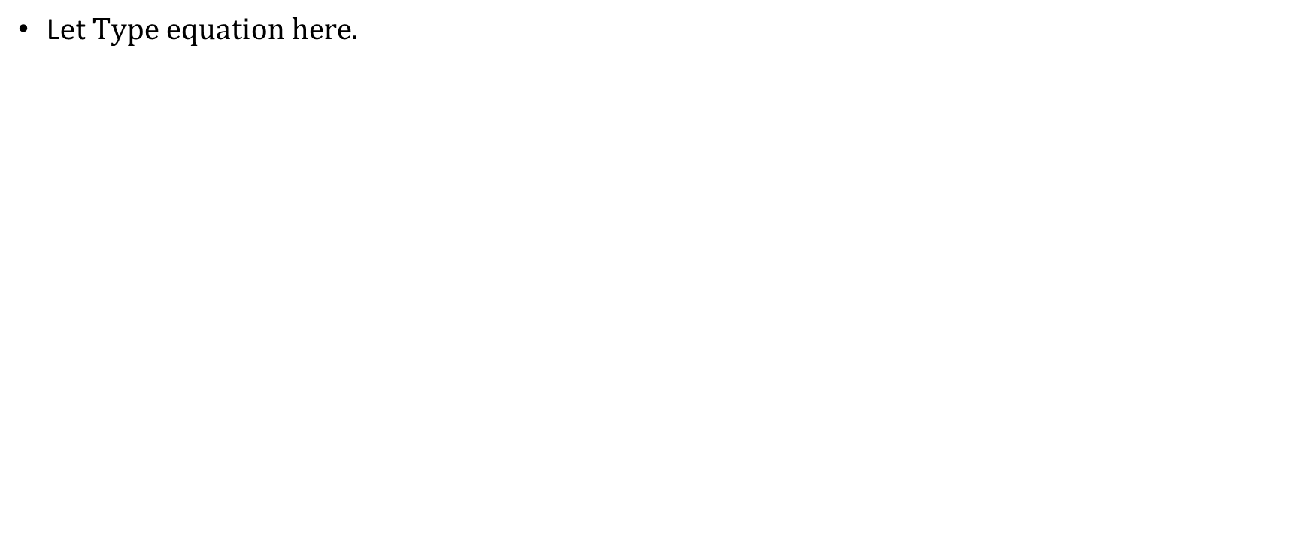
Problem Formulation
Let

