Slide 1

Financial Transactions Analysis: Credit Cards, Users, and Fraud Detection
From Data Cleaning to Insights and Power BI Dashboard made by Sohaila Elsayed

Slide 2

Agenda
Project Overview
Step 1: Data Cleaning Using Python
Step 2: Merging Data Using SQL
Step 3: Extracting Insights Using Python (with Tables)
Step 4: Creating a Dashboard in Power BI
Key Learnings & Next Steps
Q&A
"We'll follow the data pipeline step-by-step, from messy raw data to actionable insights. This project used anonymized datasets on credit cards, users, and transactions to identify fraud risks and user behaviors."

Slide 3
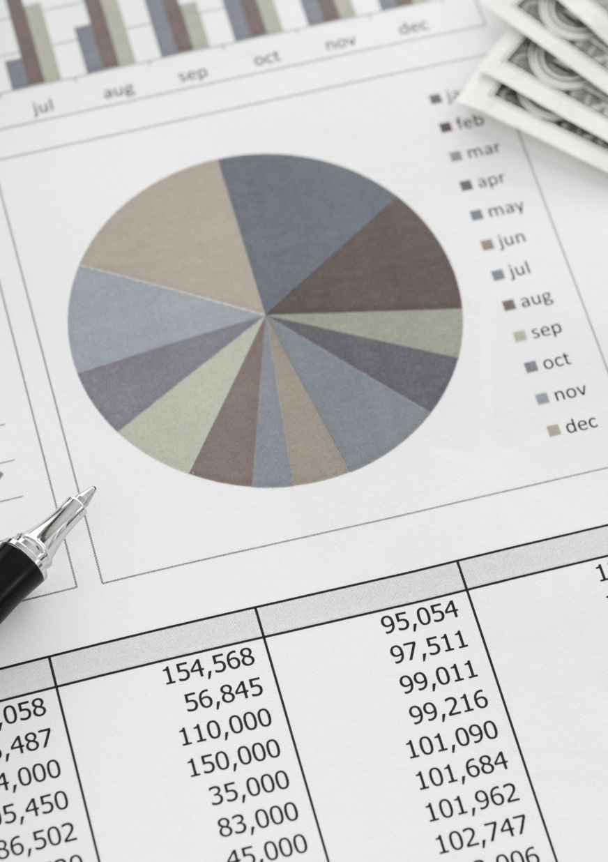
Project Overview
What I Did: Analyzed a financial dataset combining credit card details (e.g., limits, brands), user profiles (e.g., income, debt), and transaction records (e.g., amounts, errors, fraud labels). Goal: Clean data, merge sources, extract insights on debt patterns, fraud hotspots, and spending behaviors, then build an interactive dashboard.
Datasets: Credit Cards: rows (brands, types, limits, PIN changes).
Users: Income, age, debt.
Transactions: Amounts, merchants, MCC codes, fraud labels (from JSON).
Tools: Python (Pandas, Seaborn, PyODBC), SQL (joins in SQL Server), Power BI (visualizations).
Key Outcomes: Identified high-risk fraud merchants; high-income users carry more debt but lower ratios; dashboard for stakeholders.
Visual: High-level flowchart: Raw Data → Cleaning (Python) → Merging (SQL) → Analysis (Python) → Dashboard (Power BI).
Talking Points: "The project addressed real-world challenges like dirty financial data (e.g., currency symbols, nulls) and siloed sources. Insights help banks target premium cards and detect fraud."

Slide 4


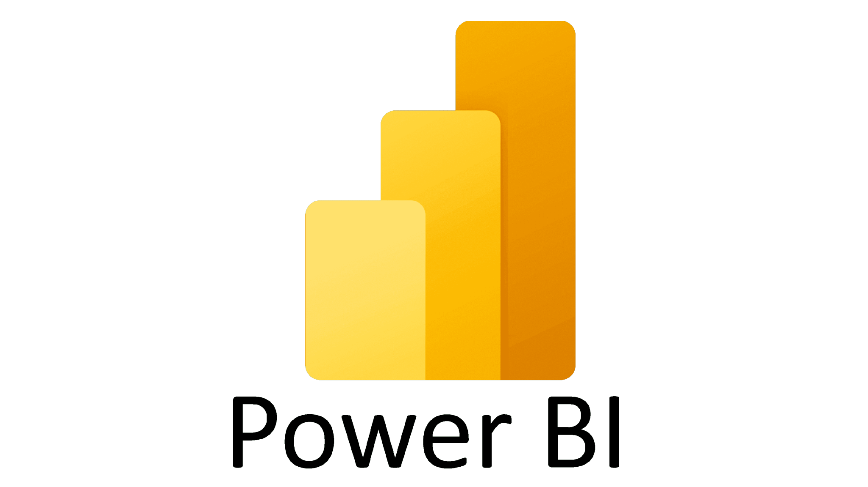
Pipline project:

Slide 5

Step 1: Data Cleaning Using Python
Focus: Explain raw data issues (e.g., strings with '$', nulls, non-numeric chars) and how Python fixed them logically.

Slide 6
Data Cleaning Using Python:
What I Did: Cleaned three datasets (credit cards, users, transactions) to make them analysis-ready. Handled formatting (e.g., '$' in amounts), nulls (logical imputation), and derived features (e.g., debt-to-income).
Why?: Raw data had inconsistencies (e.g., '₹' symbols, 'nan' strings, missing merchants) that could skew insights or cause errors in merging/analysis.
How (High-Level): Used Pandas for string cleaning, regex for numerics, and group-based imputation. No blind drops—logical fills preserved data integrity.
Visual: Before/after table snippet (e.g., raw credit_limit: '$1,000' → 1000).
Talking Points: "Cleaning was 40% of the work. We ensured numeric accuracy for financial metrics and imputed nulls based on business logic, like median amounts by card type."

Slide 7

Early Insights from Cleaning
What: Quick plots to validate cleaning (e.g., barplot for card brands, histogram for PIN changes).
How: Used Seaborn for sanity checks.Example Code (from your input): Barplot for num_cards_type; Scatter for credit_limit vs. cards_age_year.
Visual: Embed 2-3 cleaned plots (e.g., "Card Brand by Type" bar chart; "PIN Change Distribution" histogram).
Talking Points: "Post-cleaning plots confirmed data quality—e.g., Visa dominates issuance; early PIN changes (0-1 year) align with security practices."

Slide 8
Step 1 Summary
Outcomes: Cleaned datasets ready for SQL (e.g., 95% null reduction; all numerics/datetimes).
Transition: "With clean tables, we moved to SQL for merging siloed data."
Visual: Checkmark icons for completed tasks.
Talking Points: "Python cleaning transformed raw chaos into structured data—now, let's join it all in SQL."

Slide 9
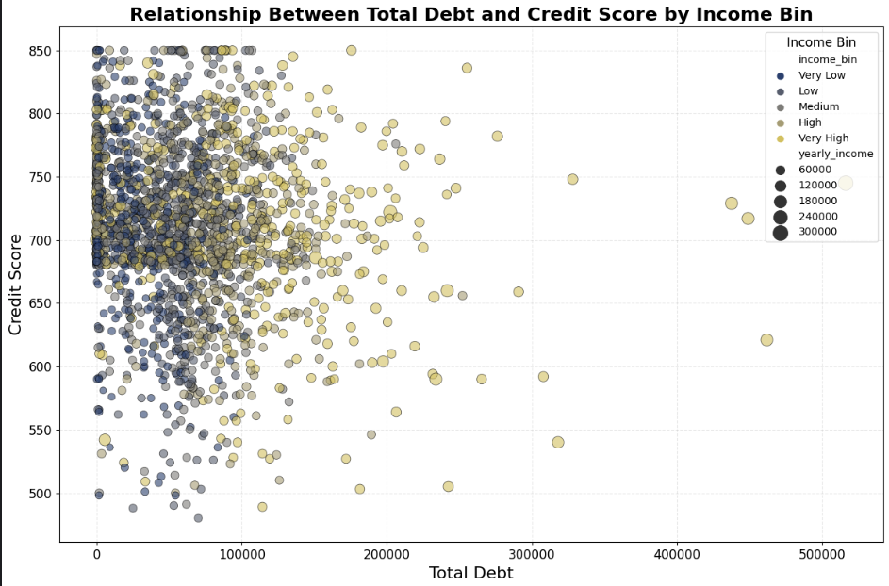
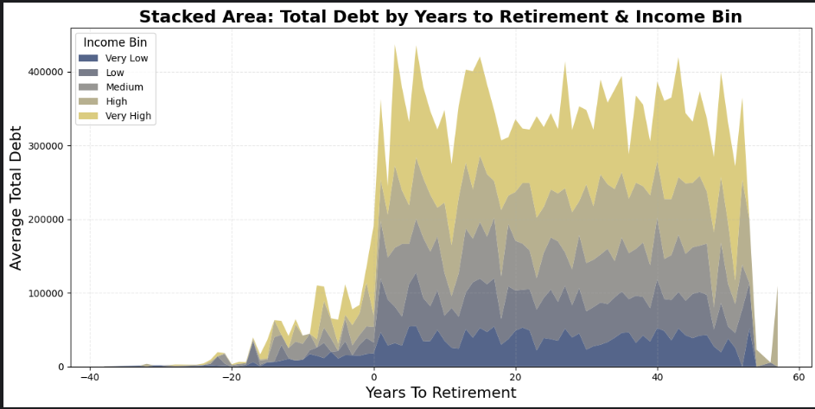
Insights

Slide 10
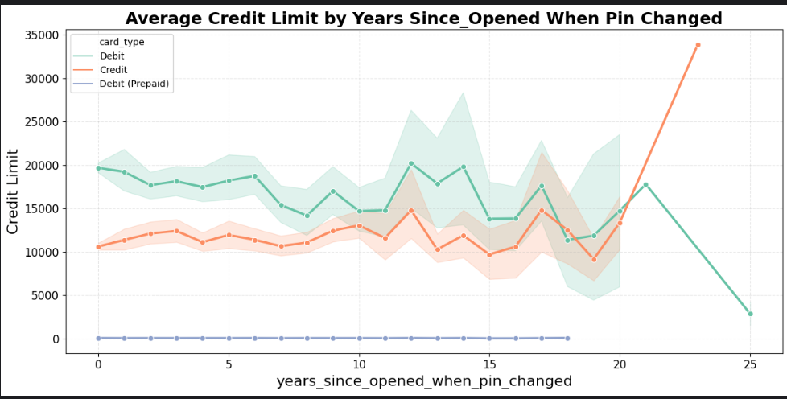
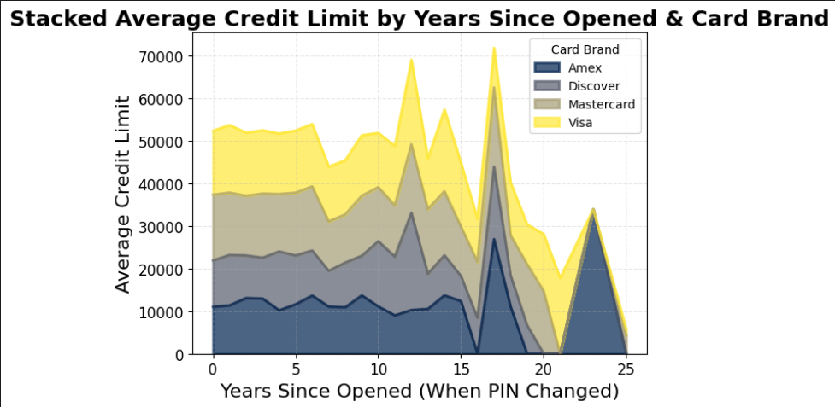
Insights:

Slide 11

Step 2: Merging Data Using SQL
Focus: Show how SQL integrated sources efficiently.

Slide 12
Step 2 Overview - Merging Data in SQL
What I Did: Created a unified view by joining credit cards (Cards_cleaning), users (User _cleaned), and transactions (transactions_data) on keys like client_id and card_id.
Why?: Data was in separate tables; joins enabled holistic analysis (e.g., user income + transaction fraud).
How (High-Level): Used SQL Server to define tables, then INNER JOIN for matching records. Queried via Python (PyODBC) for analysis.
Visual: ER Diagram (Cards ← Users; Transactions ← Cards).
Talking Points: "SQL handles large-scale joins better than Python—reduced memory use and ensured referential integrity."

Slide 13
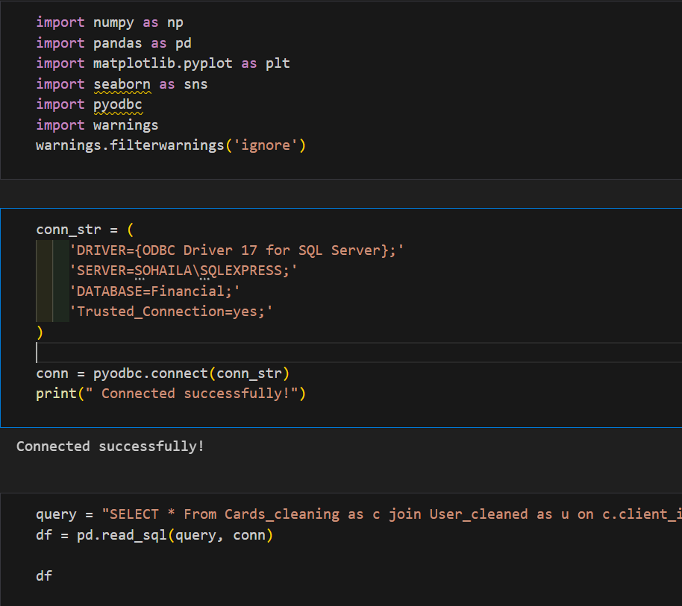
Python Connection to SQL
What: Pulled joined data into Python for further analysis.
How (Code Snippet):

Slide 14
Python Connection to SQL
Results: Single DF with all features (e.g., credit_limit + is_fraud + yearly_income).
Visual: Connection success message + df.head() table.
Talking Points: "PyODBC bridged SQL to Python—query ran in seconds on 100k+ rows. This DF powered all insights."

Slide 15
Step 2 Summary
Outcomes: Unified dataset for cross-analysis (e.g., debt by merchant); no data loss from mismatches.
Challenges: Key mismatches (handled with INNER JOIN); large data (SQL optimized).
Visual: Before (separate tables) vs. After (joined DF schema).
Talking Points: "Merging revealed connections, like high-debt users in fraud-prone transactions. Next: Extract insights from this gold-standard data."

Slide 16

Step 3: Using Python to Extract Insights and Present in a Table
Focus: Show analysis on joined data; summarize insights in tables (e.g., groupbys, pivots).

Slide 17
Step 3 Overview - Extracting Insights in Python
What I Did: Analyzed the joined DF for patterns in debt, fraud, spending (e.g., by brand, age, error type). Presented key metrics in tables for clarity.
Why?: Quantify trends (e.g., fraud by merchant) to support decisions like risk monitoring.
How: Groupbys, pivots, plots; tables for summaries (e.g., averages by bin).
Visual: Sample insight table (e.g., DTI by income bin).
Talking Points: "With merged data, Python uncovered actionable stories—e.g., low-income users have highest DTI, signaling risk."

Slide 18
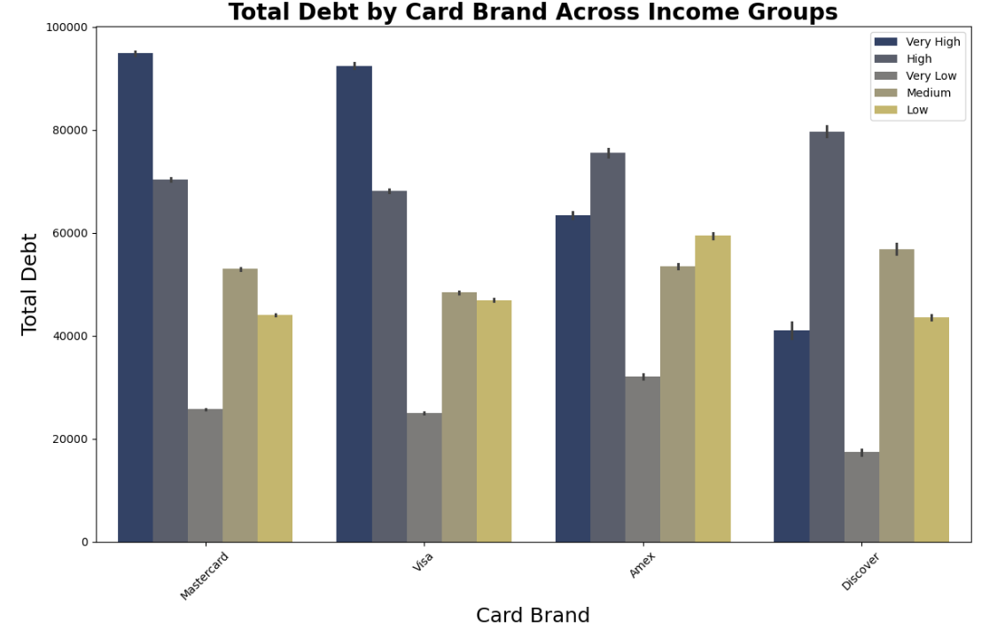
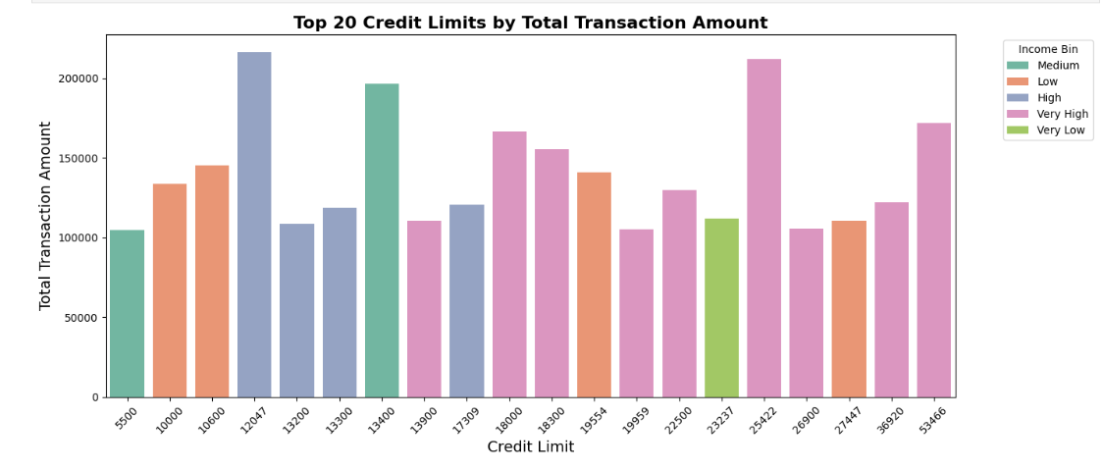
Insights:

Slide 19
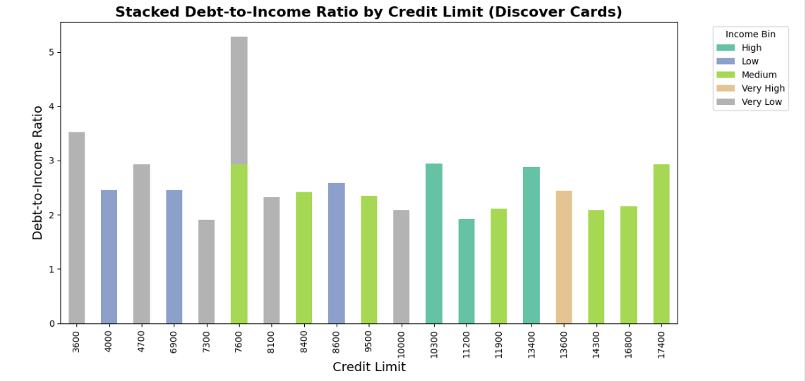
Insights:

Slide 20
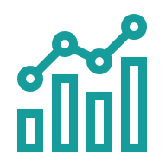
Creating a Dashboard in Power BI:
Focus: Demonstrate how Power BI turned static insights into interactive, stakeholder-friendly visuals. Emphasize ease of use, interactivity, and tying back to cleaned/merged data.

Slide 21
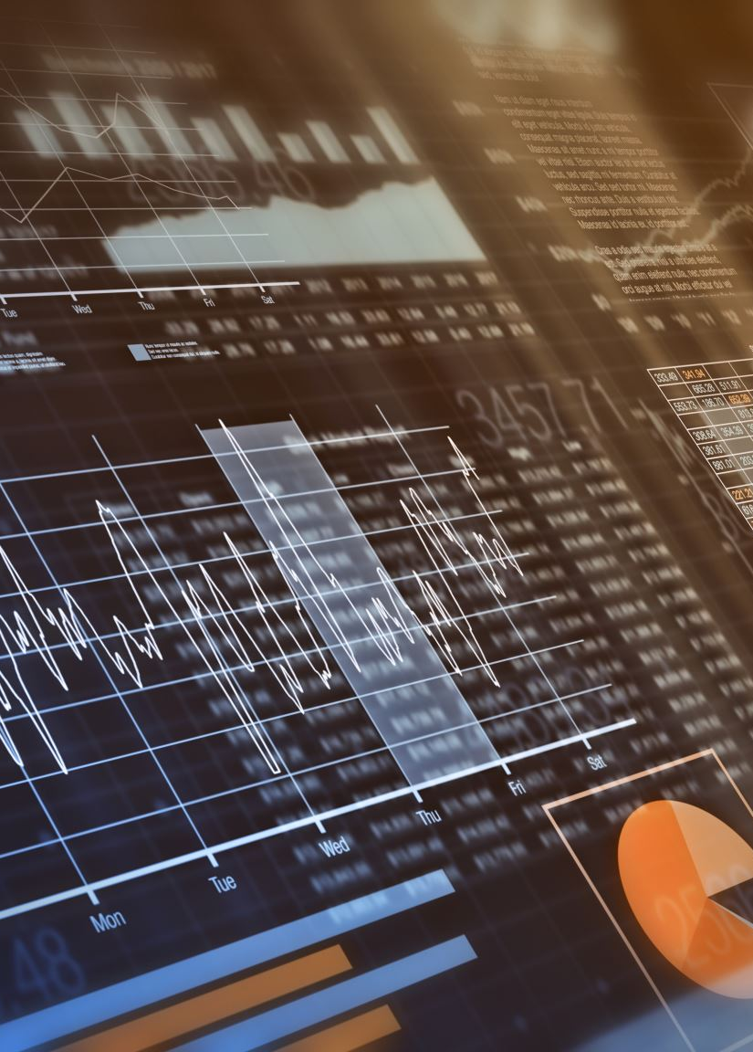
Step 4 Overview - Creating a Dashboard in Power BI
What I Did: Built an interactive dashboard to summarize the entire project—visualizing cleaned, merged data for fraud detection, debt patterns, and spending behaviors. Key pages: Overview, Fraud Analysis, User Debt, and Trends.
Why?: Python/SQL provided raw insights, but Power BI makes them dynamic (e.g., slicers for age/income) for business users to explore without code.
How (High-Level): Imported data from SQL query; measures (e.g., added visuals like bar charts, maps, and KPIs. Published to Power BI Service for sharing.
Outcomes: Dashboard reveals trends like "Top fraud merchants" with filters—e.g., click "Very Low Income" to see risk spikes.
Visual: Power BI logo + high-level dashboard screenshot (e.g., multi-page layout with KPIs like "Total Fraud Rate: 2.5%").
Talking Points: "Power BI is the 'front-end' of our pipeline—turning tables into clickable stories. It uses our joined DF to let users drill down, e.g., from card brand to transaction fraud."

Slide 22
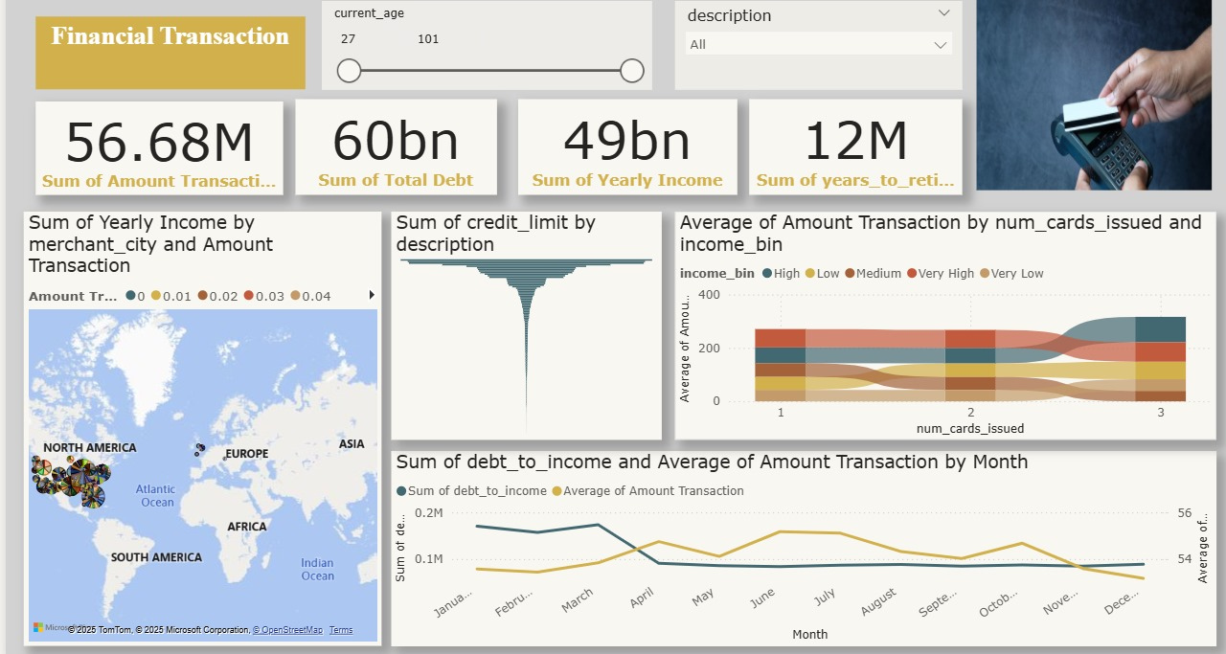

Slide 23

Thank you

