Slide 1


Mini Project
“Blood and Organ Donation Management System“
Dept. of CS&E ( DATA SCIENCE)
Adichunchanagiri Institute of Technology
Chikkamagaluru - 577102
Presented By,
Suhaina G (4AI22CD054)
Under the Guidance of
Prof. Shalini I S

Slide 2
PROBLEM STATEMENT
● Overview of the Problem:
To design and implement a system that can accurately track and record the donation of blood and organs in real-time, reducing manual effort and improving monitoring accuracy. The current methods of tracking blood and organ donations in many healthcare institutions often rely on manual entry, which increases the chances of mistakes and consumes valuable time.
●Specific Issues:
Database Selection: Choosing a suitable database to store donor and recipient information, considering factors like scalability, performance, and data integrity

Slide 3
SCOPE OF THE PROJECT
Key Focus Areas:
  Efficient registration and authentication for donors and recipients.
  Real-time matching of donors and recipients based on compatibility (e.g., blood group or organ type)..
  Secure storage and management of donor and recipient data in a MongoDB database.
Expected Benefits:
  Accessibility: Allows users to access the system remotely to register, search, or request donations..
  Time Efficiency: Accelerates the process of finding suitable donors and coordinating donations, especially in emergencies.
  Usability: Provides an intuitive interface for easy navigation and interaction.

Slide 4
PROJECT DESIGN
System Components:
  Frontend: Built using HTML and CSS for a user-friendly and responsive interface.
  Backend: Developed with Python and Flask for handling user requests
  Database: MongoDB is used for secure and scalable data storage, including donor and recipient information.
Architecture/Block Diagram:
  User Interface: Features registration, login, and dashboards for donors, recipients, and administrators.
  Donation Management: Tracks blood and organ inventory, donation history, and availability in real-time.
  Database Management: Stores user profiles, donation records in MongoDB.
  Backend: Logic to handle user authentication, data storage.

Slide 5
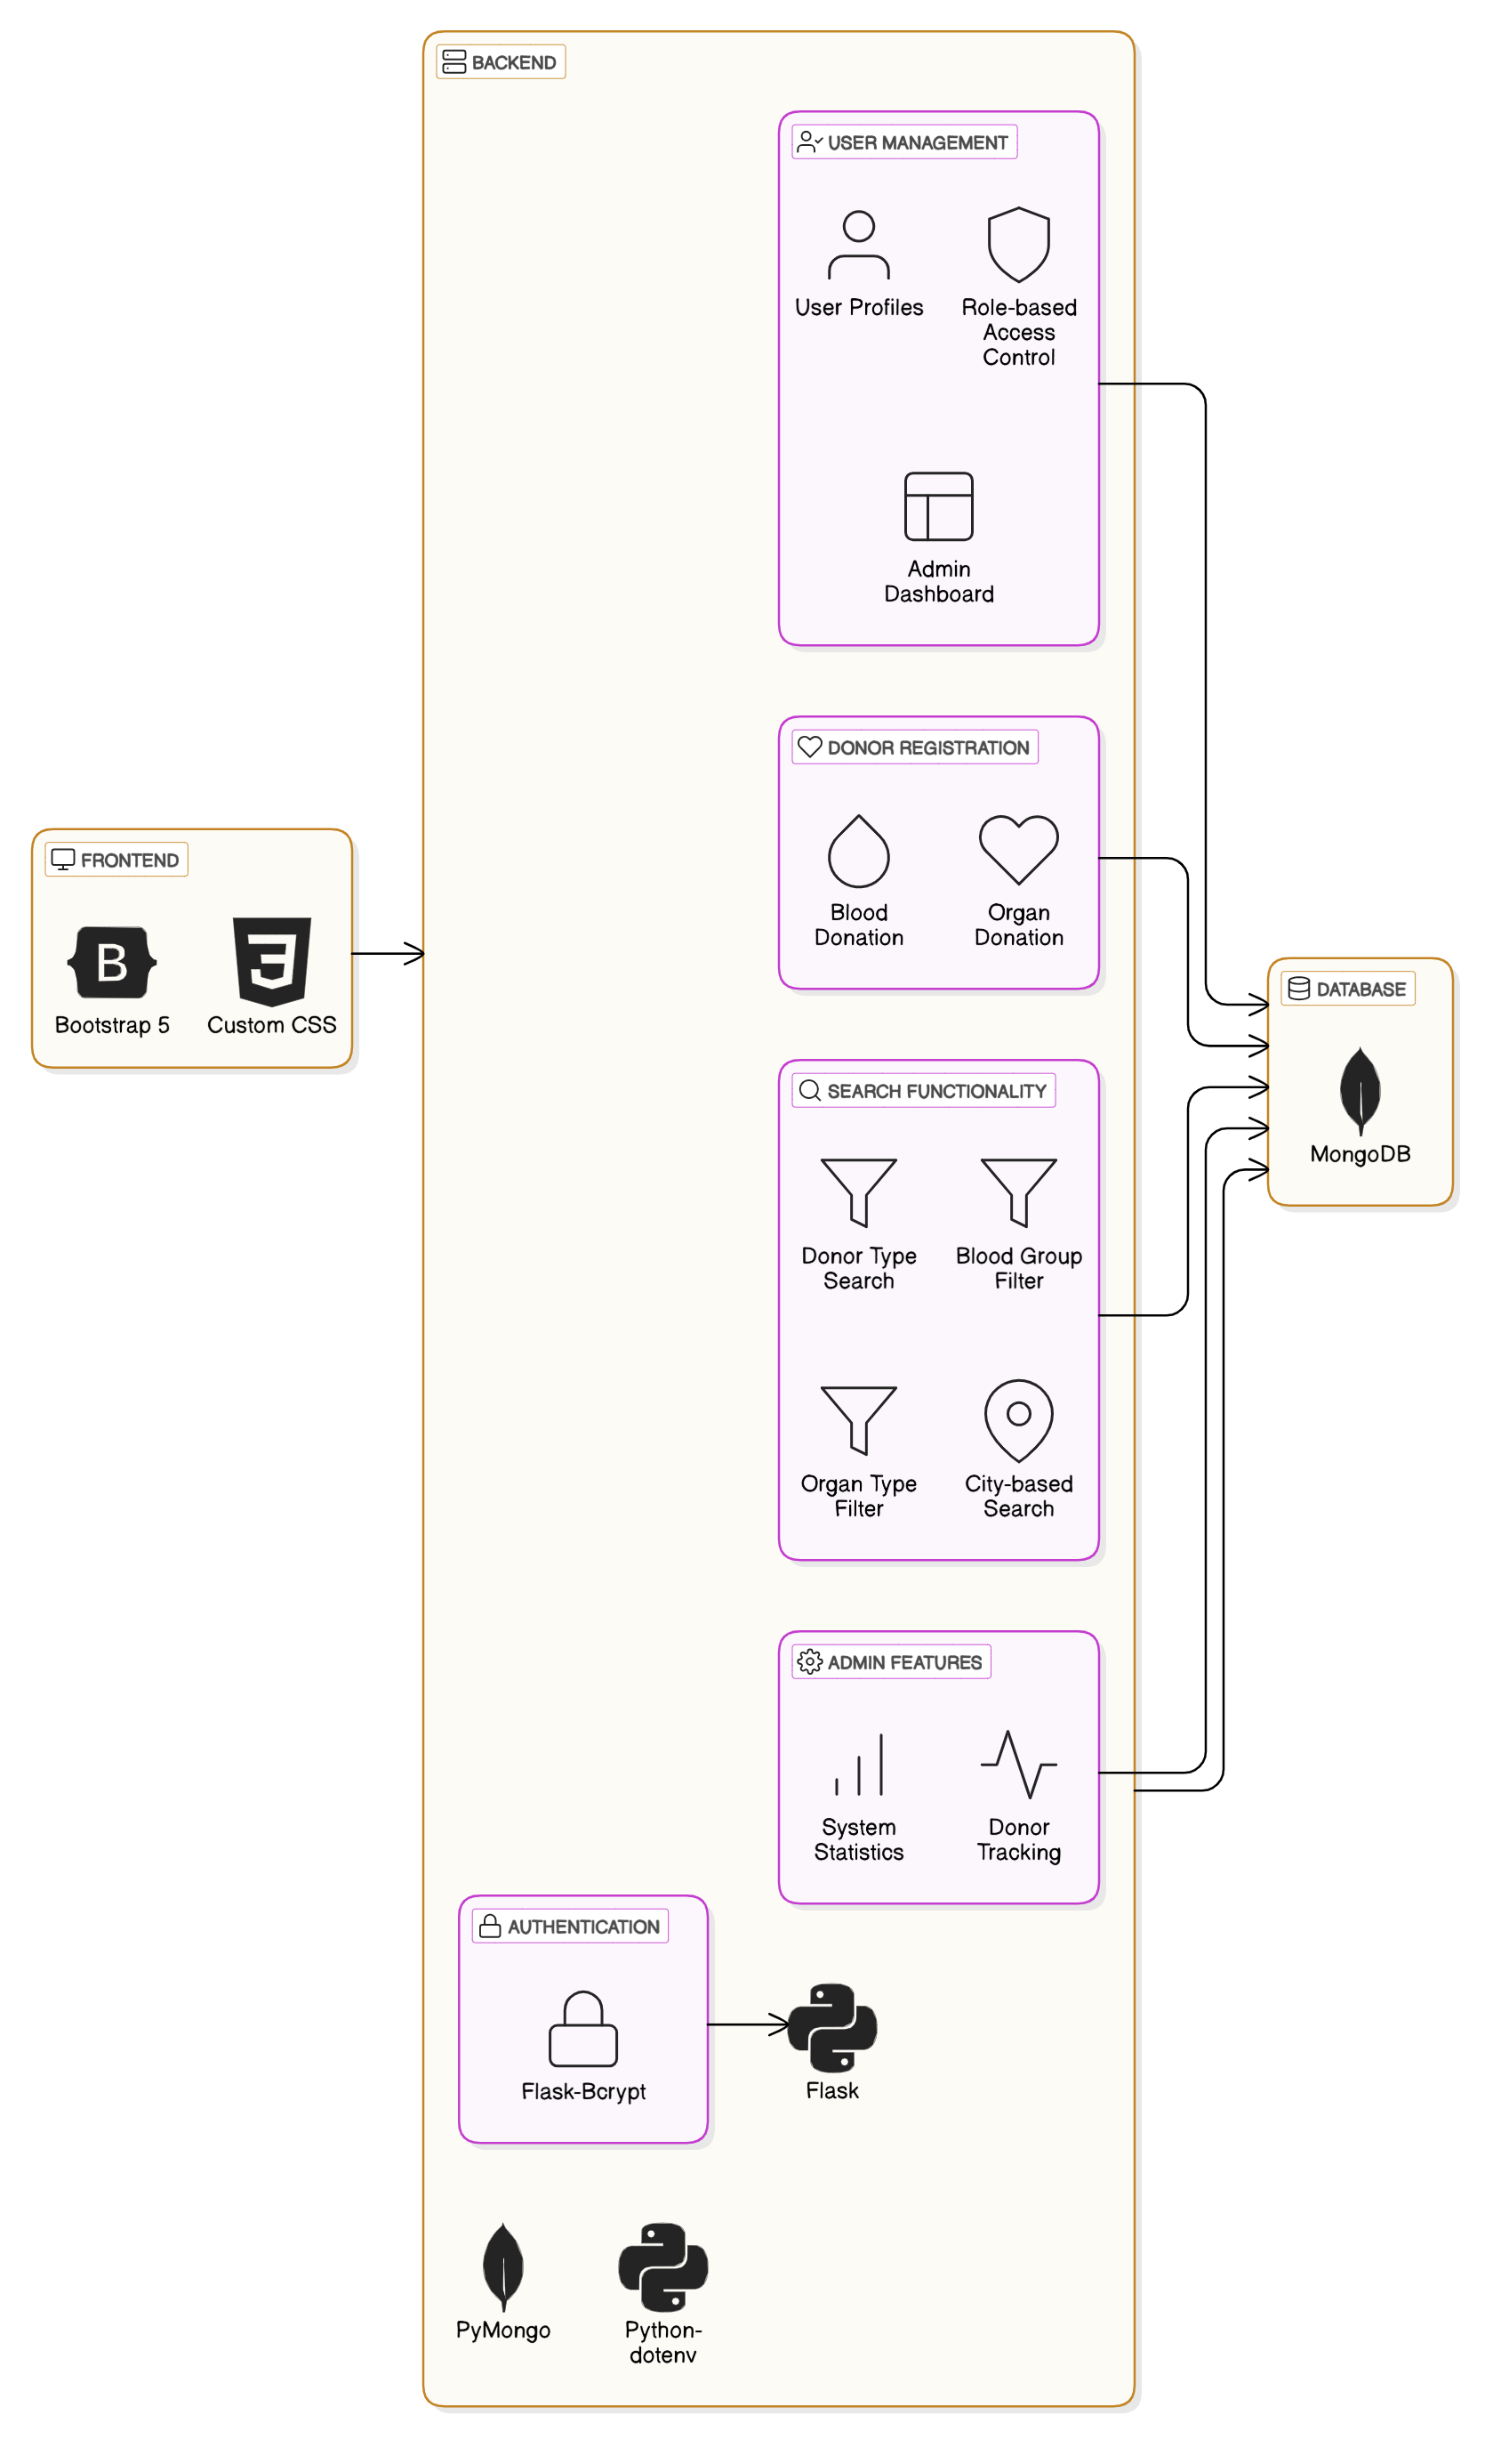
ARCHITECTURE DIAGRAM

Slide 6
METHODOLOGY
Tools and Technology :
The system will be developed using a web-based platform with modern technologies:
Frontend: HTML, CSS for creating an interactive and user-friendly interface.
Backend: Python for handling server-side logic and API interactions.
Database: MongoDB (a NoSQL database) for storing and managing donor, recipient, and inventory data.
Approach : The system will be developed using the Agile methodology, emphasizing iterative design with continuous user feedback to ensure accessibility and efficiency for all users. This approach allows for flexibility and quick adaptation to evolving requirements.

Slide 7
IMPLEMENTATION
BACKEND:
SA restful API to handle requests from the frontend,process Data and interact with the database.
FRONTEND:
The user interface for recipients, donors to interact with system.
DATABASE:
Used MongoDB to store the data of user and retrieve the data give this for blood and organ donation management system

Slide 8
RESULTS
Secure User Authentication:
Users can sign up, log in, and access personalized chat experience securely.
Passwords are securely handled in the backend
Data Visualization with Power BI Dashboard:
  Blood Shortage Deaths:
Donation Management Features:
1. Admin Dashboard:
Displays detailed data about registered donors and recipients.
2. Donor and Recipient Interaction:
  Donors: Can register their availability for blood or organ donation.
  Recipients: Can search for matching donors and request assistance.

Slide 9
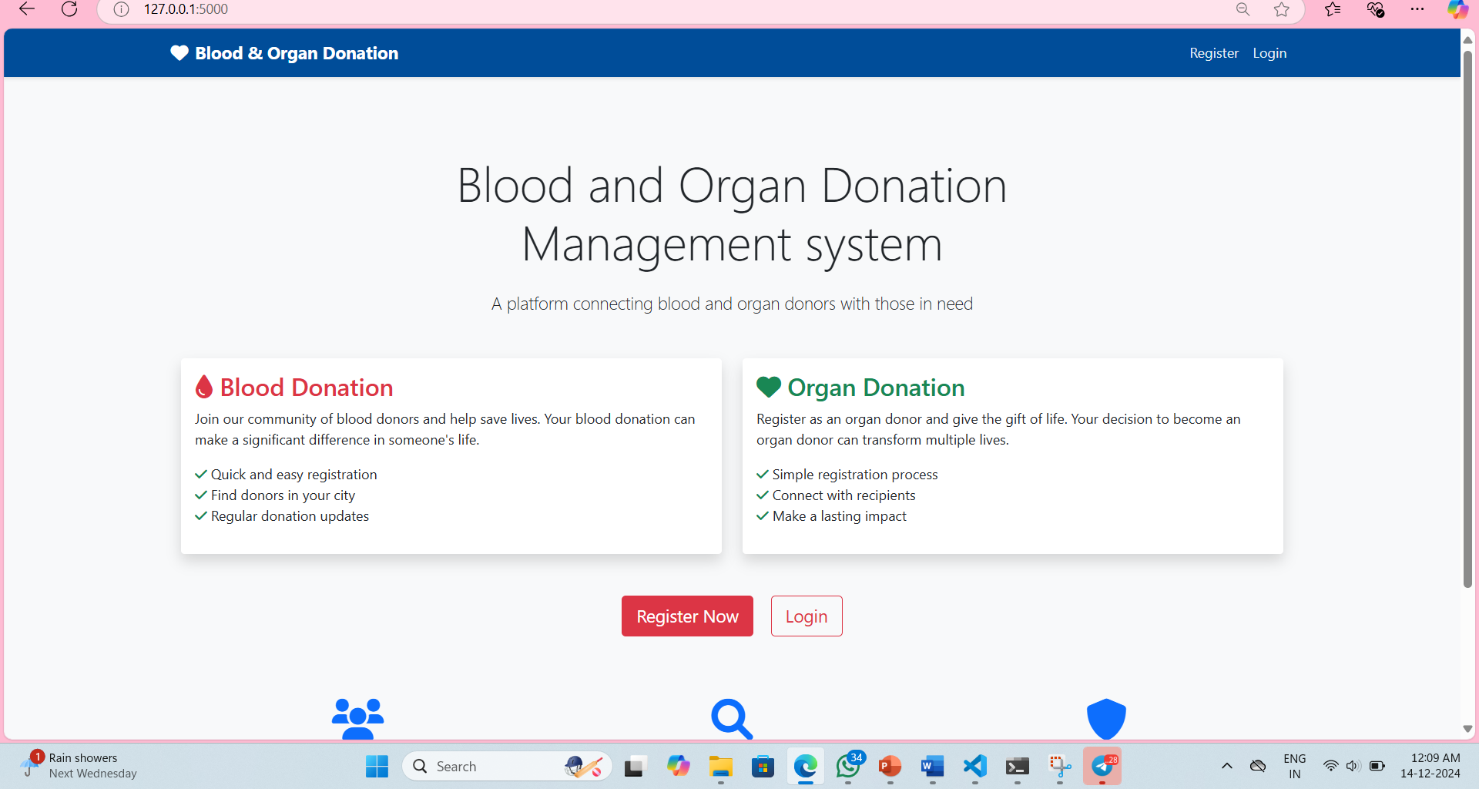
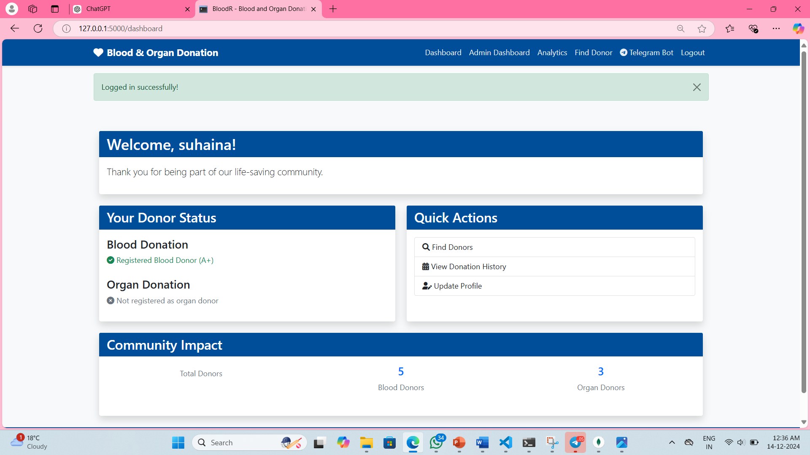
SCREENSHOTS
fig 1: Home page

Slide 10
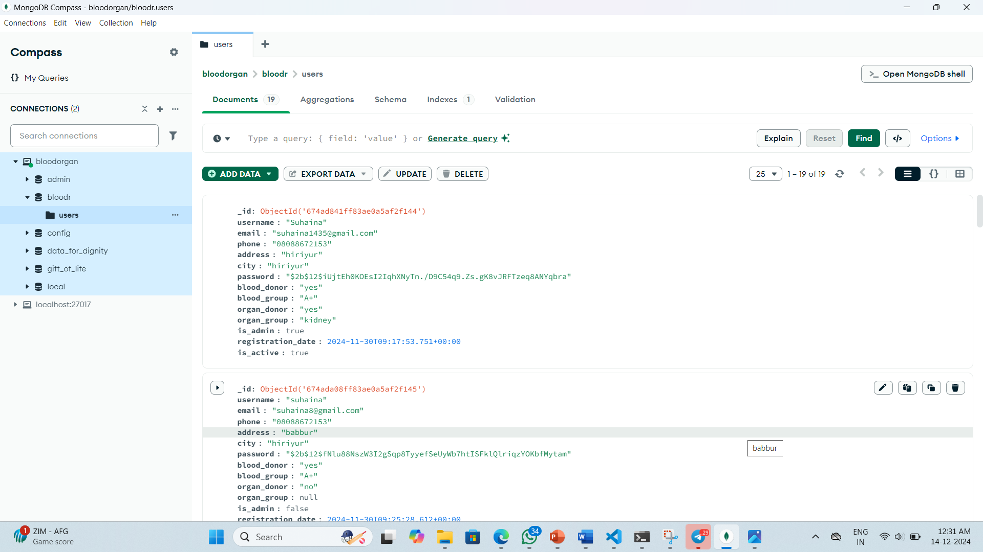
z
Fig 1: Saving the details in Mongodb

Slide 11
CHALLENGES FACED
Challenges:
1. Bot Authentication and API Access:
Challenge: Getting the bot token from Telegram and ensuring the bot has proper permissions to interact with the Telegram API.
Solution: Using BotFather to create a bot and securely storing the bot token to avoid unauthorized access.
Resolutions:
Create a Bot with BotFather:
1. Open Telegram and Search for BotFather:
In the Telegram app, search for BotFather (official Telegram bot used to create new bots).

Slide 12
2. Start a Chat with BotFather:
Click on Start to begin interacting with BotFather.
3. Create a New Bot:
Type/newbot and press Enter . BotFather will prompt you to provide a name and username for your bot
4. Get the Bot Token:
After creating the bot, BotFather will send you a message containing the API token for your bot.
TELEGRAM_BOT_TOKEN
7732780679:AAEN9fR3Jgw5xmrSZR7wQipiZjWJ3gyGQpU
TELEGRAM_BOT_USERNAME
BloodR_bot

Slide 13
CONCLUSION
Summary:
Developed a secure and scalable blood and organ donation management system with features like donor registration, search functionality, real-time donor availability updates, and integration with a Power BI dashboard for tracking blood shortages and related statistics..
Outcome:
A fully functional blood and organ donation management system ready for future enhancements such as automated notifications for blood shortages, improved user interfaces, and advanced analytics.
Final Thought:
This project demonstrates the potential of building secure and scalable healthcare systems that facilitate real-time data management and provide crucial insights, making it suitable for various healthcare organizations and emergency response teams.

Slide 14
FUTURE WORK
.
Enhancements:
  Multi-device Support: Allowing users to access their blood and organ donation data across multiple devices, ensuring seamless interaction.
  Push Notifications: Adding push notifications to alert users about available blood donations, donor matches, and critical updates on organ requests.
Integration:
Integration with Healthcare Systems: Connect the system to existing healthcare databases or hospital management systems to provide a unified view of patient needs, organ availability, and donor data.
.
Integration with Social Media: Allow users to share donation requests or drives via social media platforms, increasing awareness and encouraging participation in donation drives.

Slide 15
GIT HUB LINK
https://github.com/SuhainaG/mini-project

