Slide 1
AahaarTwin
A Personalized Meal-Response Digital Twin
Happiest Health Digital Twin Challenge 2026 — Sujal Giri, B.Tech CSE (2nd year)
Static + dynamic fusion → adverse glycemic-event prediction → conceptual doctor dashboard
5 LightGBM boosters · conformalized uncertainty · per-patient twin state · meal ranking
Research prototype — not a medical device; not for diagnosis or treatment.

Slide 2
The problem
Generic glycemic-index charts treat every body the same.
But the SAME meal spikes glucose in one person and not another — response depends on the individual's physiology, pre-meal state, and context.
Clinicians and patients need a prospective, personal answer: what will happen to MY glucose if I eat THIS meal RIGHT NOW?
And that answer must carry honest uncertainty — a point prediction without a calibrated interval is a guess wearing a lab coat.
Research prototype — not a medical device; not for diagnosis or treatment.

Slide 3
The solution: a meal-response digital twin
A per-patient twin that fuses STATIC data (HbA1c, fasting glucose/insulin, lipids, BMI, age) with DYNAMIC streams (CGM, heart rate, activity, time of day).
Predicts for any candidate meal: 2-hour glucose load (iAUC), 2-hour peak, and the ADVERSE EVENT — glucose excursion (peak ≥ 180 mg/dL) — with conformalized 90% intervals and calibrated probabilities.
Ranks candidate meals best-to-worst for THIS patient at THIS pre-meal moment.
Keeps learning: every prediction is paired with its later observed outcome; drift flags fire when errors shift systematically.
Research prototype — not a medical device; not for diagnosis or treatment.

Slide 4
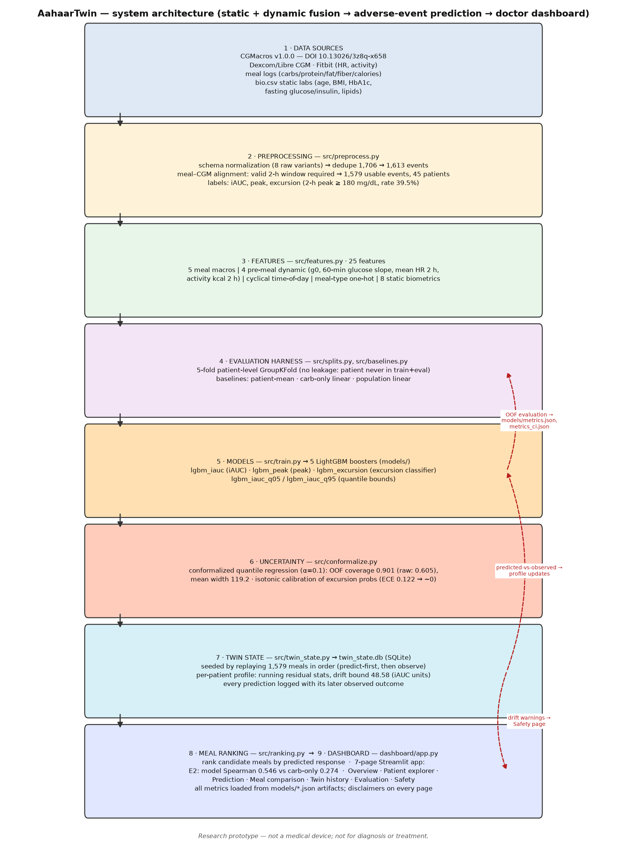
Twin architecture
Pipeline: data → preprocess → features → evaluation harness → models → uncertainty → twin state → ranking → dashboard. Dashed red: evaluation feedback loops.
Research prototype — not a medical device; not for diagnosis or treatment.

Slide 5
Data + methodology
CGMacros v1.0.0 (Gutierrez-Osuna et al., PhysioNet), DOI 10.13026/3z8q-x658. Raw data NOT redistributed (license terms unverified).
1,706 raw meal events → 1,613 post-dedup → 1,579 usable (valid 2-h CGM window) across 45 patients (17–52 meals/patient). Excursion rate 39.5%.
25 features: 5 meal macros · 4 pre-meal dynamic (g0, 60-min slope, mean HR 2h, activity kcal 2h) · cyclical time-of-day · meal type · 8 static biometrics.
Evaluation: 5-fold patient-level GroupKFold — a patient is NEVER in train and eval at once. All metrics out-of-fold; 95% CIs by patient-level bootstrap (2,000 resamples). Hyperparameters fixed a priori (seed 42).
Research prototype — not a medical device; not for diagnosis or treatment.

Slide 6
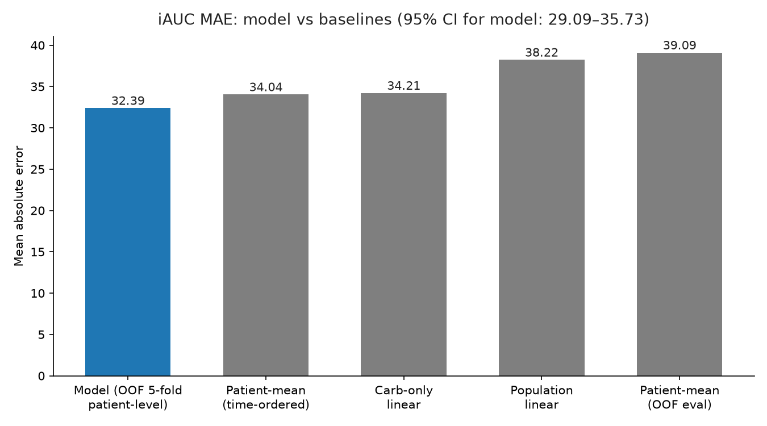
Measured results — regression
iAUC MAE 32.39 (95% CI 29.09–35.73) vs patient-mean 39.09, carb-only 34.21, population-linear 38.22.
Peak MAE 27.10 (95% CI 24.67–29.46) vs patient-mean 40.37.
Honest note: the gap is narrower against the time-ordered patient-mean baseline (34.04) — reported, not hidden.
Excursion classifier: PR-AUC 0.798 (CI 0.73–0.84), ROC-AUC 0.837 (CI 0.80–0.87); at OOF max-F1 threshold 0.347: P 0.707 / R 0.745 / F1 0.726.
iAUC MAE: model vs honest baselines (all artifact-grounded).
Research prototype — not a medical device; not for diagnosis or treatment.

Slide 7
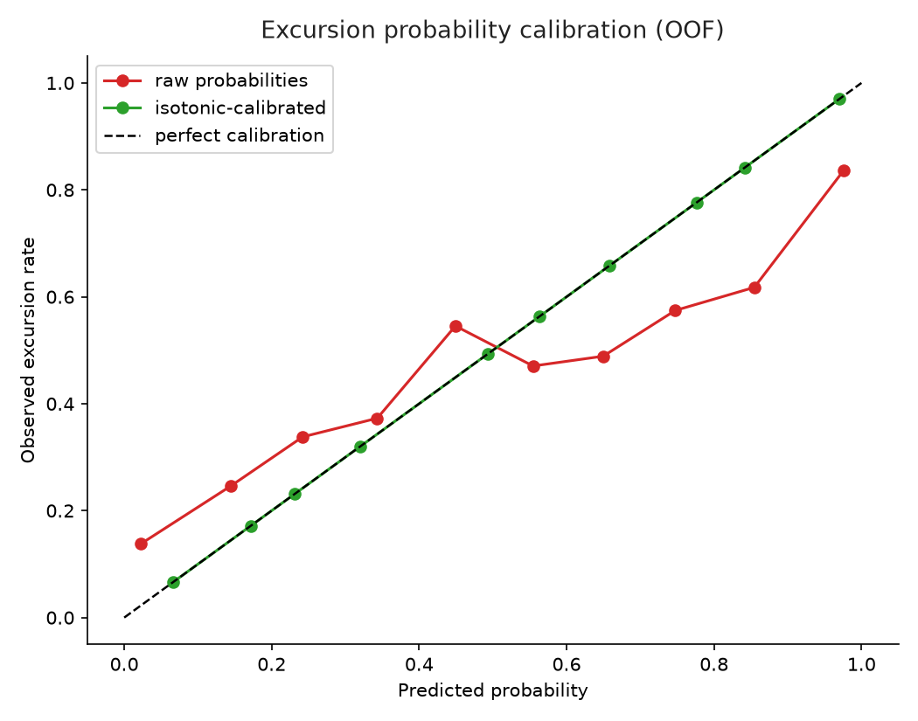
Measured results — calibration & fit
Excursion probabilities are isotonic-calibrated: ECE 0.122 raw → ~0.0.
The calibration curve (right) shows predicted probability tracking observed excursion rate across all 10 bins — the app's risk badges rest on this.
31/31 tests pass; the Streamlit app smoke-tests at HTTP 200; every dashboard metric loads from models/*.json at startup.
OOF calibration curve: raw vs isotonic-calibrated excursion probabilities.
Research prototype — not a medical device; not for diagnosis or treatment.

Slide 8
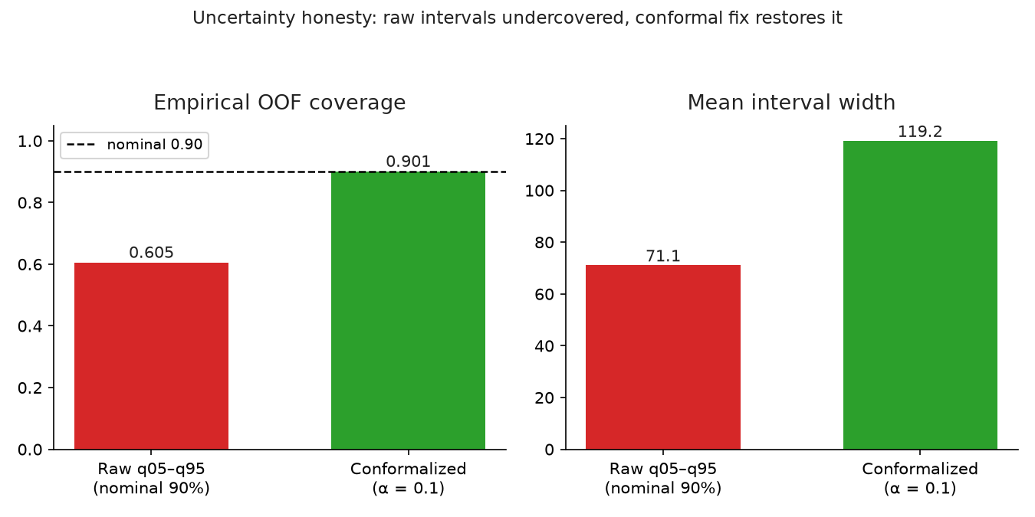
Measured results — uncertainty honesty
Raw quantile intervals (nominal 90%) covered only 60.5% of OOF outcomes — serious undercoverage we reported, not hid.
Fix: conformalized quantile regression (adjustment +24.04) → OOF coverage 0.901 at mean width 119.2.
App clips the displayed interval lower bound at 0 (glucose can't be negative); the stored interval stays symmetric/additive — documented in-app.
Coverage: raw 0.605 → conformalized 0.901. Width is the honest price.
Research prototype — not a medical device; not for diagnosis or treatment.

Slide 9
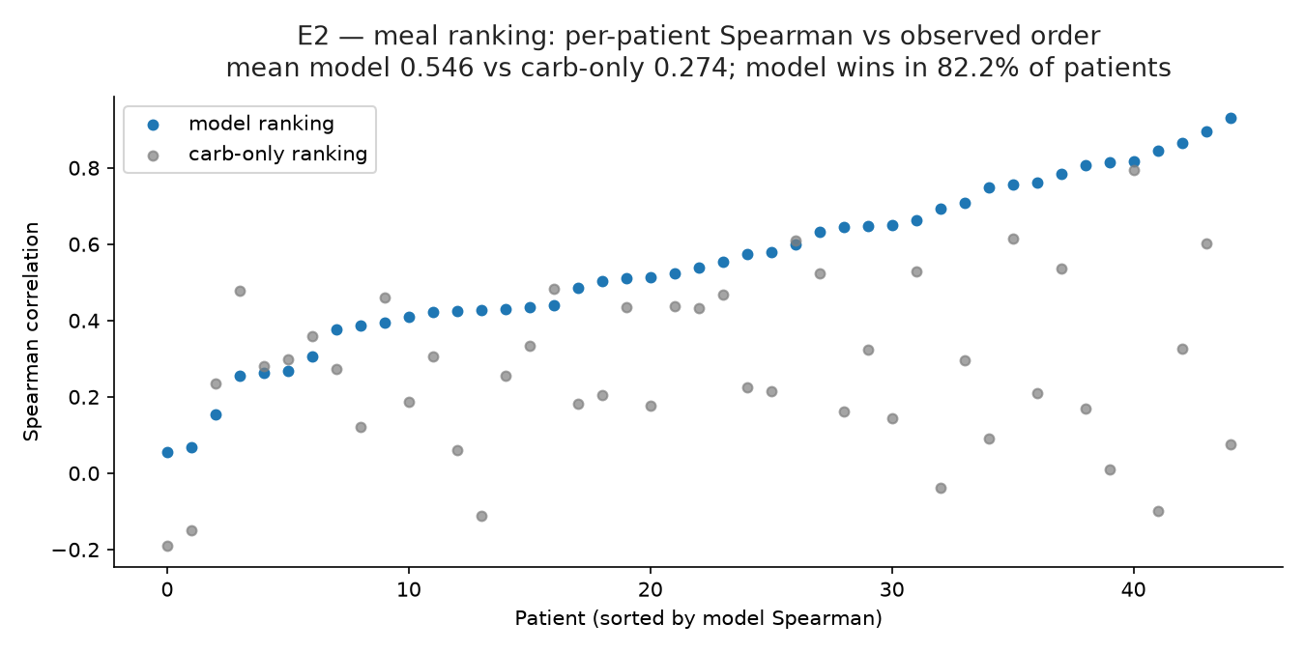
Measured results — personalization & ranking
E1 personalization (pre-registered rule: win rate > 0.5 AND bootstrap CI excludes 0): win rate 0.60, mean ΔMAE −3.68, CI [−6.96, −0.47] → SUPPORTED. Caveat: fine-tuning is evaluated, not yet in the live path.
E2 ranking: model Spearman 0.546 vs carb-only 0.274; model beats carb-only in 82.2% of patients — personalized ranking adds real value beyond carb counting.
E2: per-patient Spearman of predicted vs observed meal order.
Research prototype — not a medical device; not for diagnosis or treatment.

Slide 10
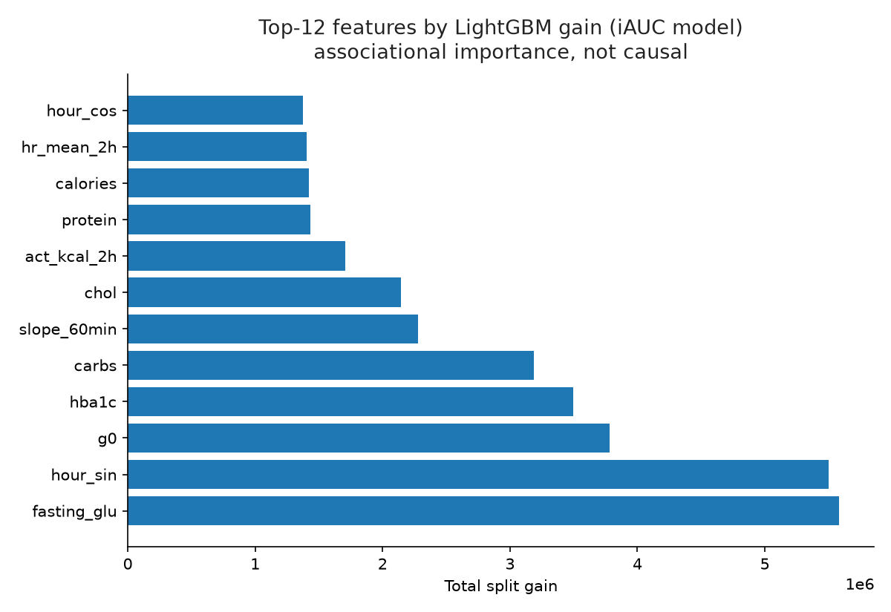
What drives the predictions
Top LightGBM gain features (iAUC model): time-of-day (hour_sin), fasting glucose, pre-meal glucose g0, carbs, HbA1c — dynamic context and static physiology both matter, not just the meal.
Feature importance is ASSOCIATIONAL, not causal — the Safety page says this in plain language.
Monotone +1 constraint on carbs keeps meal-swap direction sane.
Top-12 features by split gain (associational).
Research prototype — not a medical device; not for diagnosis or treatment.

Slide 11
The twin workflow
twin_state.db (SQLite) is seeded by honestly replaying each patient's meals: predict FIRST using only prior-meal state, then record the observation.
Per-patient profile: running residual statistics, drift bound = 1.5 × OOF iAUC MAE = 48.58. A rolling mean |residual| above the bound over 5 meals → drift flag for clinician review.
Twin history page: every prediction paired with its later observed outcome — predicted-vs-observed is a first-class view, not a footnote.
Missing DB at startup? The app auto-seeds from data/processed/meals.csv.
Research prototype — not a medical device; not for diagnosis or treatment.

Slide 12
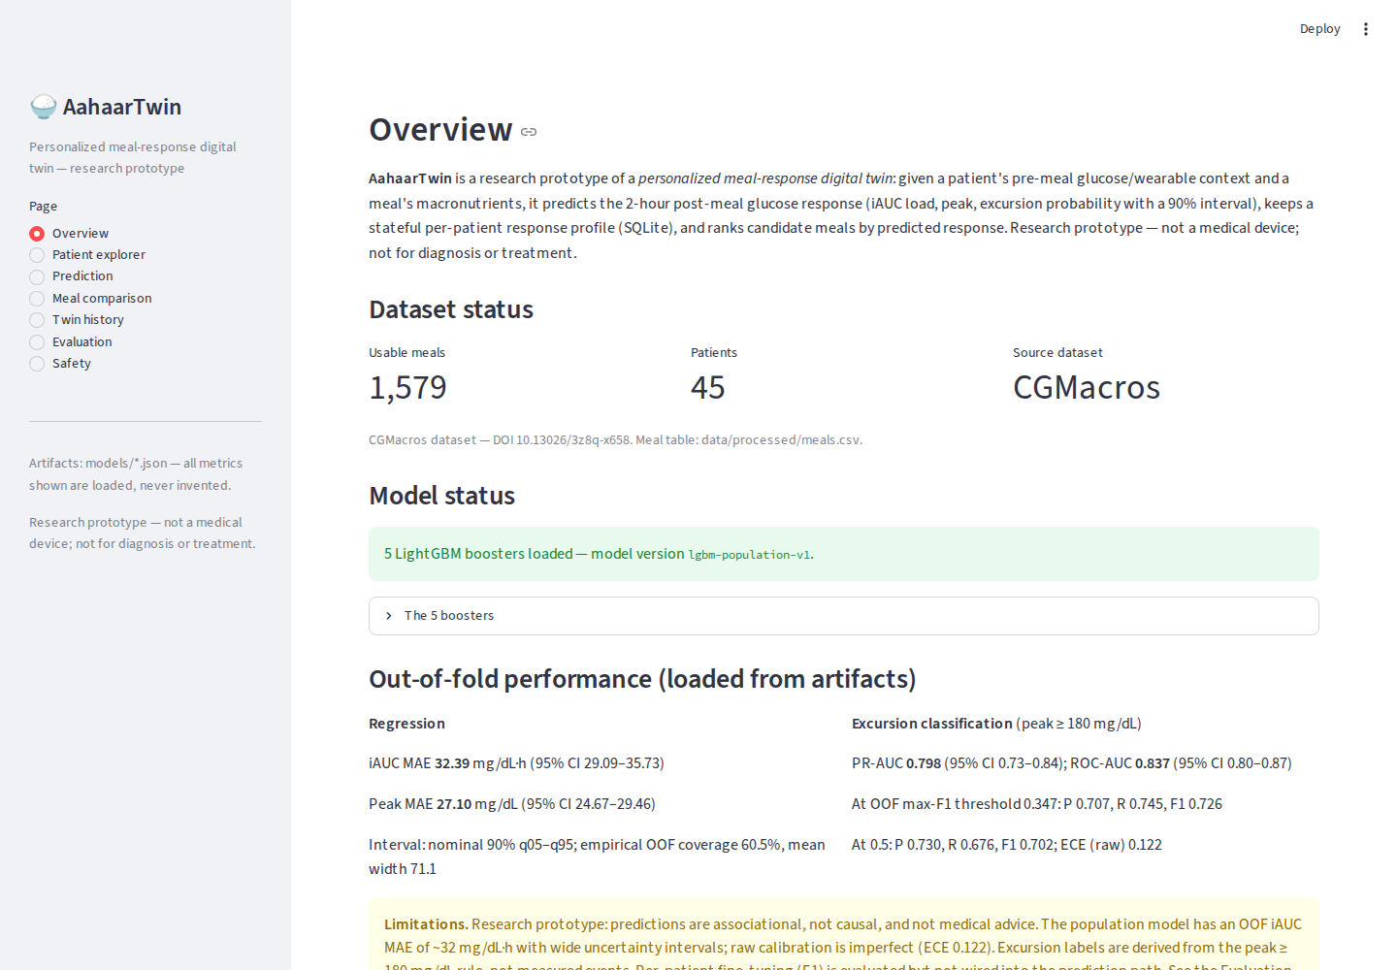
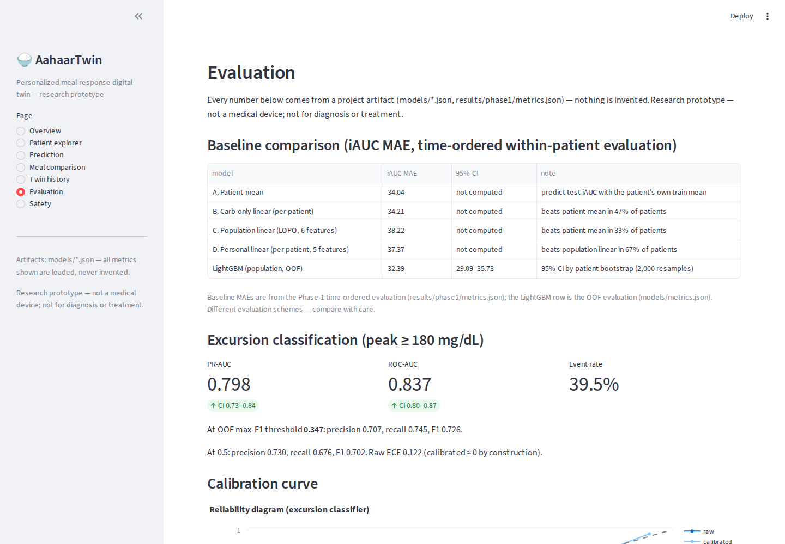
Live dashboard — Overview & Evaluation
Screenshots captured 2026-10-14 from the running Streamlit app — real pages, real artifact-loaded metrics. No mockups.

Slide 13
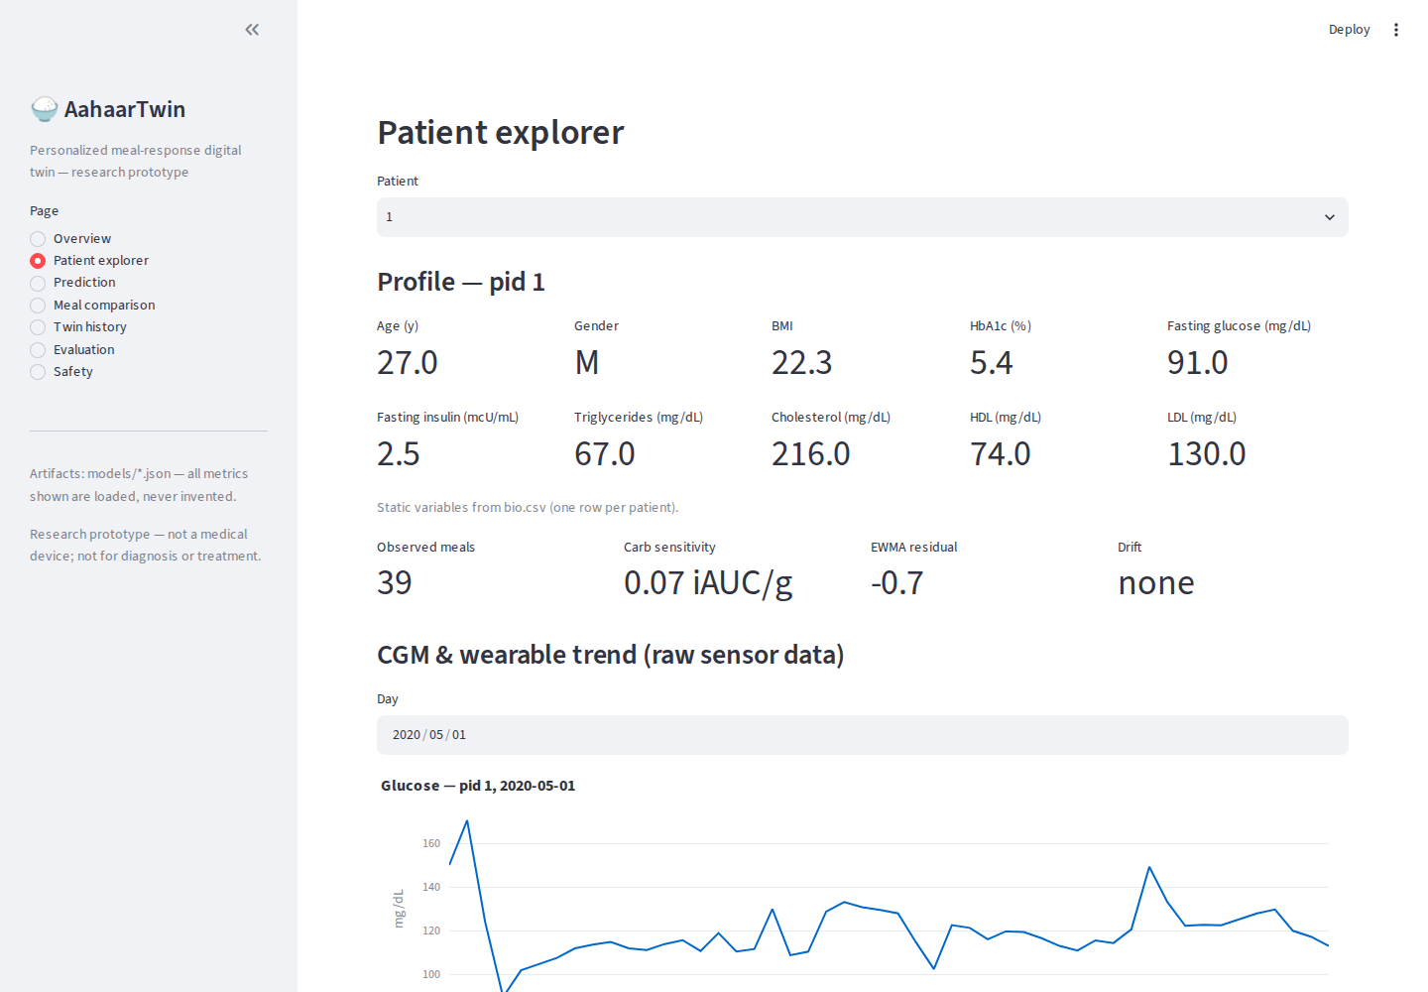
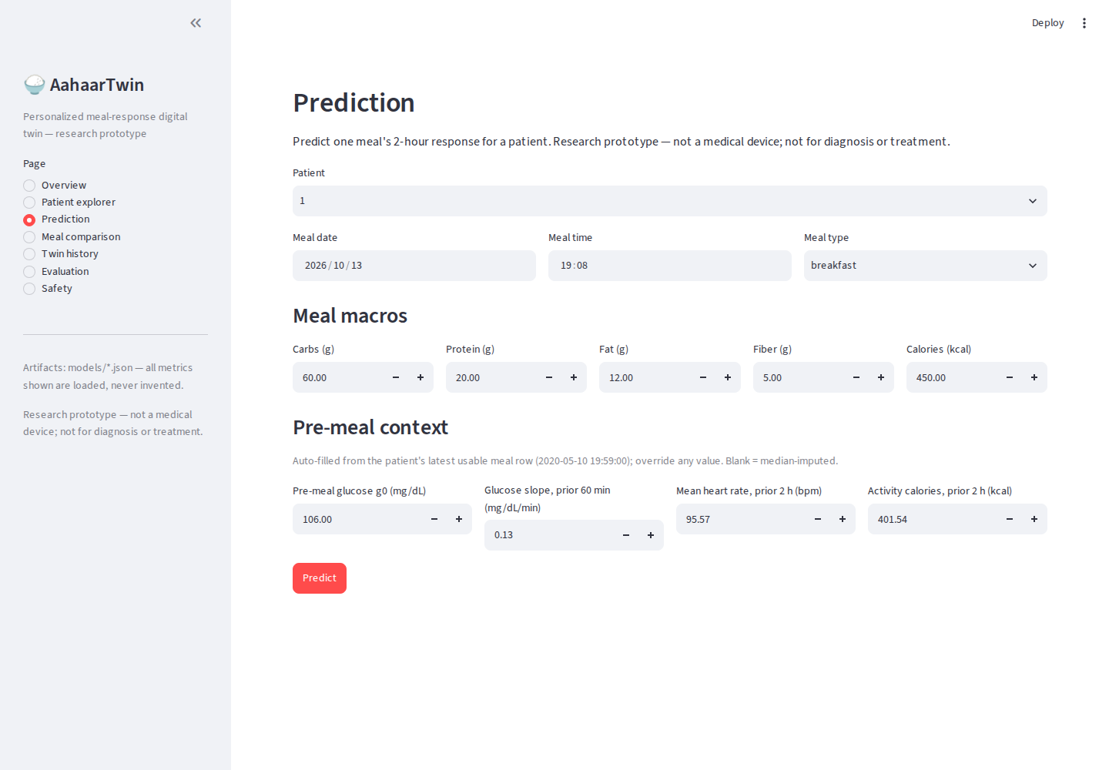
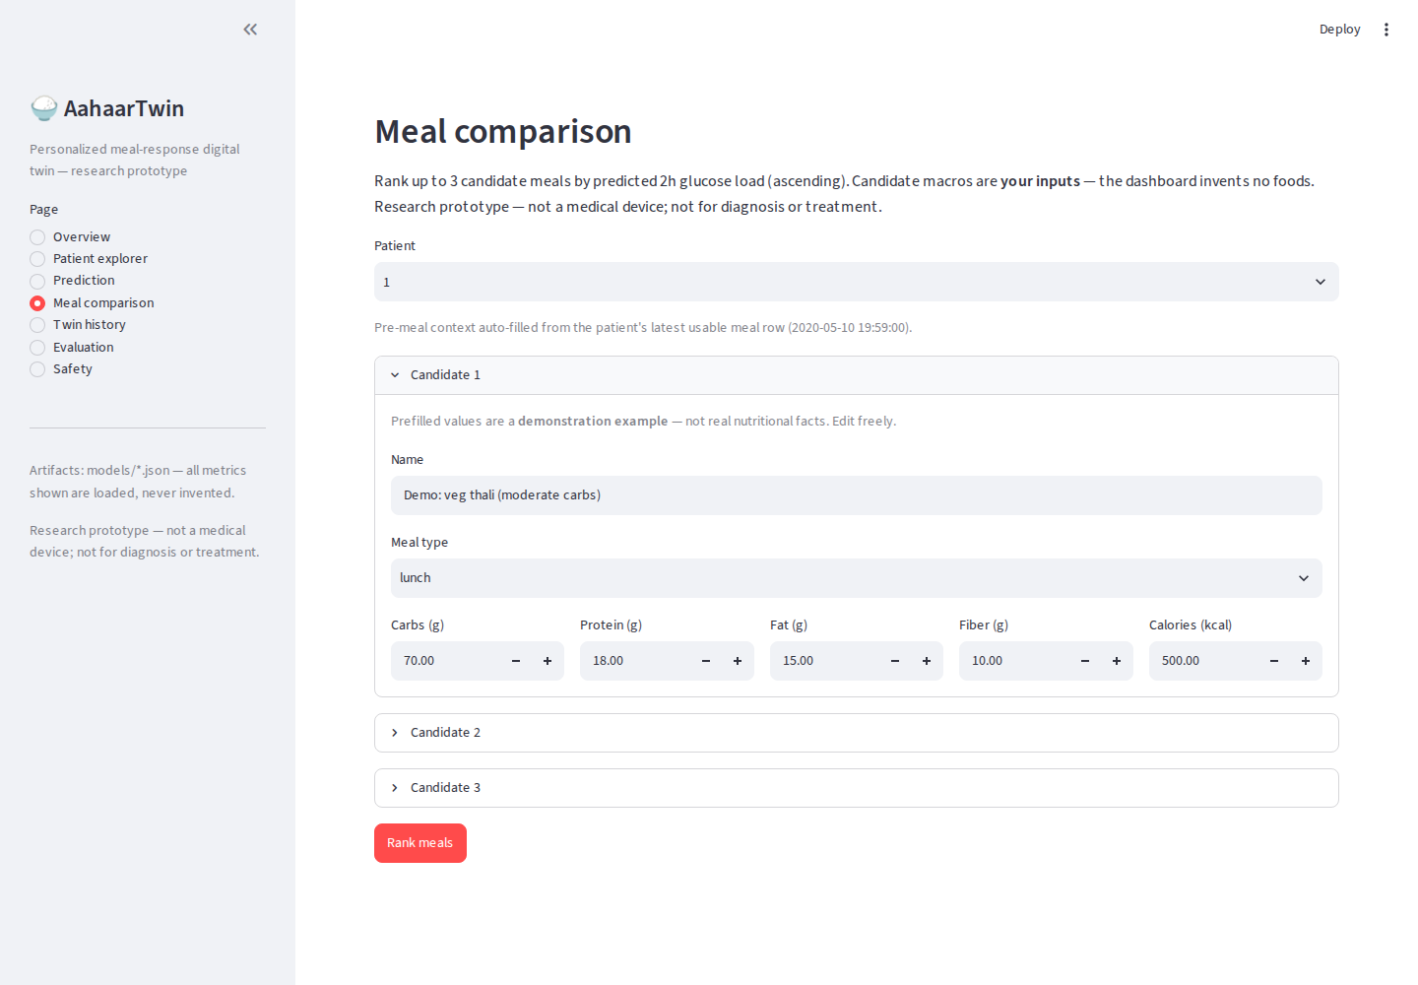
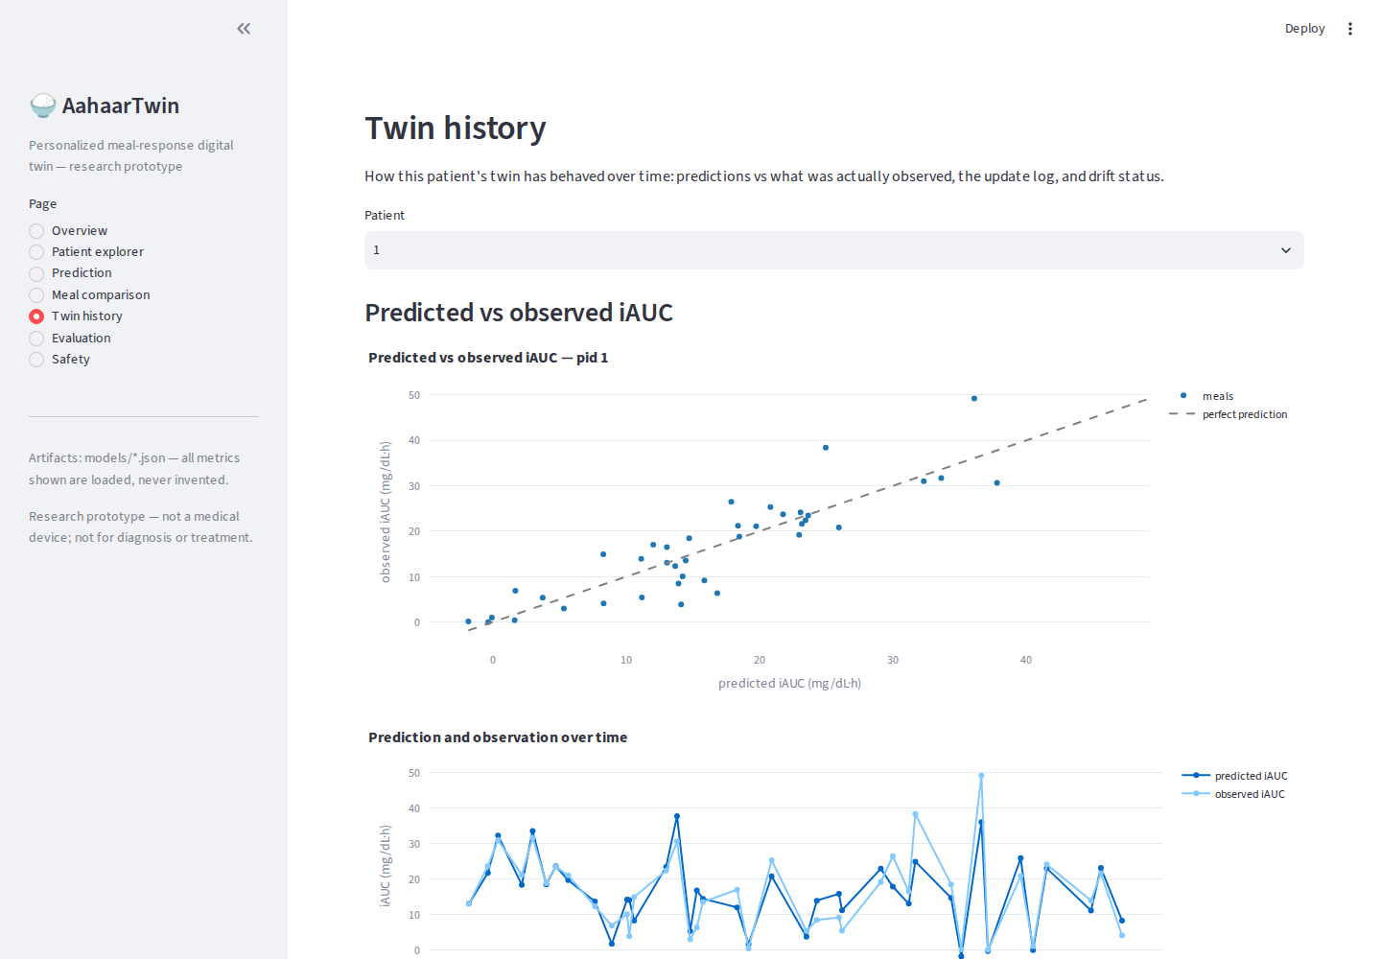
Live dashboard — Patient, Prediction, Comparison, History
Screenshots captured 2026-10-14 from the running Streamlit app — real pages, real artifact-loaded metrics. No mockups.

Slide 14
Differentiators — with evidence
Patient-level evaluation discipline: every number is out-of-fold with patient-level bootstrap CIs — no leakage, no test-tuning.
Uncertainty we fixed instead of hiding: 60.5% → 90.1% coverage via conformalization, reported with the width cost.
Pre-registered E1 decision rule with an honest verdict (SUPPORTED) and an honest caveat (not in the live path).
E2 proves the product thesis: personalized ranking beats carb-only ordering in 82.2% of patients.
Honesty engineering: artifacts-or-crash startup, input validation, disclaimers on every page, no invented claims.
Research prototype — not a medical device; not for diagnosis or treatment.

Slide 15
Limitations, future work, checklist
LIMITS: no clinical validation · 45 patients, one dataset — no India-generalization claim · peak MAE 27 mg/dL, interval width ~119 (directional, not precise) · E1 not in live path.
NEXT: ship personal fine-tuning behind a data-sufficiency gate · nutrition-goal constraints in ranking · prospective shadow evaluation · multi-site validation.
CHECKLIST: ✓ public GitHub repo (push pending user action) ✓ README 12 items ✓ architecture PDF+PPTX ✓ this presentation ✓ static+dynamic fusion → adverse-event prediction ✓ doctor dashboard ✓ MIT license, data cited not redistributed … ☐ 20-min video (to record) ☐ team name/college (to confirm).
Registration closes 18 Oct 2026 7PM IST · submission closes 20 Oct 2026 7PM IST.
Research prototype — not a medical device; not for diagnosis or treatment.

