Slide 1
AahaarTwin — System Architecture
A Personalized Meal-Response Digital Twin
Happiest Health Digital Twin Challenge 2026
Static + dynamic fusion → adverse-event prediction → doctor dashboard
5 LightGBM boosters · conformalized intervals · per-patient twin state · meal ranking
Research prototype — not a medical device; not for diagnosis or treatment.

Slide 2
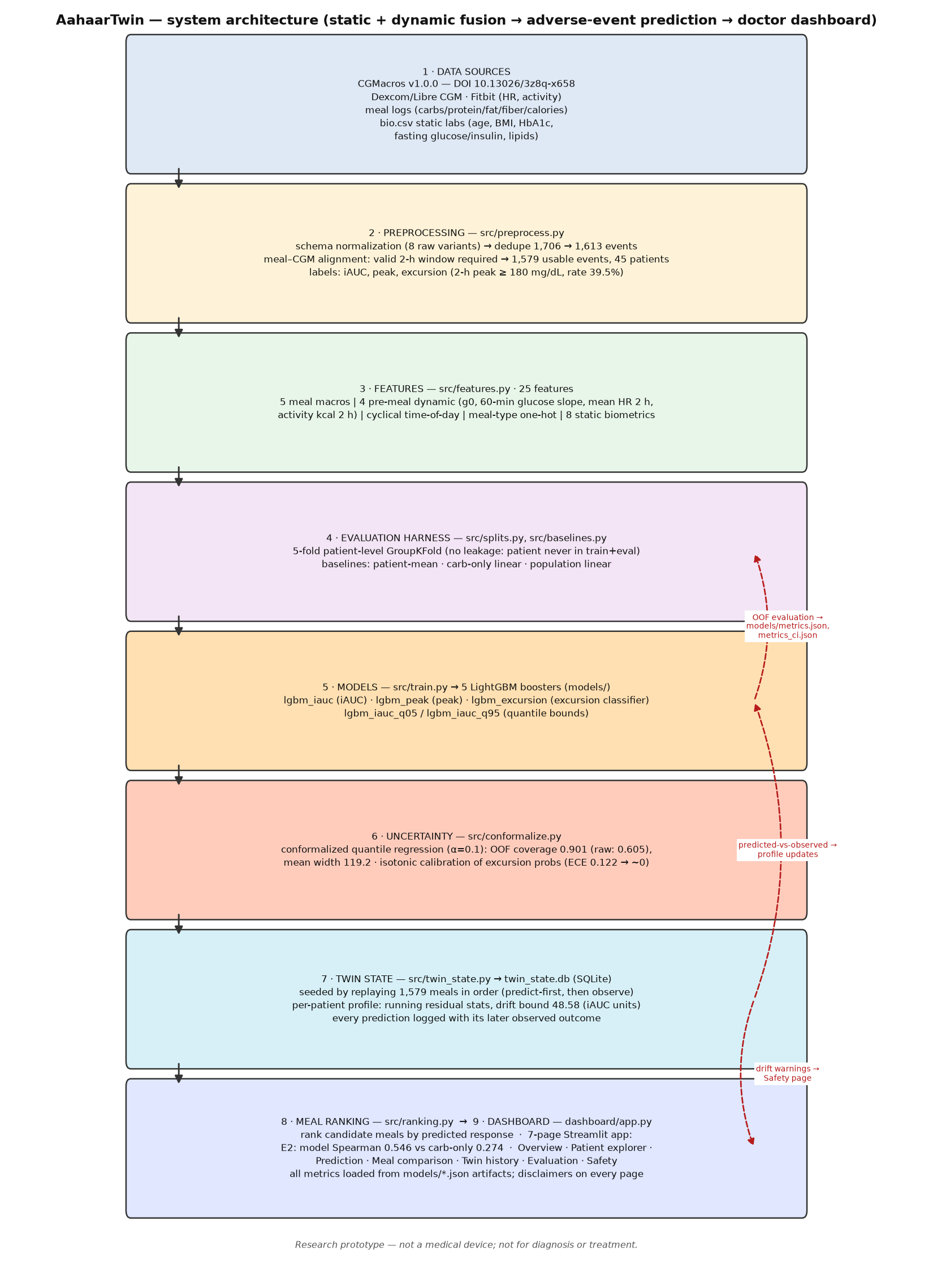
AahaarTwin architecture — data sources → preprocessing → features → evaluation harness → models → uncertainty → twin state → ranking → dashboard
Solid arrows: pipeline flow. Dashed red arrows: evaluation feedback loops (OOF evaluation, predicted-vs-observed profile updates, drift warnings → Safety page).

