Slide 1
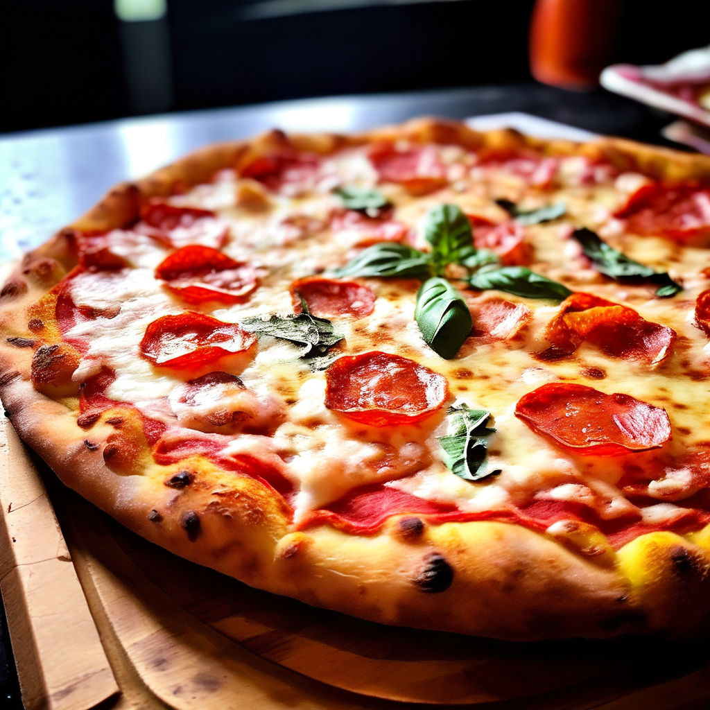
Sales Analysis
Chicago
Pizza
By Suhani

Slide 2
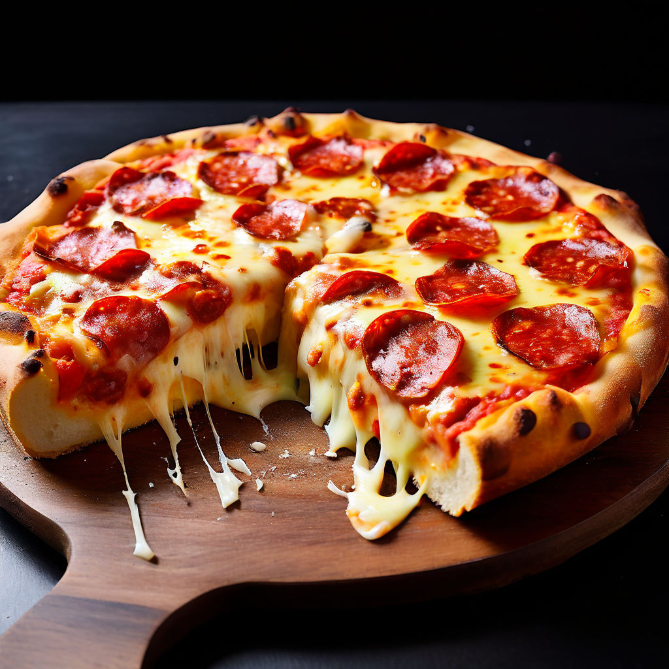
About Dataset
The data for this analysis is sourced from Kaggle's Chicago Pizza Sales Dataset, containing comprehensive sales information from a pizza restaurant chain. The dataset includes:
There are four Tables
Orders Table: 21,351 rows, 3 columns (Order ID, Order Date, Time).
Order Details Table: 48,621 rows, 4 columns (Order Details ID, Order ID, Pizza ID, Quantity).
Pizzas Table: 97 rows, 4 columns (Pizza ID, Pizza Type ID, Size, Price).
Pizza Types Table: 33 rows, 4 columns (Pizza Type ID, Name, Category, Ingredients).

Slide 3

Project Objective
The Pizza Sales Project is a data analysis Project aimed at analyzing sales data from a pizza restaurant chain. Utilizing SQL for data extraction, transformation, and analysis, the project seeks to uncover insights and provide actionable recommendations to optimize menu offerings, enhance marketing strategies, improve operational efficiency, and ultimately boost sales and customer satisfaction.
Business Objective and Problem
Business Objective: The primary goal of the business is to increase sales and profitability by optimizing our pizza menu. This involves enhancing the appeal of underperforming pizzas, leveraging customer preferences, and implementing strategic promotions to attract new customers, retain existing ones, and boost revenue across all categories.
Business Problem: Despite a diverse menu, certain pizzas (California Chicken, Four Cheese, Mexicana, Five Cheese, Spicy Italian, Italian Supreme) are underperforming in sales and revenue. This gap between our offerings and customer preferences results in missed revenue opportunities. Our aim is to identify and develop strategies to stimulate interest and sales of underperformance pizzas.

Slide 4
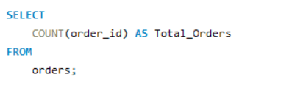
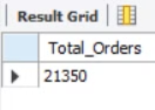
Retrieve the total number of orders placed.
Solution:
Result:

Slide 5
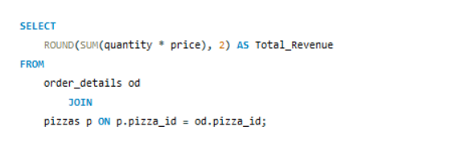
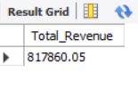
Calculate the total revenue generated from pizza sales.
Solution:
Result:

Slide 6
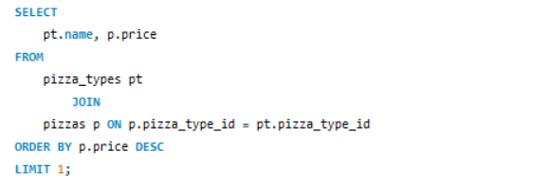
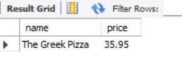
Identify the highest-priced pizza.
Solution:
Result:

Slide 7
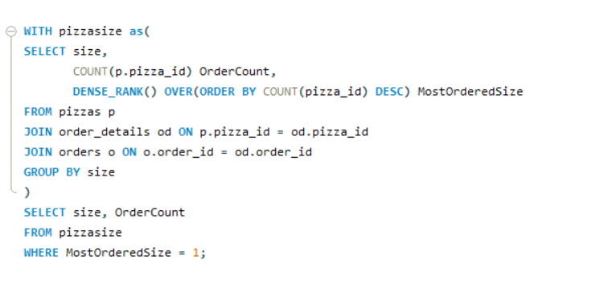

Identify the most common pizza size ordered.
Solution:
Result:

Slide 8
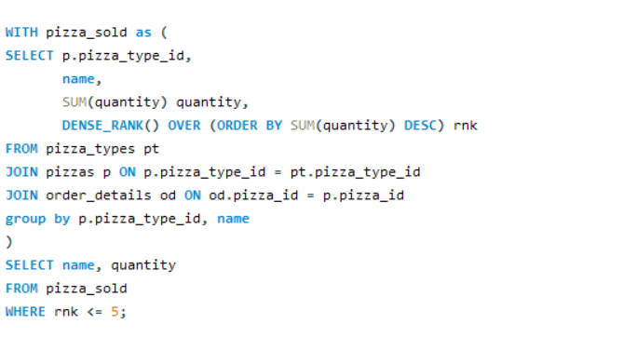
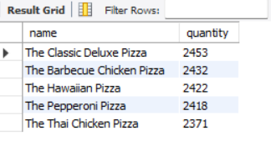
List the top 5 most ordered pizza types along with their quantities.
Solution:
Result:

Slide 9
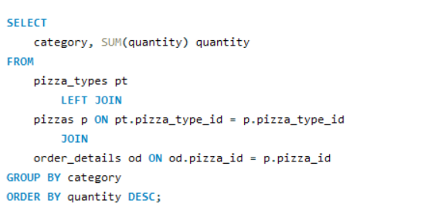
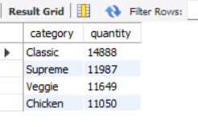
Find the total quantity of each pizza category ordered.
Solution:
Result:

Slide 10
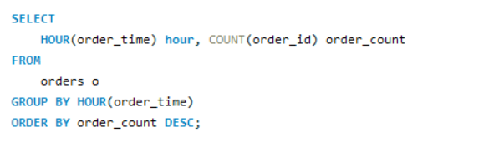
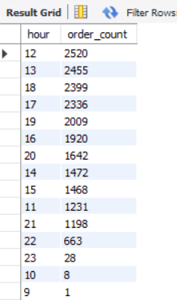
Determine the distribution of orders by hour of the day.
Solution:
Result:

Slide 11
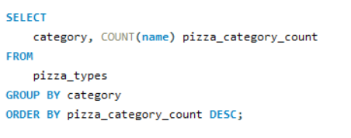
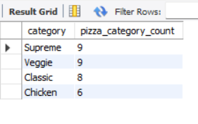
Find the category-wise distribution of pizzas.
Solution:
Result:

Slide 12
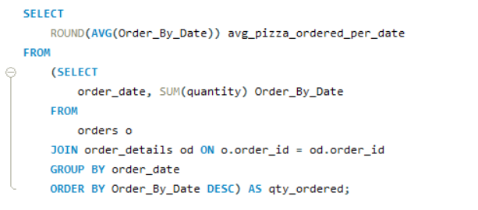
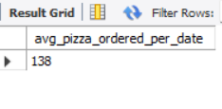
Calculate the average number of pizzas ordered per day.
Solution:
Result:

Slide 13
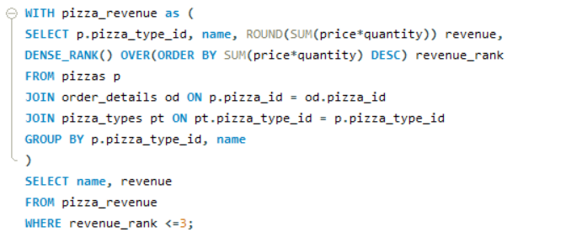
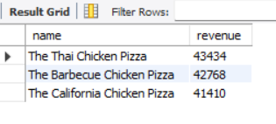
Determine the top 3 most ordered pizza types based on revenue.
Solution:
Result:

Slide 14
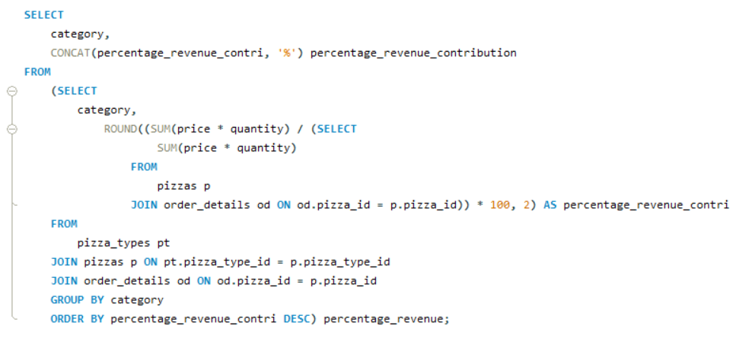
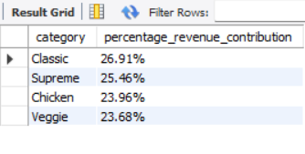
Calculate the percentage contribution of each pizza category to total revenue.
Solution:
Result:

Slide 15
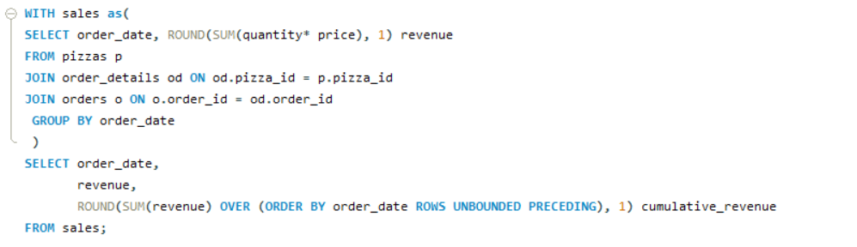
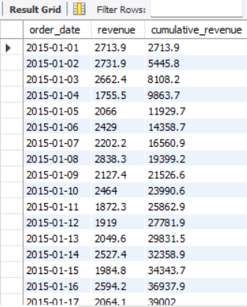
Analyze the cumulative revenue generated over time.
Solution:
Result:

Slide 16
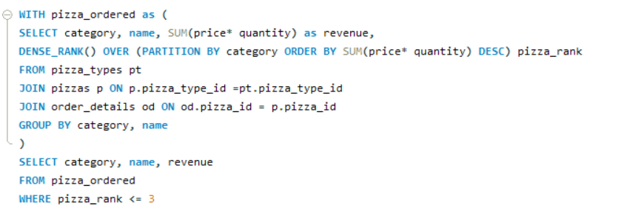
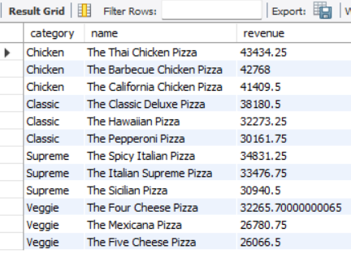
Determine the top 3 most ordered pizza types based on revenue for each pizza category.
Solution:
Result:

Slide 17
Insights
1. The total number of orders placed in 2015 was 21,350, generating a total revenue of $817,860.05.
2. The highest-priced pizza was The Greek Pizza, priced at $35.95.
3. The most commonly ordered pizza size was Large (Size L), with 18,526 orders.
4. Top 5 Most Ordered Pizzas:
The Classic Deluxe Pizza - 2,453 orders
The Barbecue Chicken Pizza - 2,432 orders
The Hawaiian Pizza - 2,422 orders
The Pepperoni Pizza - 2,418 orders
The Thai Chicken Pizza - 2,371 orders
5. Pizza Categories:
Total quantity ordered by category:
Classic: 14,888
Supreme: 11,987
Veggie: 11,649
Chicken: 11,050

Slide 18
Insights
6. Order Distribution by Hour:
Peak order hours were:
12 PM: 2,520 orders
1 PM: 2,455 orders
6 PM: 2,399 orders
5 PM: 2,336 orders
Least busy hours were early mornings and late nights.
7. On average, 138 pizzas were ordered per day.
8. Cumulative Revenue Growth:
The cumulative revenue showed a steady increase throughout the year, ending at $817,860.05 on December 31, 2015.
Each pizza category contributed as follows to the total revenue:
Classic: 26.91%
Supreme: 25.46%
Chicken: 23.96%
Veggie: 23.68%

Slide 19
Insights
10. Top Pizzas by Revenue (Chicken, Classic, Supreme, Veggie):
Chicken Category:
1. The Thai Chicken Pizza - $43,434.25
2. The Barbecue Chicken Pizza - $42,768.00
3. The California Chicken Pizza - $41,409.50
Classic Category:
1. The Classic Deluxe Pizza - $38,180.50
2. The Hawaiian Pizza - $32,273.25
3. The Pepperoni Pizza - $30,161.75
Supreme Category:
1. The Spicy Italian Pizza - $34,831.25
2. The Italian Supreme Pizza - $33,476.75
3. The Sicilian Pizza - $30,940.50
Veggie Category:
1.The Four Cheese Pizza - $32,265.70
2. The Mexicana Pizza - $26,780.75
3. The Five Cheese Pizza - $26,066.50

Slide 20
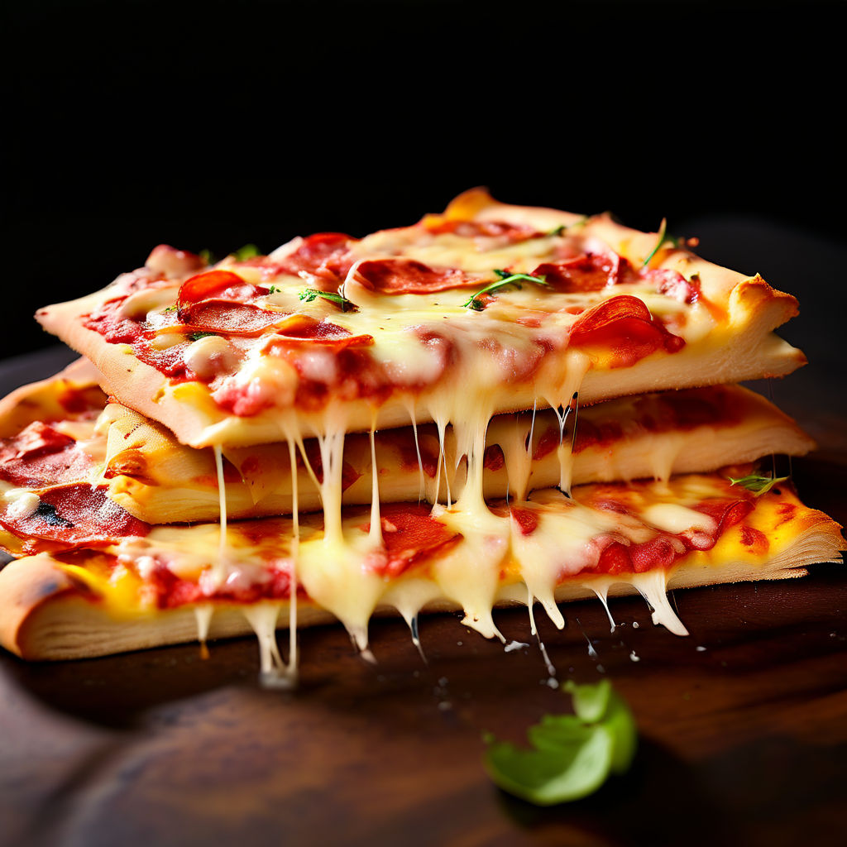
Recommendations
Focus marketing efforts on The Greek Pizza (highest priced pizza) and the top-performing pizzas like The Classic Deluxe Pizza and The Barbecue Chicken Pizza to drive sales based on revenue and popularity.
Review the pricing strategy for less popular pizzas to make them more appealing to customers.
Enhance promotions and staffing during peak hours (12 PM, 1 PM, 6 PM, and 5 PM) to maximize sales and improve customer service.
Given the popularity of Large (Size L) pizzas, consider expanding the variety in this size category to cater to customer preferences.
Develop targeted marketing campaigns for each pizza category to boost their visibility and sales, particularly for categories with lower revenue contributions.
Introduce seasonal promotions or special offers for underperforming pizzas to stimulate interest and increase sales.
Collect and analyze customer feedback to understand preferences better and make data-driven decisions for menu adjustments and new product introductions.

