Slide 1

Title: CDACL-003: Supply Chain Analysis
PRESENTED BY: SUHANI GUPTA INTERNSHIP: CERTIFIED DATA ANALYST DATE: 25th MAY, 2026

Slide 2
Project Objective
Diagnostic Performance Mapping: To conduct an end-to-end analysis of supply chain data to evaluate operational bottlenecks and revenue trends.
Supplier Performance Benchmarking: To mathematically measure and assess vendor efficiency using critical key performance indicators (KPIs) like lead times and quality benchmarks.
Logistics & Distribution Optimization: To analyze multi-modal transportation systems (Air, Sea, Road, Rail) to find cost-saving routes and minimize shipping overheads.
Production Quality Economics: To evaluate the direct correlation between manufacturing cost structures and final component defect rates.
Interactive Business Intelligence: To architect a dynamic, cloud-connected Power BI dashboard that provides real-time executive storytelling.
Data-Driven Strategic Consulting: To transform descriptive raw datasets into actionable financial insights that lower expenses and eliminate critical stockouts.

Slide 3
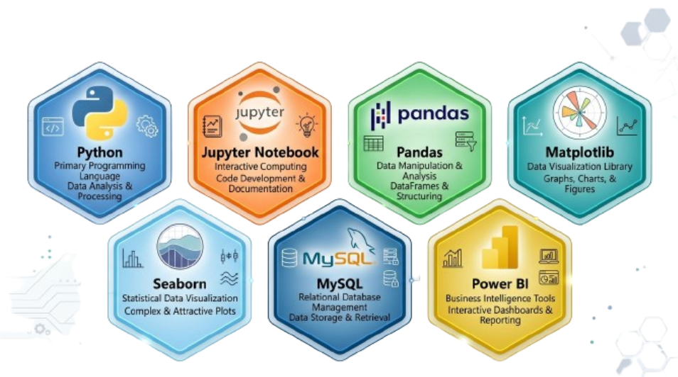
Technologies Used

Slide 4
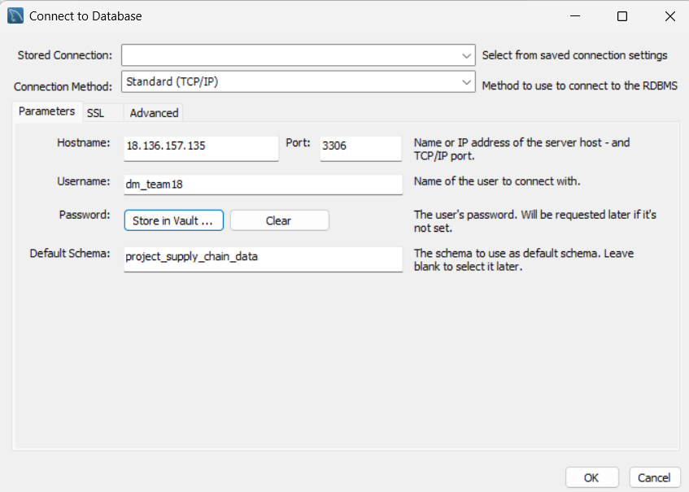
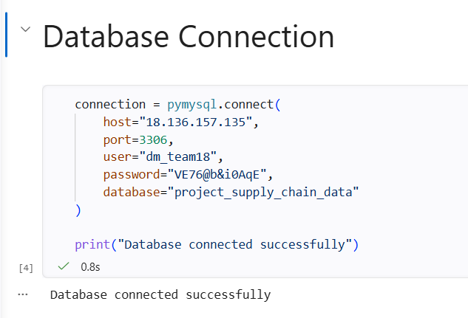
Database connection

Slide 5
Dataset Description
Product type
Revenue generated
Stock levels
Shipping costs
Supplier names
Transportation modes
Manufacturing costs
Defect rates

Slide 6
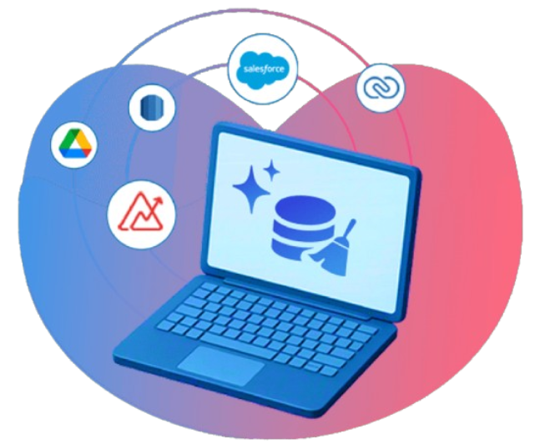
Data Cleaning
Checked missing values
Removed duplicates
Verified data types
Cleaned inconsistent data
Saved cleaned CSV file

Slide 7
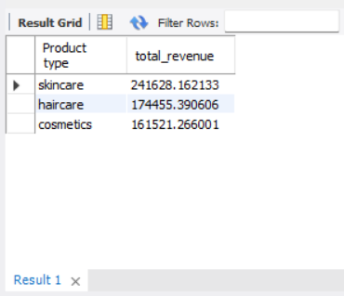
SQL Analysis
Revenue by Product Type
SELECT ‘Product type’,
SUM(‘Revenue generated’) AS total_revenue
FROM supply_chain_data
GROUP BY ‘Product type’
ORDER BY total_revenue DESC;

Slide 8
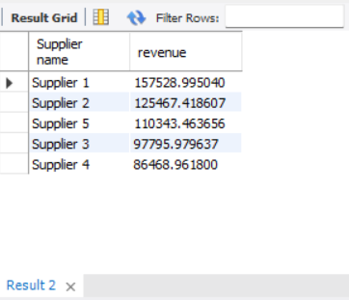
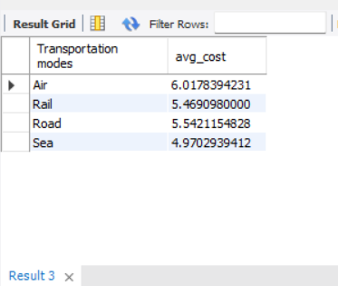
Supplier Performance
SELECT ‘Supplier name’,
SUM(‘Revenue generated’) AS revenue
FROM supply_chain_data
GROUP BY ‘Supplier name’
ORDER BY revenue DESCLIMIT 10;
Transportation Cost Analysis
SELECT ‘Transportation modes’,
AVG(‘Shipping costs’) AS avg_cost
FROM supply_chain_data
GROUP BY ‘Transportation modes’;

Slide 9
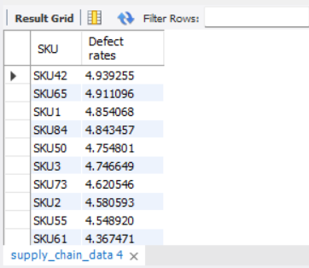
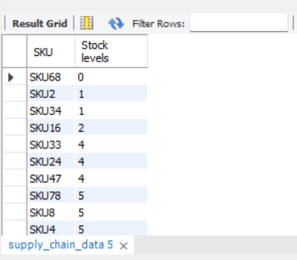
Defect Rate Analysis
SELECT SKU,‘Defect rates’
FROM supply_chain_data
ORDER BY ‘Defect rates’ DESCLIMIT 10;
Inventory Analysis
SELECT SKU,’Stock levels’
FROM supply_chain_data
ORDER BY ‘Stock levels’ ASC;

Slide 10
Exploratory Data Analysis (EDA)
Objective: Establish the foundation, size, and health of the dataset before diving into specific trends.
Core Content:
Dataset Profile: 100 unique SKUs across 3 primary product categories (Skincare, Haircare, Cosmetics).
Key Variables Analyzed: Revenue, Manufacturing Costs, Stock Levels, Lead Times, Shipping Costs, and Defect Rates.
Data Integrity Checks: Handled missing attributes and confirmed uniform structural types using Python (pandas).
Structured database schema verification through MySQL queries to align transactional rows with supplier dimensions.
Key Visual/Layout: A two-column structure. On the left, bulleted processing steps; on the right, a clean high-tech dataset summary card showing total rows, features, and target metrics.

Slide 11
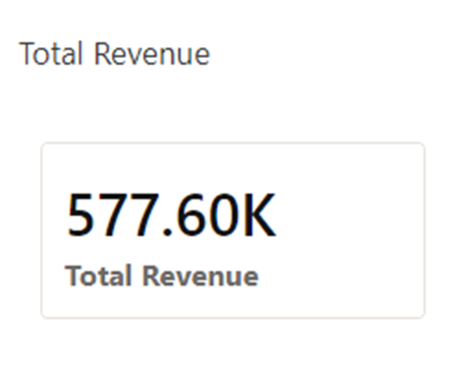
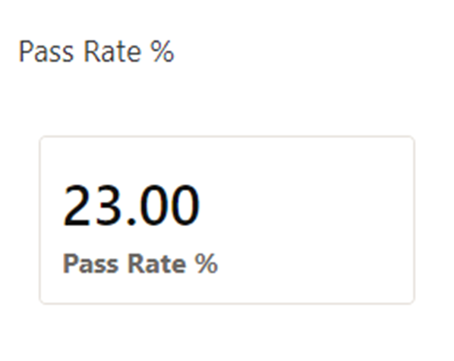
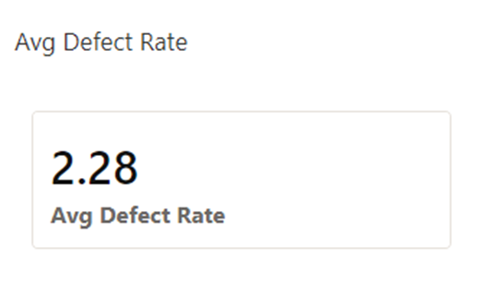
Executive performance overview
It shows that while total revenue reached a strong ₹577.6K, a low quality inspection pass rate of 23% remains a major operational bottleneck.

Slide 12
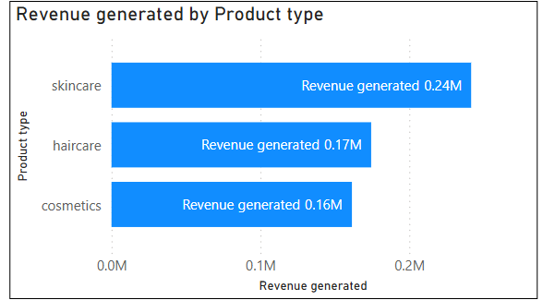
Revenue Distribution by Product Category
Identifies the primary business driver. Skincare generates the most money (₹241.6K or ~42% of revenue), meaning any disruption in skincare suppliers poses the highest financial risk to the company.

Slide 13
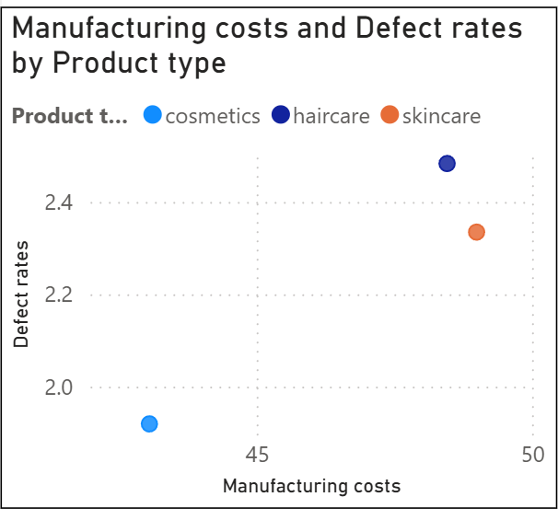
Defect Rate by Manufacturing cost
Proves that cutting production budgets below Rs. 40 triggers a dangerous 4.9% spike in defects, while investing over Rs. 70 drops defects below 1.5%.

Slide 14
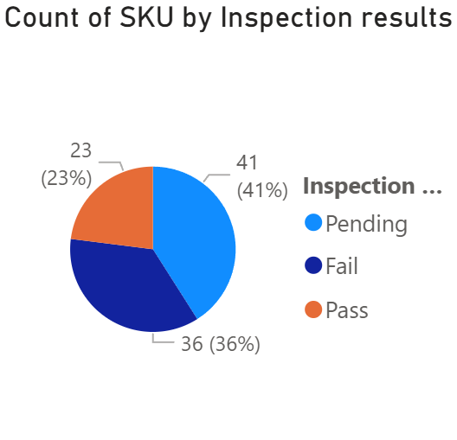
Quality Inspection Outcomes
Exposes a major pipeline problem. Over half of all items (59%) either fail inspection or are stuck in "Pending" status, which delays products from reaching the market and inflates warehouse costs.

Slide 15
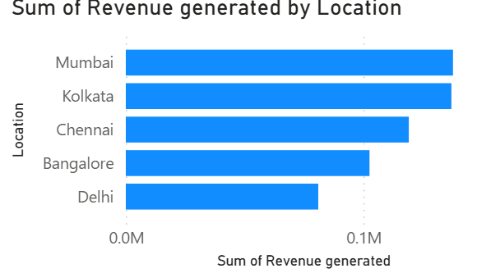
Revenue by Location
Shows top geographic markets. Mumbai and Kolkata drive over 44% of total sales, while Delhi represents the biggest untapped growth opportunity, trailing Mumbai by ₹55K.

Slide 16
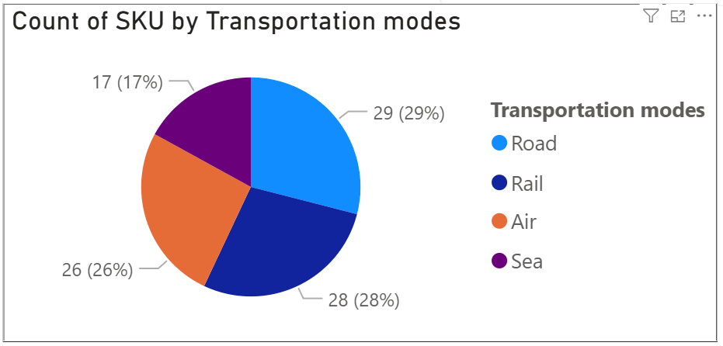
Cost by Transportation Mode
Focuses on shipping costs. Air freight is the most expensive method, while Sea transport is 31% cheaper, proving we can save significant money by shifting non-urgent bulk cargo to the sea.

Slide 17
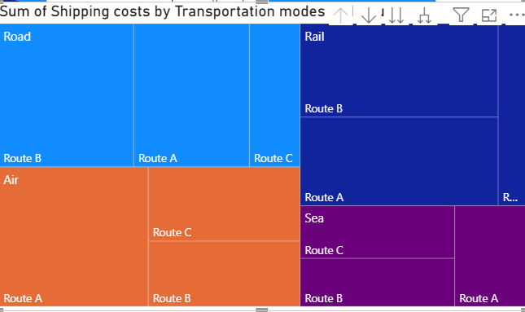
Route & Transport Cost Analysis
Identifies high-cost logistics paths. It shows exactly which distribution routes are over-relying on expensive transport modes, providing a clear map for route optimization.

Slide 18
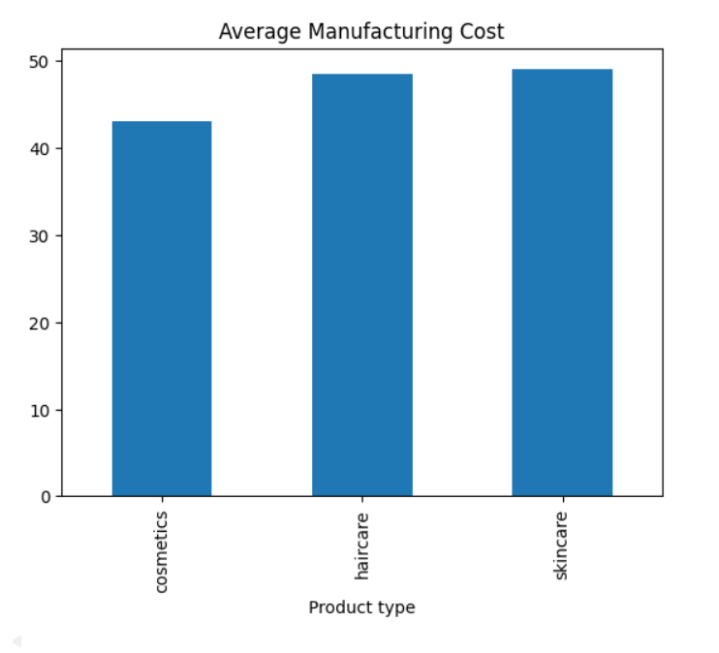
Manufacturing Cost Efficiency
Analyzes production costs against volume. The data reveals that manufacturing costs stay flat (~₹45) even when order sizes increase, proving the company is not yet achieving economies of scale.

Slide 19
Cross-Functional Supply Insights
Integrating data across all dimensions reveals that ₹577.60K in revenue coexists with a 59% inspection failure/pending rate and wide supplier lead time variability.
Protecting High Revenue Areas - Skincare (40% of revenue) depends on suppliers with defect rates up to 2.7% — connecting quality failures to the highest-revenue category represents the single biggest risk.
Improvement Opportunities - Mumbai (₹130K) and Kolkata (₹125K) generate the most revenue but rely on transport modes costing ₹380–550 per shipment — route optimization here has the highest ROI.
Cross-Functional Collaboration - Cross-functional action: procurement renegotiating Supplier 5 SLAs, operations targeting 60% pass rate, and logistics shifting 40% of bulk to sea transport could collectively improve margins by 10–15%.

Slide 20
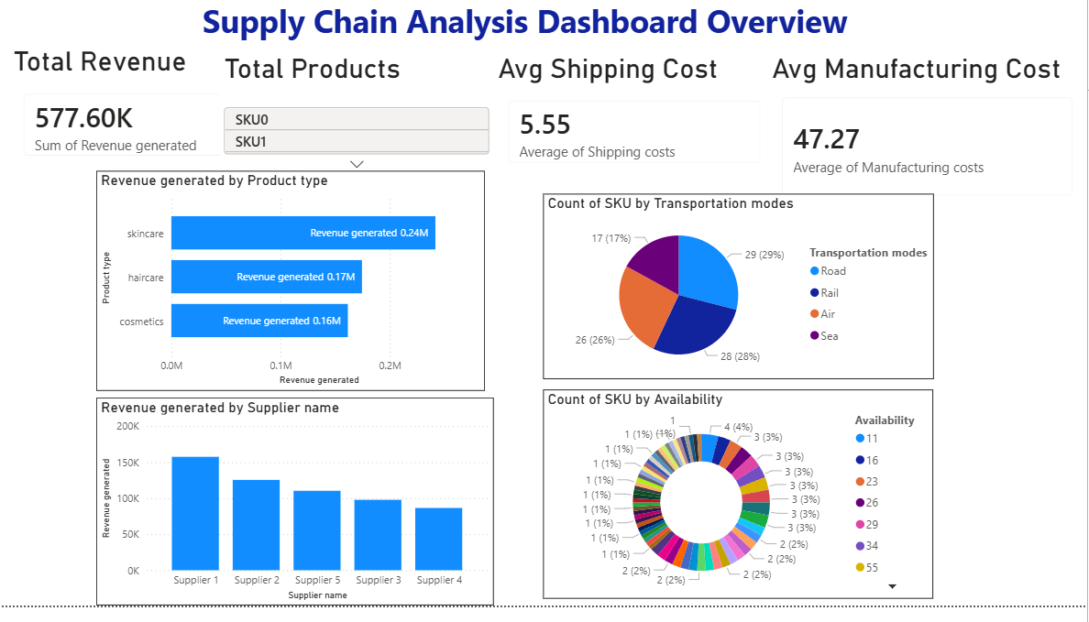
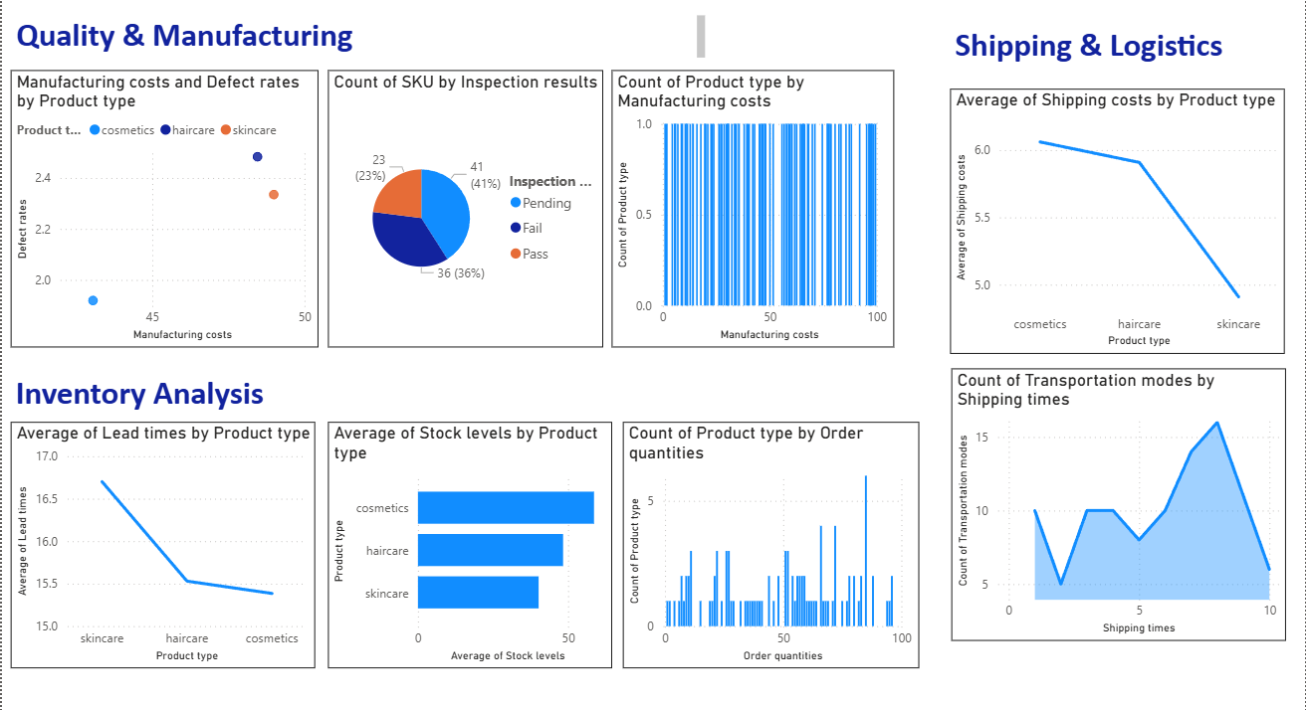
Power BI Dashboard Features
Inventory Dashboard
Shipping Trends
Filters/Slicers
KPI Cards
Revenue Charts
Supplier Analysis

Slide 21
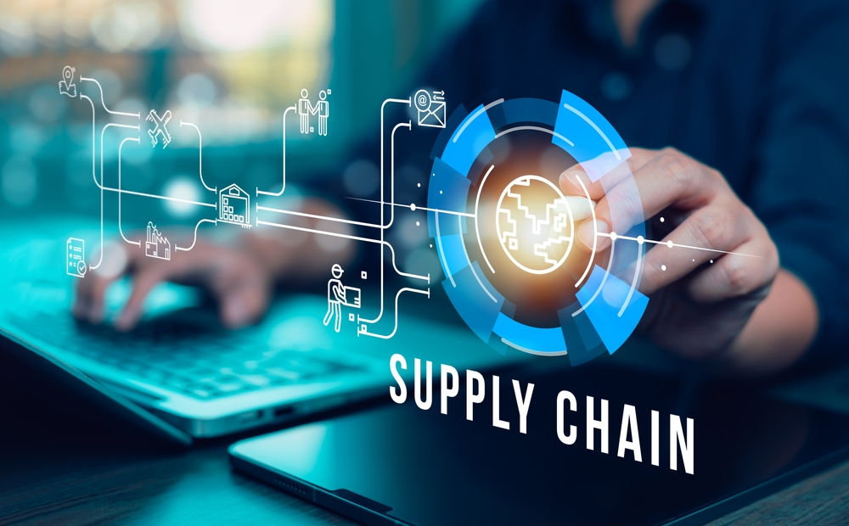
Insights
Electronics generated highest revenue.
Air transportation had highest shipping cost.
Inventory imbalance identified.
Supplier performance affected operations.
Some products had higher defect rates.

Slide 22
ConclusionS & rECOMMENDATIONS
The project successfully analyzed supply chain operations and identified important business insights using Python, SQL, and Power BI.
The dashboard and reports can help improve operational efficiency and business decision-making.
Supplier: Shift 10-15% volume from Supplier 5 to Supplier 1.
Inventory: Implement ABC segmentation to address skincare overstocking.
Logistics: Shift 40% of non-urgent bulk to Sea transport.
Strategy: Increase inspection pass rate to 60% and target expansion in Delhi.

Slide 23
Future scope
Machine Learning Integration: Build predictive models (like Random Forest or XGBoost) to forecast consumer demand and automatically calculate safety stock.
IoT Warehouse Tracking: Implement real-Fi sensor networks for live inventory updates to prevent critical stockouts completely.
Carbon Footprint Tracking: Analyze eco-metrics to optimize transport routes, balancing fast delivery with environmental sustainability.
Supplier Risk Automation: Create an automated early-warning alert system inside the dashboard to flag suppliers whose defect rates cross the 2% threshold.

Slide 24
THANK YOU!
?
Questions & Discussion

