Slide 1

PRECEPTOR
Learning management platform
Team members
Hrishitha.S
Suhani.K
Sahithi.S
Srija.S

Slide 2
ABSTRACT
Preceptor is a web based learning management system , it is used by learning institutions , educators and students to access and manage online course learning materials and enhances student learning.

Slide 3
1.NO OF PAGES
64
2.FONT STYLE
Times new roman
3. COLOR COMBINATIONS FOR BACKGROUND
Lavender, Light purple , Light Blue
4.COLOR COMBINATIONS FOR NAVIGATION BAR
Approx Tangaroa – Font
Cyan-Background
5.ICONS
Colour - Black
Size – width:66
height:78

Slide 4
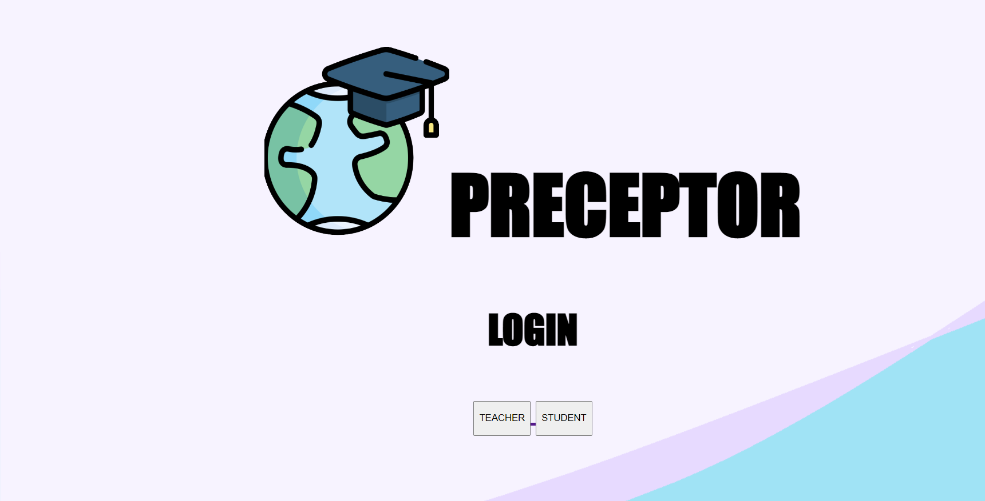
LOGIN PAGE

Slide 5
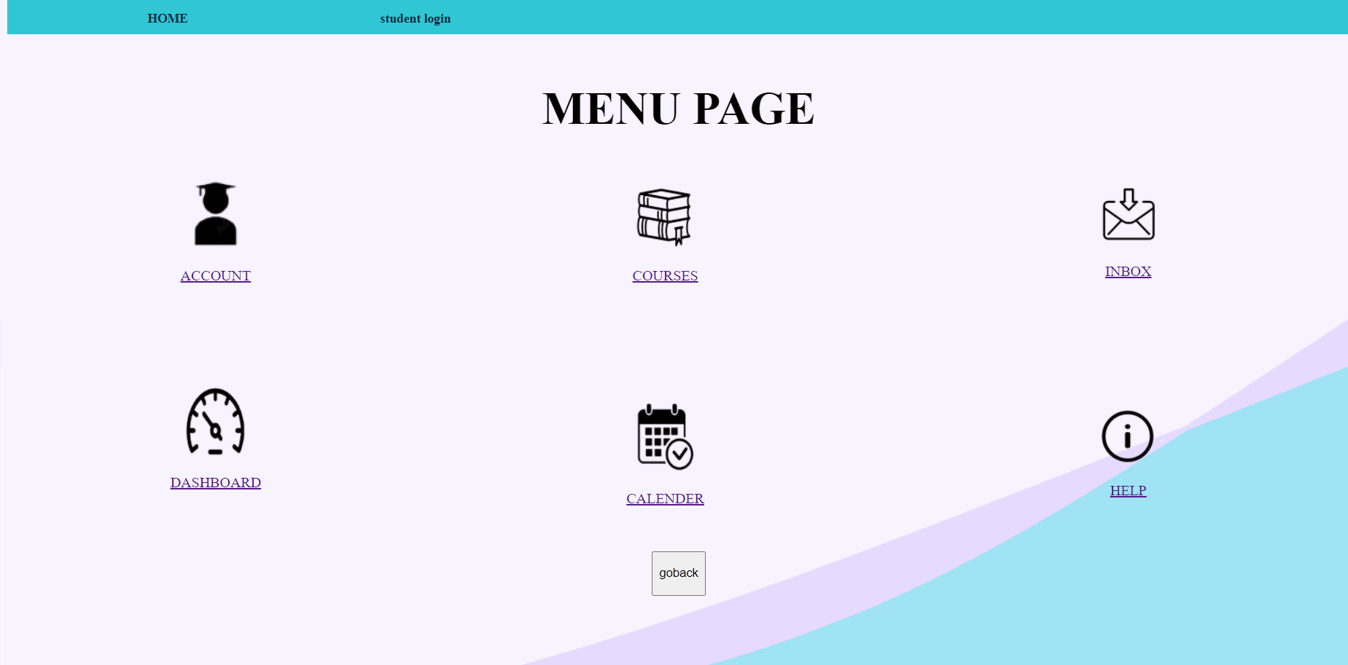
MENU PAGE

Slide 6
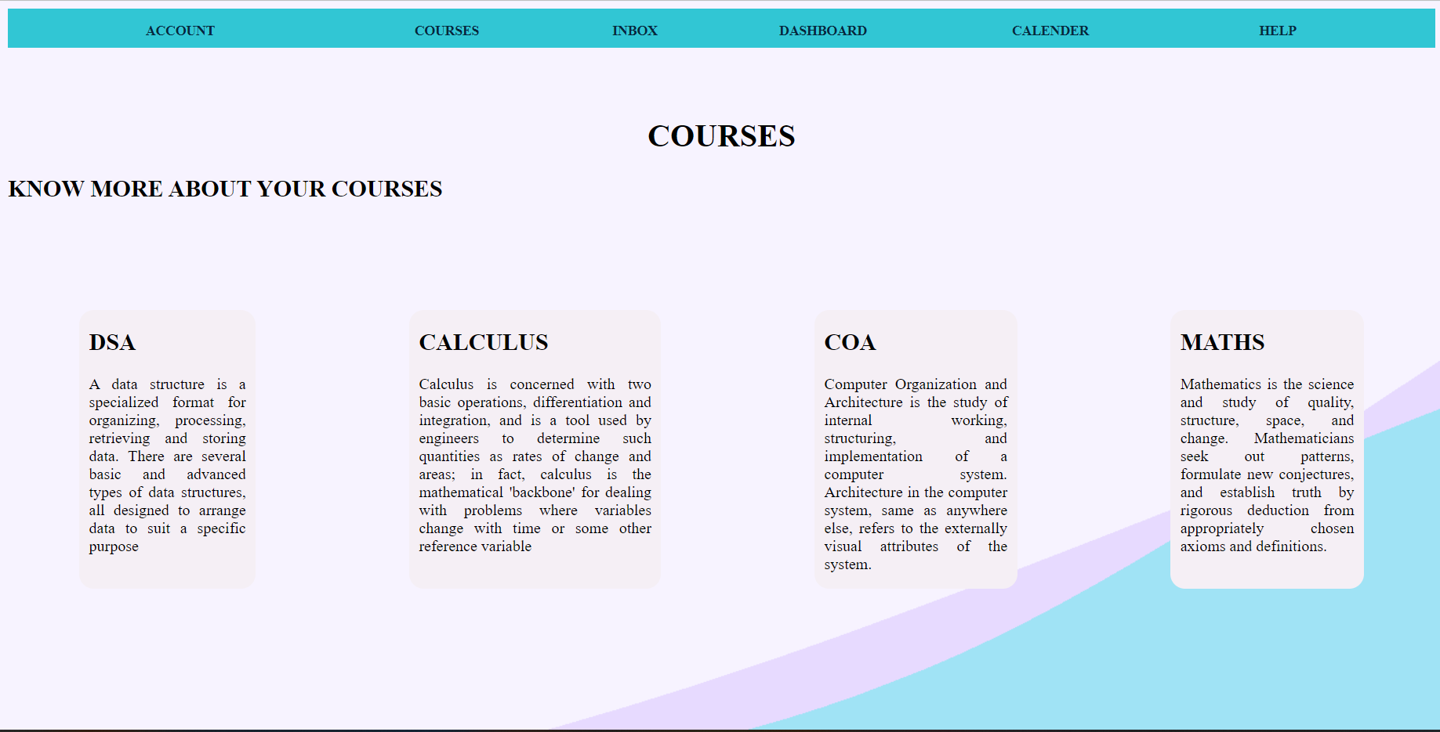
COURSES

Slide 7
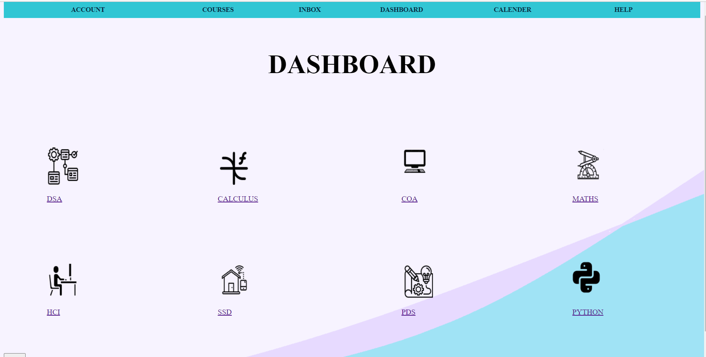
DASHBOARD

Slide 8

SUBJECT PAGE

Slide 9
CONCLUSION
Canvas tools enhance teaching power and the student's learning experience.
Save more time and effort and allowing greater focus on other priorities

Slide 10
FUTURE SCOPE
This application can make future changes according to users feedback
Students are benefited by this website educationally

Slide 11
REFERENCES
https://www.google.com/search?q=canvas+app&spell=1&sa=X&ved=2ahUKEwiwh_e_t8T7AhWlDrcAHe_RBR8QirwEKAB6BAgGEAE
https://www.google.com/search?q=colorhunt&oq=&aqs=chrome.0.69i59i450l8.293436303j0j15&sourceid=chrome&ie=UTF-8
https://www.google.com/search?q=flaticon&oq=FLAT&aqs=chrome.1.69i60j0i67i131i433j69i57j0i67j0i67i131i433j0i67j69i60l2.6315j0j9&sourceid=chrome&ie=UTF-8

