Slide 1


VIR-TRIAL Because your style shouldn’t wait for a changing room

Slide 2

VIR- TRIAL
2103a51269 - K.Suhani
2103a51260 - A.Deepthi
2103a51127 - Fariha Maheen
2103a51253 - T.Saipallavi
2103a51144 - Ch.Nikitha
Under the Guidance of
Y. Nagendar Sir
Asst Prof Dept CS&AI

Slide 3


Problem Statement:
Online shoppers struggle with uncertainty about fit and style when purchasing clothing and accessories, leading to high return rates and dissatisfaction.
Solution:
The “VIR-TRIAL" uses AR technology to let users virtually try on items in real-time, reducing uncertainty and enhancing the online shopping experience.

Slide 4
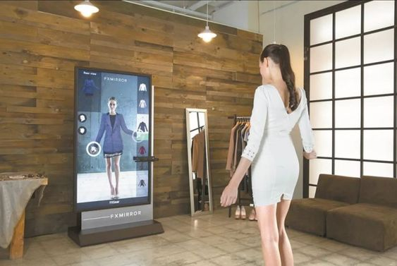
INTRODUCTION
Our project, “VIR-TRIAL" revolutionizes online shopping by allowing users to virtually try on clothes and accessories using AR technology. This application helps solve the issue of uncertainty regarding fit and appearance, offering a more interactive and engaging shopping experience. By integrating real-time body detection, it enhances convenience and personalization in the digital shopping space.

Slide 5
OBJECTIVES
Enhance Online Shopping Experience by offering a virtual platform to try on clothing and accessories in real-time using AR technology.
Improve Fit and Style Accuracy by allowing users to visualize how clothes and accessories fit on their bodies, reducing uncertainty.
Reduce Return Rates by helping users make more informed purchasing decisions, minimizing the need for returns.
Increase Customer Satisfaction by providing an interactive and personalized shopping experience with AR integration.

Slide 6
PROPOSED PLAN
RESEARCH AND PLANNING
DEVELOPMENT PHASE
TESTING AND OPTIMIZATION
FINALIZATION
Creating a website and Defining project scope, requirements, and AR technologies. Develop wireframes for the user interface and interaction flow.
Implement body detection and fitting algorithms, integrate 2D models of clothing and accessories, and build a responsive user interface.
Conduct user testing to gather feedback on usability and accuracy. Optimize the application for performance and compatibility across devices
Fix bugs, refine the code, ensure smooth operation on various devices, and prepare project documentation and a final presentation.

Slide 7
Existing Systems
AR Apps like Zara's AR
Limited interaction and no real-time try-on for users
Focused mainly on displaying clothing on pre-set models
Often lacks body fitting accuracy and customization
Supports only specific product categories (e.g., clothing, no accessories)
Myntra’s Virtual Try-On (VTO)
Only works for specific product categories like jewelry and eyewear, with limited or no support for clothing or shoes.
Requires a good internet connection and a device with AR compatibility, which can exclude users with slower internet or older devices.
Virtual rendering of jewelry and accessories may lack the fine details like texture and shine that could affect the customer’s perception.

Slide 8
Proposed Solution
The VIR-TRIAL project offers a virtual try-on experience for t-shirts, frocks, goggles, necklaces, and tiaras. Users can select an item, and by clicking the "Try Now" button, their webcam is activated. For clothing items like t-shirts and frocks, the garment will be aligned and scaled based on key body points like the shoulders and waist. For accessories like goggles, necklaces, and tiaras, face detection ensures proper placement. The system will track the user’s movements to keep the overlayed items in place as they move. Using OpenCV and MediaPipe for body and face detection, the system overlays the selected item on the user in real-time, adjusting its fit based on body landmarks for clothing or face placement for accessories. The system tracks the user's movements to ensure items stay correctly positioned.

Slide 9
TECHNOLOGIES USED
.
1.Python:
We used Python because it’s great for doing complex tasks
2. Sprite (Image Handling)
Sprite helps us manage the clothing and accessories
3. Haarcascade XML Files
These are files that help us recognize faces and detect body parts.
5. Frontend
HTML, CSS, and JavaScript work together to create the part of the website

Slide 10
Benefits of Virtual Trial Room
For Customers:
Convenience: Try before buying without leaving home.
Personalization: Tailor items to fit individual body shapes.
Confidence Boost: Visual confirmation before making a purchase.
Virtual stores: Immersive shopping experiences.
Time-Saving: Quickly try multiple products without the hassle of changing or commuting
Fun and Interactive Experience: Enjoy experimenting with different styles and looks in a digital environment.
Social Sharing: Easily share looks with friends or family for feedback before making a purchas.
For Retailers:
Lower return rates: Customers make more informed decisions.
Increased engagement: Interactive and fun shopping experience.
Competitive edge: Modern tech attracts more customers.
Reduced Operational Costs: Less need for physical fitting rooms or in-store stock.
Brand Differentiation: Stay competitive by offering modern, innovative shopping solutions.

Slide 11
Market Statistics & Trends
Current Market Situation
More and more people are shopping online due to convenience
Many shoppers worry about buying wrong-sized clothes online
Big brands like H&M, ZARA, and Nike are using virtual trial rooms
What's Working Well
Fewer people return clothes (about 20% less returns)
People buy more when they virtually try clothes
Customers feel more confident about their purchases
Online sales are increasing
Trying different colors of the same outfit
Future Outlook
More stores will add this feature
Technology will become more accurate
Easier to use for everyone
Will become a standard part of online shopping

Slide 12
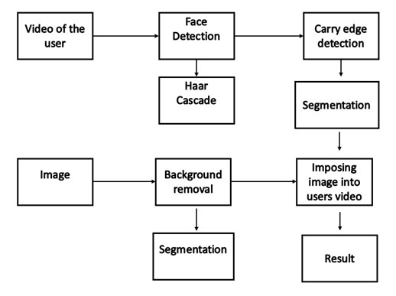
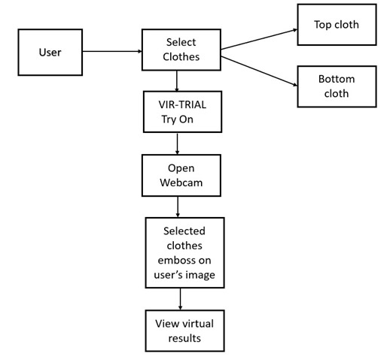
Project Design
Flowcharts

Slide 13
Extra Features
Future Scope Additions:
Extra Features that can be added in the future
Makeup Virtual trial
Footwear Virtual trial
Hairstyles Virtual trial
Home decor & furniture
Car and Automobiles
Tattoos and Body Art
Event planning
Interior Designs
Real Estates
Nail Arts
Cosmetic surgeries

Slide 14
Conclusion
A virtual trial room offers customers an immersive way to try on clothes, accessories, or other products online using augmented reality (AR) or similar technology. This allows users to visualize how items will look on them without needing to visit a physical store. It enhances the shopping experience by offering convenience, reducing product returns, and helping customers make more confident purchasing decisions. However, challenges include ensuring accurate representation of fit, color, and texture, as well as potential privacy concerns related to the use of cameras and data collection.

Slide 15
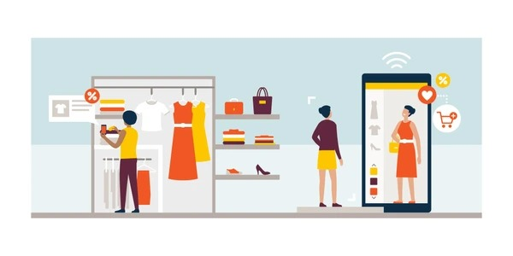
Thank you

